Slide 1
Tree
C and Data Structures
Baojian Hua
bjhua@ustc.edu.cn

Slide 2
What’ s a Tree?
book
chap1
chap2
chap3
sec11
sec12
sec21
subsec111

Slide 3
Definition of Tree
A tree is a collection of nodes, which satisfies:
there exists a unique root node r
other nodes are classified into n (n>=0) disjoint sets T_1, …, T_n, and every T_i is also a tree.
T_1, …, T_n are called sub-trees of r.
Moral:
Recursive definition
Sub-trees disjoint

Slide 4
What’ s a Tree?
unique root
book
chap1
chap2
chap3
sec11
sec12
sec21
subsec111

Slide 5
Terminologies
depth=0
root
book
internal node
depth=1
chap1
chap2
chap3
degree
depth=2
node
parent & child
sec11
sec12
sec21
depth=3
siblings
subsec111
leaves

Slide 6
Binary Tree
A binary tree is a collection of nodes, which satisfies:
there exists a unique root node r
other nodes are classified into n (0<=n<=2) disjoint ordered sets T_1, …, T_n, and every set T_i is also a binary tree.
To note:
0<=Degree(any node)<=2
the order of sub-tree is relevant

Slide 7
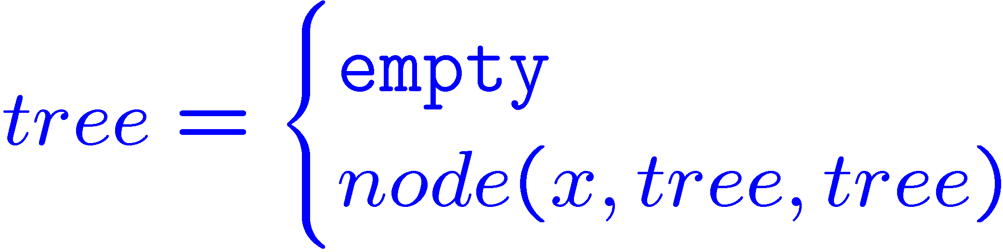
Binary Tree
Or more formally:

Slide 8
Examples
book
book
chap1
chap1
chap2
sec11
sec11
sec12
sec21
sec22
subsec111
subsec111

Slide 9
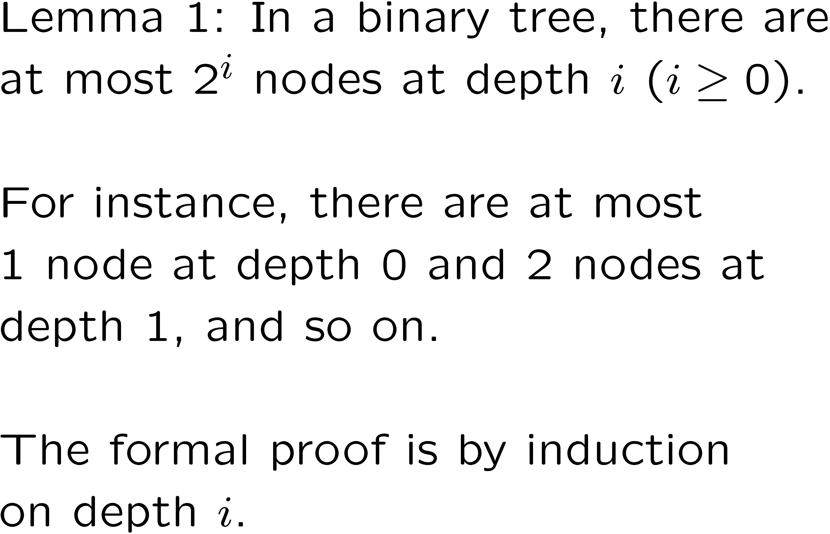
Properties of Binary Tree

Slide 10
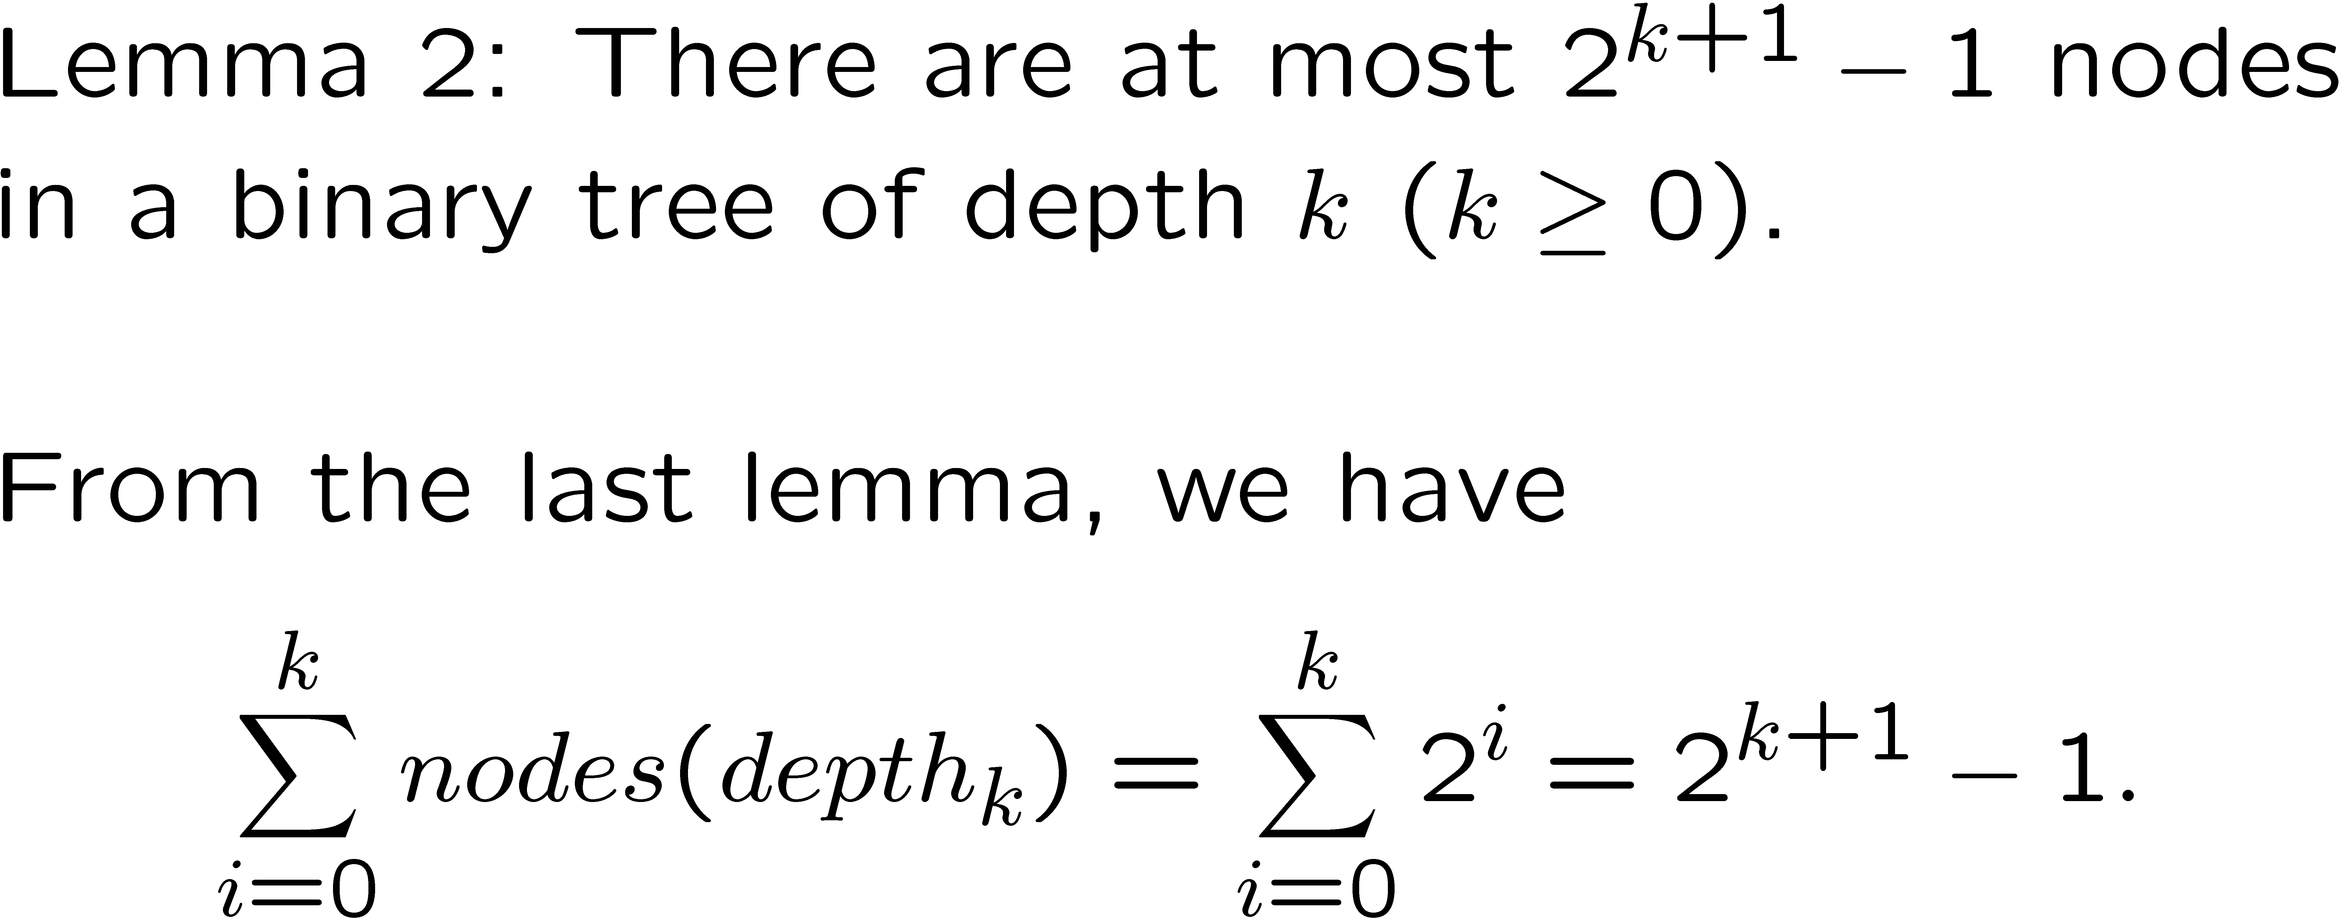
Properties of Binary Tree

Slide 11
Full and Complete Binary Tree
A full binary tree is a binary tree of depth k and 2^{k+1}-1 nodes
each node either has degree 2 (internal nodes) or degree 0 (leaves)
A n-node complete binary tree is a tree with nodes number of full binary tree

Slide 12
Tree Interfaces
// in file “tree.h”
#ifndef TREE_H
#define TREE_H
#define T Tree_t
typedef struct T *T;
T Tree_new();
T Tree_new2(T left, Poly_t data, T right);
void Tree_preOrder(T t, void(*visit)(Poly_t));
void Tree_inOrder(T t, void(*visit)(Poly_t));
void Tree_postOrder(T t, void(*visit)(Poly_t));
void Tree_levelOrder(T t, void(*visit)(Poly_t));
#undef T
#endif

Slide 13
Implementation
// in file “tree.c”
#include “tree.h”
struct Tree_t{
Poly_t data;
Tree_t left;
Tree_t right;
};
t
left
data
right

Slide 14
Operations: “new”
// “new” creates an empty new binary tree. Just
// as the case for linked list, it just returns 0.
Tree_t Tree_new(){
return 0;
}
// This is essentially a functional style tree!

Slide 15
Operations: “new2”
// “newTree2” creates an tree node with fields
// properly initialized.
Tree_t Tree_new2(Tree_t left,
Poly_t data, Tree_t right){
Tree_t t = calloc(1, sizeof (*t));
t->data = data;
t->left = left;
t->right = right;
return t;
}
t
left
data
right

Slide 16
How to build a tree?
book
chap1
chap2
sec11
sec12
sec21
sec22
subsec111
a bottom-up fashion!

Slide 17
Client Code
Create this tree:
// bottom-up creation process:
t1 = new2(0, “subsec111”, 0);
t2 = new2(t1, “sec11”, 0);
t3 = new2(0, “sec12”, 0);
t4 = new2(t2, “chap1”, t3);
…
book
chap1
chap2
sec11
sec12
sec21
sec22
subsec111

Slide 18
Tree Traversal
book
Traversal: a systematic way to visit all nodes in a tree.
For instance, the visit strategies for the right tree may be:
book, chap1, chap2
or: chap1, book, chap2
and so on.
chap1
chap2
Next, we’ll study four of them, namely: pre-order, in-order, post-order and level-order.

Slide 19
Pre-order Traversal
Pre-order:
first visit the root node of the tree
and then left subtree
and finally right subtree
Ex: book, chap1, chap2
book
chap1
chap2

Slide 20
Pre-order Traversal
void Tree_preOrder(T t, void(*visit)(Poly_t)){
if(!t)
return;
visit(t->data);
Tree_preOrder(t->left, visit);
Tree_preOrder(t->right, visit);
}
t
a
b
c
d

Slide 21
Moral
Tree is again a functional data structure
with a surprising structure as list
preOrder is a recursive algorithm:
defined on recursively defined data structures
system (machine) dedicates a stack to keep track of the recursive order
inOrder, postOrder are similar

Slide 22
Level-order Traversal
void Tree_levelOrder(T t, void(*visit)(Poly_t)){
if(!t)
return;
Queue_t q = Queue_new();
Queue_enQueue(q, t);
while(!Queue_isEmpty(q)) {
T temp = Queue_deQueue(q);
visit(temp->data);
if(temp->left)
Queue_enQueue(q, temp->left);
if(temp->right)
Queue_enQueue(q, temp->right);
}
return;
}

Slide 23
Example
t
a
b
c
d

Slide 24
Example
a
t
a
b
c
d

Slide 25
Example
b
t
a
b
c
print out “a”
d

Slide 26
Example
b
c
t
a
b
c
print out “a”
d

Slide 27
Example
c
t
a
b
c
print out “a”
print out “b”
d

Slide 28
Example
d
c
t
a
b
c
print out “a”
print out “b”
d

Slide 29
Example
d
t
a
b
c
print out “a”
print out “b”
print out “c”
d

Slide 30
Example
d
t
a
b
c
print out “a”
print out “b”
print out “c”
d

Slide 31
Example
t
a
b
c
print out “a”
print out “b”
print out “c” print out “d”
d

