Slide 1
References
Principle of Programming Languages
Baojian Hua
bjhua@ustc.edu.cn

Slide 2
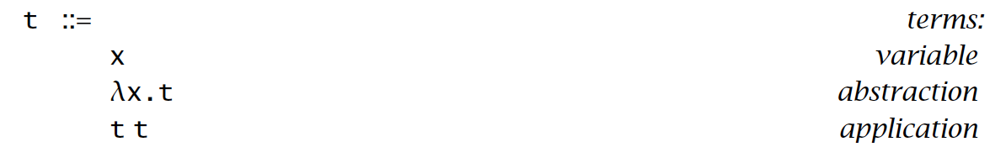
Recap: Lambda calculus

Slide 3
Functional programming?
Immutable variables:
let x = 1
in x+x ;
Mutable variables:
x = 1;
x++;

Slide 4
Basic Syntax

Slide 5
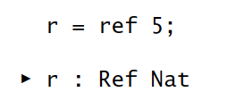
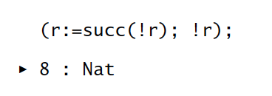
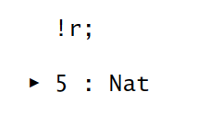
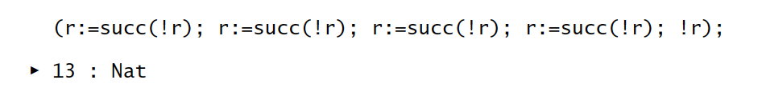
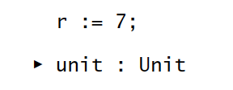
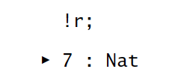
Basics
creation:
sequencing:
dereference:
assignment:
dereference:

Slide 6
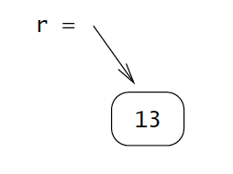
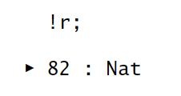
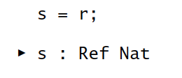
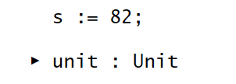
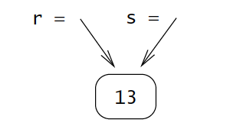
Basics, cont’
aliasing:
sequencing:

Slide 7
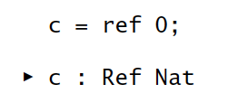
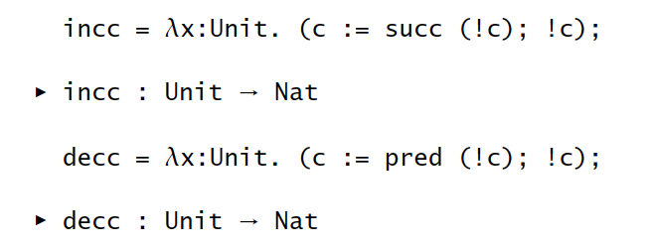
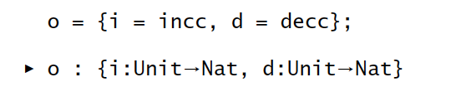
Basics, cont’
object-oriented programming (OOP):

Slide 8
Typing

Slide 9
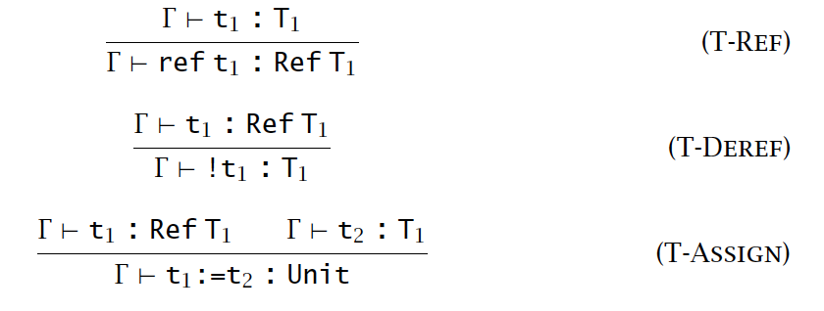
Typing relation

Slide 10
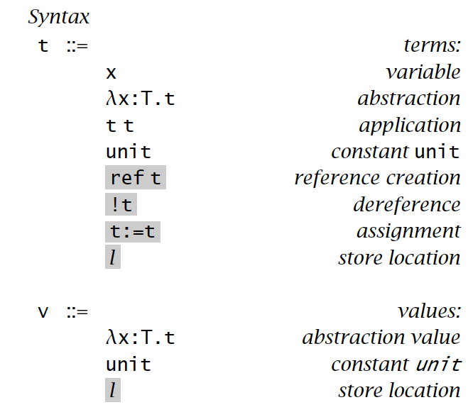
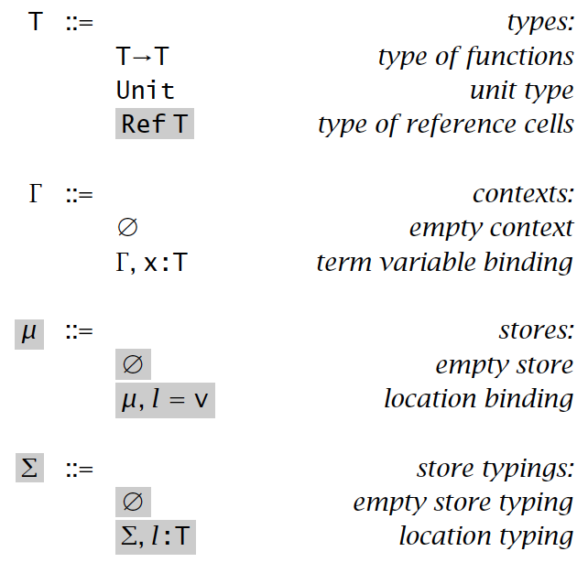
Evaluations

Slide 11
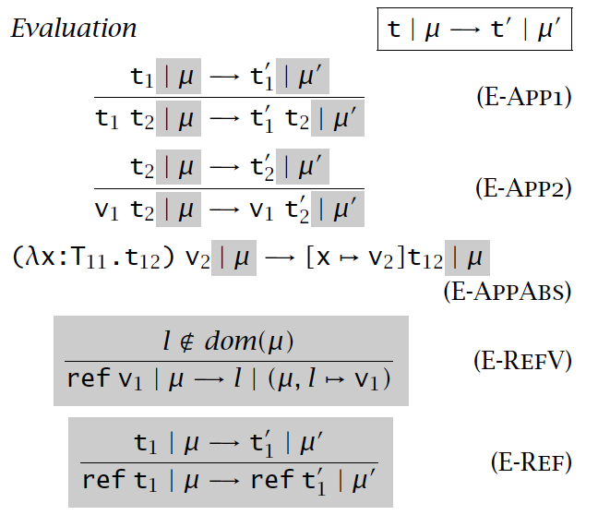
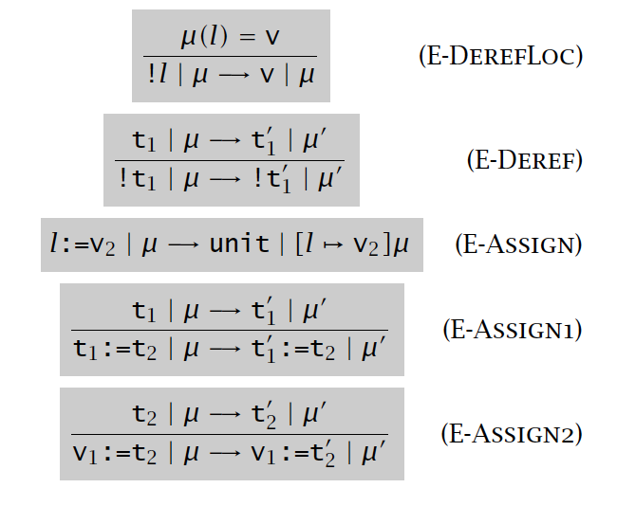
Evaluation, cont’

Slide 12
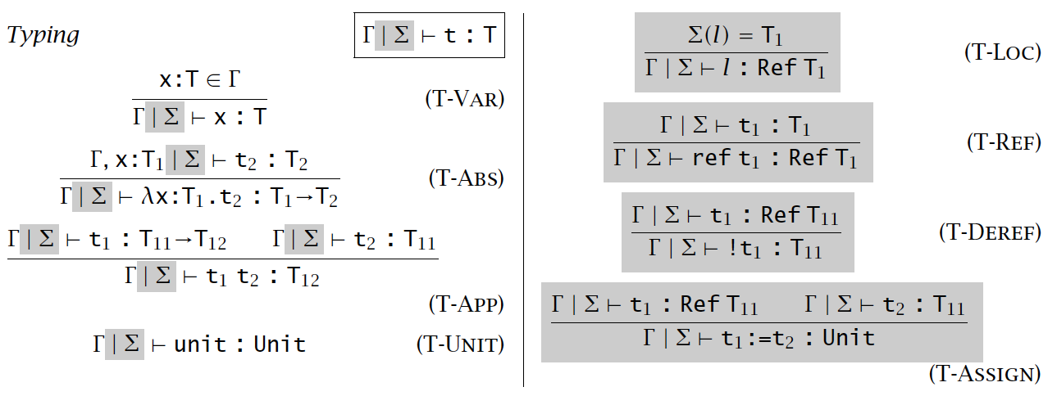
Evaluation, cont’

Slide 13
Type Safety

Slide 14
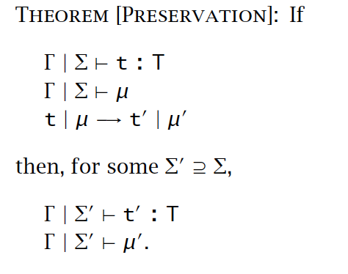
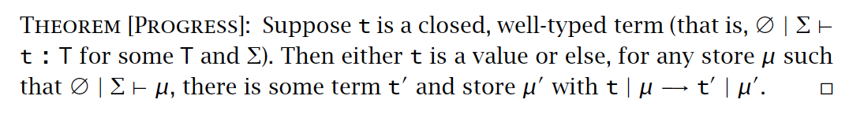
Type safety

Slide 15
Summary
Reference is a loophole for pure functional programming
to support imperative programming (assignment)
Evaluation:
introduce a virtual store
Typing:
store typing

