Slide 1
Exceptions
Principle of Programming Languages
Baojian Hua
bjhua@ustc.edu.cn

Slide 2
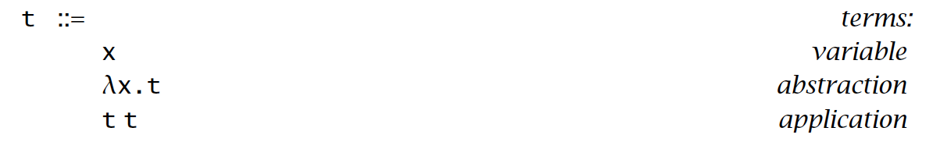
Recap: Lambda calculus

Slide 3
Exceptions
To handle exceptional cases gracefully:
divide by 0
array out of bound
out of memory
Global “jump” from callees to callers

Slide 4
Throw exceptions

Slide 5
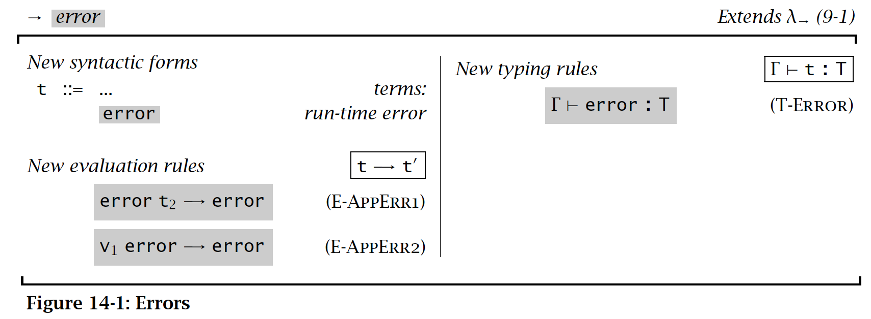
Syntax

Slide 6
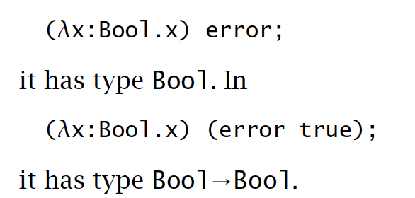

Example
Typing:
Evaluation:

Slide 7
Handling exceptions

Slide 8
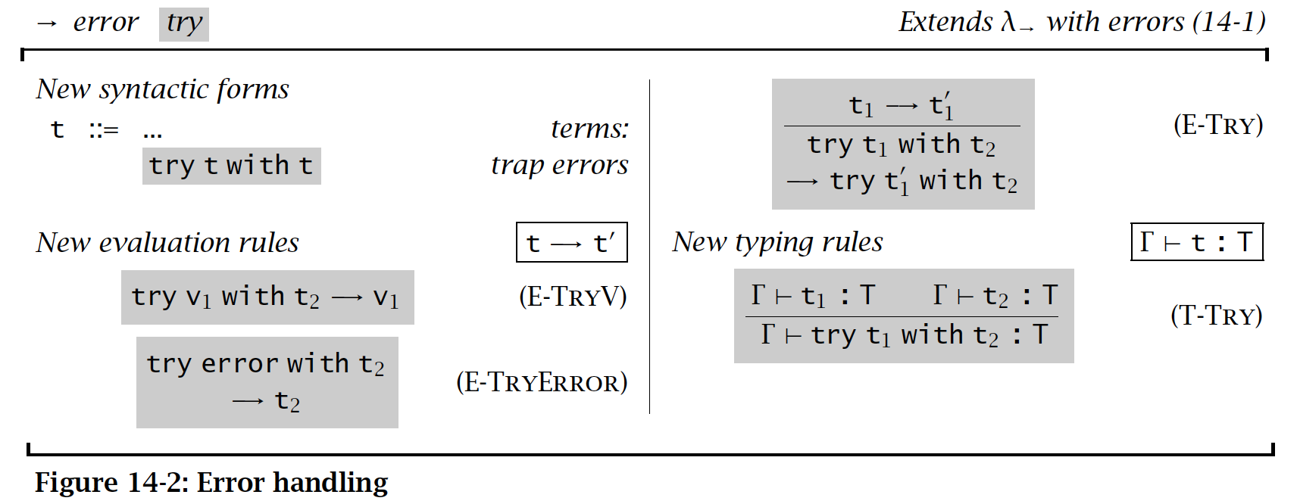
Syntax

Slide 9
Exceptions Carrying Values

Slide 10
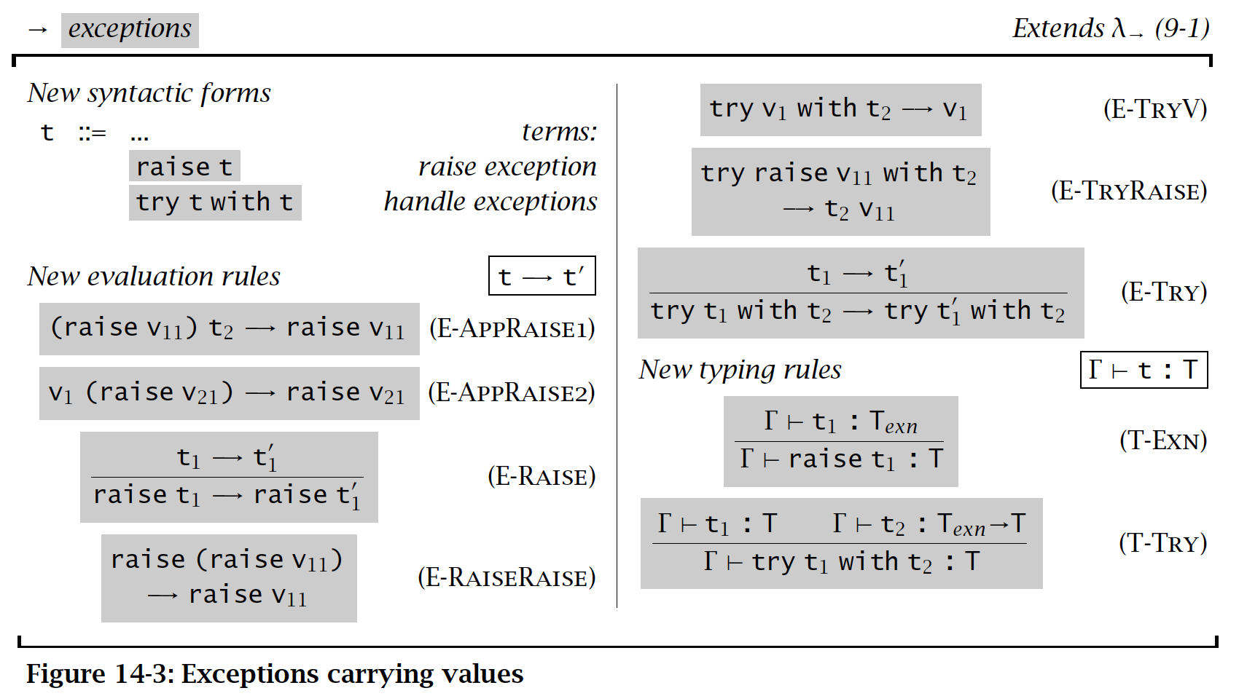
Syntax

Slide 11
Texn?
May be nat
May be string
May be data type
type texn = Nat | String of string
May be extensible data type
type texn = Nat | String of string | …
May be classes (and sub-classes)

Slide 12
Summary
Exceptions are elegant non-local control flow
to handle exceptional cases globally
Basic syntax, evaluations, and typing rules for exceptions

