Slide 1
Recursive Types
Principle of Programming Languages
Baojian Hua
bjhua@ustc.edu.cn

Slide 2
Recursive Types
Types that appear in their definitions
type list =
| Nil
| Cons of int * list
type tree =
| Leaf
| Node of int * tree * tree

Slide 3
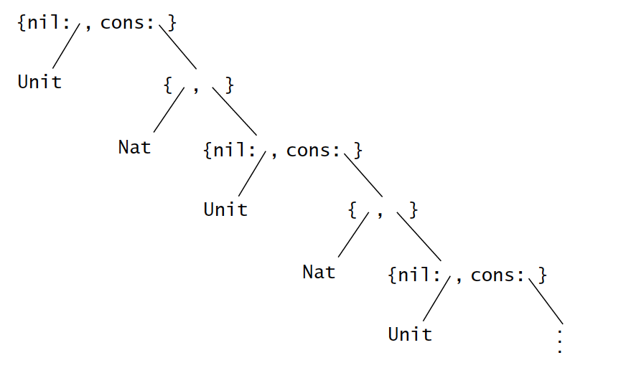
Recursive Types are infinite

Slide 4

The μ notation
A fixpoint:
”X is a type defined by the body, which includes X!”

Slide 5
Examples

Slide 6
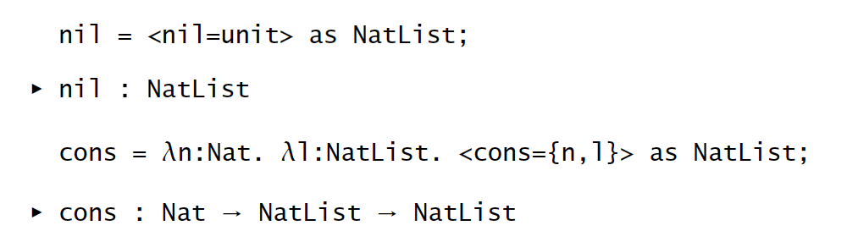
List

Slide 7
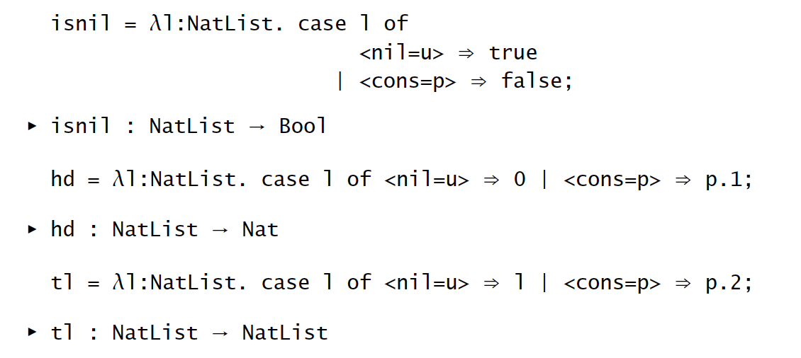
List

Slide 8
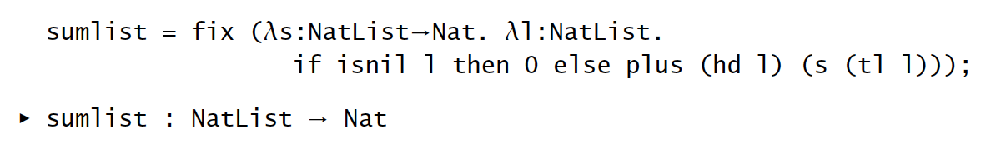
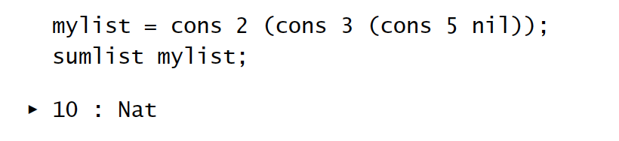
List

Slide 9
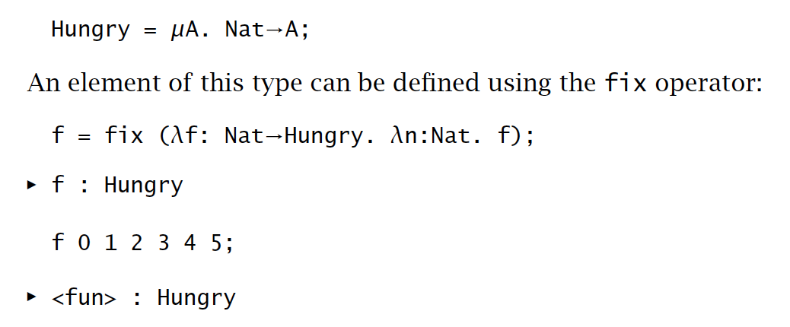
Hungry Functions

Slide 10

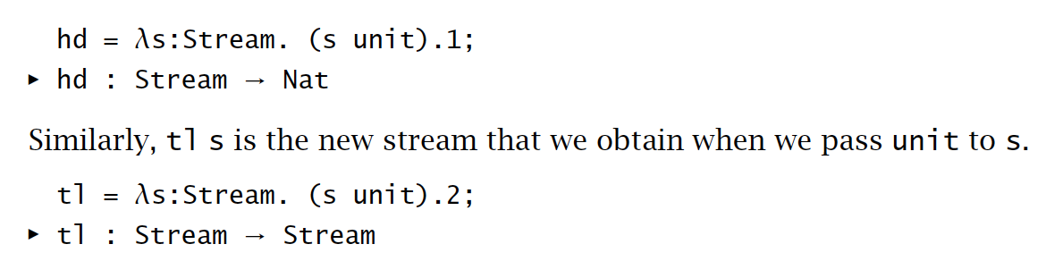
Streams

Slide 11
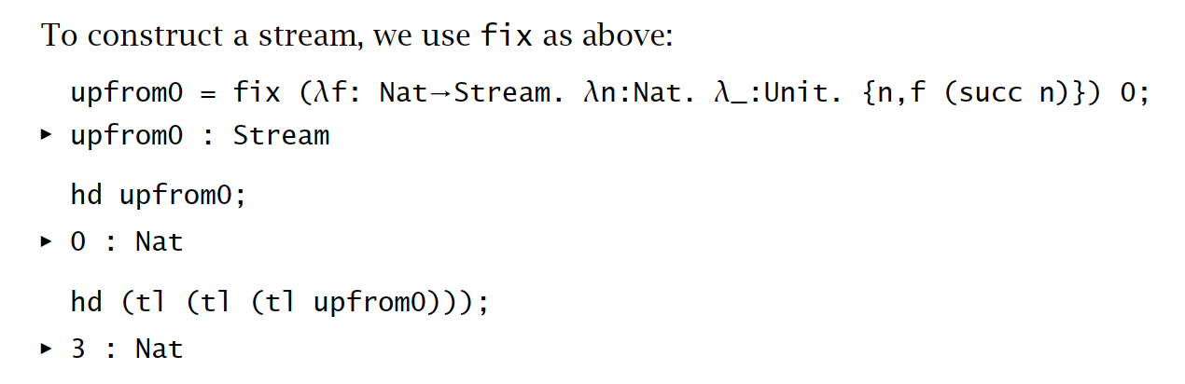
Streams, cont’

Slide 12
Formalities

Slide 13
Equi- and iso-recursive
Q: What’s the relationship between a recursive type and its one-step unfolding?
e.g.,
List
<nil: Unit, cons: {Nat, List}>

Slide 14
Equi-recursive
A: These two types are treated equal
hence the name
In any contexts, one type can be used when the other one is expected
Type checkers pay special attention to the equivalence checking

Slide 15
Iso-recursive
A: These two types are treated different but isomorphic
Special conversions are introduced to map between these two types
programmers annotate these conversions
Maybe easier to build type checkers

Slide 16
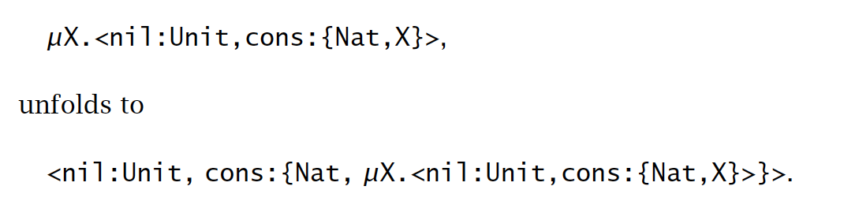
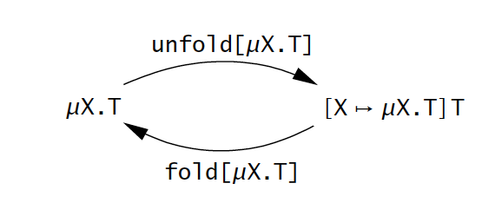
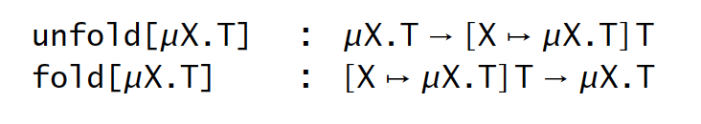
Iso-recursive

Slide 17
Iso-recursive
Iso-recursive is used in modern languages, often implicitly
ML: every type is recursive
data construction: fold
pattern matching: unfold
Java: every class is recursive
object creation: fold
method invocation: unfold

Slide 18
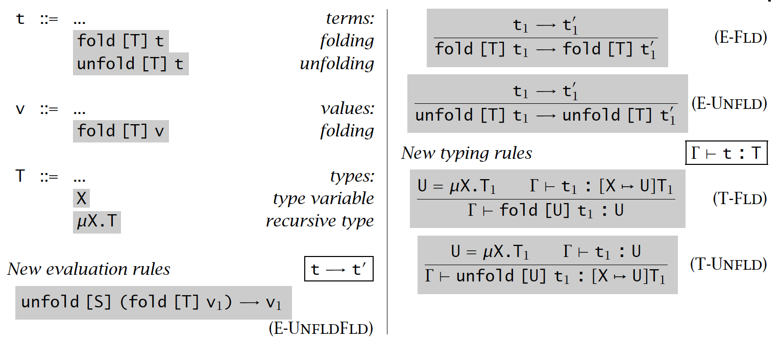
System

Slide 19

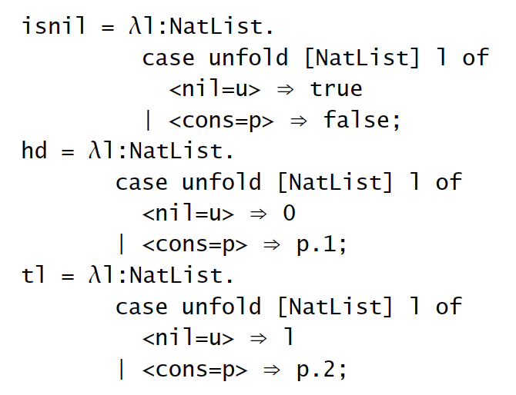
Examples

Slide 20
Summary
Recursive types are very powerful
to encode infinite data structures
Equi- and iso-recursive types
The former is lighter but more difficult to type check
the latter is heavier but type checking is easier

