Slide 1
Type Reconstruction
Principle of Programming Languages
Baojian Hua
bjhua@ustc.edu.cn

Slide 2
Type reconstruction
To infer types for programs with type variables
To enable code reuse
a piece of code with variable types can be used in difference scenarioes

Slide 3
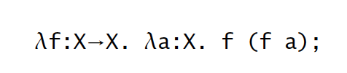
Type variables
Programs contain type variables, instead of concreate types
// parametric polymorphism
// sample C++ program
template <typename X>
X f(X a){
return a;
}

Slide 4

Type variables
Type variables must satisfy certain constraints
// informally, we should have:
Y = X -> Z
Z = X

Slide 5
Type inference
To infer types for programs without explicit types
i.e., programmers write down untyped programs
compiler annotate type variables
Combine the best of typed and untyped worlds
you have the strong types and type safety
without writing down (annoying) types

Slide 6
Type inference
// omit type variables from the program:
λ f.λ x.f x
// after parsing, compiler add type variables:
λ f:X.λ x:Y.f x
// type reconstruction:
X = Y -> Z

Slide 7
Type inference, in other languages
// Java:
var x = 55;
// JavaScript:
let x = 55;
// Rust:
let x = 55;
// C++
auto x = 55;
// Nevertheless to say, they are all local!
// Instead, the type inference we’ll be
// discussing is global!

Slide 8
Constraint-based typing

Slide 9
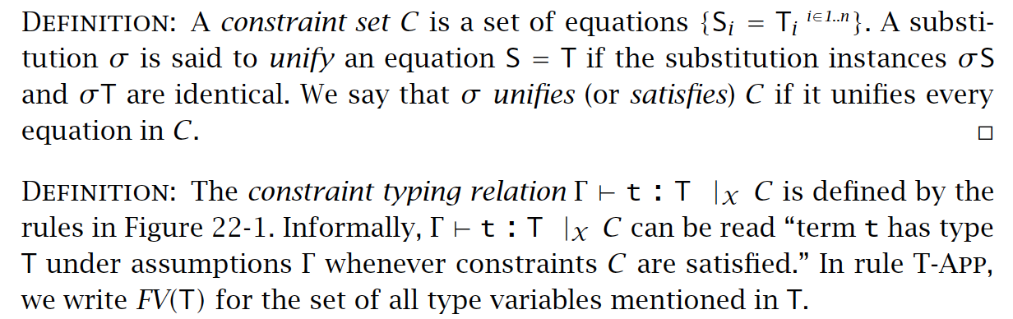
Constraint-based typing

Slide 10
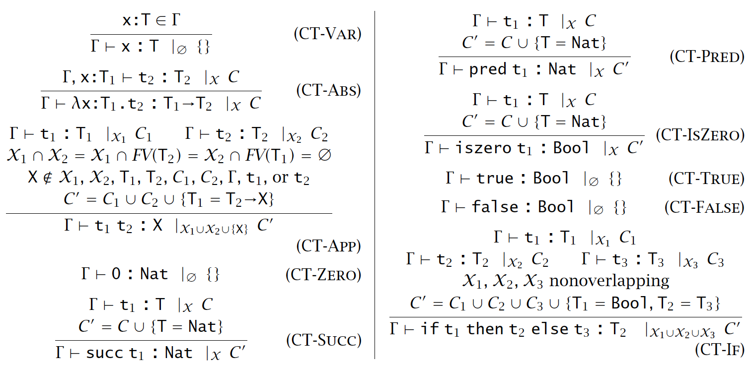
Typing rules

Slide 11
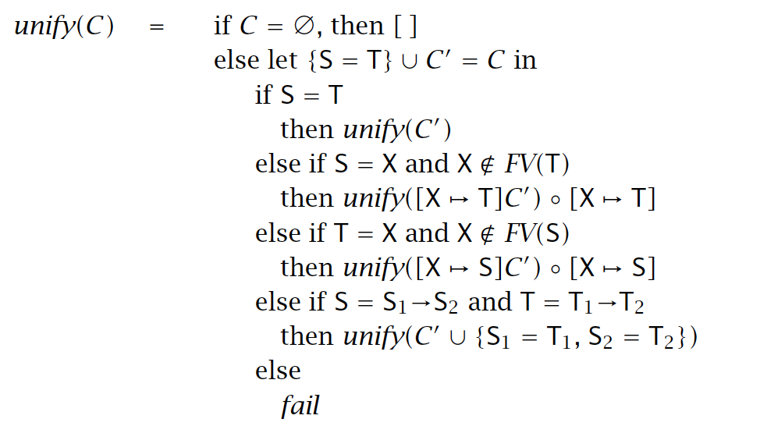
Unification algorithm

Slide 12
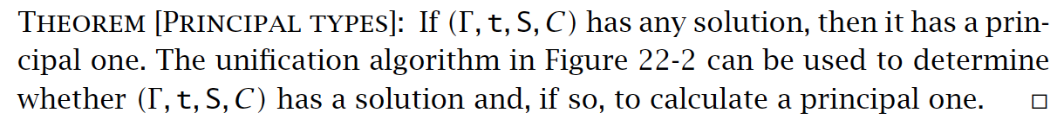
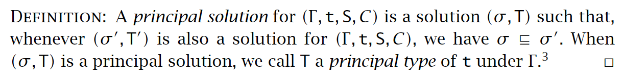
Principle types

Slide 13
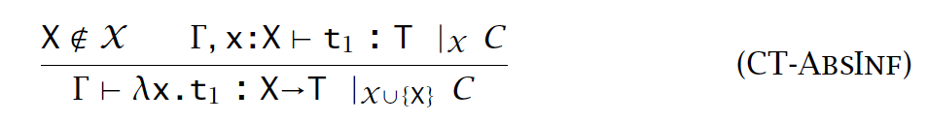
Implicit type variables
Option #1: during parsing, compiler fills in the missing type variable
this may be too early
all function application share the same type variable
Option #2: be lazy

Slide 14
Let polymorphism
A polymorphism at “let” point
a.k.a., Hindley-Milner (HM) poly
The most powerful implicit type polymorphism in production languages
not only in ML, but also in many other languages

Slide 15
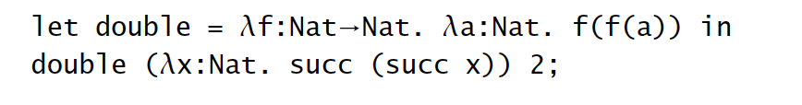
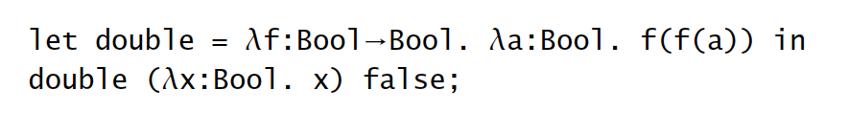
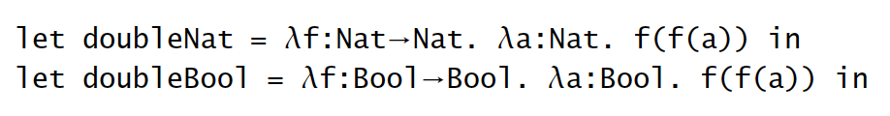
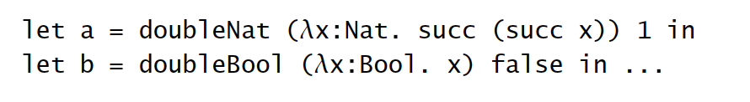
Motivation: Let polymorphism

Slide 16
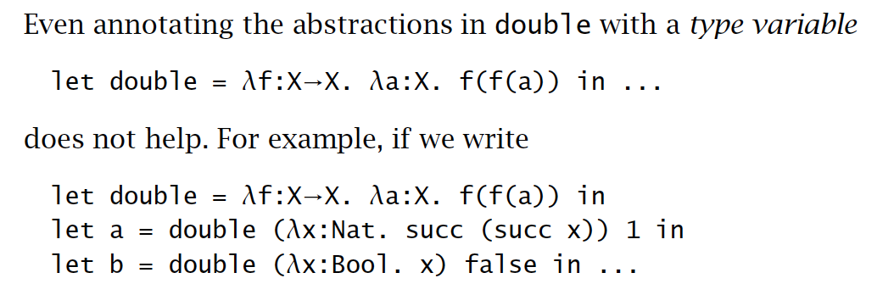
Motivation: Let polymorphism

Slide 17
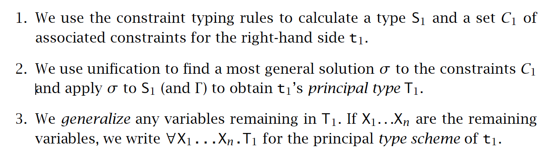
To check: let x=t1 in t2

Slide 18
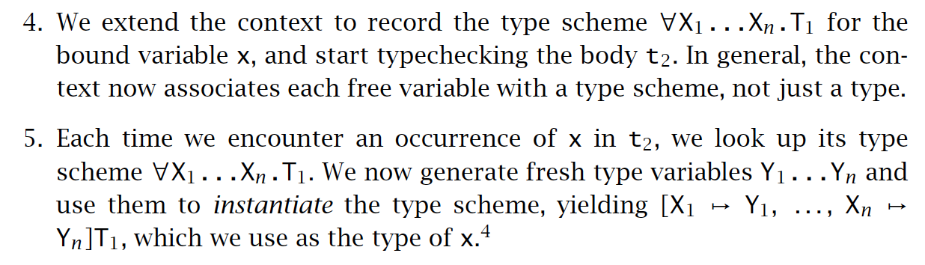
To check: let x=t1 in t2

Slide 19
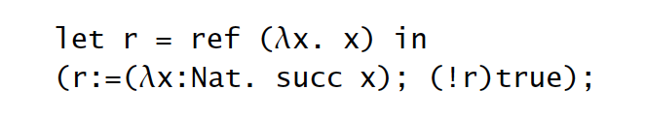
Value restriction
let x = t1 in t2:
The right hand t2 should be a syntactic value, to be generalized.

Slide 20
Summary
Type reconstruction assigns types to type variables
Type inference infer (most general) types for untyped programs
Both are used widely in modern languages

