Slide 1
Existential Types
Principle of Programming Languages
Baojian Hua
bjhua@ustc.edu.cn

Slide 2
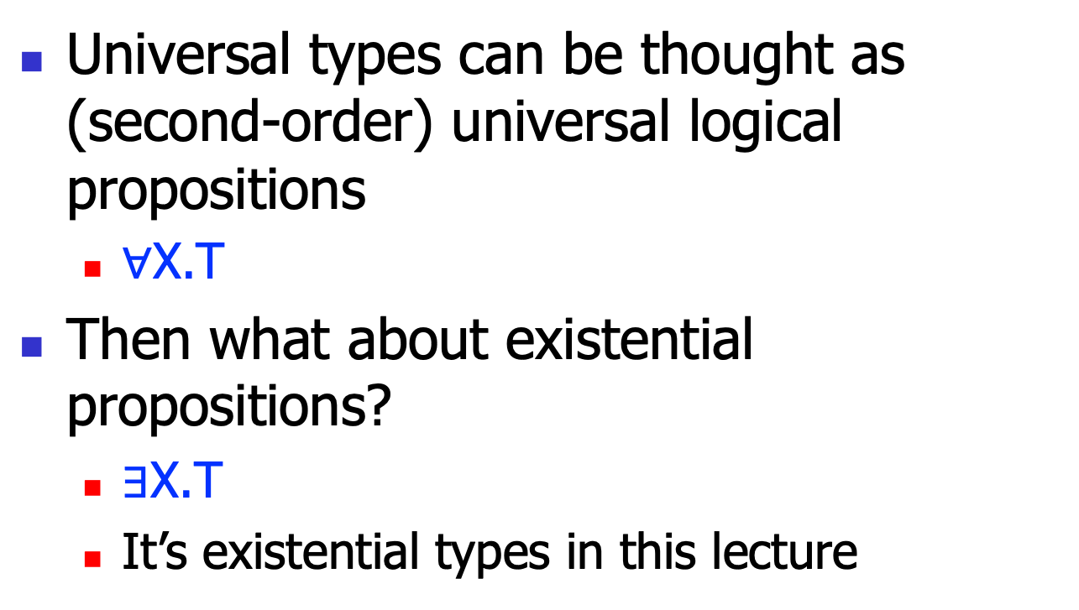
Motivation
Universal types can be thought as (second-order) universal logical propositions
$∀$X.T
Then what about existential propositions?
$∃$X.T
It’s existential types in this lecture

Slide 3
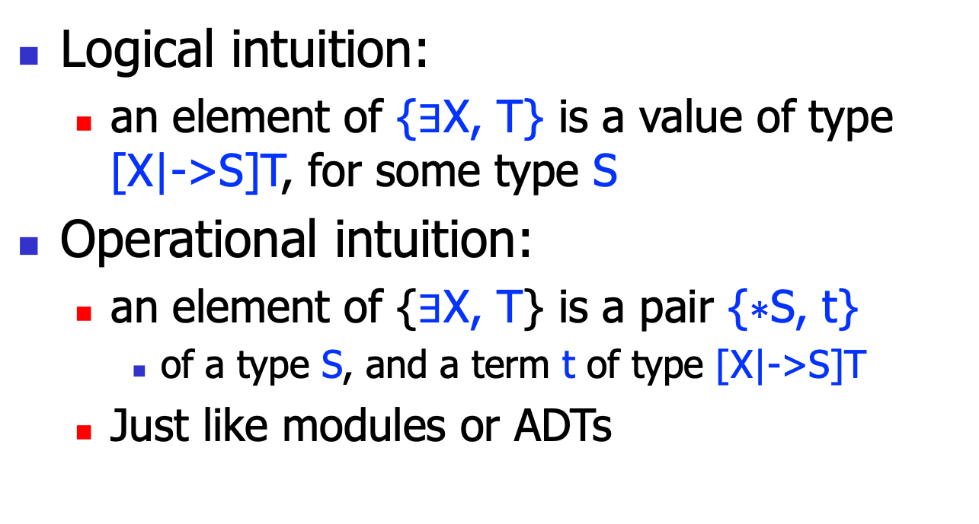
Two Views of Existential types
Logical intuition:
an element of {$∃$X, T} is a value of type [X|->S]T, for some type S
Operational intuition:
an element of {$∃$X, T} is a pair {$∗$S, t}
of a type S, and a term t of type [X|->S]T
Just like modules or ADTs

Slide 4
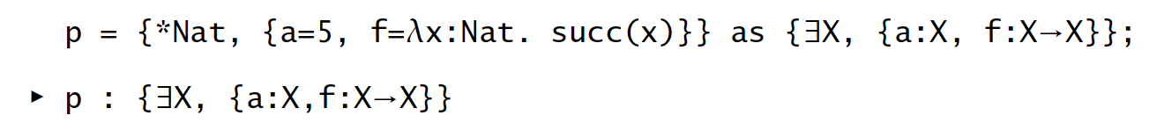
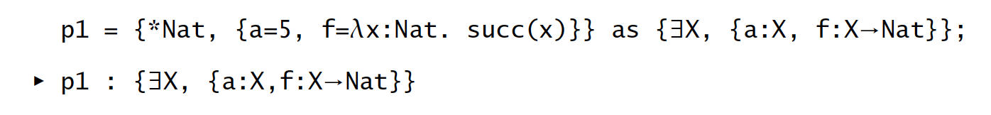
Example

Slide 5
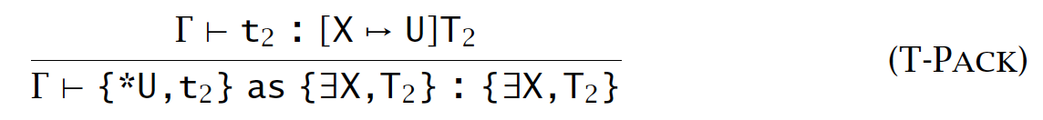
Typing Rule

Slide 6
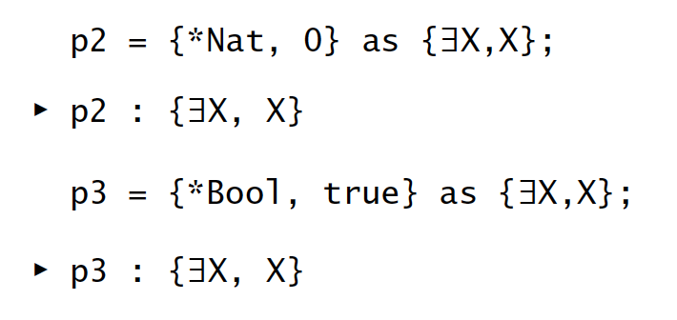
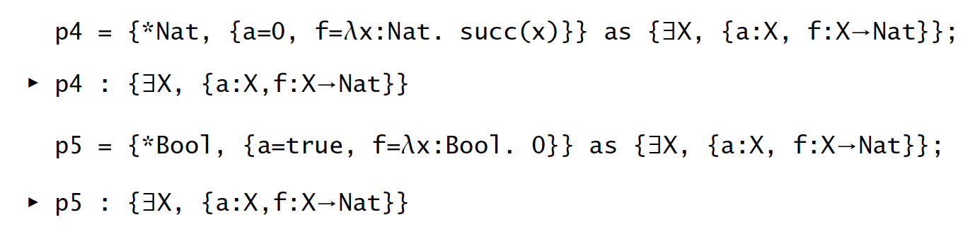
Example

Slide 7
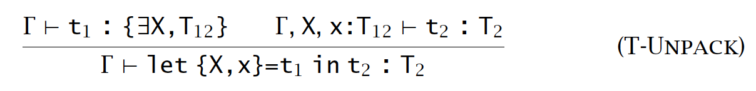
Typing Rule for Unpack

Slide 8
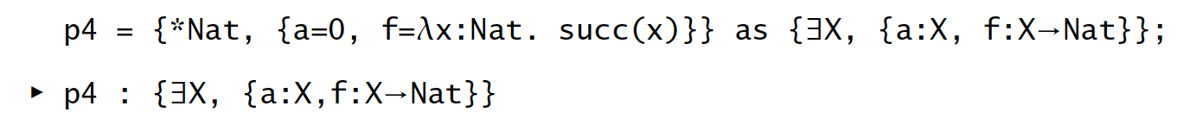
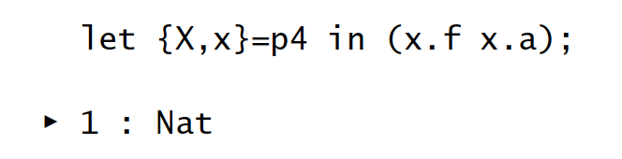
Example

Slide 9
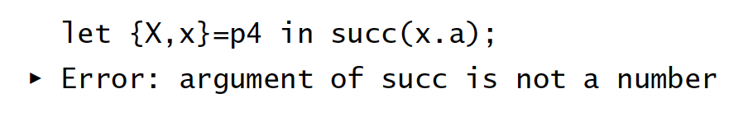
Observation #1
Abstraction is preserved:

Slide 10
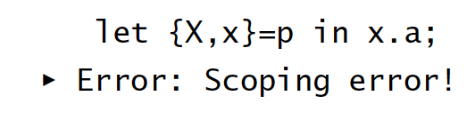
Observation #2
No type variables in conclusion:

Slide 11
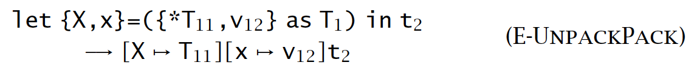
Reduction Rule for Unpack

Slide 12
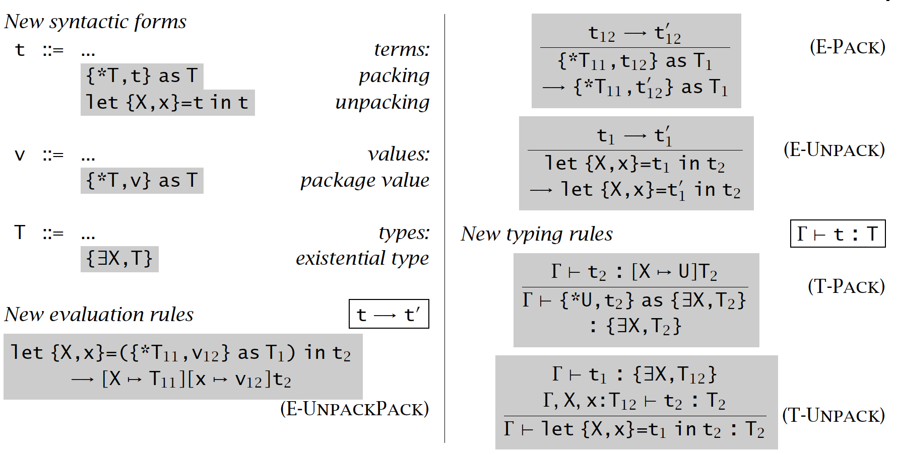
Existential Types

Slide 13
Data Abstraction with Existential Types

Slide 14
Data Abstraction
Two common forms:
Abstract data types: ADT
Objects

Slide 15
ADT
An ADT consists of:
a type name X
a concrete representation type T
a group of operations on type T
an abstraction boundary

Slide 16
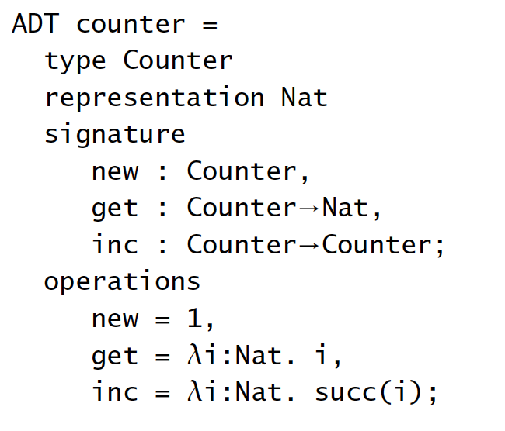
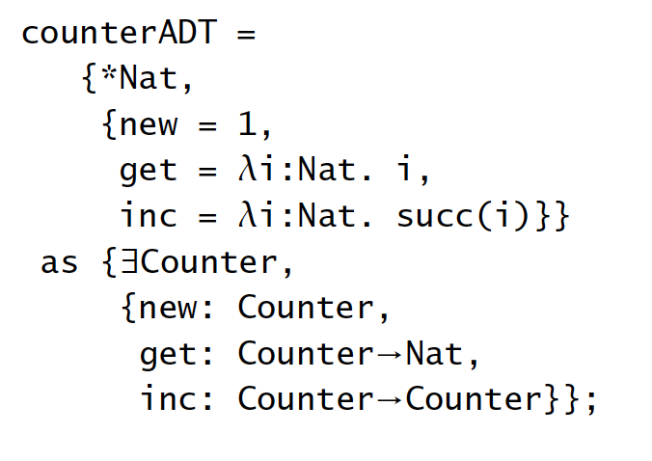
Example: Ada or Clu

Slide 17
Example: C
// counter.h:
typedef struct
Counter *Counter;
Counter new();
int get(Counter);
Counter inc(Counter);
// counter.c:
struct Counter{
int n;
};
Counter new(){
Counter c = malloc(sizeof(*c));
return c;
}
int get(Counter c){
return c->n;
}
Counter inc(Counter c){
c->n++;
return c;
}

Slide 18
Representation Independence
RI:
the concrete representation can be substituted by an alternative one
Advantages:
limits the change of the program
limits the dependency
to encourage developers think abstractly

Slide 19
Objects
An object consists of:
an internal state X
a group of methods to operate on the state

Slide 20
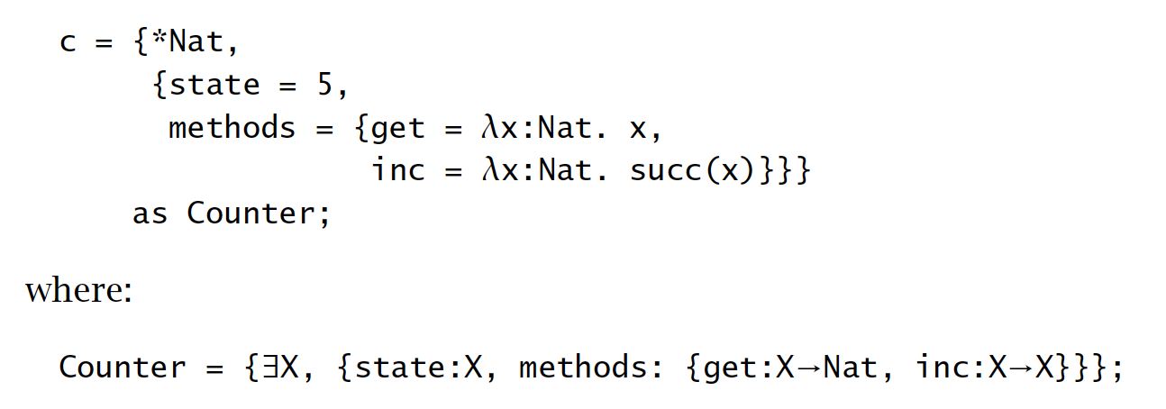
Example

Slide 21
Summary
Existential types enforce abstraction or information hidings
Very powerful abstractions to model ADTs or objects

