Slide 1
Type Operators
Principle of Programming Languages
Baojian Hua
bjhua@ustc.edu.cn

Slide 2
Motivation
Type-level functions:
// pair.cpp:
template <typename X, typename Y>
class Pair{
X a;
Y b;
public:
Pair(X a, Y b){…}
}
int main(){
Pair p; // type error!
}

Slide 3


Type-level Functions
Type abstraction (on types):
And type applications (on types):

Slide 4
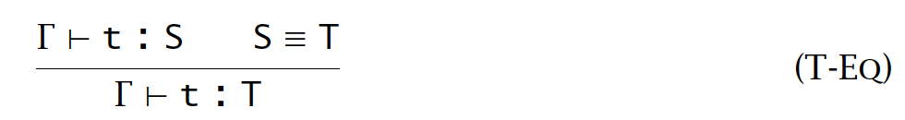
Type equivalence is nontrivial
// For an identify type function:
ID = λX.X
// These type terms are equivalent:
Nat -> Nat
ID Nat -> Nat
ID Nat -> ID Nat
ID (Nat -> Nat)
// Thus, type equivalence involves nontrivial computing:
// and typing with type equivalence:

Slide 5
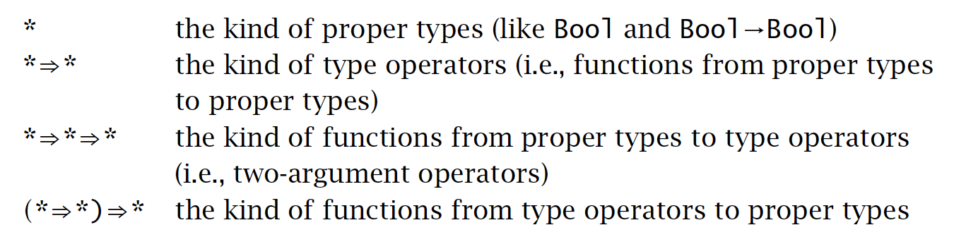

Type application may be meaningless
// For example:
Bool Nat
(λX.(X Nat)) Bool
// We introduce kinding for types, just like typing for terms:
// Sample type operator:

Slide 6
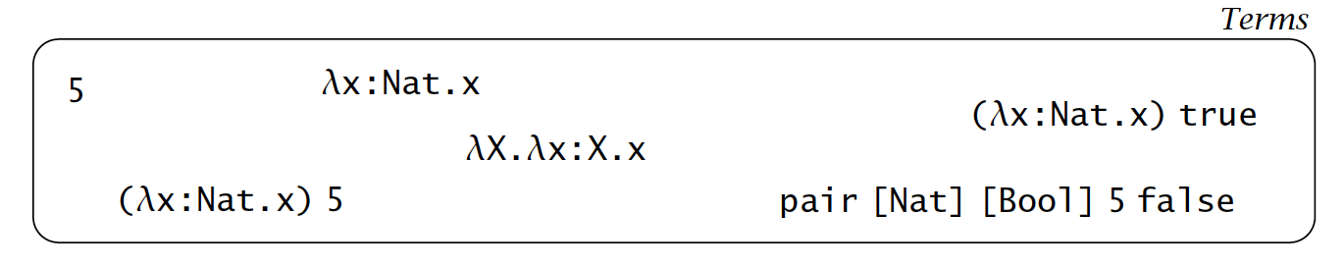
Terms

Slide 7
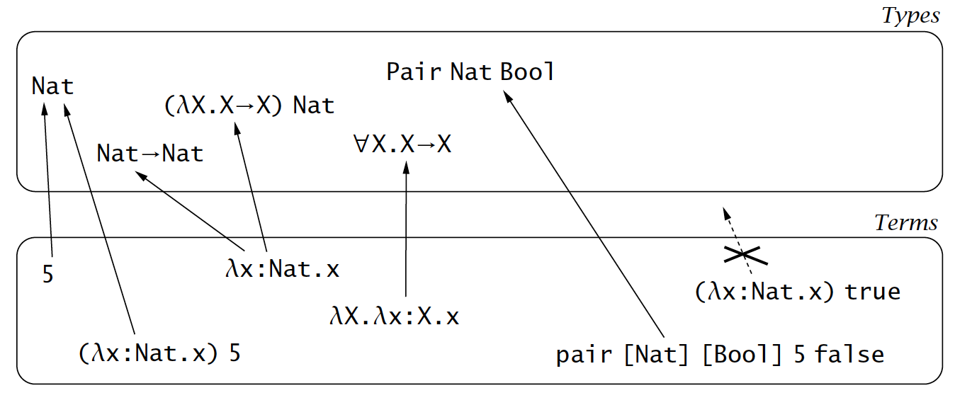
Typing

Slide 8
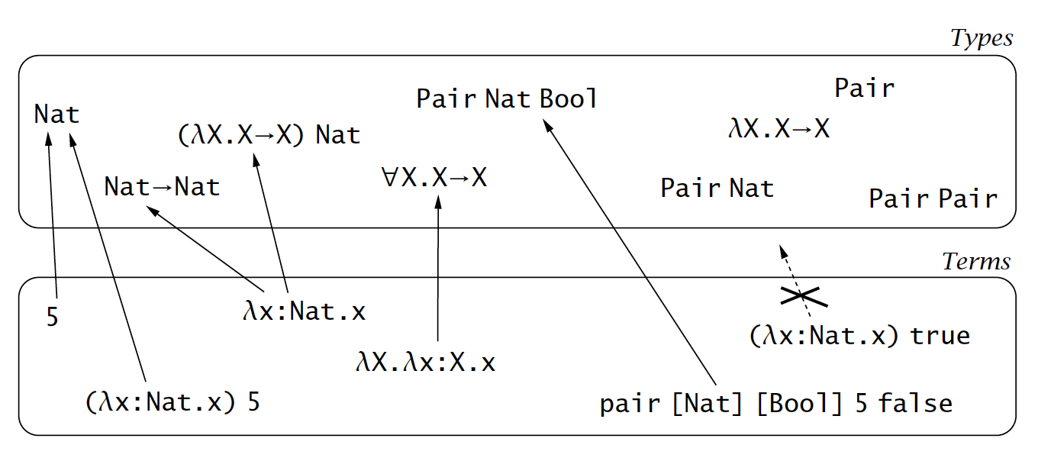
Type Operators

Slide 9
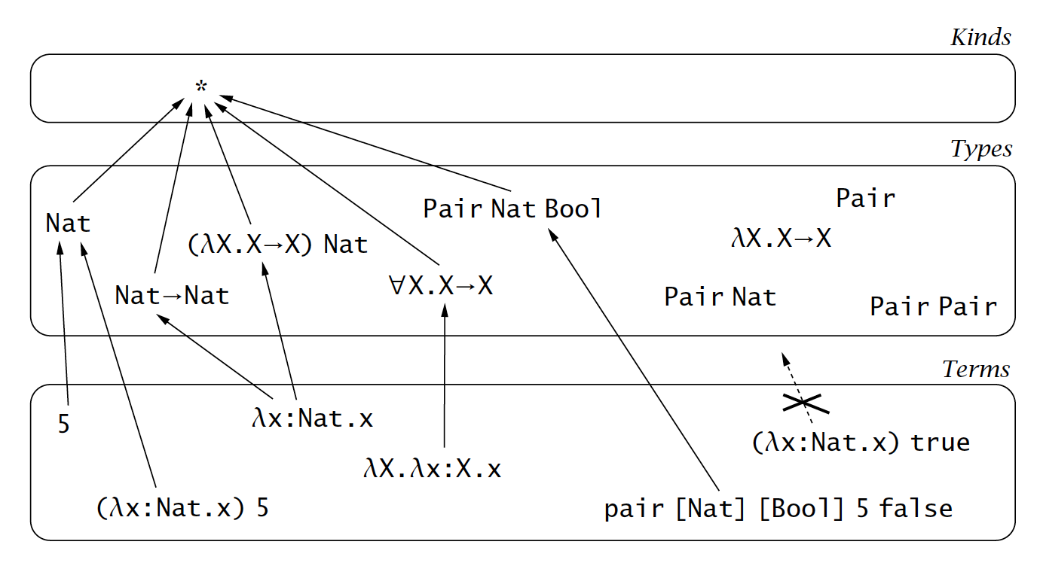
Kinding

Slide 10
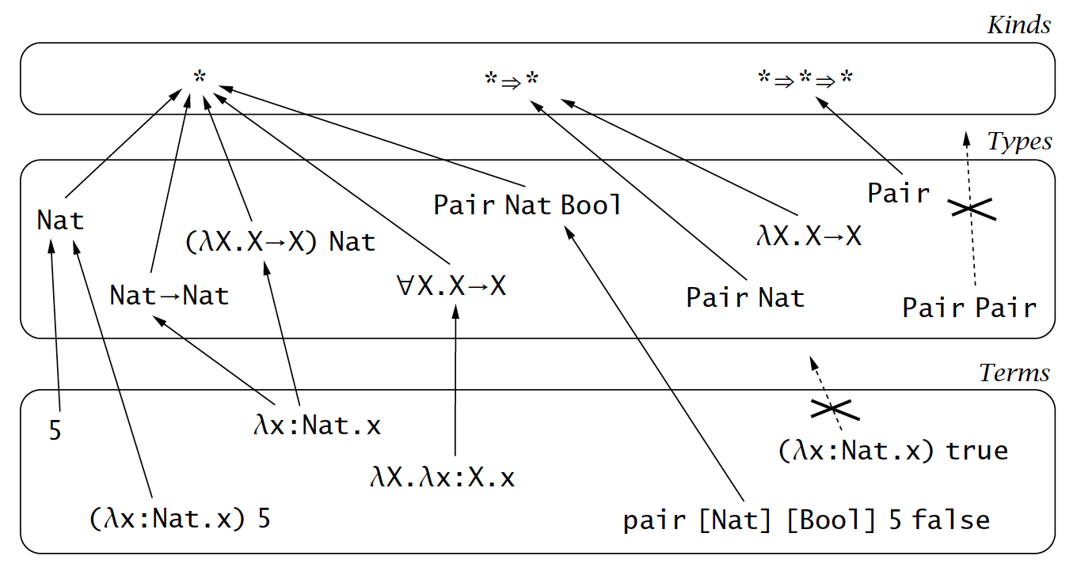
Type Operator Kinding

Slide 11
Why stop at 3 levels?
Type theorists have investigated more than 3 levels
so-called pure type systems (PTS)
but has not seen widespread use in main-streaming programming languages
3 is enough for your career (hopefully)
Today’s languages are equipped with some limited forms of kinding
see below for examples

Slide 12
Example: C++ templates
// pair.cpp:
template <typename X, typename Y>
class Pair{
X a;
Y b;
public:
Pair(X a, Y b){…}
}
int main(){
Pair<int, int> p;
}

Slide 13
Example: Java generics
// Pair.java:
class Pair<X, Y>{
X a;
Y b;
public Pair(X a, Y b){…}
}
Pair<Integer, Integer> p = new Pair<Integer, Integer>(3, 4);

Slide 14
Example: ML type variable
// pair.ml:
type (‘a, ‘b) pair =
T of ‘a * ‘b
// type arguments are implicit:
let p = T (3, 4)

Slide 15
λω

Slide 16
λω
Simply-typed λ−calculus with type operators
Syntax
evaluation rules
typing rules
kinding rules

Slide 17
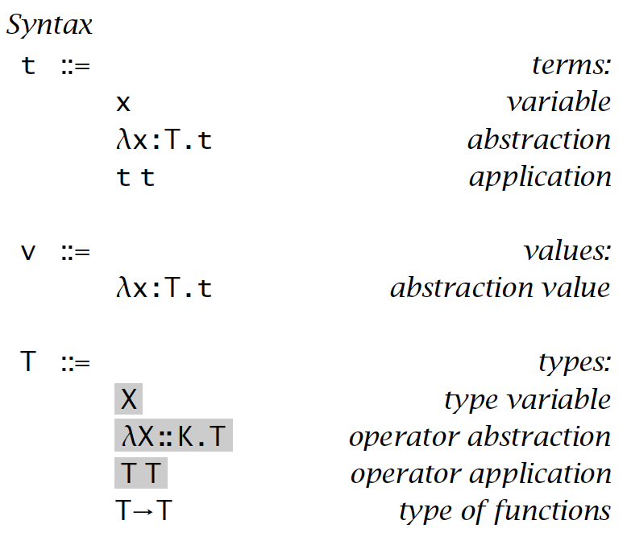
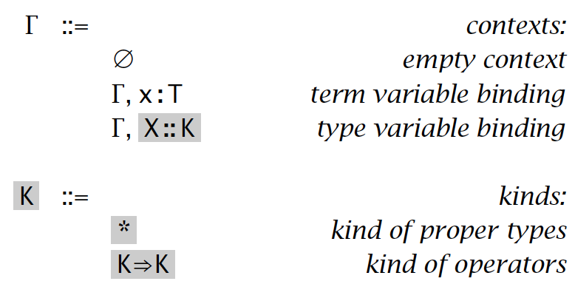
Syntax

Slide 18
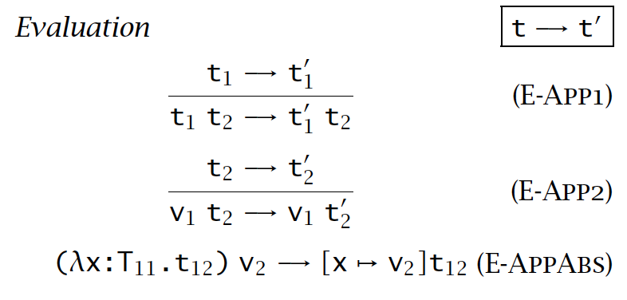
Evaluation rules

Slide 19
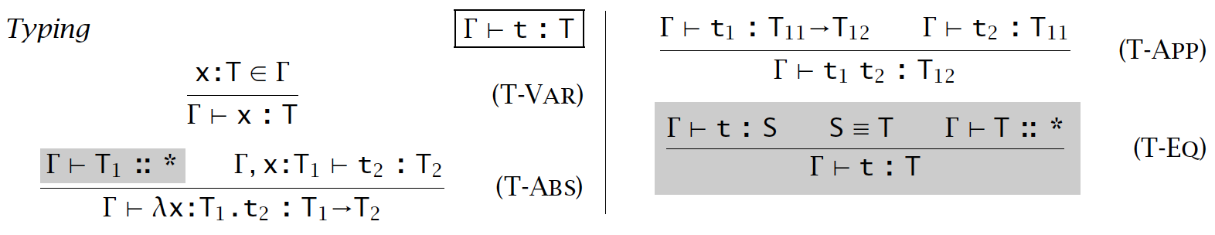
Typing rules

Slide 20
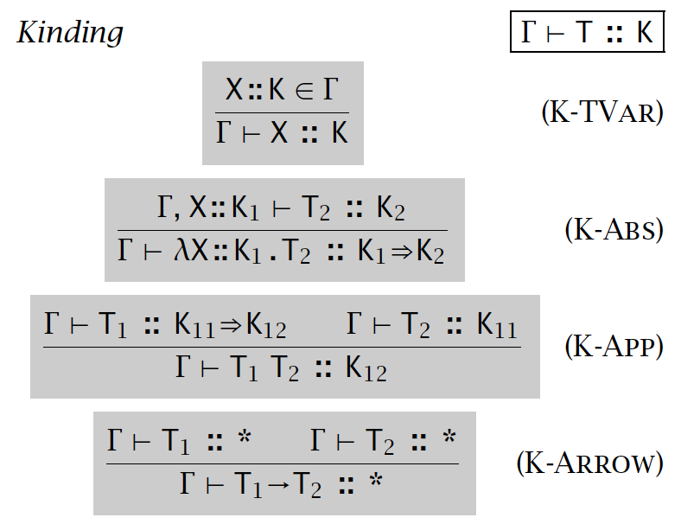
Kinding Rules

Slide 21
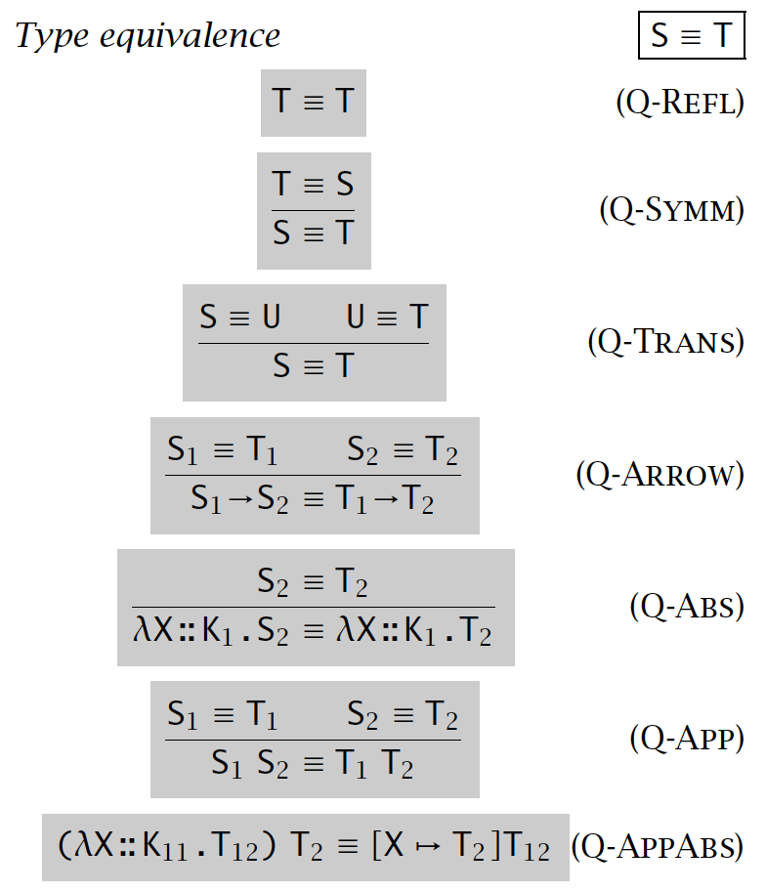
Type Equivalence

Slide 22
Type checking algorithm
Non-trivial
as there are computations on types, not only on terms
Key insight:
perform computations on types
then compare the structural equivalence
See the assignment

Slide 23
Summary
Type operators are type-level functions
i.e., we have lifted the abstraction one-level up
Type checking this system is non-trivial

