Slide 1
Universal Types
Principle of Programming Languages
Baojian Hua
bjhua@ustc.edu.cn

Slide 2
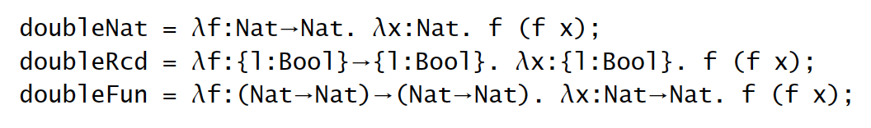
Motivation
Abstraction principle: each functionality should be implemented just once.

Slide 3
Polymorphism
Parametric poly:
functions take type variables
a.k.a.: templates or generics
Ad-hoc poly:
values can be viewed as different types
e.g., method overloading
Subtyping poly:
as we’ve discussed

Slide 4
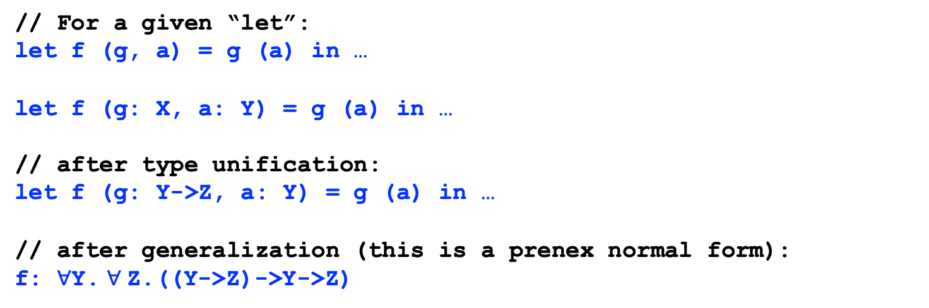
Let poly revisited
// For a given “let”:
let f (g, a) = g (a) in …
let f (g: X, a: Y) = g (a) in …
// after type unification:
let f (g: Y->Z, a: Y) = g (a) in …
// after generalization (this is a prenex normal form):
f: $∀$Y. $∀$Z.((Y->Z)->Y->Z)

Slide 5
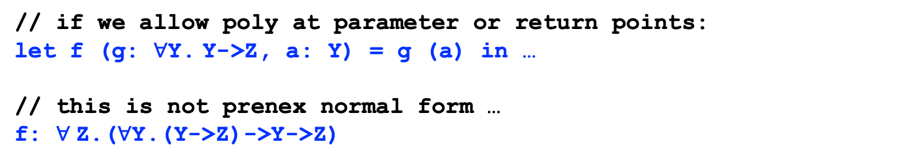
Let poly revisited
// if we allow poly at parameter or return points:
let f (g: $∀$Y. Y->Z, a: Y) = g (a) in …
// this is not prenex normal form …
f: $∀$Z.($∀$Y.(Y->Z)->Y->Z)

Slide 6
System F

Slide 7
System F
First discovered by Jean-Yves Girard (1972)
as a proof theory for logic
Independently, by a computer scientist, John Reynolds (1974)
polymorphic lambda-calculus
System F == Second-order logic

Slide 8
System F
Type abstraction and application:
λX.t
t [T]
Evaluations:

Slide 9
Example
// omit type variables from the program:
λ X.λ a:X.a
// after parsing, compiler add type variables:
(λ X.λ a:X.a) [Nat] -> λ a:Nat. a
// C++ template
template <typename X>
X f(X a){
return a;
}
f<int>(33);

Slide 10
Example
// omit type variables from the program:
λ X.λ a:X.a
// after parsing, compiler add type variables:
(λ X.λ a:X.a) [Nat] -> λ a:Nat. a
// Java generics:
<X> X f(X a){
return a;
}
f(33);

Slide 11
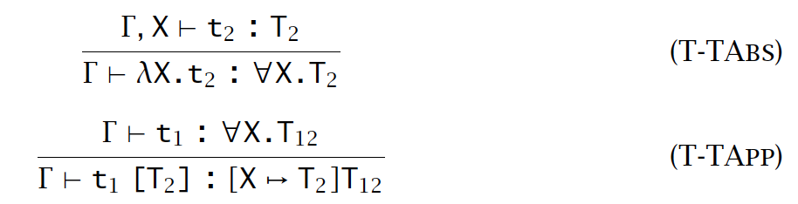
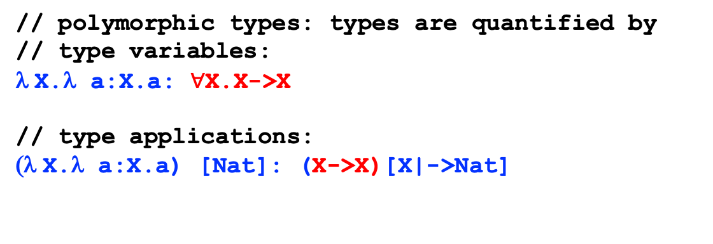
Polymorphic types
// polymorphic types: types are quantified by
// type variables:
λ X.λ a:X.a: $∀$X.X->X
// type applications:
(λ X.λ a:X.a) [Nat]: (X->X)[X|->Nat]

Slide 12
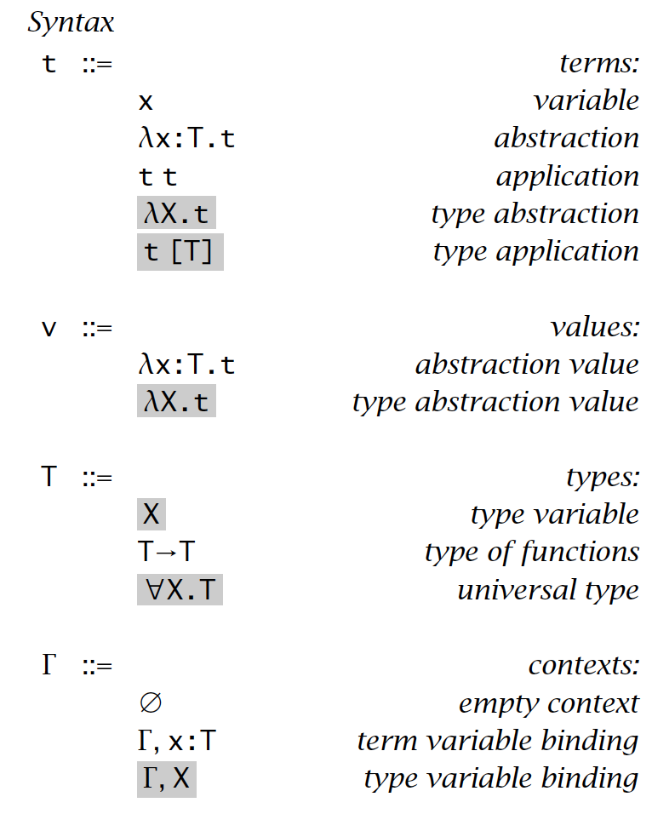
System F
Type abstraction and application:
Polymorphic types:
Environment contains type variables:

Slide 13
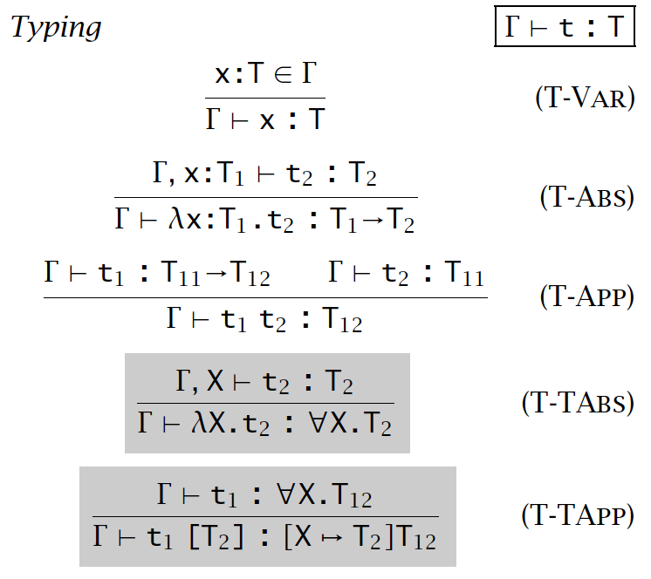
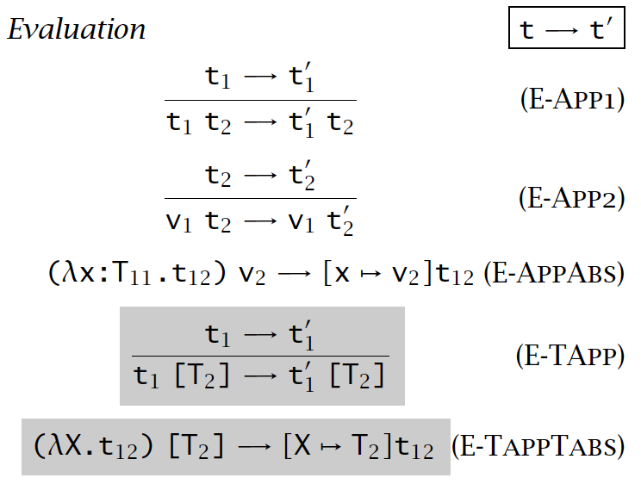
System F

Slide 14
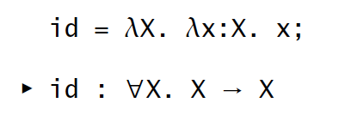
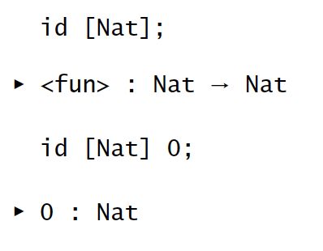
Example: identity

Slide 15
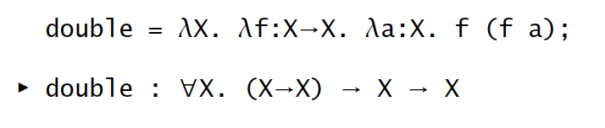
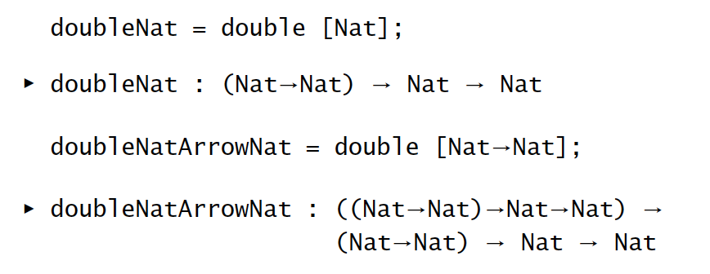
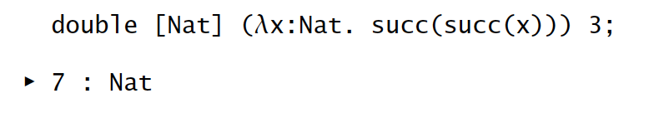
Example: double

Slide 16
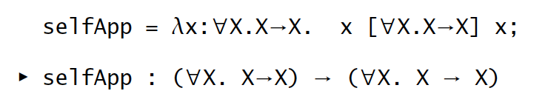
Example, untyped term
How to type this term?
λx. x x

Slide 17
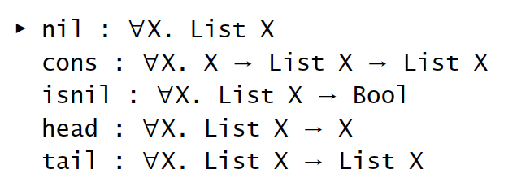
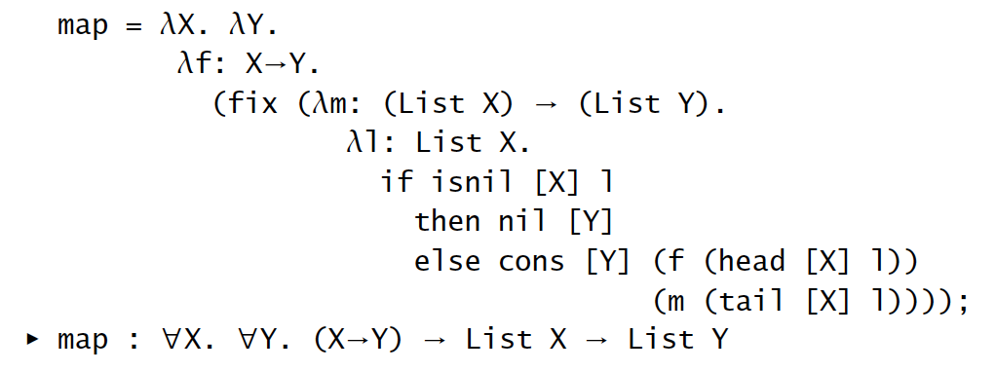
Example: list

Slide 18
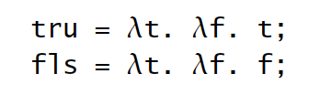

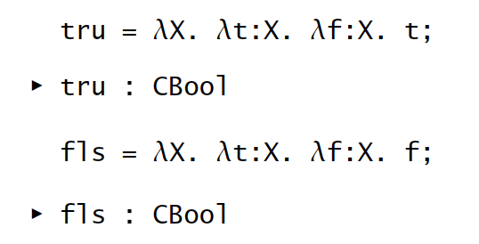
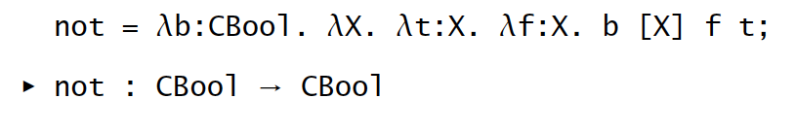
Example: bool

Slide 19
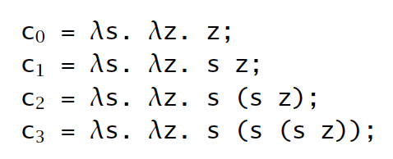

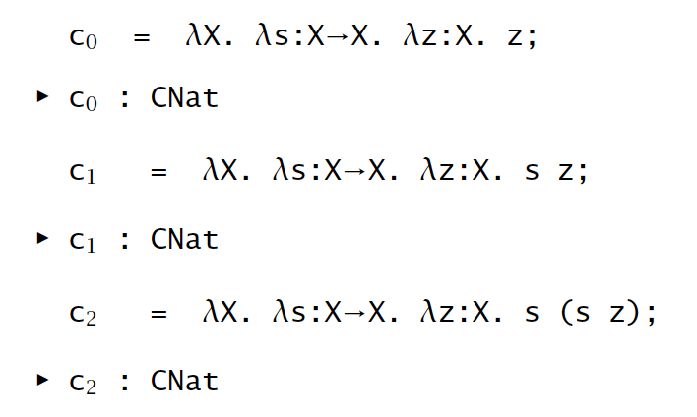
Example: nat

Slide 20
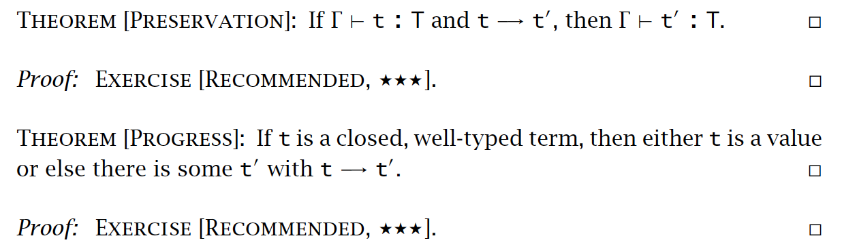
Properties

Slide 21
Erasure, Typability, and Type reconstruction

Slide 22
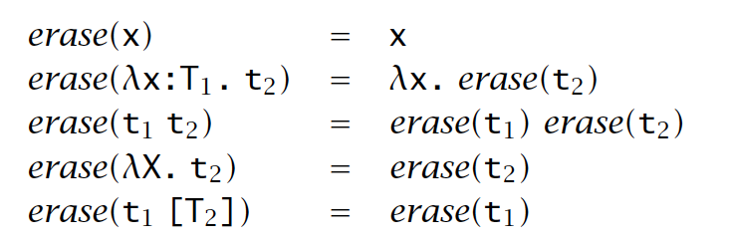
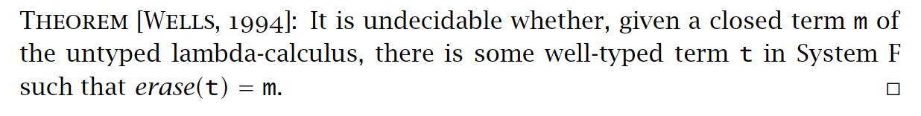
Erasure of Types

Slide 23
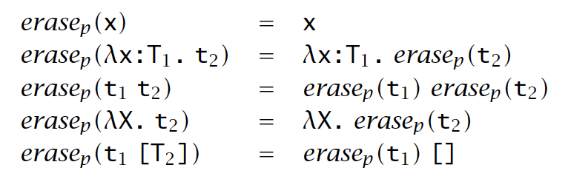
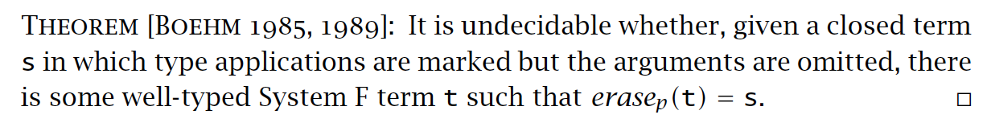
Erasure of Type Applications

Slide 24
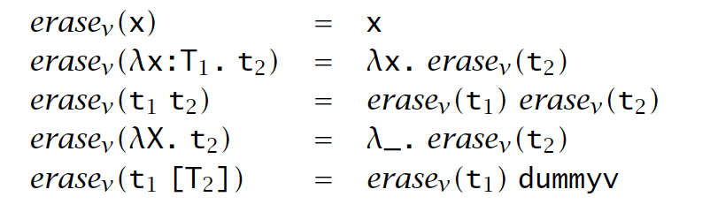
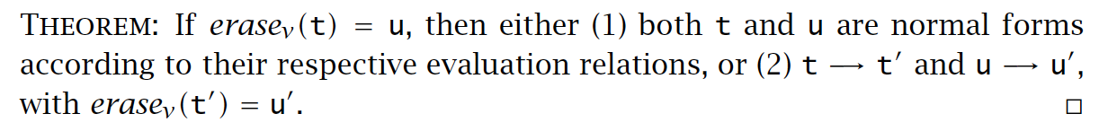
Erasure and Evaluation Order

Slide 25



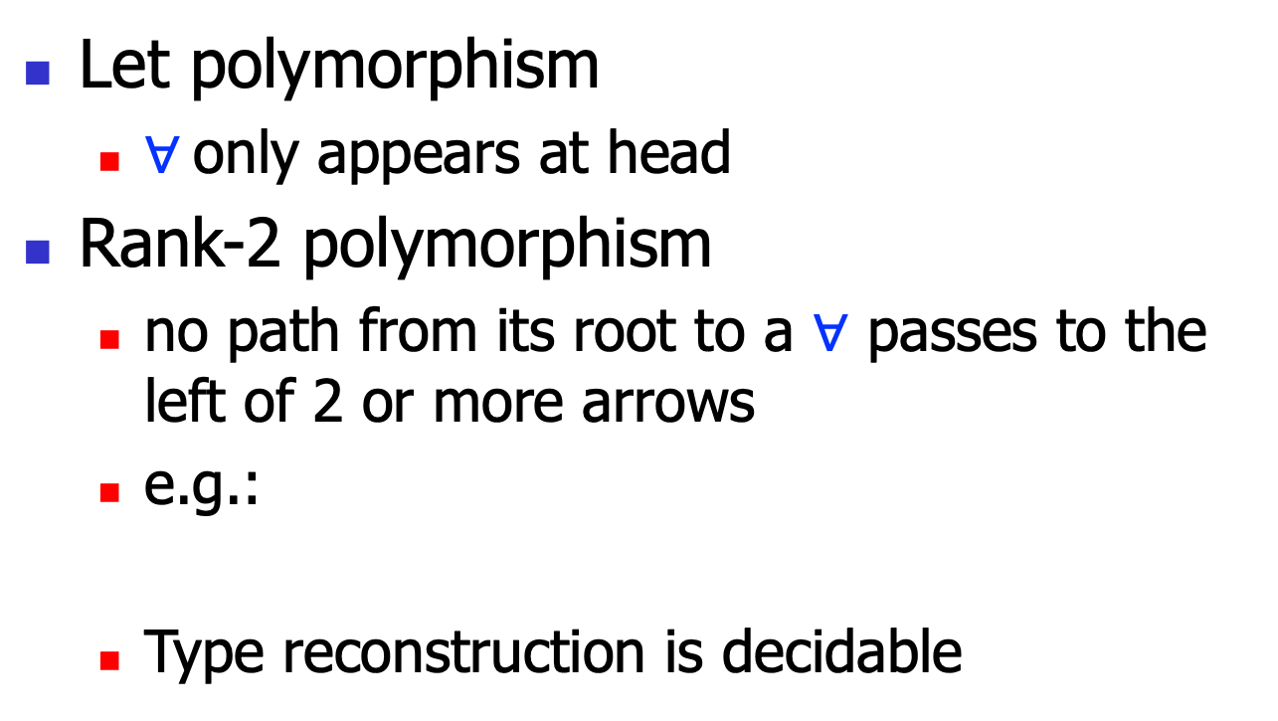
Fragments of System F
Let polymorphism
$∀$only appears at head
Rank-2 polymorphism
no path from its root to a $∀$ passes to the left of 2 or more arrows
e.g.:
Type reconstruction is decidable

Slide 26
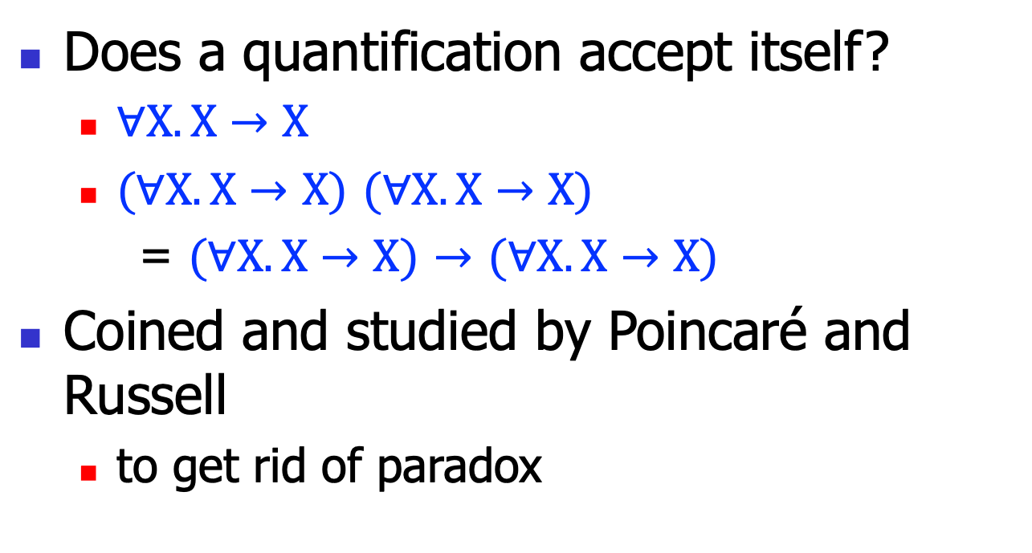
Impredicativity
Does a quantification accept itself?
$∀X.X→X$
$(∀X.X→X$) $(∀X.X→X$)
= $(∀X.X→X$) $→$ $(∀X.X→X$)
Coined and studied by Poincaré and Russell
to get rid of paradox

Slide 27
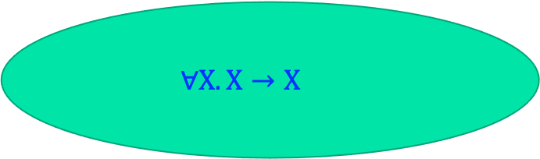

Predicative
A quantification does not accept itself
e.g., Let poly
X ranges over monotypes (no $∀$)
$$∀X.X→X$$
Bool, Bool->Bool, …

Slide 28
Summary
System F includes parametric polymorphism
Very powerful to express more invariants
Type reconstruction is (sadly) undecidable
thus heavy type notations

