Slide 1
Arrays
Formal Methods Foundation
Baojian Hua
bjhua@ustc.edu.cn

Slide 2
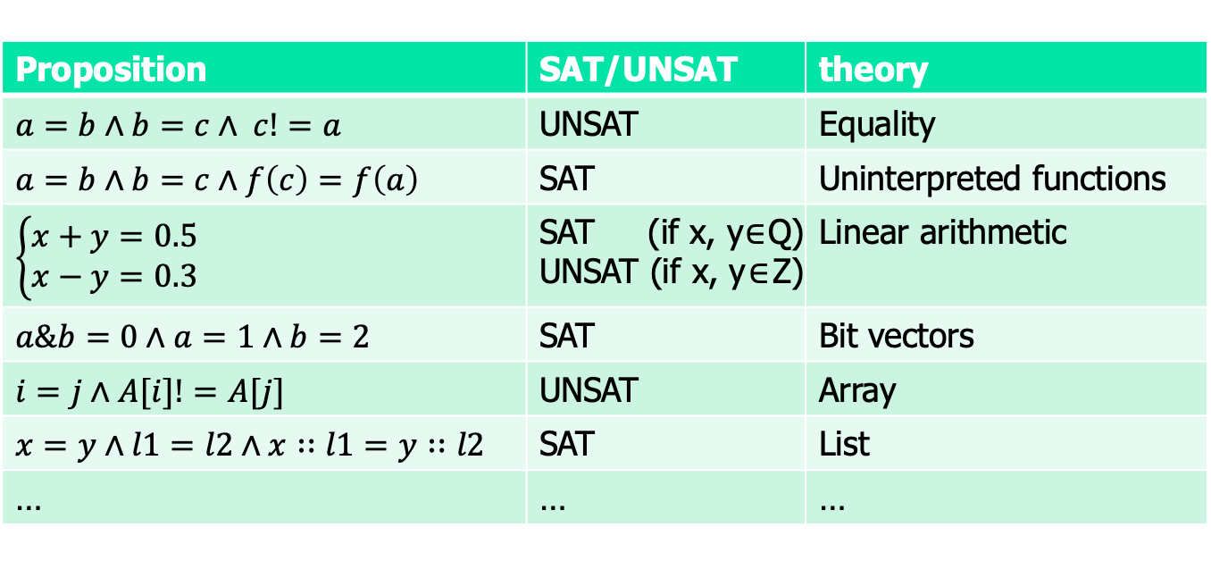
Motivation: theory
Are these satisfiable?
Proposition | SAT/UNSAT | theory
$a=b∧b=c∧ c!=a$ | UNSAT | Equality
$$a=b∧b=c∧f\left(c\right)=f\left(a\right)$$ | SAT | Uninterpreted functions
$$\left\{\begin{aligned}x+y=0.5 \\ x−y=0.3\end{aligned}\right.$$ | SAT (if x, y$∈$Q) UNSAT (if x, y$∈$Z) | Linear arithmetic
$a\&b=0∧a=1∧b=2$ | SAT | Bit vectors
$i=j∧A[i]!=A[j]$ | UNSAT | Array
$x=y∧l1=l2∧x∷l1=y∷l2$ | SAT | List
… | … | …

Slide 3

Satisfiability modulo theory (SMT)
SAT
Theory
Solvers
SMT
Equality + UF
Arithmetic
Bit-vectors
…

Slide 4
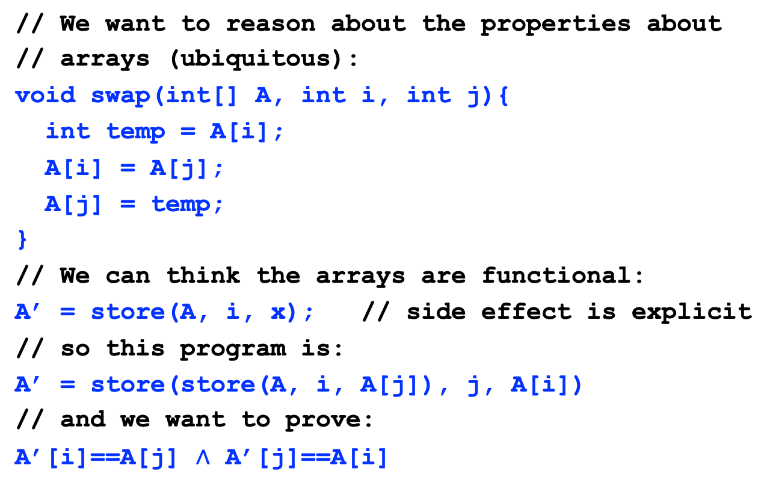
Motivation
// We want to reason about the properties about
// arrays (ubiquitous):
void swap(int[] A, int i, int j){
int temp = A[i];
A[i] = A[j];
A[j] = temp;
}
// We can think the arrays are functional:
A’ = store(A, i, x); // side effect is explicit
// so this program is:
A’ = store(store(A, i, A[j]), j, A[i])
// and we want to prove:
A’[i]==A[j] $∧$ A’[j]==A[i]

Slide 5
Motivation
// Functional programming matters:
int[] swap(int[] A, int i, int j){
int[] A’, A’’;
A’ = store(A, i, A[j]);
A’’ = store(A’, j, A[i]);
return A’’;
}
// In some languages, this is called vectors.
// Always easy to reason about functional programs.

Slide 6
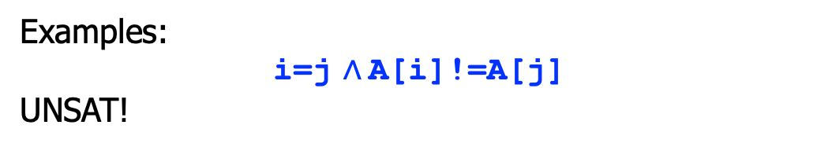

Arrays: the syntax
E ::= x | E[E] | store(E, E, E) | …
R ::= E=E | …
P ::= R
$\text{|} \text{P}∧\text{P}$
array write (update)
array read (select)
also contain array variables
Examples:
i=j $∧$A[i]!=A[j]
UNSAT!
Examples in Z3:
A = Array('A', IntSort(), IntSort()) i, j = Ints('i j') solve(i==j, A[i]!=A[j])

Slide 7
Example again
void swap(int[] A, int i, int j){
int temp = A[i];
A[i] = A[j];
A[j] = temp;
}
// Z3’s representation:
A = Array(‘A’, IntSort(), IntSort())
i, j = Ints(‘i j’)
A1 = Store(Store(A, i, A[j]), j, A[i])
// and we want to prove (by solving):
solve(Not(And(A1[i]==A[j], A1[j]==A[i])))

Slide 8













Inference rules for arrays
$$A=B$$
$$i=j$$
$$(Index)$$
$$A\left[i\right]=B[j]$$
$$i=j$$
$$(RAW1)$$
$$Store\left(A, i, x\right)\left[j\right]=x$$
$$i!=j$$
$$(RAW2)$$
$$Store\left(A, i, x\right)\left[j\right]=A[j]$$
$$∀i.A\left[i\right]=B[i]$$
$$(Extensionality)$$
$$A=B$$

Slide 9
Decision procedure:
Array Elimination

Slide 10
How to design a decision procedure for arrays?
The basic idea is to eliminate array.
think arrays as functions
Transform array
operations to function
operations
do decisions on the
target theory
with array
w.o.
array
E

Slide 11
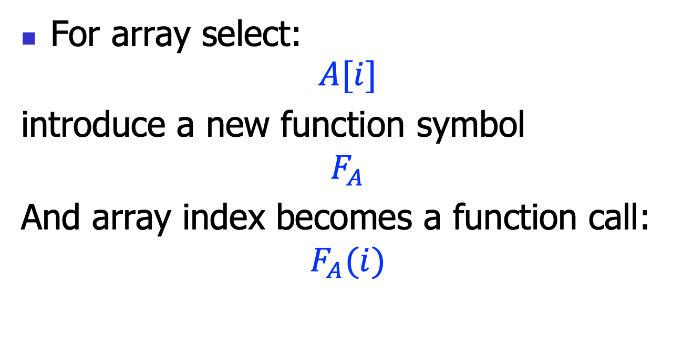
Array select
For array select:
$$A[i]$$
introduce a new function symbol
$$F_{A}$$
And array index becomes a function call:
$$F_{A}(i)$$

Slide 12
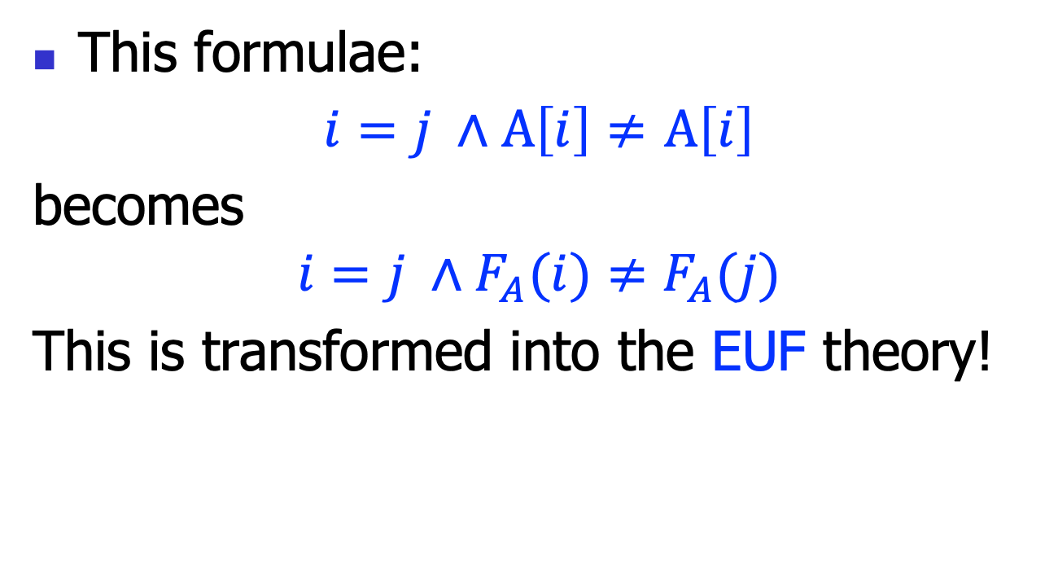
Array select example
This formulae:
$i=j ∧A\left[i\right]≠$ $A\left[i\right]$
becomes
$$i=j ∧F_{A}(i)≠F_{A}(j)$$
This is transformed into the EUF theory!

Slide 13
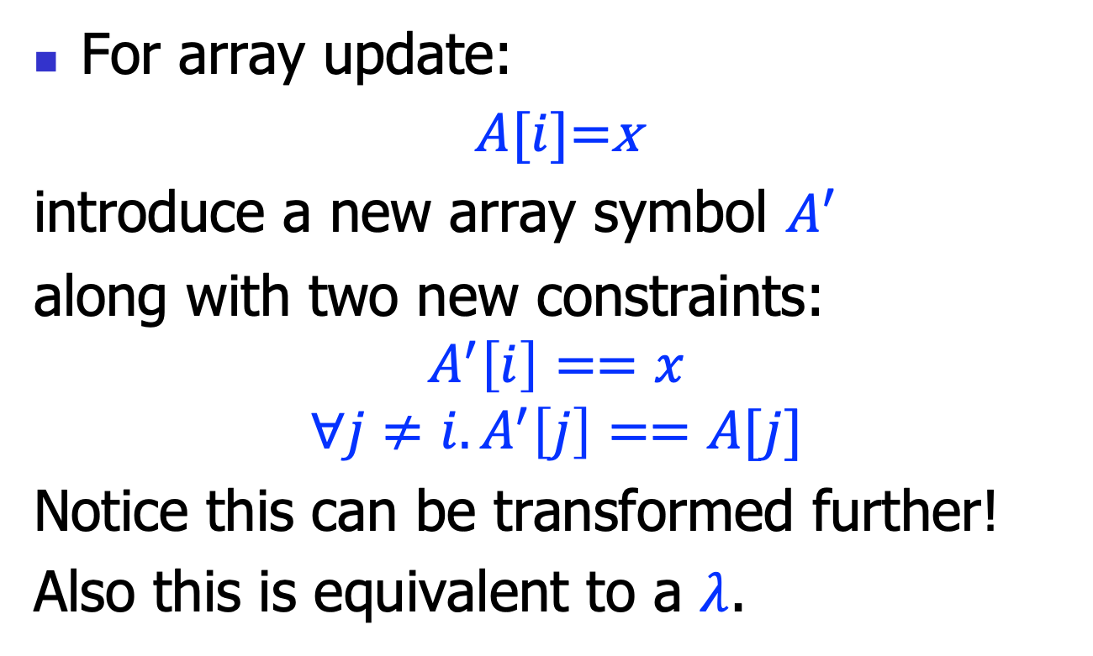
Array update
For array update:
$A[i]$=x
introduce a new array symbol $A′$
along with two new constraints:
$$A^{′}\left[i\right]==x$$
$${∀j≠i.A}^{′}\left[j\right]==A[j]$$
Notice this can be transformed further!
Also this is equivalent to a $λ$.

Slide 14
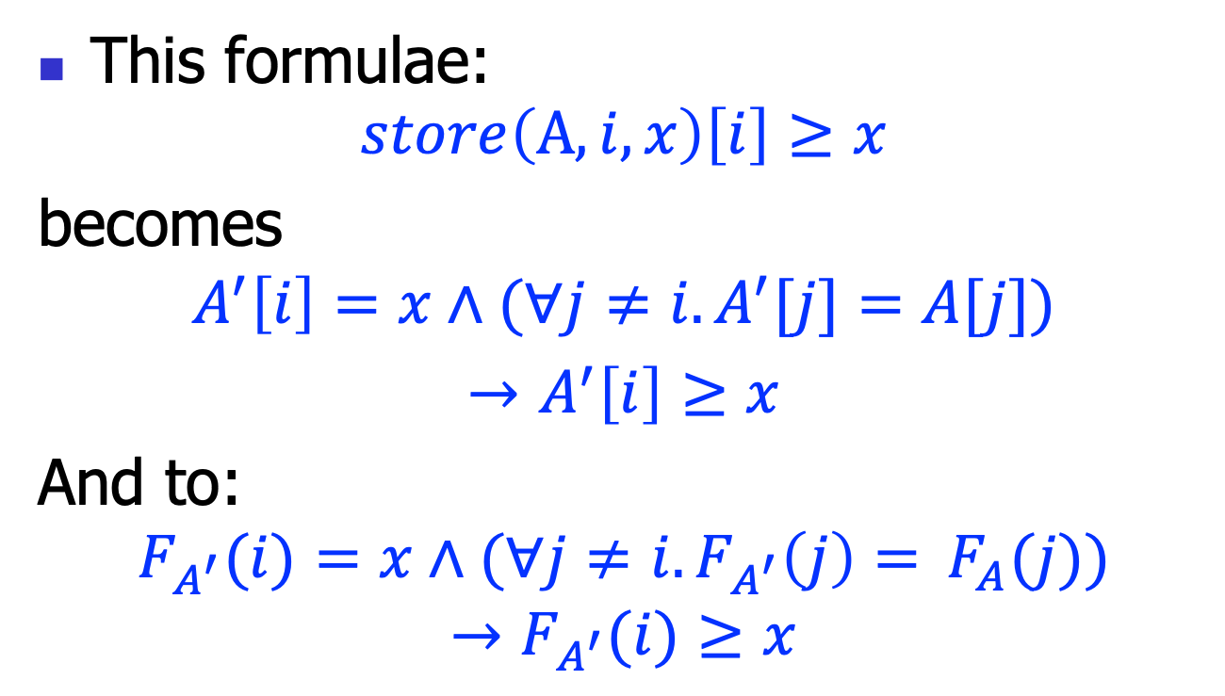
Array update example
This formulae:
$$store\left(A, i,x\right)\left[i\right]≥x$$
becomes
$$A^{′}\left[i\right]=x∧{(∀j≠i.A}^{′}[j]=A[j])$$
$→$ $A^{′}\left[i\right]≥x$
And to:
$$F_{A^{′}}(i)=x∧{(∀j≠i.F_{A^{′}}\left(j\right)= }^{ }F_{A}(j))$$
$$→F_{A^{′}}(i)≥x$$

Slide 15
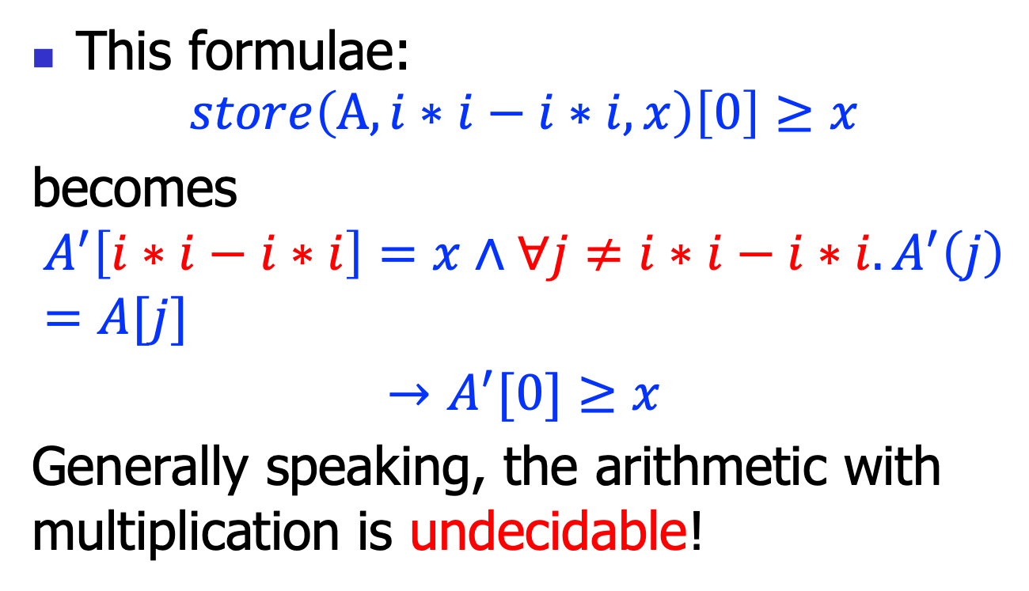
Problems
This formulae:
$$store\left(A,i∗i−i∗i,x\right)\left[0\right]≥x$$
becomes
$$A^{′}\left[i∗i−i∗i\right]=x∧{∀j≠i∗i−i∗i.A}^{′}\left(j\right)=A[j]$$
$→$ $A^{′}[0]≥x$
Generally speaking, the arithmetic with multiplication is undecidable!

Slide 16
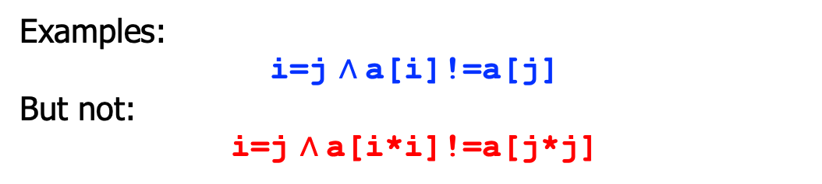

Arrays: the restricted syntax
I ::= x | c | c*x | I+I
E ::= x | x[I] | store(x, I, E) | …
R ::= E=E | …
P ::= R
$\text{|} \text{P}∧\text{P}$
index I is restricted
index is I, but not E
arrays are atomic variables
Examples:
i=j $∧$a[i]!=a[j]
But not:
i=j $∧$a[i*i]!=a[j*j]

Slide 17
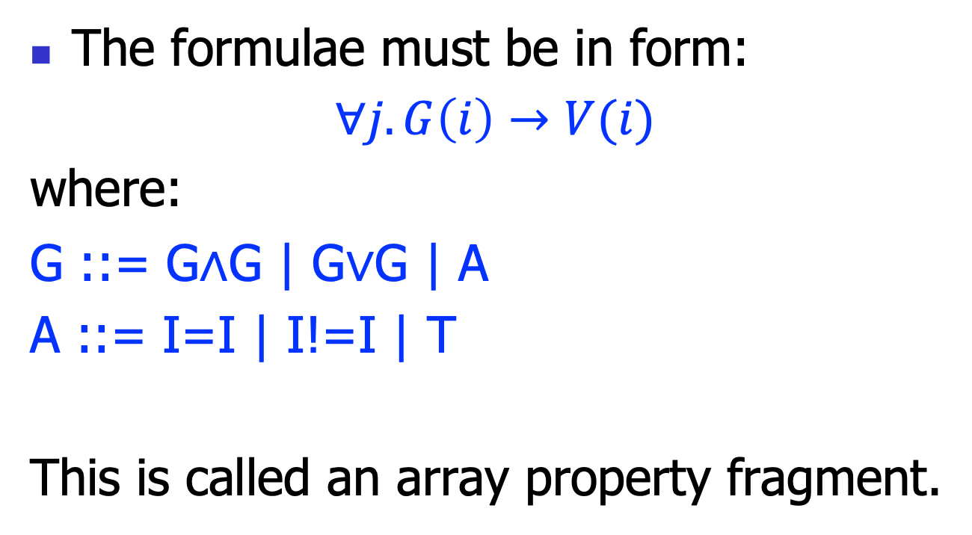
Array property
The formulae must be in form:
∀𝑗$.G\left(i\right)→V(i)$
where:
G ::= G$∧$G | G$∨$G | A
A ::= I=I | I!=I | T
This is called an array property fragment.

Slide 18
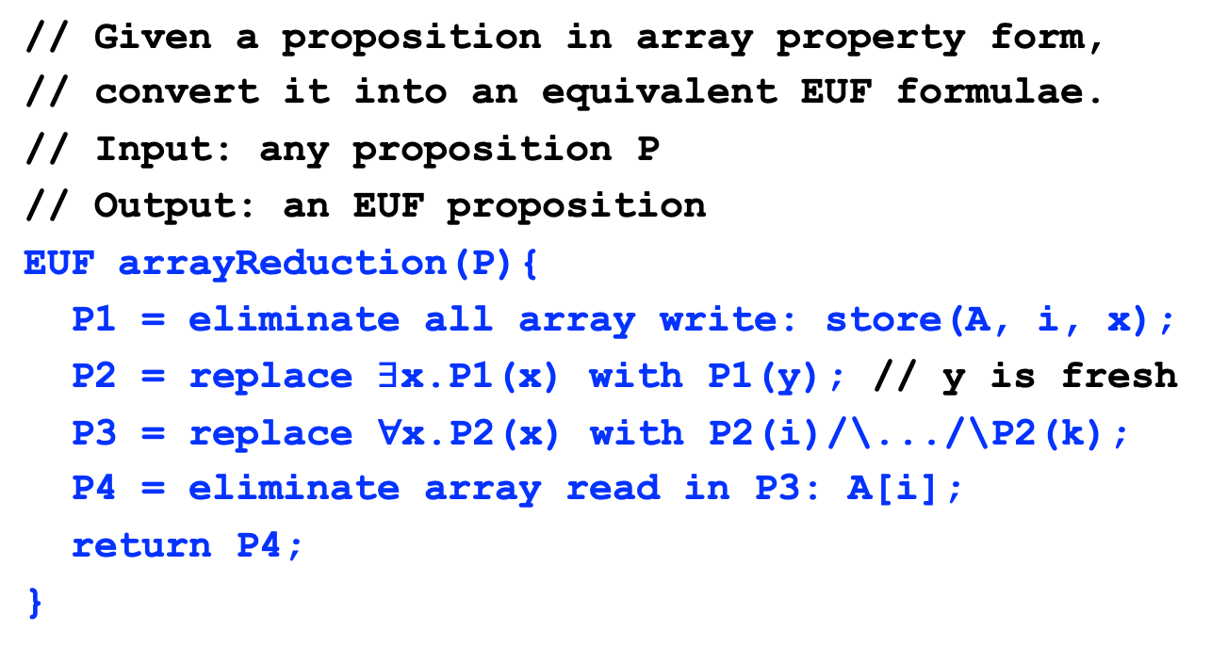
Array reduction algorithm
// Given a proposition in array property form,
// convert it into an equivalent EUF formulae.
// Input: any proposition P
// Output: an EUF proposition
EUF arrayReduction(P){
P1 = eliminate all array write: store(A, i, x);
P2 = replace $∃$x.P1(x) with P1(y); // y is fresh
P3 = replace ∀x.P2(x) with P2(i)/\.../\P2(k);
P4 = eliminate array read in P3: A[i];
return P4;
}

Slide 19
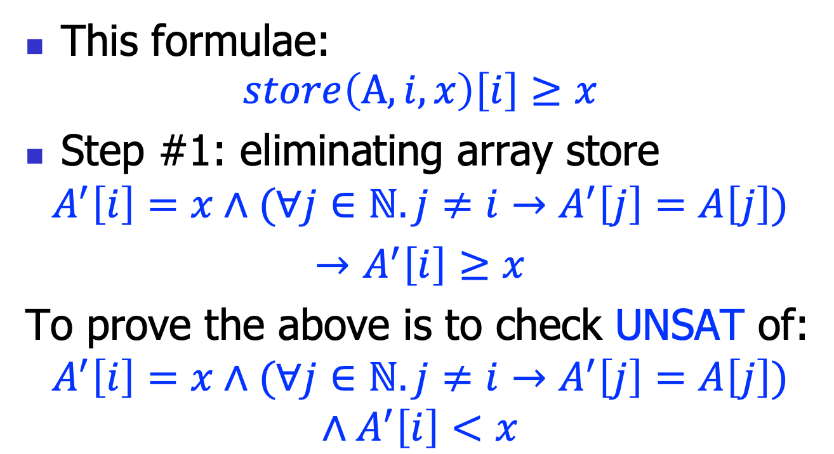
Array reduction example
This formulae:
$$store\left(A, i,x\right)\left[i\right]≥x$$
Step #1: eliminating array store
$$A^{′}\left[i\right]=x∧(∀j∈ℕ.j≠i→A^{′}\left[j\right]=A\left[j\right])$$
$→$ $A^{′}\left[i\right]≥x$
To prove the above is to check UNSAT of:
$$A^{′}\left[i\right]=x∧(∀j∈ℕ.j≠i→A^{′}\left[j\right]=A\left[j\right])$$
$$∧A^{′}\left[i\right]<x$$

Slide 20
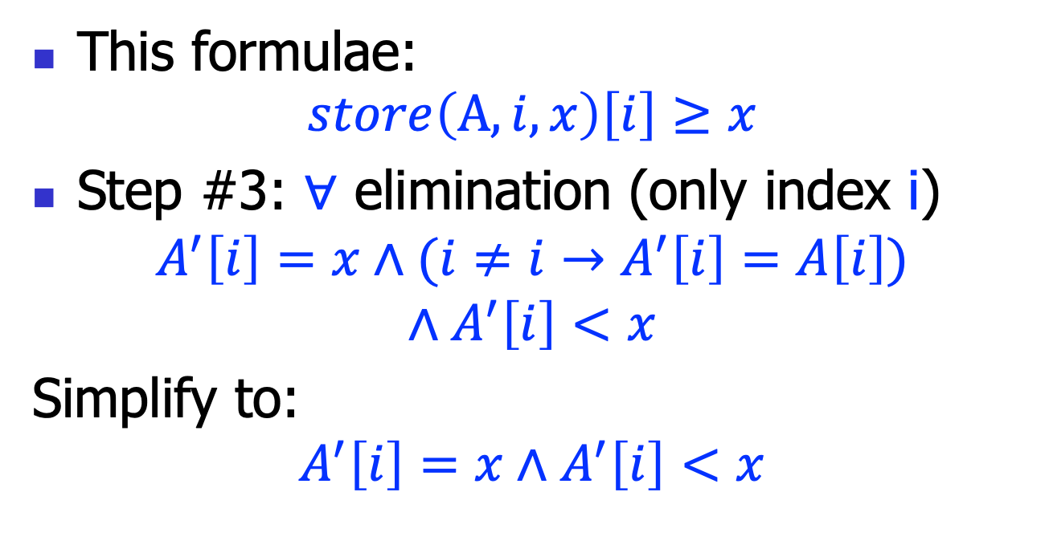
Array reduction example
This formulae:
$$store\left(A, i,x\right)\left[i\right]≥x$$
Step #3: $∀$ elimination (only index i)
$$A^{′}\left[i\right]=x∧(i≠i→A^{′}\left[i\right]=A\left[i\right])$$
$$∧A^{′}\left[i\right]<x$$
Simplify to:
$$A^{′}\left[i\right]=x∧A^{′}\left[i\right]<x$$

Slide 21
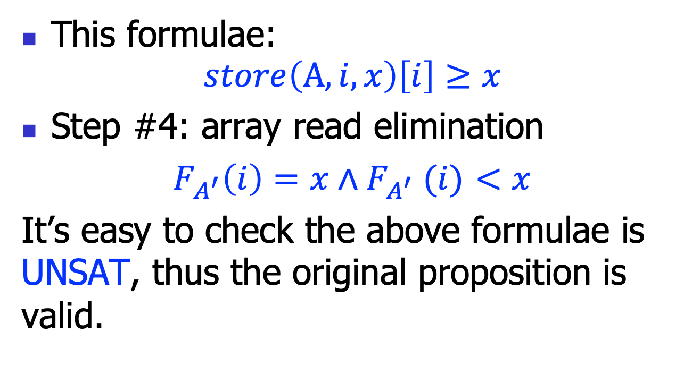
Array reduction example
This formulae:
$$store\left(A, i,x\right)\left[i\right]≥x$$
Step #4: array read elimination
$F_{A^{′}}\left(i\right)=x{∧F}_{A^{′}}(i)$ $<x$
It’s easy to check the above formulae is UNSAT, thus the original proposition is valid.

Slide 22
Theory of Hash Tables

Slide 23
The interfaces are similar
// Array:
read(A, i);
store(A, i, x);
// Hash tables:
lookup(H, k);
update(H, k, v);
// This suggests we can design a theory for hash
// tables, much like the one for arrays.

Slide 24
Example
// The key difference is the “Key” type:
void swap(HashTable hash, Key i, Key j){
Value temp = lookup(hash, i);
update(hash, i, lookup(hash, j));
update(hash, j, temp), ;
}
// We an think the hash table functional:
a’ = update(a, i, x);
// so this program is:
a’ = update(update(a, i, lookup(a, j),j, lookup(a, i)))
// and we want to prove:
lookup(a’,i)==lookup(a,j) /\ lookup(a’, j)==lookup(a, i)

Slide 25
Summary
Array is a widely used data structure
We develop a theory to reason about arrays
by reducing to EUF
The array interface is general
can be generalized to hash table, etc..

