Slide 1
Formal Method 2022-Spring
Recitation Lecture 03

Slide 2
回顾：课程逻辑
应用
符号执行/混合执行
程序验证
程序分析
程序合成
可满足性问题
SAT
Theory
EUF
LA
Bit Vector
Array
Pointer
Combination
逻辑
命题逻辑（符号系统、证明系统、推导规则）
构造逻辑
谓词逻辑
霍尔逻辑
数学基础
集合论
计算复杂性理论
形式文法
结构化归纳法

Slide 3
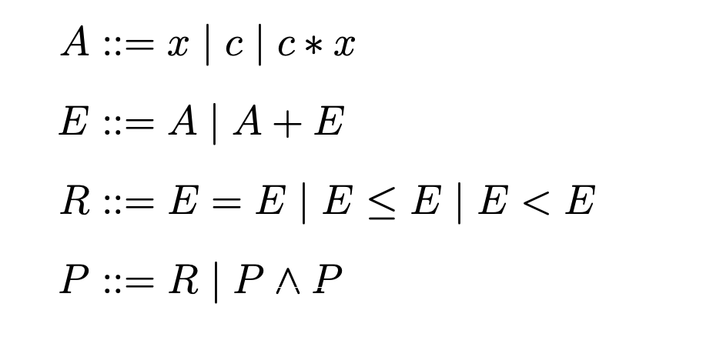
线性算数理论：语法
A：原子要素
- x, c 统称为个体，个体的取值范围：论域
E: 表达式
- 支持减法表达式(因为c可以为负数)
R: 关系式
- 约束
P：命题
- 由一个或多个约束组成
- 语法

Slide 4
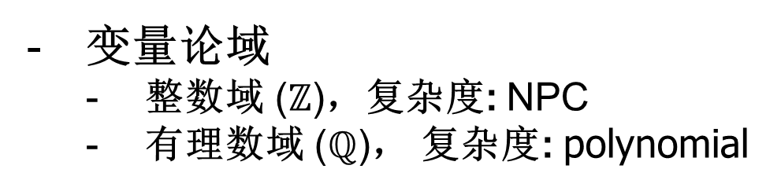
线性算数理论：求解算法
变量论域
整数域 ($ℤ$)，复杂度: NPC
有理数域 ($ℚ$)， 复杂度: polynomial
问题规模
大规模： Simplex Branch and Bound
小规模: Fourier-Motzkin Omega test
Algorithms | Fourier-Motzkin | Simplex | B&B | Omega
domain | Q | Q | Z | Z

Slide 5
线性算数理论：算法
Fourier-Motzkin
单纯形法
分支定界

Slide 6
线性算数理论：Fourier-Motzkin
解决实数论域上的线性算数命题的算法
核心思想：不断消去变量，直到得到命题的最终结果
在每一轮消去变量的过程中，都可能产生关系式数量爆炸
不属于高效的算法
在变量数量较少的情况下，该算法仍然是实用的

Slide 7
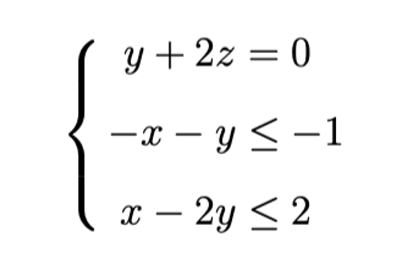
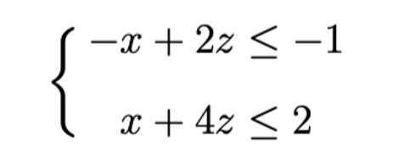

线性算数理论：Fourier-Motzkin
等式消去
代入法（选择一个等式约束，将要消去的变量用其他变量表示出来，代入到其他约束中）
2. 变量消去
启发式地选择一个变量，配对其所有上下界，从而消去变量（产生新约束）

Slide 8
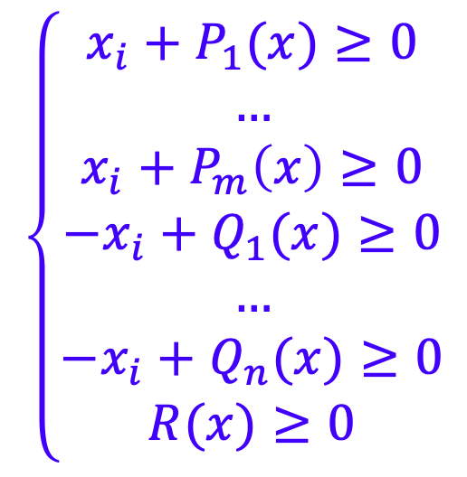
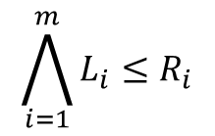
线性算数理论：Fourier-Motzkin
消元
正规化
$$\bigwedge_{i=1}^{m}{L_{i}≤R_{i}}$$

Slide 9
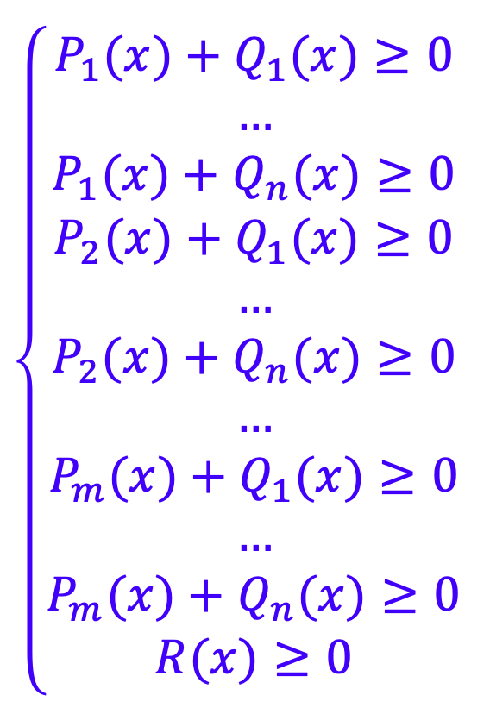
线性算数理论：Fourier-Motzkin
消元
消除变量
配对所有上下界（正系数和负系数的x_{i} 逐个配对进行消去）
若算法发现一对相互冲突的约束，直接返回UNSAT
消去变量的顺序不固定，贪婪启发式算法优先考虑产生较少新约束的变量

Slide 10
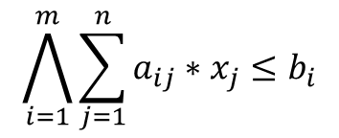
线性算数理论：Fourier-Motzkin
无界变量 & 有界变量
$$\bigwedge_{i=1}^{m}{\sum_{j=1}^{n}{a_{ij}∗x_{j}≤b_{i}}}$$
考虑
当变量$x_{j}$的系数$a_{ij}$在命题P中全部为正时（有上界），或者全部为负时（有下界），我们称$x_{j}$为无界变量。
当变量$x_{j}$的系数$a_{ij}$在命题P中既有正数也有负数时，变量$x_{j}$既有上界也有下界。则称$x_{j}$为有界变量。
无界变量消去：
移除包含该变量的所有约束（可能会导致其他变量成为无界变量，这个步骤不断迭代，直到不包含无界变量）

Slide 11
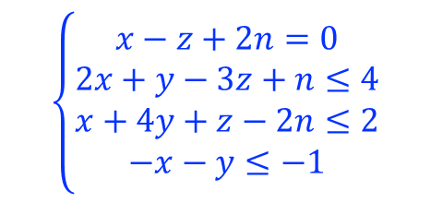

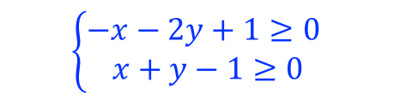

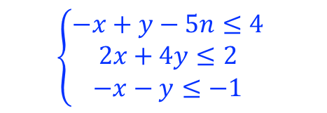
线性算数理论：消元法
Example
$$\left\{\begin{aligned}x−z+2n=0 \\ 2x+y−3z+n≤4 \\ x+4y+z−2n≤2 \\ −x−y≤−1\end{aligned}\right.$$
z = x+2n
$$\left\{\begin{aligned}−x+y−5n≤4 \\ 2x+4y≤2 \\ −x−y≤−1 \end{aligned}\right.$$
n为无界变量
消除等式
$$\left\{\begin{aligned}2x+4y≤2 \\ −x−y≤−1 \end{aligned}\right.$$
正规化
消去变量x
$$\left\{\begin{aligned}−x−2y+1≥0 \\ x+y−1≥0\end{aligned}\right.$$
$$−y≥0$$

Slide 12


线性算数理论：消元法
只剩一个变量
2. 剩下的变量同符号（都为无界变量）
$$\left\{\begin{aligned}x−a≥0 \\ x−b≥0 \\ −x−c≥0 \\ −x−d≥0 \\ n≥0\end{aligned}\right.$$
检查系数为0的约束
检查系数为正的约束，得出下界
检查系数为负的约束，得出上界
$$\left\{\begin{aligned}x−2y−a≥0 \\ x−3y−b≥0 \end{aligned}\right.$$
仅求是否可满足：直接去除约束，返回SAT
要求给出一个解：推荐使用正负无限值：numpy.inf,-numpy.inf

Slide 13

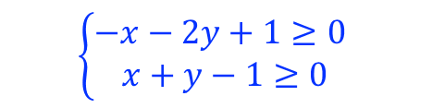
线性算数理论：消元法
Example
$$\left\{\begin{aligned}x−z+2n=0 \\ 2x+y−3z+n≤4 \\ x+4y+z−2n≤2 \\ −x−y≤−1\end{aligned}\right.$$
z = x+2n
$$\left\{\begin{aligned}−x+y−5n≤4 \\ 2x+4y≤2 \\ −x−y≤−1 \end{aligned}\right.$$
n为无界变量
消除等式
$$\left\{\begin{aligned}2x+4y≤2 \\ −x−y≤−1 \end{aligned}\right.$$
y= 0
x= 1
n = -1
z = -1
y= 0
x= 1
n = -1
正规化
消去变量x
$$\left\{\begin{aligned}−x−2y+1≥0 \\ x+y−1≥0\end{aligned}\right.$$
$$−y≥0$$
y= 0
x= 1
y= 0

Slide 14
线性算数理论：算法
Fourier-Motzkin
单纯形法
分支定界

Slide 15
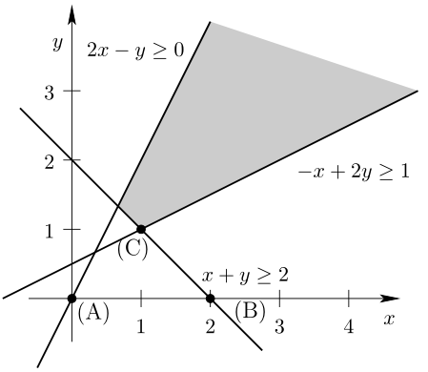
线性算数理论：几何意义
线性约束可满足性问题可以转换为几何问题
每个变量代表一个维度
每个约束定义一个凸子空间
不等式定义一个半空间
等式定义一个超平面
解空间由半空间和超平面交集定义，形成一个凸多面体
凸集可以这样描述:用一条直线连接集合里两个元素，这条连线上的所有元素都在这个集合里，这个集合称为凸集；

Slide 16
线性算数理论：单纯形法
单纯形法（Simplex Algorithm）于1947年由George Dantzig发明
最初用于解决线性规划问题
线性算数的可满足性问题是线性规划的一个子问题
最坏情况下的时间复杂度是指数级的
可以有效解决含有大量线性约束的线性算数问题

Slide 17
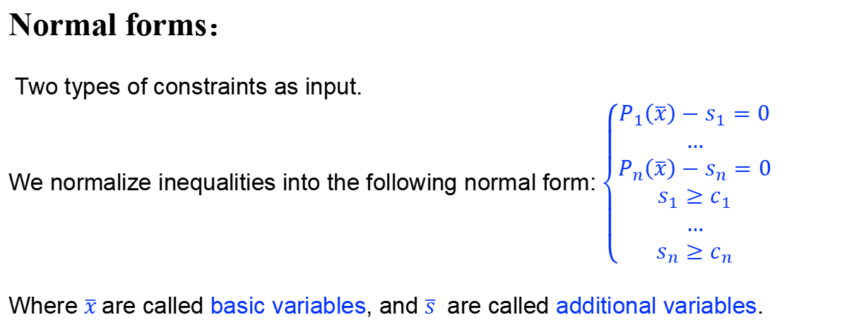
线性算数理论：单纯形法
Normal forms：
Two types of constraints as input.
We normalize inequalities into the following normal form: $\left\{\begin{aligned}P_{1}\left(\overline{x}\right)−s_{1}=0 \\ … \\ P_{n}\left(\overline{x}\right)−s_{n}=0 \\ s_{1}≥c_{1} \\ … \\ s_{n}≥c_{n}\end{aligned}\right.$
Where $\overline{x}$are called basic variables, and $\overline{s}$ are called additional variables.

Slide 18
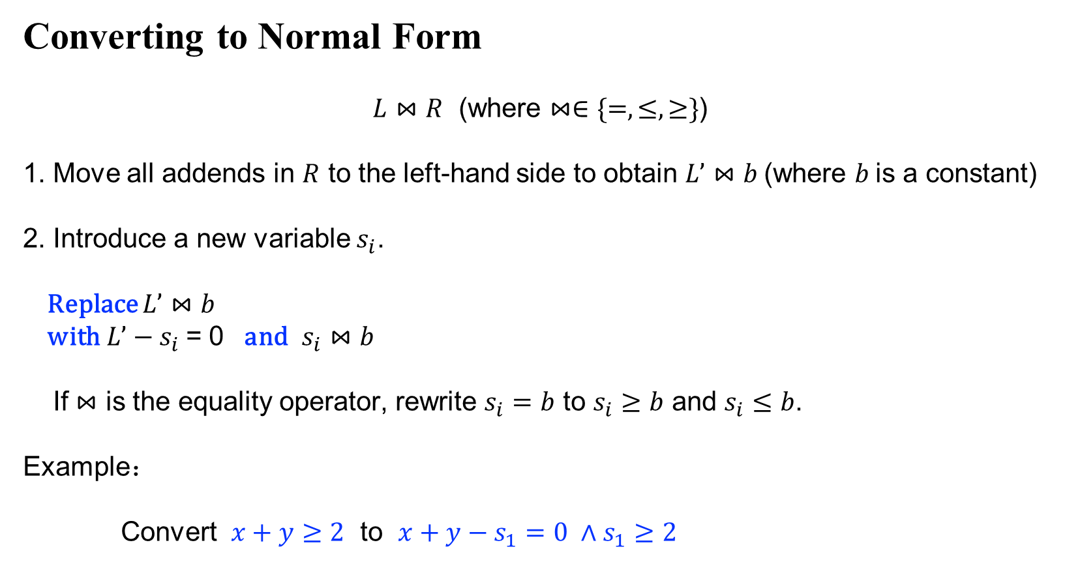
线性算数理论：单纯形法
Converting to Normal Form
$L⋈R$ (where $⋈∈\{=,≤,≥\}$)
1. Move all addends in $R$ to the left-hand side to obtain $L’⋈b$(where $b$is a constant)
2. Introduce a new variable $s_{i}$.
Replace $L’⋈b$
with$L’−s_{i}$ = 0 and $s_{i}⋈b$
If $⋈$ is the equality operator, rewrite $s_{i}=b$ to $s_{i}≥b$ and $s_{i}≤b$.
Example：
Convert $x+y≥2$ to $x+y−s_{1}=0 ∧s_{1}≥2$

Slide 19

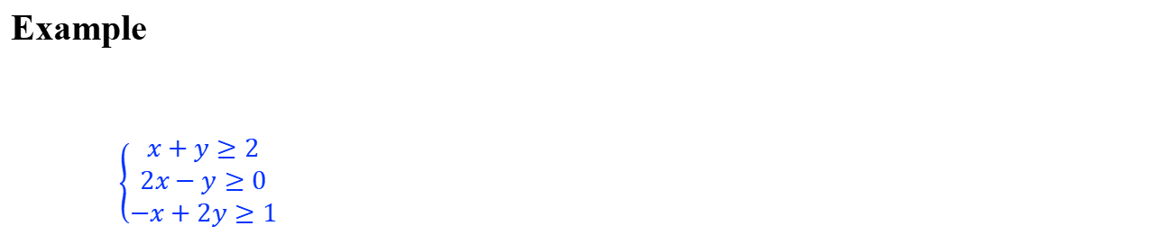
线性算数理论：单纯形法
Example
$\left\{\begin{aligned}x+y≥2 \\ 2x−y≥0 \\ −x+2y≥1\end{aligned}\right.$
$$\left\{\begin{aligned}x+y−s1=0 \\ 2x−y−s2=0 \\ −x+2y−s3=0 \\ s1≥2 \\ s2≥0 \\ s3≥1\end{aligned}\right.$$
normalize

Slide 20
线性算数理论：单纯形法
Simplex algorithm
simplex(){
tab = constructTableau();
for(each additional var si){
if(si violates its constraint){
if(there is a suitable xj)
pivot(si, xj);
else return UNSAT;
}
}
return SAT;
}

Slide 21
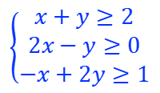
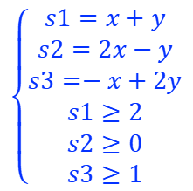
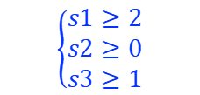
线性算数理论：单纯形法
$$\left\{\begin{aligned}x+y−s1=0 \\ 2x−y−s2=0 \\ −x+2y−s3=0 \\ s1≥2 \\ s2≥0 \\ s3≥1\end{aligned}\right.$$
$$\left\{\begin{aligned}s1=x+y \\ s2=2x−y \\ s3=−x+2y \\ s1≥2 \\ s2≥0 \\ s3≥1\end{aligned}\right.$$
$$\left\{\begin{aligned}x+y≥2 \\ 2x−y≥0 \\ −x+2y≥1\end{aligned}\right.$$
normalize
Tableau：
 | x | y
s1 | 1 | 1
s2 | 2 | -1
s3 | -1 | 2
$$\left\{\begin{aligned}s1≥2 \\ s2≥0 \\ s3≥1\end{aligned}\right.$$

Slide 22
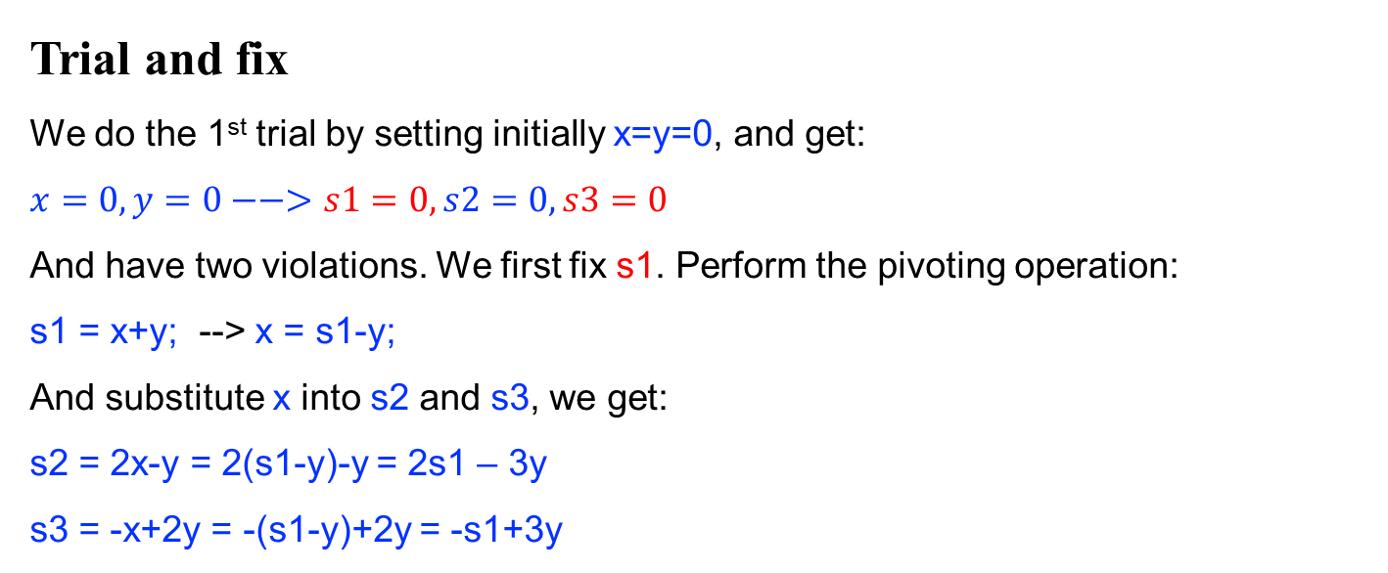
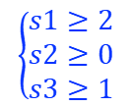
线性算数理论：单纯形法
 | x | y
s1 | 1 | 1
s2 | 2 | -1
s3 | -1 | 2
$$\left\{\begin{aligned}x+y≥2 \\ 2x−y≥0 \\ −x+2y≥1\end{aligned}\right.$$
$$\left\{\begin{aligned}s1≥2 \\ s2≥0 \\ s3≥1\end{aligned}\right.$$
Trial and fix
We do the 1st trial by setting initially x=y=0, and get:
$$x=0, y=0−−>s1=0, s2=0, s3=0$$
And have two violations. We first fix s1. Perform the pivoting operation:
s1 = x+y; --> x = s1-y;
And substitute x into s2 and s3, we get:
s2 = 2x-y = 2(s1-y)-y = 2s1 – 3y
s3 = -x+2y = -(s1-y)+2y = -s1+3y
 | x | y
s1 | 1 | 1
s2 | 2 | -1
s3 | -1 | 2
$$\left\{\begin{aligned}s1≥2 \\ s2≥0 \\ s3≥1\end{aligned}\right.$$
pivote(s,x)
(x,y) = (x0,y0)
(s,y)= (bound(s), y0)

Slide 23
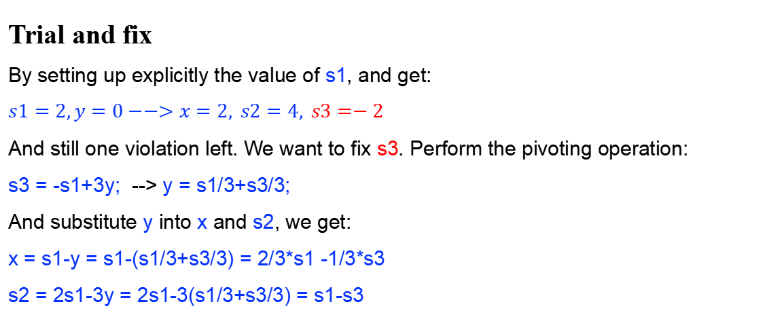
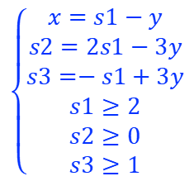
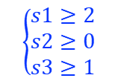
线性算数理论：单纯形法
$$\left\{\begin{aligned}x=s1−y \\ s2=2s1−3y \\ s3=−s1+3y \\ s1≥2 \\ s2≥0 \\ s3≥1\end{aligned}\right.$$
 | s1 | y
x | 1 | -1
s2 | 2 | -3
s3 | -1 | 3
$$\left\{\begin{aligned}x+y≥2 \\ 2x−y≥0 \\ −x+2y≥1\end{aligned}\right.$$
$$\left\{\begin{aligned}s1≥2 \\ s2≥0 \\ s3≥1\end{aligned}\right.$$
Trial and fix
By setting up explicitly the value of s1, and get:
$$s1=2,y=0−−>x=2, s2=4, s3=−2$$
And still one violation left. We want to fix s3. Perform the pivoting operation:
s3 = -s1+3y; --> y = s1/3+s3/3;
And substitute y into x and s2, we get:
x = s1-y = s1-(s1/3+s3/3) = 2/3*s1 -1/3*s3
s2 = 2s1-3y = 2s1-3(s1/3+s3/3) = s1-s3
 | s1 | y
x | 1 | -1
s2 | 2 | -3
s3 | -1 | 3
$$\left\{\begin{aligned}s1≥2 \\ s2≥0 \\ s3≥1\end{aligned}\right.$$

Slide 24
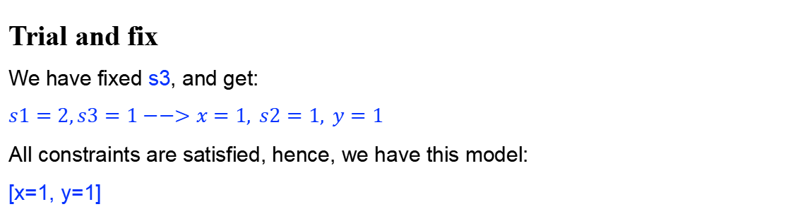
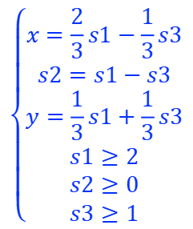
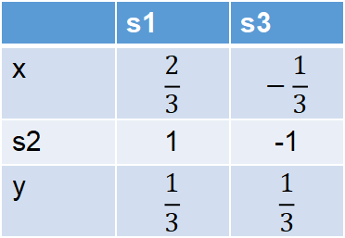
线性算数理论：单纯形法
$$\left\{\begin{aligned}x=\frac{2}{3}s1−\frac{1}{3}s3 \\ s2=s1−s3 \\ y=\frac{1}{3}s1+\frac{1}{3}s3 \\ s1≥2 \\ s2≥0 \\ s3≥1\end{aligned}\right.$$
 | s1 | s3
x | $$\frac{2}{3}$$ | $$−\frac{1}{3}$$
s2 | 1 | -1
y | $$\frac{1}{3}$$ | $$\frac{1}{3}$$
$$\left\{\begin{aligned}x+y≥2 \\ 2x−y≥0 \\ −x+2y≥1\end{aligned}\right.$$
$$\left\{\begin{aligned}s1≥2 \\ s2≥0 \\ s3≥1\end{aligned}\right.$$
Trial and fix
We have fixed s3, and get:
$$s1=2,s3=1−−>x=1, s2=1, y=1$$
All constraints are satisfied, hence, we have this model:
[x=1, y=1]

Slide 25
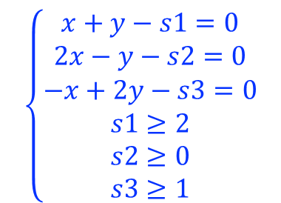
线性算数理论：单纯形法
几何学意义
s2 =0
$$\left\{\begin{aligned}x+y−s1=0 \\ 2x−y−s2=0 \\ −x+2y−s3=0 \\ s1≥2 \\ s2≥0 \\ s3≥1\end{aligned}\right.$$
1.trial: (x,y) = (0,0), pivote(s1,x)
2. trial: (s1,y) = (2,0), pivote(s3,y)
3.trial: (s1,s3) = (2,1) sat
s3 = 1
1.trial: (x,y) = (0,0), pivote(s1,y)
2. trial: (x,s1) = (0,2), pivote(s2,x)
3.trial: (s2,s1) = (0,2) sat
s1 = 2

Slide 26
线性算数理论：算法
Fourier-Motzkin
单纯形法
分支定界

Slide 27
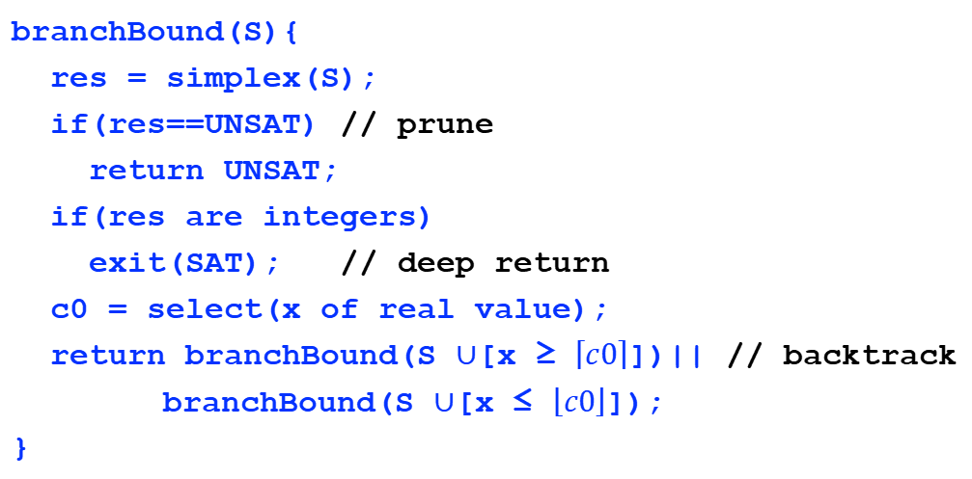
线性算数理论：分支定界
branchBound(S){
res = simplex(S);
if(res==UNSAT) // prune
return UNSAT;
if(res are integers)
exit(SAT); // deep return
c0 = select(x of real value);
return branchBound(S $∪$[x ≥ $\left\lceil c0\right\rceil$])|| // backtrack
branchBound(S $∪$[x ≤ $\left\lfloor c0\right\rfloor$]);
}

Slide 28
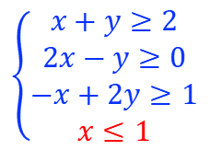
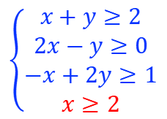

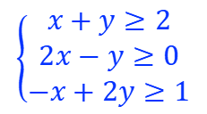
线性算数理论：分支定界
ILP
$$\left\{\begin{aligned}x+y≥2 \\ 2x−y≥0 \\ −x+2y≥1\end{aligned}\right.$$
where x, y $∈ℤ$
Suppose:
[x=1.7, y=3.5]
$$\left\{\begin{aligned}x+y≥2 \\ 2x−y≥0 \\ −x+2y≥1 \\ x≥2\end{aligned}\right.$$
$$\left\{\begin{aligned}x+y≥2 \\ 2x−y≥0 \\ −x+2y≥1 \\ x≤1\end{aligned}\right.$$

Slide 29
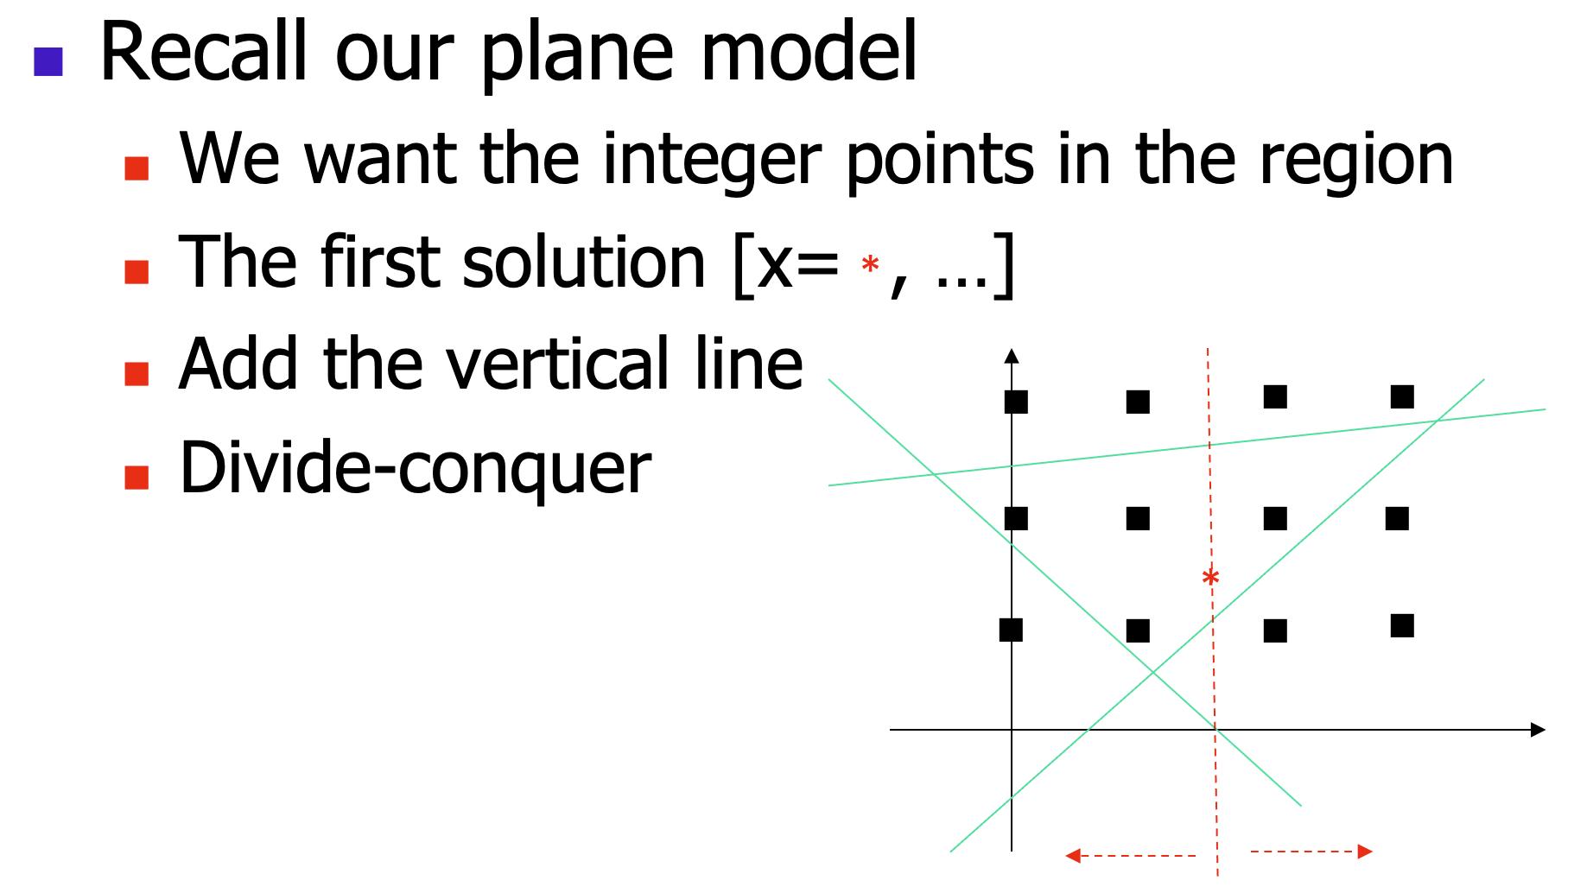
线性算数理论：分支定界

Slide 30
数据结构理论
比特向量
数组
指针

Slide 31
数据结构理论
比特向量
数组
指针

Slide 32
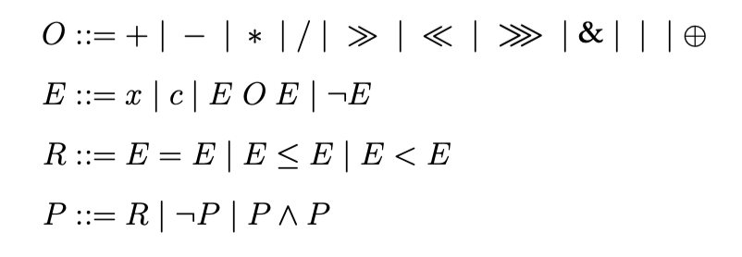
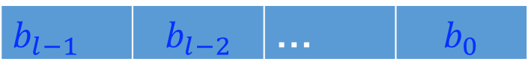
比特向量理论
Syntax
bit vector b
$b_{l−1}$ | $$b_{l−2}$$ | … | $$b_{0}$$

Slide 33
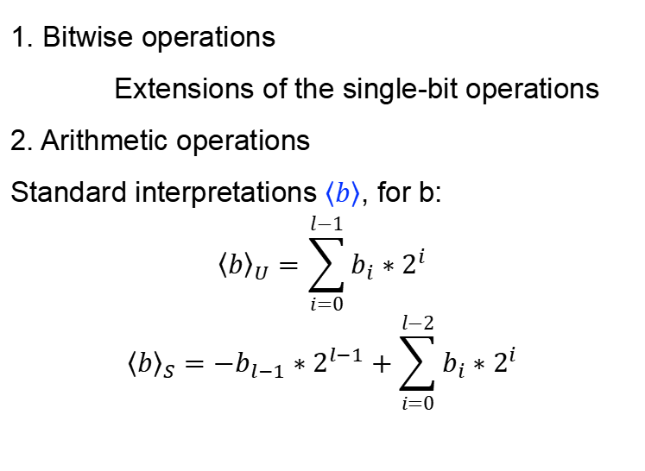
比特向量理论
Semantics
1. Bitwise operations
Extensions of the single-bit operations
2. Arithmetic operations
Standard interpretations $\left\langle b\right\rangle$, for b:
$${\left\langle b\right\rangle }_{U}=\sum_{i=0}^{l−1}{b_{i}∗2^{i}}$$
$${\left\langle b\right\rangle }_{S}={−b}_{l−1}∗2^{l−1}+\sum_{i=0}^{l−2}{b_{i}∗2^{i}}$$

Slide 34

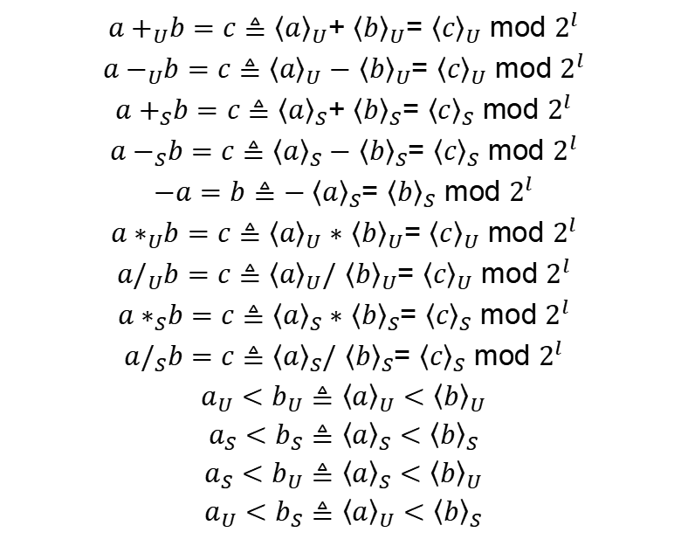
比特向量理论
Semantics: arithmetic operations
${a+}_{U}b=c≜$ ${\left\langle a\right\rangle }_{U}$+ ${\left\langle b\right\rangle }_{U}$= ${\left\langle c\right\rangle }_{U}$ mod $2^{l}$
${a−}_{U}b=c≜$ ${\left\langle a\right\rangle }_{U}−$ ${\left\langle b\right\rangle }_{U}$= ${\left\langle c\right\rangle }_{U}$ mod $2^{l}$
${a+}_{S}b=c≜$ ${\left\langle a\right\rangle }_{S}$+ ${\left\langle b\right\rangle }_{S}$= ${\left\langle c\right\rangle }_{S}$ mod $2^{l}$
${a−}_{S}b=c≜$ ${\left\langle a\right\rangle }_{S}−$ ${\left\langle b\right\rangle }_{S}$= ${\left\langle c\right\rangle }_{S}$ mod $2^{l}$
$−a=b≜$ ${−\left\langle a\right\rangle }_{S}$= ${\left\langle b\right\rangle }_{S}$ mod $2^{l}$
${a∗}_{U}b=c≜$ ${\left\langle a\right\rangle }_{U}∗$ ${\left\langle b\right\rangle }_{U}$= ${\left\langle c\right\rangle }_{U}$ mod $2^{l}$
${a/}_{U}b=c≜$ ${\left\langle a\right\rangle }_{U}/$ ${\left\langle b\right\rangle }_{U}$= ${\left\langle c\right\rangle }_{U}$ mod $2^{l}$
${a∗}_{S}b=c≜$ ${\left\langle a\right\rangle }_{S}∗$ ${\left\langle b\right\rangle }_{S}$= ${\left\langle c\right\rangle }_{S}$ mod $2^{l}$
${a/}_{S}b=c≜$ ${\left\langle a\right\rangle }_{S}/$ ${\left\langle b\right\rangle }_{S}$= ${\left\langle c\right\rangle }_{S}$ mod $2^{l}$
$a_{U}<b_{U}≜$ ${\left\langle a\right\rangle }_{U}<$ ${\left\langle b\right\rangle }_{U}$
$a_{S}<b_{S}≜$ ${\left\langle a\right\rangle }_{S}<$ ${\left\langle b\right\rangle }_{S}$
$a_{S}<b_{U}≜$ ${\left\langle a\right\rangle }_{S}<$ ${\left\langle b\right\rangle }_{U}$
$a_{U}<b_{S}≜$ ${\left\langle a\right\rangle }_{U}<$ ${\left\langle b\right\rangle }_{S}$
BV
Z
$$\left\langle c\right\rangle$$

Slide 35
比特向量理论
Decision procedures for bit vectors

Slide 36
比特向量理论
Bit-blasting algorithm
C = {}; // a set of all generated constraints
// two main passes:
// 1. blast each proposition;
// 2. generate constrains
bitBlast(P){
// convert the proposition to atomic bools
blastProp(P);
// generate constraints
genConsProp(P); }

Slide 37
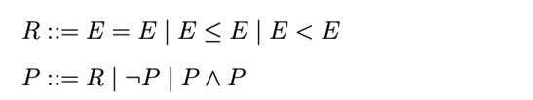
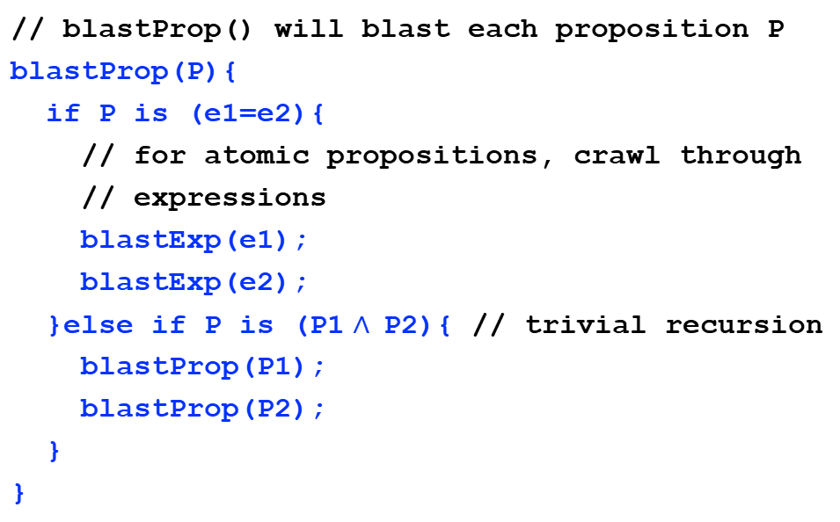
比特向量理论
Bit-blasting algorithm : pass #1: blasting
// blastProp() will blast each proposition P
blastProp(P){
if P is (e1=e2){
// for atomic propositions, crawl through
// expressions
blastExp(e1);
blastExp(e2);
}else if P is (P1 $∧$P2){ // trivial recursion
blastProp(P1);
blastProp(P2);
}
}

Slide 38

比特向量理论
Bit-blasting algorithm : pass #1: blasting
// genCons() will generate constraints
blastExp(e){
if e is x:
// a vector of boolean variables
return (b0, b1, …, bn);
if e is c:
return (b0, b1, …, bn);
if e is e1+e2:
(b0, …, bn) = blastExp(e1);
(c0, …, cn) = blastExp(e2);
return (d0, …, dn); // attach to e1+e2
// other cases are similar
}

Slide 39

比特向量理论
// to blast the following propositions
x=1 $∧$ y=2 $∧$ x&y=1
// tree structure:
∧
=
f0, …, fn
∧
&
1
g0, …, gn
=
=
x
y
b0, …, bn
c0, …, cn
b0, …, bn
d0, …, dn
x
1
y
2
d0, …, dn
e0, …, en

Slide 40
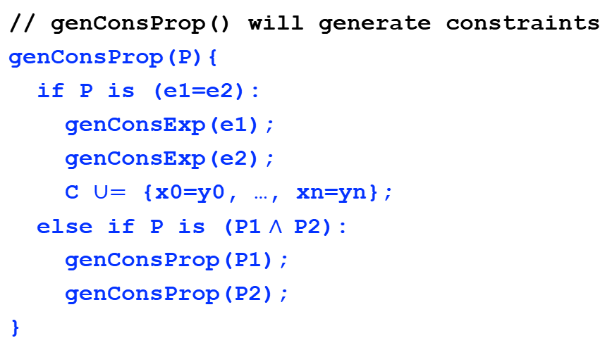
比特向量理论
Bit-blasting algorithm : step #2: generating constr’
// genConsProp() will generate constraints
genConsProp(P){
if P is (e1=e2):
genConsExp(e1);
genConsExp(e2);
C $∪=$ {x0=y0, …, xn=yn};
else if P is (P1 $∧$P2):
genConsProp(P1);
genConsProp(P2);
}

Slide 41

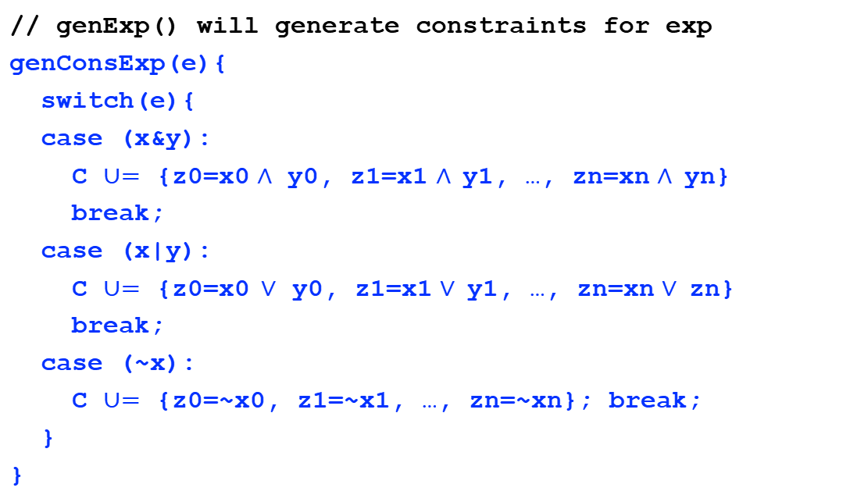
比特向量理论
Bit-blasting algorithm : step #2: generating constr’
// genExp() will generate constraints for exp
genConsExp(e){
switch(e){
case (x&y):
C $∪=$ {z0=x0 $∧$ y0, z1=x1 $∧$y1, …, zn=xn $∧$yn}
break;
case (x|y):
C $∪=$ {z0=x0$∨$ y0, z1=x1 $∨$y1, …, zn=xn $∨$zn}
break;
case (~x):
C $∪=$ {z0=~x0, z1=~x1, …, zn=~xn}; break;
}
}

Slide 42

比特向量理论
// to blast the following propositions
x=1 $∧$ y=2 $∧$ x&y=1
// tree structure:
∧
f0=g0, …, fn=gn
=
f0=b0∧d0, …, fn=bn∧dn
g0, …, gn
f0, …, fn
∧
&
1
g0=T, …, gn=F
b0=c0, …, bn=cn
d0=e0, …, dn=en
=
c0=T, …, cn=F
=
x
y
b0, …, bn
c0, …, cn
b0, …, bn
d0, …, dn
x
1
y
2
e0=F, e1=T, …, en=F
d0, …, dn
e0, …, en

Slide 43
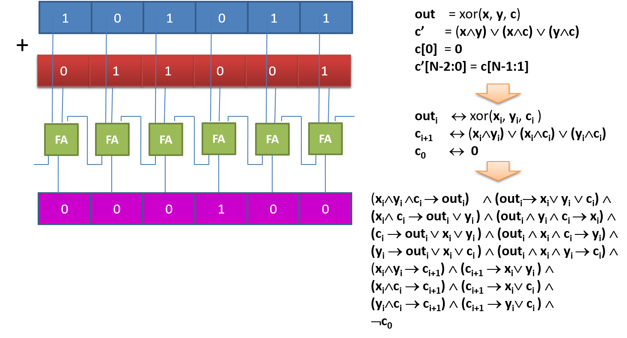

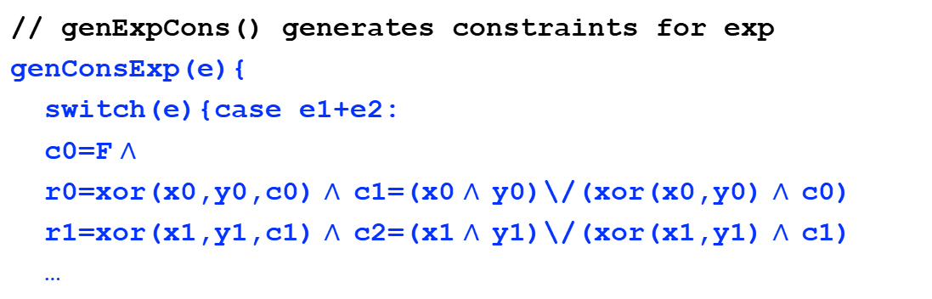
比特向量理论
Bit-blasting algorithm : cont’
// genExpCons() generates constraints for exp
genConsExp(e){
switch(e){case e1+e2:
c0=F $∧$
r0=xor(x0,y0,c0) $∧$c1=(x0 $∧$y0)\/(xor(x0,y0) $∧$c0)
r1=xor(x1,y1,c1) $∧$c2=(x1 $∧$y1)\/(xor(x1,y1) $∧$c1)
…

Slide 44
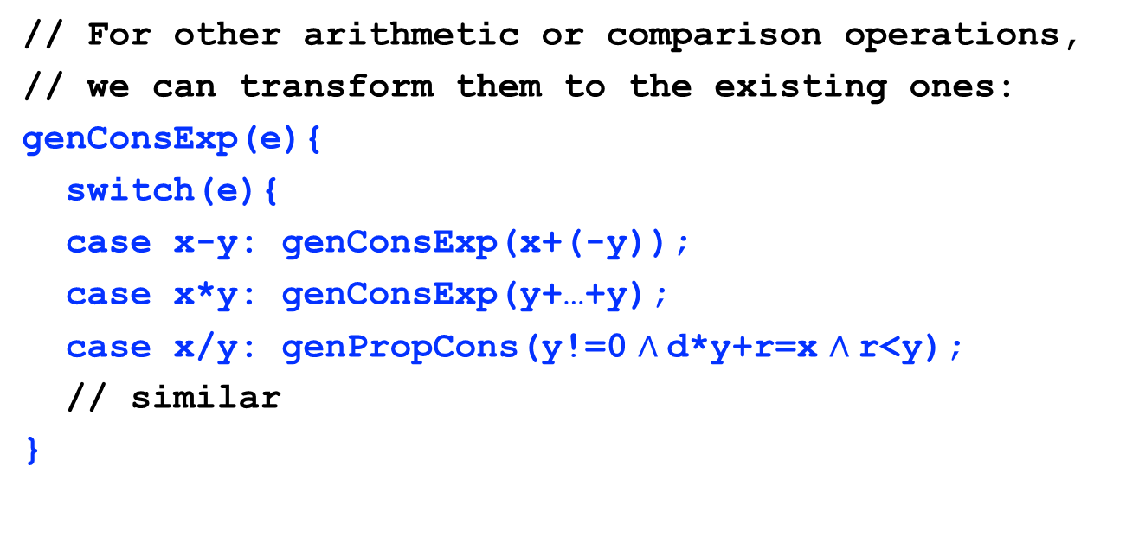
比特向量理论
Bit-blasting algorithm : cont’
// For other arithmetic or comparison operations,
// we can transform them to the existing ones:
genConsExp(e){
switch(e){
case x-y: genConsExp(x+(-y));
case x*y: genConsExp(y+…+y);
case x/y: genPropCons(y!=0 $∧$d*y+r=x $∧$r<y);
// similar
}

Slide 45
数据结构理论
比特向量
数组
指针

Slide 46
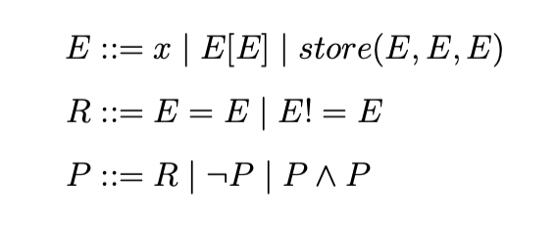
数组理论
Syntax
the restricted syntax
I ::= x | c | c*x | I+I
E ::= x | x[I] | store(x, I, E) | …
…
a[i*i]!=a[j*j]

Slide 47













Inference rules for arrays
数组理论
$$A=B$$
$$i=j$$
$$(Index)$$
$$A\left[i\right]=B[j]$$
$$i=j$$
$$(RAW1)$$
$$Store\left(A, i, x\right)\left[j\right]=x$$
$$i!=j$$
$$(RAW2)$$
$$Store\left(A, i, x\right)\left[j\right]=A[j]$$
$$∀i.A\left[i\right]=B[i]$$
$$(Extensionality)$$
$$A=B$$

Slide 48
数组理论
Decision procedures：Array Elimination

Slide 49
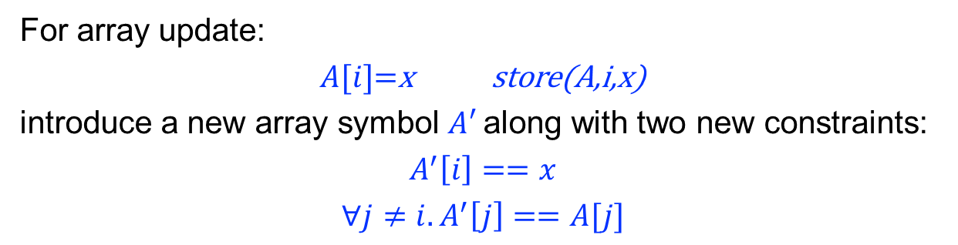

数组理论
Array select
For array select:
$$A[i]$$
introduce a new function symbol
$$F_{A}$$
And array index becomes a function call:$F_{A}(i)$
Array update
For array update:
$A[i]$=x store(A,i,x)
introduce a new array symbol $A′$along with two new constraints:
$$A^{′}\left[i\right]==x$$
$${∀j≠i.A}^{′}\left[j\right]==A[j]$$

Slide 50

数组理论
Array reduction algorithm
// Given a proposition in array property form,
// convert it into an equivalent EUF formulae.
// Input: any proposition P
// Output: an EUF proposition
EUF arrayReduction(P){
P1 = eliminate all array write: store(A, i, x);
P2 = replace $∃$x.P1(x) with P1(y); // y is fresh
P3 = replace ∀x.P2(x) with P2(i)/\.../\P2(k);
P4 = eliminate array read in P3: A[i];
return P4;
}

Slide 51

数组理论
Example
This formulae:
$(∀x∈N.x<i →A\left[x\right]=0)∧A^{′}=store\left(A,i,0\right) →(∀x∈N.x≤i →$ $A^{′}\left[x\right]=0)$
To prove the above is to check UNSAT of:
$$(∀x∈N.x<i →A\left[x\right]=0)∧A^{′}=store\left(A,i,0\right)∧(∃x∈N.x≤i∧A^{′}\left[x\right]≠0)$$

Slide 52

数组理论
This formulae:
$$(∀x∈N.x<i →A\left[x\right]=0)∧A^{′}=store\left(A,i,0\right)∧(∃x∈N.x≤i∧A^{′}\left[x\right]≠0)$$
Step #1: eliminating array store
$$(∀x∈N.x<i →A\left[x\right]=0)∧A^{′}\left[i\right]=0∧{∀j≠i.A}^{′}\left[j\right]=A[j]$$
$$∧(∃x∈N.x≤i∧A^{′}\left[x\right]≠0)$$

Slide 53

数组理论
This formulae:
$$(∀x∈N.x<i →A\left[x\right]=0)∧A^{′}\left[i\right]=0∧{∀j≠i.A}^{′}\left[j\right]=A[j]$$
$$∧(∃x∈N.x≤i∧A^{′}\left[x\right]≠0)$$
Step #2: $∃$eliminating(with a new variable z $∈N$)
$$(∀x∈N.x<i →A\left[x\right]=0)∧A^{′}\left[i\right]=0∧{∀j≠i.A}^{′}\left[j\right]=A[j]$$
$$∧z≤i∧A^{′}\left[z\right]≠0$$

Slide 54

数组理论
This formulae:
$$(∀x∈N.x<i →A\left[x\right]=0)∧A^{′}\left[i\right]=0∧{∀j≠i.A}^{′}\left[j\right]=A[j]$$
$$∧z≤i∧A^{′}\left[z\right]≠0$$
Step #3: $∀$ eliminating( index: {i, z} )
$$(i<i →A\left[i\right]=0)∧(z<i →A\left[z\right]=0){∧A}^{′}\left[i\right]=0∧({i≠i→A}^{′}\left[i\right]=A\left[i\right])$$
$$∧({z≠i→A}^{′}\left[z\right]=A\left[z\right]) ∧z≤i∧A^{′}\left[z\right]≠0$$
Simplify to:
$$(z<i →A\left[z\right]=0){∧A}^{′}\left[i\right]=0$$
$$∧({z≠i→A}^{′}\left[z\right]=A\left[z\right]) ∧z≤i∧A^{′}\left[z\right]≠0$$

Slide 55

数组理论
Example
This formulae:
$$(z<i →A\left[z\right]=0){∧A}^{′}\left[i\right]=0∧({z≠i→A}^{′}\left[z\right]=A\left[z\right]) ∧z≤i∧A^{′}\left[z\right]≠0$$
Step #4: array read elimination
$$(z<i →F_{A}\left(z\right)=0){∧F}_{A^{′}}(i)=0∧({z≠i→F}_{A^{′}}(z)=F_{A}\left(z\right)) ∧z≤i∧F_{A^{′}}(z)≠0$$
It’s easy to check the above formulae is UNSAT, thus the original proposition is valid.

Slide 56
数据结构理论
比特向量
数组
指针

Slide 57

指针理论：内存模型
假设有内存模型：
- 内存中存储整型
- 内存地址也用整型表示
- S: x$→$a表示将变量 x 映射到地址a
- H: a$→$v表示将地址 a 映射到值v
S: 符号表
H: 内存
x
x = 88;
y = 99;
p = &y;
q = &p;
104
88
y
103
99
p
102
103
101
q
100
102

Slide 58

指针理论
Syntax

Slide 59



指针理论
Semantics
$⟦P/\backslash Q⟧=$ $⟦P⟧$ $/\backslash$ $⟦Q⟧$
$⟦\sim P⟧$ = ~$⟦P⟧$
$⟦E=E⟧$ = $⟦E⟧$ = $⟦E⟧$
$⟦E<E⟧$ = $⟦E⟧<⟦E⟧$
$⟦T=T⟧$ = $⟦T⟧$ = $⟦T⟧$
$⟦T<T⟧$ = $⟦T⟧<⟦T⟧$
$⟦x⟧$ = $H(S\left(x\right))$
$⟦T+E⟧$ = $⟦T⟧$ + $⟦E⟧$
$⟦\&x⟧$ = $S(x)$
$⟦\&∗T⟧$ = $⟦T⟧$
$⟦∗T⟧$ = $H(⟦T⟧)$
$⟦NULL⟧$ = $0$
$⟦n⟧$ = $n$
$⟦x⟧$ = $H(S\left(x\right))$
$⟦E+E⟧$ = $⟦E⟧$ + $⟦E⟧$
$⟦E−E⟧$ = $⟦E⟧−⟦E⟧$
$⟦∗T⟧$ = $H(⟦T⟧)$

Slide 60
指针理论
Semantics-based decision procedure

Slide 61

指针理论
Decision procedure
// Input: the proposition P
sat(P){
P’ = ⟦P⟧;
return sat(P’);
}
Example
p=&a $∧$a=1 $→$ *p=1

Slide 62


指针理论
p=&a $∧$a=1 $→$ *p=1
$⟦P/\backslash Q⟧=$ $⟦P⟧$ $/\backslash$ $⟦Q⟧$
$⟦\sim R⟧$ = ~$⟦R⟧$
$⟦E=E⟧$ = $⟦E⟧$ = $⟦E⟧$
$⟦E<E⟧$ = $⟦E⟧<⟦E⟧$
$⟦T=T⟧$ = $⟦T⟧$ = $⟦T⟧$
$⟦T<T⟧$ = $⟦T⟧<⟦T⟧$
$⟦x⟧$ = $H(S\left(x\right))$
$⟦T+E⟧$ = $⟦T⟧$ + $⟦E⟧$
$⟦\&x⟧$ = $S(x)$
$⟦\&∗T⟧$ = $⟦T⟧$
$⟦∗T⟧$ = $H(⟦T⟧)$
$⟦NULL⟧$ = $0$
$⟦n⟧$ = $n$
$⟦x⟧$ = $H(S\left(x\right))$
$⟦E+E⟧$ = $⟦E⟧$ + $⟦E⟧$
$⟦E−E⟧$ = $⟦E⟧−⟦E⟧$
$⟦∗T⟧$ = $H(⟦T⟧)$

Slide 63

指针理论
$⟦P/\backslash Q⟧=$ $⟦P⟧$ $/\backslash$ $⟦Q⟧$
$⟦\sim R⟧$ = ~$⟦R⟧$
$⟦E=E⟧$ = $⟦E⟧$ = $⟦E⟧$
$⟦E<E⟧$ = $⟦E⟧<⟦E⟧$
$⟦T=T⟧$ = $⟦T⟧$ = $⟦T⟧$
$⟦T<T⟧$ = $⟦T⟧<⟦T⟧$
$⟦n⟧$ = $n$
$⟦x⟧$ = $H(S\left(x\right))$
$⟦E+E⟧$ = $⟦E⟧$ + $⟦E⟧$
$⟦E−E⟧$ = $⟦E⟧−⟦E⟧$
$⟦∗T⟧$ = $H(⟦T⟧)$
$⟦x⟧$ = $H(S\left(x\right))$
$⟦T+E⟧$ = $⟦T⟧$ + $⟦E⟧$
$⟦\&x⟧$ = $S(x)$
$⟦\&∗T⟧$ = $⟦T⟧$
$⟦∗T⟧$ = $H(⟦T⟧)$
$⟦NULL⟧$ = $0$
p=&a $∧$a=1 $→$ *p=1
$$⟦p=\&a∧a=1→ ∗p=1⟧$$
$$⟦p=\&a∧a=1⟧→⟦∗p=1⟧$$
$$⟦p=\&a⟧∧⟦a=1⟧→⟦∗p=1⟧$$
$$H(S\left(p\right))=S(a)∧H(S(a))=1→H(H\left(S\left(p\right)\right))=1$$

Slide 64
指针理论
Pure variables
We call a variable x pure, if x’s address is not taken of: &x
Or else, the variable x is called escaped
We can introduce a new sort a memory : R(x)
The standard translation: H(S(x))
For pure vars, new translation: R(x)

Slide 65
指针理论
Memory partitions
The basic idea to partition the memory further
so that we have a more fine-grained memory model
so that we can reason more subtle properties of the memory
We study a type-based approach

Slide 66





指针理论：转换到EUF
转换到EUF：

Slide 67
指针理论：内存模型
H:内存
$$H\left(H(S\left(p\right))\right)=1∧H(H\left(H(S(q)))\right)=1→H(S\left(p\right))!=H(S\left(q\right))$$
S:符号表
p
1
q

Slide 68
指针理论：内存模型
R: 寄存器
H:内存
$$H\left(H(S\left(p\right))\right)=1∧H(H\left(H(S(q)))\right)=1→H(S\left(p\right))!=H(S\left(q\right))$$
p
假设我们的内存模型用寄存器存储纯变量（没有取址操作的变量）：
q
S:符号表
0
1

Slide 69
指针理论：内存模型
R: 寄存器
H:内存
$$H\left(H(S\left(p\right))\right)=1∧H(H\left(H(S(q)))\right)=1→H(S\left(p\right))!=H(S\left(q\right))$$
p
假设我们的内存模型用寄存器存储纯变量（没有取址操作的变量）：
q
$$H(R(p))=1∧H(H(R(q)))=1→R(p)!=R(q)$$
S:符号表
0
1

Slide 70
指针理论：内存模型
R: 寄存器
H:内存
$$H\left(H(S\left(p\right))\right)=1∧H(H\left(H(S(q)))\right)=1→H(S\left(p\right))!=H(S\left(q\right))$$
p
假设我们的内存模型用寄存器存储纯变量（没有取址操作的变量）：
q
$$H(R(p))=1∧H(H(R(q)))=1→R(p)!=R(q)$$
S:符号表
0
假设我们对内存进行分区
1
H1：addr -> int
H2: addr -> addr
0x04
0x03
0x02
0x04
0x01

Slide 71
指针理论：内存模型
R: 寄存器
H:内存
$$H\left(H(S\left(p\right))\right)=1∧H(H\left(H(S(q)))\right)=1→H(S\left(p\right))!=H(S\left(q\right))$$
p
假设我们的内存模型用寄存器存储纯变量（没有取址操作的变量）：
q
$$H(R(p))=1∧H(H(R(q)))=1→R(p)!=R(q)$$
S:符号表
假设我们对内存进行分区,区分内存中的地址与整数
0
H1：addr -> int
H2: addr -> addr
0x04
1
0x03
0x02
0x04
0x01
$$H1(R(p))) = 1 /\backslash H1(H2(R(q))) = 1 −> R(p) != R(q)$$

Slide 72
指针理论：内存模型
R: 寄存器
H:内存
$$H\left(H(S\left(p\right))\right)=1∧H(H\left(H(S(q)))\right)=1→H(S\left(p\right))!=H(S\left(q\right))$$
p
假设我们的内存模型用寄存器存储纯变量（没有取址操作的变量）：
q
$$H(R(p))=1∧H(H(R(q)))=1→R(p)!=R(q)$$
S:符号表
假设我们对内存进行分区,区分内存中的地址与整数
0
H1：addr -> int
H2: addr -> addr
0x04
1
0x03
0x02
0x04
0x01
$$H1(R(p))) = 1 /\backslash H1(H2(R(q))) = 1 −> R(p) != R(q)$$

Slide 73

理论结合
The theory combination problem, in general, is undecidable
Even the underlying theories are decidable
To make it decidable, we require:
$𝒯1$ and $𝒯2$ are decidable
$Σ1$ $∩$ $Σ2$=$φ$ (except for =)
stably infinite

Slide 74

Nelson-Oppen algorithm
nelson_oppen(P){
P1 $∧$... $∧$Pn = purify(P);
L:
if(some Pi is UNSAT)
return UNSAT;
if(some Pi implies x=y){
broadcast(x=y);
goto L;
}
if(Pi implies x₁=y₁ $∨$… $∨$x_{n}=y_{n})
nelson_oppen(P, x_{i}=y_{i});
return SAT;
}

Slide 75

DPLL(T)
The Nelson-Oppen procedure for deciding the satisfiability of a conjunction of formulae from theories
(x1 > x2) $∧$ (f(x1) == f(x2)) $∧$ …
But what about general formulae, say:
x=1 $∧$ (x=2 $∨$ x=3)…
This can be solved by the DPLL(T) framework!

Slide 76

DPLL(T) algorithm
FOL formulae
dpllt(P){
$𝓑$ = abstract(P);
while(true){
($𝓤$, res) = dpll($𝓑$);
if(res==UNSAT)
return UNSAT;
$𝓣$ = refine($𝓤$);
res =nelson_oppen($𝓣$);
if(res==SAT)
return SAT;
$𝓑$ =$𝓑∧$ $¬𝓤;$
}
}
DPLL
Nelson-Oppen
Theory
1
Theory
2
Theory
n
…

Slide 77



DPLL(T) example
P=
$$x_{1}≤1∧x_{2}≥0∧(f\left(x_{1}−x_{2}\right)=f\left(store\left(A,x_{0},0\right)\left[x_{0}\right]\right)∨{f(x}_{1}+x_{2})=f(4))$$
FOL formulae
$𝓑$ = A $∧$B $∧$(C $∨$D)
DPLL
$𝓤$ = A $∧$B $∧$C $∧$D, res=SAT
$𝓣$ = $x_{1}≤1∧x_{2}≥0∧f\left(x_{1}−x_{2}\right)=f\left(store\left(A,x_{0},0\right)\left[x_{0}\right]\right)∧{f(x}_{1}+x_{2})=f(4)$
Nelson-Oppen
Theory
1
Theory
2
Theory
n
…

Slide 78







Nelson-Oppen
// The initial proposition:
// After purification:
$$x_{1}≤1∧x_{2}≥0∧f\left(x_{1}−x_{2}\right)=f\left(store\left(A,x_{0},0\right)\left[x_{0}\right]\right)∧{f(x}_{1}+x_{2})=f(4)$$
$$x_{1}≤1∧x_{2}≥0∧f\left(t_{1}\right)=f\left(t_{2}\right)∧t_{1}=x_{1}−x_{2}{∧t}_{2}=store\left(A,x_{0},0\right)\left[x_{0}\right]∧ f\left(t_{3}\right)=f\left(4\right)∧t_{3}=x_{1}+x_{2}$$
LA | Array | EUF
$$x_{1}≤1$$ $$x_{2}≥0$$ $$t_{1}=x_{1}−x_{2}$$ $$t_{3}=x_{1}+x_{2}$$ | $$t_{2}=store\left(A,x_{0},0\right)\left[x_{0}\right]$$ | $$f\left(t_{1}\right)=f\left(t_{2}\right)$$ $$f\left(t_{3}\right)=f\left(4\right)$$
$t_{2}$=0
$t_{2}$=0
$t_{2}$=0
$$t_{1}=0$$
$$t_{3}=4$$
$$t_{1}=0$$
$$t_{3}=4$$
$$t_{1}=0$$
$$t_{3}=4$$
UNSAT

Slide 79

DPLL(T) example
P=
$$x_{1}≤1∧x_{2}≥0∧(f\left(x_{1}−x_{2}\right)=f\left(store\left(A,x_{0},0\right)\left[x_{0}\right]\right)∨{f(x}_{1}+x_{2})=f(4))$$
FOL formulae
$𝓑$ = A $∧$B $∧$(C $∨$D)
DPLL
$𝓤$ = A $∧$B $∧$C $∧$D, res=SAT
$𝓣$ = $x_{1}≤1∧x_{2}≥0∧f\left(x_{1}−x_{2}\right)=f\left(store\left(A,x_{0},0\right)\left[x_{0}\right]\right)∧{f(x}_{1}+x_{2})=f(4)$
Nelson-Oppen
UNSAT
$𝓑$ = A $∧$B $∧$(C $∨$D) $∧$~ $𝓤$
Theory
1
Theory
2
Theory
n
…

Slide 80


DPLL(T) example
P=
$$x_{1}≤1∧x_{2}≥0∧(f\left(x_{1}−x_{2}\right)=f\left(store\left(A,x_{0},0\right)\left[x_{0}\right]\right)∨{f(x}_{1}+x_{2})=f(4))$$
FOL formulae
$𝓑$ = A $∧$B $∧$(C $∨$D) $∧$(~A$∨$~B$∨$~C$∨\text{\sim }$D)
DPLL
$𝓤$ = A $∧$B $∧$C $∧ \text{\sim }$D, res=SAT
$𝓣$ = $x_{1}≤1∧x_{2}≥0∧f\left(x_{1}−x_{2}\right)=f\left(store\left(A,x_{0},0\right)\left[x_{0}\right]\right)∧{f(x}_{1}+x_{2})≠f(4)$
Nelson-Oppen
Theory
1
Theory
2
Theory
n
…

Slide 81











Nelson-Oppen
// The initial proposition:
// After purification:
$$x_{1}≤1∧x_{2}≥0∧f\left(x_{1}−x_{2}\right)=f\left(store\left(A,x_{0},0\right)\left[x_{0}\right]\right)∧{f(x}_{1}+x_{2})≠f(4)$$
$$x_{1}≤1∧x_{2}≥0∧f\left(t_{1}\right)=f\left(t_{2}\right)∧t_{1}=x_{1}−x_{2}{∧t}_{2}=store\left(A,x_{0},0\right)\left[x_{0}\right]∧ f\left(t_{3}\right)≠f\left(4\right)∧t_{3}=x_{1}+x_{2}$$
LA | Array | EUF
$$x_{1}≤1$$ $$x_{2}≥0$$ $$t_{3}=x_{1}+x_{2}$$ $$t_{1}=x_{1}−x_{2}$$ | $$t_{2}=store\left(A,x_{0},0\right)\left[x_{0}\right]$$ | $$f\left(t_{1}\right)=f\left(t_{2}\right)$$ $$f\left(t_{3}\right)≠f\left(4\right)$$
$t_{2}$=0
$t_{2}$=0
$t_{2}$=0
$$t_{1}=0$$
$$t_{1}=0$$
$$t_{1}=0$$
$$x_{1}=1$$
$$x_{2}=1$$
$$t_{3}=2$$
$$x_{1}=0$$
$$x_{2}=0$$
$$t_{3}=0$$
$$t_{3}=2$$
$$t_{3}=0$$

Slide 82
谢谢，周末愉快！

