Slide 1
Hoare logic
Formal Methods Foundation
Baojian Hua
bjhua@ustc.edu.cn

Slide 2
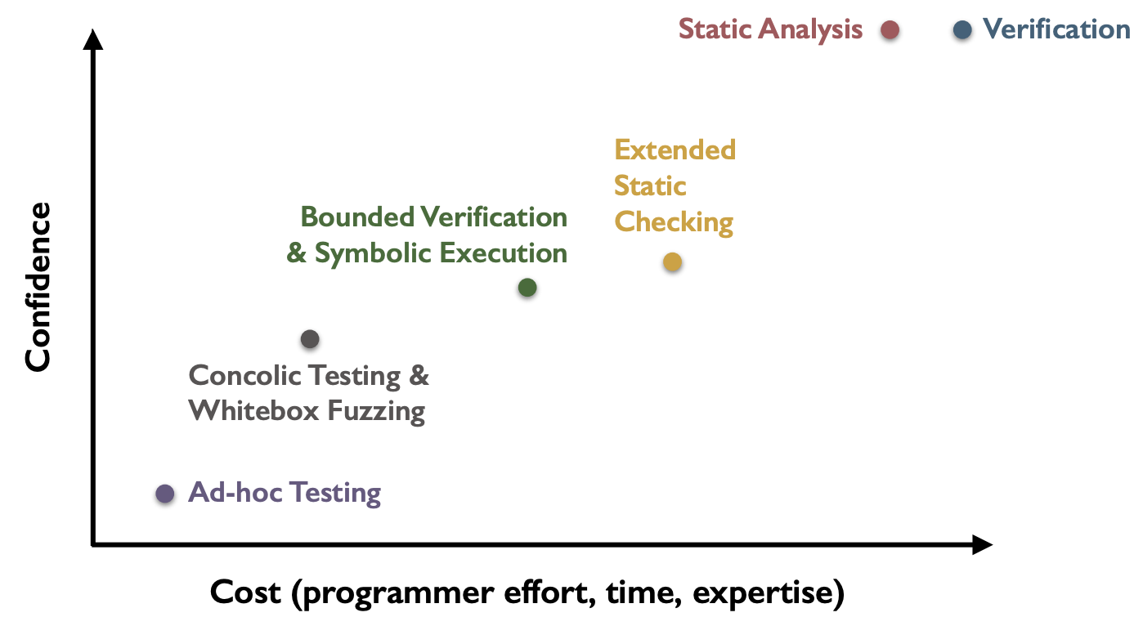
Spectrum of program validation methods
This topic

Slide 3
Overview
This lecture’s topic is about proving program correctness
based on the idea of Hoare logic
One of the oldest and deepest ideas in CS
Still important today
successful applications in many fields
due to the advancement in proof theory and constraint solvers/theorem provers

Slide 4

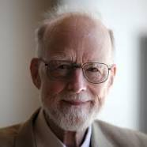
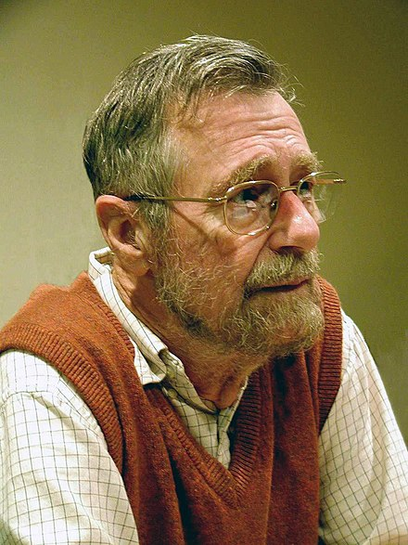
Capsule history
1967: Assigning Meaning to Programs (Floyd)
1978 Turing Award
1969: An Axiomatic Basis for Computer Programming (Hoare)
1980 Turing Award
1975: Guarded Commands, Nondeterminacy and Formal Derivation of Programs (Dijkstra)
1972 Turing Award

Slide 5
Many Languages Today
The idea of Hoare logic has been applied to many languages again and again
and even to the same language
To name a few:
Dafny (C#), Boogie (.Net IL), F* (F#), VCC (C), Prusti (Rust), Creusot (Rust), Aeneas (Rust), and Verus (Rust)

Slide 6
Many Successful Stories
CompCert:
the first fully verified C compiler
seL4:
the first verified operating system (micro-)kernel

Slide 7
Motivation

Slide 8
Program correctness
For this program, how can we guarantee its correctness?
But first of all, what do we express correctness?
def abs(n){
if(n>=0)
return n;
else
return 0-n;
}

Slide 9
Program correctness
A daily practice is to leverage comments
we specify the intended requirements via natural language
and the implementation should satisfy these requirements
// pre: take any n as input
// post: return an integer that less than 0
def abs(n){
if(n>=0)
return n;
else
return 0-n;
}

Slide 10
Program correctness
But comments are not ideal for checking correctness
it is ambiguous
it does not check
it does not evolve
i.e., it targets for human, but not machine
// pre: take any n as input
// post: return an integer that is equal or greater than 0
def abs(n){
if(n>=0)
return n;
else
return 0-n;
}

Slide 11
Program correctness
logical formulae
A better idea is to use logic!
we specify the requirements via logical formulas
it is checked against code automatically
it evolves with code
i.e., it targets both human and machine
// pre: True
// post: result>=0
def abs(n){
if(n>=0)
return n;
else
return 0-n;
}

Slide 12
Redundancy
Both comments are logic formulas are essentially redundancy
discrepancies with regarding to rigorous
still true in the era of AI?

Slide 13
Correctness?
logical formulae
A better idea is to use logic!
we specify the requirements via logical formulas
it is checked against code automatically
it evolves with code
i.e., it targets both human and machine
// pre: True
// post: result>=0
def abs(n){
if(n>=0)
return n;
else
return 0-n;
}

Slide 14
Motivation
logical formulae
For this program, how can we guarantee n==5?
Note that program testing is not effective for this:
we cannot enumerate all possible values for n!
// pre: n<0
// post: n==5
def sum(n){
while(n<5)
n = n+1;
return n;
}

Slide 15
Big picture
Logic
Hoare logic connects the logic and program!
Programs
prover/
solver

Slide 16
Recall the IMP language
O ::= + | - | * | /
E ::= n | x | E O E
B ::= E==E | E!=E | B&&B | B||B | !B
S ::= skip
| x=E
| S;S
| if(B, S, S)
| while(B, S)
F ::= f(x1, …, xn){S; return E;}

Slide 17
Hoare logic: Hoare Triple

Slide 18

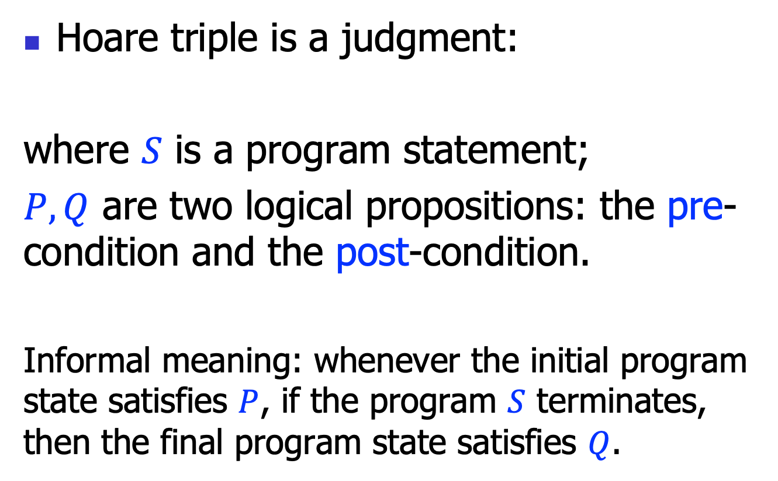
Hoare triple
Hoare triple is a judgment:
where $S$ is a program statement;
$P, Q$ are two logical propositions: the pre-condition and the post-condition.
Informal meaning: whenever the initial program state satisfies $P$, if the program $S$ terminates, then the final program state satisfies $Q$.
$$\left\{P\right\} S \{Q\}$$

Slide 19
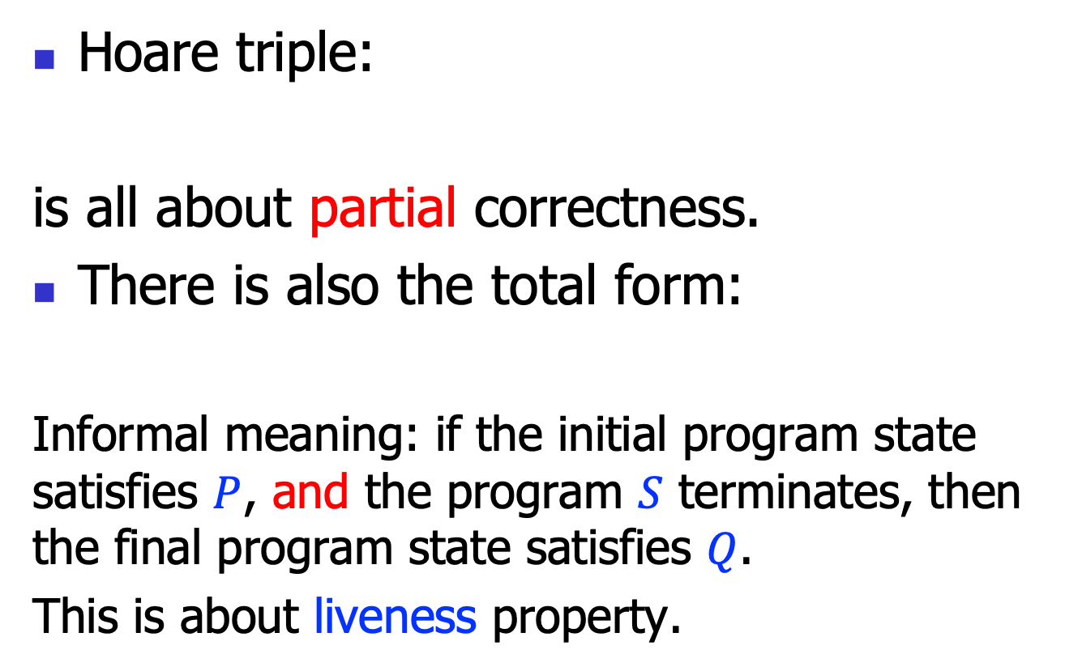

Partial and total correctness
Hoare triple:
is all about partial correctness.
There is also the total form:
Informal meaning: if the initial program state satisfies $P$, and the program $S$ terminates, then the final program state satisfies $Q$.
This is about liveness property.
$$\left\{P\right\} S \{Q\}$$
$$\left[P\right] S [Q]$$

Slide 20
Hoare triple example
{n==0}
n = n+1
{n==1}
FOL propositions, to be specific, the linear arithmetic theory propositions!

Slide 21
Hoare triple example 2
{n<0}
sum(n){
while(n<5)
n = n+1;
return n;
}
{result==5}
FOL propositions, to be specific, the linear arithmetic theory propositions!
Also note that we use “result” (like a reserved key word) to represent the return result of this function.

Slide 22
Hoare triple semantics
For the Hoare triple:
Let’s define the semantics more formally:
what’s the formal language to define the propositions?
When can we say a proposition P holds in a given program state?
$$\left\{P\right\} S \{Q\}$$

Slide 23
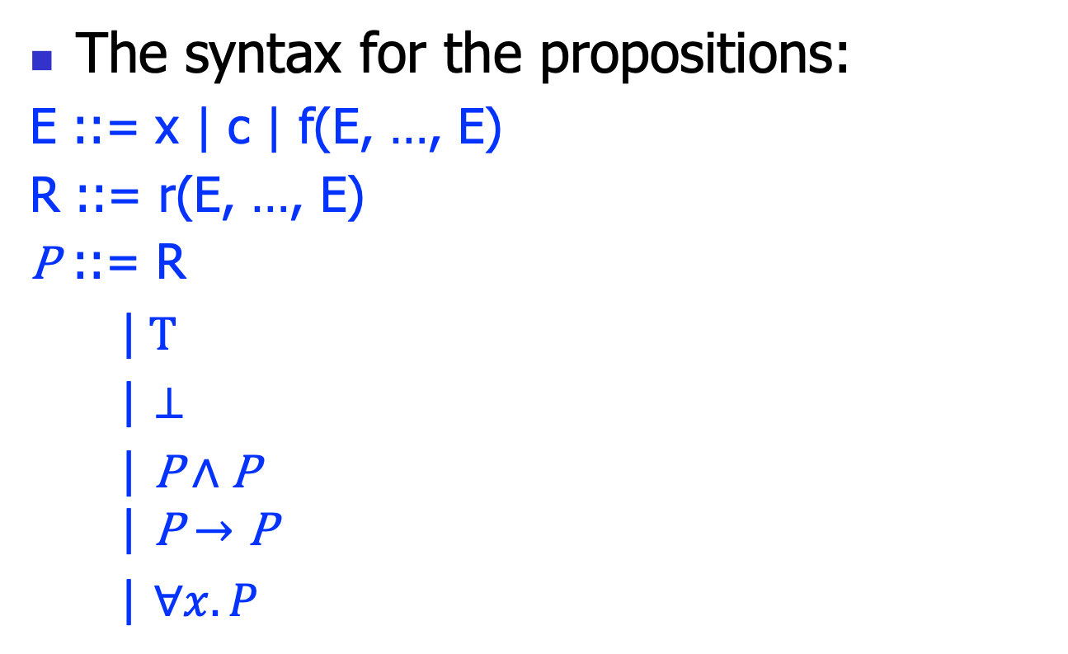
Proposition syntax
The syntax for the propositions:
E ::= x | c | f(E, …, E)
R ::= r(E, …, E)
P ::= R
|$T$
| $⊥$
$\text{|} \text{P}∧\text{P}$
$$\text{|} \text{P}→\text{P}$$
| $∀x.P$

Slide 24
Proposition syntax
Essentially, we use a fragment of the FOL
In practice, other variants exist, say Temporal logic (for protocols), etc..
Also can contain domain specific relations (user extensible)
Say: type(x, T) to indicate x has type T
A tradeoff between simplicity and expressiveness (design art)

Slide 25
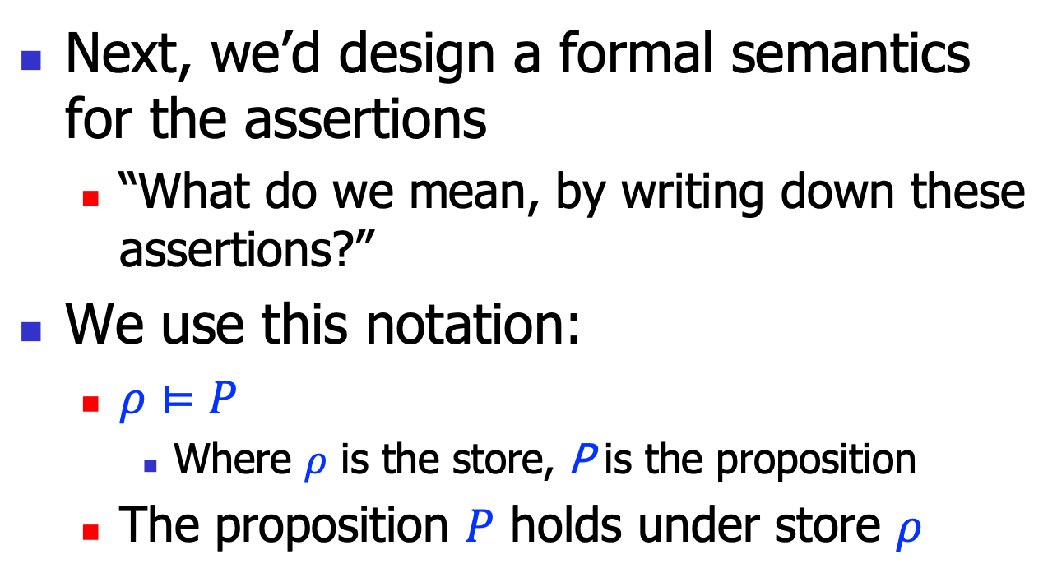
Proposition semantics
Next, we’d design a formal semantics for the assertions
“What do we mean, by writing down these assertions?”
We use this notation:
$ρ⊨P$
Where $ρ$ is the store, P is the proposition
The proposition $P$ holds under store $ρ$

Slide 26
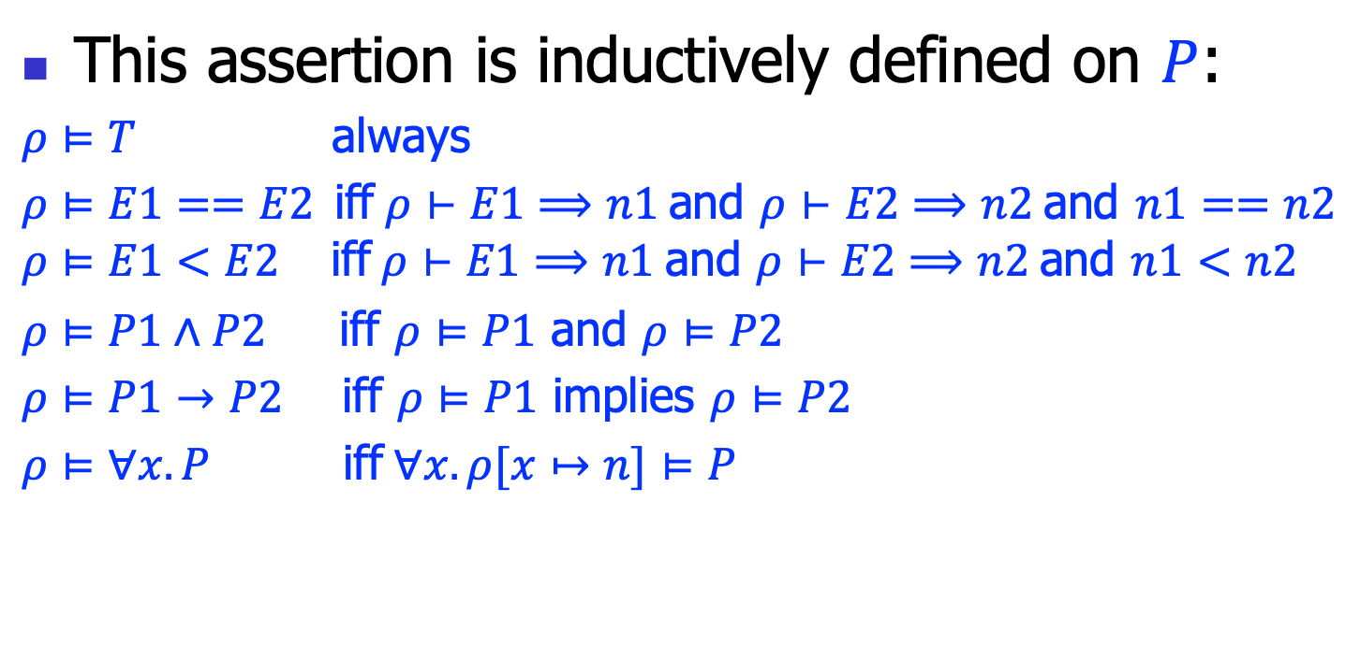
Proposition semantics
This assertion is inductively defined on $P$:
$ρ⊨T$ always
$ρ⊨E1==E2$iff$ρ⊢E1⟹n1$ and $ρ⊢E2⟹n2$ and $n1==n2$
$$ρ⊨E1<E2 \text{iff} ρ⊢E1⟹n1 \text{and} ρ⊢E2⟹n2 \text{and} n1<n2$$
$ρ⊨P1∧P2$ iff $ρ⊨P1$ and $ρ⊨P2$
$ρ⊨P1→P2$ iff $ρ⊨P1$ implies $ρ⊨P2$
$ρ⊨∀x.P$ iff$∀x.ρ[x↦n]⊨P$

Slide 27
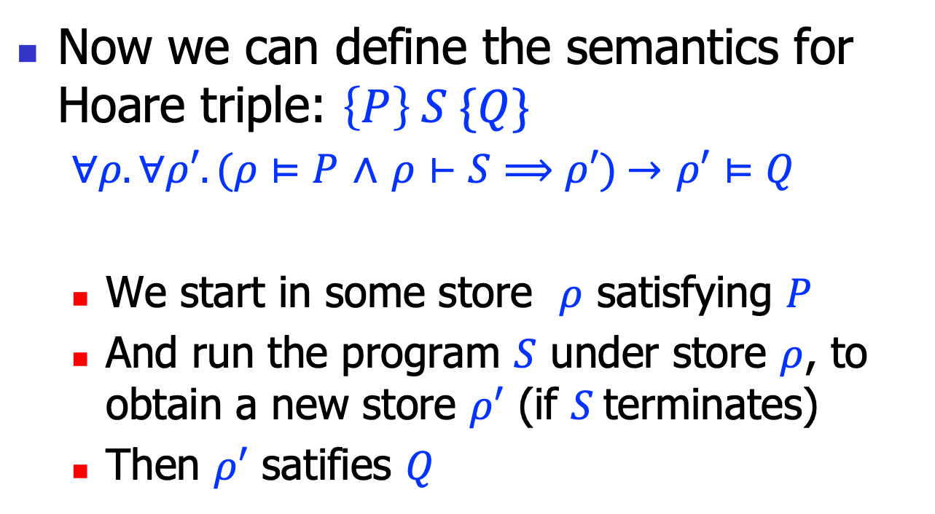
Hoare triple semantics
Now we can define the semantics for Hoare triple: $\left\{P\right\} S \{Q\}$
$∀ρ.∀ρ′.(ρ⊨P$ $∧$ $ρ⊢S⟹ρ′)$ $→$ $ρ′⊨Q$
We start in some store $ρ$ satisfying $P$
And run the program $S$ under store $ρ$, to obtain a new store $ρ′$ (if $S$terminates)
Then $ρ′$ satifies $Q$

Slide 28
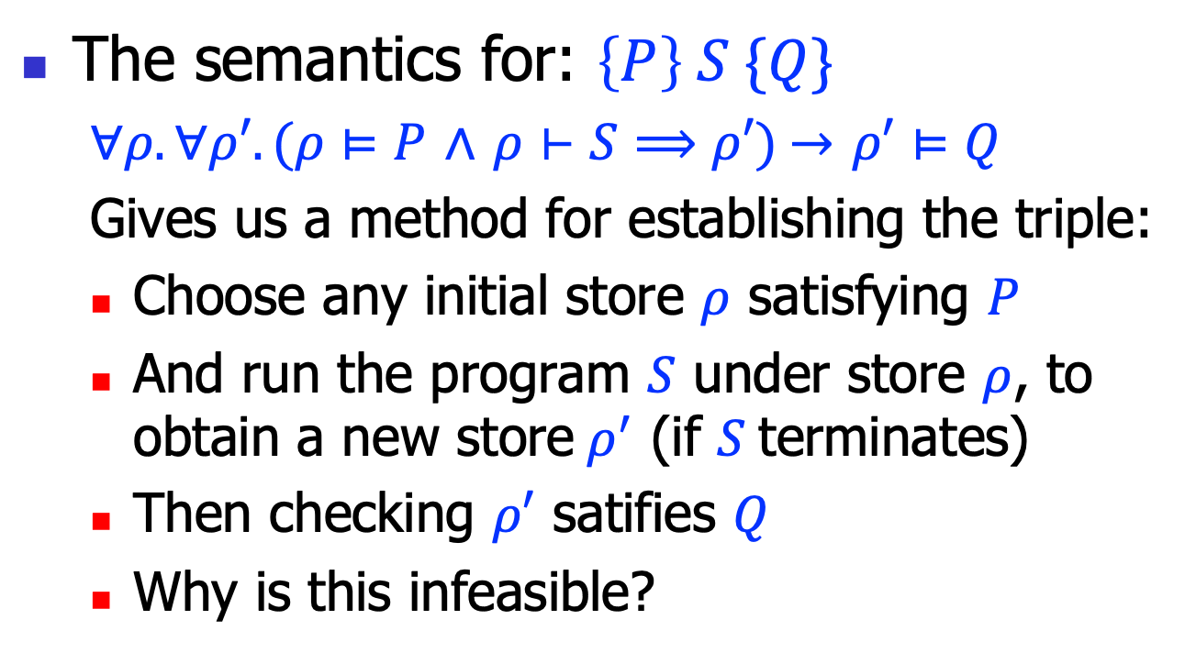
Exhausted testing
The semantics for: $\left\{P\right\} S \{Q\}$
$∀ρ.∀ρ′.(ρ⊨P$ $∧$ $ρ⊢S⟹ρ′)$ $→$ $ρ′⊨Q$
Gives us a method for establishing the triple:
Choose any initial store $ρ$ satisfying $P$
And run the program $S$ under store $ρ$, to obtain a new store$ρ^{′}$ (if $S$terminates)
Then checking $ρ′$ satifies $Q$
Why is this infeasible?

Slide 29
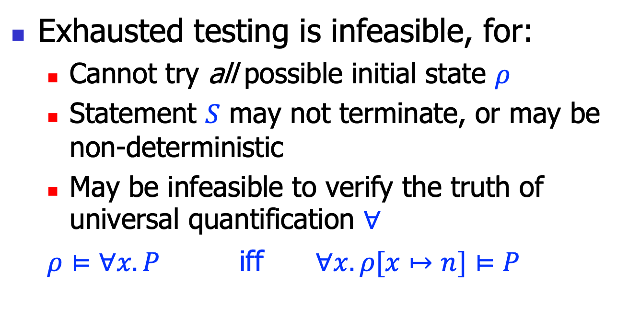
Exhausted testing, cont’
Exhausted testing is infeasible, for:
Cannot try all possible initial state $ρ$
Statement $S$ may not terminate, or may be non-deterministic
May be infeasible to verify the truth of universal quantification $∀$
$ρ⊨∀x.P$ iff $∀x.ρ[x↦n]⊨P$

Slide 30
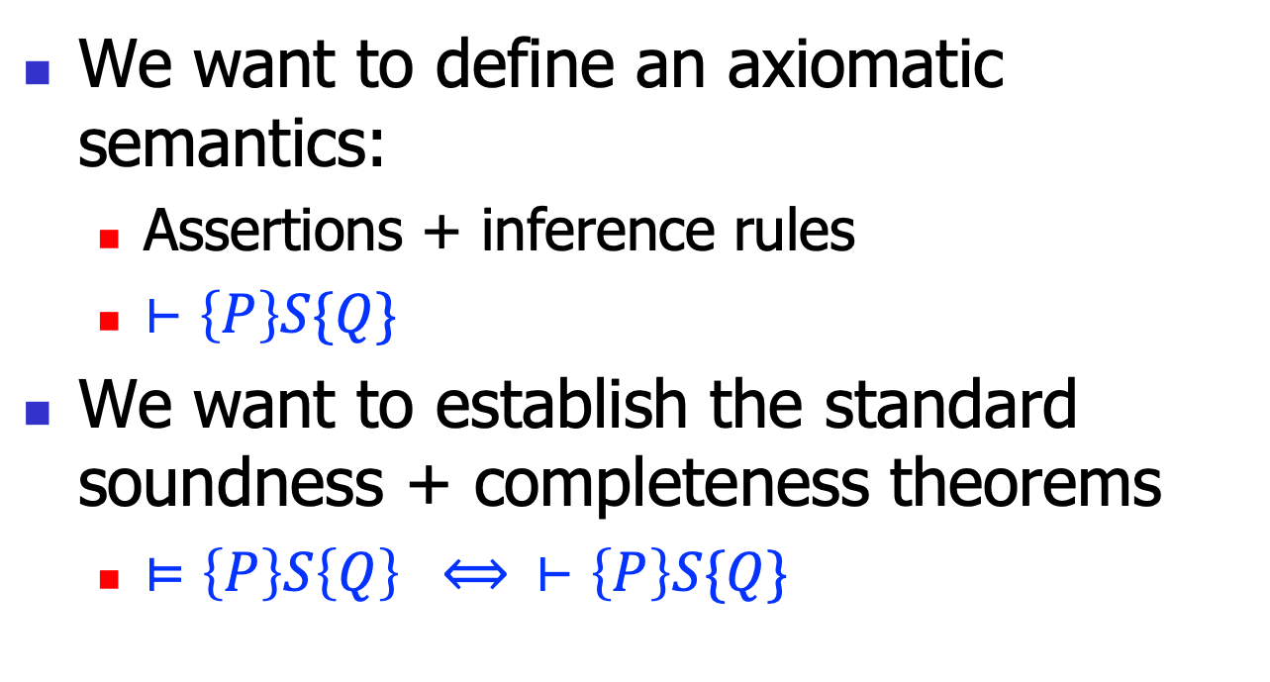
Axiomatic semantics
We want to define an axiomatic semantics:
Assertions + inference rules
$⊢\left\{P\right\}S\{Q\}$
We want to establish the standard soundness + completeness theorems
$⊨\left\{P\right\}S\left\{Q\right\} ⟺ ⊢\left\{P\right\}S\{Q\}$

Slide 31
Hoare logic: inference rules

Slide 32
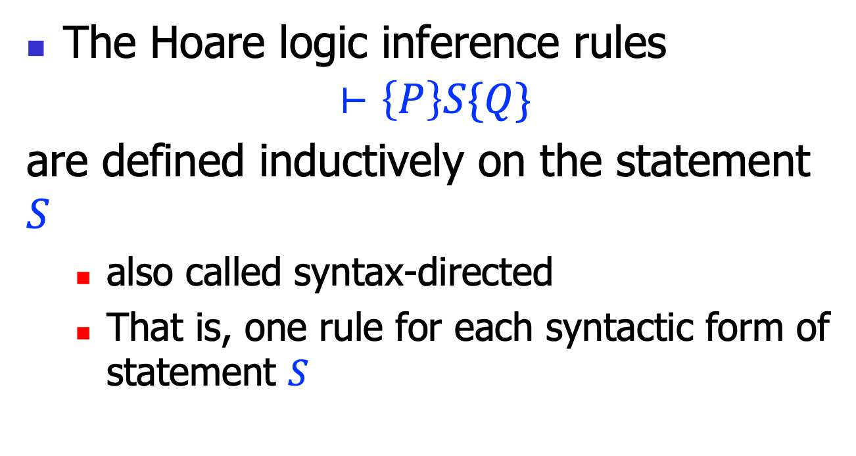
Inference rules
The Hoare logic inference rules
$$⊢\left\{P\right\}S\{Q\}$$
are defined inductively on the statement $S$
also called syntax-directed
That is, one rule for each syntactic form of statement $S$

Slide 33


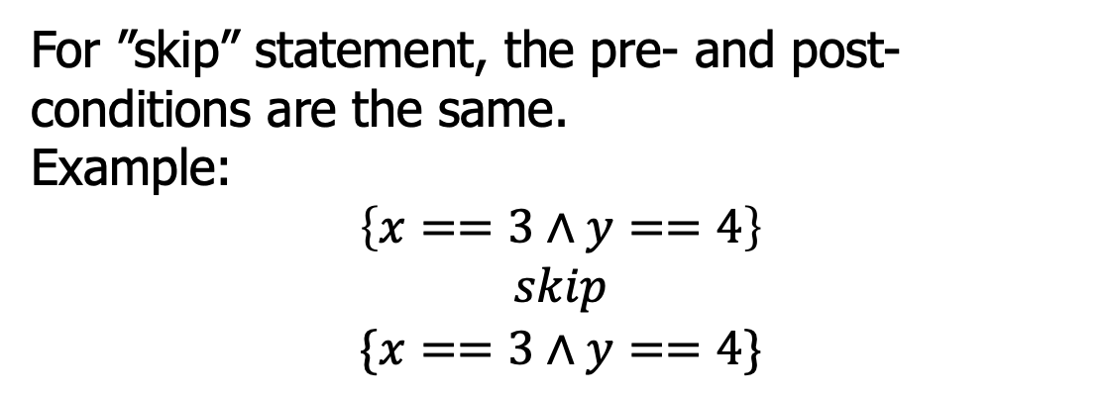
Hoare logic rules: empty
$$(H−Skip)$$
$$\left\{P\right\}skip\{P\}$$
For ”skip” statement, the pre- and post-conditions are the same.
Example:
$$\left\{x==3∧y==4\right\}$$
$$skip$$
$$\{x==3∧y==4\}$$

Slide 34


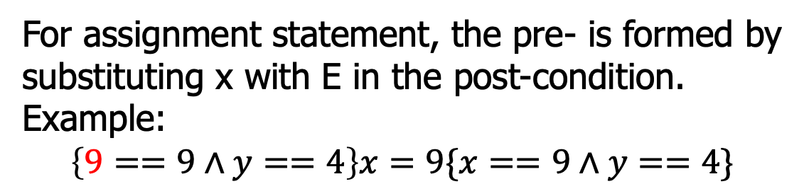
Hoare logic rules: assignment
$$(H−Assign)$$
$$\left\{P[x↦E]\right\}x=E\{P\}$$
For assignment statement, the pre- is formed by substituting x with E in the post-condition.
Example:
$$\left\{9==9∧y==4\right\}x=9\{x==9∧y==4\}$$
$$\left\{y+z>k\right\}x=y+z\{x>k\}$$
$$\left\{x+1>k\right\}x=x+1\{x>k\}$$

Slide 35


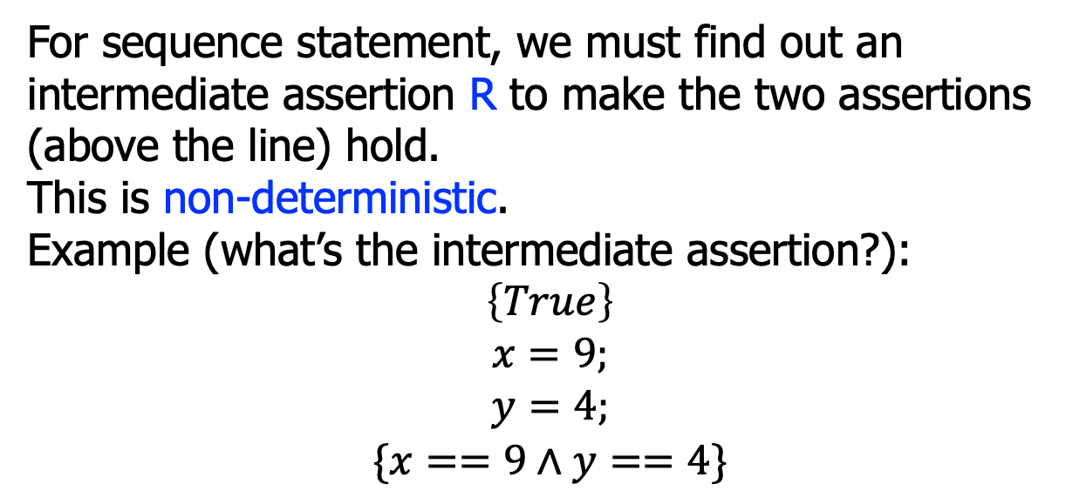


Hoare logic rules: sequence
$$\left\{P\right\}S1\{R\}$$
$$\left\{R\right\}S2\{Q\}$$
$$(H−Seq)$$
$$\left\{P\right\} S1;S2 \{Q\}$$
For sequence statement, we must find out an intermediate assertion R to make the two assertions (above the line) hold.
This is non-deterministic.
Example (what’s the intermediate assertion?):
$$\left\{True\right\}$$
$$x=9;$$
$$y=4;$$
$$\{x==9∧y==4\}$$

Slide 36


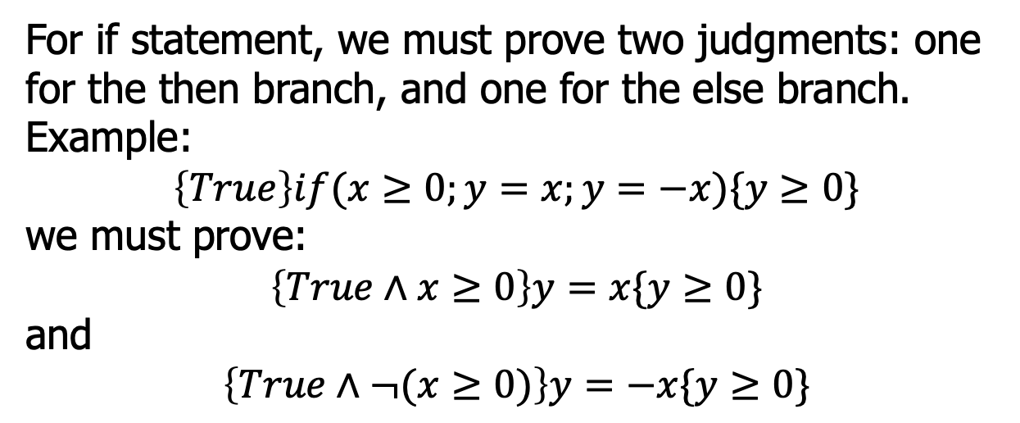


Hoare logic rules: if
$$\left\{P∧B\right\}S1\{Q\}$$
$$\left\{P∧¬B\right\}S2\{Q\}$$
$$(H−If)$$
$$\left\{P\right\}if\left(B;S1;S2\right)\{Q\}$$
For if statement, we must prove two judgments: one for the then branch, and one for the else branch.
Example:
$$\left\{True\right\}if(x≥0;y=x;y=−x)\{y≥0\}$$
we must prove:
$$\left\{True∧x≥0\right\}y=x\{y≥0\}$$
and
$$\left\{True∧¬(x≥0)\right\}y=−x\{y≥0\}$$

Slide 37


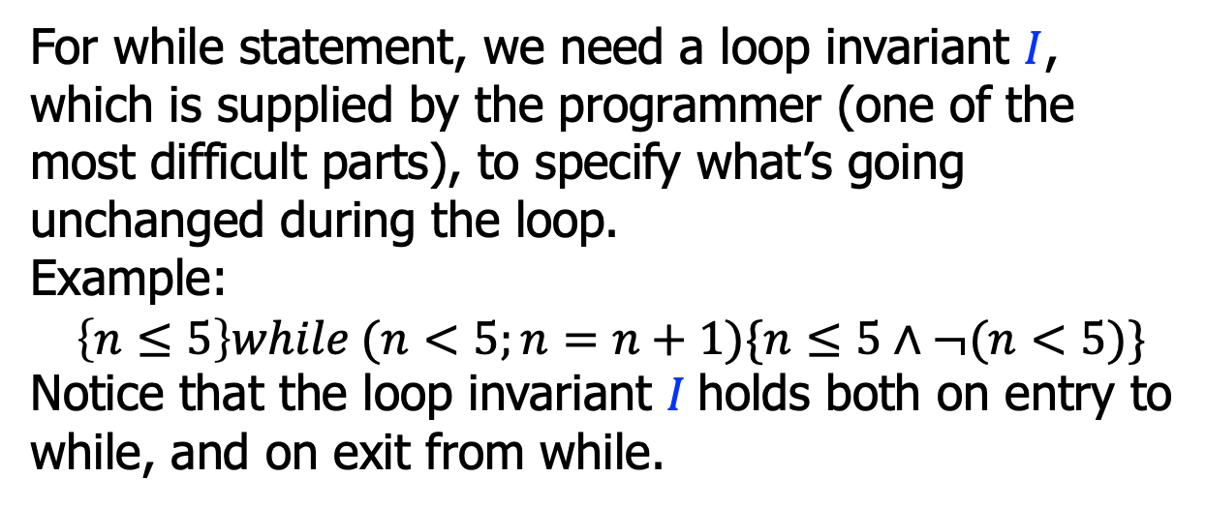

Hoare logic rules: while
$$\left\{I∧B\right\}S\{I\}$$
$$(H−While)$$
$$\left\{I\right\}while(B;S)\{I∧¬B\}$$
For while statement, we need a loop invariant $I$, which is supplied by the programmer (one of the most difficult parts), to specify what’s going unchanged during the loop.
Example:
$$\left\{n≤5\right\}while (n<5;n=n+1)\{n≤5∧¬(n<5)\}$$
Notice that the loop invariant $I$holds both on entry to while, and on exit from while.

Slide 38
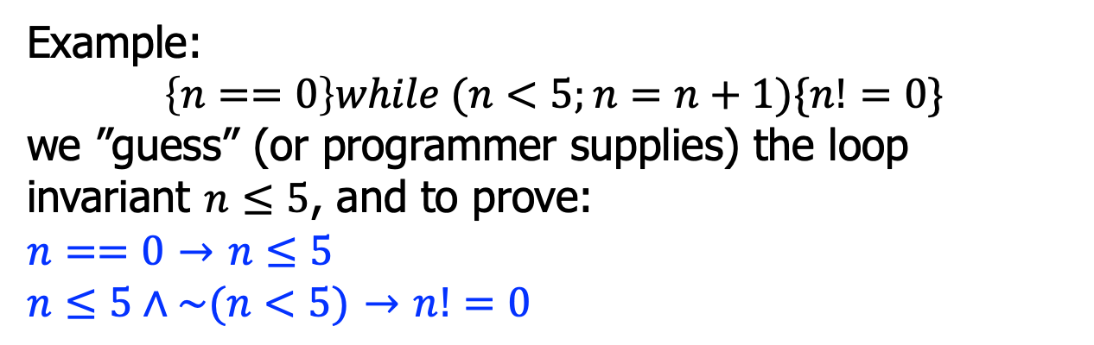

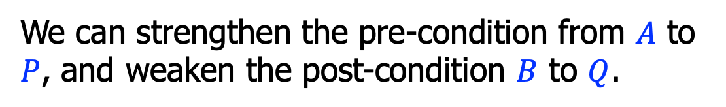




Hoare logic rules: consequence
$$P→A$$
$$\left\{A\right\}S\{B\}$$
$$B→Q$$
$$(H−Conseq)$$
$$\left\{P\right\}S\{Q\}$$
We can strengthen the pre-condition from $A$ to $P$, and weaken the post-condition $B$ to $Q$.
Example:
$$\left\{n==0\right\}while (n<5;n=n+1)\{n!=0\}$$
we ”guess” (or programmer supplies) the loop invariant $n≤5$, and to prove:
$n==0$ $→$ $n≤5$
$n≤5∧\sim (n<5)$ $→$ $n!=0$

Slide 39

Hoare logic rules: example
To prove this judgment:
using the assignment rule:
$$\left\{True\right\}x=5\{x==5\}$$
$$(H−Assign)$$
$$\left\{P[x↦E]\right\}x=E\{P\}$$
$$\left\{\left(x==5\right)[x↦5]\right\}x=5\{x==5\}$$
$$\left\{\left(5==5\right)\right\}x=5\{x==5\}$$
Using the consequence rule:
$$True→5==5$$

Slide 40



Or, the proof tree
To prove:
$$\left\{True\right\}x=5\{x==5\}$$
$$(H−Assign)$$
$$True→(5==5)$$
$$\left\{\left(x==5\right)[x↦5]\right\}x=5\{x==5\}$$
$$(H−Conseq)$$
$$\left\{True\right\}x=5\{x==5\}$$

Slide 41






Hoare logic rules: example
To prove this judgment:
the proof tree:
$$\left\{True\right\}if(y≤0;x=1;x=y)\{x>0\}$$
$$True∧y≤0→1>0$$
$$\left\{1>0\right\}x=1\{x>0\}$$
$$…$$
$$\left\{True∧y≤0\right\}x=1\{x>0\}$$
$$\left\{True∧¬(y≤0)\right\}x=y\{x>0\}$$
$$(H−If)$$
$$\left\{True\right\}if(y≤0;x=1;x=y)\{x>0\}$$

Slide 42





Hoare logic rules: example
To prove this judgment:
the proof tree:
$$\left\{x<0\right\}while\left(x<5;x=x+1\right)\{x==5\}$$
$$(x≤5∧x<5)→((x+1)≤5)$$
$$\left\{(x+1)≤5\right\}x=x+1\{x≤5\}$$
$$\left\{x≤5∧x<5\right\}x=x+1\{x≤5\}$$
$$x<0→x≤5$$
$$\left\{x≤5\right\}while(x<5;x=x+1)\{x≤5∧¬(x<5)\}$$
$$…$$
$$\left\{x<0\right\}while(x<5;x=x+1)\{x==5\}$$

Slide 43

Hoare logic rules: example
To prove this judgment:
the proof tree for “while”:
{n>=0}
s = 0;
i = 0;
while(i<=n){
s=s+i;
i=i+1;
}
{2*s==n*(n+1)}
$$i≤\left(n+1\right)∧s=Sum\left(i−1\right)∧i≤n → \text{(}i+1)≤\left(n+1\right)∧s+i=Sum\left(i\right)$$
$$\text{(}i+1)≤\left(n+1\right)∧s+i=Sum\left(i\right)$$
($i+1)≤\left(n+1\right)∧s=Sum\left(i+1−1\right)$
$$\left\{i≤\left(n+1\right)∧s=Sum\left(i−1\right)∧i≤n\right\}s=s+i;i=i+1\{i≤\left(n+1\right)∧s=Sum\left(i−1\right)\}$$
$$\left\{i≤\left(n+1\right)∧s=Sum\left(i−1\right)\right\}while(…)\{i≤\left(n+1\right)∧s=Sum(i−1)∧¬(i≤n)\}$$

Slide 44
Summary
We discussed Hoare logic
An axiomatic system to specify program semantics
FOL, judgments and inference rules
To prove program properties formally, requires considerable proof engineering efforts
But we can establish some automatic techniques, to be discussed next

