Slide 1
Higher-Order Polymorphism
Principle of Programming Languages
Baojian Hua
bjhua@ustc.edu.cn

Slide 2


Recap
Polymorphic functions (System F):
λX.λx:X.x
(λX.λx:X.x) [Bool]
Polymorphic types (λω):

Slide 3
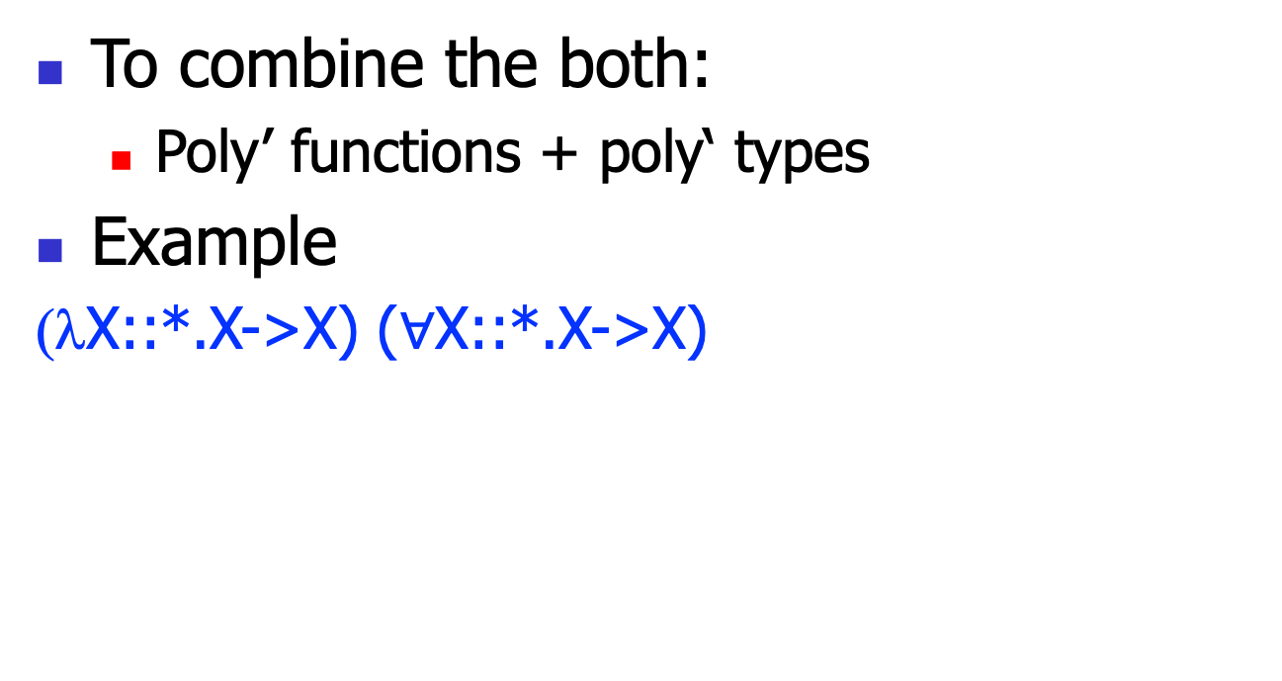
Fω
To combine the both:
Poly’ functions + poly‘ types
Example
(λX::*.X->X) ($∀$X::*.X->X)

Slide 4
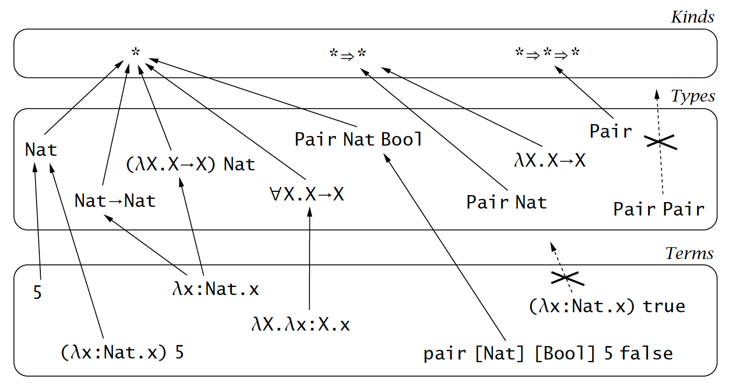
The Hierarchy

Slide 5
Example: C++ templates
// pair.cpp:
template <typename X, typename Y>
class Pair{
X a;
Y b;
public:
Pair(X a, Y b){…}
}
template <typename Z>
Z foo(Z x){return z;}
int main(){
Pair<int, int> p;
foo<int>(55);
}

Slide 6
Example: Java generics
// Pair.java:
class Pair<X, Y>{
X a;
Y b;
public Pair(X a, Y b){…}
<Z> Z foo(Z x){return x;}
}
Pair<Integer, Integer> p = new Pair<Integer, Integer>(3, 4);

Slide 7
Fω

Slide 8
Fω
System F with type operators
Syntax
Evaluation rules
Typing rules
Kinding rules

Slide 9
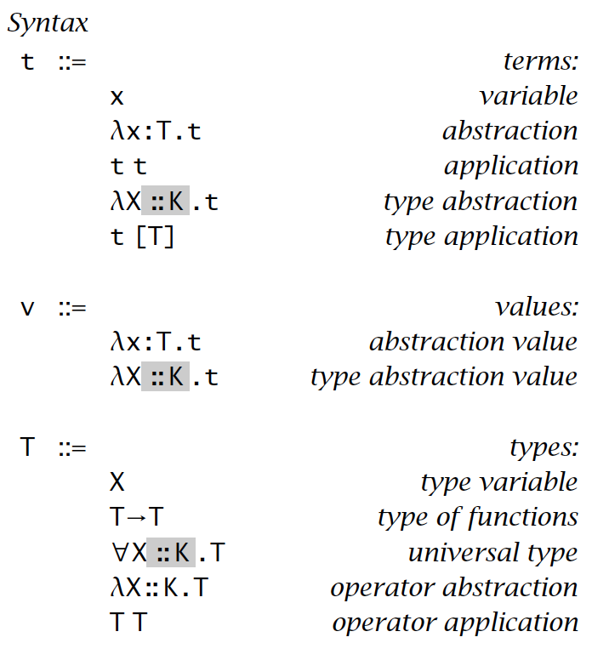
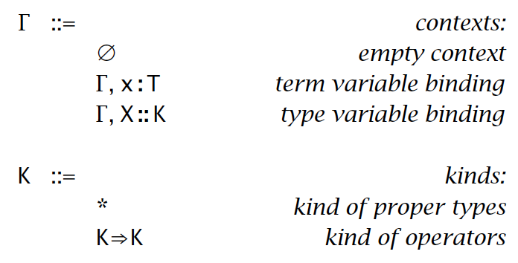
Syntax

Slide 10
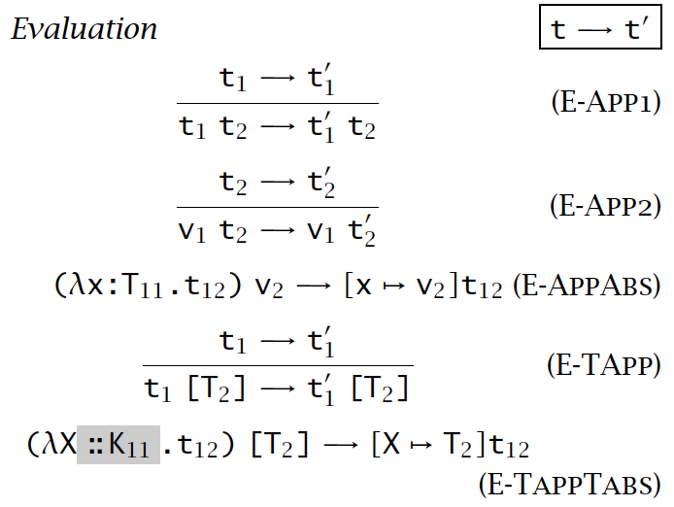
Evaluation rules

Slide 11
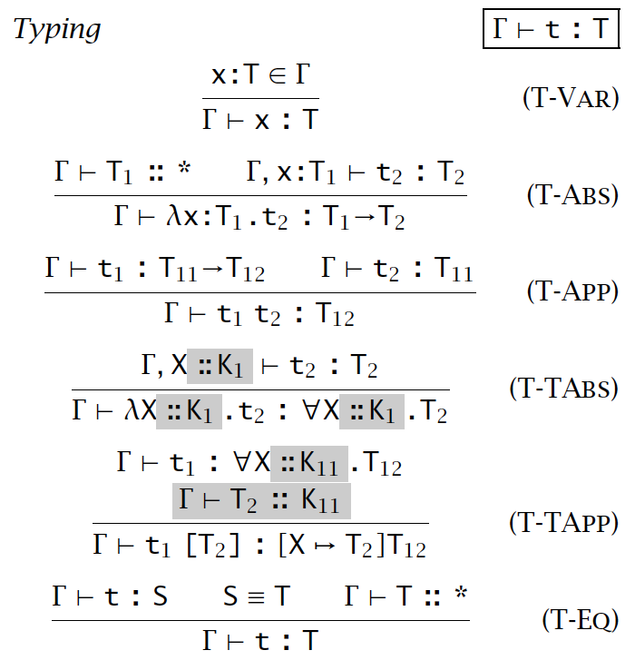
Typing rules

Slide 12
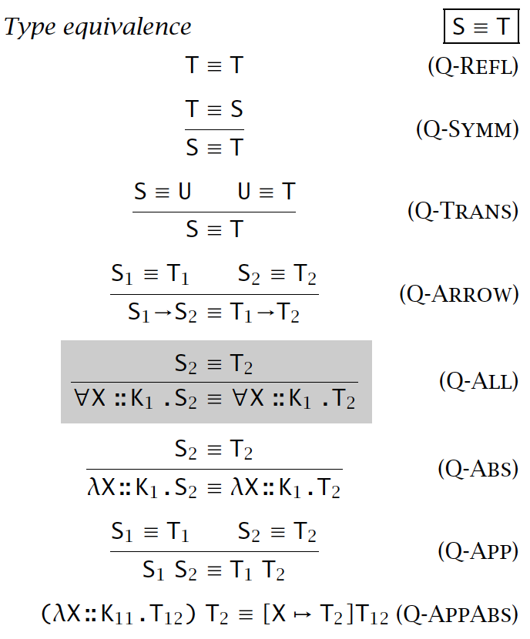
Type Equivalence

Slide 13
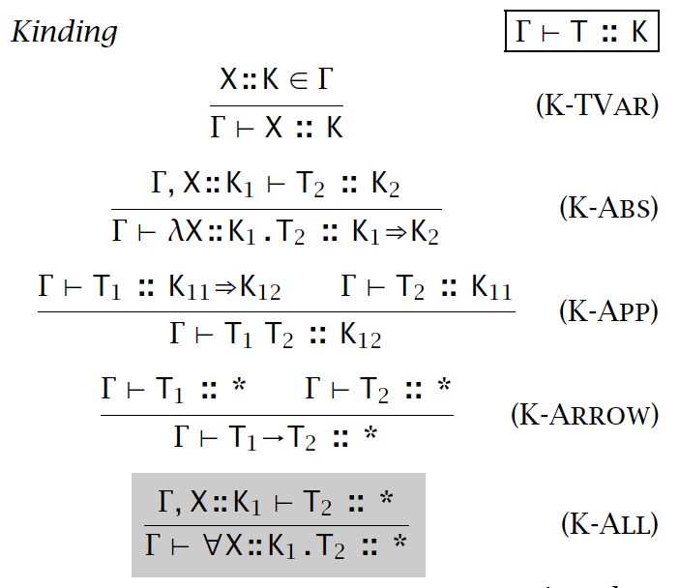
Kinding Rules

Slide 14
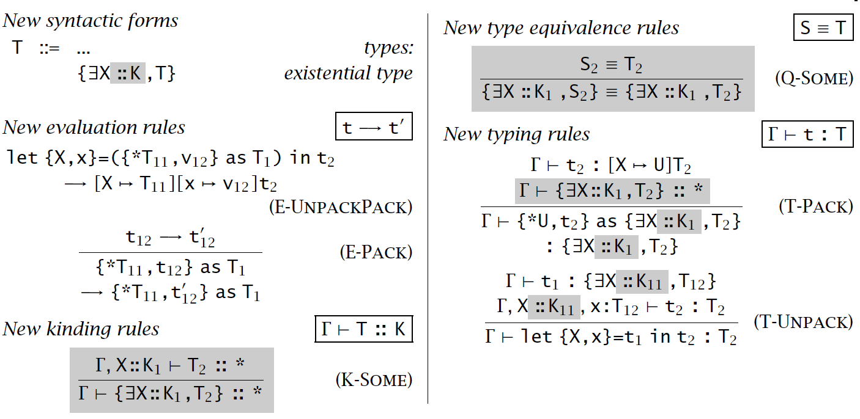
Extended with existentials

Slide 15
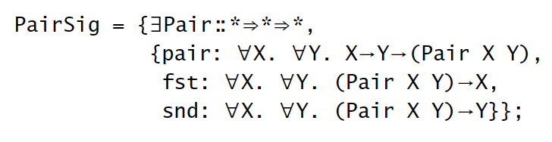
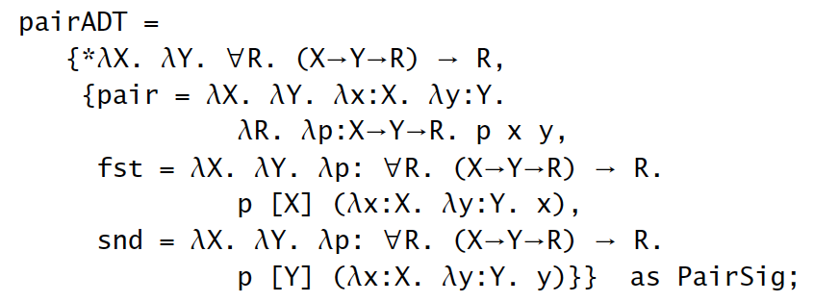
Example
An ADT PairSig taking type operators:

Slide 16
Type checking algorithm
Non-trivial
as there are computations on types, not only on terms
Key insight:
perform computations on types
then compare the structural equivalence
See the assignment

Slide 17
Properties

Slide 18
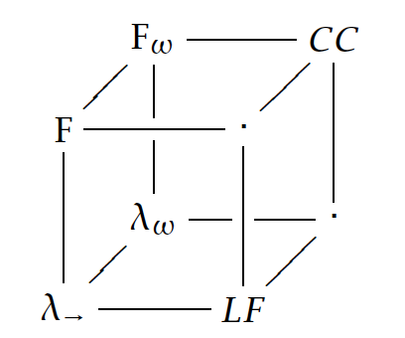
Barendregt cube (1991)

Slide 19
Summary
Fω is a system of higher-order polymorphism
to combine poly’ funcs and poly’ types
Barendregt cube:
present a clean and unified infrastructure pure type systems

