Slide 1
Overview
Principle of Programming Languages
Baojian Hua
bjhua@ustc.edu.cn

Slide 2
What are programming languages?
Very important fields, communication between programmers and HW
model the HW
express the abstraction
Very active fields, both in academia and industry
new languages are routinely developed

Slide 3
What is this course about?
This year, we will discuss languages and systems for heterogeneous platforms
GPU, NPU, TPU, ASIC, etc.
With a focus on languages and abstractions for GPUs
which is arguably the most popular one

Slide 4
Why is this course important?
Heterogeneous platforms are ubiquitous
mobile devices, laptops, edge devices, clouds, …
The push from AI
computing power takes priority
Heterogeneous programming thinking and skills are critical

Slide 5
What you can get out of this course?
A more modern and sophisticated perspective on heterogeneous systems
A deep understanding of languages and programming skills
Powerful tools/techniques for program design/reasoning/analysis:
For everyday usage

Slide 6
What background is needed?
Basic knowledge of computer architectures
Basic programming skills
especially, C and Python
Deep learning is a bonus, but not required

Slide 7
How This Course Works

Slide 8
Administrivia
Course page:
https://csslab-ustc.github.io/courses/popl26/
Schedule
Readings
Assignments
…
Check frequently

Slide 9
Structure of this course
Lectures
Friday, 8am
Programming assignments
8 PAs planned (see course website)
Presentation?
TBA
Test
final

Slide 10
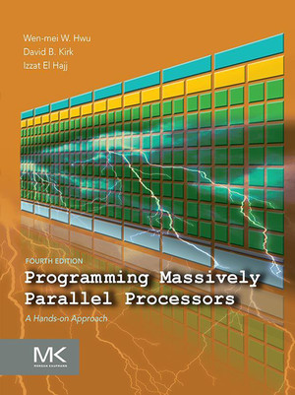
Textbooks & Reference
Key textbook:
Programming Massively Parallel Processors
Other references on course website

Slide 11
Programming assignments
Language used: Cuda, Python DSL
Platform
leetgpu

Slide 12
Grading (Tentative)
50% for assignment and presentations
50% for test

Slide 13
Summary
This is a practice-oriented course
Have a thorough understanding of principles for programming languages for heterogeneous platforms
Fun and profitable

Slide 14
Last Thing
Read the textbook
Chap 1-4
Start with the programming assignment #1

