Slide 1
Equality and uninterpreted functions theory
Formal Methods Foundation
Baojian Hua
bjhua@ustc.edu.cn

Slide 2
Motivation: SAT
SAT: given a proposition P, is it satisfiable?
SAT for propositional logic:
NPC, but practically efficient
We’ve studied algorithms like DPLL
SAT for predicate logic:
Undecidable!
restrict ourselves to some specific subset: called a theory

Slide 3
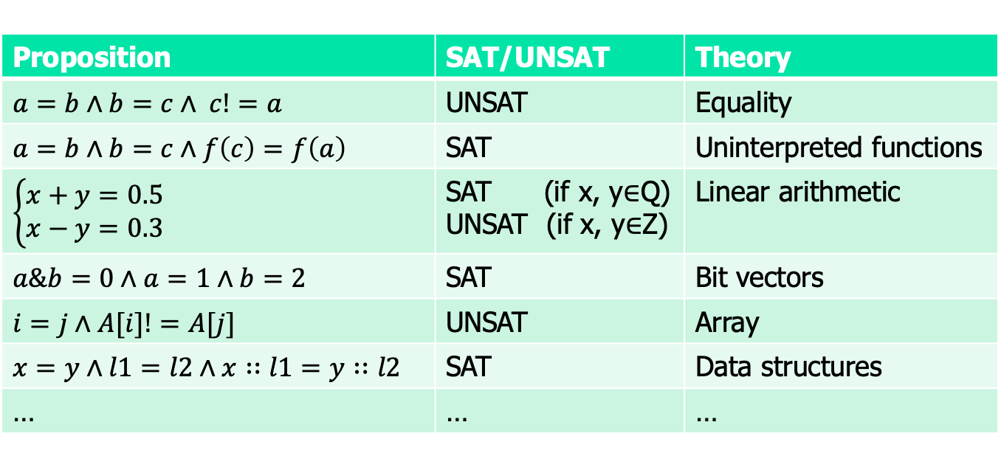
Motivation: theory
Are these satisfiable?
Proposition | SAT/UNSAT | Theory
$a=b∧b=c∧ c!=a$ | UNSAT | Equality
$$a=b∧b=c∧f\left(c\right)=f\left(a\right)$$ | SAT | Uninterpreted functions
$$\left\{\begin{aligned}x+y=0.5 \\ x−y=0.3\end{aligned}\right.$$ | SAT (if x, y$∈$Q) UNSAT (if x, y$∈$Z) | Linear arithmetic
$a\&b=0∧a=1∧b=2$ | SAT | Bit vectors
$i=j∧A[i]!=A[j]$ | UNSAT | Array
$x=y∧l1=l2∧x∷l1=y∷l2$ | SAT | Data structures
… | … | …

Slide 4

Satisfiability modulo theory (SMT)
SAT
Theory
Solvers
SMT
Equality + UF
Arithmetic
Bit-vectors
…

Slide 5
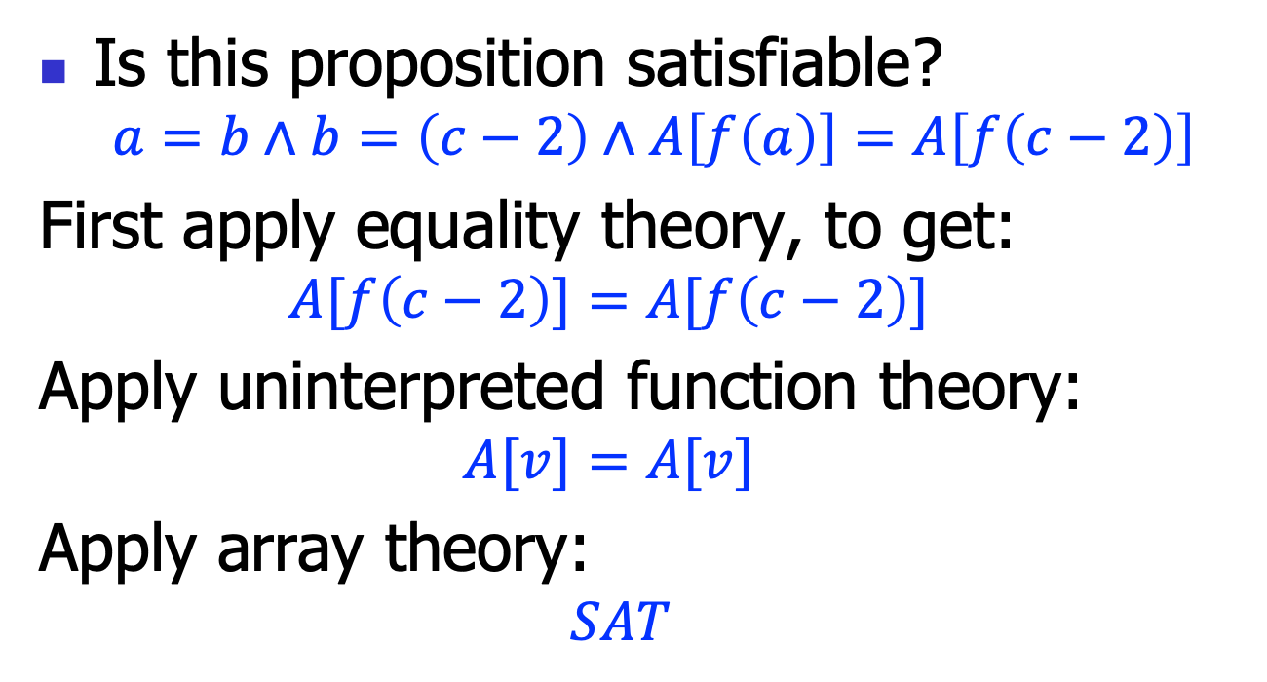
Theory combination
Is this proposition satisfiable?
$$a=b∧b=\left(c−2\right)∧A\left[f\left(a\right)\right]=A\left[f\left(c−2\right)\right]$$
First apply equality theory, to get:
$$A[f\left(c−2\right)]=A[f\left(c−2\right)]$$
Apply uninterpreted function theory:
$$A[v]=A[v]$$
Apply array theory:
$$SAT$$

Slide 6
Roadmap
Study carefully several theories separately
Various applications
Then the infrastructure to combine them together

Slide 7
Theory of Equality and Uninterpreted Functions (EUF)

Slide 8
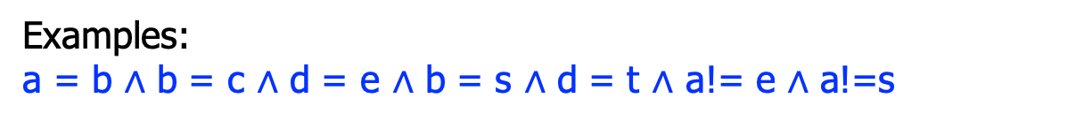

Equality theory: the syntax
x: a set of variables
E ::= x | c
R ::= E=E | E!=E
P ::= R
$\text{|} \text{P}∧\text{P}$
c: a set of constants
Relations are only = or !=
A conjunction fragment.
Examples:
a = b $∧$ b = c $∧$ d = e $∧$ b = s $∧$ d = t $∧$ a!= e $∧$ a!=s
# or in Z3:
S = DeclareSort('S') a, b, c, d, e, s, t = Consts('a b c d e s t', S) solve(a == b, b == c, d == e, b == s, d == t, a != e,
a != s)

Slide 9
Motivation: solving equality
a = b, b = c, d = e, b = s, d = t, a!= e, a!=s
a
b
c
d
e
s
t

Slide 10
Motivation: solving equality
a = b, b = c, d = e, b = s, d = t, a!= e, a!=s
a
b
c
d
e
s
t

Slide 11
Motivation: solving equality
a = b, b = c, d = e, b = s, d = t, a!= e, a!=s
a, b
c
d
e
s
t

Slide 12
Motivation: solving equality
a = b, b = c, d = e, b = s, d = t, a!= e, a!=s
a, b
c
d
e
s
t

Slide 13
Motivation: solving equality
a = b, b = c, d = e, b = s, d = t, a!= e, a!=s
a, b, c
d
e
s
t

Slide 14
Motivation: solving equality
a = b, b = c, d = e, b = s, d = t, a!= e, a!=s
a, b, c
d
e
s
t

Slide 15
Motivation: solving equality
a = b, b = c, d = e, b = s, d = t, a!= e, a!=s
a, b, c
d, e
s
t

Slide 16
Motivation: solving equality
a = b, b = c, d = e, b = s, d = t, a!= e, a!=s
a, b, c
d, e
s
t

Slide 17
Motivation: solving equality
a = b, b = c, d = e, b = s, d = t, a!= e, a!=s
a, b, c, s
d, e
t

Slide 18
Motivation: solving equality
a = b, b = c, d = e, b = s, d = t, a!= e, a!=s
a, b, c, s
d, e, t

Slide 19
Motivation: solving equality
a = b, b = c, d = e, b = s, d = t, a!= e, a!=s
a, b, c, s
d, e, t
Unsat!
Algorithm:
Maintain a group of sets;
For x = y, union the sets for x and y;
For x !=y, checking the inSet() relation.

Slide 20
Naïve algorithm
decideEquality(){
for(each “x=y”){
setx = find(x);
sety = find(y);
union(setx, sety);
}
for(each “x!=y”){
setx = find(x);
sety = find(y);
if(setx == sety)
return UNSAT;
}
return SAT;
}
Direct set-based implementation would be inefficient.
There is classical algorithm (data structure) called union-find.

Slide 21
Motivation: union-find
a = b, b = c, d = e, b = s, d = t, a!= e, a!=s
2
1
3
4
d, e
a
s
t
b
c

Slide 22
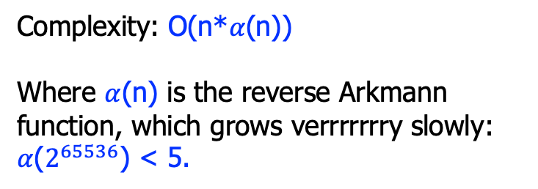
Motivation: union-find
a = b, b = c, d = e, b = s, d = t, a!= e, a!=s
2
1
4
d, e
a
t
b
c
s
Complexity: O(n*$α$(n))
Where $α$(n) is the reverse Arkmann function, which grows verrrrrrry slowly:
$α$($2^{65536}$) < 5.

Slide 23

Equality theory with uninterpreted functions
f: uninterpreted functions, which is always abstract
E ::= x | c | f(E, …, E)
R ::= E=E | E!=E
P ::= R
$\text{|} \text{P}∧\text{P}$
Examples:
a = b, b = c, d = e, b = s, d = t, f(a, g(d))!=f(b, g(e))
# or in Z3:
S = DeclareSort('S’) f = Function(’f’, S, S, S); g = Function(‘g, S, S) a, b, c, d, e, s, t = Consts('a b c d e s t', S) solve(a == b, b == c, d == e, b == s, d == t,
f(a, g(d)) != f(b, g(e)))

Slide 24





Congruence rule
What do we actually mean by saying a function f is “uninterpreted”?
The congruence rule:
Compare with interpreted functions:
+(1, 4) = +(2, 3)
An abstraction! (more to say later)
$$e1=e1′$$
$$…$$
$$en=en′$$
$$(Congruence)$$
$$f\left(e1, …, en\right)=f(e1^{′}, …, en^{′})$$

Slide 25
Motivation: solving equality
a = b, b = c, d = e, b = s, d = t, f(a, g(d))!=f(b, g(e))
Also list all sub-terms!
a
b
c
d
e
s
t
g(d)
g(e)
f(a, g(d))
f(b, g(e))

Slide 26
Motivation: solving equality
a = b, b = c, d = e, b = s, d = t, f(a, g(d))!=f(b, g(e))
a, b, c, s
d, e, t
g(d)
g(e)
f(a, g(d))
f(b, g(e))

Slide 27
Motivation: solving equality
a = b, b = c, d = e, b = s, d = t, f(a, g(d))!=f(b, g(e))
Congruence
Rule!
a, b, c, s
d, e, t
g(d), g(e)
f(a, g(d))
f(b, g(e))

Slide 28
Motivation: solving equality
a = b, b = c, d = e, b = s, d = t, f(a, g(d))!=f(b, g(e))
Congruence
Rule!
a, b, c, s
d, e, t
g(d), g(e)
f(a, g(d))
f(b, g(e))

Slide 29
Motivation: solving equality
a = b, b = c, d = e, b = s, d = t, f(a, g(d))!=f(b, g(e))
Congruence
Rule!
a, b, c, s
d, e, t
g(d), g(e)
f(a, g(d)), f(b, g(e))

Slide 30
Motivation: solving equality
a = b, b = c, d = e, b = s, d = t, f(a, g(d))!=f(b, g(e))
Congruence
Rule!
a, b, c, s
d, e, t
g(d), g(e)
f(a, g(d)), f(b, g(e))
UNSAT!

Slide 31
Congruence closure
congruenceClosure(){
for(each “x=y”)
…;
while(stillChanging){ // closure
if(s1=t1, …, sn=tn){
union(f(s1, …, sn), f(t1, …, tn));
}
}
for(each “x!=y”)
…;
return SAT;
}

Slide 32
EUF theory applications

Slide 33
#1: Program equivalence
int power3(int in){
int i, out_a;
out_a = in;
for(i = 0; i < 2; i++)
out_a = out_a * in;
return out_a;
}
int power3_new(int in){
int out_b;
out_b = (in*in)*in;
return out_b;
}
The two programs should be equivalent. But how do we prove that fact?
Remember the implication of uninterpreted functions?

Slide 34

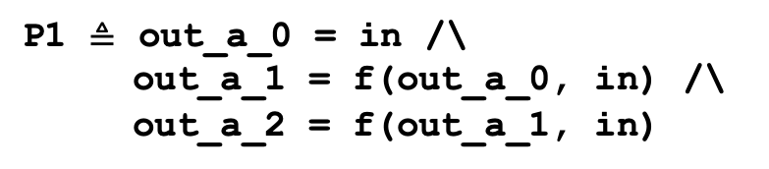
#1: Program equivalence
int power3(int in){
int i, out_a;
out_a_0 = in;
// loop unrool and SSA
out_a_1 = out_a_0 * in;
out_a_2 = out_a_1 * in;
return out_a_2;
}
int power3_new(int in){
int out_b;
out_b = (in*in)*in;
return out_b;
}
P2 $≜$ out_b = f(f(in, in), in)
P1 $≜$ out_a_0 = in /\
out_a_1 = f(out_a_0, in) /\
out_a_2 = f(out_a_1, in)
P1/\ P2 -> out_a_2=out_b

Slide 35
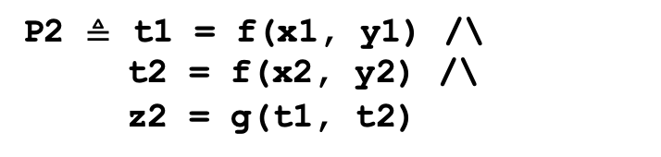
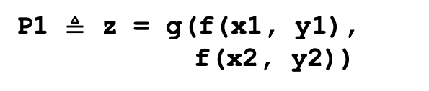
#2: Translation validation
// source code:
z = (x1 + y1)*(x2 + y2);
// generated 3-address
// code:
t1 = x1 + y1;
t2 = x2 + y2;
z = t1 * t2;
P1 $≜$ z = g(f(x1, y1),
f(x2, y2))
P2 $≜$ t1 = f(x1, y1) /\
t2 = f(x2, y2) /\
z2 = g(t1, t2)
P1/\ P2 -> z=z2

Slide 36
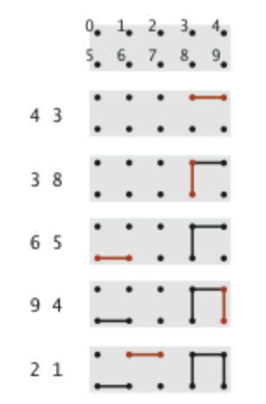
#3: Dynamic connectivity
The input is a sequence of pairs of integers, where each integer represents an object of some type and we are to interpret the pair (p, q) as meaning p is connected to q.
Our goal is to write a program to determine whether a pair (p, q) is connected.
(Adapted from the book: Algorithms in Java.)
Question: is (3, 9) connected?
is (0, 9) connected?

Slide 37
#3: Dynamic connectivity
# Formalize the point:
point = DeclareSort(“p”)
# establish equality:
solver = Solver()
solver.add([p4 == p3,
p3 == p8,
p6 == p5,
p9 == p4,
p2 == p1])
# check connectivity:
solver.check(p3 == p9)
solver.check(p0 == p9)
Question: is 3 9 connected?
is 0 9 connected?

