Slide 1
Bit Vectors
Formal Methods Foundation
Baojian Hua
bjhua@ustc.edu.cn

Slide 2
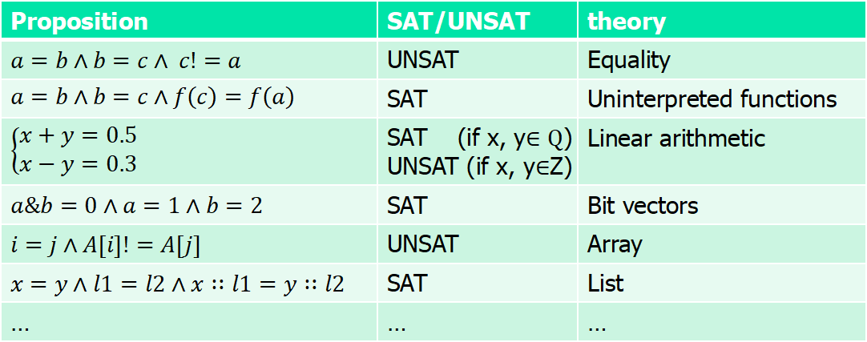
Motivation: theory
Are these satisfiable?
Proposition | SAT/UNSAT | theory
$a=b∧b=c∧ c!=a$ | UNSAT | Equality
$$a=b∧b=c∧f\left(c\right)=f\left(a\right)$$ | SAT | Uninterpreted functions
$$\left\{\begin{aligned}x+y=0.5 \\ x−y=0.3\end{aligned}\right.$$ | SAT (if x, y$∈Q$) UNSAT (if x, y$∈$Z) | Linear arithmetic
$a\&b=0∧a=1∧b=2$ | SAT | Bit vectors
$i=j∧A[i]!=A[j]$ | UNSAT | Array
$x=y∧l1=l2∧x∷l1=y∷l2$ | SAT | List
… | … | …

Slide 3

Satisfiability modulo theory (SMT)
SAT
Theory
Solvers
SMT
Equality + UF
Arithmetic
Bit-vectors
…

Slide 4
Motivation
// A notorious bug in early JDK (reported in 2006,
// existed in JDK for nearly 10 years).
// The standard binary search (java.util.Arrays):
// By Joshua Bloch.
int binarySearch(int[] arr, int target){
int low = 0, high = arr.length-1;
while(low <= high)
int middle = (low+high)/2;
if(arr[middle] == target)
return middle;
if(arr[middle] > target)
high = middle - 1;
else
low = middle + 1;
}
return -1;
}

Slide 5

Motivation
// Isn’t this the standard textbook algorithm?
int binarySearch(int[] arr, int target){
int low = 0, high = arr.length-1;
while(low <= high)
int middle = (low+high)/2;
if(arr[middle] == target)
return middle;
if(arr[middle] > target)
high = middle - 1;
else
low = middle + 1;
}
return -1;
}
int = [${−2}^{31}, 2^{31}−1$]

Slide 6
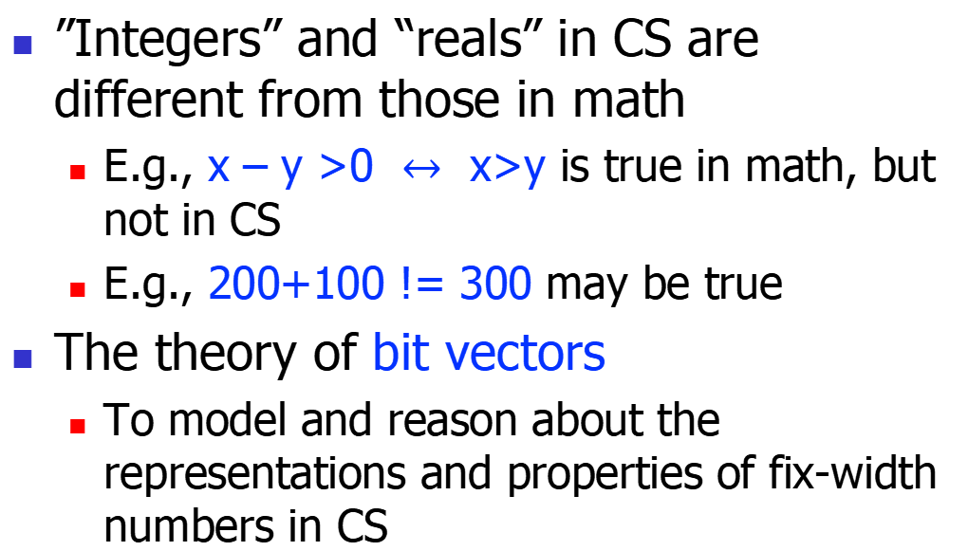
Bit vector
”Integers” and “reals” in CS are different from those in math
E.g., x – y >0 $↔$ x>y is true in math, but not in CS
E.g., 200+100 != 300 may be true
The theory of bit vectors
To model and reason about the representations and properties of fix-width numbers in CS

Slide 7

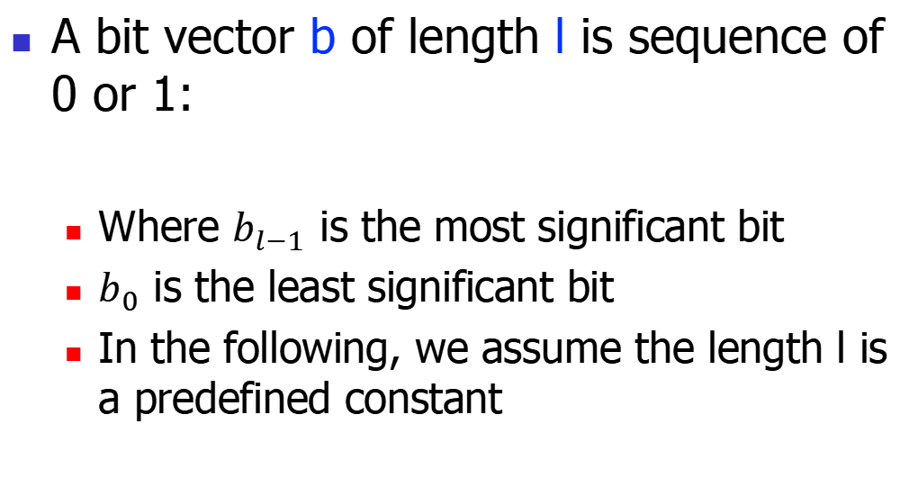
Bit vector, cont’
A bit vector b of length l is sequence of 0 or 1:
Where $b_{l−1}$ is the most significant bit
$b_{0}$ is the least significant bit
In the following, we assume the length l is a predefined constant
$b_{l−1}$ | $$b_{l−2}$$ | … | $$b_{0}$$

Slide 8


Bit vectors: the syntax
$⊕$ ::= + | - | * | / | << | >> | >>> | & | | | xor
E ::= x | c | E $⊕$ E | ~E
R ::= E=E | E<=E | E<E
P ::= R
$\text{|} \text{P}∧\text{P}$
o: a group of binary operators
Examples:
$$x==1∧y==3∧x\&y=0$$
UNSAT!
Examples in Z3:
x, y = BitVecs(‘x y’, 32)
solve(x==1, y==3, x&y ==0)

Slide 9

Semantics: bitwise operations
The bitwise operations are easy and straightforward
Extensions of the single-bit operations
x&y = $⋀$x[i] & y[i]
x|y = x[i] | y[i]
x xor y = x[i] xor y[i]
~x = ~x[i]
…

Slide 10
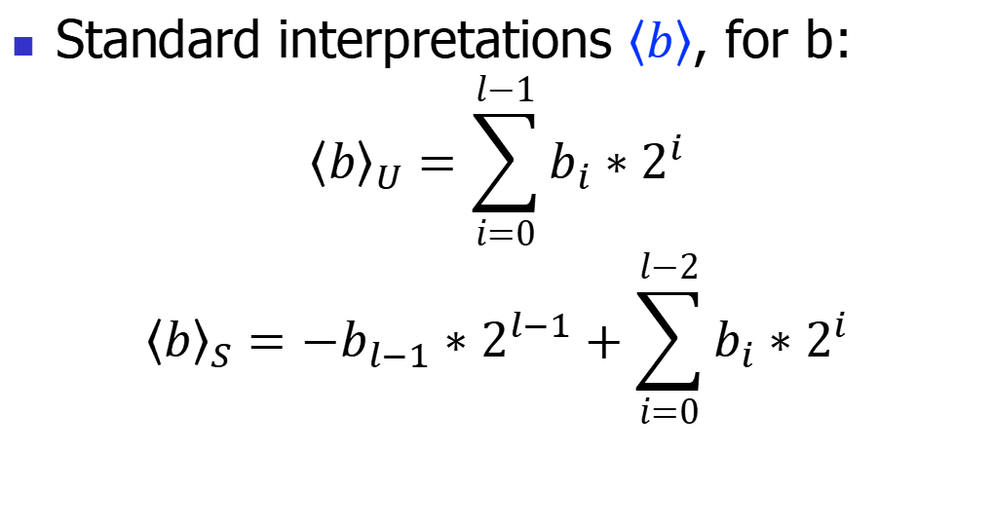
Semantics: arithmetic operations
Standard interpretations $\left\langle b\right\rangle$, for b:
$${\left\langle b\right\rangle }_{U}=\sum_{i=0}^{l−1}{b_{i}∗2^{i}}$$
$${\left\langle b\right\rangle }_{S}={−b}_{l−1}∗2^{l−1}+\sum_{i=0}^{l−2}{b_{i}∗2^{i}}$$
Example (for l=8):
<11001000>U = 200
<11001000>S = -56

Slide 11
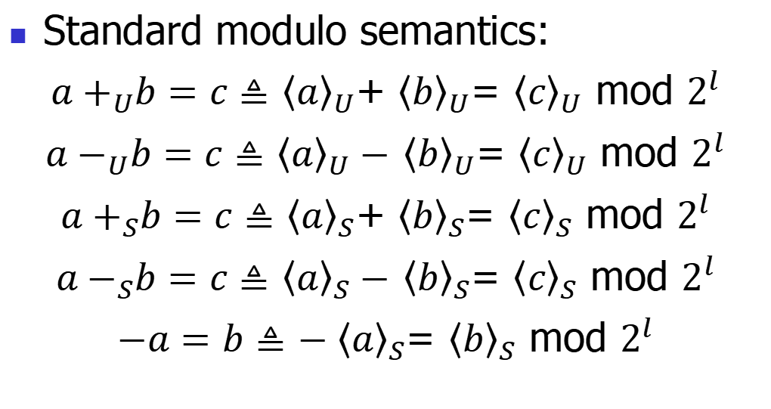
Semantics: arithmetic operations
Standard modulo semantics:
${a+}_{U}b=c≜$ ${\left\langle a\right\rangle }_{U}$+ ${\left\langle b\right\rangle }_{U}$= ${\left\langle c\right\rangle }_{U}$ mod $2^{l}$
${a−}_{U}b=c≜$ ${\left\langle a\right\rangle }_{U}−$ ${\left\langle b\right\rangle }_{U}$= ${\left\langle c\right\rangle }_{U}$ mod $2^{l}$
${a+}_{S}b=c≜$ ${\left\langle a\right\rangle }_{S}$+ ${\left\langle b\right\rangle }_{S}$= ${\left\langle c\right\rangle }_{S}$ mod $2^{l}$
${a−}_{S}b=c≜$ ${\left\langle a\right\rangle }_{S}−$ ${\left\langle b\right\rangle }_{S}$= ${\left\langle c\right\rangle }_{S}$ mod $2^{l}$
$−a=b≜$ ${−\left\langle a\right\rangle }_{S}$= ${\left\langle b\right\rangle }_{S}$ mod $2^{l}$

Slide 12

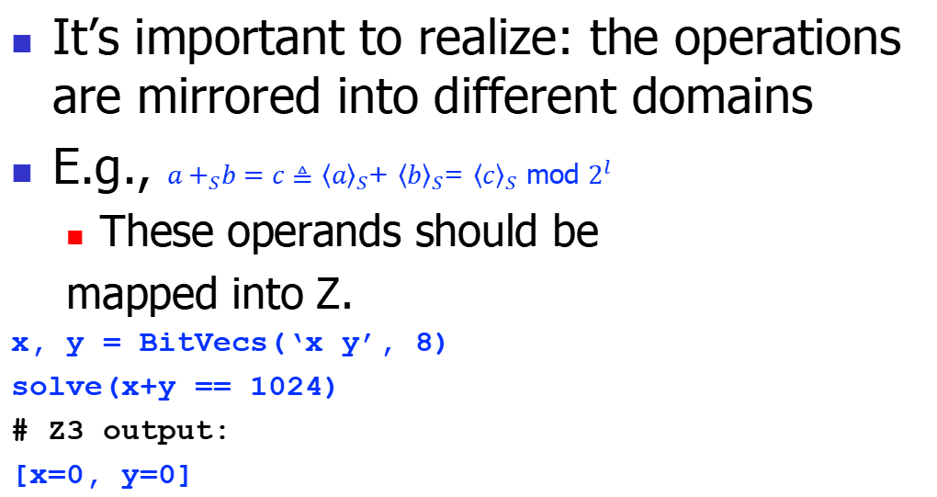
Semantics: arithmetic operations
It’s important to realize: the operations are mirrored into different domains
E.g., ${a+}_{S}b=c≜$ ${\left\langle a\right\rangle }_{S}$+ ${\left\langle b\right\rangle }_{S}$= ${\left\langle c\right\rangle }_{S}$ mod $2^{l}$
These operands should be
mapped into Z.
x, y = BitVecs(‘x y’, 8)
solve(x+y == 1024)
# Z3 output:
[x=0, y=0]
BV
Z
$${\left\langle c\right\rangle }_{S}$$

Slide 13
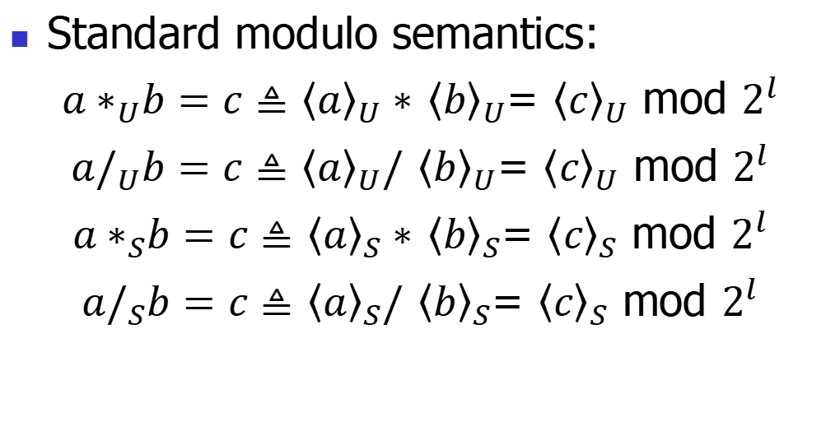
Semantics: arithmetic operations
Standard modulo semantics:
${a∗}_{U}b=c≜$ ${\left\langle a\right\rangle }_{U}∗$ ${\left\langle b\right\rangle }_{U}$= ${\left\langle c\right\rangle }_{U}$ mod $2^{l}$
${a/}_{U}b=c≜$ ${\left\langle a\right\rangle }_{U}/$ ${\left\langle b\right\rangle }_{U}$= ${\left\langle c\right\rangle }_{U}$ mod $2^{l}$
${a∗}_{S}b=c≜$ ${\left\langle a\right\rangle }_{S}∗$ ${\left\langle b\right\rangle }_{S}$= ${\left\langle c\right\rangle }_{S}$ mod $2^{l}$
${a/}_{S}b=c≜$ ${\left\langle a\right\rangle }_{S}/$ ${\left\langle b\right\rangle }_{S}$= ${\left\langle c\right\rangle }_{S}$ mod $2^{l}$

Slide 14
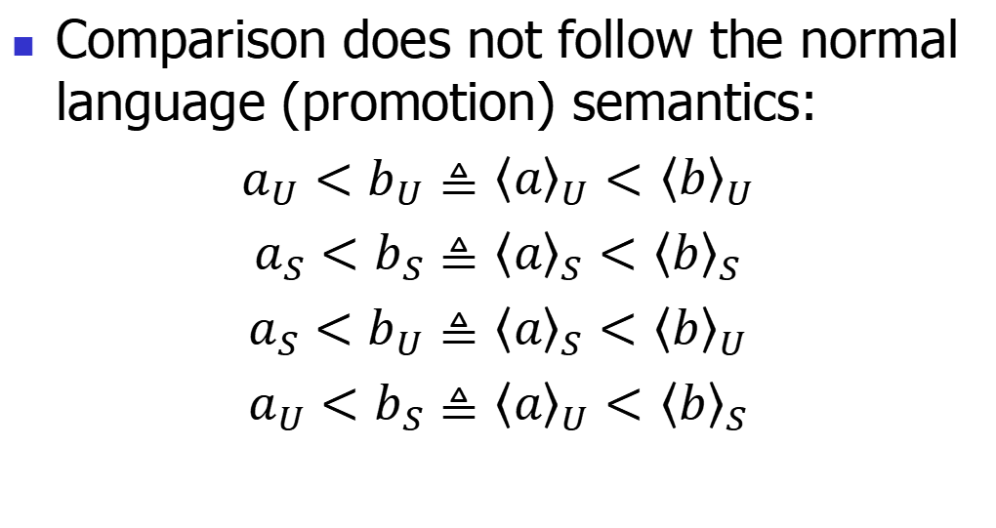
Semantics: arithmetic operations
Comparison does not follow the normal language (promotion) semantics:
$a_{U}<b_{U}≜$ ${\left\langle a\right\rangle }_{U}<$ ${\left\langle b\right\rangle }_{U}$
$a_{S}<b_{S}≜$ ${\left\langle a\right\rangle }_{S}<$ ${\left\langle b\right\rangle }_{S}$
$a_{S}<b_{U}≜$ ${\left\langle a\right\rangle }_{S}<$ ${\left\langle b\right\rangle }_{U}$
$a_{U}<b_{S}≜$ ${\left\langle a\right\rangle }_{U}<$ ${\left\langle b\right\rangle }_{S}$

Slide 15
Decision procedures for bit vectors

Slide 16


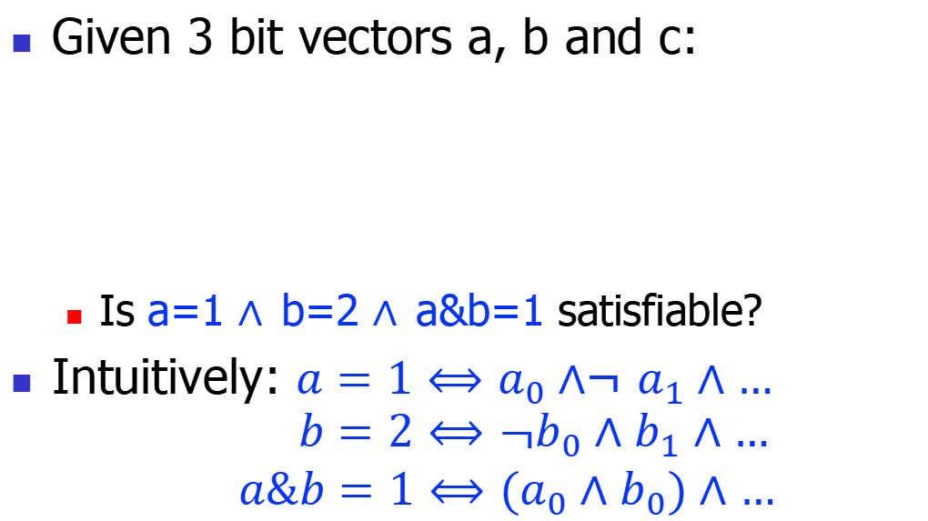
Motivation
Given 3 bit vectors a, b and c:
Is a=1 $∧$b=2 $∧$a&b=1 satisfiable?
Intuitively: ${a=1⟺a}_{0}∧$¬ $a_{1}∧…$
$${ b=2⟺\text{¬}b}_{0}∧b_{1}∧…$$
$${ a\&b=1⟺(a}_{0}∧b_{0})∧…$$
$a_{l−1}$ | $$a_{l−2}$$ | … | $$a_{0}$$
T
T
F
$b_{l−1}$ | $$b_{l−2}$$ | … | $$b_{0}$$
$c_{l−1}$ | $$c_{l−2}$$ | … | $$c_{0}$$
T

Slide 17
Motivation
Bit vectors are represented by the corresponding propositions
Bit vector operations are compiled to the semantically equivalent operations on propositions
Also called constraints
These constraints are handled by a SAT
This is the bit-blasting algorithm

Slide 18
Bit-blasting algorithm
C = {}; // a set of all generated constraints
// two main passes:
// 1. blast each proposition;
// 2. generate constrains
bitBlast(P){
// convert the proposition to atomic bools
blastProp(P);
// generate constraints
genConsProp(P); }

Slide 19
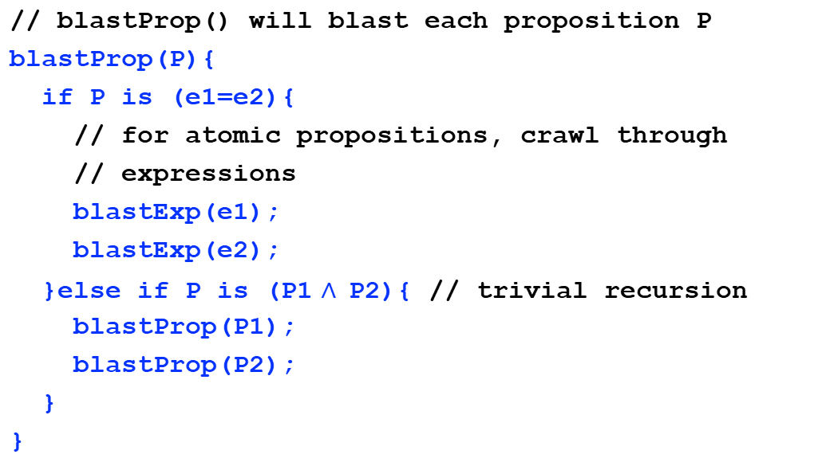
Bit-blasting algorithm: pass #1: blasting
// blastProp() will blast each proposition P
blastProp(P){
if P is (e1=e2){
// for atomic propositions, crawl through
// expressions
blastExp(e1);
blastExp(e2);
}else if P is (P1 $∧$P2){ // trivial recursion
blastProp(P1);
blastProp(P2);
}
}

Slide 20
Bit-blasting algorithm: pass #1: blasting
// genCons() will generate constraints
blastExp(e){
if e is x:
// a vector of boolean variables
return (b0, b1, …, bn);
if e is c:
return (b0, b1, …, bn);
if e is e1+e2:
(b0, …, bn) = blastExp(e1);
(c0, …, cn) = blastExp(e2);
return (d0, …, dn); // attach to e1+e2
// other cases are similar
}

Slide 21

Blasting example
// to blast the following propositions
x=1 $∧$ y=2 $∧$ x&y=1
// tree structure:
∧
=
f0, …, fn
g0, …, gn
∧
&
1
=
=
x
y
b0, …, bn
c0, …, cn
b0, …, bn
d0, …, dn
x
1
y
2
d0, …, dn
e0, …, en

Slide 22
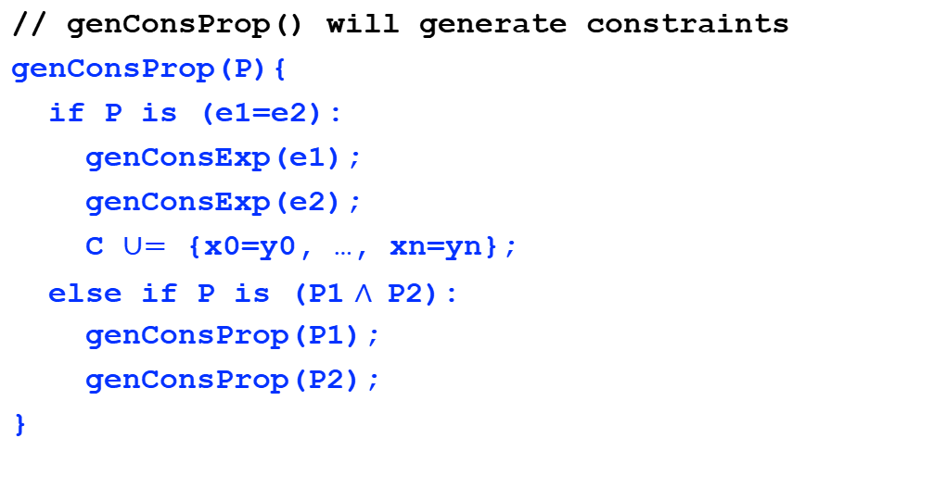
Bit-blasting algorithm: step #2: generating constr’
// genConsProp() will generate constraints
genConsProp(P){
if P is (e1=e2):
genConsExp(e1);
genConsExp(e2);
C $∪=$ {x0=y0, …, xn=yn};
else if P is (P1 $∧$P2):
genConsProp(P1);
genConsProp(P2);
}

Slide 23
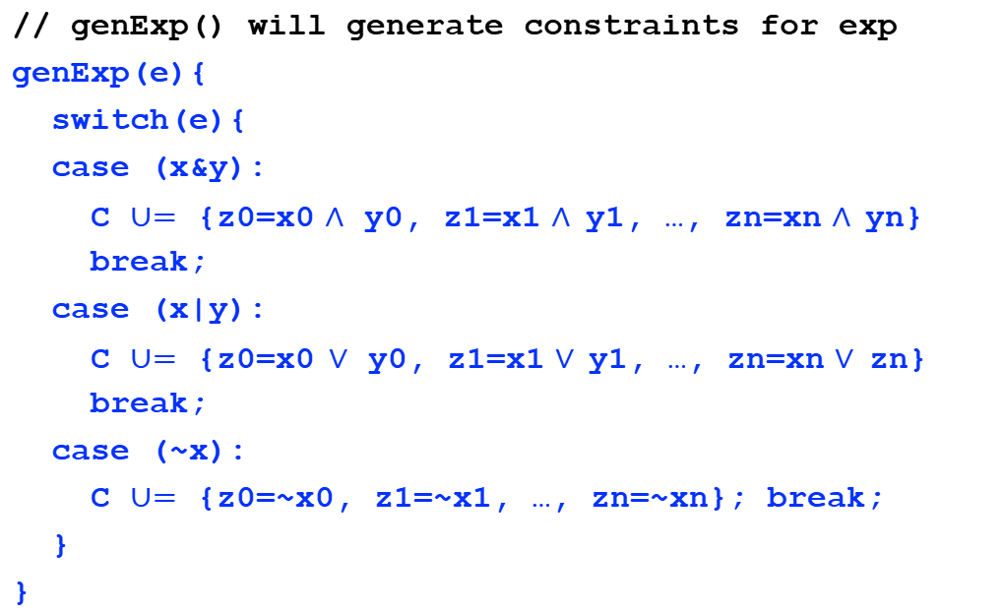
Bit-blasting algorithm: step #2: generating constr’
// genExp() will generate constraints for exp
genExp(e){
switch(e){
case (x&y):
C $∪=$ {z0=x0 $∧$ y0, z1=x1 $∧$y1, …, zn=xn $∧$yn}
break;
case (x|y):
C $∪=$ {z0=x0$∨$ y0, z1=x1 $∨$y1, …, zn=xn $∨$zn}
break;
case (~x):
C $∪=$ {z0=~x0, z1=~x1, …, zn=~xn}; break;
}
}

Slide 24
Constraint generation example
// to blast the following propositions
x=1 $∧$ y=2 $∧$ x&y=1
// tree structure:
∧
f0=g0, …, fn=gn
=
f0=b0∧d0, …, fn=bn∧dn
g0, …, gn
f0, …, fn
∧
&
1
b0=c0, …, bn=cn
d0=e0, …, dn=en
g0=T, …, gn=F
=
c0=T, …, cn=F
=
x
y
b0, …, bn
c0, …, cn
b0, …, bn
d0, …, dn
x
1
y
2
e0=F, e1=T, …, en=F
d0, …, dn
e0, …, en

Slide 25
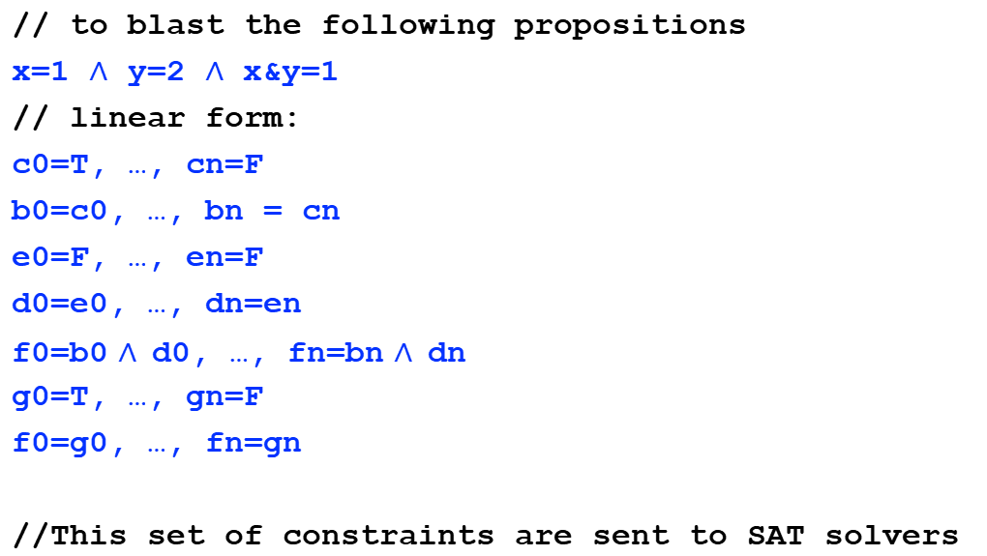
Constraint generation example
// to blast the following propositions
x=1 $∧$ y=2 $∧$ x&y=1
// linear form:
c0=T, …, cn=F
b0=c0, …, bn = cn
e0=F, …, en=F
d0=e0, …, dn=en
f0=b0 $∧$d0, …, fn=bn $∧$dn
g0=T, …, gn=F
f0=g0, …, fn=gn
//This set of constraints are sent to SAT solvers

Slide 26
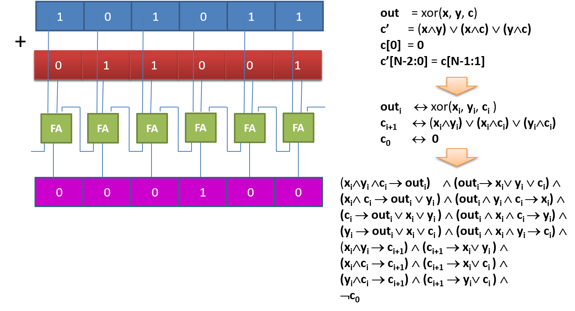
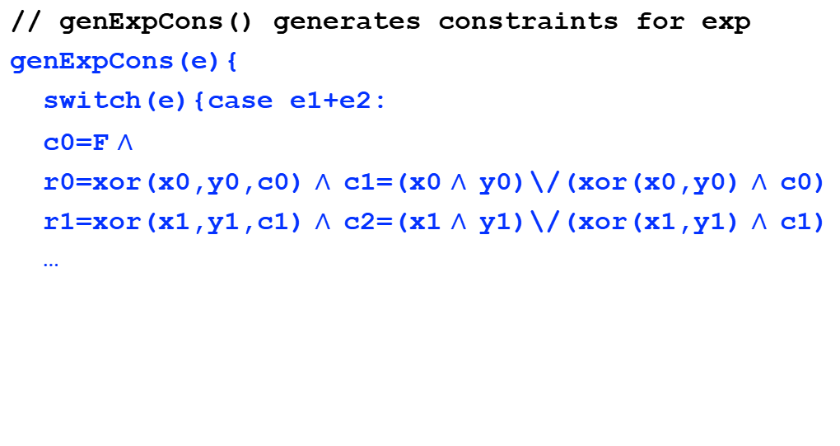
Bit-blasting algorithm, cont’
// genExpCons() generates constraints for exp
genExpCons(e){
switch(e){case e1+e2:
c0=F $∧$
r0=xor(x0,y0,c0) $∧$c1=(x0 $∧$y0)\/(xor(x0,y0) $∧$c0)
r1=xor(x1,y1,c1) $∧$c2=(x1 $∧$y1)\/(xor(x1,y1) $∧$c1)
…

Slide 27
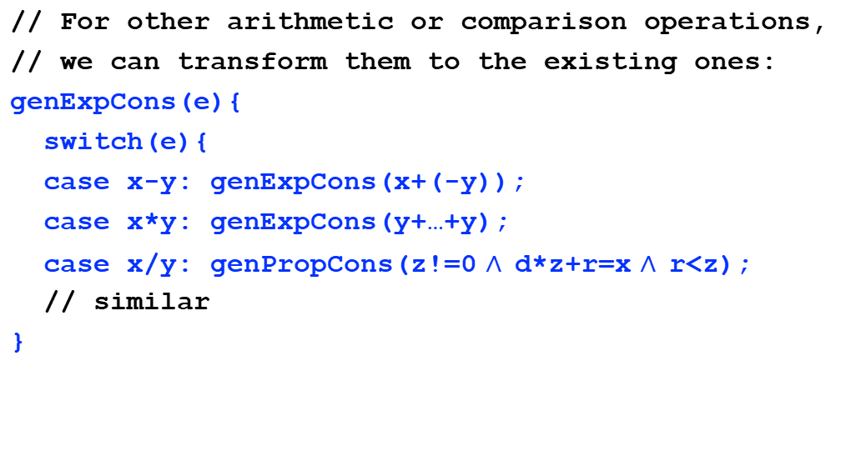
Bit-blasting algorithm, cont’
// For other arithmetic or comparison operations,
// we can transform them to the existing ones:
genExpCons(e){
switch(e){
case x-y: genExpCons(x+(-y));
case x*y: genExpCons(y+…+y);
case x/y: genPropCons(z!=0 $∧$d*z+r=x $∧$r<z);
// similar
}

Slide 28
Incremental Bit Blasting

Slide 29


Motivation: the complexity
Consider the constraint complexity:
x&y=x0 $∧$y0, x1 $∧$y1, …, xn $∧$yn
$2^{n}$ props, for n conjunctions
x*y =
$$\underbrace{\text{x}\text{+}\text{x}\text{+…+}\text{x}}$$
y

Slide 30
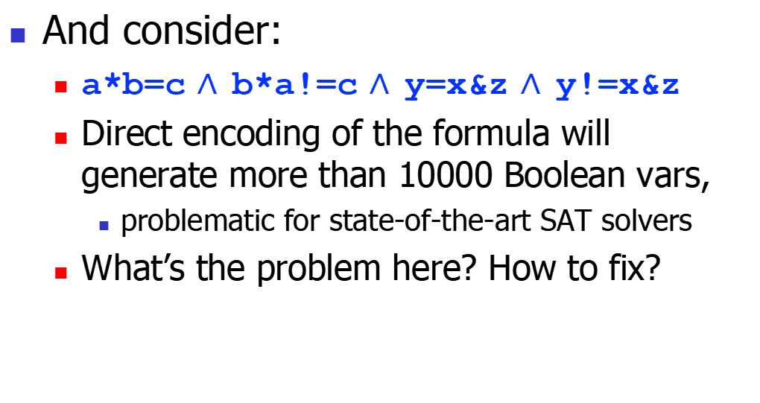
Motivation
And consider:
a*b=c $∧$b*a!=c $∧$y=x&z $∧$y!=x&z
Direct encoding of the formula will generate more than 10000 Boolean vars,
problematic for state-of-the-art SAT solvers
What’s the problem here? How to fix?

Slide 31
Incremental Algorithm
a*b=c $∧$b*a!=c $∧$y=x&z ∧ y!=x&z
Analyze the “easier” part
This is called an incremental algorithm. Essentially a lazy strategy.
solve
SAT
Analyze the “hard” part
UNSAT
finished

Slide 32
Bit-vectors applications

Slide 33
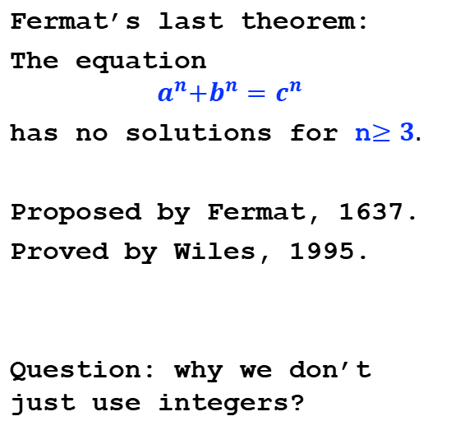
#1: Fermat‘s last theorem
solver = Solver()
a, b, c = BitVecs(‘a b c’, 64)
magic = 0xffffffffffff0000
solver.add(a&magic == 0)
solver.add(b&magic == 0)
solver.add(c&magic == 0)
# for simple case: n=3
solver.add(a*a*a + b*b*b
== c*c*c)
solver.check()
Fermat’s last theorem:
The equation
$$a^{n}{+b}^{n}=c^{n}$$
has no solutions for n$≥3.$
Proposed by Fermat, 1637.
Proved by Wiles, 1995.
Question: why we don’t just use integers?

Slide 34
Summary
Bit vectors offer a natural abstraction for fixed-width numbers in CS
not only integers, but also reals
Thus very convenient to reason about computer programs
to discuss more in future lectures

