Slide 1
Predicate logic
Formal Methods Foundation
Baojian Hua
bjhua@ustc.edu.cn

Slide 2
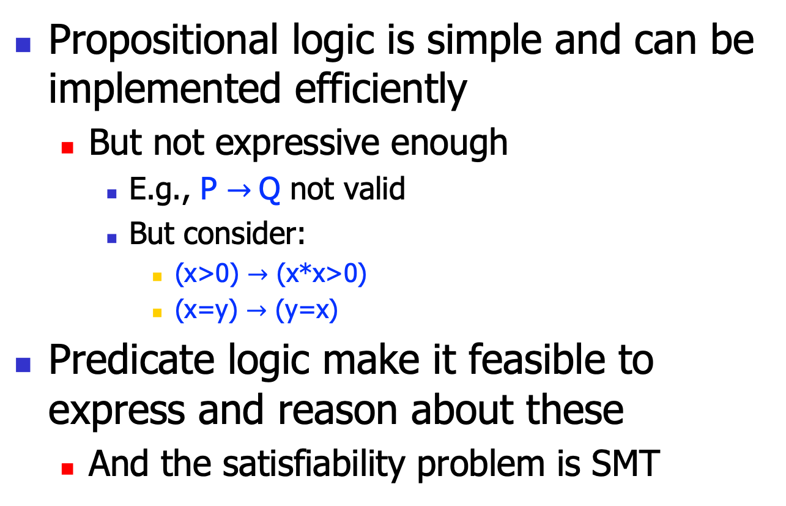
Motivation
Propositional logic is simple and can be implemented efficiently
But not expressive enough
E.g., P $→$Q not valid
But consider:
(x>0) $→$ (x*x>0)
(x=y) $→$ (y=x)
Predicate logic make it feasible to express and reason about these
And the satisfiability problem is SMT

Slide 3
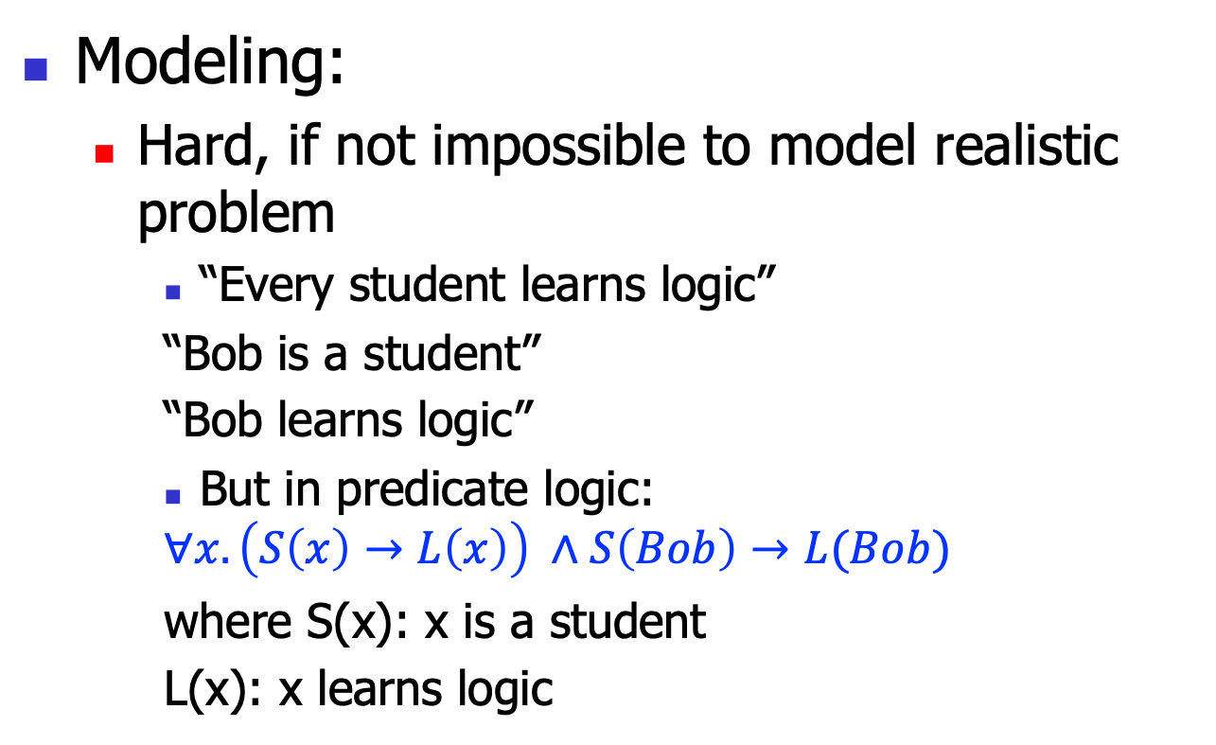
Motivation
Modeling:
Hard, if not impossible to model realistic problem
“Every student learns logic”
“Bob is a student”
“Bob learns logic”
But in predicate logic:
$$∀x.\left(S\left(x\right)→L\left(x\right)\right) ∧S\left(Bob\right)→L(Bob)$$
where S(x): x is a student
L(x): x learns logic

Slide 4
Predicate logic:
The syntax

Slide 5

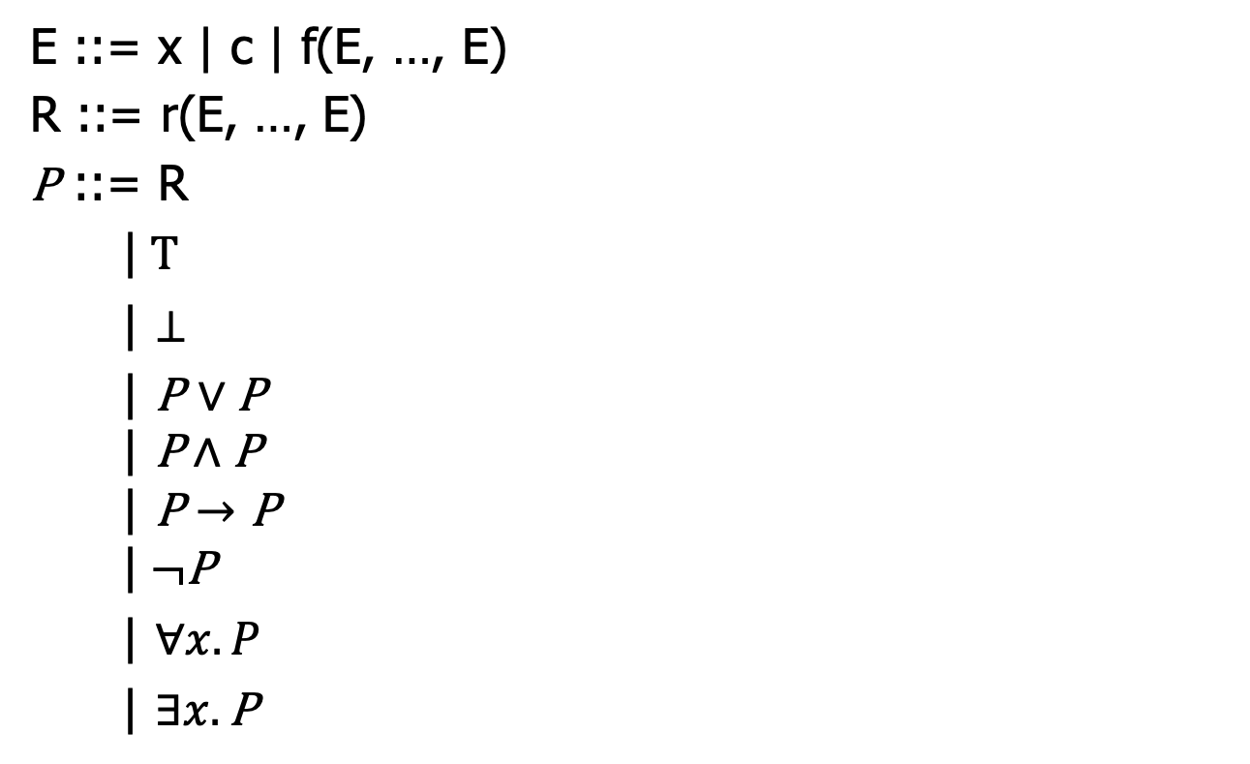

The syntax
x: a set of variables
c: a set of constants
E ::= x | c | f(E, …, E)
R ::= r(E, …, E)
P ::= R
|$T$
| $⊥$
| P $∨$ P
$$\text{|} \text{P}∧\text{P}$$
$$\text{|} \text{P}→\text{P}$$
$$\text{|} ¬\text{P}$$
| $∀x.P$
| $∃x.\text{P}$
f: a set of functions.
Thus, E stands for computations!
r: a set of relations
R is an atomic proposition, note that R has internal structures
$∀$: universal quantifiers
$∃$: existential quantifier

Slide 6
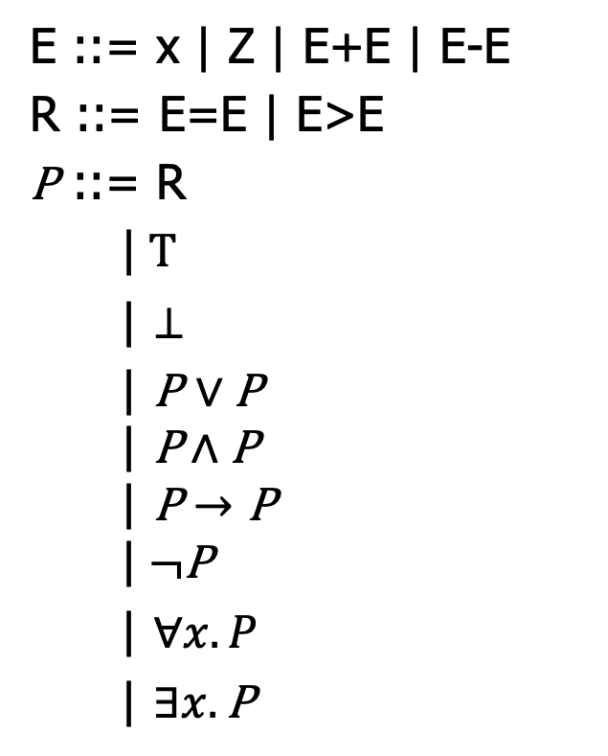
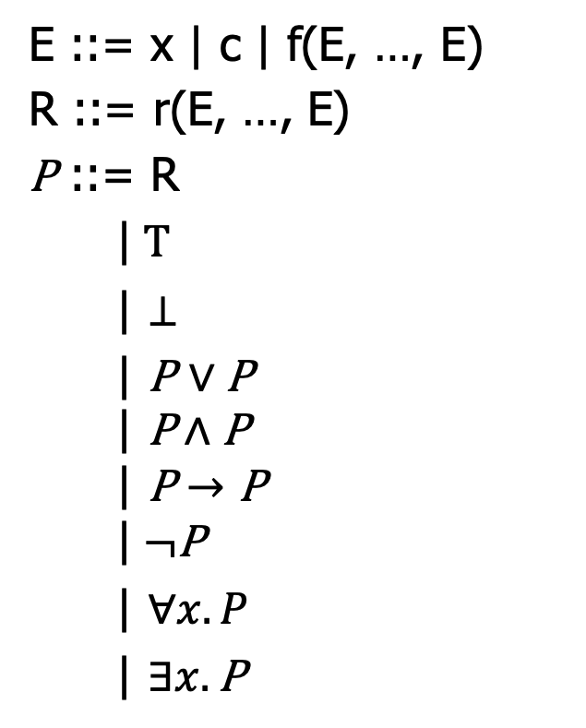
Intuitions: to encode Z
E ::= x | c | f(E, …, E)
R ::= r(E, …, E)
P ::= R
|$T$
| $⊥$
| P $∨$ P
$$\text{|} \text{P}∧\text{P}$$
$$\text{|} \text{P}→\text{P}$$
$$\text{|} ¬\text{P}$$
| $∀x.P$
| $∃x.\text{P}$
E ::= x | Z | E+E | E-E
R ::= E=E | E>E
P ::= R
|$T$
| $⊥$
| P $∨$ P
$$\text{|} \text{P}∧\text{P}$$
$$\text{|} \text{P}→\text{P}$$
$$\text{|} ¬\text{P}$$
| $∀x.P$
| $∃x.\text{P}$

Slide 7
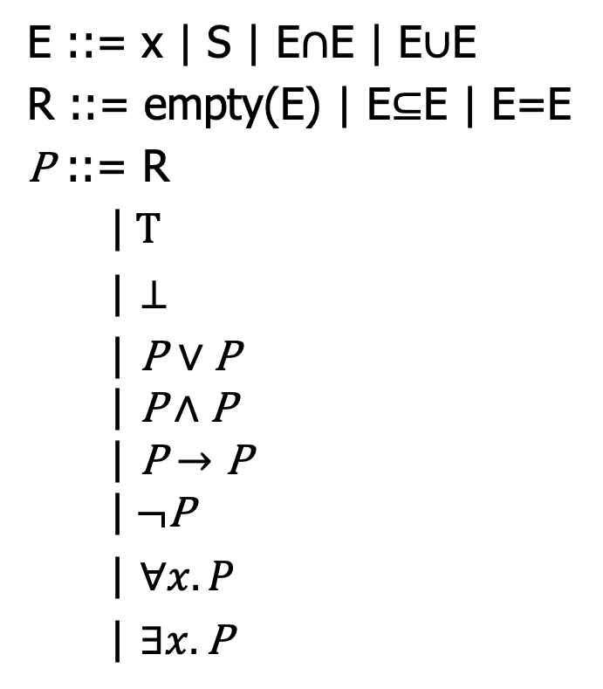
Intuitions: to encode set theory
E ::= x | c | f(E, …, E)
R ::= r(E, …, E)
P ::= R
|$T$
| $⊥$
| P $∨$ P
$$\text{|} \text{P}∧\text{P}$$
$$\text{|} \text{P}→\text{P}$$
$$\text{|} ¬\text{P}$$
| $∀x.P$
| $∃x.\text{P}$
E ::= x | S | E$∩$E | E$∪$E
R ::= empty(E) | E$⊆$E | E=E
P ::= R
|$T$
| $⊥$
| P $∨$ P
$$\text{|} \text{P}∧\text{P}$$
$$\text{|} \text{P}→\text{P}$$
$$\text{|} ¬\text{P}$$
| $∀x.P$
| $∃x.\text{P}$

Slide 8
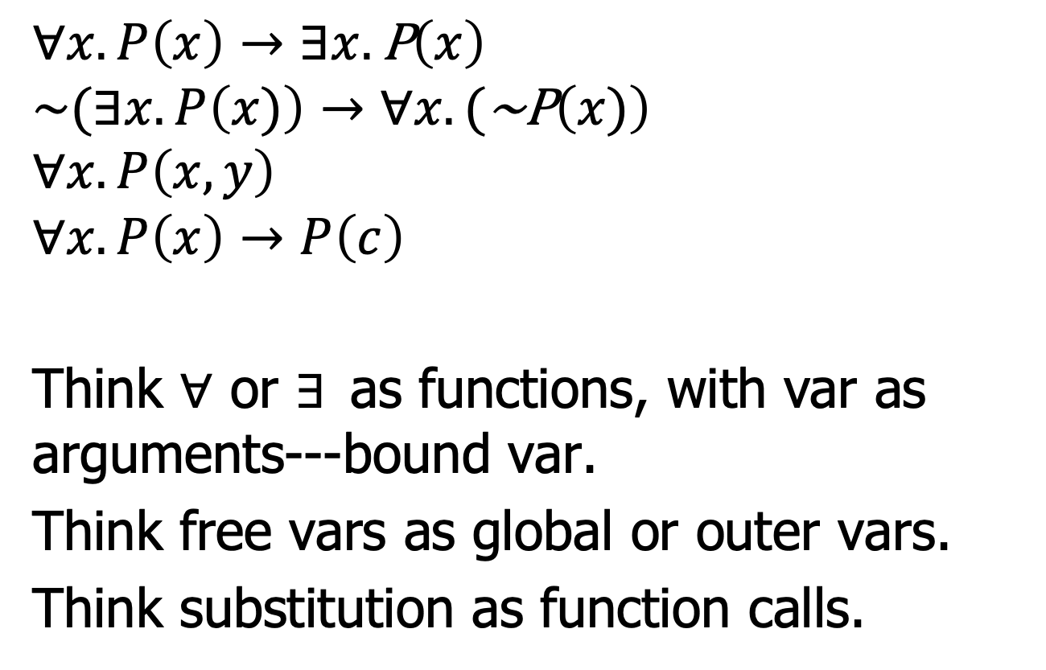
Bound and free variables
$$∀x.P\left(x\right)→∃x.\text{P}\left(x\right)$$
$$\sim (∃x.P\left(x)\right)→∀x.(\text{\sim }\text{P}\left(x)\right)$$
$$∀x.P\left(x, y\right)$$
$$∀x.P\left(x\right)→P\left(c\right)$$
Think $∀$ or $∃$as functions, with var as arguments---bound var.
Think free vars as global or outer vars.
Think substitution as function calls.

Slide 9
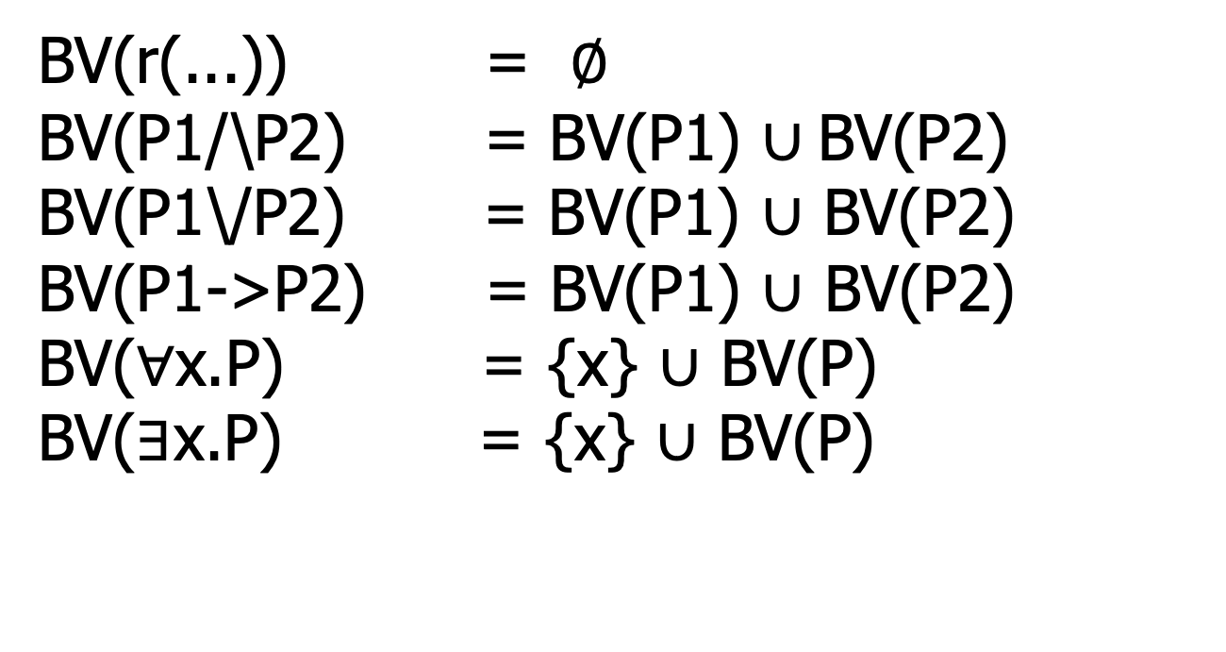
Bound variables: BV(P)
BV(r(...)) = $∅$ BV(P1/\P2) = BV(P1) $∪$BV(P2) BV(P1\/P2) = BV(P1) $∪$ BV(P2) BV(P1->P2) = BV(P1) $∪$ BV(P2) BV($∀$x.P) = {x} $∪$ BV(P) BV($∃$x.P) = {x} $∪$ BV(P)

Slide 10
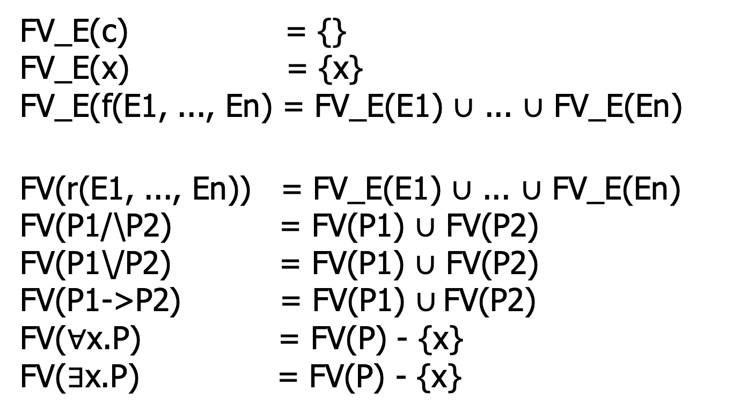
Free variables: FV(P)
FV_E(c) = {} FV_E(x) = {x} FV_E(f(E1, ..., En) = FV_E(E1) $∪$ ... $∪$ FV_E(En)
FV(r(E1, ..., En)) = FV_E(E1) $∪$ ... $∪$ FV_E(En) FV(P1/\P2) = FV(P1) $∪$ FV(P2) FV(P1\/P2) = FV(P1) $∪$ FV(P2) FV(P1->P2) = FV(P1) $∪$FV(P2) FV($∀$x.P) = FV(P) - {x} FV($∃$x.P) = FV(P) - {x}

Slide 11
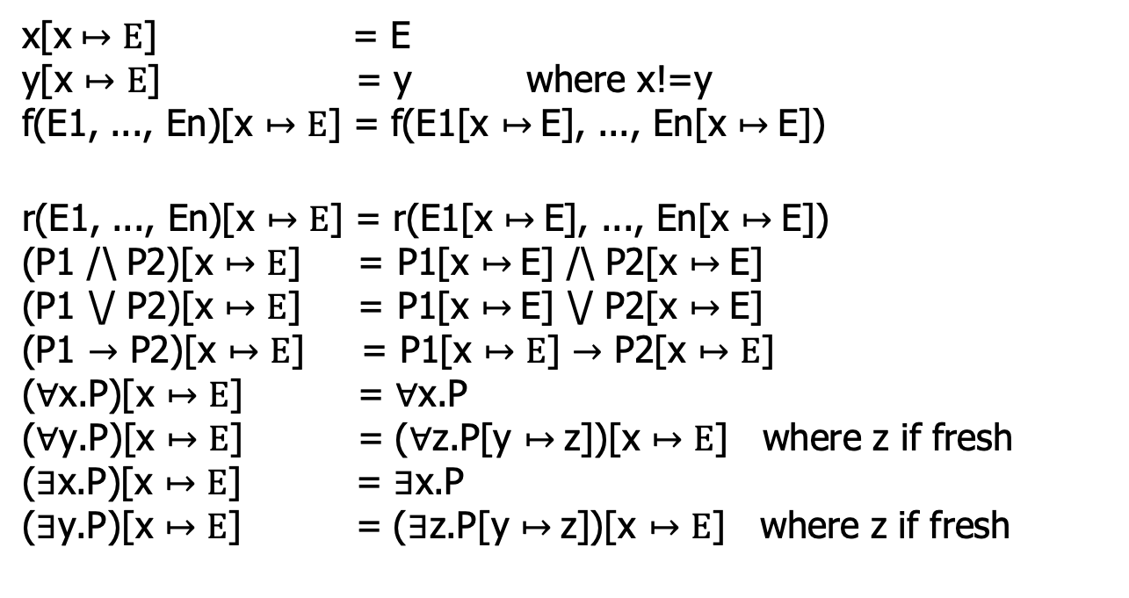

Substitution: P[x$↦$E]
x[x$↦E$] = E y[x $↦E$] = y where x!=y f(E1, ..., En)[x $↦E$] = f(E1[x $↦$E], ..., En[x $↦$E])
r(E1, ..., En)[x $↦E$] = r(E1[x $↦$E], ..., En[x $↦$E]) (P1 /\ P2)[x $↦E$] = P1[x $↦$E] /\ P2[x $↦$E] (P1 \/ P2)[x $↦E$] = P1[x $↦$E] \/ P2[x $↦$E] (P1 $→$ P2)[x $↦E$] = P1[x $↦E$] $→$ P2[x $↦E$] ($∀$x.P)[x $↦E$] = $∀$x.P ($∀$y.P)[x $↦E$] = ($∀$z.P[y $↦$z])[x $↦E$] where z if fresh ($∃$x.P)[x $↦E$] = $∃$x.P ($∃$y.P)[x $↦E$] = ($∃$z.P[y $↦$z])[x $↦E$] where z if fresh

Slide 12
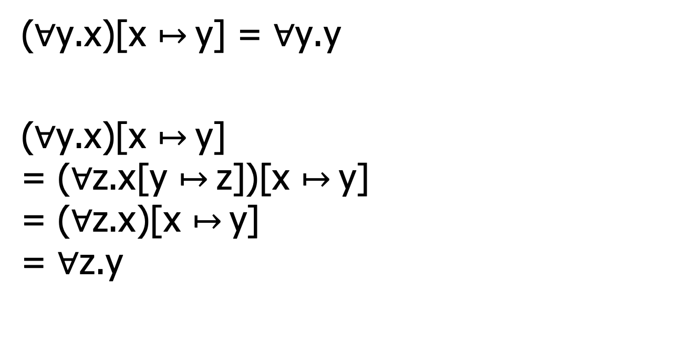

$α−$renaming
($∀$y.x)[x $↦$y] = $∀$y.y
($∀$y.x)[x $↦$y] = ($∀$z.x[y $↦$z])[x $↦$y] = ($∀$z.x)[x $↦$y] = $∀$z.y

Slide 13
Predicate logic:
the proof theory

Slide 14
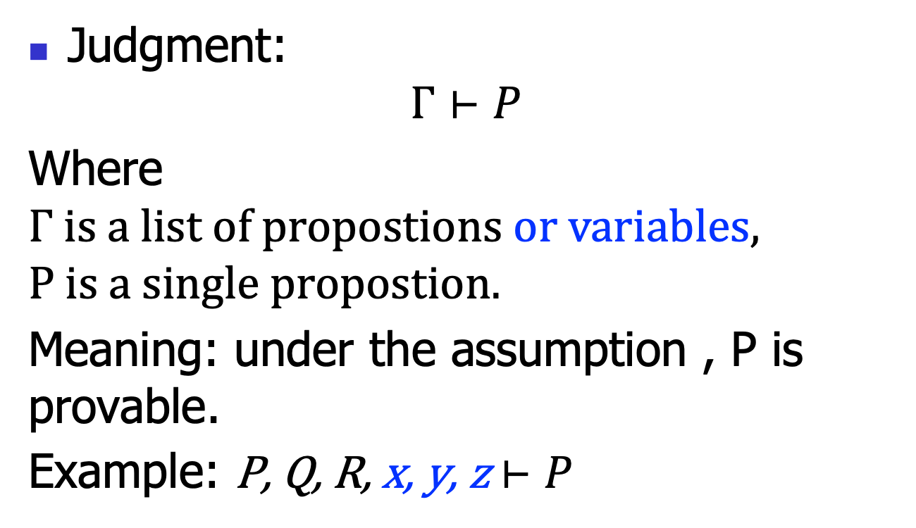
Natural deduction: judgments
Judgment:
$$Γ⊢P$$
Where $Γ is a list of propostions or variables,$
$$P is a single propostion.$$
Meaning: under the assumption , P is provable.
Example: P, Q, R, x, y, z $⊢P$

Slide 15





Natural deduction: Inference rules
Each rule takes this form:
$$Γ1⊢P1$$
$$…$$
$$Γn⊢Pn$$
$$(name)$$
$$Γ⊢P$$
The hypotheses (above the line)
The conclusion (below the line)
The rule name (right the line)
If n==0, then this rule is called an axiom;
Or else called a rule.

Slide 16





Natural deduction: Inference rules
Rule for props:
$$Γ, x⊢P$$
$$(∀I)$$
$$Γ⊢∀x.P$$
$$Γ⊢∀x.P$$
$$(∀E)$$
$$Γ⊢P[x↦E]$$

Slide 17







Natural deduction: Inference rules
Rule for props:
$$Γ⊢P[x↦E]$$
$$(∃I)$$
$$Γ⊢∃x.P$$
$$Γ⊢∃x.P$$
$$Γ,x, P⊢Q$$
$$(∃E)$$
$$Γ⊢Q$$

Slide 18




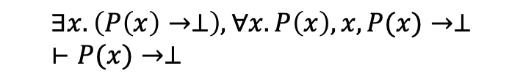






Example
Try to prove:$∃x.(P\left(x\right)→⊥)→(∀x.P\left(x\right)→⊥)$
$$∃x.\left(P\left(x\right)→⊥\right), ∀x.P\left(x\right)⊢∃x.(P(x)→⊥)$$
$$(Var)$$
$$∃x.\left(P\left(x\right)→⊥\right), ∀x.P\left(x\right), x,P(x)→⊥⊢P(x)→⊥$$
$$∃x.\left(P\left(x\right)→⊥\right), ∀x.P\left(x\right)⊢∀x.P(x)$$
$$(∃E)$$
$$(∀E)$$
$$∃x.\left(P\left(x\right)→⊥\right), ∀x.P\left(x\right)⊢P(x)→⊥$$
$$∃x.\left(P\left(x\right)→⊥\right), ∀x.P\left(x\right)⊢P(x)$$
$$(→E)$$
$$∃x.\left(P\left(x\right)→⊥\right), ∀x.P\left(x\right)⊢ ⊥$$
$$(→I)$$
$$∃x.(P\left(x\right)→⊥)⊢(∀x.P\left(x\right)→⊥)$$
$$(→I)$$
$$⊢∃x.(P\left(x\right)→⊥)→(∀x.P\left(x\right)→⊥)$$

Slide 19
Proof engineering
There has been great advancement in the automatic or semiautomatic proof assistant
Thus, we can conduct the above proof using such assistant
So CS also boosts math.
Let’s just study one example
You will do more in the 2nd assignment

Slide 20
Predicate logic:
Semantics

Slide 21
Semantics
The above proof system cares about when a proposition is provable
Axioms and proof rules
Roughly, semantics is more about computation
Models and computation rules
To obtain a result of “true” or “false”

Slide 22

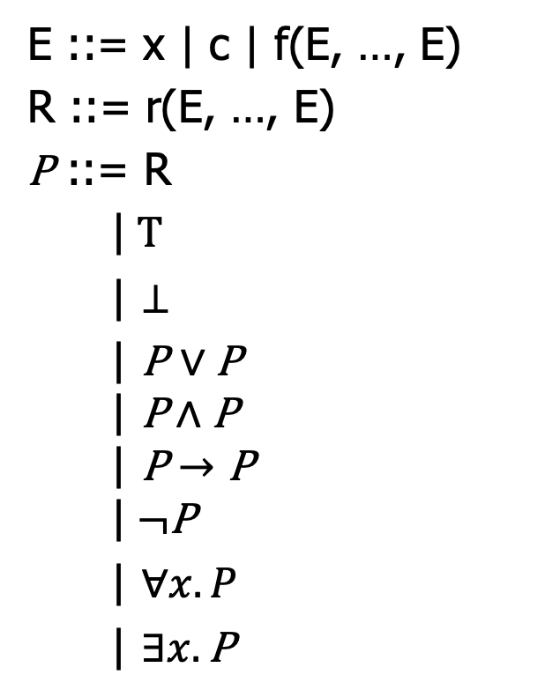

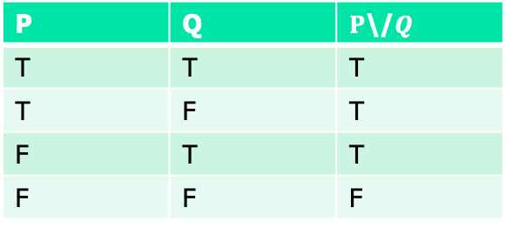
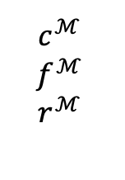
Motivation
C is often treated as a 0-arity function.
A
$$c^{ℳ }$$
$$f^{ℳ }$$
$$r^{ℳ }$$
E ::= x | c | f(E, …, E)
R ::= r(E, …, E)
P ::= R
|$T$
| $⊥$
| P $∨$ P
$$\text{|} \text{P}∧\text{P}$$
$$\text{|} \text{P}→\text{P}$$
$$\text{|} ¬\text{P}$$
| $∀x.P$
| $∃x.\text{P}$
V
$$⊨_{V}^{ℳ}\text{P}$$
$$ℳ$$
P | Q | $P$\/$Q$
T | T | T
T | F | T
F | T | T
F | F | F

Slide 23
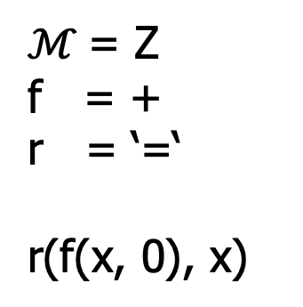

Motivation
A
$$c^{ℳ }$$
$$f^{ℳ }$$
$$r^{ℳ }$$
E ::= x | c | f(E, …, E)
R ::= r(E, …, E)
P ::= R
|$T$
| $⊥$
| P $∨$ P
$$\text{|} \text{P}∧\text{P}$$
$$\text{|} \text{P}→\text{P}$$
$$\text{|} ¬\text{P}$$
| $∀x.P$
| $∃x.\text{P}$
V
$$⊨_{V}^{ℳ}\text{P}$$
$$ℳ$$
$ℳ$= Z
f = +
r = ‘=‘
r(f(x, 0), x)
P | Q | $P$\/$Q$
T | T | T
T | F | T
F | T | T
F | F | F

Slide 24
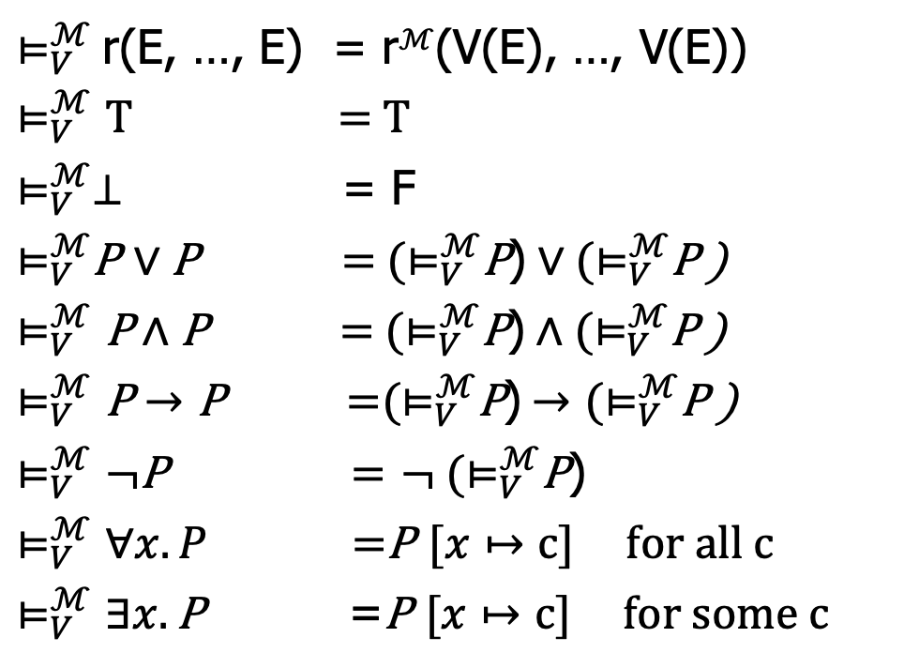
Model-based semantics
$⊨_{V}^{ℳ}$r(E, …, E) = r$ℳ$(V(E), …, V(E))
$⊨_{V}^{ℳ}T$ = T
$⊨_{V}^{ℳ}⊥$ = F
$⊨_{V}^{ℳ}$P $∨$ P = ${(⊨}_{V}^{ℳ}$P)$∨{(⊨}_{V}^{ℳ}$P )
$⊨_{V}^{ℳ}\text{P}∧\text{P}$ = ${(⊨}_{V}^{ℳ}$P)$∧{(⊨}_{V}^{ℳ}$P )
$⊨_{V}^{ℳ}\text{P}→\text{P}$ =${(⊨}_{V}^{ℳ}$P)$→{(⊨}_{V}^{ℳ}$P )
$⊨_{V}^{ℳ}¬\text{P}$ = $¬ {(⊨}_{V}^{ℳ}$P)
$⊨_{V}^{ℳ}∀x.P$ =P $[x↦c]$ for all c
$⊨_{V}^{ℳ}∃x.\text{P}$ =P $[x↦c]$ for some c

Slide 25
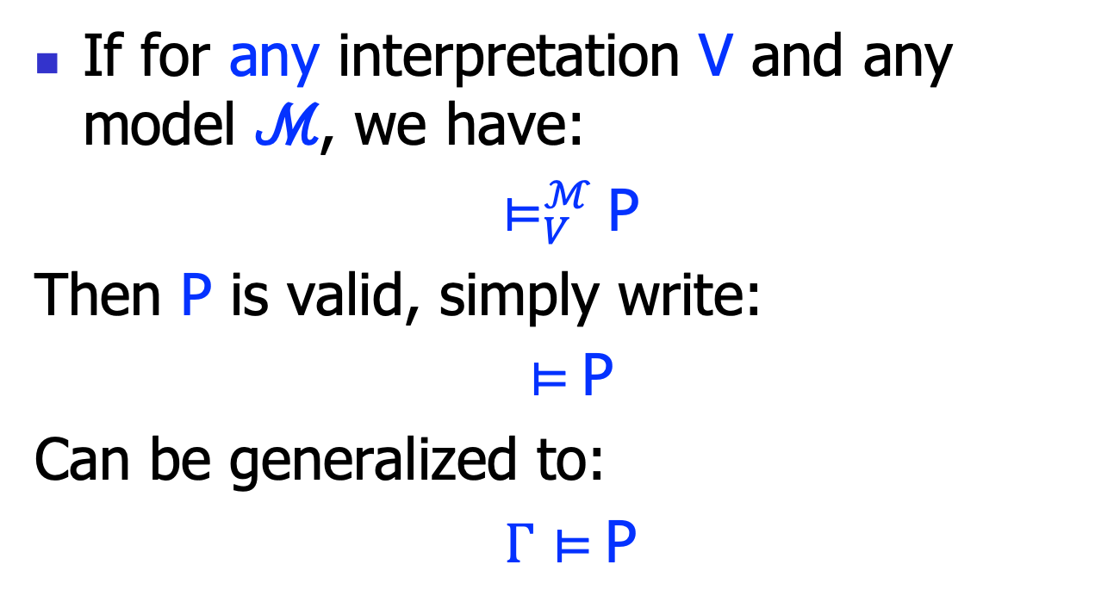
Validity
If for any interpretation V and any model ℳ, we have:
$⊨_{V}^{ℳ}$P
Then P is valid, simply write:
$⊨$P
Can be generalized to:
$Γ⊨$P

Slide 26
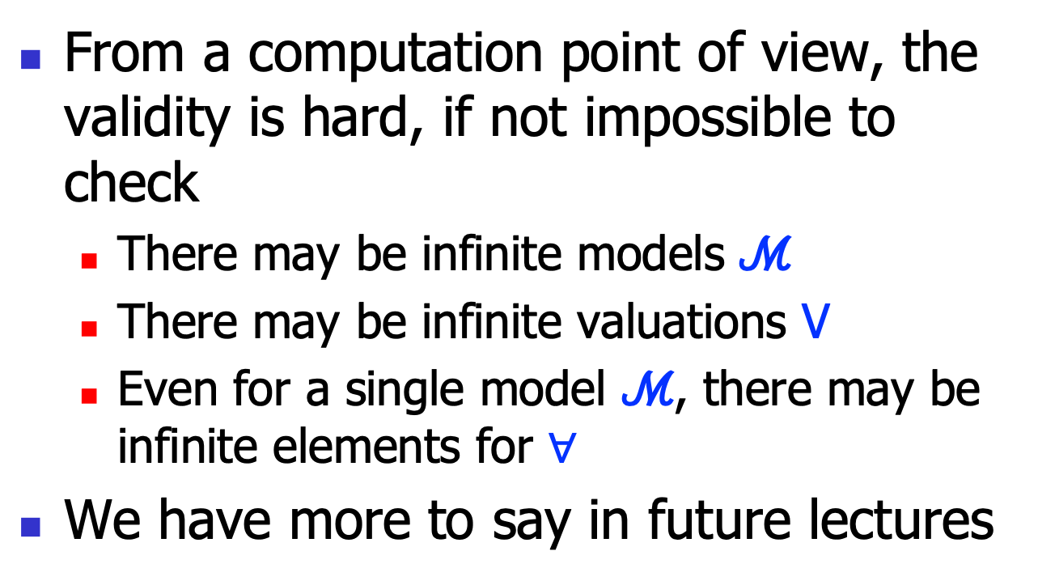
Remarks
From a computation point of view, the validity is hard, if not impossible to check
There may be infinite models ℳ
There may be infinite valuations V
Even for a single model ℳ, there may be infinite elements for $∀$
We have more to say in future lectures

Slide 27
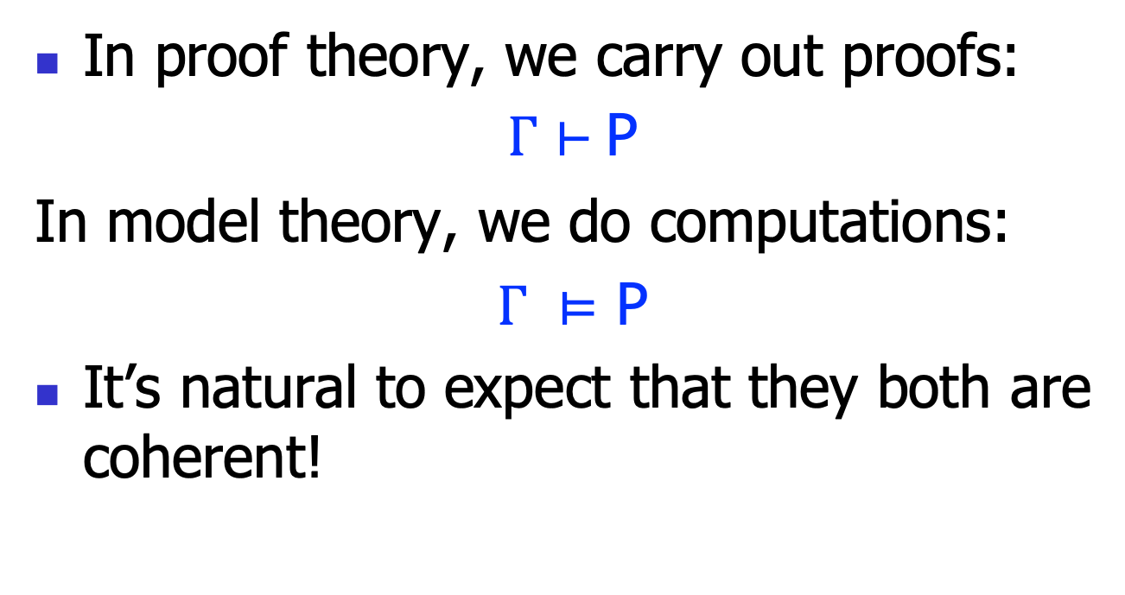
Two notions of validity
In proof theory, we carry out proofs:
$Γ⊢$ P
In model theory, we do computations:
$Γ ⊨$ P
It’s natural to expect that they both are coherent!

Slide 28

Soundness and completeness
Soundness:
$Γ⊢$ P => $Γ ⊨$ P
Completeness:
$Γ ⊨ \text{P}=>Γ⊢$ P

Slide 29
Encoding Predicate logic in Z3

Slide 30
Key steps
#1: create target domains
using “sort”
e.g., to represent “person”:
person_sort = DeclareSort(“person_sort”)
#2: declare new variables and functions
note that Z3 treats predicates as bool-valued functions
e.g., “a person zhangsan”:
zhangsan = Const(“zhangsan”, person_sort)
is_student = Function(”is_student”, person_sort, boolsort())
learn_logic = Function(”learn_logic, person_sort, boolsort())

Slide 31
Key steps, cont’
#3: build the propositions
e.g., “every student should learn logic”:
ForAll([Const(‘x’, person_sort)],
Implies(is_student(Const(‘x’, person_sort)), learn_logic(Const(‘x’, person_sort)))
read the code in the handout

