Slide 1
Satisfiability
Formal Methods Foundation
Baojian Hua
bjhua@ustc.edu.cn

Slide 2
Satisfiability (SAT)
Satisfiability is a key problem in math
To answer whether or not a proposition can evaluate to true, under some model
One of the fundamental problems in CS
Many theoretical studies
The 1st NPC (Cook-Levin, 1971)
Many algorithmic improvements
to make it practical enough
Many applications
We’ll discuss some in future lectures

Slide 3
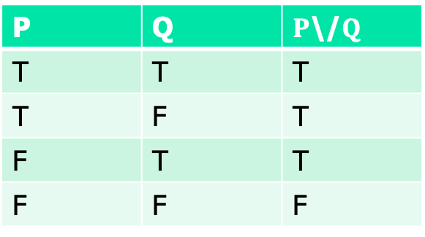
Motivation
Recall the truth table:
SAT: for a given proposition P, is there a model that makes P true?
Also called a boolean satisfiability problem
P | Q | $P$\/$Q$
T | T | T
T | F | T
F | T | T
F | F | F

Slide 4
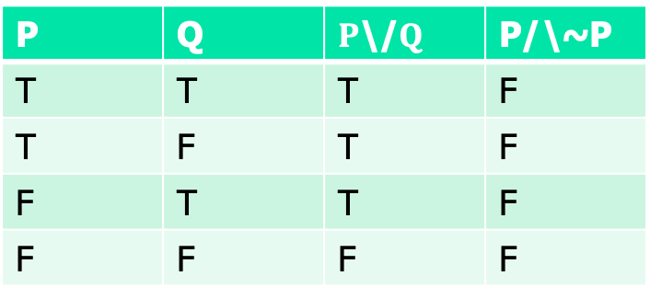
Motivation
Recall the truth table:
SAT: for a given proposition P, is there a model that makes P true?
P | Q | $P$\/$Q$ | P/\~P
T | T | T | F
T | F | T | F
F | T | T | F
F | F | F | F

Slide 5
SAT vs. valid
So, sat is weaker than valid
Valid: in all model, P is true
Sat: in one model, P is true
But there is an important relationship:
Valid(P) <==> unsat(~P)
So, in order to prove P, we can show unsatisfiability of ~P

Slide 6
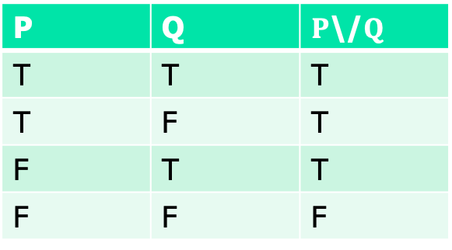
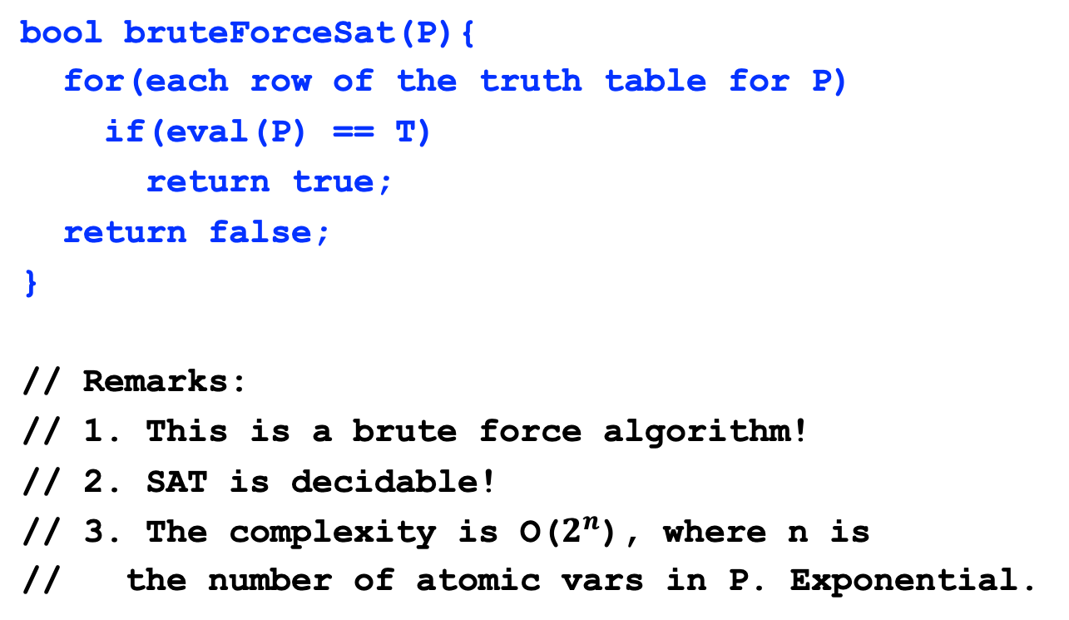
SAT algorithm
P | Q | $P$\/$Q$
T | T | T
T | F | T
F | T | T
F | F | F
bool bruteForceSat(P){
for(each row of the truth table for P)
if(eval(P) == T)
return true;
return false;
}
// Remarks:
// 1. This is a brute force algorithm!
// 2. SAT is decidable!
// 3. The complexity is O($2^{n}$), where n is
// the number of atomic vars in P. Exponential.

Slide 7
SAT is NP-Complete
Can we do better than the above exponential algorithm?
Short answer: “unknown”
P=NP?
SAT is the 1st NPC (Cook-Levin, 1971)
But there are many algorithmic breakthroughs in recent years
Make many practical SAT problems solvable

Slide 8
Progress

Slide 9
Practical algorithms for SAT

Slide 10
Roadmap
We’ll study a very popular algorithm: DPLL
The roadmap:
Normal form:
Key insights: don’t handle arbitrary propositions, but only normalized ones
the simpler, the easier
Negation normal (NNF), conjunctive normal form (CNF)
Resolution
Key insight: simplify propositions during eval

Slide 11

Negation normal form
Right is the CFG for NNF:
Negation only appears before atomic vars
No implication ->
NNF example:
p1 /\ ~p2 \/ p3 \/ ~p4
Non NNF:
p1 /\ ~(p2 \/ p3) \/ ~p4
P ::= $\text{p}$
| $¬\text{p}$
|$T$
| $⊥$
| P $∨$ P
$$\text{|} \text{P}∧\text{P}$$

Slide 12
Implication elimination
Rules for eliminating implication:
C(p) = p
C(~p) = ~p
C(P/\Q) = C(P) /\ C(Q)
C(P\/Q) = C(P) \/ C(Q)
C(P->Q) = ~C(P) \/ C(Q)

Slide 13
Implication elimination example
C(p -> (q -> p))
= ~C(p) \/ C(q -> p)
= ~p \/ (~C(q) \/ C(p))
= ~p \/ (~q \/ p)
And the final result can be further turned into:
= ~p \/ p \/ ~q
= T

Slide 14
Conversion into NNF
Rules for conversion into NNF:
C(p) = p
C(~p) = ~p
C(~~P) = C(P)
C(P/\Q) = C(P) /\ C(Q)
C(P\/Q) = C(P) \/ C(Q)
C(~(P/\Q)) = C(~P) \/ C(~Q)
C(~(P\/Q)) = C(~P) /\ C(~Q)

Slide 15
NNF conversion example
C(~((p1 /\ ~p2) \/ (p3 \/ ~p4)))
= C(~(p1 /\ ~p2)) /\ C(~(p3 \/ ~p4))
= (C(~p1) \/ C(~(~p2))) /\ (C(~p3) \/ C(~(~p4)))
= (~p1 \/ p2) \/ (~p3 \/ p4)
So intuitively, NNF basically pushes the “~” connective deeper into a given proposition.

Slide 16
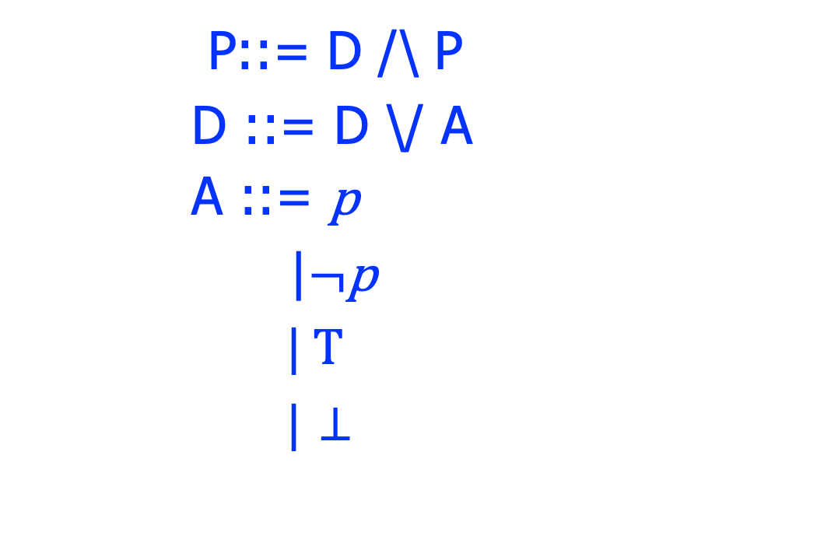
Conjunctive normal form(CNF)
The CFG for CNF right
A proposition P is a conjunction of disjunctive clause D
D is a disjunction of atoms
CNF Example:
(p1 \/ ~p2) /\ (p3 \/ ~p4)
Non CNF:
p1 /\ (~p2 \/ p3) \/ ~p4
P::= D /\ P
D ::= D \/ A
A ::= $\text{p}$
|$¬\text{p}$
| T
| $⊥$

Slide 17
Conversion into CNF
Rules for converting into CNF:
C(p) = p
C(~p) = ~p
C(P/\Q) = C(P) /\ C(Q)
C(P\/Q) = D(C(P), C(Q))
D(P=P1/\P2, Q) = D(P1, Q) /\ D(P2, Q)
D(P, Q=Q1/\Q2) = D(P, Q1) /\ D(P, Q2)
D(P, Q) = P \/ Q

Slide 18
CNF example
C((~p1 /\ p2) \/ (~p2 /\ p4))
= D(C(~p1 /\ p2), C(~p2 /\ p4))
= D(~p1 /\ p2, ~p2 /\ p4)
= D(~p1, ~p2 /\ p4) /\ D(p2, ~p2 /\ p4)
= (D(~p1, ~p2) /\ D(~p1, p4)) /\ …
= ((~p1\/~p2) /\ (~p1\/p4)) /\ …
Remarks:
Think both C( ) and D( ) as compilers;
The D( ) function basically pushes the \/ connective deeper into a given proposition P.

Slide 19
DIMACS standard
For CNF, each prop is denoted by a positive integer, it’s negation is the corresponding negative number, each clause is ended by 0
Example:
(~p1\/~p2) /\ (~p1\/p4)
-1 -2 0 -1 4 0

Slide 20
DPLL algorithm
An initial but still very popular algorithm
Davis-Putnam (DP) algorithm, 1960
Davis, Logemann, and Loveland, 1962
Based on the truth table method, but with key improvements:
Splitting rule
Unit propagation (1-clause) rule

Slide 21
DPLL motivation
To check the satisfiability of:
(~p1\/~p2) /\ (p2\/p4)
1. Splitting:
(~p1\/~p2) /\ (p2\/p4)
p1 = T
p1 = F
(~T\/~p2) /\ (p2\/p4)
(~F\/~p2) /\ (p2\/p4)

Slide 22
DPLL motivation
To check the satisfiability of:
(~p1\/~p2) /\ (p2\/p4)
1. Splitting:
(~p1\/~p2) /\ (p2\/p4)
p1 = T
p1 = F
~p2 /\ (p2\/p4)
p2\/p4
p2 should only be F, in order to make the whole prop. SAT

Slide 23
DPLL motivation
To check the satisfiability of:
(~p1\/~p2) /\ (p2\/p4)
1. Splitting:
(~p1\/~p2) /\ (p2\/p4)
p2 = F
p1 = T
p1 = F
~F /\ (p2\/p4)
p2\/p4
And propagate the the value of p2 into other clause

Slide 24
DPLL motivation
To check the satisfiability of:
(~p1\/~p2) /\ (p2\/p4)
1. Splitting:
(~p1\/~p2) /\ (p2\/p4)
p2 = F
p1 = T
p1 = F
~F /\ (F \/p4)
p2\/p4
And propagate the the value of p2 into other clause

Slide 25
DPLL motivation
To check the satisfiability of:
(~p1\/~p2) /\ (p2\/p4)
1. Splitting:
(~p1\/~p2) /\ (p2\/p4)
p2 = F
p1 = T
p1 = F
p4
p2\/p4
Local simplification

Slide 26
DPLL motivation
To check the satisfiability of:
(~p1\/~p2) /\ (p2\/p4)
1. Splitting:
(~p1\/~p2) /\ (p2\/p4)
p4 = T
p2 = F
p1 = T
p1 = F
p4
p2\/p4
Trivial assignment to p4

Slide 27
DPLL motivation
To check the satisfiability of:
(~p1\/~p2) /\ (p2\/p4)
1. Splitting:
(~p1\/~p2) /\ (p2\/p4)
p4 = T
p2 = F
p1 = T
p1 = F
T
p2\/p4
The model:
[p1=T, p2=F, p4=T]
We only need just 1 try, instead of $2^{3}=8 !$

Slide 28
DPLL algorithm
dpll(P){
if(P==T)
return sat;
if(P==F)
return unsat;
unitProp(P); // unit prop and simplify P
x = select_atomic(P); // choose an atomic prop
if(dpll(P[x|->T])) // splitting
return sat;
return dpll(P[x|->F]);
}

Slide 29
State-of-the-art
New algorithms:
E.g., CDCL
Many improvements and engineering effort
Careful encoding of the propositions
Backtracking…
As a result, modern SAT solvers are practical enough

Slide 30
Modeling and reasoning with SAT

Slide 31
The general scheme
The hard part!
Solution found!
Problem modeling/
constraints
SAT solver/
Theorem prover
SAT
UNSAT
No solutions
Memout/
timeout
UNKNOWN

Slide 32
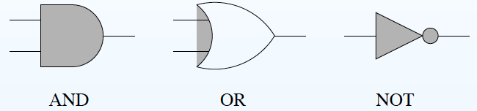
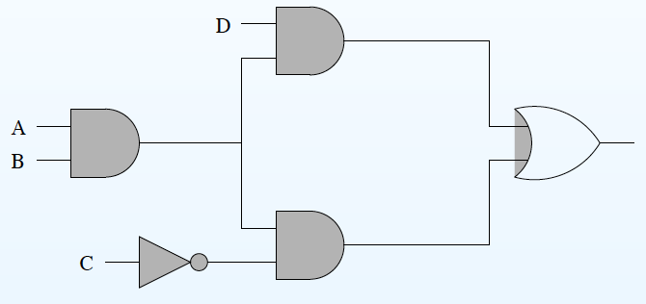
Example 1: circuit layout
SAT for the following prop:
((A /\ B) /\ D) \/ ((A /\ B) /\ ~C)
Output “True”?

Slide 33

Example 2: seat arrangement
Modeling the problem:
Ai: Alice takes seat Ai
Bi: Bob takes seat Bi
Ci: Bob take the seat Ci
Where 1<=i<=3.
Modeling the constraint:
Alice must take just one seat:
(A1/\~A2/\~A3) \/ (~A1/\A2/\~A3) \/ (~A1/\~A2/\A3)
2. Bob (Carol) takes just one seat:
…
3. The 1st seat just taken by 1 person:
(A1/\~B1/\~C1) \/ (~A1/\B1/\~C1) \/ (~A1/\~B1/\C1)
4. Alice cannot sit near to Carol:
(A1->~B2)/\(A2->~B1)/\(A2->~B3)/\(A3->~B2)
3 people Alice, Bob, Carol, take 3 seats.
Constraints:
Alice cannot sit near to Carol;
Bob cannot sit right to Alice.
Question:
Is there any solution?
How many solutions in total?

Slide 34
Example 3: subset sum
Modeling the problem:
x_i: a proposition indicating whether the i^{th} element in S is selected.
E.g.,
x_0 x_1 x_2 x_3
{2, 3, 8, -5}
Then we have:
(x_i → S[i]) \/ (¬x_i → 0)
Or abbreviated as an if expression:
If(x_i, S[i], 0)
The following encodes ∑ T = 0:
If(x_0, S[0], 0) +…+ If(x_n, S[n], 0) == 0
And the subset is nonempty T ≠∅:
Or(x_0, …, x_n)
Given an integer set S, is there a subset T⊆S and T ≠∅, such that
∑ T = 0.
Example: {2, 3, 8, -5}
the subset: {2, 3, -5}.

Slide 35
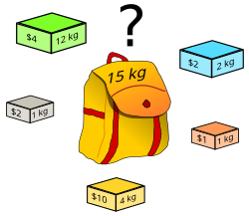
Example 4: knapsack
We model the existence part (i.e., without the target function) of knapsack with SAT:
x_i: whether to select the i^{th} item.
We have the constraint:
∑(If(x_i), W[i], 0) <= C
Problem: given n items with weight W[] and value V[]:
For a knapsack of maximal weight C, how to select some items to maximize ∑ V[].
 | t1 | … | tn
V | v1 | … | vn
W | w1 | … | wn

Slide 36

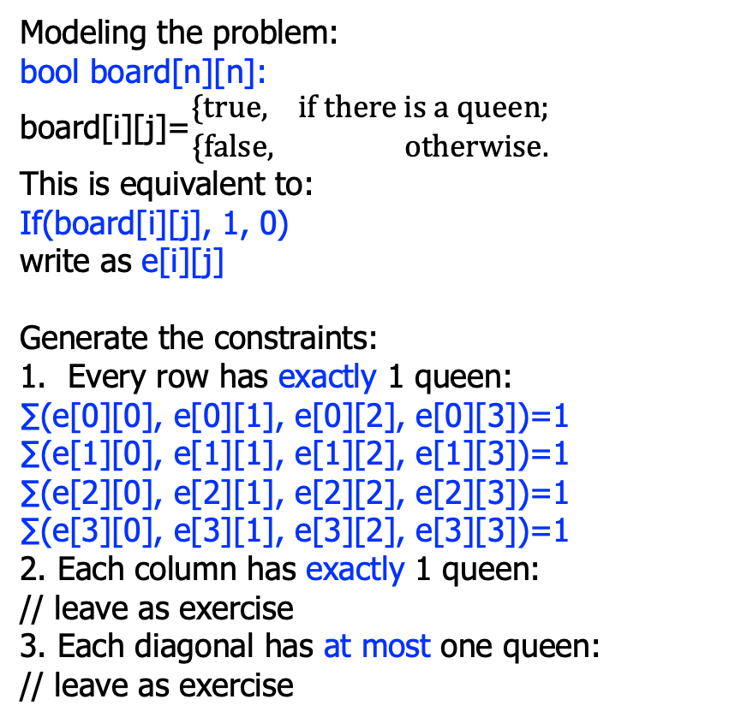
Example 5: n-queens puzzle
Modeling the problem:
bool board[n][n]:
board[i][j]=$\begin{matrix}\{true, if there is a queen; \\ \{false, otherwise.\end{matrix}$
This is equivalent to:
If(board[i][j], 1, 0)
write as e[i][j]
Generate the constraints:
Every row has exactly 1 queen:
∑(e[0][0], e[0][1], e[0][2], e[0][3])=1
∑(e[1][0], e[1][1], e[1][2], e[1][3])=1
∑(e[2][0], e[2][1], e[2][2], e[2][3])=1
∑(e[3][0], e[3][1], e[3][2], e[3][3])=1
2. Each column has exactly 1 queen:
// leave as exercise
3. Each diagonal has at most one queen:
// leave as exercise
Is it possible to put n queens on a n*n board, so that no queens can attack each other?
Not on the same row;
Not on the same column;
Not on the same diagonal.
E.g., the above is a solution to the 4-queens puzzle.

Slide 37
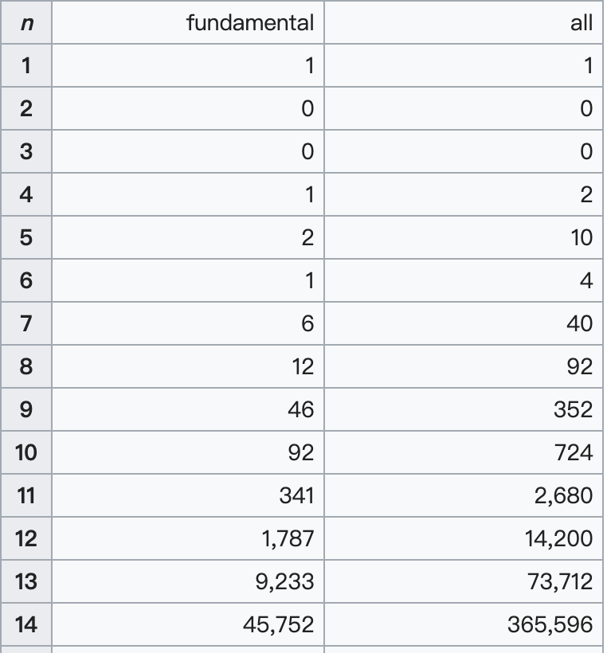
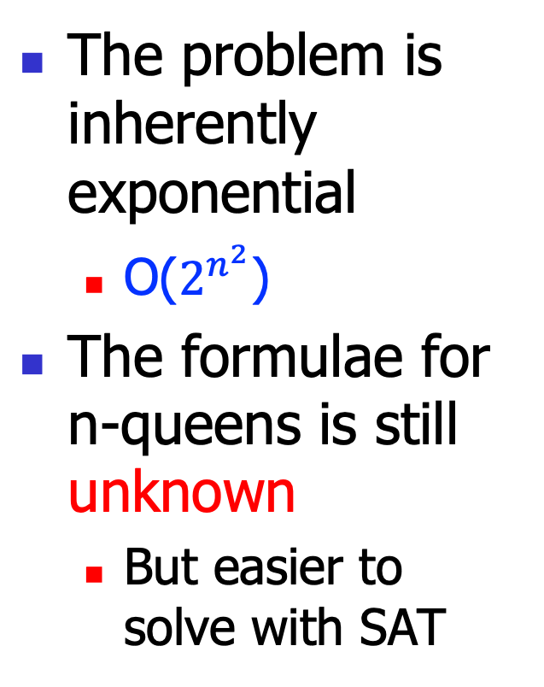
Example 5: n-queens puzzle
The problem is inherently exponential
O($2^{n^{2}}$)
The formulae for n-queens is still unknown
But easier to solve with SAT

Slide 38
Summary
SAT-based problem solving has a natural deductive flavor
Thus make the problem easier to express
You can compare with more traditional recursion-based or loop-based method
But encoding problems into SAT may be tedious and error-prone
We’ll discuss more advanced techniques, in future lectures

