Slide 1
Constructive logic
Formal Methods Foundation
Baojian Hua
bjhua@ustc.edu.cn

Slide 2
Constructive logic
Developed by Heyting, Brouwer, etc..
1930’
A logic for constructive reasoning
Also called intuitive logic
Has a natural computation content:
Thus the widely used in CS
E.g., the Curry-Howard correspondence to type theory

Slide 3
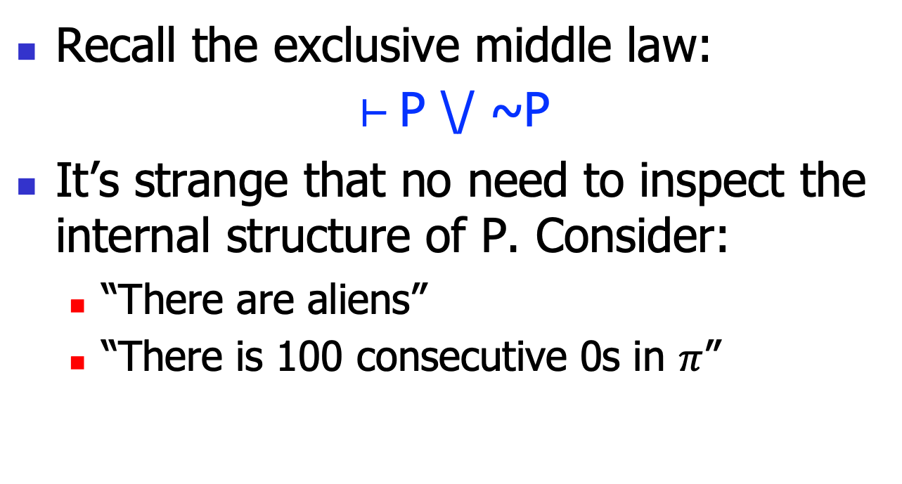
Motivation
Recall the exclusive middle law:
$⊢$ P \/ ~P
It’s strange that no need to inspect the internal structure of P. Consider:
“There are aliens”
“There is 100 consecutive 0s in $π$”

Slide 4
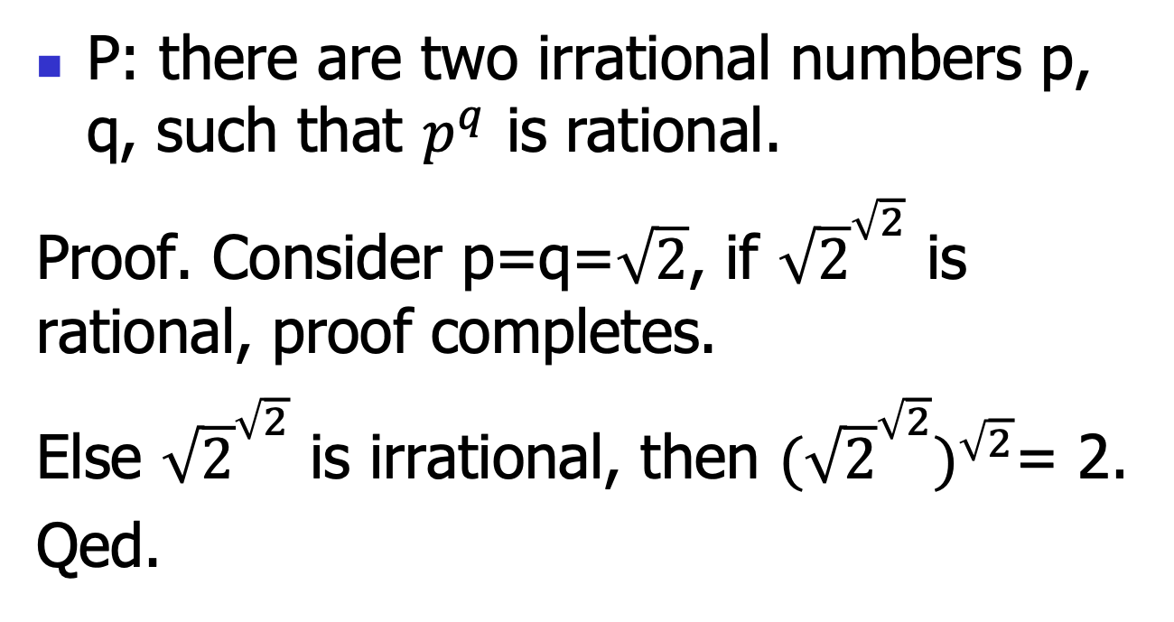
Motivation
P: there are two irrational numbers p, q, such that $p^{q}$ is rational.
Proof. Consider p=q=$\sqrt{2}$, if ${\sqrt{2}}^{\sqrt{2}}$ is rational, proof completes.
Else ${\sqrt{2}}^{\sqrt{2}}$ is irrational, then ${{(\sqrt{2}}^{\sqrt{2}})}^{\sqrt{2}}$= 2.
Qed.

Slide 5
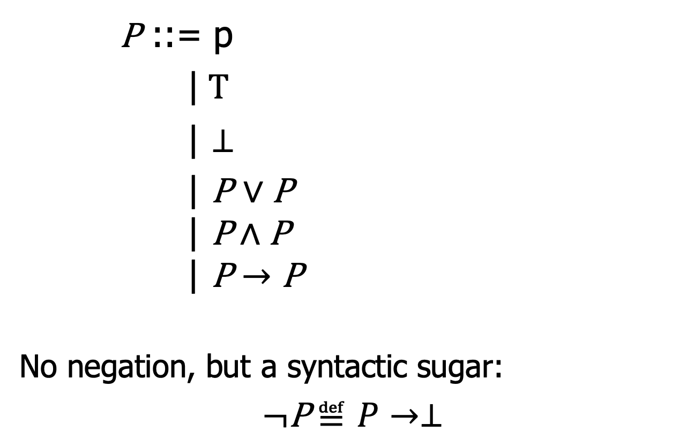
The syntax
P ::= p
|$T$
| $⊥$
| P $∨$ P
$$\text{|} \text{P}∧\text{P}$$
$$\text{|} \text{P}→\text{P}$$
No negation, but a syntactic sugar:
$¬\text{P}$ $≝P→⊥$

Slide 6
Constructive logic:
Proof theory

Slide 7
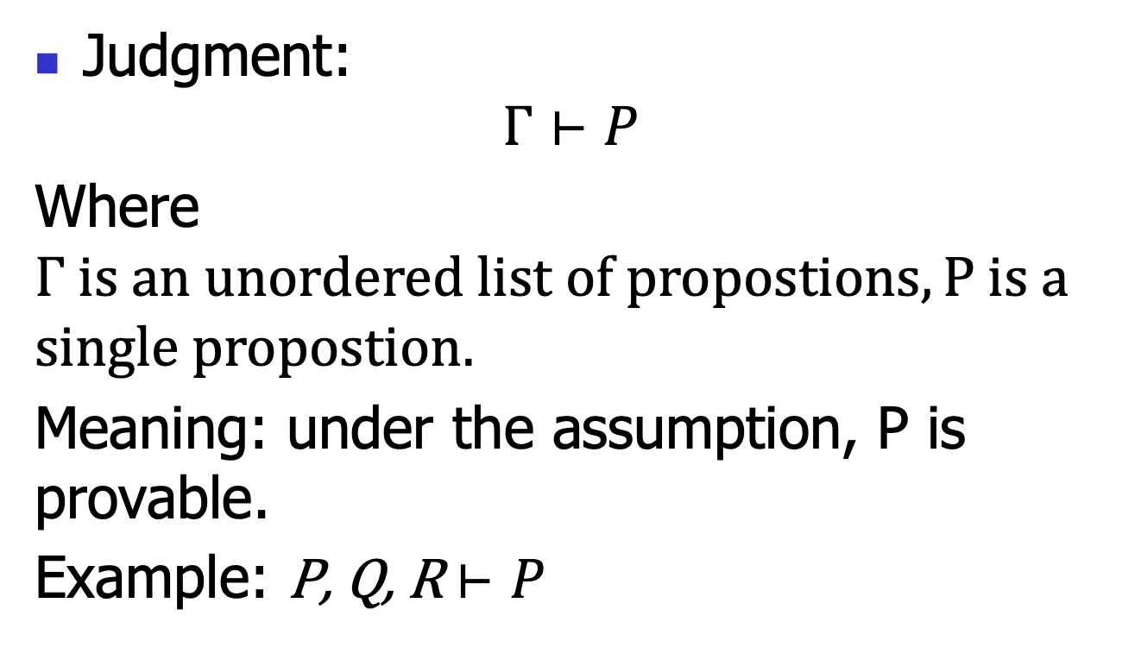
Natural deduction: judgments
Judgment:
$$Γ⊢P$$
Where $Γ is an unordered list of propostions, P is a$
$$single propostion.$$
Meaning: under the assumption, P is provable.
Example: P, Q, R $⊢P$

Slide 8





Natural deduction: Inference rules
Each rule takes this form:
$$Γ1⊢P1$$
$$…$$
$$Γn⊢Pn$$
$$(name)$$
$$Γ⊢P$$
The hypotheses (above the line)
The conclusion (below the line)
The rule name (right the line)
If n==0, then this rule is called an axiom;
Or else called a rule.

Slide 9


Natural deduction: Inference rules
Rule for props:
$$(Var)$$
$$Γ, P⊢P$$
Note this is an axiom.
Informally: under the assumption P, P is provable.

Slide 10


Natural deduction: Inference rules
Rule for T:
$$(TI)$$
$$Γ⊢ T$$
Note this is an axiom.
Informally: T is provable unconditionally.

Slide 11


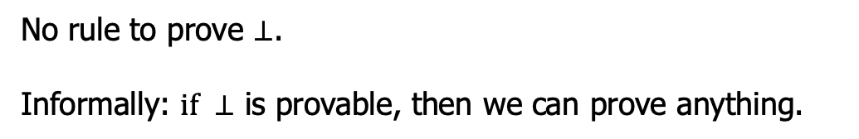

Natural deduction: Inference rules
Rule for $⊥$:
$Γ⊢$ $⊥$
$$(⊥E)$$
$$Γ⊢P$$
No rule to prove $⊥$.
Informally: $if ⊥$ is provable, then we can prove anything.

Slide 12




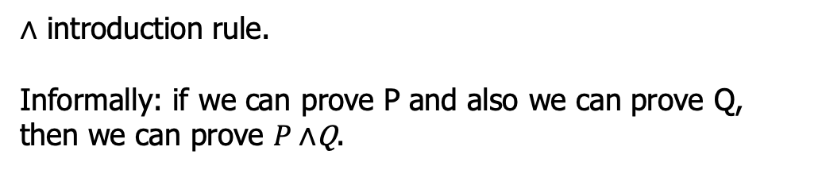

Natural deduction: Inference rules
Rule for $∧$:
$Γ⊢$ $P$
$Γ⊢$ $Q$
$$(∧I)$$
$Γ⊢P∧$Q
$∧$ introduction rule.
Informally: if we can prove P and also we can prove Q, then we can prove $P∧$Q.

Slide 13




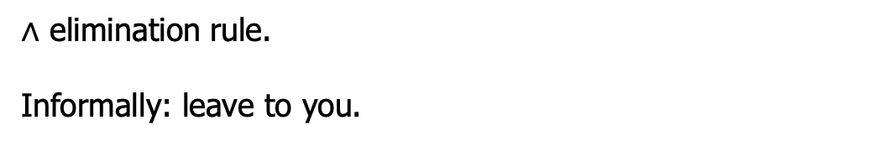


Natural deduction: Inference rules
Rule for $∧$:
$Γ⊢$ $P∧\text{Q}$
$Γ⊢$ $P∧\text{Q}$
$$(∧E1)$$
$$(∧E2)$$
$$Γ⊢P$$
$$Γ⊢Q$$
$∧$ elimination rule.
Informally: leave to you.

Slide 14





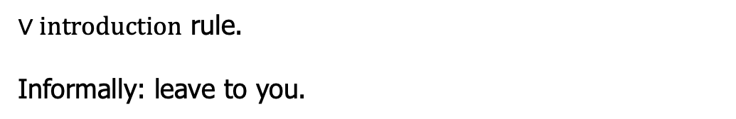


Natural deduction: Inference rules
Rule for $∨$:
$Γ⊢$ $P$
$Γ⊢$ $\text{Q}$
$$(∨I1)$$
$$(∨I2)$$
$Γ⊢P$ $∨ \text{Q}$
$$Γ⊢P ∨ \text{Q}$$
$∨introduction$ rule.
Informally: leave to you.

Slide 15





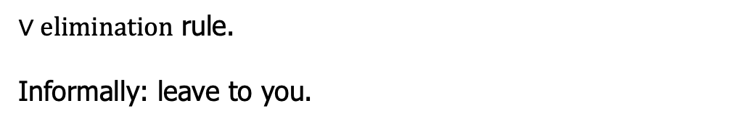
Natural deduction: Inference rules
Rule for $∨$:
$Γ⊢$ $P∨ \text{Q}$
$Γ, P⊢$ $R$
$Γ, Q⊢$ $R$
$$(∨E)$$
$$Γ⊢R$$
$∨elimination$ rule.
Informally: leave to you.

Slide 16







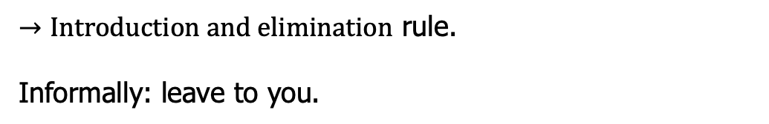

Natural deduction: Inference rules
Rule for$→$:
$Γ, P⊢$ $\text{Q}$
$Γ⊢P$ $→$ $\text{Q}$
$$Γ⊢P$$
$$(→I)$$
$$(→E)$$
$$Γ⊢P→Q$$
$$Γ⊢Q$$
$→Introduction and elimination$ rule.
Informally: leave to you.

Slide 17







Example
Try to prove $P∧Q→P$:
$$(var)$$
$P∧Q⊢P$ $∧Q$
$$(∧E)$$
$$P∧Q⊢P$$
$$(→I)$$
$$⊢P∧Q→P$$
This is called a proof tree!

Slide 18











Example
Try to prove $P∧Q→Q∧P$:
$$(var)$$
$$(var)$$
$$P∧Q⊢P∧Q$$
$$P∧Q⊢P∧Q$$
$$(∧E2)$$
$$(∧E1)$$
$$P∧Q⊢Q$$
$$P∧Q⊢P$$
$$(∧I)$$
$$P∧Q⊢Q∧P$$
$$(→I)$$
$$⊢P∧Q→Q∧P$$
This is called a proof tree!

Slide 19
Proof engineering
There has been great advancement in the automatic or semiautomatic proof assistants
Thus, we can conduct the above proof using such assistants
So CS also boosts math.
Let’s just study one example
You will do more in the 2nd assignment

Slide 20
Constructive logic:
Semantics

Slide 21
Semantics
The above proof theory cares about when a proposition is provable
Axioms and proof rules
Roughly, semantics is more about computation
Models and computation rules
To obtain a result of “true” or “false”

Slide 22
Model is not unique
We give another model for classical logic: bool algebra
This is a special algebra called a lattice
1
0
max, min, -
Bool algebra

Slide 23
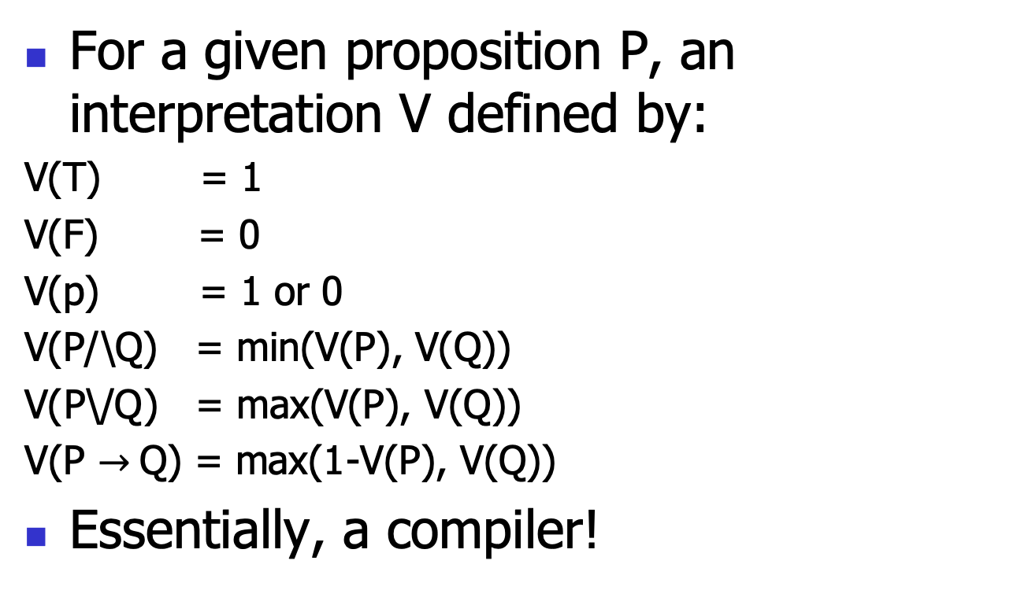
Interpretation
For a given proposition P, an interpretation V defined by:
V(T) = 1
V(F) = 0
V(p) = 1 or 0
V(P/\Q) = min(V(P), V(Q))
V(P\/Q) = max(V(P), V(Q))
V(P $→$Q) = max(1-V(P), V(Q))
Essentially, a compiler!
A
B
V

Slide 24
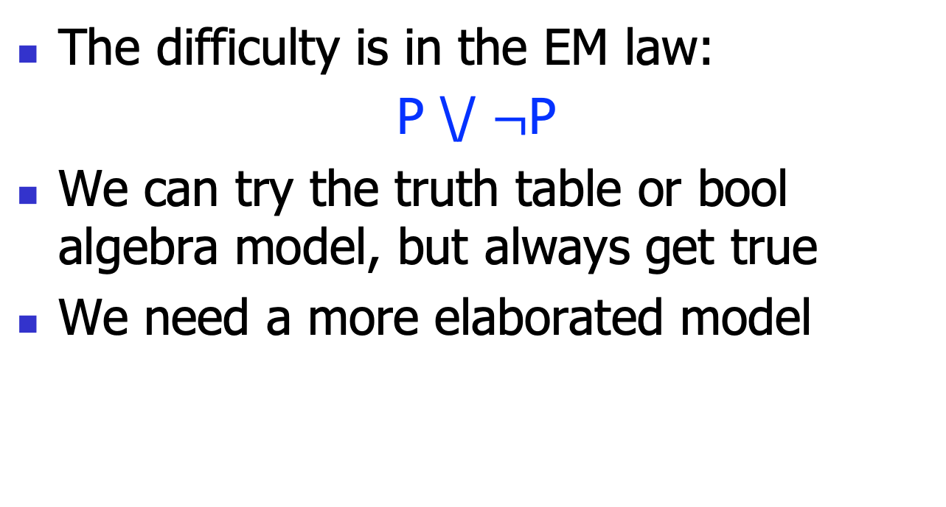
Model for constructive logic
The difficulty is in the EM law:
P \/ $¬$P
We can try the truth table or bool algebra model, but always get true
We need a more elaborated model

Slide 25
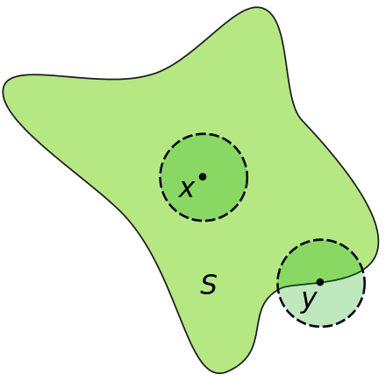

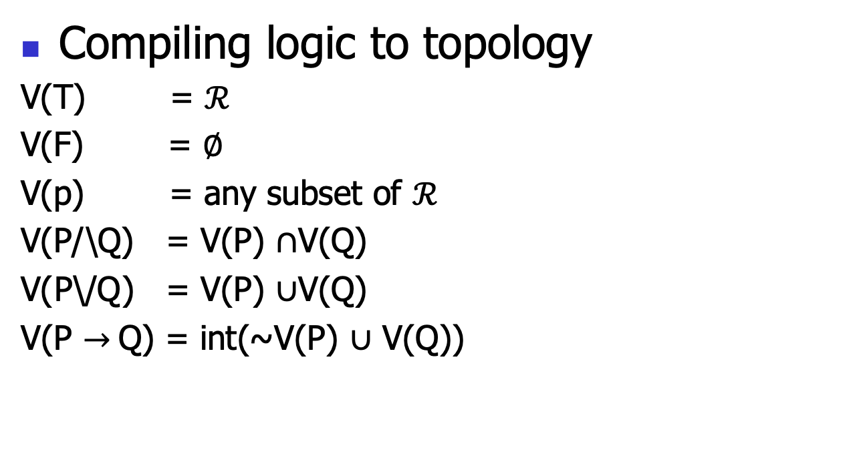
Heyting algebra
Compiling logic to topology
V(T) = $ℛ$
V(F) = $∅$
V(p) = any subset of $ℛ$
V(P/\Q) = V(P) $∩$V(Q)
V(P\/Q) = V(P) $∪$V(Q)
V(P $→$Q) = int(~V(P) $∪$ V(Q))
P($ℛ)$
$∩$, $∪$, ~, int
Heyting algebra
int([0, 1]) = (0, 1)
int(R) = R

Slide 26
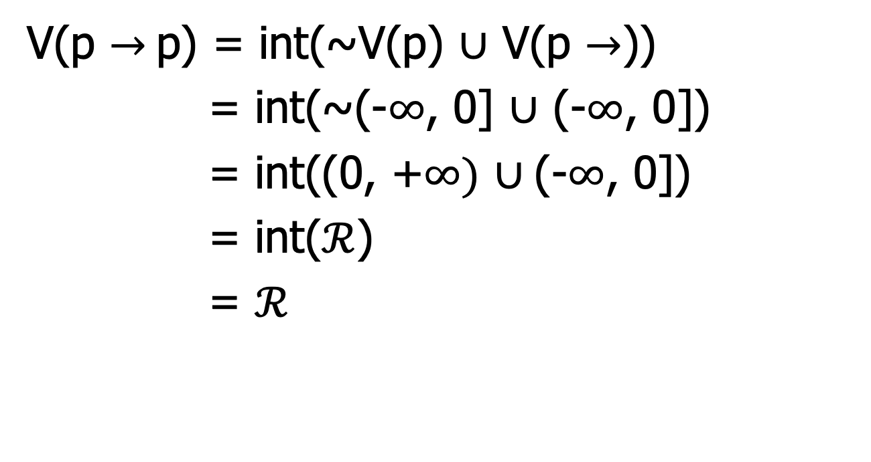
Example
V(p $→$p) = int(~V(p) $∪$ V(p $→$))
= int(~(-$∞$, 0] $∪$ (-$∞$, 0])
= int((0, +$∞)$ $∪$(-$∞$, 0])
= int($ℛ$)
= $ℛ$

Slide 27
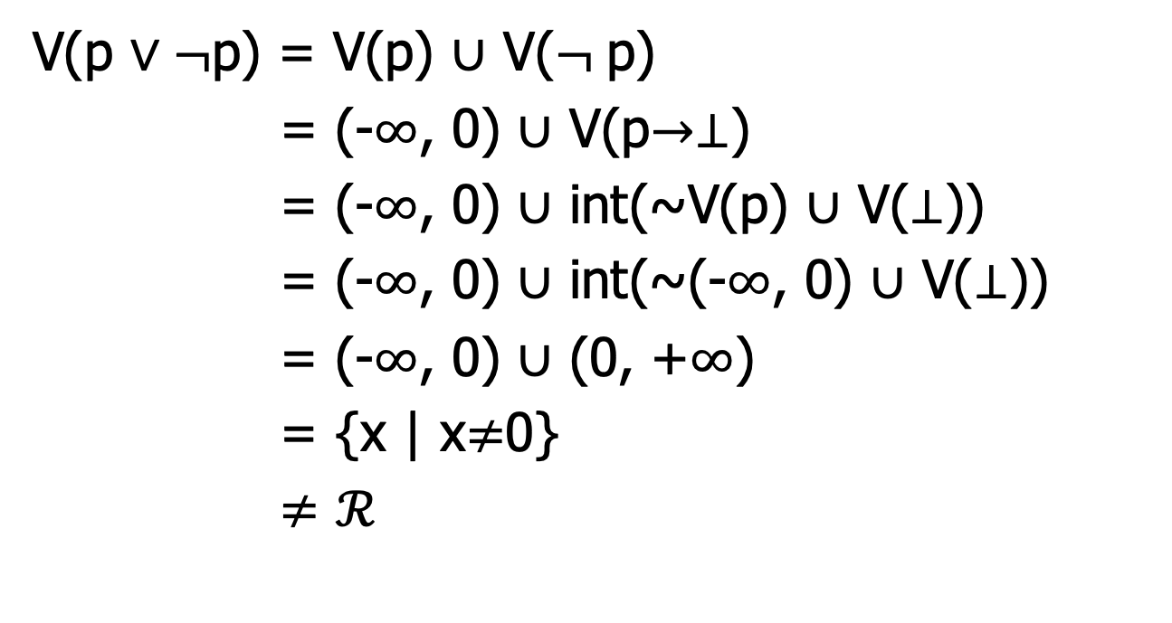
Example
V(p $∨¬$p) = V(p) $∪$ V($¬$p)
= (-$∞$, 0) $∪$ V(p$→⊥$)
= (-$∞$, 0) $∪$ int(~V(p) $∪$ V($⊥$))
= (-$∞$, 0) $∪$ int(~(-$∞$, 0) $∪$ V($⊥$))
= (-$∞$, 0) $∪$ (0, +$∞$)
= {x | x$≠$0}
$≠$ $ℛ$

Slide 28
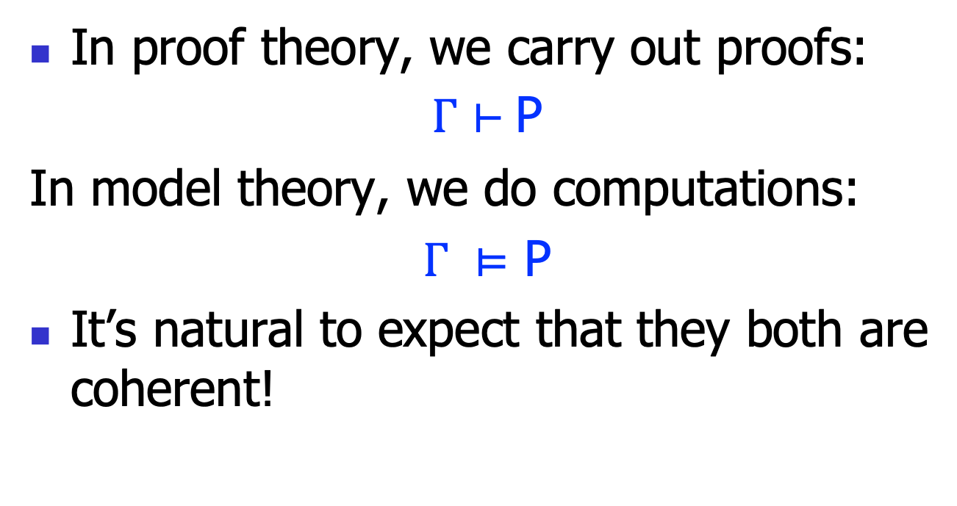
Two notions of validity
In proof theory, we carry out proofs:
$Γ⊢$ P
In model theory, we do computations:
$Γ ⊨$ P
It’s natural to expect that they both are coherent!

Slide 29

Soundness and completeness
Soundness:
$Γ⊢$ P => $Γ ⊨$ P
Completeness:
$Γ ⊨ \text{P}=>Γ⊢$ P

