Slide 1
Formal Method 2021-Fall
Recitation Lecture 04

Slide 2
Assignment 8: Concrete execution
java
Java Source Code → AST → JVM Bytecode → JVM
MiniPy
AST → Concrete Execution Engine(Python)
VM
Class Memory -> 内存
Interpreter -> CPU
Operational semantics rules -> 指令集

Slide 3
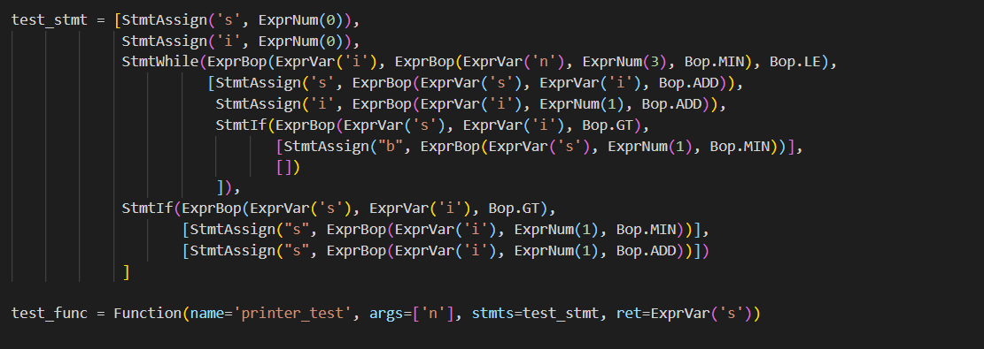
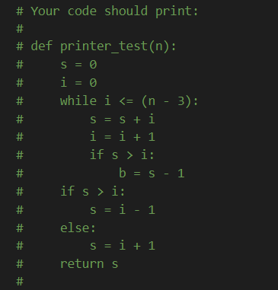


Slide 4
Operational semantics
build a virtual machine, compile to the VM
IMP
O ::= + | - | * | / | == | != | > | < | >= | …
E ::= n | x | E O E
S ::= pass
| x=E
| S;S
| f(E1, …, En)
| if(E, S, S)
| while(E, S)
F ::= f(x1, …, xn){S; return E;}

Slide 5

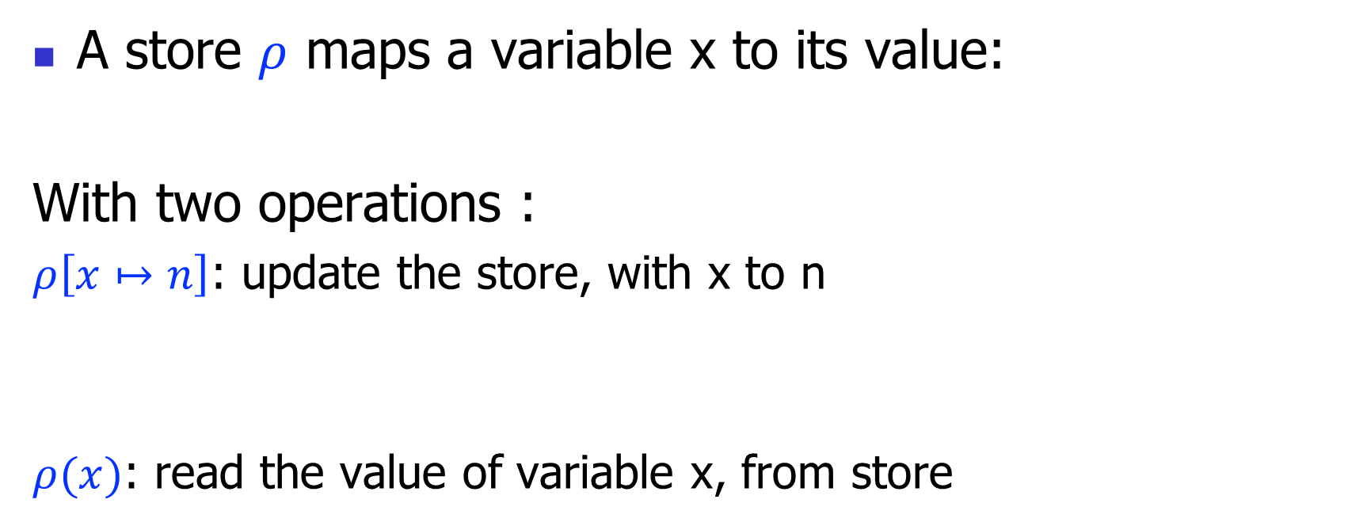
Operational semantics: store
A store $ρ$ maps a variable x to its value:
With two operations :
$ρ\left[x↦n\right]$: update the store, with x to n
$ρ(x)$: read the value of variable x, from store
$$ρ:x↦n$$
concrete_memory: Dict[str, int]
concrete_memory["x"] = n
concrete_memory["x"]

Slide 6

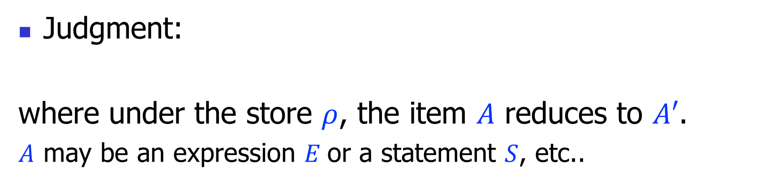
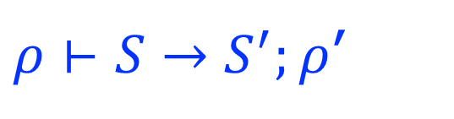

Operational semantics: judgment
Judgment:
where under the store $ρ$, the item $A$ reduces to $A′$.
$A$ may be an expression $E$or a statement $S$, etc..
$$ρ⊢A→A′$$
$$ρ⊢E→E′$$
$ρ⊢S→S^{′};ρ$’

Slide 7

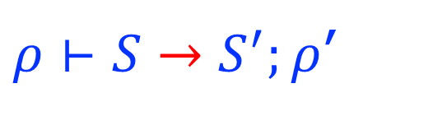

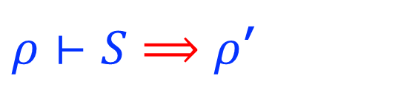


Operational semantics styles
Big-step operational semantics
$$ρ⊢E⟹n$$
$3∗(4+5)⟹$ 27
$ρ⊢S⟹ρ$’
Small-step operational semantics
$$ρ⊢E→E′$$
$3∗(4+5)⟹$ 3*9
$ρ⊢S→S^{′};ρ$’

Slide 8










Rules for expressions(Big-step)
$$(E−n)$$
$$ρ⊢n⟹n$$
…
$$ρ\left(x\right)=n$$
$(E−−)$, $\left(E−∗\right),(E−/)$
$$(E−x)$$
$$ρ⊢x⟹n$$
$$ρ⊢E1⟹n1$$
$$ρ⊢E2⟹n2$$
$$n=n1+n2$$
$$(E−+)$$
$$ρ⊢E1+E2⟹n$$

Slide 9


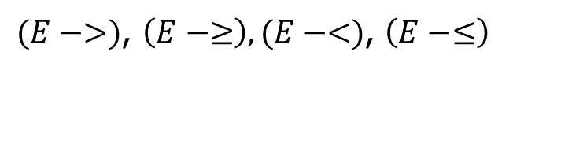










Rules for expressions (Big-step)
$$ρ⊢E1⟹n1$$
$$ρ⊢E2⟹n2$$
$$n1==n2$$
$$(E−==1)$$
$$ρ⊢E1==E2⟹1$$
$$ρ⊢E1⟹n1$$
$$ρ⊢E2⟹n2$$
$$n1≠n2$$
$$(E−==2)$$
$$ρ⊢E1==E2⟹0$$
…
$(E−>)$, $\left(E−≥\right),(E−<)$, $\left(E−≤\right)$
$$ρ⊢E1⟹n1$$
$$ρ⊢E2⟹n2$$
$$n1==n2$$
$$(E−≠1)$$
$$ρ⊢E1!=E2⟹0$$
$$ρ⊢E1⟹n1$$
$$ρ⊢E2⟹n2$$
$$n1≠n2$$
$$(E−≠2)$$
$$ρ⊢E1!=E2⟹1$$

Slide 10








Rules for statement (Big-step)
$$(E−Skip)$$
$$ρ⊢pass⟹ρ$$
$$ρ⊢E⟹n$$
$$(E−Assign)$$
$$ρ⊢x=E⟹ρ[x↦n]$$
$$ρ⊢S1⟹ρ1$$
$$ρ1⊢S2⟹ρ2$$
$$(E−Seq)$$
$$ρ⊢S1;S2⟹ρ2$$

Slide 11







Rules for statement (Big-step)
$$ρ⊢E⟹1$$
$$ρ⊢S1⟹ρ1$$
$$(E−If1)$$
$$ρ⊢if\left(E;S1;S2\right)⟹ρ1$$
$$ρ⊢E⟹0$$
$$ρ⊢S2⟹ρ2$$
$$(E−If2)$$
$$ρ⊢if(E;S1;S2)⟹ρ2$$

Slide 12






Rules for statement (Big-step)
$$ρ⊢E⟹0$$
$$(E−While1)$$
$$ρ⊢while\left(E;S\right)⟹ρ$$
$$ρ⊢E⟹1$$
$$ρ⊢S⟹ρ′$$
$$ρ′⊢while(E;S)⟹ρ′′$$
$$(E−While2)$$
$$ρ⊢while\left(E;S\right)⟹ρ′′$$

Slide 13















Rules for expressions (Small-step)
$$ρ\left(x\right)=n$$
$$(E−x)$$
$$ρ⊢x→n$$
$$ρ⊢E1→E1^{′}$$
$$(E−+1)$$
$(E−−)\text{,} \left(E−∗\right),(E−/),(E−=)$, $(E−≠)$, $(E−>)$, $\left(E−≥\right),$
$(E−<)$, $\left(E−≤\right)$
$$\left(2+3\right)+(5+4)$$
$$ρ⊢E1+E2→E1^{′}+E2$$
…
5$+(5+4)$
$$ρ⊢E2→E2^{′}$$
$$(E−+2)$$
5$+9$
$$ρ⊢n1+E2→n1+E2′$$
$$n=n1+n2$$
$$(E−+3)$$
$$ρ⊢n1+n2→n$$

Slide 14





Rules for statements (Small-step)
$$(E−Skip)$$
$$ρ⊢pass→ .;ρ$$
$$ρ⊢E→E′$$
$$(E−Assign1)$$
$$ρ⊢x=E→x=E^{′};ρ$$
$$(E−Assign2)$$
$$ρ⊢x=n→.;ρ[x↦n]$$

Slide 15




Rules for statements (Small-step)
$$ρ⊢S1→S1′;ρ′$$
$$(E−Seq1)$$
$$ρ⊢S1;S2→S1^{′};S2;ρ′$$
$$ρ⊢S1→ .;ρ′$$
$$(E−Seq2)$$
$$ρ⊢S1;S2→S2; ρ′$$

Slide 16



Rules for statements (Small-step)
$$ρ⊢E→E′$$
$$(E−If1)$$
$$ρ⊢if\left(E;S1;S2\right)→if\left(E′;S1;S2\right); ρ$$
$$(E−If2)$$
$$ρ⊢if(1;S1;S2)→S1; ρ$$
$$(E−If3)$$
$$ρ⊢if(0;S1;S2)→S2; ρ$$

Slide 17




Rules for statements (Small-step)
$$ρ⊢E→E′$$
$$(E−While1)$$
$$ρ⊢while\left(E;S\right)→while\left(E′;S\right); ρ$$
$$ρ⊢E→1$$
$$(E−While2)$$
$$ρ⊢while\left(E;S\right)→S;while\left(E;S\right); ρ$$
$$ρ⊢E→0$$
$$(E−While3)$$
$$ρ⊢while\left(E;S\right)→ .;ρ$$

Slide 18
Function call/return
Function calls and returns as special syntactic sugar (like Basic)
x = f(E1, …, En)
-->
x1 = E1;
…;
xn = En;
S_{f};
x = f;
return E;
-->
f = E;

Slide 19
Symbolic execution
关键思想：
符号输入值（每个不能由静态代码分析确定的值，都由符号表示）
符号执行引擎，始终维护<下一条执行语句，符号存储，路径条件>三元组
条件分支（if） → fork , 并添加对应的路径条件
赋值语句 → 更新符号存储

Slide 20
Architecture
programs
symbolic executor
concrete
execution
model
path conditions/obligations
bug triggered?
solver

Slide 21
Assignment 8: Symbolic execution
每次遇到 if-statement 启动两个子进程，if-statement的判断条件需要立刻加入path condition
所有路径条件需要在加入的时候做转换，如果加入的判断条件是m==n, 那么需要转换为
((42 - a) * 5) == ((c + 20) * 2)
使用python Queue收集每条子进程，最后做统一处理
Variable | Symbolic valule
a | ExprVar("a")
b | ExprBop(ExprNum(42), ExprVar("a"), Bop.MIN)
c | ExprBop(ExprVar("c"), ExprNum(20), Bop.ADD)
m | ExprBop(ExprVar("b"), ExprNum(5), Bop.MUL)
n | ExprBop(ExprVar("c"), ExprNum(2), Bop.MUL)
m == n
| |
b * 5 c * 2
| |
42 - a c + 20
| |
a c

Slide 22
Example
// Symbolic executing the following program:
void foo(int a, int b){
int x = 1, y = 0;
if(a != 0){
y = 3+x;
if(b == 0)
x = 2*(a+b);
}
assert(x-y != 0);
}
Step #1: construct ”symbolic” values for function input:
Variable | value
a | a
b | b
Step #2: executing the program with the
symbolic input, maintaining the symbolic
program state:
Variable | value
a | a
b | b
x | 1
y | 0
Can we construct the values for input x and y, to make this assertion fail?

Slide 23
Example
Variable | value
a | a
b | b
x | 1
y | 0
a!=0
a==0
// For branching, the process
// forks:
void foo(int a, int b){
int x = 1, y = 0;
if(a != 0){
y = 3+x;
if(b == 0)
x = 2*(a+b);
}
assert(x-y != 0);
}
Variable | value
a | a
b | b
x | 1
y | 0
Variable | value
a | a
b | b
x | 1
y | 0
The obligation:
x-y==0
that is:
1-0==0
USNAT!

Slide 24
Example
Variable | value
a | a
b | b
x | 1
y | 0
a!=0
a==0
// For branching, the process
// forks:
void foo(int a, int b){
int x = 1, y = 0;
if(a != 0){
y = 3+x;
if(b == 0)
x = 2*(a+b);
}
assert(x-y != 0);
}
Variable | value
a | a
b | b
x | 1
y | 4
Variable | value
a | a
b | b
x | 1
y | 0
b==0
b!=0
The obligation:
x-y==0
that is:
1-0==0
Variable | value
a | a
b | b
x | 1
y | 4
Variable | value
a | a
b | b
x | 1
y | 4
USNAT!
The obligation:
x-y==0
that is:
1-4==0
USNAT!

Slide 25

Example
Variable | value
a | a
b | b
x | 1
y | 0
a!=0
a==0
// For branching, the process
// forks:
void foo(int a, int b){
int x = 1, y = 0;
if(a != 0){
y = 3+x;
if(b == 0)
x = 2*(a+b);
}
assert(x-y != 0);
}
Variable | value
a | a
b | b
x | 1
y | 4
Variable | value
a | a
b | b
x | 1
y | 0
b==0
b!=0
The obligation:
x-y==0
that is:
1-0==0
Variable | value
a | a
b | b
x | 2*(a+b)
y | 4
Variable | value
a | a
b | b
x | 1
y | 4
USNAT!
The obligation:
x-y==0
that is:
2*(a+b)-4==0
The obligation:
x-y==0
that is:
1-4==0
Send this formulae to Z3:
a!=0 ∧ b==0 $∧$ 2*(a+b)-4==0
[a=2, b=0]
USNAT!

Slide 26
Practical issues
Path explosion
Loops and recursions
Heap modeling
Environment modeling
Constraint solving

Slide 27






#1: Path explosion
// The program:
int foo(){
if(e1)
if(e11)
…;
else
…;
else
if(e21)
…;
else
…;
}
e1
e1
$¬$e1
e11
e21
e1 $∧$e11
e1$∧¬$e11
$¬$e1 $∧¬$e21
$¬$e1 $∧$e21
e…
e…
e…
e…
With nested ‘if’ statements of depth N, the number of possible paths are ${O(2}^{N}).$

Slide 28
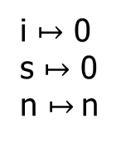

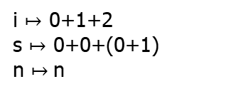
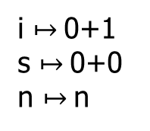
#2: Loops and recursions
// Loops introduce non-termination:
int sum(int n){
int s = 0, i = 0;
while(i<=n){
s = s+i;
i = i+1;
}
return s;
}
i $↦$ 0
s $↦$ 0
n $↦$n
i<=n
0<=n
$¬$e
s
i $↦$0+1
s $↦$0+0
n $↦$n
i<=n
0+1<=n
i<=n
i $↦$ 0+1+2
s $↦$ 0+0+(0+1)
n $↦$n
s
0+1+2<=n
s

Slide 29
#2: Loops and recursion
Bounded symbolic execution
finitize the loops
// Original:
int sum(int n){
int s = 0, i = 0;
while(e){
S;
}
return s;
}
// New:
int sum(int n){
int s = 0, i = 0;
if(e){
S;
}
return s;
}
One possible conversion
if(e){S;}

Slide 30
#3: Heap modeling
// The program:
void foobar(int i, int j){
int a[2] = {0};
if(i>1 || j>1)
return;
a[i] = 5;
assert(a[j] != 5);
}
What values of i and j to make the assert() fail?

Slide 31
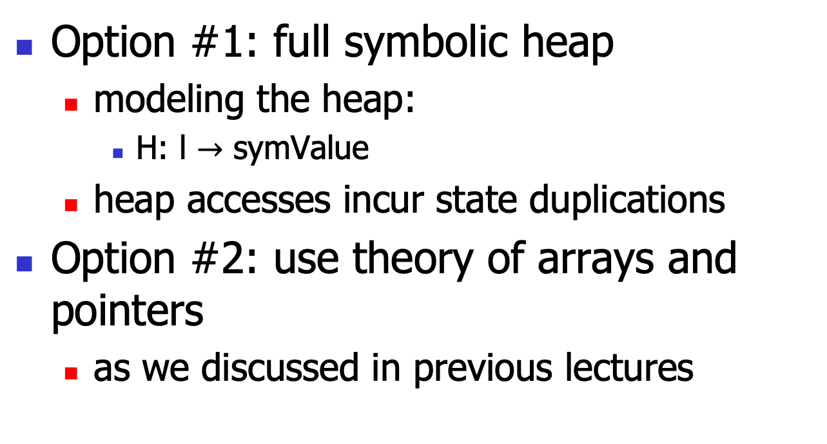
#3: Heap modeling
Option #1: full symbolic heap
modeling the heap:
H: l $→$ symValue
heap accesses incur state duplications
Option #2: use theory of arrays and pointers
as we discussed in previous lectures

Slide 32

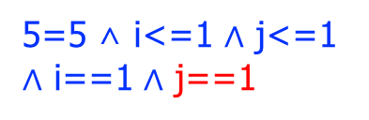

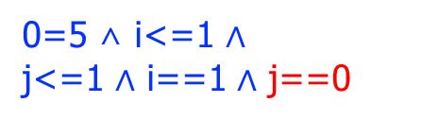
state forking
Variable | value
i | i
j | j
a[0] | 0
a[1] | 0
i<=1 /\ j<=1
i>1 \/ j>1
void foobar(int i, int j){
int a[2] = {0};
if(i>1 || j>1)
return;
a[i] = 5;
assert(a[j] != 5);
}
Variable | value
i | i
j | j
a[0] | 0
a[1] | 0
Variable | value
i | i
j | j
a[0] | 0
a[1] | 0
i==0
i==1
Variable | value
i | i
j | j
a[0] | 5
a[1] | 0
Variable | value
i | i
j | j
a[0] | 0
a[1] | 5
0=5 ∧ i<=1 $∧$
j<=1 $∧$ i==1 $∧$ j==0
j==0
j==0
5=5 ∧ i<=1 $∧$ j<=1 $∧$ i==0 $∧$ j==0
USNAT!
[i=0, j=0]
0=5 ∧ i<=1 $∧$ j<=1 $∧$ i==0 $∧$ j==1
5=5 ∧ i<=1 $∧$ j<=1 $∧$ i==1 $∧$ j==1
j==1
j==1
USNAT!
[i=1, j=1]

Slide 33
#4: Environment modeling
The software components must interact with the external environments
invoke libraries, system calls, env. vars, …
The symbolic executor must model the environment
the whole software stack!
tedious and error-prone

Slide 34
#5: constraint solving
// The program:
void foo(int i, int j){
int a = i*i*i;
int b = j*j*j;
1/(a+b);
}
The generated obligation is:
i*i*i+j*j*j==0
which may be beyond the capability of some SMT solvers (recall that the general non-linear theory, in theory, is undecidable).

Slide 35
Concolic Execution
Step #1: generate random concrete input and symbolic input
Step #2, run program with the two inputs
maintain the concrete+symbolic states
For branching, generate path conditions
just like in the symbolic execution
but don’t fork(), only go to feasible path
After one run, negate the result PCs, send them to solver, to get other concreate input
Go to step #2, re-run the program

Slide 36






The general form
// Conceptually, we negate one of PCs one time:
int foo(int x, int y){
if(b1)
if(b2)
if(…)
if(bn)
return x/y;
else …;
else …;
else …;
else return 0;
}
b1
b1 $∧$b2
b1 $∧$b2 $∧$ ...
b1
b1 $∧$b2 $∧$ ... $∧$bn
b1
b1 $∧$b2 $∧$ ... $∧$bn $∧$y==0
b2
b…
b1 $∧$b2
b1 $∧$b2 $∧$ ... $∧$bn
x/y
b…
b…
b…

Slide 37
Architecture
programs
with concrete + symbolic inputs
model
concolic executor
path conditions/obligations
solver

Slide 38
Concolic execution
Step #1: generate random concrete input and symbolic input :
int foo(int x, int y){
int z = x+y;
if(x==32467289)
return x/y;
else
return 0;
}
Variable | value | sym.value
x | 1 | x
y | 1 | y
Step #2: executing the program with two input, maintaining the the concrete+symbolic state:
Variable | value | sym.value
x | 1 | x
y | 1 | y
z | 2 | x+y

Slide 39
Concolic execution
// For branch, the executor branches according to
// the concreate value, and we add a “path
// condition” to the
// target branch:
int foo(int x, int y){
int z = x+y;
if(x==32467289)
return x/y;
else
return 0;
}
Variable | value | sym.value
x | 1 | x
y | 1 | y
z | 2 | x+y
if
x != 32467289
x/y
0
After run and get the PCs, we negate the PCs:
x == 32467289
and send it to solver, to get new inputs:
[x = 32467289, y =1]

Slide 40

Concolic execution
// With the new path condition and obligations,
// we can generate final constraints:
int foo(int x, int y){
int z = x+y;
if(x==32467289)
return x/y;
else
return 0;
}
Variable | value | sym.value
x | 32467289 | x
y | 1 | y
z | 32467290 | x+y
if
x == 32467289
x/y
0
x == 32467289 $∧$ y==0
y==0
And the model:
[x == 32467289, y==0]

Slide 41
Concolic execution
// with the new input, and try to trigger the “DivideByZero”:
int foo(int x, int y){
int z = x+y;
if(x==32467289)
return x/y;
else
return 0;
}
Variable | value | sym.value
x | 32467289 | x
y | 0 | y
z | 32467289 | x+y
if
We run the program 3 rounds in total!
x == 32467289
x == 32467289 $∧$ y==0
x/y
0
Trigger the “DivideByZero”!
y==0

Slide 42
Practical issues
Constraint solving
Path explosion
Loops and recursions
Environment modeling

Slide 43
#1: Constraint solving
Variable | value | sym.value
x | 2 | x
y | 2 | y
m | 8 | x*x*x
x*x*x!=y
(m!=y)
// sample function:
int foo(int x, int y){
m = x*x*x;
if(m==y){
assert(…);
}else{
…;
}
return 1;
}
Variable | value | sym.value
x | 2 | x
y | 2 | y
m | 8 | x*x*x
8
The path cond:
x*x*x!=y
we negate it and send to solver (Z3):
x*x*x==y
but if we found this is unsolvable, we can weaken this by replace the symbolic value of m with its concreate value!
Thus we have this (weakened) PC:
8 == y
we regenerate new input, and restart the execution!

Slide 44
#1: Constraint solving
Variable | value | sym.value
x | 2 | x
y | 8 | y
m | 8 | x*x*x
m==y
// sample function:
int foo(int x, int y){
m = x*x*x;
if(m==y){
assert(…);
}else{
…;
}
return 1;
}
Variable | value | sym.value
x | 2 | x
y | 8 | y
m | 8 | x*x*x

Slide 45
#2: Path explosion
In concolic execution, the number of paths explored can be controlled, according to:
the total number
the coverage
the timeout
etc..
// The program:
int foo(){
if(e1)
if(e11)
…;
else
…;
else
if(e21)
…;
else
…;
}
e1
e1
$¬$e1
e11
e21
e1 $∧$e11
e1$∧¬$e11
$¬$e1 $∧¬$e21
$¬$e1 $∧$e21
e…
e…
e…
e…
With nested ‘if’ statements of depth N, the number of possible paths are ${O(2}^{N}).$

Slide 46
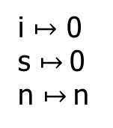
#3: Loops and recursions
// Loops introduce non-termination:
int sum(int n){
int s = 0, i = 0;
while(i<=n){
s = s+i;
i = i+1;
}
return s;
}
i $↦$ 0
s $↦$0
n $↦$n
i<=n
e
$¬$e
e
s

Slide 47
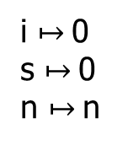
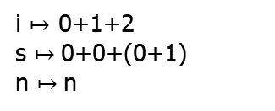
#3: Loops and recursions
// Loops introduce non-termination:
int sum(int n){
int s = 0, i = 0;
while(i<=n){
s = s+i;
i = i+1;
}
return s;
}
i $↦$0
s $↦$0
n $↦$n
i<=n
0<=n
$¬$e
s
i $↦$0+1
s $↦$0+0
n $↦$n
i<=n
0+1<=n
i<=n
i $↦$ 0+1+2
s $↦$0+0+(0+1)
n $↦$n
s
0+1+2<=n
s
No need to finitize the loops.

Slide 48
#4: Environment modeling
// lib() is a library function:
int foo(int n){
if(e){
x = lib(n);
}else{
x = 2*n-4;
}
return 1/x;
}
e
e
$¬$e
lib()
...
If we don’t establish a symbolic model for the “lib()” function, we cannot symbolic check the true branch.
But we can still concolic executes that branch!
So the symbolic model for the environment is just to improve the precision!

Slide 49
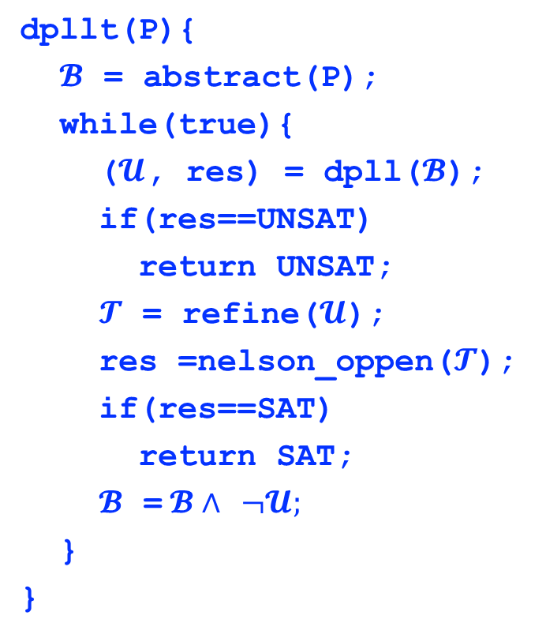
DPLL(T) algorithm
FOL formulae
dpllt(P){
$𝓑$ = abstract(P);
while(true){
($𝓤$, res) = dpll($𝓑$);
if(res==UNSAT)
return UNSAT;
$𝓣$ = refine($𝓤$);
res =nelson_oppen($𝓣$);
if(res==SAT)
return SAT;
$𝓑$ =$𝓑∧$ $¬𝓤;$
}
}
DPLL
Nelson-Oppen
Theory
1
Theory
2
Theory
n
…

Slide 50


DPLL(T) example
FOL formulae
P = (x $≥$1) $∧$ (x $≤$2) $∧$ P(x) $∧$ (~P(1)$∨$~P(2)) (suppose x$∈ℤ$)
$𝓑$ = A $∧$ B$∧$C $∧$(D $∨$E)
DPLL
$𝓤$ = A $∧$B $∧$C $∧$D $∧$E, res=SAT
$𝓣$ = (x $≥$1) $∧$(x $≤$2) $∧$P(x) $∧$ ~P(1) $∧$ ~P(2)
Nelson-Oppen
Theory
1
Theory
2
Theory
n
…

Slide 51
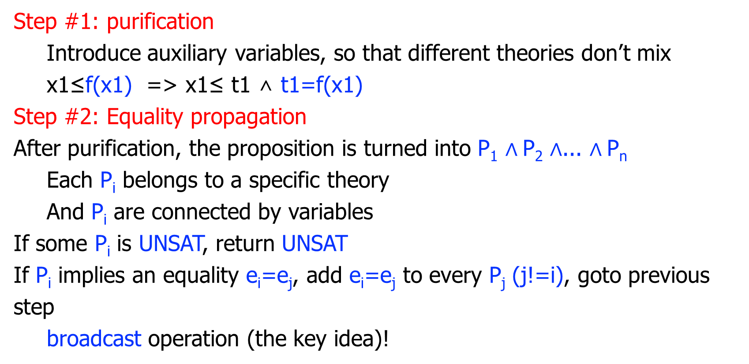
Nelson-Oppen
Step #1: purification
Introduce auxiliary variables, so that different theories don’t mix
x1≤f(x1) => x1≤ t1 ∧ t1=f(x1)
Step #2: Equality propagation
After purification, the proposition is turned into P₁ $∧$P₂ $∧$... $∧$P_{n}
Each P_{i} belongs to a specific theory
And P_{i} are connected by variables
If some P_{i} is UNSAT, return UNSAT
If P_{i} implies an equality e_{i}=e_{j}, add e_{i}=e_{j} to every P_{j} (j!=i), goto previous step
broadcast operation (the key idea)!

Slide 52
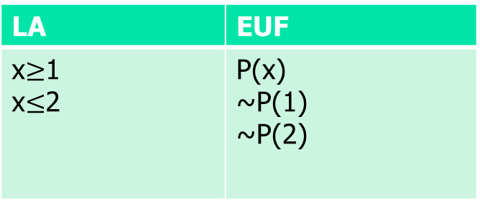

Not always so simple…
(x $≥$1) $∧$ (x $≤$2) $∧$ P(x) $∧$ ~P(1) $∧$ ~P(2) (suppose x$∈ℤ$):
// After purification:
// Neither theory can imply an equality.
// But the proposition is UNSAT!
LA | EUF
x$≥$1 x$≤$2 | P(x) ~P(1) ~P(2)

Slide 53
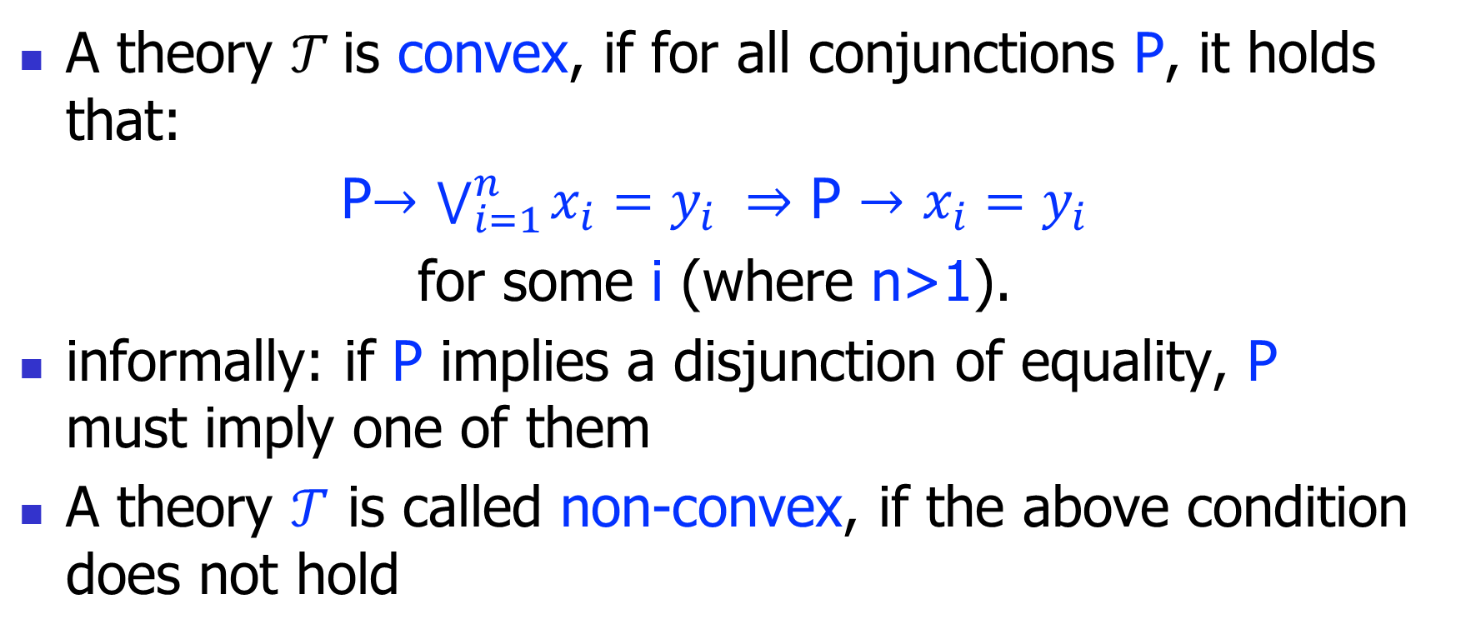
Theory Convexity
A theory $𝒯$is convex, if for all conjunctions P, it holds that:
P$→$ $\bigvee_{i=1}^{n}{x_{i}=y_{i}} ⇒$ P $→$ $x_{i}=y_{i}$
for some i (where n>1).
informally: if P implies a disjunction of equality, P must imply one of them
A theory $𝒯$ is called non-convex, if the above condition does not hold

Slide 54

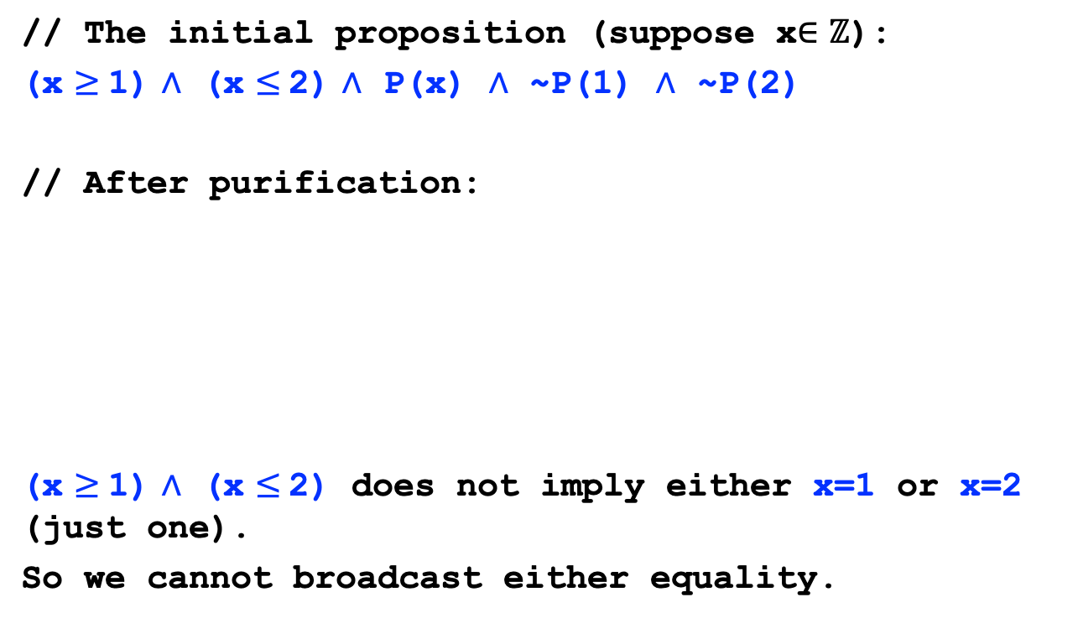
Non-convex theory example
// The initial proposition (suppose x$∈ℤ$):
(x $≥$1) $∧$ (x $≤$2) $∧$ P(x) $∧$ ~P(1) $∧$ ~P(2)
// After purification:
(x $≥$1) $∧$ (x $≤$2) does not imply either x=1 or x=2 (just one).
So we cannot broadcast either equality.
LA | EUF
x$≥$1 x$≤$2 | P(x) ~P(1) ~P(2)

Slide 55
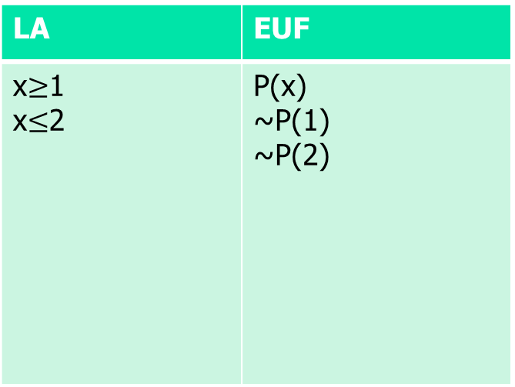
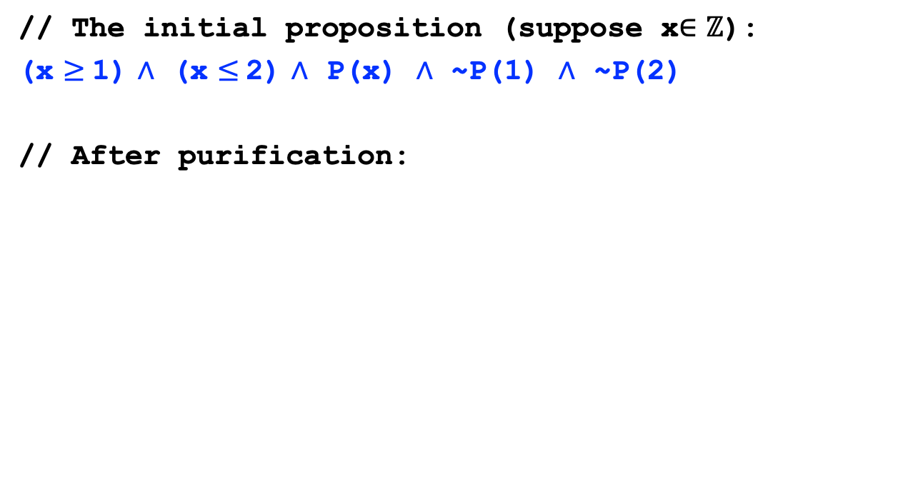

Non-convexity introduces splitting
// The initial proposition (suppose x$∈ℤ$):
(x $≥$1) $∧$ (x $≤$2) $∧$ P(x) $∧$ ~P(1) $∧$ ~P(2)
// After purification:
LA | EUF
x$≥$1 x$≤$2 | P(x) ~P(1) ~P(2)
State split!
x=1 $∨$ x=2
x=1
x=2
UNSAT
UNSAT

Slide 56

DPLL(T) example
FOL formulae
P = (x $≥$1) $∧$ (x $≤$2) $∧$ P(x) $∧$ (~P(1)$∨$~P(2)) (suppose x$∈ℤ$)
$𝓑$ = A $∧$ B$∧$C $∧$(D $∨$E)
DPLL
$𝓤$ = A $∧$B $∧$C $∧$D $∧$E, res=SAT
$𝓣$ = (x $≥$1) $∧$(x $≤$2) $∧$P(x) $∧$ ~P(1) $∧$ ~P(2)
Nelson-Oppen
res = UNSAT
$𝓑$ = A $∧$ B$∧$C $∧$(D $∨$E) $∧$~ $𝓤$
Theory
1
Theory
2
Theory
n
…

Slide 57

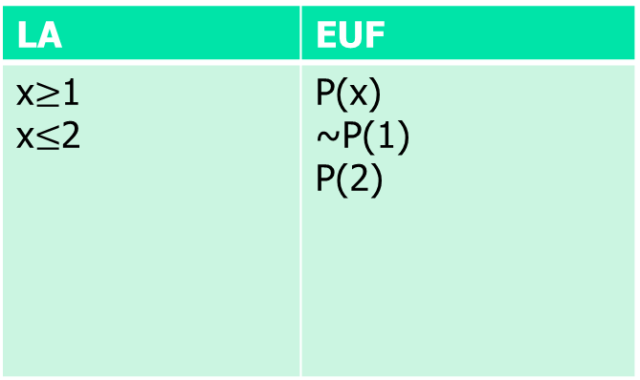

DPLL(T) example
P = (x $≥$1) $∧$ (x $≤$2) $∧$ P(x) $∧$ (~P(1)$∨$~P(2)) (suppose x$∈ℤ$)
FOL formulae
$𝓑$ = A $∧$ B$∧$C $∧$(D $∨$E) $∧$(~A$∨$~B$∨$~C$∨$~D$∨$~E)
DPLL
$𝓤$ = A $∧$B $∧$C $∧$D $∧$~E, res=SAT
$𝓣$ = (x $≥$1) $∧$(x $≤$2) $∧$P(x) $∧$ ~P(1) $∧$ P(2)
Nelson-Oppen
res = SAT
LA | EUF
x$≥$1 x$≤$2 | P(x) ~P(1) P(2)
The algorithm
terminates with
an SAT result.
Theory
1
Theory
2
Theory
n
…
x=1 $∨$ x=2
x=1
x=2
UNSAT
SAT
[x=2, ~P(1), P(2)]

