Slide 1
Program synthesis
Formal Methods Foundation
Baojian Hua
bjhua@ustc.edu.cn

Slide 2
Overview
Program synthesis is about computer programming computer!
  Or automated programming
The task is to find out a program which satisfies some desired properties (specifications)
  The holy grail of CS since 1950’s

Slide 3
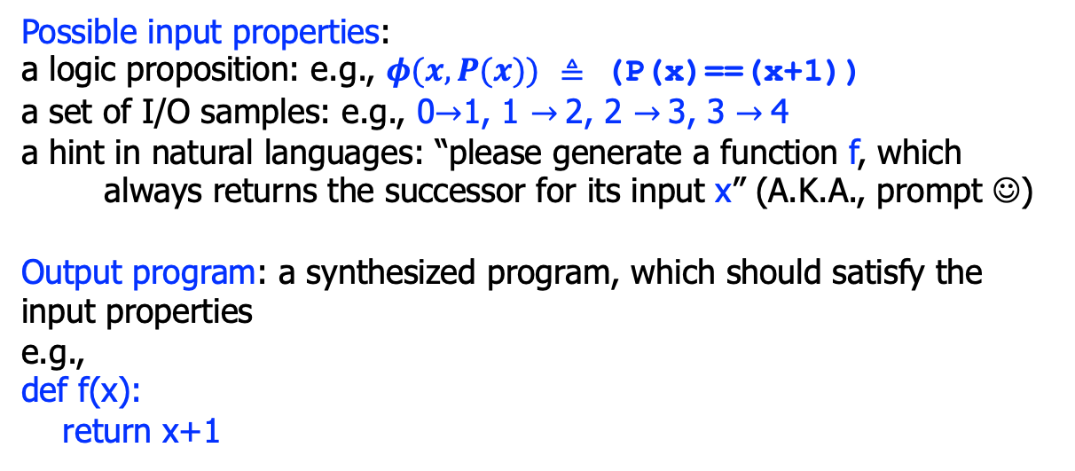
Architecture
Input properties
Synthesizer
Output program
Possible input properties:
a logic proposition: e.g., $φ(x, P(x))$ $≜$ (P(x)==(x+1))
a set of I/O samples: e.g., 0$→$1, 1 $→$2, 2 $→$3, 3 $→$4
a hint in natural languages: “please generate a function f, which
always returns the successor for its input x” (A.K.A., prompt ☺)
Output program: a synthesized program, which should satisfy the input properties
e.g.,
def f(x):
return x+1

Slide 4
Syntax-guided Synthesis (SyGuS)

Slide 5
Inductive syntax-directed synthesis: architecture
Input properties
Synthesizer
Output program
Syntax
Input properties: the desired properties a program should satisfy
Output program: the synthesized program
Syntax: a syntax skeleton the program (also called a sketch)

Slide 6
Sketch
Input properties
Synthesizer
Output program
(0, 0)->0
(1, 0)->1
(0, 1)->1
Syntax
// Sketch program:
def f(x, y):
res = ???
return res
The symbol ??? represents a hole in the program.
The task of the synthesizer is to fill in this hole, by synthesizing a program fragment.
We give the input properties in the form of I/O samples.

Slide 7
Sketch
(0, 0)->0
(1, 0)->1
(0, 1)->1
Input properties
Output program
Synthesizer
H ::= V O V
V ::= x | y
O ::= + | -
Syntax
The insight here is to allow only binary operations “+” or “-”, on atomic variables “x” and “y”.
// Target program:
def f(x, y):
res = ???
return res
H
Without any restrictions, the search space to be filled in the hole is infinite, say:
x+y, x|y, x&y, max(x, y), …
We use the syntax sketch to limit the search space!

Slide 8
Sketch encoding
(0, 0)->0
(1, 0)->1
(0, 1)->1
Input properties
Output program
Synthesizer
H ::= V O V
V ::= x | y
O ::= + | -
Syntax
How to encode the “hole” within a solver?
// Target program:
def f(x, y):
res = ??
return res
+ | -
x | y
H
def hole_op(h, l, r):
If(h==0, l+r, l-r)
def hole_var(h, x, y):
If(h==0, x, y)

Slide 9
Sketch encoding
(0, 0)->0
(1, 0)->1
(0, 1)->1
Input properties
Output program
Synthesizer
H ::= V O V
V ::= x | y
O ::= + | -
Syntax
h0 = Int(‘h0’)
h1 = Int(‘h1’)
h2 = Int(‘h2’)
def hole(x, y):
hole_op(h0,
hole_var(h1, x, y),
hole_var(h2, x, y))
+/-
// Target program:
def f(x, y):
res = ??
return res
x/y
x/y
H

Slide 10
Adding constraints
Input properties
Synthesizer
Output program
(0, 0)->0, (1, 0)->1, (0, 1)->1
H ::= V O V
V ::= x | y
O ::= + | -
Syntax
h0 = Int(‘h0’)
h1 = Int(‘h1’)
h2 = Int(‘h2’)
def hole(x, y):
hole_op(h0,
hole_var(h1, x, y),
hole_var(h2, x, y))
+/-
// Target program:
def f(x, y):
res = ??
return res
x/y
x/y
H
hole(0,0)==0
hole(1,0)==1
hole(0,1)==1

Slide 11
The model
Input properties
Synthesizer
Output program
(0, 0)->0, (1, 0)->1, (0, 1)->1
H ::= V O V
V ::= x | y
O ::= + | -
Syntax
h0 = Int(‘h0’)
h1 = Int(‘h1’)
h2 = Int(‘h2’)
def hole(x, y):
hole_op(h0,
hole_var(h1, x, y),
hole_var(h2, x, y))
+/-
// Target program:
def f(x, y):
res = ??
return res
}
x/y
x/y
H
hole(0,0)==0
hole(1,0)==1
hole(0,1)==1
h0 = 0
h1 = 0
h1 = 1

Slide 12
Generate programs
Input properties
Synthesizer
Output program
(0, 0)->0, (1, 0)->1, (0, 1)->1
x + y
H ::= V O V
V ::= x | y
O ::= + | -
Syntax
h0 = Int(‘h0’)
h1 = Int(‘h1’)
h2 = Int(‘h2’)
def hole(x, y):
hole_op(h0,
hole_var(h1, x, y),
hole_var(h2, x, y))
+/-
// Target program:
def f(x, y):
res =
return res
x/y
x/y
hole
hole(0,0)==0
hole(1,0)==1
hole(0,1)==1
x + y
h0 = 0
h1 = 0
h1 = 1

Slide 13
To enumerate all programs
Two key observations:
  #1: The synthesized program may not be correct
    after all, we are synthesizing from the partial known facts
    later, we’ll see how to verify this
  #2: we can enumerate all possible programs
    negate the solution (we’ve seen several times)

Slide 14
To enumerate all programs
// Suppose the first solution gives us:
[h0=0, h1=0, h2=1]
// +, x, y
// By negating this, we have:
solver.append(Not(And(h0==0, h1==0, h2==1))
// Asking the solver:
solver.check()
m = solver.model()
// we get:
[h0=0, h1=1, h2=0]
// +, y, x
// we can get other solutions in a similar manner

Slide 15
Scaling the synthesizer
Input properties
Synthesizer
Output program
(0, 0)->0, (1, 0)->1, (0, 1)->1
(1, 1)->1
H ::= V O V
V ::= x | y
O ::= + | -
| & | |
Syntax
We have one more I/O sample: (1, 1)->1
If we apply the above procedure, we’ll get “UNSAT”.
This is not surprising, as we can verify that no combinations can obtain the result.
Let’s scale the sketch a little bit.
// Target program:
def f(x, y):
res =
return res
H

Slide 16
Scaling the synthesizer
Input properties
Synthesizer
Output program
(0, 0)->0, (1, 0)->1, (0, 1)->1
(1, 1)->1
x | y
H ::= V O V
V ::= x | y
O ::= + | -
| & | |
Syntax
def hole_op(h, l, r):
If(h==0,
l+r,
If(h==1,
l-r,
If(h==2,
l&r,
l|r)))
// Target program:
def f(x, y):
res =
return res
hole
x | y

Slide 17
Summary
We discussed program synthesis
  to produce a program, from some sort of specification
The syntax-directed approach
  programmers specify the specification, along with some syntax sketch
  the solver solves the constraints

