Slide 1
Typed Arithmetic Expression
Principle of Programming Languages
Baojian Hua
bjhua@ustc.edu.cn

Slide 2
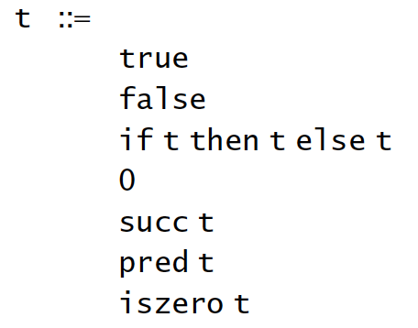
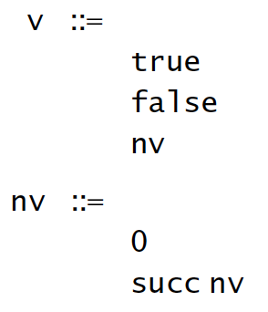
Recap: untyped arithmetic
Stuck: a term could not evaluate any more, but not a value:
pred (false)
iszero (true)
if (succ 0) then 0 else false
Intuitively, operators are applied to wrong operands.
Can we classify the operators, according to their types?

Slide 3
Types
We distinguish two different types of terms:
Bool: to represent boolean values
Nat: to represent natural values
Typing relation
t: T
a term t is of type T (statically)

Slide 4
Statically…
It means we don’t need to run the program:
pred (1): Nat
iszero (0): Bool
if <…> then 0 else false: ???
we must know the value of <…>

Slide 5
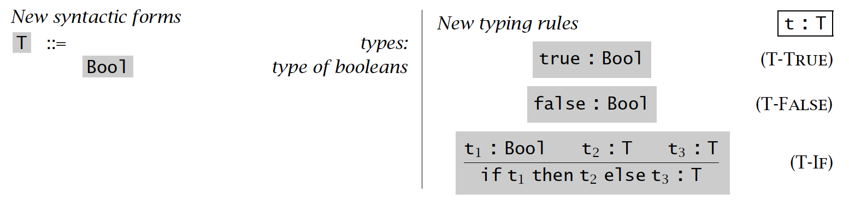
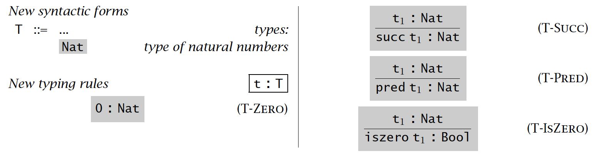
Typing relation

Slide 6
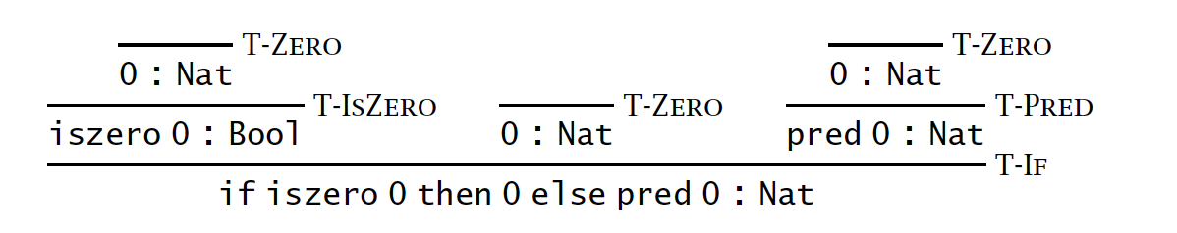
Typing derivation

Slide 7
Implementation

Slide 8
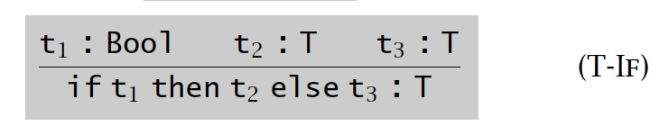
Type checking
type t =
| True
| False
| If of t * t * t
| Zero
| Succ of t
| Pred of t
| IsZero of t
type tipe =
| Bool
| Nat
let rec check (t: t): tipe =
match t with
| True -> Bool
| False -> Bool
| If (t1, t2, t3) ->
let tipe1 = check t1
tipe2 = check t2
tipe3 = check t3
in match tipe1 with
| Bool -> …
| Nat -> error “wrong type”

Slide 9
Properties

Slide 10
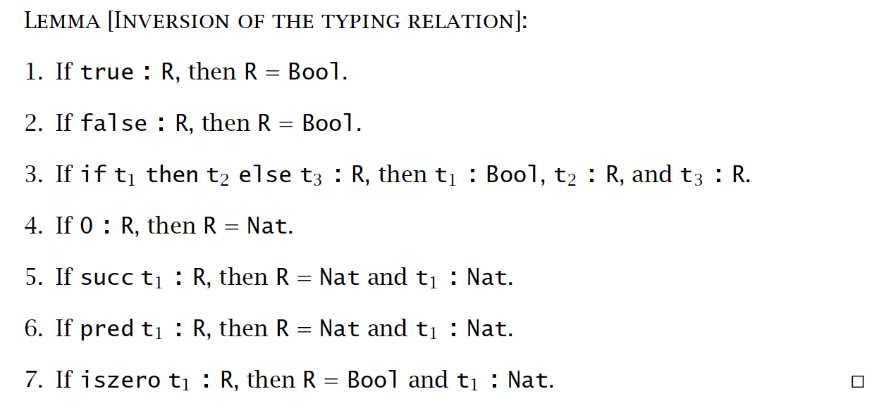
Inversion lemma

Slide 11
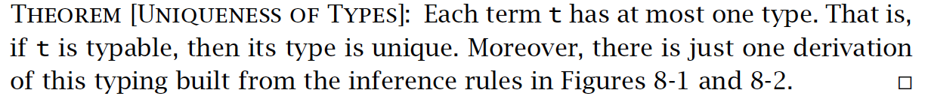
Uniqueness of types

Slide 12
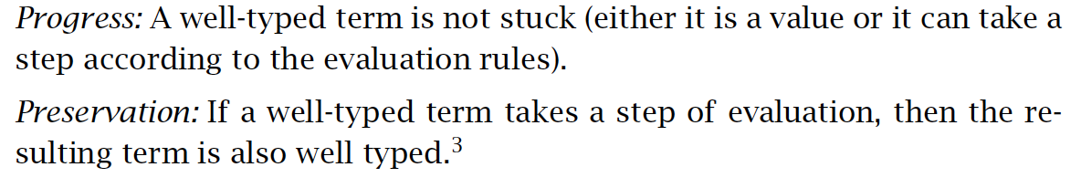
Safety = Progress + Preservation
t1 -> t2 -> t3 -> t4 -> …
: : : : :
T1 T2 T3 T4 …

Slide 13
Progress
Proof. By induction on the typing relation t: T.
true: Bool
false: Bool
if t1 then t2 else t3: T, then t1: bool, t2: T, t3: T
apply induction hypothesis on t1: bool,
t1 is a value or t1 -> t1’,
if true then t2 else t3 -> t2
if false then t2 else t3 -> t3
if t1 then t2 else t3 -> if t1’ then t2 else t3
Other cases are similar.

Slide 14
Preservation
Proof. By induction on the typing relation t: T.
true: Bool
false: Bool
if t1 then t2 else t3: T, then t1: bool, t2: T, t3: T
analyze the cases of t -> t’:
if true then t2 else t3 -> t2
if false then t2 else t3 -> t3
if t1 then t2 else t3 -> if t1’ then t2 else t3
Other cases are similar.

Slide 15
Summary
Typing relation on arithmetics
Can be performed by compilers via so-called type checking
Safety = progress + preservation

