Slide 1
Simply Typed lambda calculus
Principle of Programming Languages
Baojian Hua
bjhua@ustc.edu.cn

Slide 2
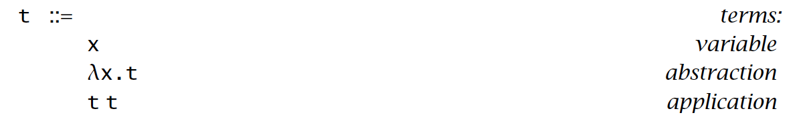
Recap: Lambda calculus

Slide 3
Why theory matters?
Some lambda code in Python:
lambda x: x
(lambda x: lambda y: x+y) (3) (4)
omega = lambda x: x (x)
omega (omega)
l = [1, 2, 3, 4]
print(list(map(lambda x: x*x, l))

Slide 4
Why theory matters?
Some lambda code in JavaScript:
(x) => x
((x) => (y) => x+y) (3) (4)
omega = (x) => x (x)
omega (omega)
let l = [1, 2, 3, 4]
l.map((x) => x*x)

Slide 5
Why theory matters?
Some lambda code in Java (8.0 or later):
Id id = (x) -> x;
id.id (3);
(x) -> (y) -> x + y; ???
omega ???
omega (omega) ???
Integer[] l = {1, 2, 3, 4};
Arrays.toList(l).forEach ((x) -> …);

Slide 6
Why theory matters?
Some lambda code in C++ (C++ 11):
auto id = [](int x) -> int {return x;}
(x) -> (y) -> x + y; ???
omega ???
omega (omega) ???

Slide 7
Typing

Slide 8
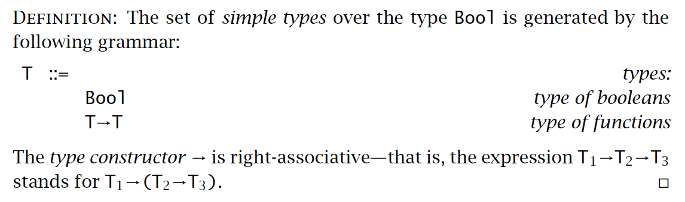
Function type
Examples:
Bool
Bool -> Bool
Bool -> (Bool -> Bool)
(Bool -> Bool) -> (Bool -> Bool)

Slide 9
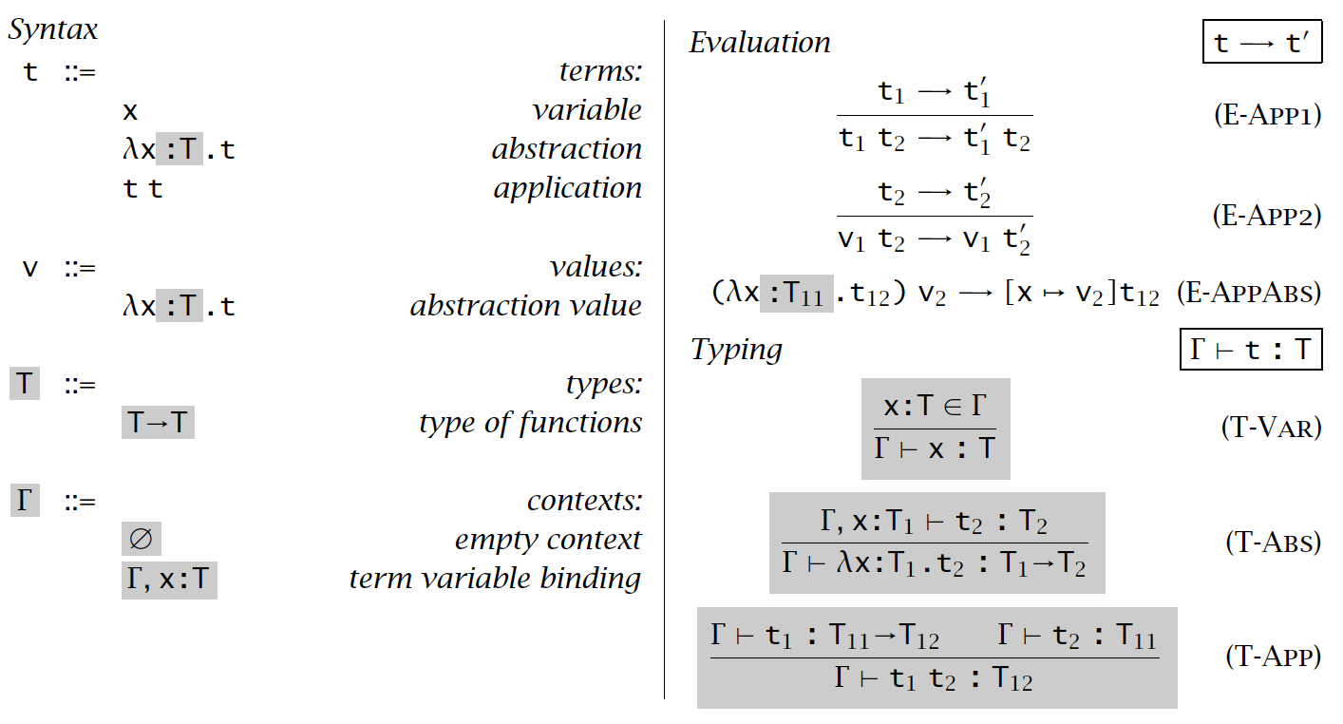
Typing relation

Slide 10
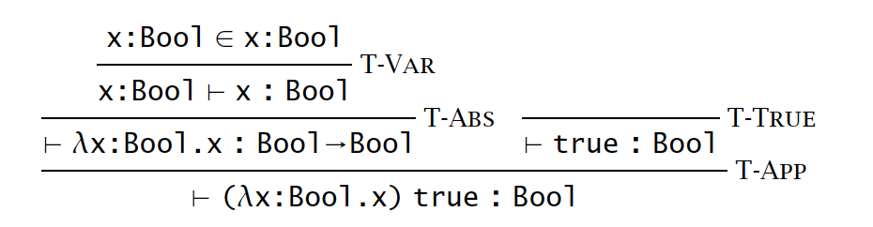
Derivations

Slide 11
Type checking

Slide 12
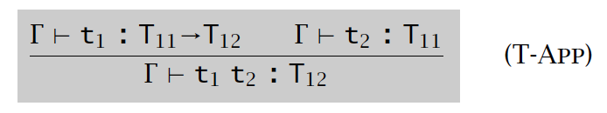
Type checking
type t =
| Var of string
| Lambda of string * tipe * t
| App of t * t
type tipe =
| Bool
| Arrow of tipe * tipe
type env = (string * tipe) list
let rec check (g: env, t: t): Tipe =
match t with
| Var x -> lookup (env, x)
| Lambda (x, tipe, t) ->
check(insert(g, x, tipe), t)
| App (t1, t2) ->
let left = check(g, t1) in
let right = check(g, t2) in
match left with
| Bool -> error …
| Arrow (ty1, ty2) -> …

Slide 13
Properties

Slide 14
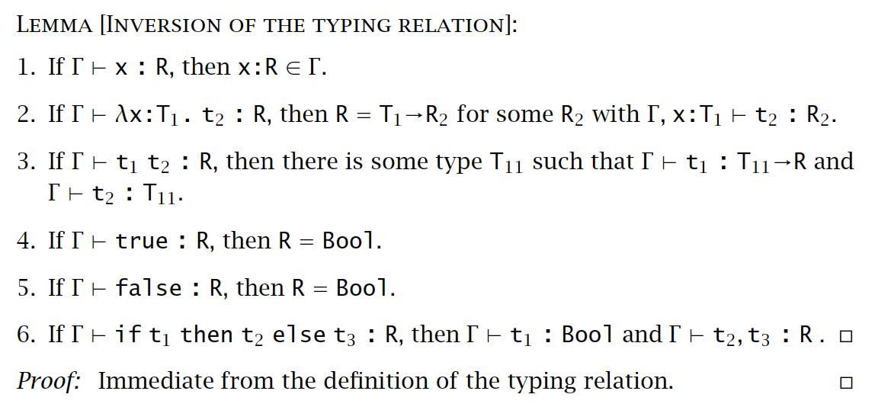
Inversion lemma

Slide 15
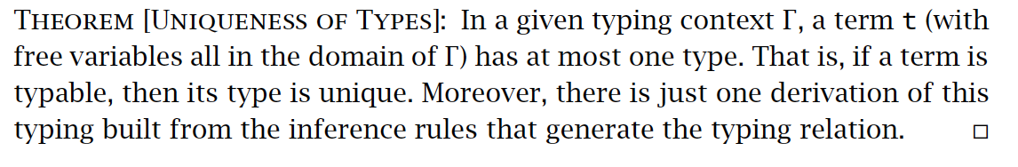
Uniqueness of types

Slide 16
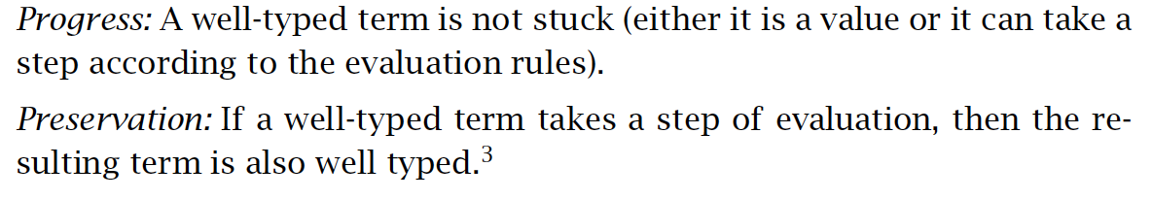
Safety = Progress + Preservation
t1 -> t2 -> t3 -> t4 -> …
: : : : :
T1 T2 T3 T4 …

Slide 17
Progress
Proof. By induction on the typing relation t: T.
Γ |- x: T
Γ |- (λx:T1.t): T
Γ |- t1 t2: T, then t1: T1-> T and t2: T1
apply induction hypothesis on t1: T1 and t2: T1.

Slide 18
Preservation
Proof. By induction on the typing relation t: T.
Leave as exercise.

Slide 19
Curry-Howard Isomorphism

Slide 20
Curry-Howard Isomorphism
A deep connection between Math (logic) and CS
by Curry 1958, and Howard 1980
Key observation: a proof of logic formulae is a program (vice versa)
Ex. P -> Q
P /\ Q

Slide 21
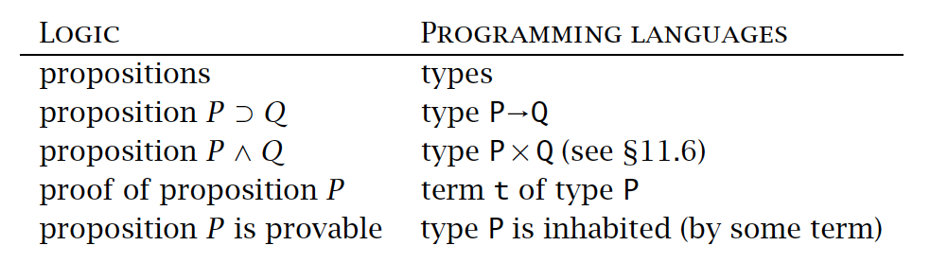
Curry-Howard Isomorphism

Slide 22
Erasure and Typability

Slide 23
Type erasure
Key insight: types are not needed during evaluation.
Or, in compiler’s terminology, types are erased after type checking.
At least for some statically typed languages, such as C.
But not for dynamical languages like Python or Java

Slide 24
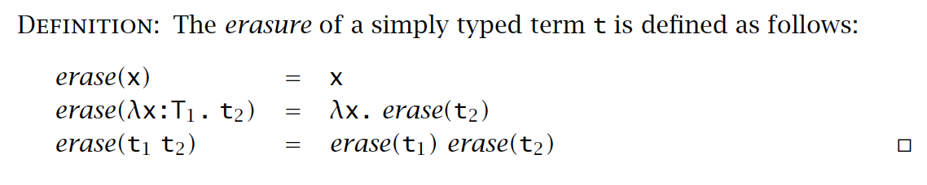
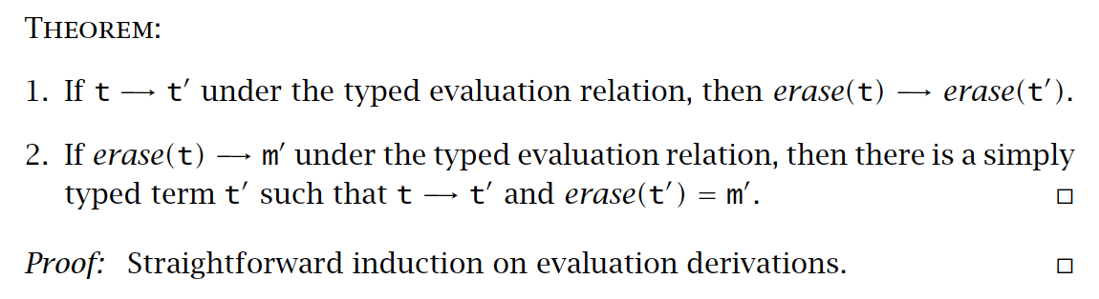
Type erasure

Slide 25
No FREE lunch
It should be noted that type system is a kind of constraints.
E.x: omega = λx. x x
can we assign a type to it?
safe
unsafe
types
more
advanced
types

Slide 26
Summary
Typing relation on lambda calculus
Can be performed by compilers via so-called type checking
Safety = progress + preservation
Deep connection with math via the Curry-Howard isomorphism

