Slide 1
Property-based Testing
Formal Methods Foundation
Baojian Hua
bjhua@ustc.edu.cn

Slide 2
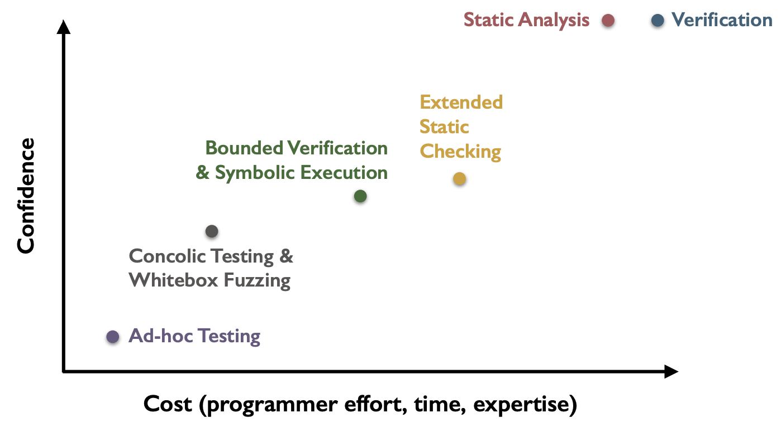
Spectrum of program validation methods
Today’s topic

Slide 3
How does software testing work?
// Suppose we want to test an addition function:
def add(x: int, y: int)->int:
return x+y
// The idea of expected output-based testing:
// testers specify the expected output.
assert add(0, 0)==0
assert add(1, 1)==2
assert add(3, 4)==7
… // others
called “testing oracle”

Slide 4
Why testing may fail?
// How to test the buggy “add” implementation:
def add(x: int, y: int)->int:
match x:
case 1234567890: return y
case _: return x+y
// Constructing effective testing oracles with a // black-box strategy remains challenging:
assert add(0, 0)==0
assert add(3, 4)==7
assert add(1024, 987)==2111
… // more

Slide 5
Does a white-box strategy help?
// White-box testing/fuzzing may also be hard:
void foo(int a, int b){
int x = 1, y = 0;
if(a != 0){
y = 3+x;
if(b == 0)
x = 2*(a+b);
}
assert(x-y != 0);
}
Input: a=0, b=0
Get: x=1, y=0
Input: a=1, b=0
Get: x=2, y=4
Input: a=1, b=1
Get: x=1, y=4
…
Can we construct the values for inputs x and y, to trigger this assertion?

Slide 6


Program testing in general

Slide 7
Randomization
// How to test the buggy “add” implementation:
def add(x: int, y: int)->int:
match x:
case 1234567890: return y
case _: return x+y
// We may randomize the inputs:
rx = randomInt()
ry = randomInt()
expected_value = ???
assert add(rx, ry) == expected_value
How can we construct the expected values that are used as oracles?

Slide 8
Constructing Oracles
Idea #1: differential testing
  to write another reference implementation with the same functionality but maybe different algorithms
def add(x: int, y: int)->int:
match x:
case 1234567890: return y
case _: return x+y
rx = randomInt()
ry = randomInt()
expected_value = add_ref(rx, ry)
assert add(rx, ry) == expected_value
def add_ref(x: int, y:int)->int:
return x+y

Slide 9
Constructing Oracles
Idea #1: differential testing
  to write another reference implementation with the same functionality but maybe different algorithms
  but writing such reference implementation may be non-trivial
  and may also be buggy

Slide 10
Constructing Oracles
Idea #2: metamorphic testing
  to specify the relationship between different executions
def add(x: int, y: int)->int:
match x:
case 1234567890: return y
case _: return x+y
rx = randomInt()
ry = randomInt()
value1 = add(rx, ry)
value2 = add(-rx, -ry)
assert value1 == -value2

Slide 11
Constructing Oracles
Idea #2: metamorphic testing
  to specify the relationship between different executions
  but specifying the relationship itself may be challenging
  and identifying the root causes may also be non-trivial

Slide 12
Property-based Testing (PBT)

Slide 13
Brief History
1997: Property-Based Testing: A New Approach to Testing for Assurance (Fink & Bishop)
2000: QuickCheck: A Lightweight Tool for Random Testing of Haskell Programs (Claessen & Hughes)
Many practical systems, e.g.:
  “hypothesis” for Python
  “jqwik” for Java
  ”proptest” for Rust

Slide 14
Key Idea
Instead of specifying the expected output, testers specify the expected properties:
  often manifesting as logic formulae
    which we have discussed in previous lectures
  along with strategies to generate test data
    data are used to test the properties
    with default strategy of randomization

Slide 15
Architecture
Tester
// Properties (logic formulae):
add(x, y) == add(y, x)
add(0, x) == x
add(x, 0) == x
add(x, -x) == 0
// Strategies (e.g., randomization):
st.integers()
st.integers().map(lambda x=>x*x)
// Program being tested:
def add(x: int, y: int)
->int:
match x:
case 1234567890: return y
case _: return x+y
PBT system
Checker API
Pass / Fail?
Generator
Shrinker
Programmer

Slide 16
Complete Running Example in
Hypothesis
// Program being tested:
def add(x: int, y: int)
->int:
match x:
case 1234567890: return y
case _: return x+y
// various properties:
def add_prop1(x, y):
assert add(x, y) == add(y, x)
def add_prop2(x, y):
assert add(x, 0) == x
def add_prop3(x, y):
assert add(x, -x) == 0
// Generators:
@given(st.integers(), st.integers())
@settings(max_examples=10000)
def test_add(x: int, y: int):
add_prop1(x, y)
add_prop2(x, y)
add_prop3(x, y)
// entry:
if __name__ == “__main__”:
test_add()
Predicate logic formulae,
which almost define “+” uniquely.

Slide 17
Constructing Properties
(or, Writing Logical Formulae)

Slide 18
Sample Properties
Algebraic properties
  commutativity, associativity, …
    f(x, y)=f(y, x), f(f(x, y), z)=f(x, f(y, z))
Idempotence
  f(f(x))=f(x)
    e.g., sort(sort(l))=sort(l)
Inversion
  e.g.: serialization/deserialization, inc/dec, lock/unlock, …

Slide 19
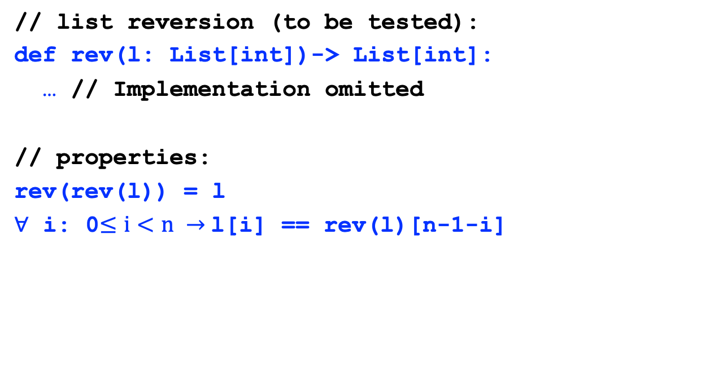
More Example #1:
List Reverse
// list reversion (to be tested):
def rev(l: List[int])-> List[int]:
… // Implementation omitted
// properties:
rev(rev(l)) = l
$∀$ i: 0$≤i<n →$l[i] == rev(l)[n-1-i]

Slide 20
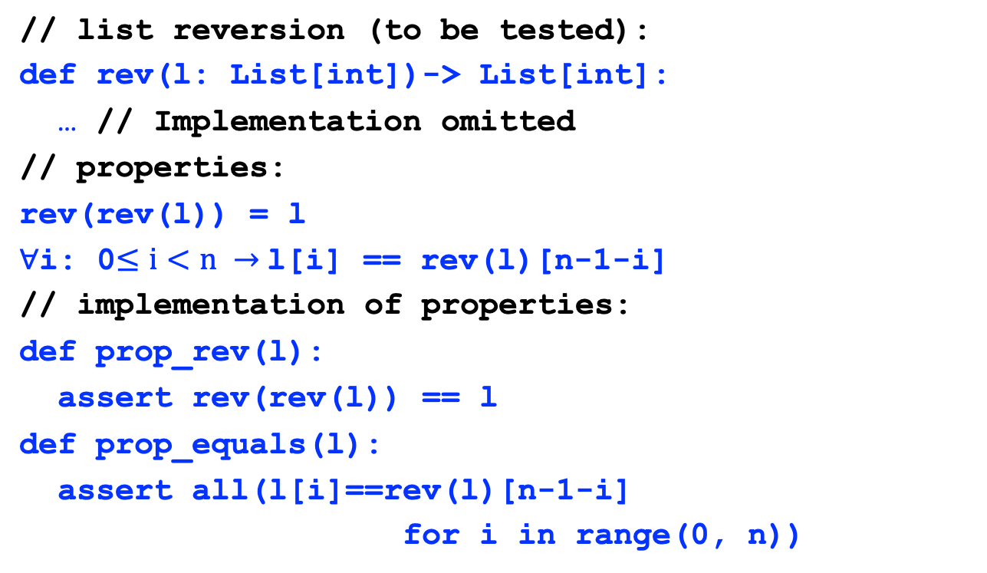
More Example #1:
List Reverse
// list reversion (to be tested):
def rev(l: List[int])-> List[int]:
… // Implementation omitted
// properties:
rev(rev(l)) = l
$∀$i: 0$≤i<n →$l[i] == rev(l)[n-1-i]
// implementation of properties:
def prop_rev(l):
assert rev(rev(l)) == l
def prop_equals(l):
assert all(l[i]==rev(l)[n-1-i]
for i in range(0, n))

Slide 21
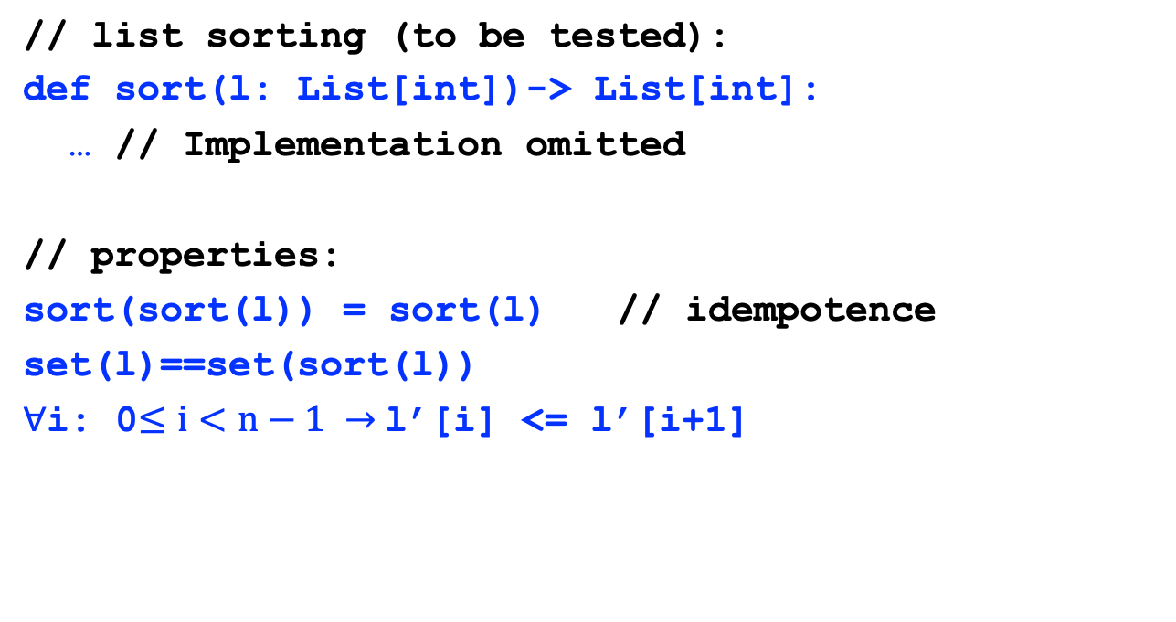
More Example #2:
List Sorting
// list sorting (to be tested):
def sort(l: List[int])-> List[int]:
… // Implementation omitted
// properties:
sort(sort(l)) = sort(l) // idempotence
set(l)==set(sort(l))
$∀$i: 0$≤i<n−1 →$l’[i] <= l’[i+1]

Slide 22
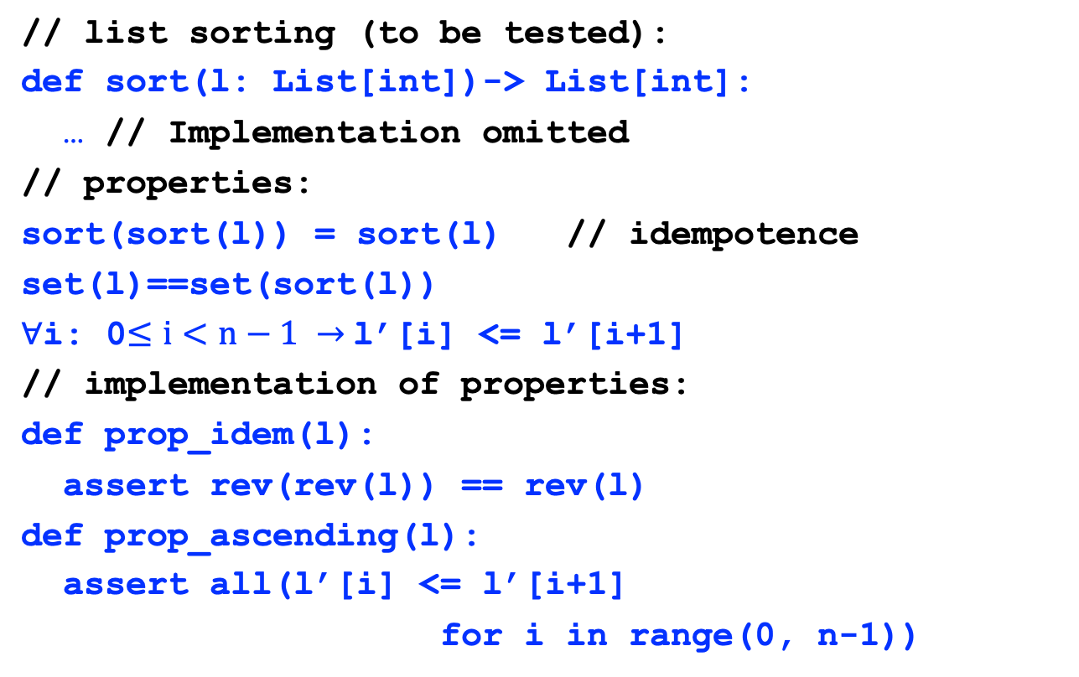
More Example #2:
List Sorting
// list sorting (to be tested):
def sort(l: List[int])-> List[int]:
… // Implementation omitted
// properties:
sort(sort(l)) = sort(l) // idempotence
set(l)==set(sort(l))
$∀$i: 0$≤i<n−1 →$l’[i] <= l’[i+1]
// implementation of properties:
def prop_idem(l):
assert rev(rev(l)) == rev(l)
def prop_ascending(l):
assert all(l’[i] <= l’[i+1]
for i in range(0, n-1))

Slide 23
Proving Properties:
Beyond Property Checking

Slide 24
Property Checking vs Proving
PBTs checks the properties for correctness
  but w.r.t the generated inputs
Sound but incomplete
  we can identify the existence of bugs
  but not the absence of bugs
We can leverage theorem proving to ensure the completeness

Slide 25
Example #1: addition
// Program being tested (Python):
def add(x: int, y: int)
->int:
match x:
case 1234567890: return y
case _: return x+y
// various properties:
def add_prop1(x, y):
assert add(x, y) == add(y, x)
def add_prop2(x, y):
assert add(x, 0) == x
def add_prop3(x, y):
assert add(x, -x) == 0
// Program being proved (Lean):
def add x y := Int.add x y
// various proofs:
theorem add_prop1:
add x y = add y x
:= by unfold add; grind
theorem add_prop2:
add x 0 = x
:= by unfold add; grind
def add_prop3:
add x (-x) = 0
:= by unfold add; grind

Slide 26
Example #2: list reverse
// Program being tested (Python):
def rev(l: List[int])->List[int]:
match l:
…
// various properties:
def rev_prop1(l):
assert rev(rev(l)) == l
def rev_prop2(l, l’):
\forall i:0<=i<n ->
l[i] == l’[n-1-i]
// Program being proved (Lean):
def rev (l: List Int) := l.reverse
// various proofs:
theorem rev_prop1:
rev (rev l) = l
:= by unfold rev; grind
def is_order l l’ n :=
\forall i, i<n \to l[i]=l’[n-1-i]
theorem rev_prop2:
is_order l (rev l) l.length
:= by … // tedious proof…

Slide 27
Example #3: list sort
// Program being tested (Python):
def sort(l: List[int])->List[int]:
match l:
…
// various properties:
def sort_prop1(l):
assert sort(sort(l)) == sort(l)
def sort_prop2(l):
assert set(l) == set(sort(l))
def sort_prop3(l, l’):
\forall i: 0<=i<n ->
l’[i] <= l’[i+1]
// Program being proved (Lean):
def sort(l: List Int):= l.mergeSort
// various proofs:
theorem sort_prop1:
sort (sort l) = sort(l)
:= by // tedious proof…
theorem sort_prop2:
l.toSet = (sort l).toSet
:= by … // tedious proof…
theorem sort_prop3:
is_sorted (sort l) l.length
:= by … // tedious proof…

Slide 28
More on Testcase Generation

Slide 29
Testcase Generation
PBTs, by default, generate and check properties by random inputs
  while it offers some strategies to tune the data generation process
    e.g., only generate even integers as inputs
They hence may fail to reveal deep bugs
  especially those hide within complex control flows

Slide 30
Example
// Program being tested (Python):
def nest_add(x: int, y: int) -> int:
if x == 123456789:
if y == 987654321:
return 0
return x+y
// a property that does not really hold:
def fake_prop_add(x, y):
assert nest_add(x, y) == x+y
// does PBT reveal this bug?
@given(st.integers(), st.integers())
@settings(max_examples=10000)
# @settings(max_examples=10000, backend="crosshair")
def test_add(x: int, y: int):
fake_prop_add(x, y)
A new backend to generate symbolic inputs and triage them! (To be discussed next)

Slide 31
Summary
PBTs are based on the idea of testing with properties (logic formulae)
PBTs requires deep understanding of the program being tested
  but still remain black-boxed
PBTs can reveal subtle bugs that may be overlooked by output-based testings

