Slide 1
Type System Introduction
Principle of Programming Languages
Baojian Hua
bjhua@ustc.edu.cn

Slide 2
Type System (Theory)
A type system is a tractable syntactic method for proving the absence of certain program behaviors by classifying phrases according to the kinds of values they compute.

Slide 3
Properties
Tools for programs
Build into many programming languages
Automatic and tractable
No help from programmers are needed
Compilers do the hard work
Tractable means efficient
Often polynomial, sometimes exponential
Will discuss the polymorphism

Slide 4
Properties
Classification of phrases
E.g., atoms
int: -2, -1, 0, 1, 2
String: “hello”, ”world”
Compositions:
x + y: int, iff x: int & y: int
Type errors:
x+y: ?? If x: int & y: String

Slide 5
Properties
Static approximations
E.g.,
if <exp> then e1 else e2
And types of e1 and e2 must match!
Thus the reasoning is conservative
Prove the absence rather than presence of some properties

Slide 6
What type systems are good for?
Detecting errors
Many errors can be detected and fixed earlier with type systems
Enforce abstraction:
To build modules and hide information
An interface can be seen as the types of modules
Java interfaces, C .h files, OCaml .mli, …
We’ll see existential types later

Slide 7
What type systems are good for?
Documentation
Type annotations form syntactic checkable documentations
Good practice to put types on even in implicit typed languages
E.g., Python, OCaml
Language safety:
A language is safe if it protects its own abstractions

Slide 8
What type systems are good for?
Efficiency
Remove unnecessary dynamic checking code
E.g., dependent types for array range checking
Compiler generate more efficient code
E.g., register allocation
Even dynamic languages perform runtime type checks
E.g., Python

Slide 9
Type system and language design
Should go hand-in-hand
Untyped languages offer programmers little help to write reliable programs
Often untyped => typed
Python
JavaScript => TypeScript
Typed languages are often cumbersome
Type inference
We’ll discuss Hindley-Milner inference

Slide 10
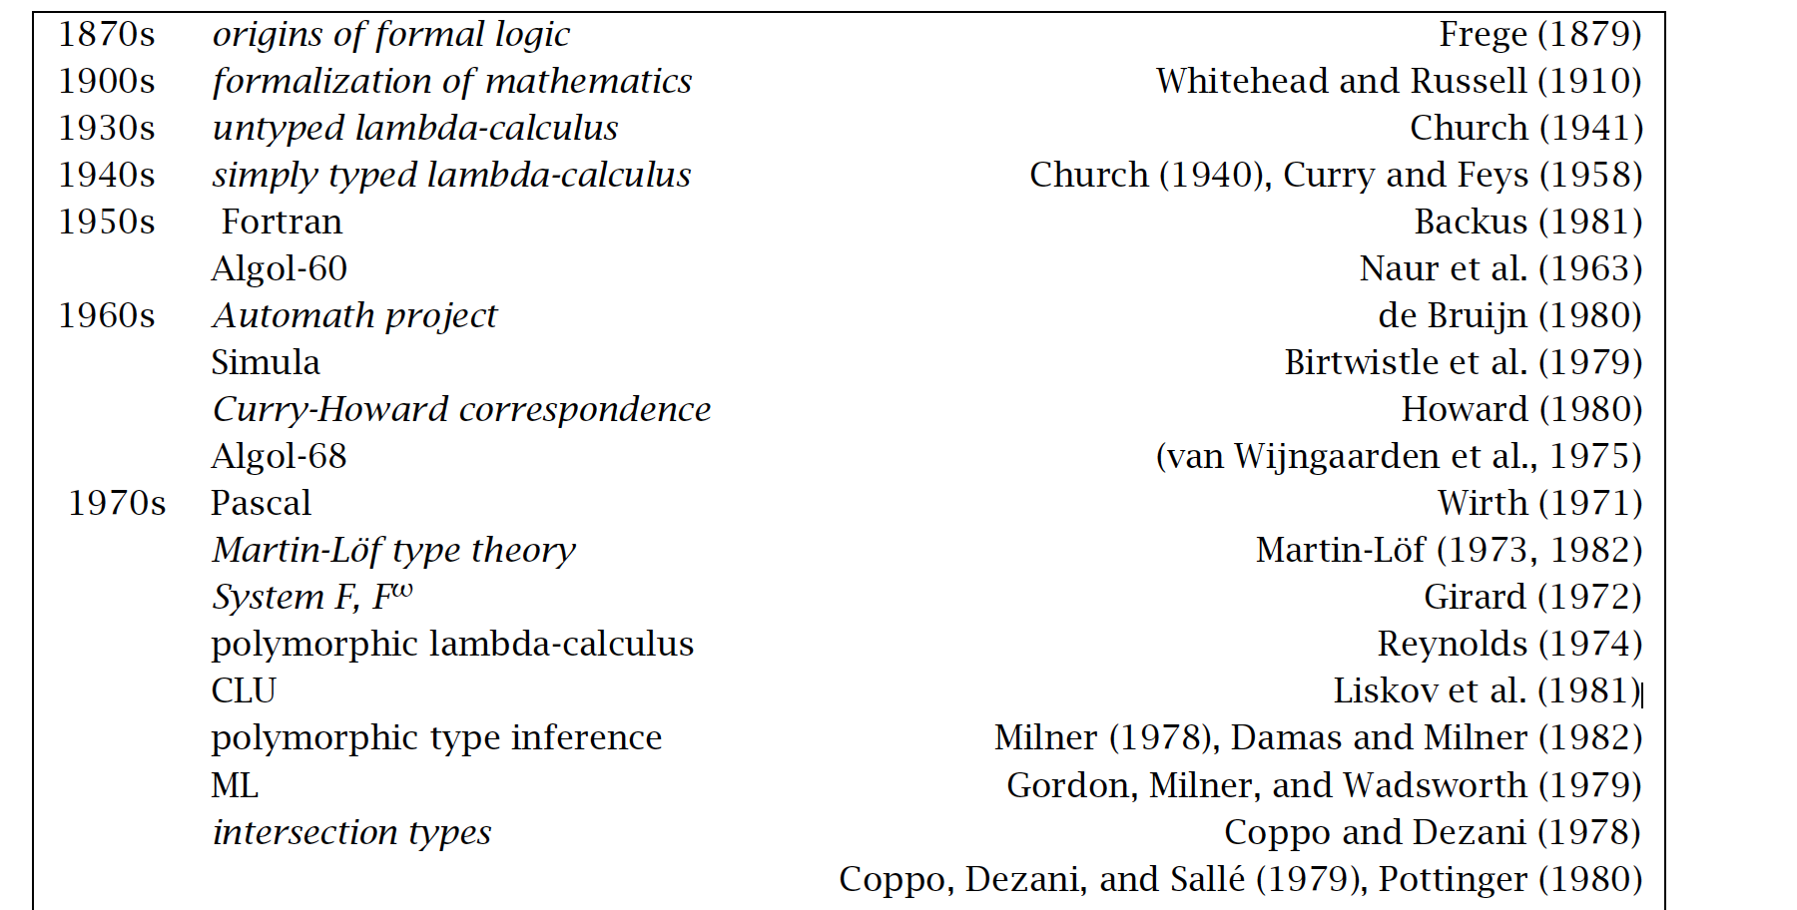
History and perspective

Slide 11
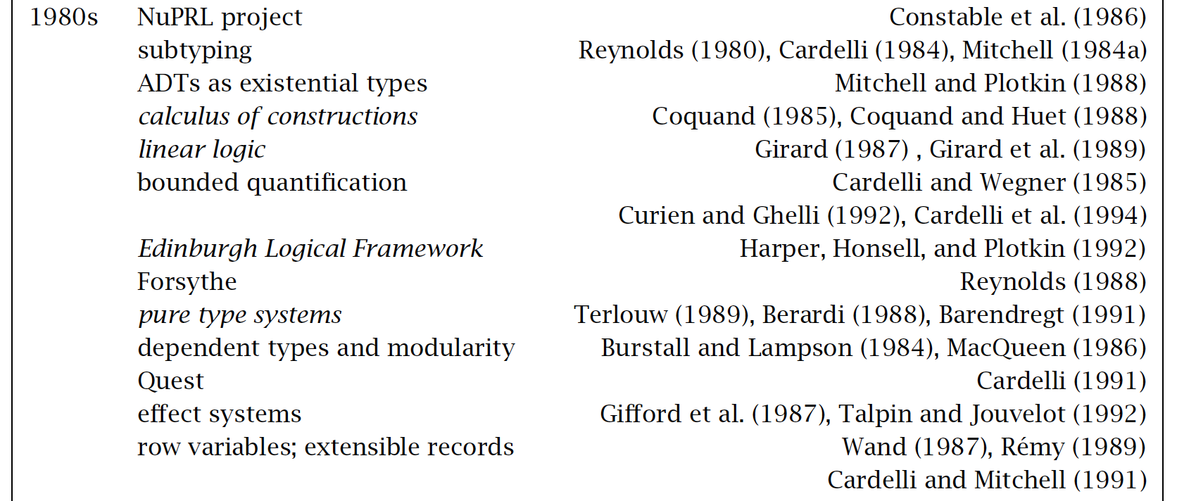
History and perspective

Slide 12
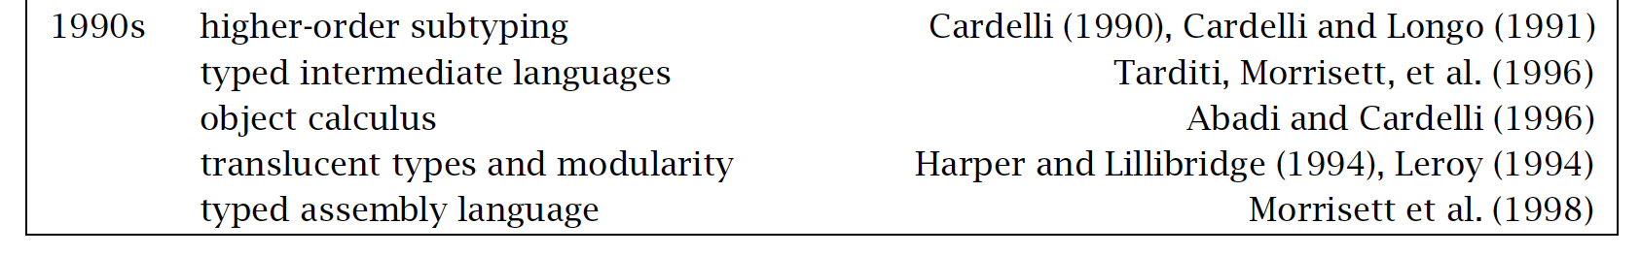
History and perspective

Slide 13
Summary
Type systems are basic discipline for modern programming languages
Many advantages for language design, security, performance, etc.
Long history and successful applications

