Slide 1
Mathematical foundation
Principle of Programming Languages
Baojian Hua
bjhua@ustc.edu.cn

Slide 2
Goals
We review some of the key results from basic mathematics
Set, relation, function
Context free grammar
Induction
We assume you’ve learned some of this from elementary math course
We just give a quick review
To make this course self-contained

Slide 3
Set, Relation, Function

Slide 4
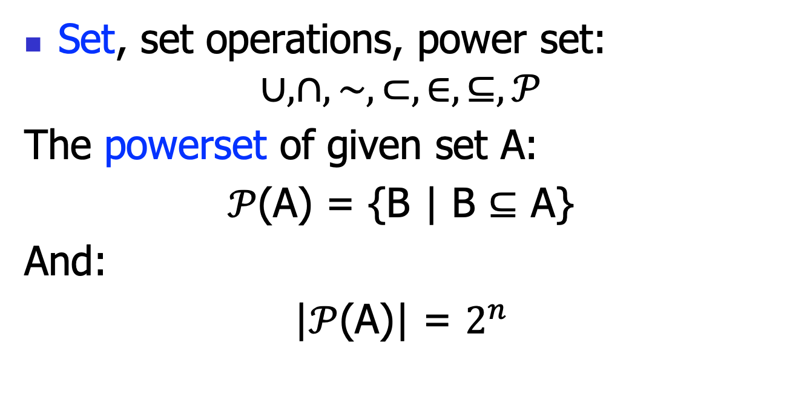
Sets
Set, set operations, power set:
$$∪, ∩,\sim ,⊂, ∈,⊆,𝒫$$
The powerset of given set A:
$𝒫$(A) = {B | B $⊆$ A}
And:
|$𝒫$(A)| = $2^{n}$

Slide 5
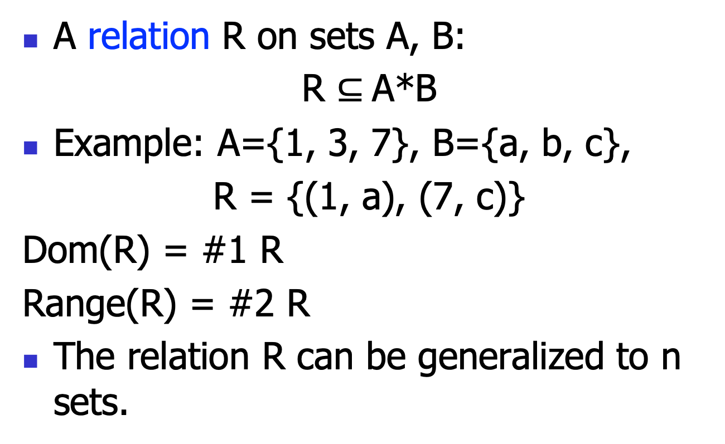
Relation
A relation R on sets A, B:
R $⊆$A*B
Example: A={1, 3, 7}, B={a, b, c},
R = {(1, a), (7, c)}
Dom(R) = #1 R
Range(R) = #2 R
The relation R can be generalized to n sets.

Slide 6
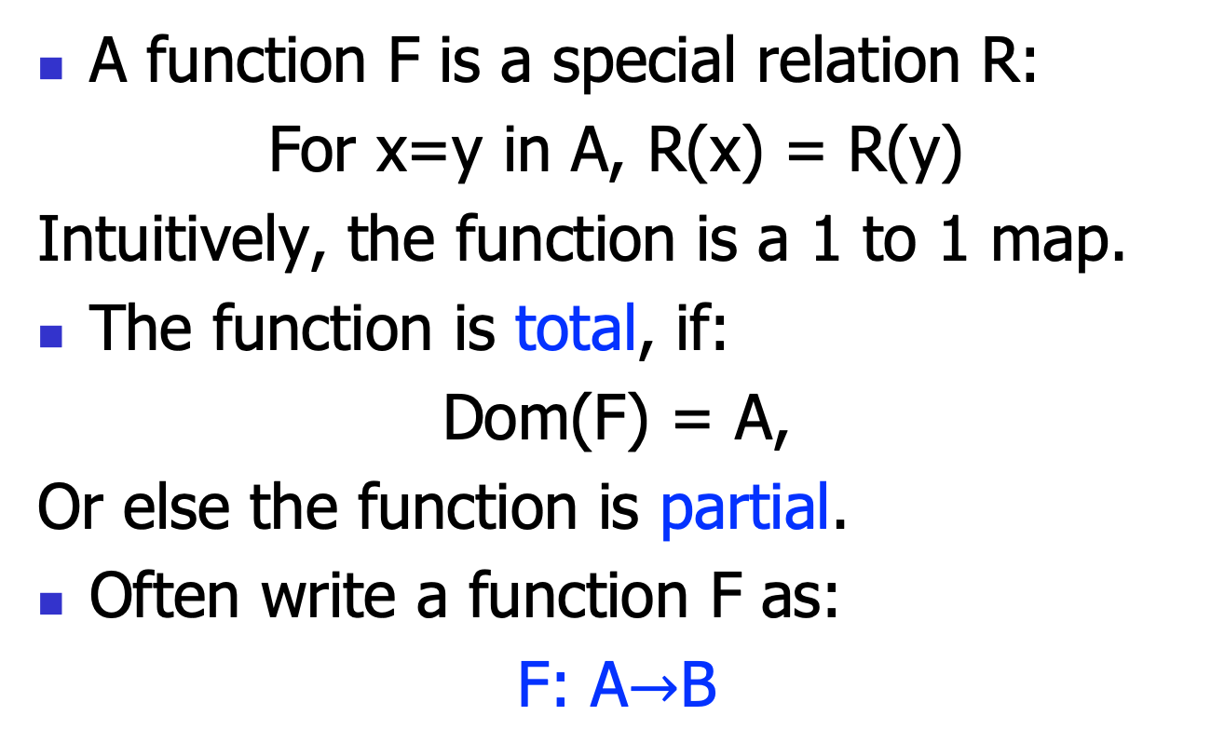
Function
A function F is a special relation R:
For x=y in A, R(x) = R(y)
Intuitively, the function is a 1 to 1 map.
The function is total, if:
Dom(F) = A,
Or else the function is partial.
Often write a function F as:
F: A$→$B

Slide 7
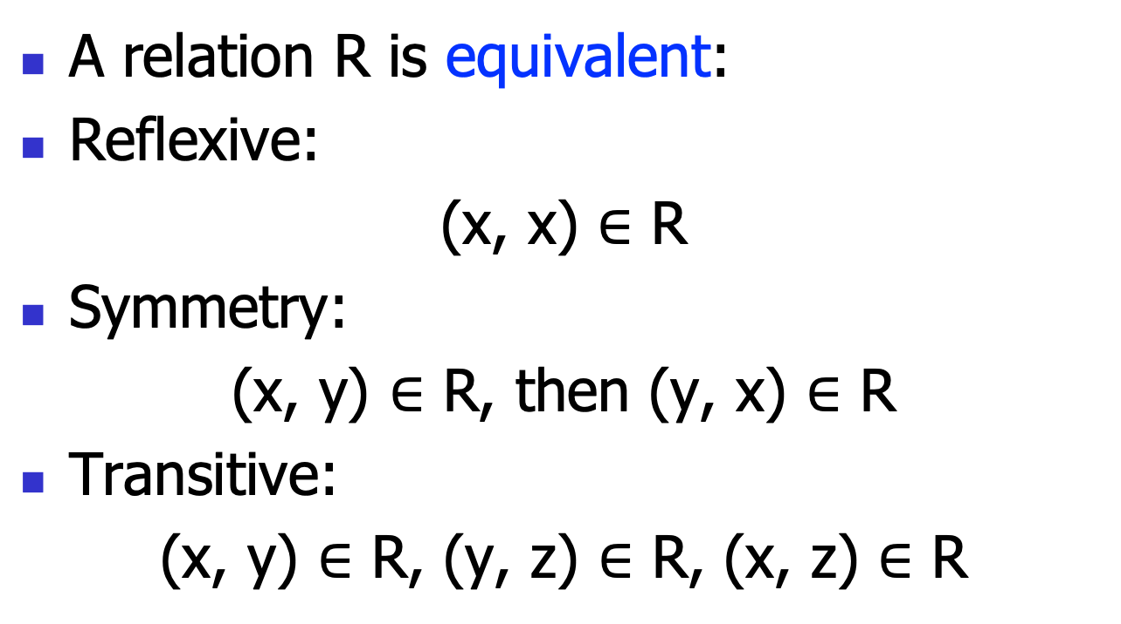
More Relation
A relation R is equivalent:
Reflexive:
(x, x) $∈$ R
Symmetry:
(x, y) $∈$ R, then (y, x) $∈$ R
Transitive:
(x, y) $∈$ R, (y, z) $∈$ R, (x, z) $∈$ R

Slide 8
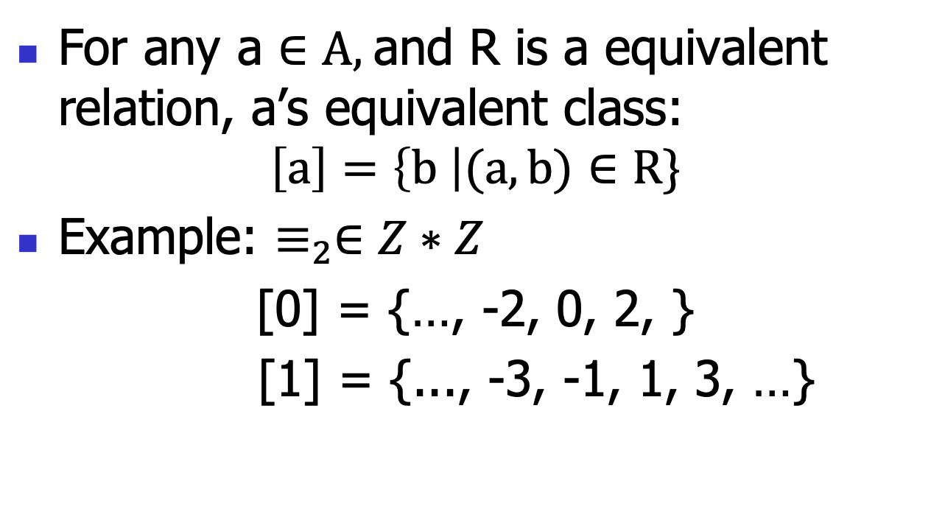
Equivalent class
For any a $∈A,$and R is a equivalent relation, a’s equivalent class:
$$\left[a\right]=\left\{b \right|(a, b)∈R\}$$
Example: $≡_{2}∈Z∗Z$
[0] = {…, -2, 0, 2, }
[1] = {..., -3, -1, 1, 3, …}

Slide 9
Context-free Grammar

Slide 10
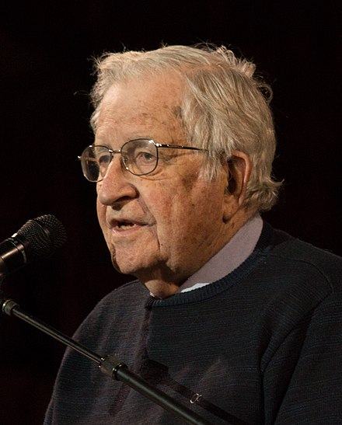
Context-free Grammar: History
Developed by Noam Chomsky in 1956
To study linguistics
A long time standing question in understanding natural languages (even to today’s deep learning)
First used in the design of the Algo language
Backus, Naur, 1957-60
Expressive enough to encode language syntax, yet simple enough to write parsers

Slide 11
Context-free Grammar (CFG)
A CFG consists of 4 components:
a set of terminals (tokens): T
a set of nonterminals: N
a set of production rules: P
s -> t1 t2 … tn
with s∈N, and t1, …, tn ∈(T ∪N)
a unique start nonterminal: S

Slide 12
Example
// SLP as in Tiger book chap. 1 (simplified):
N = {S, E}
T = {SEMICOLON, ID, NUM, PLUS, TIMES, IF, ASSIGN,
PRINT, LPAREN, RPAREN}
S = S
S -> S SEMICOLON S
| ID ASSIGN E
| PRINT LPAREN E RPAREN
E -> ID
| NUM
| E PLUS E
| E TIMES E

Slide 13
Derivation
A derivation:
Starts with the unique start nonterminal S
repeatedly replacing a right-hand nonterminal T by the body of a production rule of the nonterminal T
stop when right-hand are all terminals
The final string consists only of terminals and is called a sentence (program)

Slide 14
Example
S -> S ; S
| id := E
| print (E)
E -> …
S -> … (a choice)
derive me
x := 5;
print (x)

Slide 15
Example
S -> S ; S
| id := E
| print (E)
E -> id
| num
| E + E
| E * E
S -> S ; S
-> x := E ; S
-> x := 5 ; S
-> x := 5 ; print (E)
-> x := 5 ; print (x)
derive me
x := 5;
print (x)

Slide 16
Another Try to Derive the same Program
S -> S ; S
| id := E
| print (E)
E -> …
S -> x := E
-> x := 5
-> ??? // stuck! :-(
derive me
x := 5;
print (x)

Slide 17
Derivation
For same string, there may exist many different derivations
left-most derivation
right-most derivation
Parsing is the problem of taking a string of terminals and figure out whether it could be derived from a CFG
If not, error-detection

Slide 18
Parse Trees
Derivation can also be represented as trees
useful to understand AST (discussed later)
Idea:
each internal node is labeled with a nonterminal
each leaf node is labeled with a terminal
each use of a rule in a derivation explains how to generate children in the parse tree from the parent

Slide 19
Example
S -> S ; S
| …
S
S
;
S
x
:=
E
print
(
E
)
derive me
x := 5;
print (x)
5
x

Slide 20
Parse Tree has Meanings: post-order traversal
S -> S ; S
| …
S
S
;
S
x
:=
E
print
(
E
)
derive me
x := 5;
print (x)
5
x

Slide 21
Summary
Review some basic math background knowledge
Set, relation, function
Basic context-free grammar
Will be used extensively in the following lectures

