Slide 1
Untyped Arithmetic
Principle of Programming Languages
Baojian Hua
bjhua@ustc.edu.cn

Slide 2
Syntax and induction

Slide 3
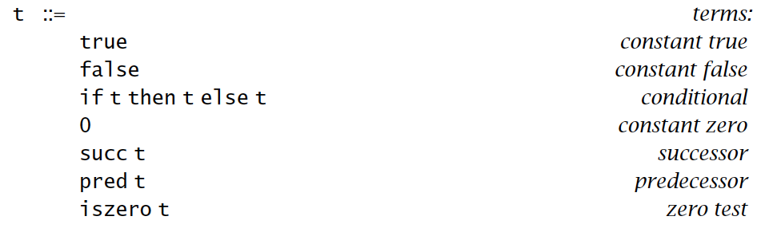
Syntax

Slide 4
Evaluation
if false then 0 else 1;
1
iszero (pred (succ 0));
true
But what about:
if 1 then 0 else 1;
if false then true else 1;

Slide 5
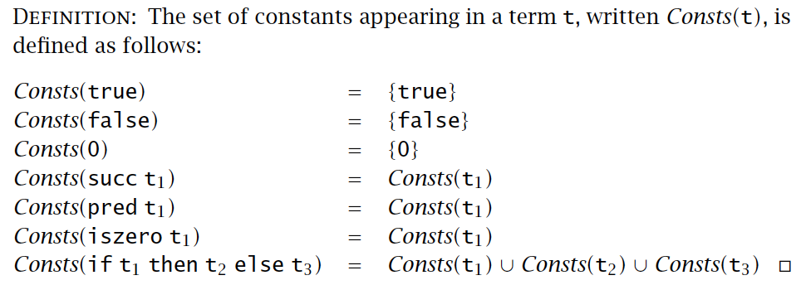
Induction: Consts

Slide 6
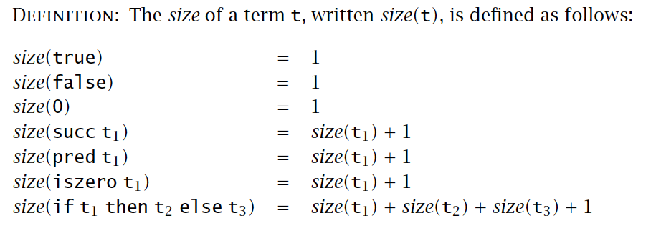
Induction: size

Slide 7
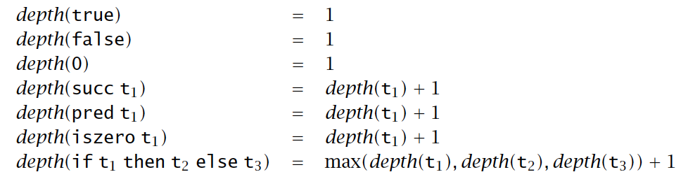
Induction: depth

Slide 8
Properties
Lemma: The number of distinct constants in a term t is no greater than the size of t (i.e., |Consts(t)| <= size(t)).

Slide 9
Properties
Lemma: The number of distinct constants in a term t is no greater than the size of t (i.e., |Consts(t)| <= size(t)).
Proof.
t = true, then |Consts(t)| = |{true}| =1,
Size(true) = 1;
t = false, then |Consts(t)| = |{false}| =1,
Size(false) = 1;

Slide 10
Properties
Proof.
t = 0, then |Consts(t)| = |{0}| =1,
Size(0) = 1;
t = succ(t1), suppose the proposition holds for t1, we have
|Consts(t1)| <= Size(t1);
Try to prove
|Consts(t)| <= Size(t);

Slide 11
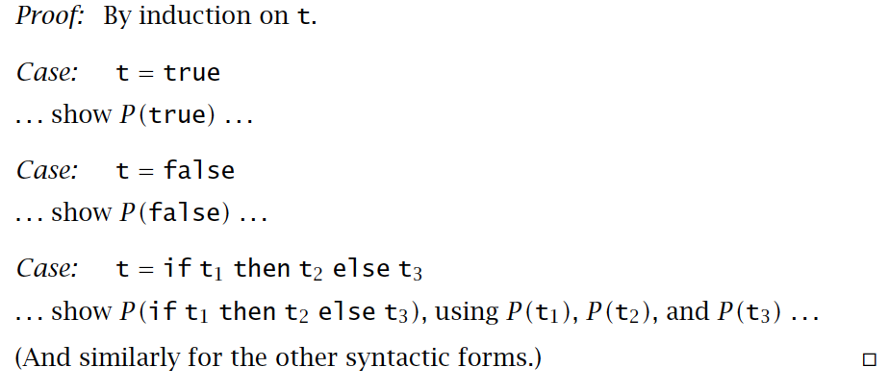
General forms for induction

Slide 12
Operational semantics

Slide 13
Semantics styles
Axiomatic semantics
Think compile to logics
Denotational semantics
Think compile to domains
Operations semantics
Think compile to abstract machines

Slide 14
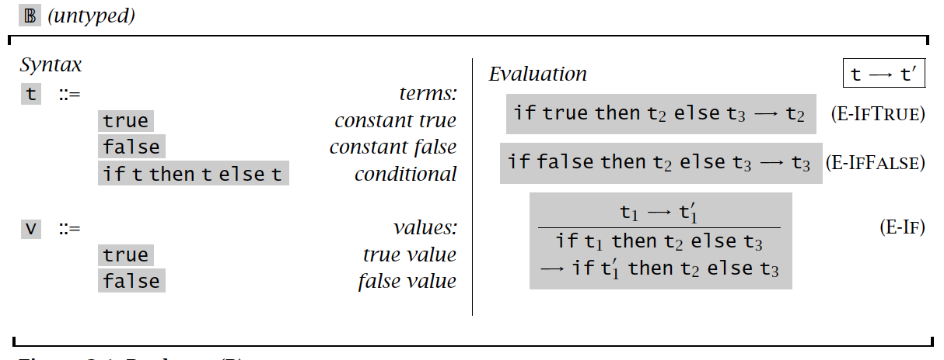
Operational semantics

Slide 15
Examples
if true then (if false then false else false) else true
if false then false else false
if false then (if false then false else false) else true
true

Slide 16


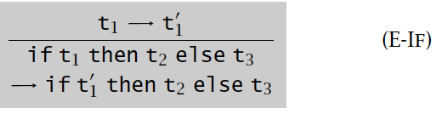
Properties
Theorem [Determinacy of one-step evaluation]: If t -> t1 and t ->t2, then t1 = t2.
Proof. By induction on t->t1. (Not on t!)
Case:
Case:
Case:

Slide 17
More properties
Normal forms: if no rules apply
Theorem: a term t is normal form, iff, t is a value.
Proof. <= easy.
=> By contradiction, then induction.

Slide 18
Multi-step evaluation
Definition: The multi-step evaluation relation →∗ is the reflexive, transitive closure of one-step evaluation.
Theorem [Uniqueness of normal forms]: If t →∗ u and t →∗ u′, where u and u′ are both normal forms, then u = u′.
Also known as “confluence”
Theorem [Termination of Evaluation]: For every term t there is some normal form t′ such that t →∗ t′.

Slide 19
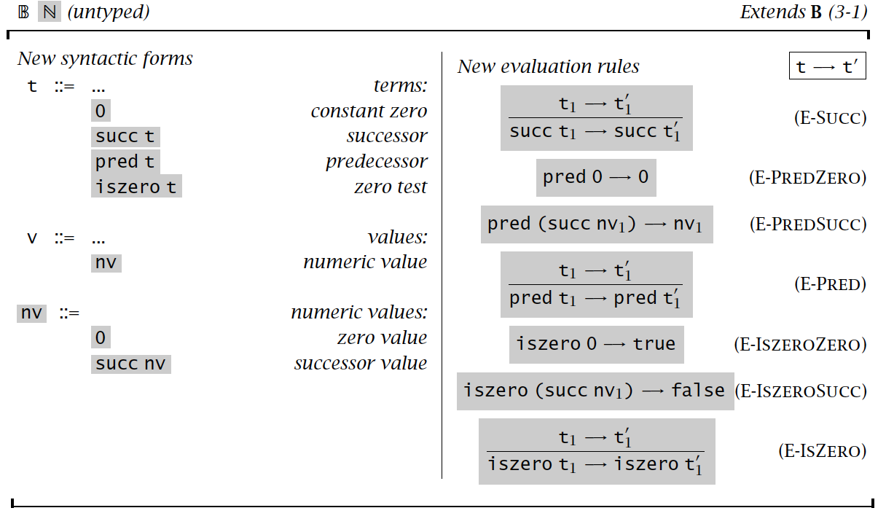
Operational semantics

Slide 20
Examples
pred(succ (pred zero))
Pred zero?
Pred(succ (zero))?

Slide 21
Stuckness
A term is normal form, but not a value
Pred true
Succ false
Iszero true
If pred zero then 1 else 0
Stuckness means wrong states
It’s the motivation for type systems

Slide 22
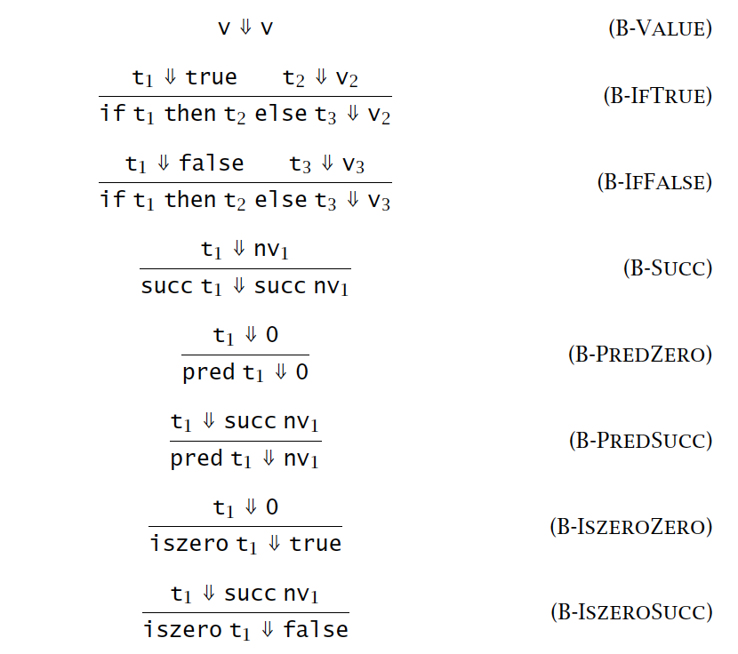
Big-step evaluation

Slide 23
Summary
Syntax for untyped arithmetic expressions
Prove nontrivial properties by inductions
Operations semantics
Small-step
Multi-step
Big-step

