Slide 1
Simply Extensions
Principle of Programming Languages
Baojian Hua
bjhua@ustc.edu.cn

Slide 2
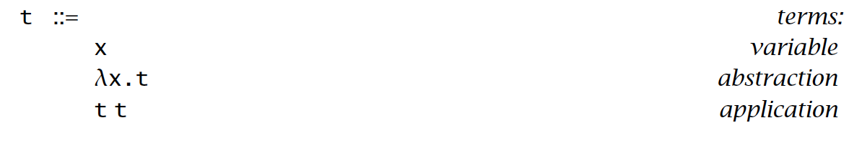
Recap: Lambda calculus

Slide 3
Extensions?
Good for theoretic study
But bad for realistic programming
we need extend the basic structures with derived forms
often called syntax sugar

Slide 4
Base Types

Slide 5
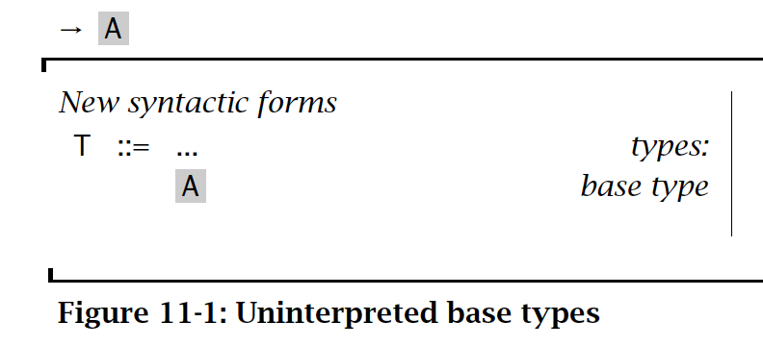
Base Types
Uninterpreted abstract types:

Slide 6
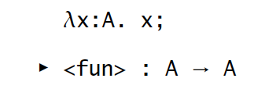
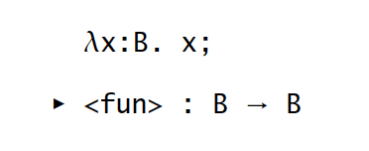
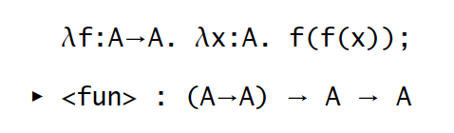
Base Types
Examples:

Slide 7
Unit type

Slide 8
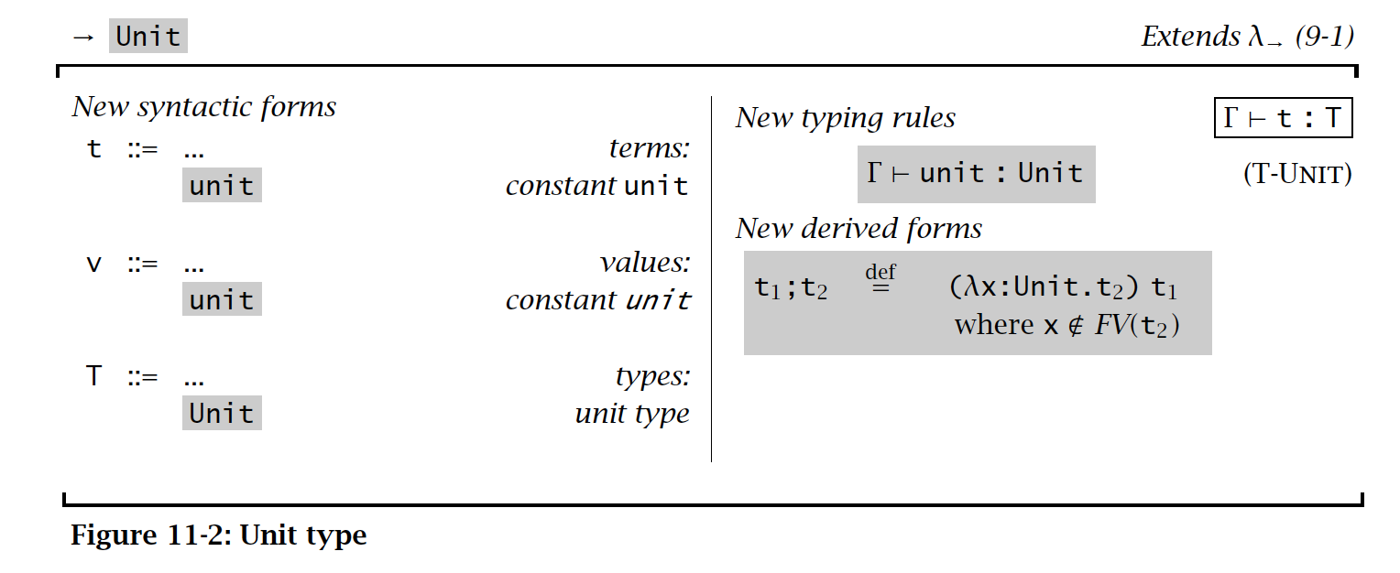
Unit Types
Stands for empty values:

Slide 9
Sequencing & Wildcard

Slide 10
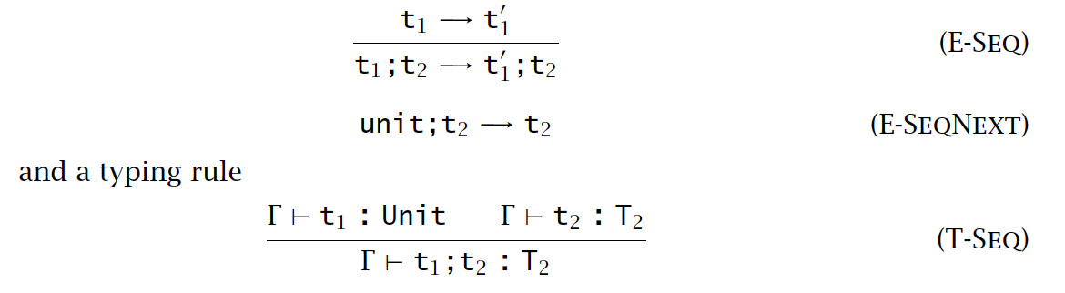
Sequencing

Slide 11

Wildcard

Slide 12
Ascription

Slide 13
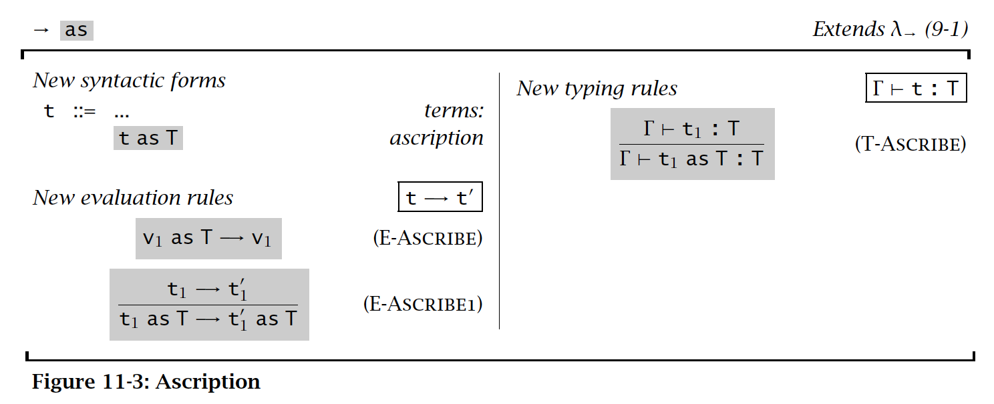
Ascription

Slide 14
Let Binding

Slide 15
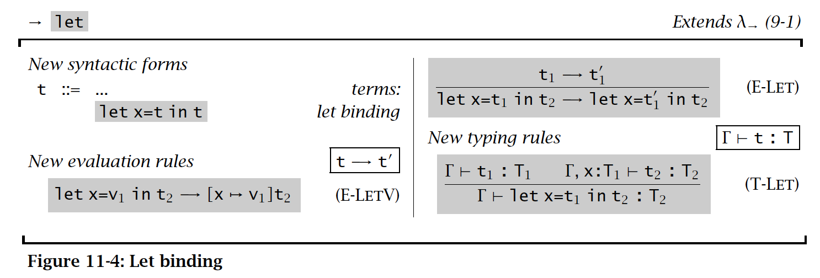
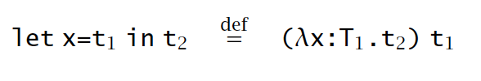
Let Binding

Slide 16
Pair

Slide 17
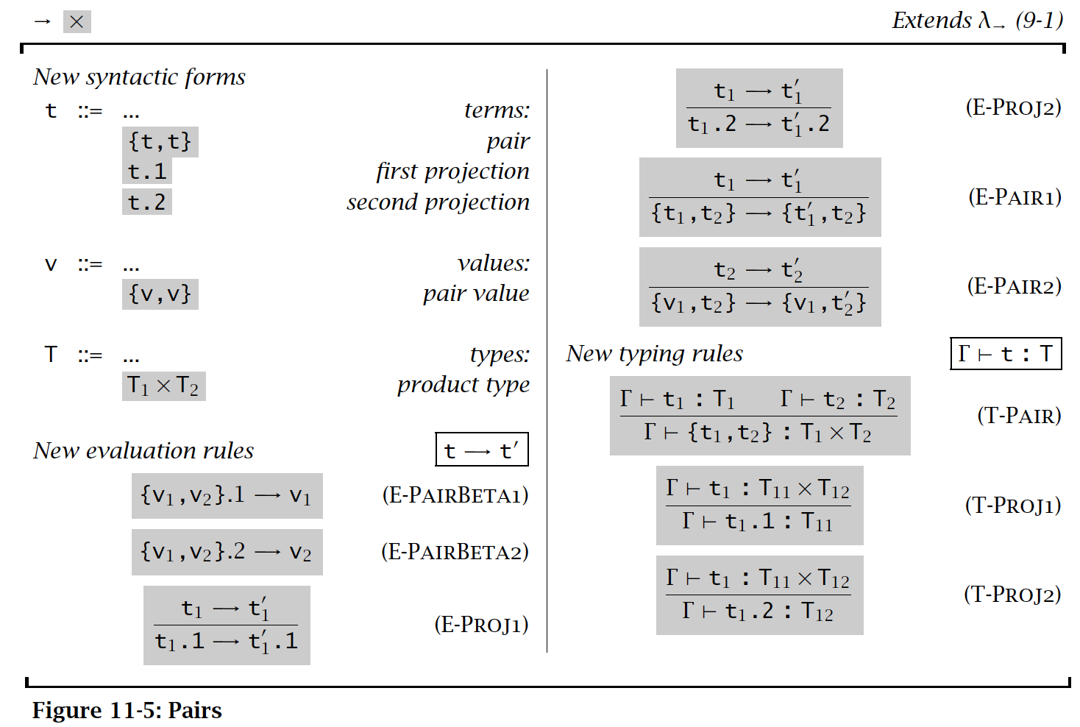
Pair

Slide 18
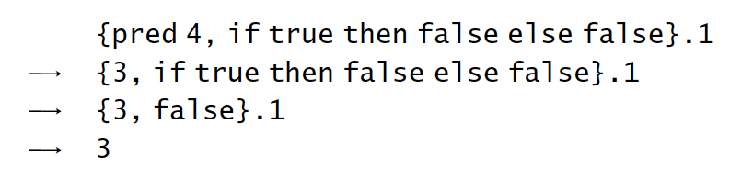
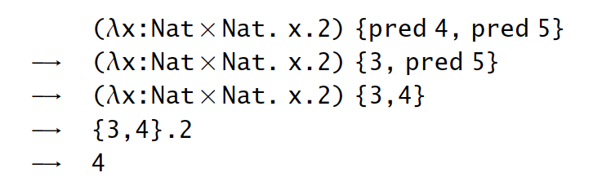
Examples

Slide 19
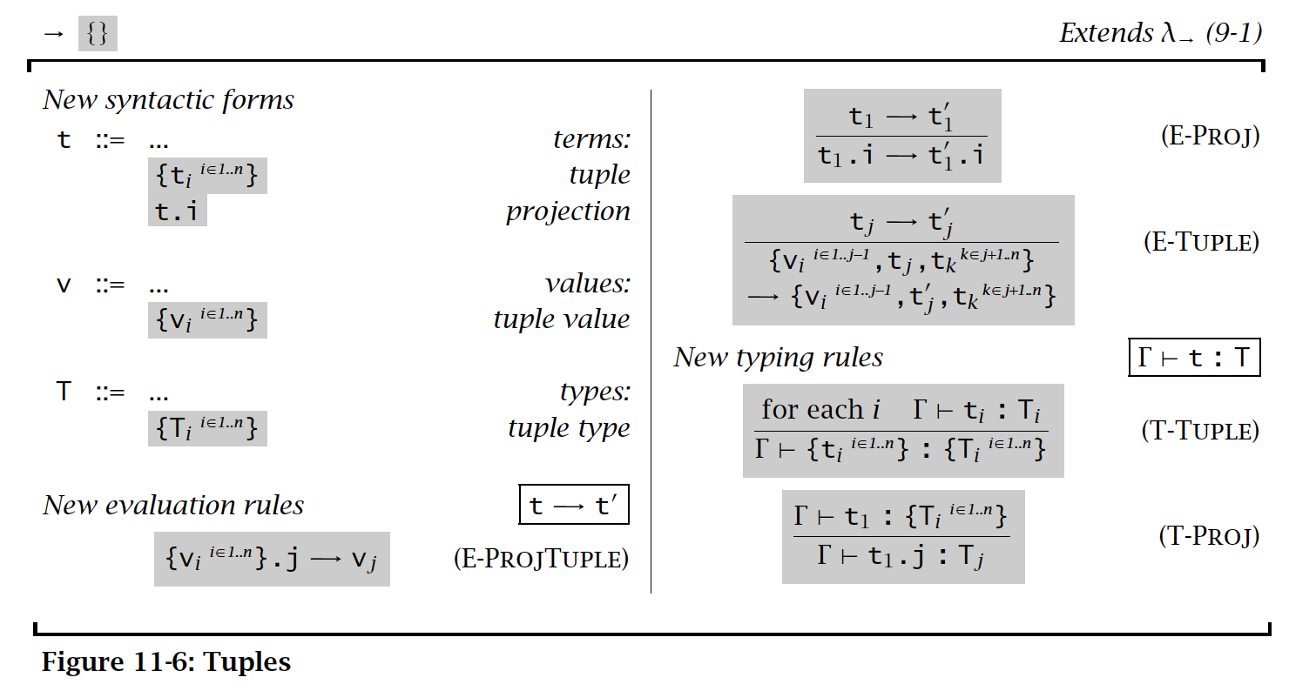
Tuple

Slide 20
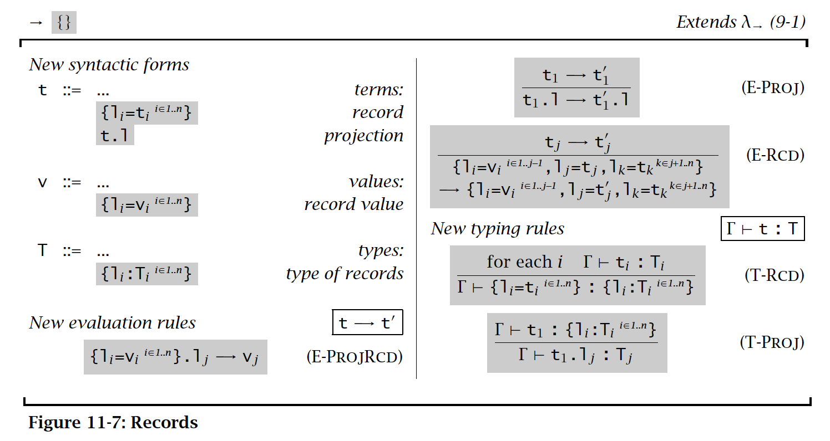
Records

Slide 21
Sum

Slide 22
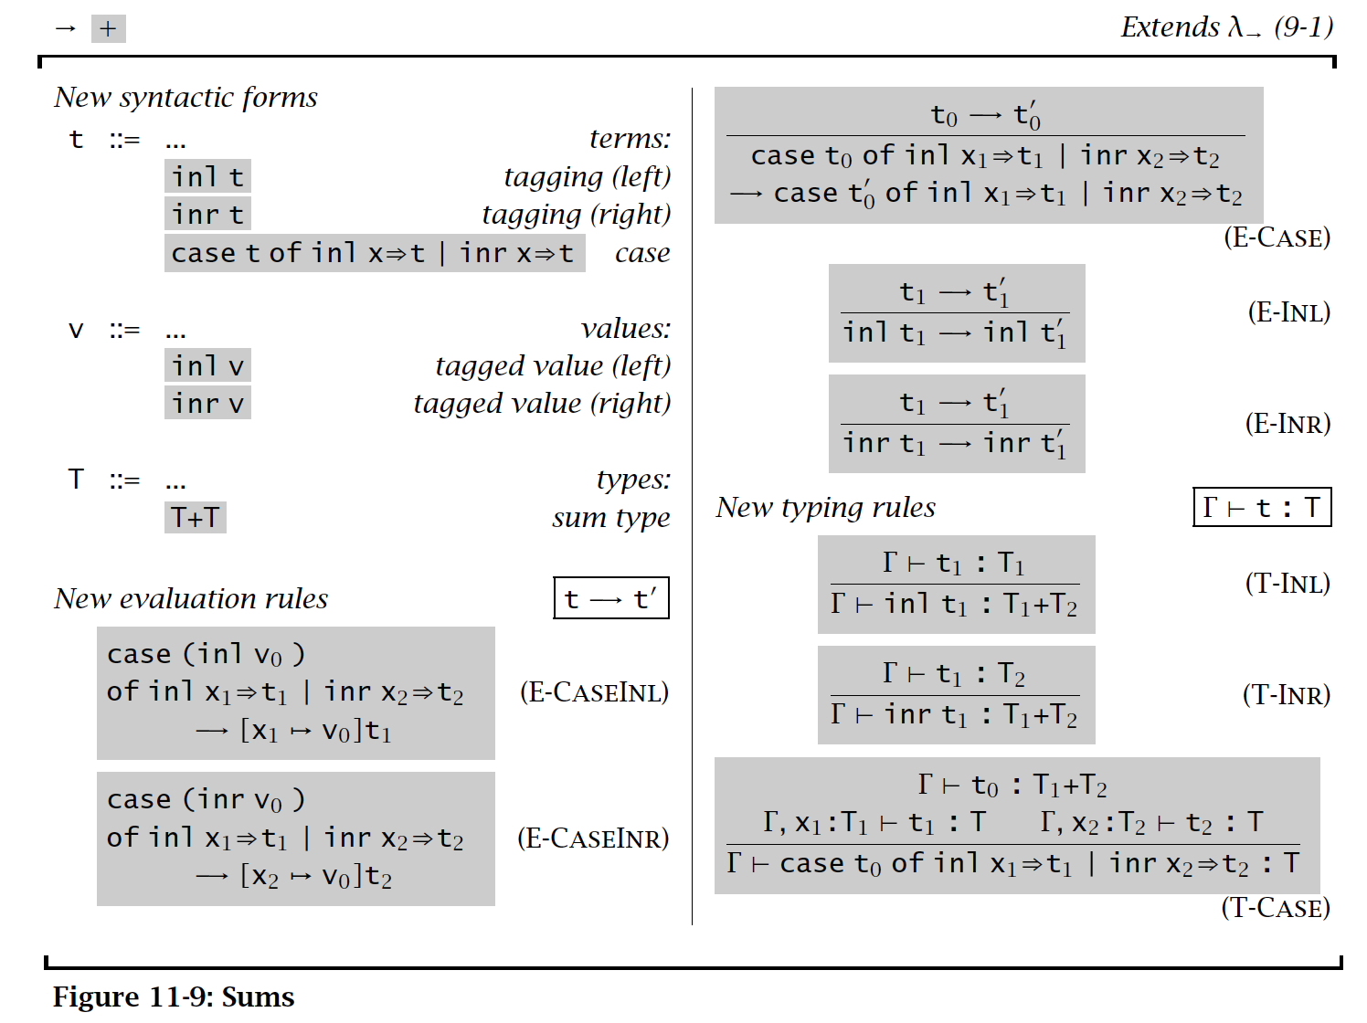
Sum

Slide 23
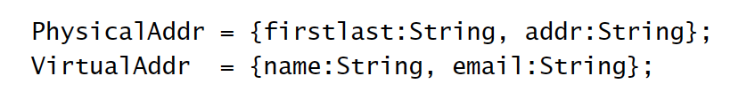

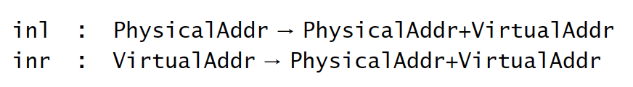
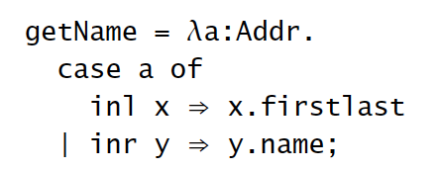
Examples

Slide 24
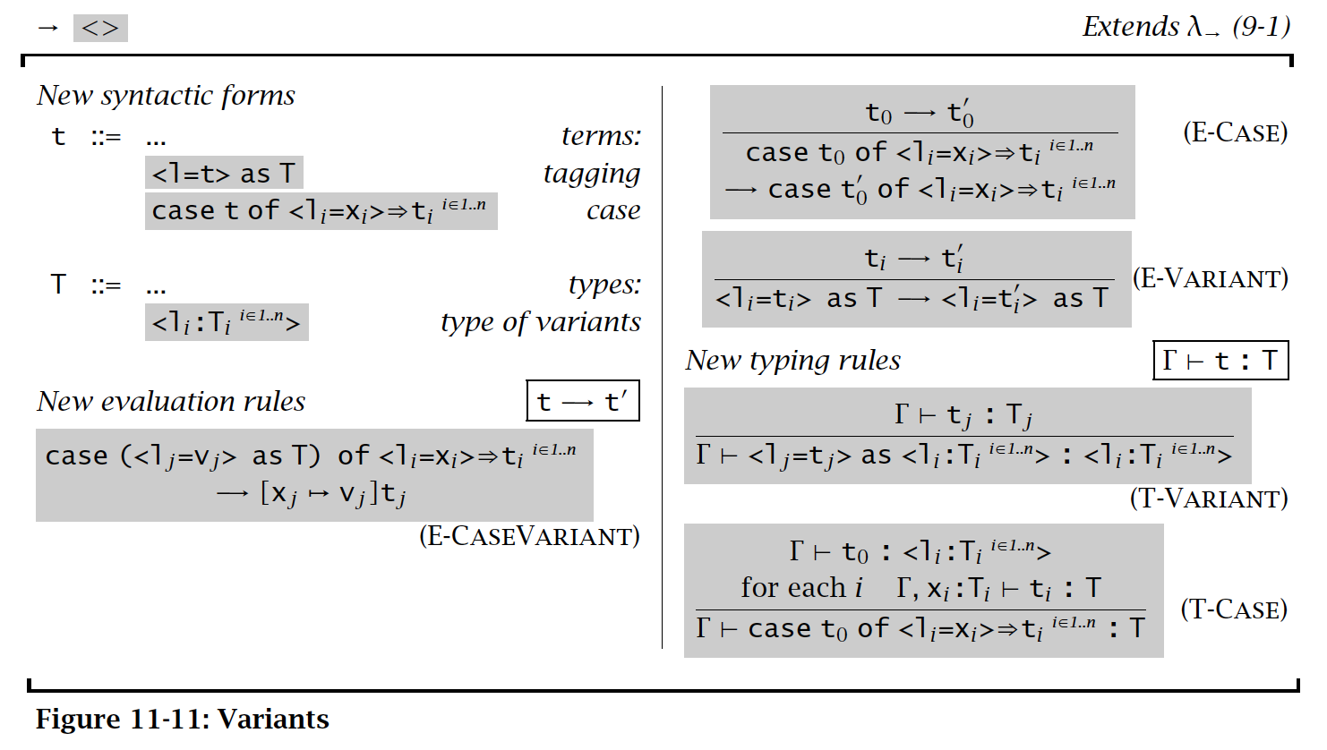
Variant

Slide 25


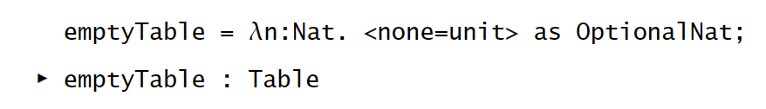
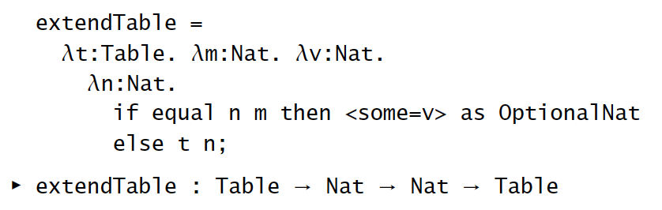
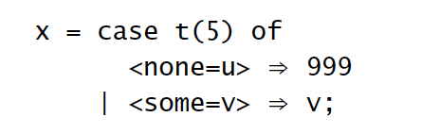
Options

Slide 26
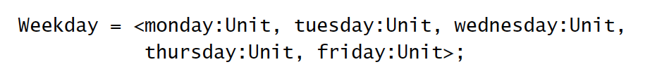
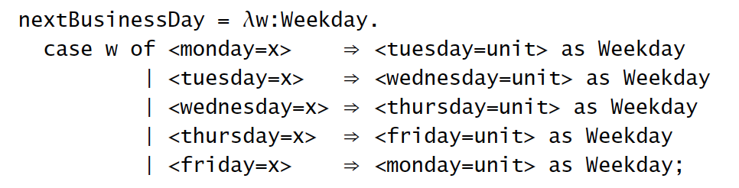
Enumeration

Slide 27
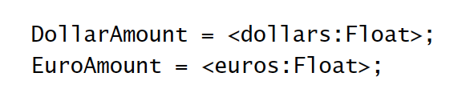
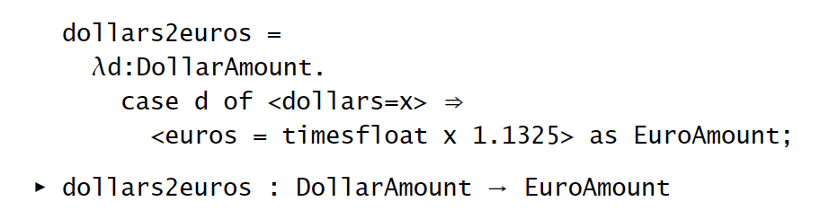
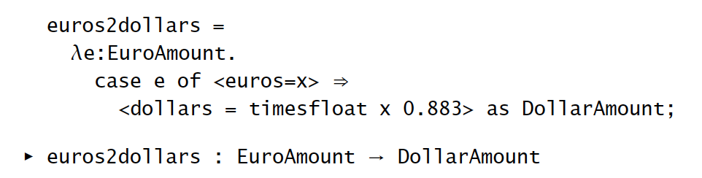
Single-Field Variants

Slide 28
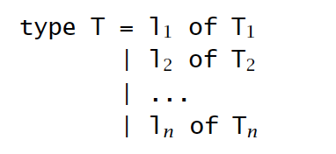
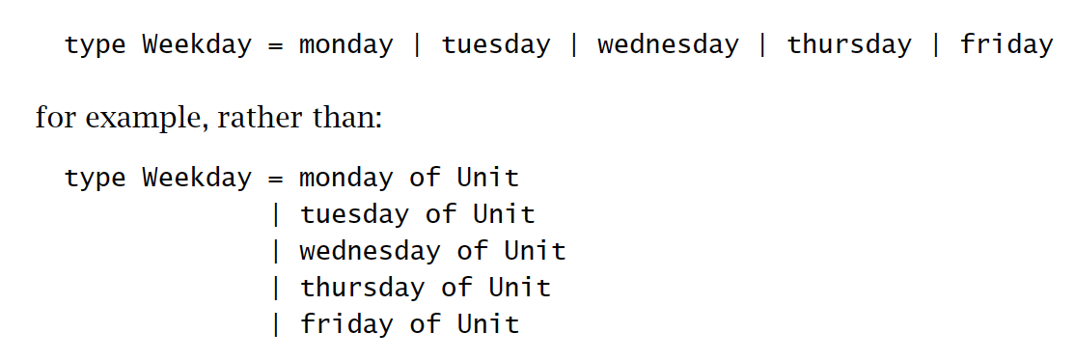
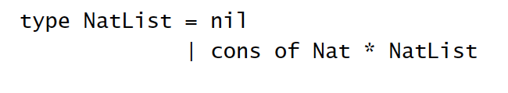
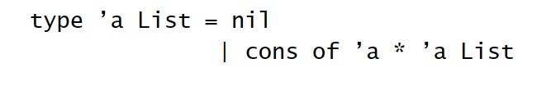
Variants and Datatype
Key differences:
datatypes don’t need explicit type annotations;
datatypes can be recursive;
datatypes can be polymorphic.

Slide 29
General Recursion

Slide 30
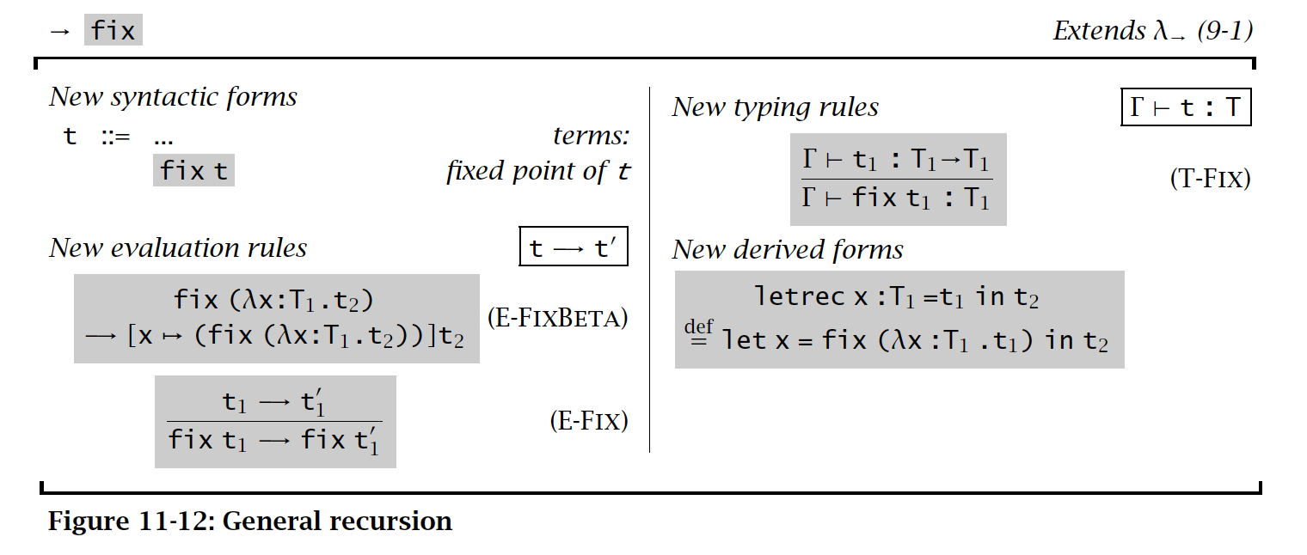
General Recursion

Slide 31
List

Slide 32
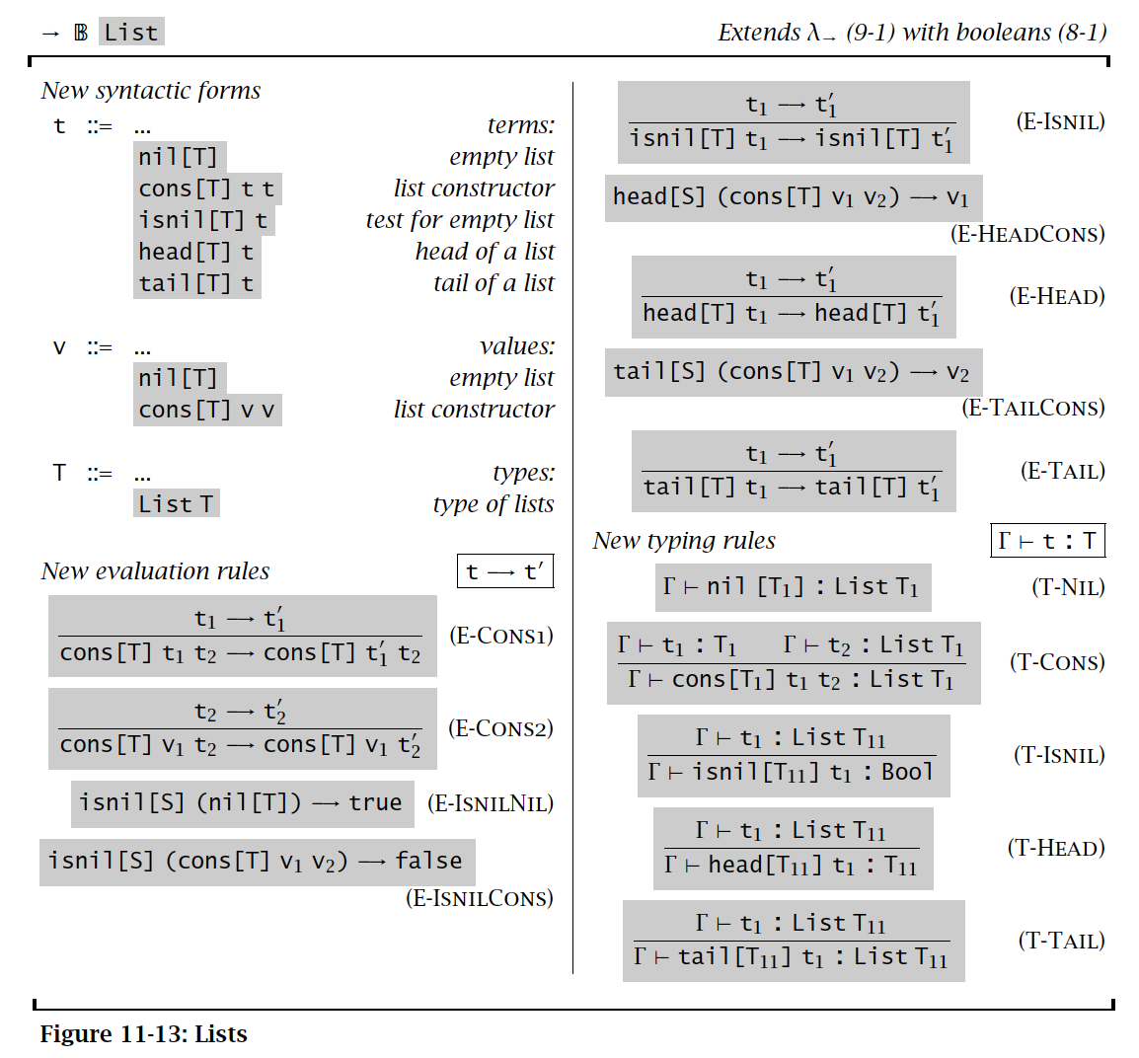
List

Slide 33
Summary
Simple extensions to lambda
syntax sugars
Forms the core language of common languages such as OCaml
without modules (to be discussed later)

