Slide 1
Metatheory of Subtyping
Principle of Programming Languages
Baojian Hua
bjhua@ustc.edu.cn

Slide 2
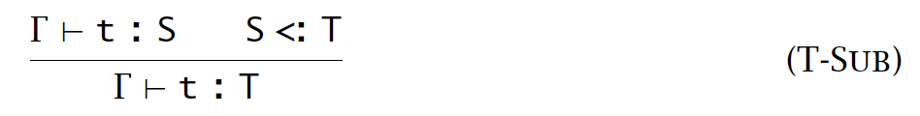
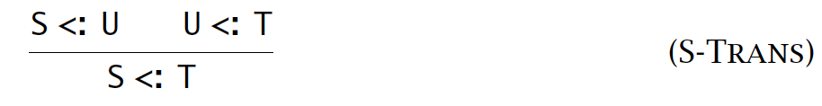
Motivation
Subtyping rules are not well-suited for writing type checking algorithms:
not syntax-directed

Slide 3
Syntax-directed…
// type checking code
let rec check(t: term): tipe =
math t with
| ??? -> ??? (* guess a type “S”? *)

Slide 4
Algorithmic Subtyping

Slide 5
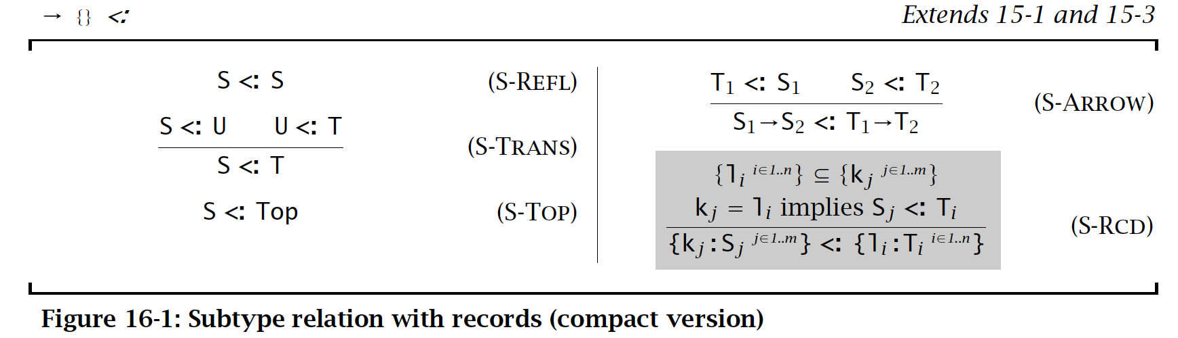
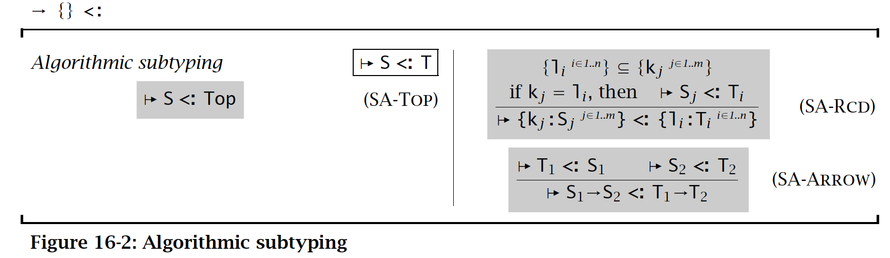
Algorithmic subtyping

Slide 6
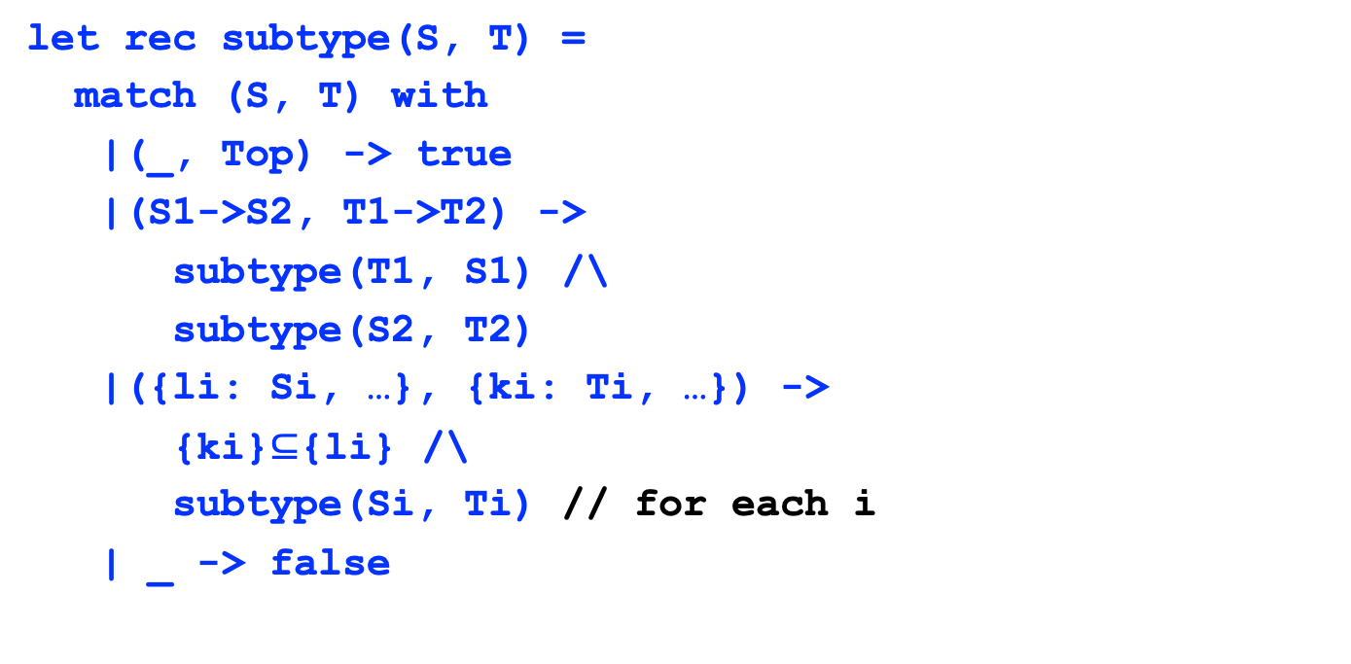
Algorithm
let rec subtype(S, T) =
match (S, T) with
|(_, Top) -> true
|(S1->S2, T1->T2) ->
subtype(T1, S1) /\
subtype(S2, T2)
|({li: Si, …}, {ki: Ti, …}) ->
{ki}$⊆${li} /\
subtype(Si, Ti) // for each i
| _ -> false

Slide 7
Why we bother to have both?
Declarative ones:
to claim and prove properties
Algorithmic ones:
effective implementations
We should prove equivalence
nontrivial
we’ll see more in future lectures

Slide 8
Algorithmic Typing

Slide 9
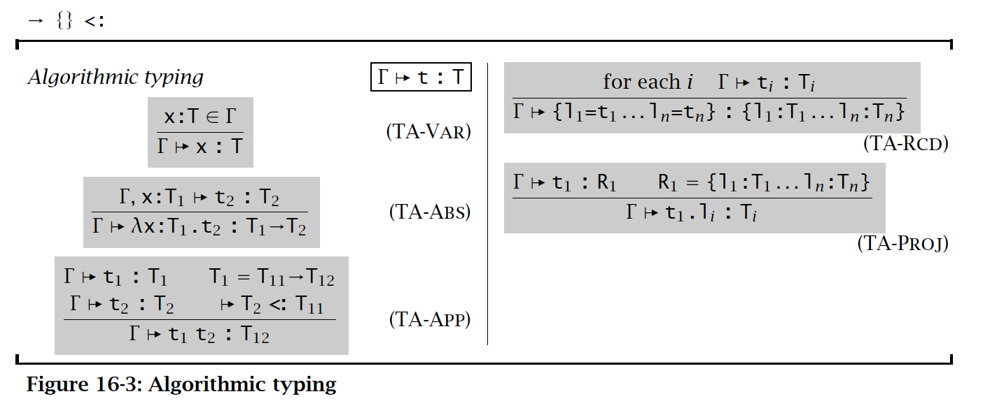
Algorithmic Typing

Slide 10
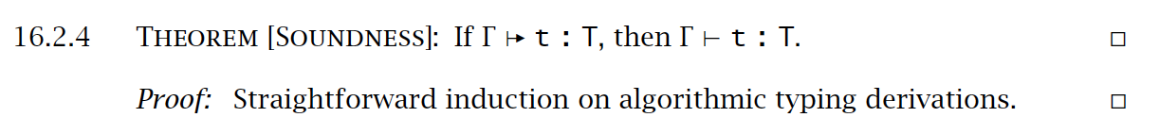
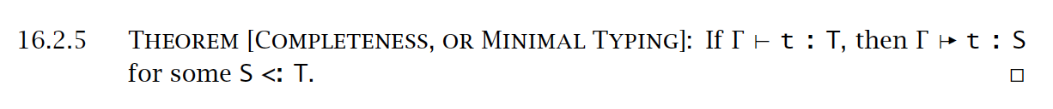
Properties

Slide 11
Summary
Metatheory for subtyping
i.e., type checking algorithms for subtyping and typing
type-directed

