Slide 1
Hoare logic
Formal Methods Foundation
Baojian Hua
bjhua@ustc.edu.cn

Slide 2
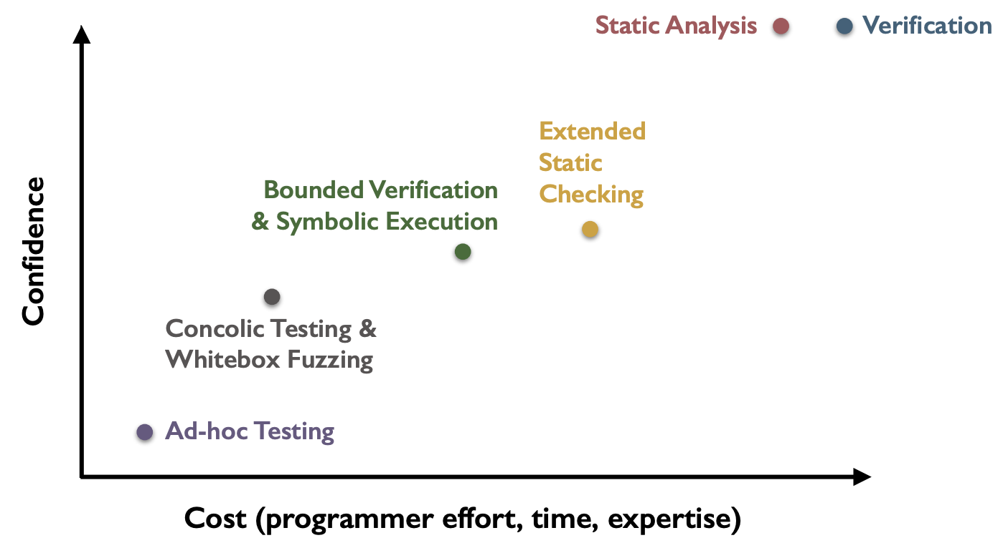
Spectrum of program validation methods
This topic

Slide 3
Overview
This lecture’s topic is about proving program correctness
based on the idea of Hoare logic
One of the oldest and deepest ideas in CS
Still important today
successful applications in many fields
due to the advancement in proof theory and constraint solvers/theorem provers

Slide 4

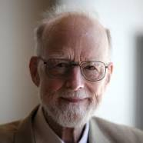
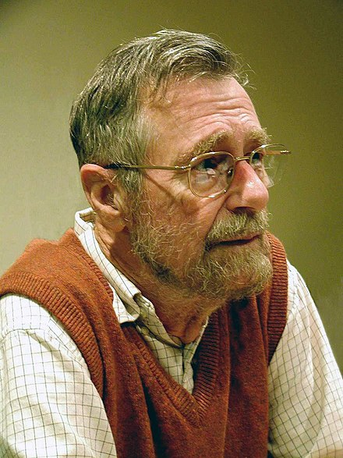
Capsule history
1967: Assigning Meaning to Programs (Floyd)
1978 Turing Award
1969: An Axiomatic Basis for Computer Programming (Hoare)
1980 Turing Award
1975: Guarded Commands, Nondeterminacy and Formal Derivation of Programs (Dijkstra)
1972 Turing Award

Slide 5
Many Languages Today
The idea of Hoare logic has been applied to many languages again and again
and even to the same language
To name a few:
Dafny (C#), Boogie (.Net IL), F* (F#), VCC (C), Prusti (Rust), Creusot (Rust), Aeneas (Rust), and Verus (Rust)

Slide 6
Many Successful Stories
CompCert:
the first fully verified C compiler
seL4:
the first verified operating system (micro-)kernel

Slide 7
Motivation

Slide 8
Program correctness
For this program, how can we guarantee its correctness?
But first of all, how do we express correctness?
fn abs(n){
if(n>=0)
return n;
else
return 0-n;
}

Slide 9
Program correctness
A daily practice is to leverage comments
we specify the intended requirements via natural language
and the implementation should satisfy these requirements
// pre: take any integer n as input
// post: return an integer that is equal or greater than 0
fn abs(n){
if(n>=0)
return n;
else
return 0-n;
}

Slide 10
Program correctness
But comments suffer from several limitations for checking correctness
it is ambiguous
it does not check
it does not evolve
caveat: it targets for human, but not machine
// pre: take any integer n as input
// post: return an integer that is equal or greater than 0
fn abs(n){
if(n>=0)
return n;
else
return 0-n;
}

Slide 11
Program correctness
logical formulae
A better idea is to utilize logic!
we specify the requirements via logical formulas
it is checked against code automatically
it evolves with code
i.e., it targets both human and machine
// pre: True
// post: result>=0
fn abs(n){
if(n>=0)
return n;
else
return 0-n;
}

Slide 12
Redundancy
The key insight:
leverage redundancy to specify and check correctness
Both comments are logic formulas are essentially redundancy
discrepancies regarding rigorousness

Slide 13
Scale to Complex Programs
logical formulae
For this program, how can we guarantee result==5?
Note that program testing is ineffective for this:
we cannot enumerate all possible values for n!
// pre: n<0
// post: result==5
fn sum(n){
while(n<5)
n = n+1;
return n;
}

Slide 14
Big picture
Logic
Hoare logic connects the logic and program!
Programs
prover/
solver

Slide 15
Hoare logic: Hoare Triple

Slide 16

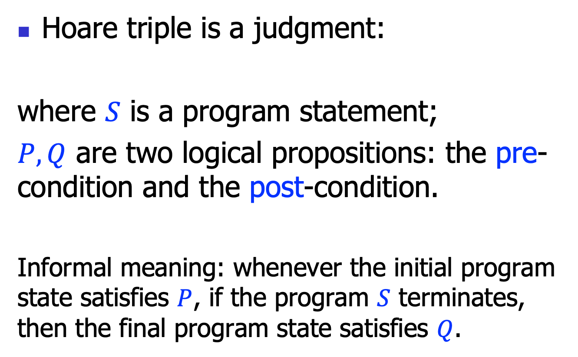
Hoare triple
Hoare triple is a judgment:
where $S$ is a program statement;
$P, Q$ are two logical propositions: the pre-condition and the post-condition.
Informal meaning: whenever the initial program state satisfies $P$, if the program $S$ terminates, then the final program state satisfies $Q$.
$$\left\{P\right\} S \{Q\}$$

Slide 17
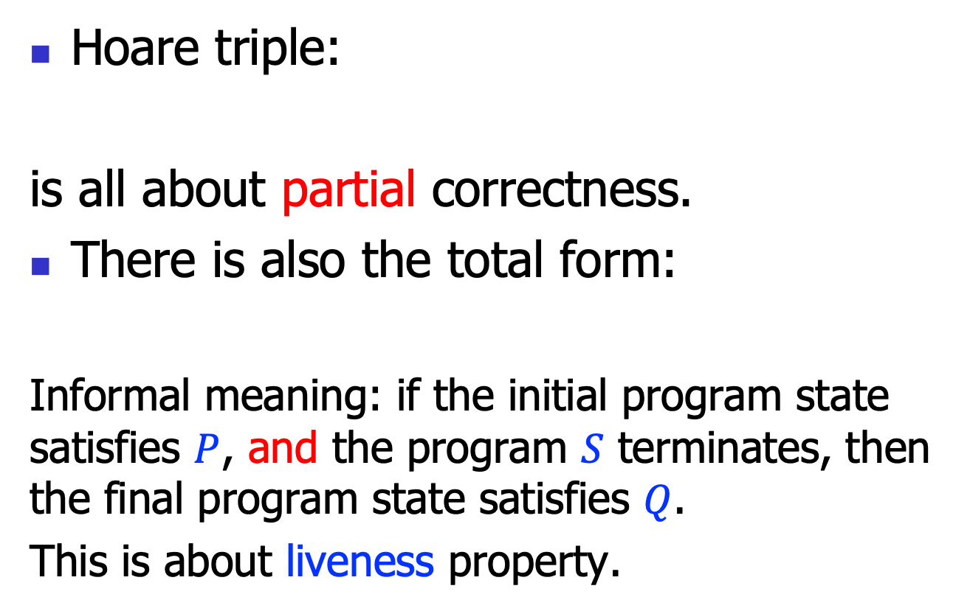

Partial and total correctness
Hoare triple:
is all about partial correctness.
There is also the total form:
Informal meaning: if the initial program state satisfies $P$, and the program $S$ terminates, then the final program state satisfies $Q$.
This is about liveness property.
$$\left\{P\right\} S \{Q\}$$
$$\left[P\right] S [Q]$$

Slide 18
Hoare triple example
{n>=0}
n = n+1
{n>=1}
FOL propositions, to be specific, the linear arithmetic theory propositions!

Slide 19
Hoare triple example 2
{n<0}
sum(n){
while(n<5)
n = n+1;
return n;
}
{result==5}
FOL propositions, to be specific, the linear arithmetic theory propositions!
Also note that we use “result” (like a reserved key word) to represent the return result of this function.

Slide 20
Hoare triple semantics
For the Hoare triple:
Let’s define the semantics more formally:
what’s the formal language to define the propositions?
When can we say a proposition P holds in a given program state?
$$\left\{P\right\} S \{Q\}$$

Slide 21
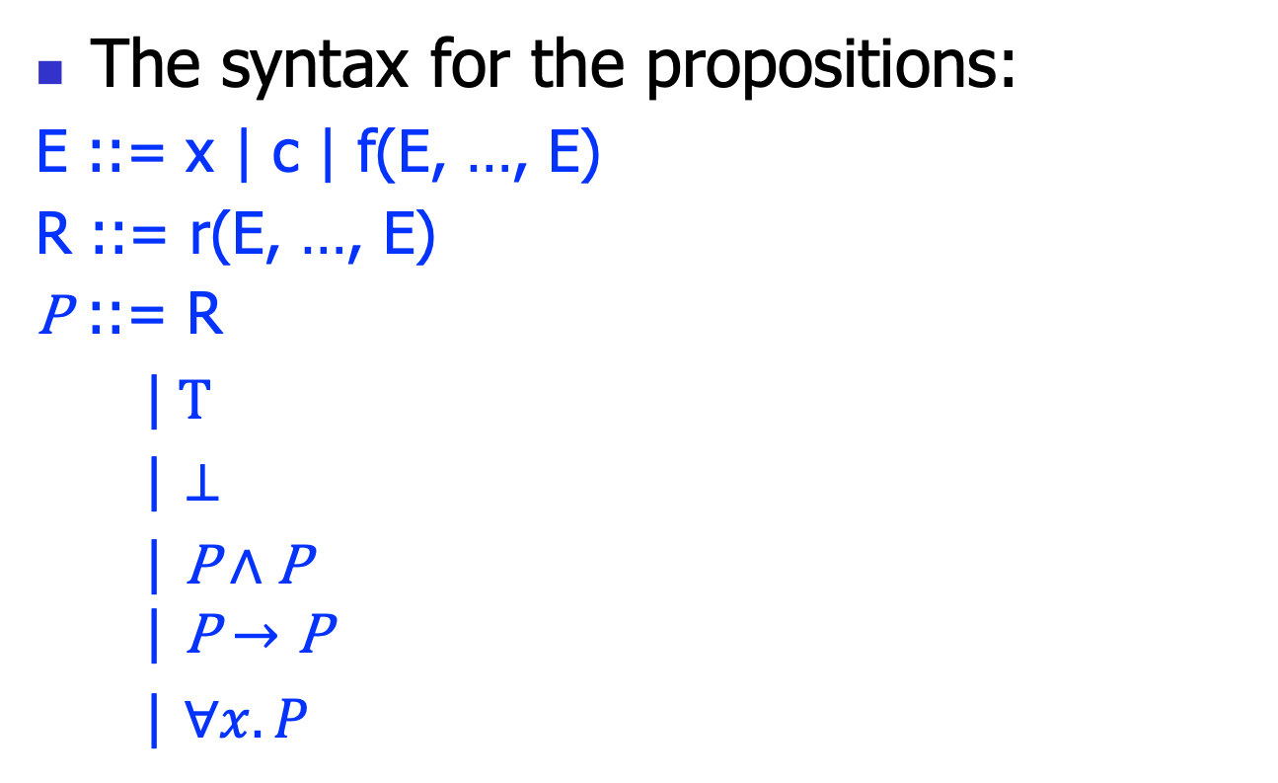
Proposition syntax
The syntax for the propositions:
E ::= x | c | f(E, …, E)
R ::= r(E, …, E)
P ::= R
|$T$
| $⊥$
$\text{|} \text{P}∧\text{P}$
$$\text{|} \text{P}→\text{P}$$
| $∀x.P$

Slide 22
Proposition syntax
Essentially, we use a fragment of the FOL
In practice, other variants exist, say Temporal logic (for protocols), etc..
Also can contain domain specific relations (user extensible)
Say: type(x, T) to indicate x has type T
A tradeoff between simplicity and expressiveness (design art)

Slide 23
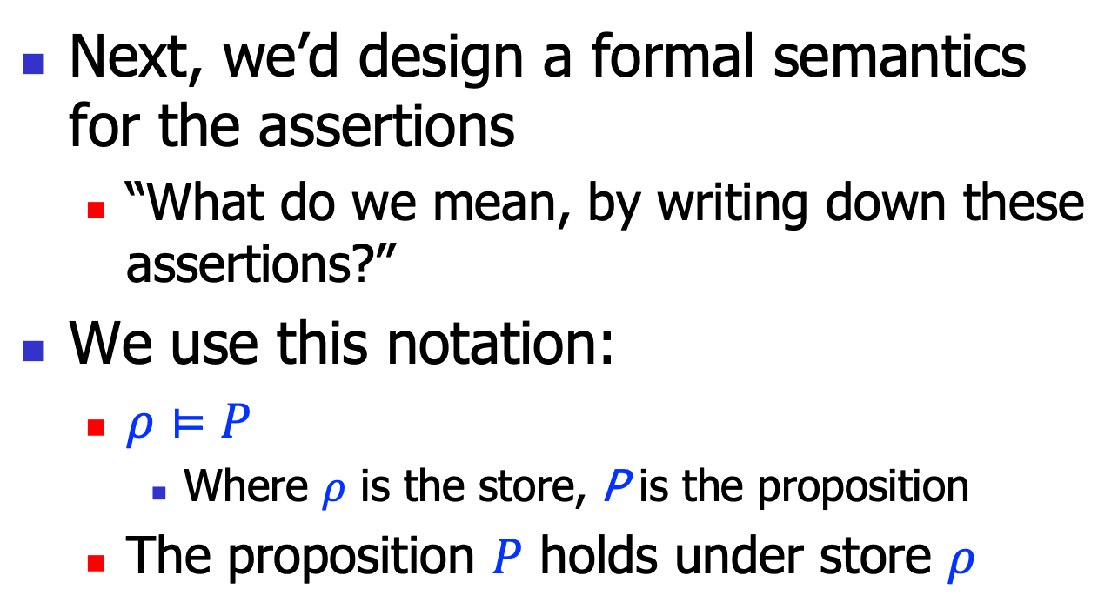
Proposition semantics
Next, we’d design a formal semantics for the assertions
“What do we mean, by writing down these assertions?”
We use this notation:
$ρ⊨P$
Where $ρ$ is the store, P is the proposition
The proposition $P$ holds under store $ρ$

Slide 24
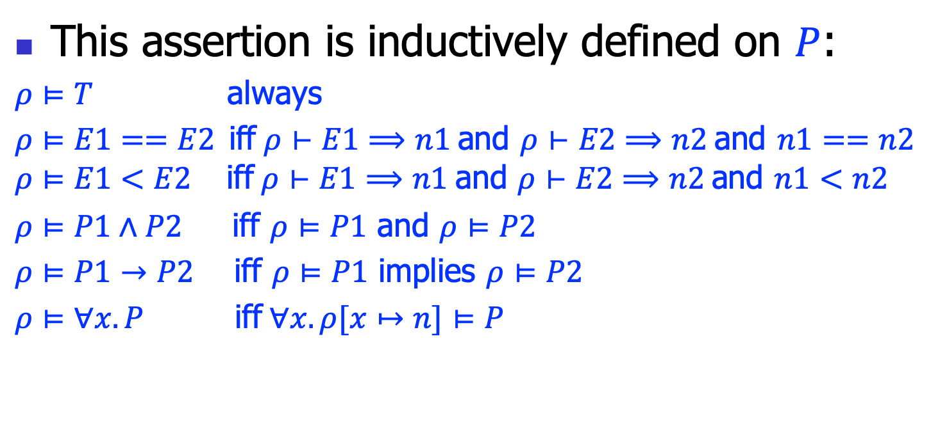
Proposition semantics
This assertion is inductively defined on $P$:
$ρ⊨T$ always
$ρ⊨E1==E2$iff$ρ⊢E1⟹n1$ and $ρ⊢E2⟹n2$ and $n1==n2$
$$ρ⊨E1<E2 \text{iff} ρ⊢E1⟹n1 \text{and} ρ⊢E2⟹n2 \text{and} n1<n2$$
$ρ⊨P1∧P2$ iff $ρ⊨P1$ and $ρ⊨P2$
$ρ⊨P1→P2$ iff $ρ⊨P1$ implies $ρ⊨P2$
$ρ⊨∀x.P$ iff$∀x.ρ[x↦n]⊨P$

Slide 25
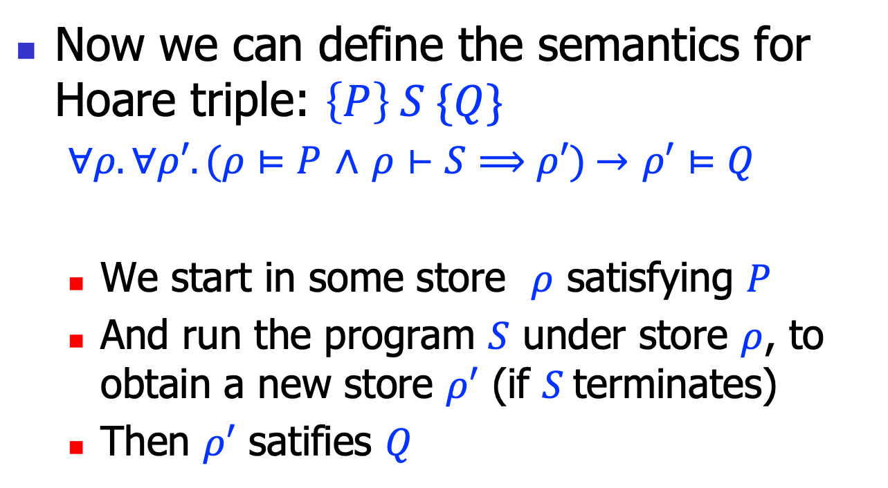
Hoare triple semantics
Now we can define the semantics for Hoare triple: $\left\{P\right\} S \{Q\}$
$∀ρ.∀ρ′.(ρ⊨P$ $∧$ $ρ⊢S⟹ρ′)$ $→$ $ρ′⊨Q$
We start in some store $ρ$ satisfying $P$
And run the program $S$ under store $ρ$, to obtain a new store $ρ′$ (if $S$terminates)
Then $ρ′$ satifies $Q$

Slide 26
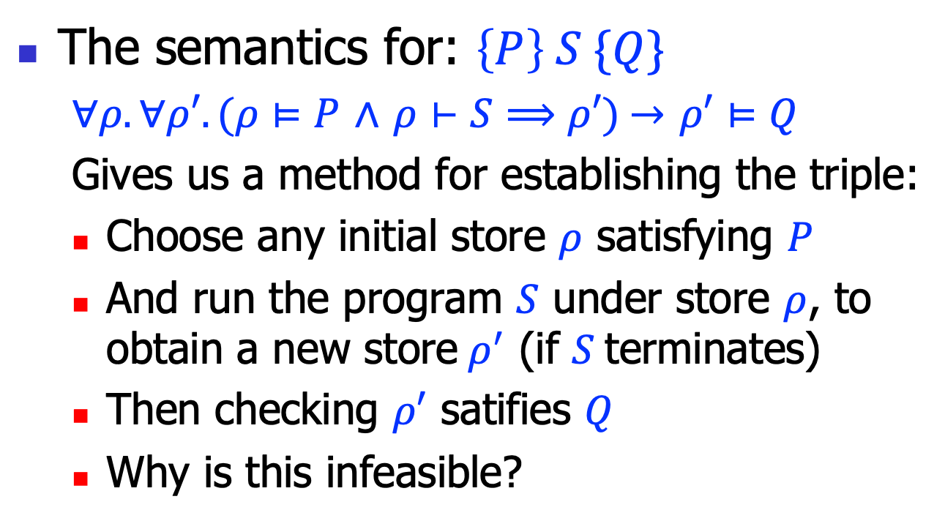
Exhausted testing
The semantics for: $\left\{P\right\} S \{Q\}$
$∀ρ.∀ρ′.(ρ⊨P$ $∧$ $ρ⊢S⟹ρ′)$ $→$ $ρ′⊨Q$
Gives us a method for establishing the triple:
Choose any initial store $ρ$ satisfying $P$
And run the program $S$ under store $ρ$, to obtain a new store$ρ^{′}$ (if $S$terminates)
Then checking $ρ′$ satifies $Q$
Why is this infeasible?

Slide 27
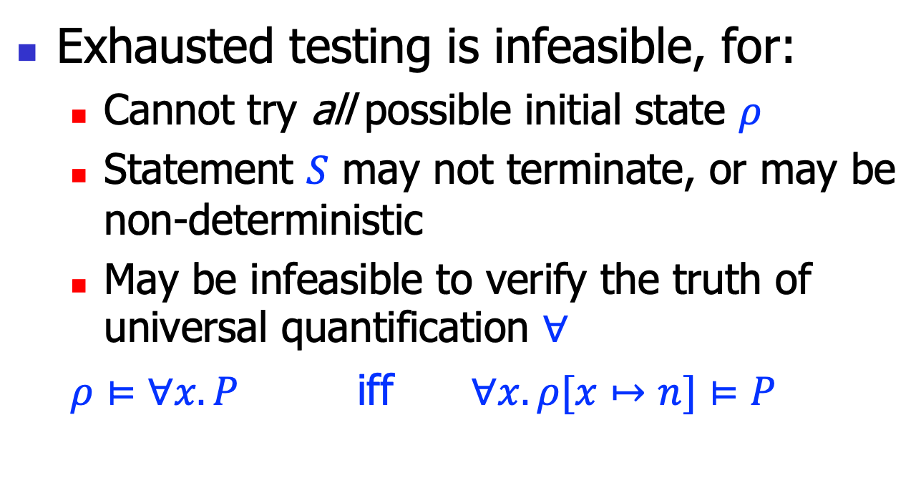
Exhausted testing, cont’
Exhausted testing is infeasible, for:
Cannot try all possible initial state $ρ$
Statement $S$ may not terminate, or may be non-deterministic
May be infeasible to verify the truth of universal quantification $∀$
$ρ⊨∀x.P$ iff $∀x.ρ[x↦n]⊨P$

Slide 28
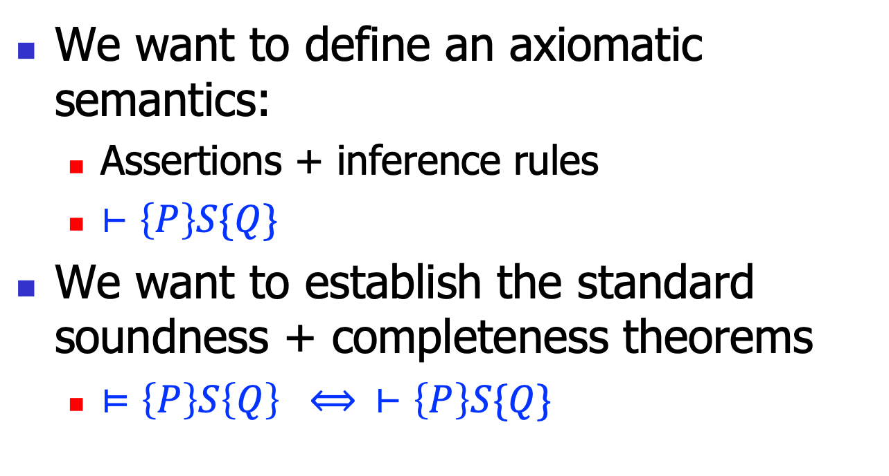
Axiomatic semantics
We want to define an axiomatic semantics:
Assertions + inference rules
$⊢\left\{P\right\}S\{Q\}$
We want to establish the standard soundness + completeness theorems
$⊨\left\{P\right\}S\left\{Q\right\} ⟺ ⊢\left\{P\right\}S\{Q\}$

Slide 29
Hoare logic: inference rules

Slide 30
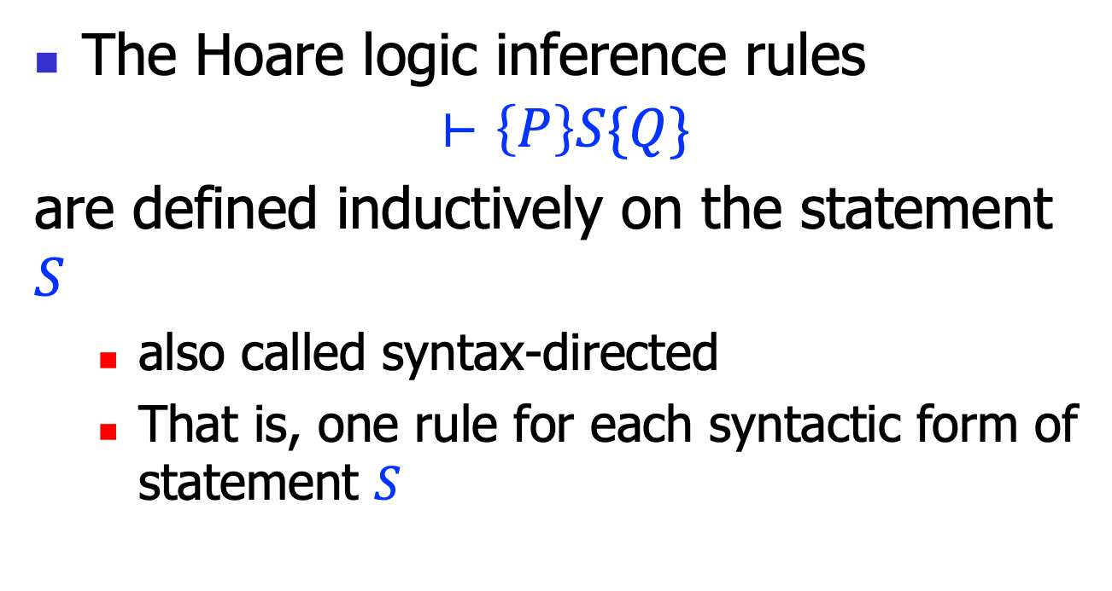
Inference rules
The Hoare logic inference rules
$$⊢\left\{P\right\}S\{Q\}$$
are defined inductively on the statement $S$
also called syntax-directed
That is, one rule for each syntactic form of statement $S$

Slide 31


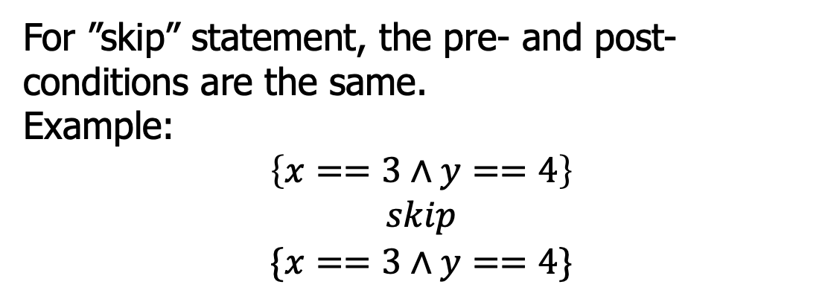
Hoare logic rules: empty
$$(H−Skip)$$
$$\left\{P\right\}skip\{P\}$$
For ”skip” statement, the pre- and post-conditions are the same.
Example:
$$\left\{x==3∧y==4\right\}$$
$$skip$$
$$\{x==3∧y==4\}$$

Slide 32


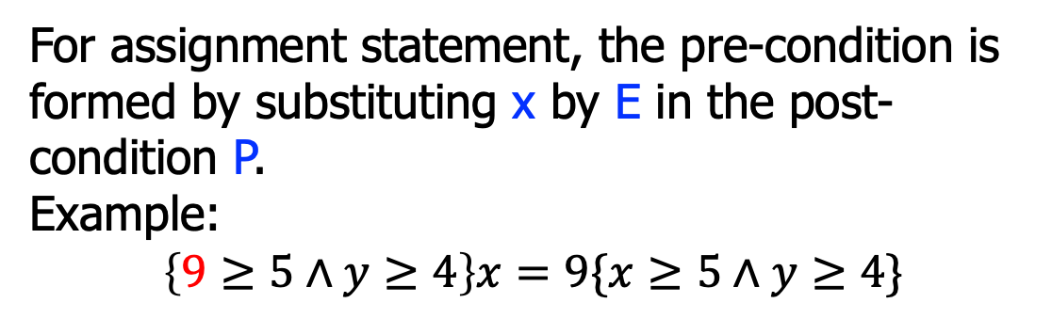
Hoare logic rules: assignment
$$(H−Assign)$$
$$\left\{P[x↦E]\right\}x=E\{P\}$$
For assignment statement, the pre-condition is formed by substituting x by E in the post-condition P.
Example:
$$\left\{9≥5∧y≥4\right\}x=9\{x≥5∧y≥4\}$$
$$\left\{y+z>k\right\}x=y+z\{x>k\}$$
$$\left\{x+1>k\right\}x=x+1\{x>k\}$$

Slide 33


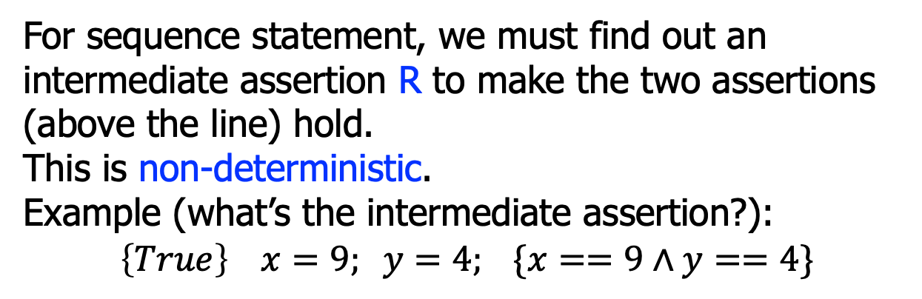


Hoare logic rules: sequence
$$\left\{P\right\}S1\{R\}$$
$$\left\{R\right\}S2\{Q\}$$
$$(H−Seq)$$
$$\left\{P\right\} S1;S2 \{Q\}$$
For sequence statement, we must find out an intermediate assertion R to make the two assertions (above the line) hold.
This is non-deterministic.
Example (what’s the intermediate assertion?):
$$\left\{True\right\} x=9; y=4; \{x==9∧y==4\}$$

Slide 34


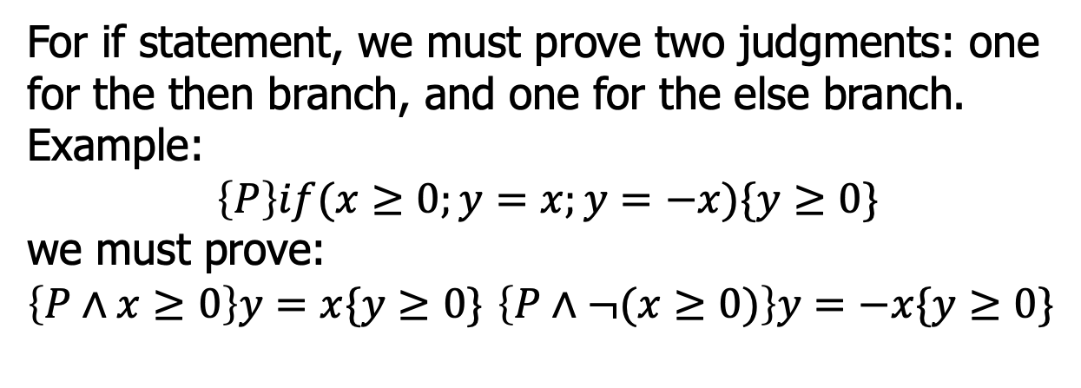


Hoare logic rules: if
$$\left\{P∧B\right\}S1\{Q\}$$
$$\left\{P∧¬B\right\}S2\{Q\}$$
$$(H−If)$$
$$\left\{P\right\}if\left(B;S1;S2\right)\{Q\}$$
For if statement, we must prove two judgments: one for the then branch, and one for the else branch.
Example:
$$\left\{P\right\}if(x≥0;y=x;y=−x)\{y≥0\}$$
we must prove:
$\left\{P∧x≥0\right\}y=x\{y≥0\}$ $\left\{P∧¬(x≥0)\right\}y=−x\{y≥0\}$

Slide 35


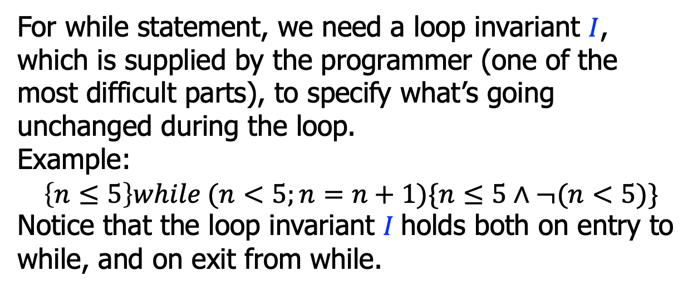

Hoare logic rules: while
$$\left\{I∧B\right\}S\{I\}$$
$$(H−While)$$
$$\left\{I\right\}while(B;S)\{I∧¬B\}$$
For while statement, we need a loop invariant $I$, which is supplied by the programmer (one of the most difficult parts), to specify what’s going unchanged during the loop.
Example:
$$\left\{n≤5\right\}while (n<5;n=n+1)\{n≤5∧¬(n<5)\}$$
Notice that the loop invariant $I$holds both on entry to while, and on exit from while.

Slide 36
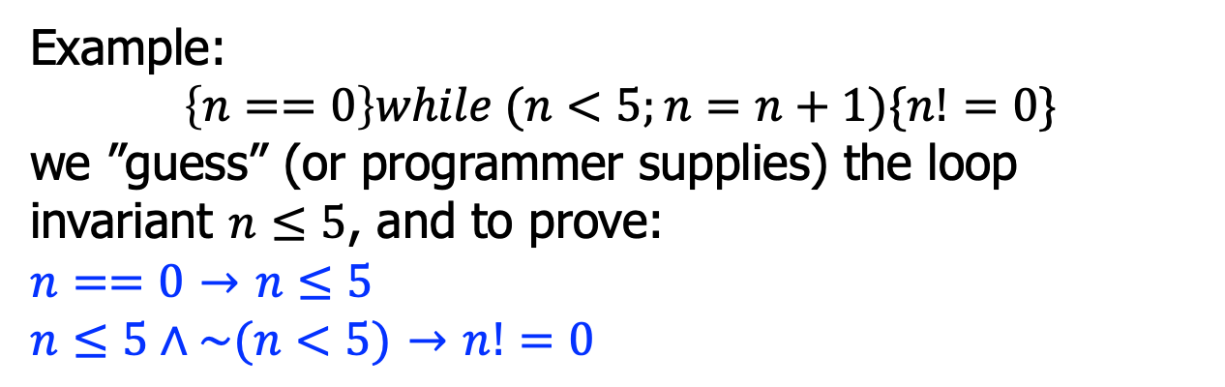

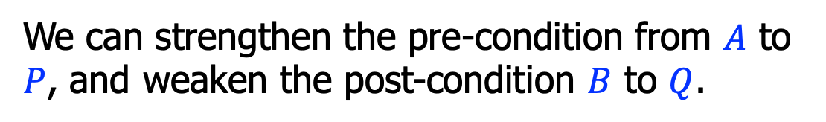




Hoare logic rules: consequence
$$P→A$$
$$\left\{A\right\}S\{B\}$$
$$B→Q$$
$$(H−Conseq)$$
$$\left\{P\right\}S\{Q\}$$
We can strengthen the pre-condition from $A$ to $P$, and weaken the post-condition $B$ to $Q$.
Example:
$$\left\{n==0\right\}while (n<5;n=n+1)\{n!=0\}$$
we ”guess” (or programmer supplies) the loop invariant $n≤5$, and to prove:
$n==0$ $→$ $n≤5$
$n≤5∧\sim (n<5)$ $→$ $n!=0$

Slide 37

Hoare logic rules: example
To prove this judgment:
using the assignment rule:
$$\left\{True\right\}x=5\{x==5\}$$
$$(H−Assign)$$
$$\left\{P[x↦E]\right\}x=E\{P\}$$
$$\left\{\left(x==5\right)[x↦5]\right\}x=5\{x==5\}$$
$$\left\{\left(5==5\right)\right\}x=5\{x==5\}$$
Using the consequence rule:
$$True→5==5$$

Slide 38



Or, the proof tree
To prove:
$$\left\{True\right\}x=5\{x==5\}$$
$$(H−Assign)$$
$$True→(5==5)$$
$$\left\{\left(x==5\right)[x↦5]\right\}x=5\{x==5\}$$
$$(H−Conseq)$$
$$\left\{True\right\}x=5\{x==5\}$$

Slide 39






Hoare logic rules: example
To prove this judgment:
the proof tree:
$$\left\{True\right\}if(y≤0;x=1;x=y)\{x>0\}$$
$$True∧y≤0→1>0$$
$$\left\{1>0\right\}x=1\{x>0\}$$
$$…$$
$$\left\{True∧y≤0\right\}x=1\{x>0\}$$
$$\left\{True∧¬(y≤0)\right\}x=y\{x>0\}$$
$$(H−If)$$
$$\left\{True\right\}if(y≤0;x=1;x=y)\{x>0\}$$

Slide 40





Hoare logic rules: example
To prove this judgment:
the proof tree:
$$\left\{x<0\right\}while\left(x<5;x=x+1\right)\{x==5\}$$
$$(x≤5∧x<5)→((x+1)≤5)$$
$$\left\{(x+1)≤5\right\}x=x+1\{x≤5\}$$
$$\left\{x≤5∧x<5\right\}x=x+1\{x≤5\}$$
$$x<0→x≤5$$
$$\left\{x≤5\right\}while(x<5;x=x+1)\{x≤5∧¬(x<5)\}$$
$$…$$
$$\left\{x<0\right\}while(x<5;x=x+1)\{x==5\}$$

Slide 41

Hoare logic rules: example
To prove this judgment:
the proof tree for “while”:
{n>=0}
s = 0;
i = 0;
while(i<=n){
s=s+i;
i=i+1;
}
{2*s==n*(n+1)}
$$i≤\left(n+1\right)∧s=Sum\left(i−1\right)∧i≤n → \text{(}i+1)≤\left(n+1\right)∧s+i=Sum\left(i\right)$$
$$\text{(}i+1)≤\left(n+1\right)∧s+i=Sum\left(i\right)$$
($i+1)≤\left(n+1\right)∧s=Sum\left(i+1−1\right)$
$$\left\{i≤\left(n+1\right)∧s=Sum\left(i−1\right)∧i≤n\right\}s=s+i;i=i+1\{i≤\left(n+1\right)∧s=Sum\left(i−1\right)\}$$
$$\left\{i≤\left(n+1\right)∧s=Sum\left(i−1\right)\right\}while(…)\{i≤\left(n+1\right)∧s=Sum(i−1)∧¬(i≤n)\}$$

Slide 42
Summary
Hoare logic is an axiomatic system to reason program correctness
FOL, judgments, and inference rules
Proving program properties formally requires considerable proof engineering efforts
But we can leverage off-the-shelf automatic techniques and tools, to be discussed next

