Slide 1
Subtyping
Principle of Programming Languages
Baojian Hua
bjhua@ustc.edu.cn

Slide 2
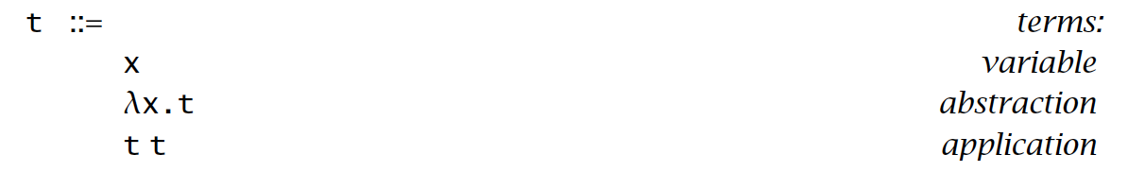
Recap: Lambda calculus

Slide 3
Roadmap
To study various typing mechanisms:
simply-typed
subtyping (a.k.a, subtyping polymorphism)
recursive types
polymorphisms
higher-order types
Subtyping is also a key feature of OOP

Slide 4
Subtyping

Slide 5
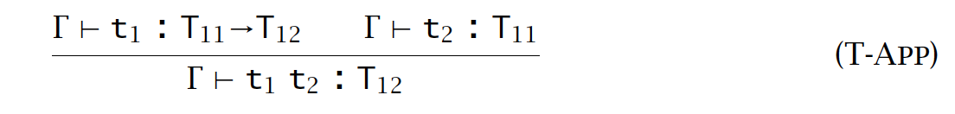

Motivation

Slide 6
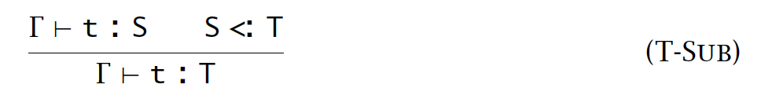
Subsumption
Introduce a notation: S <: T
S is a subtype of T
elements in S is a subset of elements in T
A subtyping relation:

Slide 7
Subtyping Relation

Slide 8

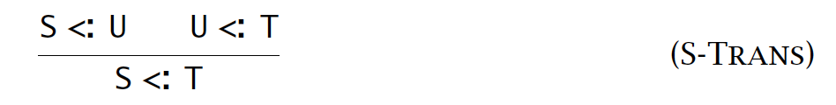
Properties
Reflexivity:
Transitivity:
Record width:

Slide 9
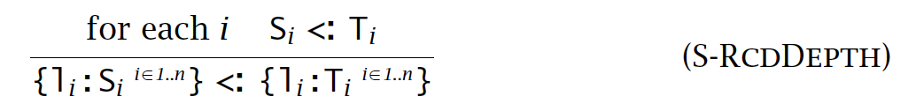
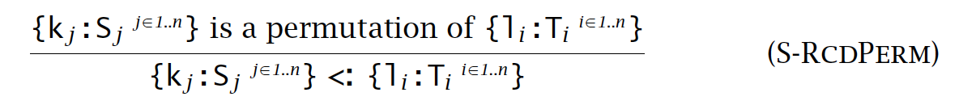
Properties, cont’
Record depth:
Record permutation:

Slide 10
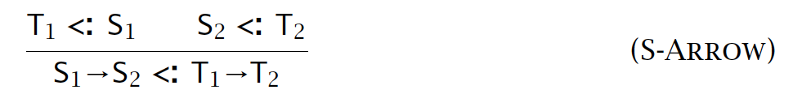
Properties, cont’
Arrow:
Top:

Slide 11
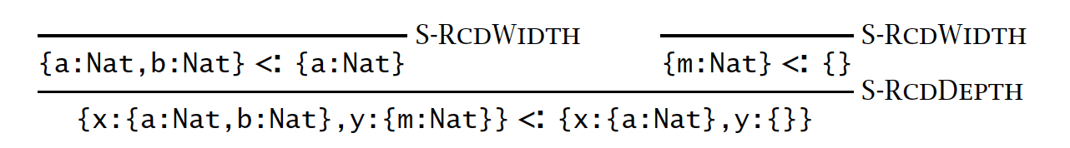
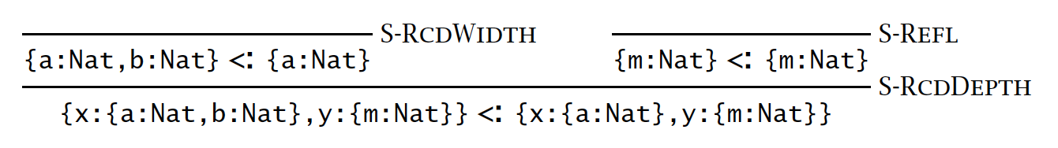
Examples
Example 1:
Example 2:

Slide 12
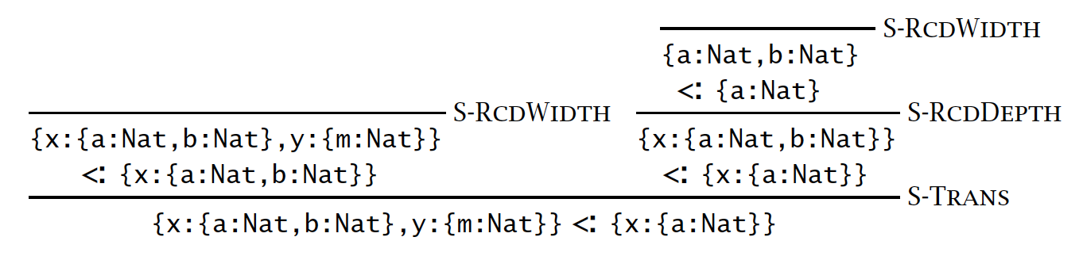
Examples, cont’
Example 3:

Slide 13
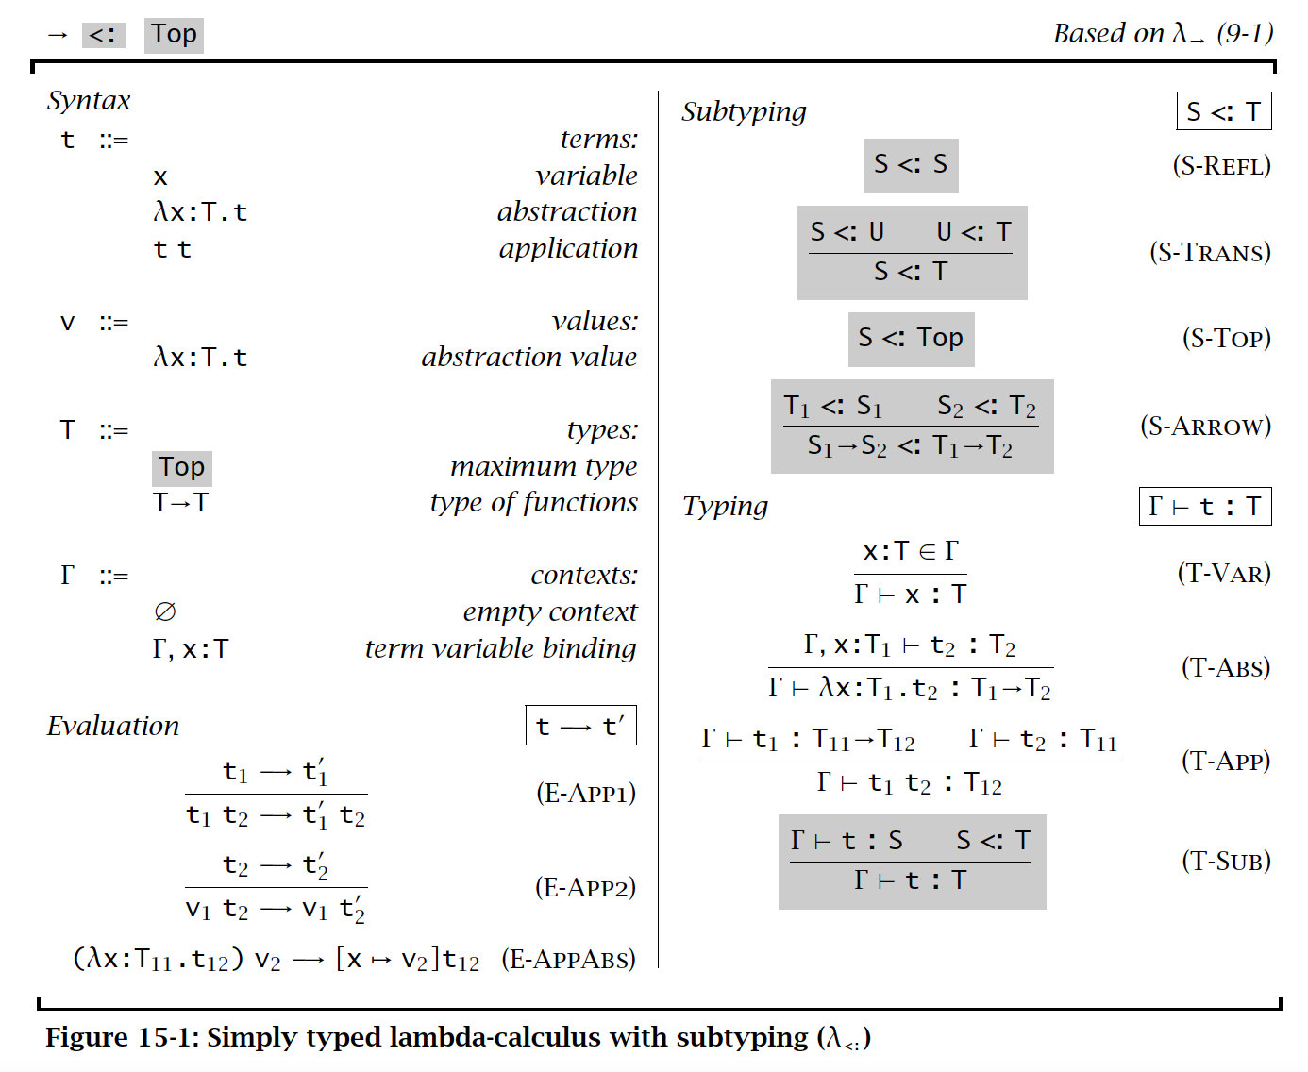
Simply typed

Slide 14
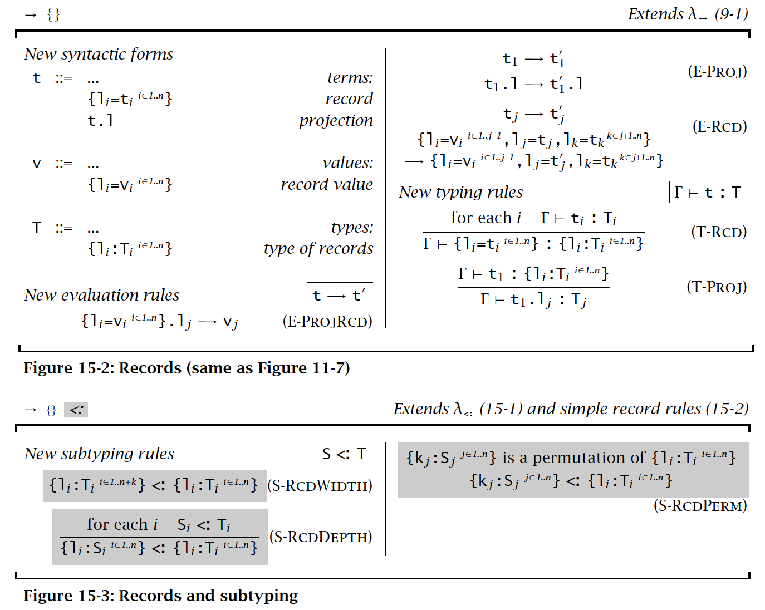
Record

Slide 15
Type Safety

Slide 16
Type safety

Slide 17
Type Casting

Slide 18
Up vs. Down Casting
Given S <: T
for e: S, (T)e is called an up-casting
for e: T, (S)e is called a down-casting
Up-casting is generally type safe
just less informative
Down-casting is generally unsafe
runtime checking are needed

Slide 19
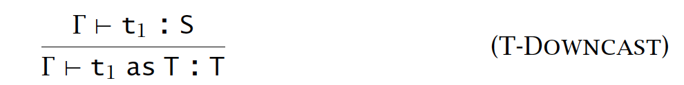
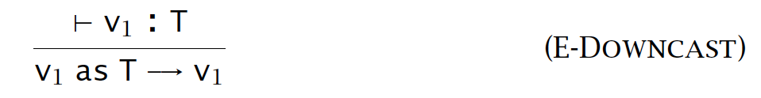
Typing Rules
T <: S
Runtime checking (reflection):

Slide 20
Poor man’s polymorphism
// modern Java
class List<T>{
T data;
List<T> next;
}
List<T> l =
new List<Integer> …;
// stone-age Java (pre 5.0)
class List{
Object data;
List next;
}
List l =
new List(new Integer(…));

Slide 21
Down-casting
// to sum up a list ”l” of integers:
int sum(List l){
int s = 0;
while(l != null){
Integer d = (Integer)l.data; // Inefficient!
s += d;
}
return s;
}

Slide 22
Type-switch
// After Java 17.0.
// A functional binary
// tree:
abstract class Tree{}
class Empty extends
Tree{}
class Node extends Tree{
int data;
Tree left;
Tree right;
}
// Pre-order traversal:
void preOrder(Tree t){
switch(t){
case Empty s -> {}
case Node s -> {
s.data;
s.left;
s.right;
}
}
}

Slide 23
References and Arrays

Slide 24
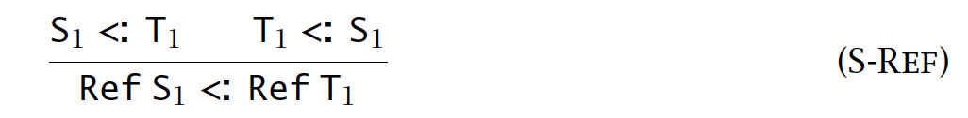
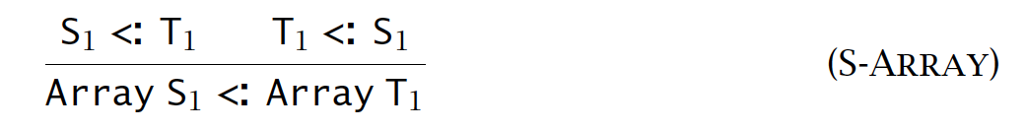
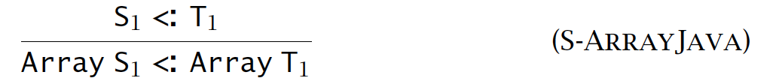
Rules
References:
Arrays:
Java arrays (pitfalls):

Slide 25
Java array pitfalls
// suppose C <: B <: A
void f(B[] x){
x[0] = new B();
// runtime exception
}
// case 1:
C[] m = new …;
f(m);
// case 2:
A[] n = new …;
f(n); // compiler error
Thus, for each array assignment, a new runtime check is inserted, which incurs considerable cost.
Generally considered a design pitfall for Java.

Slide 26
Summary
Simply typed lambda with subtyping
also popular in OOP
Basic syntax, evaluations, and typing rules

