Slide 1
Propositional logic
Formal Methods Foundation
Baojian Hua
bjhua@ustc.edu.cn

Slide 2
Mathematical logic
A mathematical field to study reasoning
  Proof theory, set theory, model theory, recursion theory
  Many connection to other fields of math.
    The foundation of math
Also deep connection to CS:
  Type theory, logic programming, computer-aided verification (CAV), etc..

Slide 3
Topics in this course
We study propositional and predicate logic
  Both the classical one and constructive one
From a more CS and algorithmic point of view:
  Computer aided proof engineering, SAT/SMT, etc..
  Application to many practical CS problems

Slide 4
Brief history

Slide 5
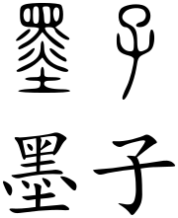
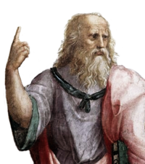
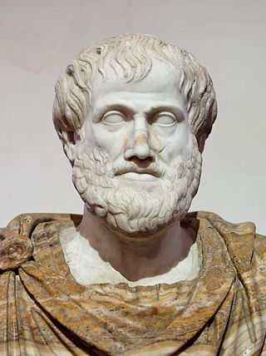
Early time
Formal logic appeared 2000 years ago
  China/India/Greece…
  More close to philosophy
  Mozi/Plato/Aristotle/…
Not rigorous enough, but the modern propositional/predicate logic appeared

Slide 6
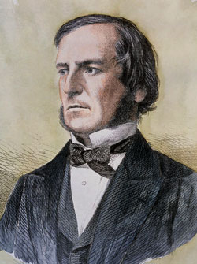
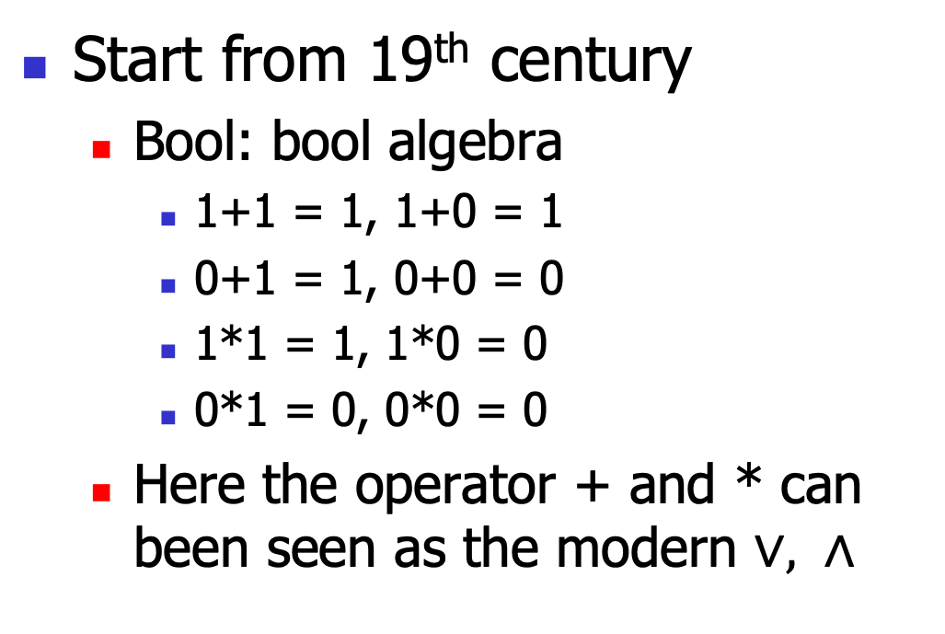
Modern logic
Start from 19th century
  Bool: bool algebra
    1+1 = 1, 1+0 = 1
    0+1 = 1, 0+0 = 0
    1*1 = 1, 1*0 = 0
    0*1 = 0, 0*0 = 0
  Here the operator + and * can been seen as the modern $∨, ∧$

Slide 7
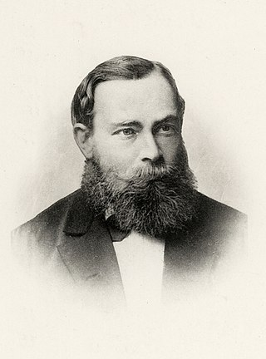
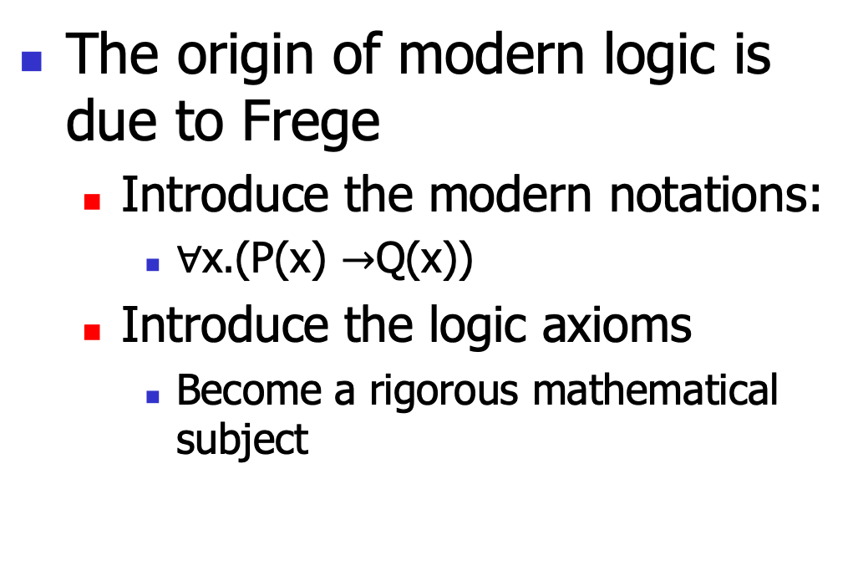
Modern logic
The origin of modern logic is due to Frege
  Introduce the modern notations:
    $∀$x.(P(x) $→$Q(x))
  Introduce the logic axioms
    Become a rigorous mathematical subject

Slide 8
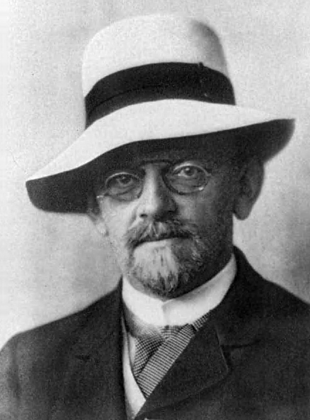
Hilbert‘s program
For the set theory, there appeared many paradox
  Russell’s (hair-cutter, God)
To formalize mathematics, Hilbert introduced a program to use the axiomatic approach:
  The 10th problem

Slide 9
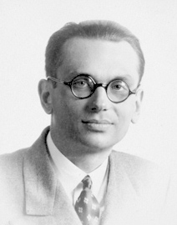
Incompleteness
Gödel proved the incompleteness theorem
  Any nontrivial system of axioms is incomplete
    There will always be a problem we can not prove or disprove
Make Hilbert’s program impossible

Slide 10
Propositional logic:
The syntax

Slide 11
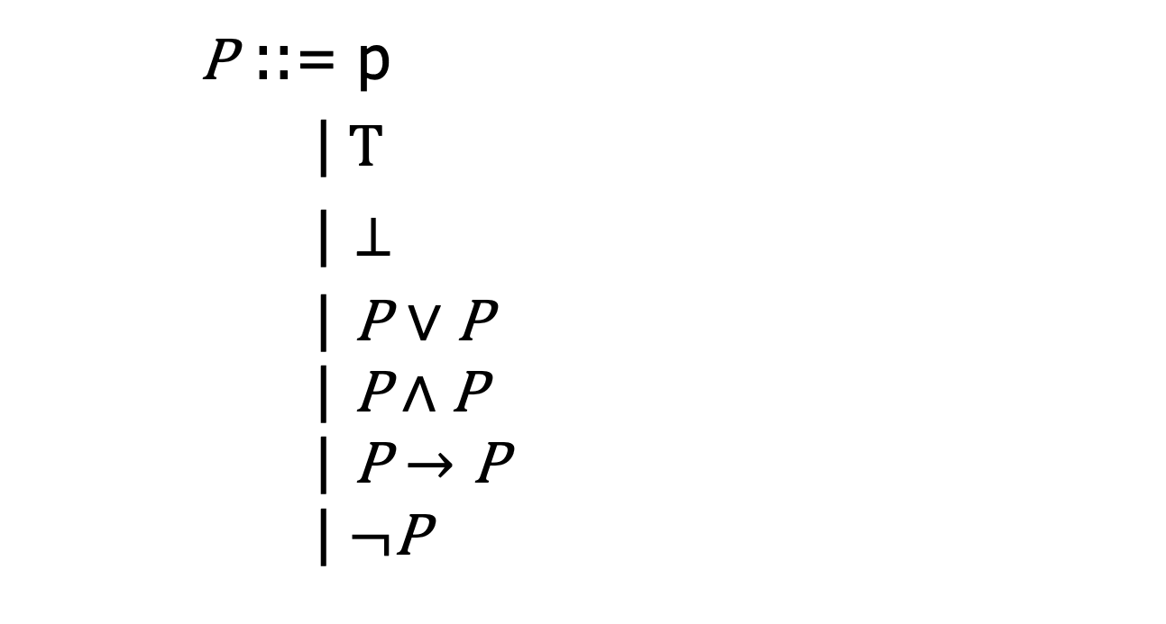
The syntax
P ::= p
|$T$
| $⊥$
| P $∨$ P
$$\text{|} \text{P}∧\text{P}$$
$$\text{|} \text{P}→\text{P}$$
$$\text{|} ¬\text{P}$$
A set of variable
Top element: think “true”
Bottom element: think “false”
Disjunction: think “or”
Conjunction: think “and”
Imply: think “if”
Negation: think “not”

Slide 12
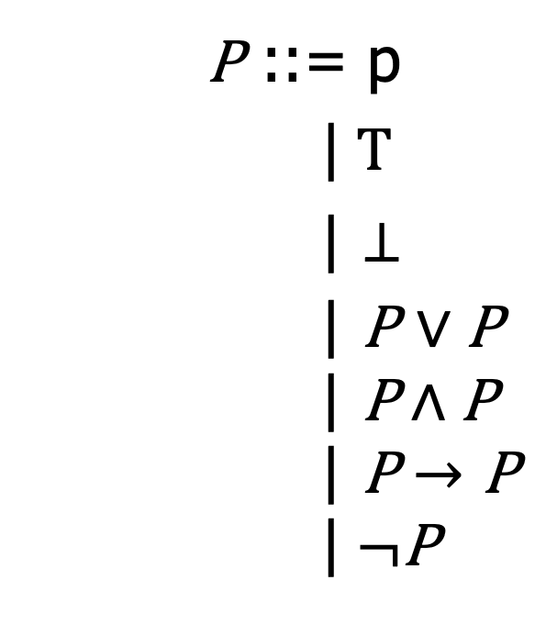
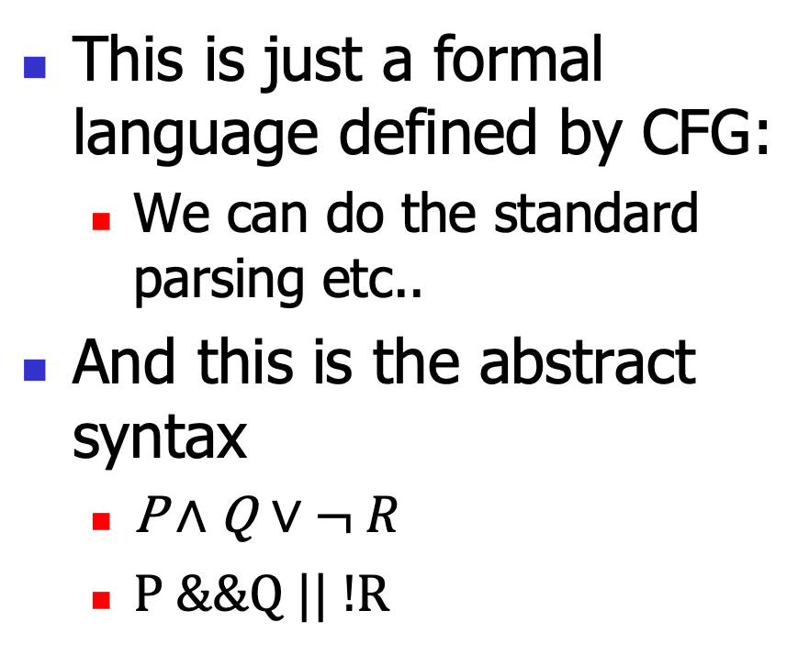
CS view point
This is just a formal language defined by CFG:
  We can do the standard parsing etc..
And this is the abstract syntax
  $\text{P}∧\text{Q}$ $∨$ $¬ R$
  P &&Q || !R
P ::= p
|$T$
| $⊥$
| P $∨$ P
$$\text{|} \text{P}∧\text{P}$$
$$\text{|} \text{P}→\text{P}$$
$$\text{|} ¬\text{P}$$

Slide 13
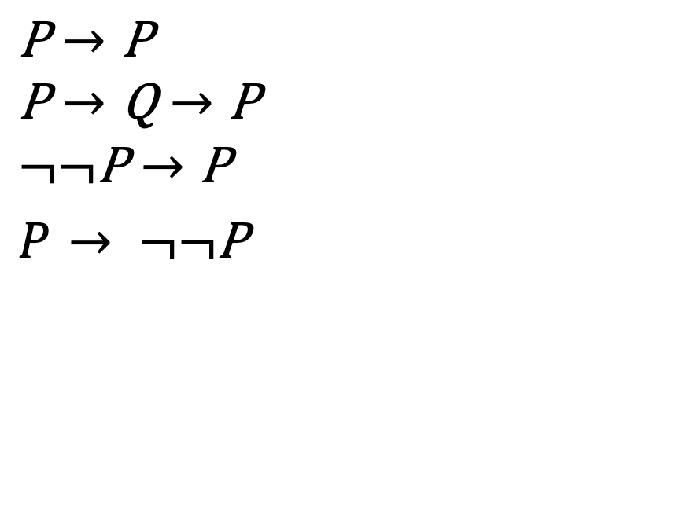
Examples
$$\text{P}→\text{P}$$
$$\text{P}→\text{Q}→\text{P}$$
$$¬¬\text{P}→\text{P}$$
$P$ $→ ¬¬\text{P}$
P ::= p
|$T$
| $⊥$
| P $∨$ P
$$\text{|} \text{P}∧\text{P}$$
$$\text{|} \text{P}→\text{P}$$
$$\text{|} ¬\text{P}$$

Slide 14
Propositional logic:
The proof system

Slide 15
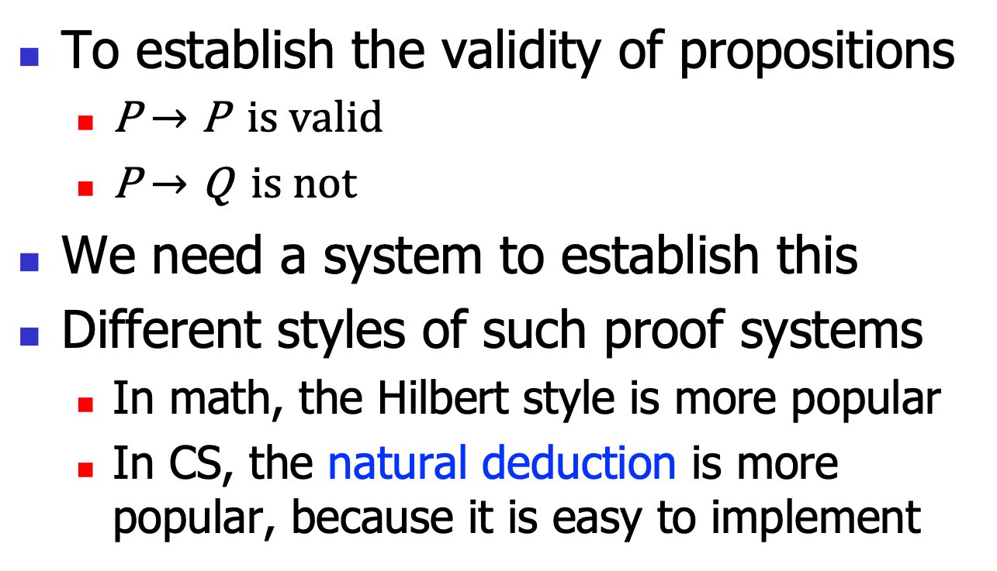
Goals
To establish the validity of propositions
  $\text{P}→\text{P}$ is valid
  $\text{P}→\text{Q}$ is not
We need a system to establish this
Different styles of such proof systems
  In math, the Hilbert style is more popular
  In CS, the natural deduction is more popular, because it is easy to implement

Slide 16
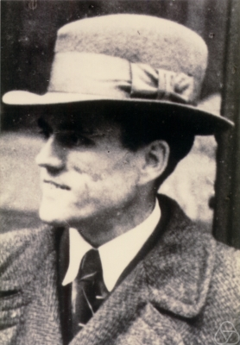
Brief History
Gerhard Gentzen, 1934/35
  Untersuchungen über das logische Schließen
    Investigations into Logical Reasoning
A system to reason the logic deduction itself

Slide 17
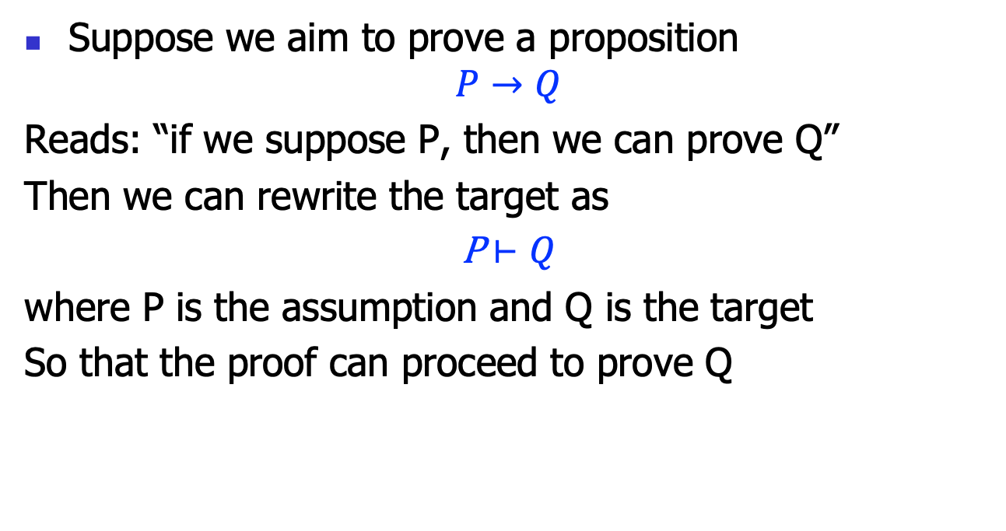
Natural deduction: basic idea
Suppose we aim to prove a proposition
$$P→Q$$
Reads: “if we suppose P, then we can prove Q”
Then we can rewrite the target as
P $⊢Q$
where P is the assumption and Q is the target
So that the proof can proceed to prove Q

Slide 18
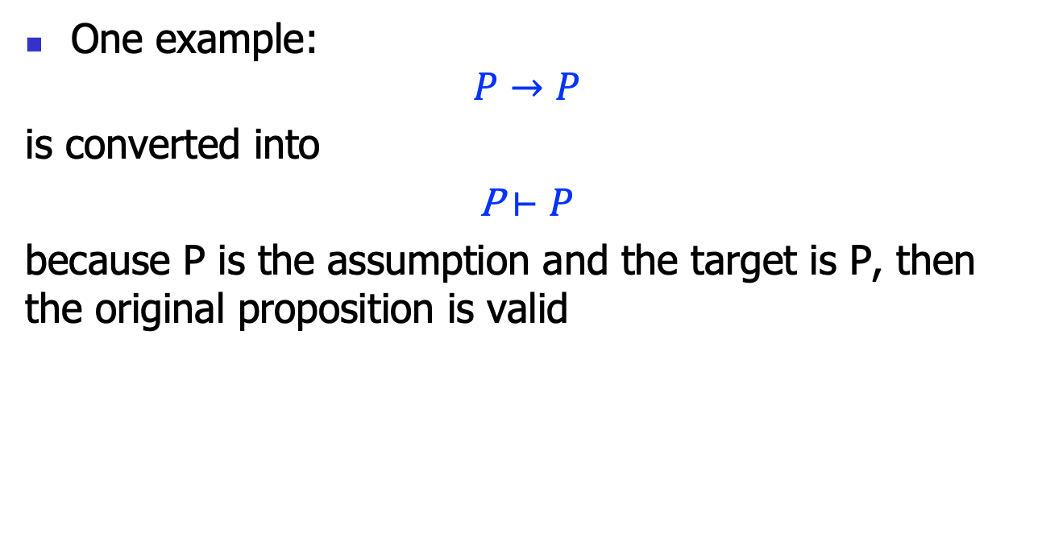
Natural deduction: basic idea
One example:
$$P→P$$
is converted into
P $⊢P$
because P is the assumption and the target is P, then the original proposition is valid

Slide 19
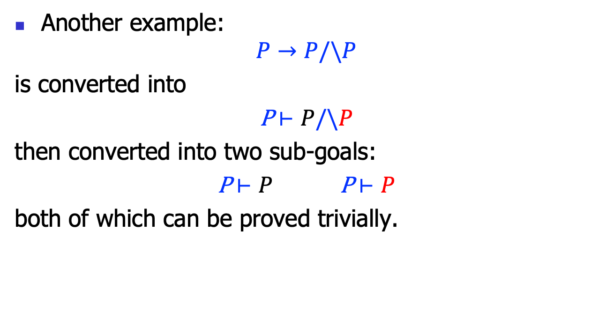
Natural deduction: basic idea
Another example:
$$P→P/\backslash P$$
is converted into
P $⊢P/\backslash P$
then converted into two sub-goals:
P $⊢P$ P $⊢P$
both of which can be proved trivially.

Slide 20
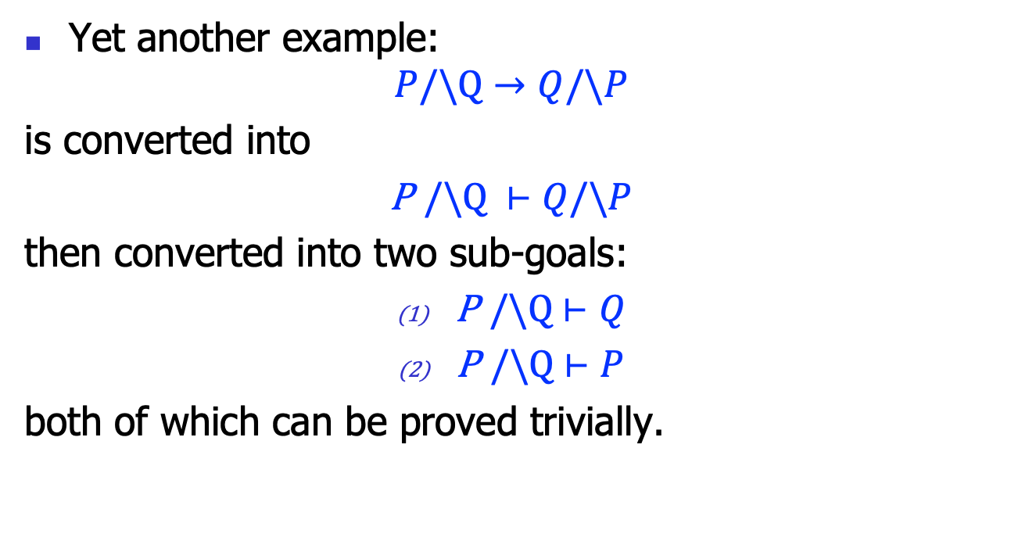
Natural deduction: basic idea
Yet another example:
$$P/\backslash Q→Q/\backslash P$$
is converted into
P $/\backslash Q$ $⊢Q/\backslash P$
then converted into two sub-goals:
P $/\backslash Q$ $⊢Q$
P $/\backslash Q$ $⊢P$
both of which can be proved trivially.

Slide 21
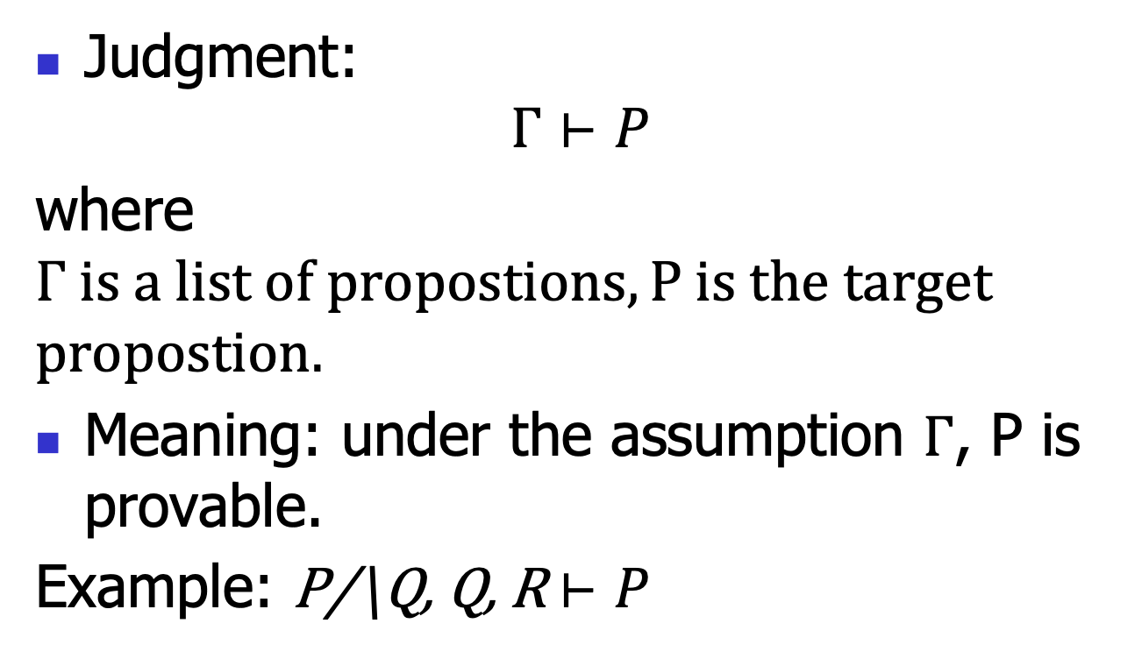
Natural deduction: judgments
Judgment:
$$Γ⊢P$$
where $Γ is a list of propostions, P is the target$
$$propostion.$$
Meaning: under the assumption $Γ$, P is provable.
Example: P/\Q, Q, R $⊢P$

Slide 22





Natural deduction:
Inference rules
Each rule takes this form:
$$Γ⊢P1$$
$$…$$
$$Γ⊢Pn$$
$$(name)$$
$$Γ⊢P$$
The hypotheses (above the line)
The conclusion (below the line)
The rule name (right the line)
If n==0, then this rule is called an axiom;
Otherwise it is called a rule.

Slide 23


Natural deduction:
Inference rules
Rule for props:
$$(Var)$$
$$Γ, P⊢P$$
Note this is an axiom.
Informally: under the assumption P, P is provable.

Slide 24


Natural deduction:
Inference rules
Rule for T:
$$(TI)$$
$$Γ⊢ T$$
Note this is an axiom.
Informally: T is provable unconditionally.

Slide 25
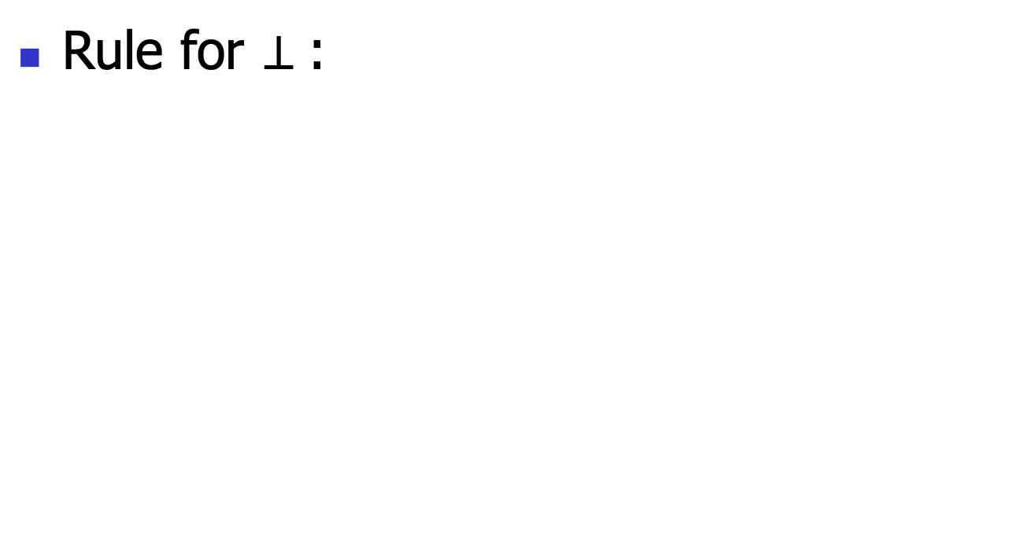

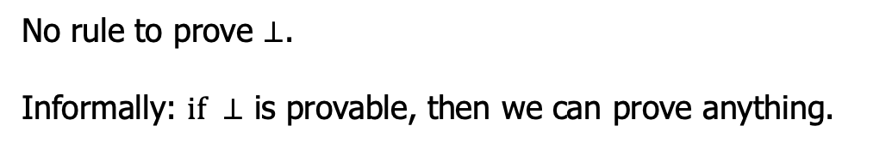

Natural deduction:
Inference rules
Rule for $⊥$:
$Γ⊢$ $⊥$
$$(⊥E)$$
$$Γ⊢P$$
No rule to prove $⊥$.
Informally: $if ⊥$ is provable, then we can prove anything.

Slide 26




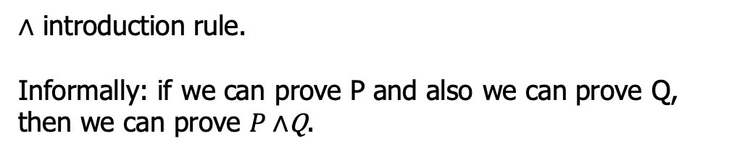

Natural deduction:
Inference rules
Rule for $∧$:
$Γ⊢$ $P$
$Γ⊢$ $Q$
$$(∧I)$$
$Γ⊢P∧$Q
$∧$ introduction rule.
Informally: if we can prove P and also we can prove Q, then we can prove $P∧$Q.

Slide 27




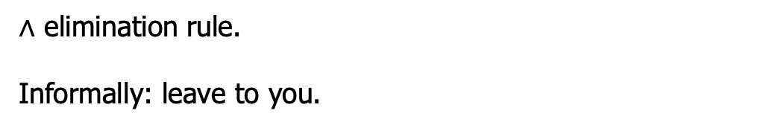


Natural deduction:
Inference rules
Rule for $∧$:
$Γ⊢$ $P∧\text{Q}$
$Γ⊢$ $P∧\text{Q}$
$$(∧E1)$$
$$(∧E2)$$
$$Γ⊢P$$
$$Γ⊢Q$$
$∧$ elimination rule.
Informally: leave to you.

Slide 28





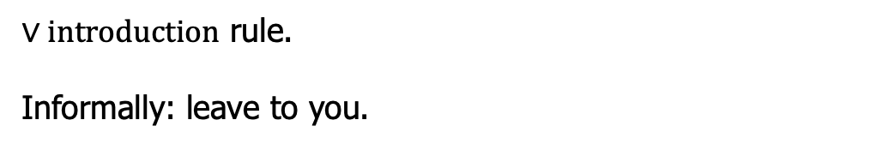


Natural deduction:
Inference rules
Rule for $∨$:
$Γ⊢$ $P$
$Γ⊢$ $\text{Q}$
$$(∨I1)$$
$$(∨I2)$$
$Γ⊢P$ $∨ \text{Q}$
$$Γ⊢P ∨ \text{Q}$$
$∨introduction$ rule.
Informally: leave to you.

Slide 29





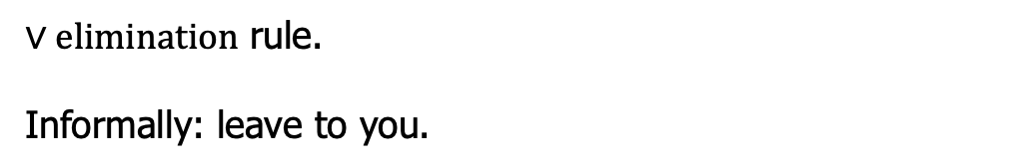
Natural deduction:
Inference rules
Rule for $∨$:
$Γ⊢$ $P∨ \text{Q}$
$Γ, P⊢$ $R$
$Γ, Q⊢$ $R$
$$(∨E)$$
$$Γ⊢R$$
$∨elimination$ rule.
Informally: leave to you.

Slide 30







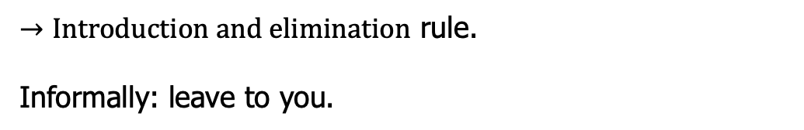

Natural deduction:
Inference rules
Rule for$→$:
$Γ, P⊢$ $\text{Q}$
$Γ⊢P$ $→$ $\text{Q}$
$$Γ⊢P$$
$$(→I)$$
$$(→E)$$
$$Γ⊢P→Q$$
$$Γ⊢Q$$
$→Introduction and elimination$ rule.
Informally: leave to you.

Slide 31






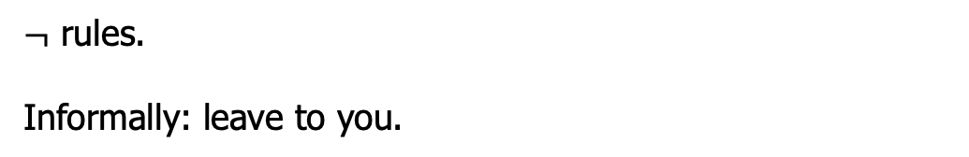

Natural deduction:
Inference rules
Rule for$¬$:
$$Γ, P⊢ ⊥$$
$$Γ⊢P$$
$$Γ⊢¬P$$
$$(¬I)$$
$$(¬E)$$
$$Γ⊢¬P$$
$$Γ⊢⊥$$
$¬$ rules.
Informally: leave to you.

Slide 32
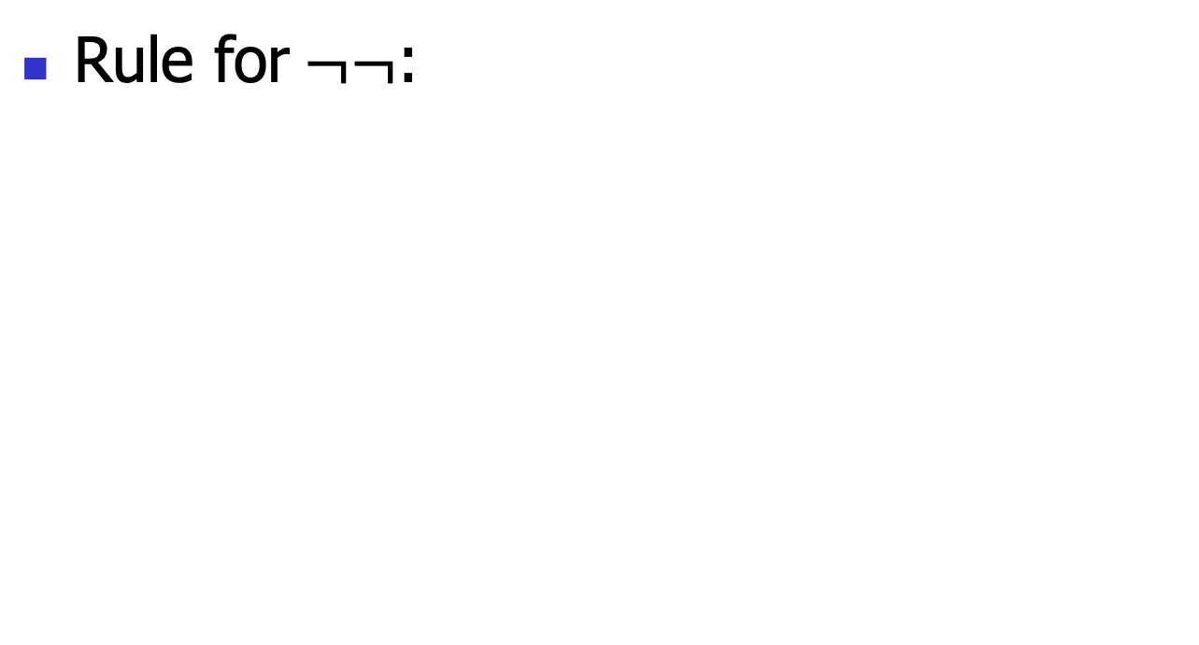


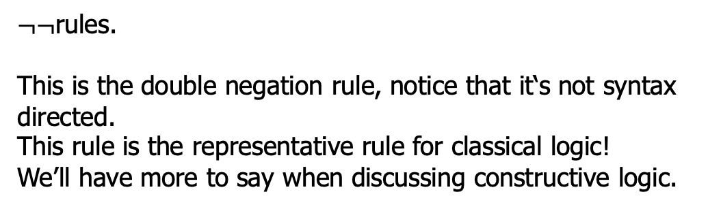
Natural deduction:
Inference rules
Rule for$¬¬$:
$$Γ⊢¬¬P$$
$$(¬¬E)$$
$$Γ⊢P$$
$¬¬$rules.
This is the double negation rule, notice that it‘s not syntax directed.
This rule is the representative rule for classical logic!
We’ll have more to say when discussing constructive logic.

Slide 33







Example
Try to prove $P∧Q→P$:
$$(var)$$
$P∧Q⊢P$ $∧Q$
$$(∧E)$$
$$P∧Q⊢P$$
$$(→I)$$
$$⊢P∧Q→P$$
This is called a proof tree!

Slide 34
Proof engineering
There has been great advancement in the automatic or semiautomatic proof assistant
  Thus, we can conduct the above proof using such assistant
  So CS also boosts math.
  Let’s just study one example
    You will do more in the 2nd assignment

Slide 35
Propositional logic:
Semantics

Slide 36
Semantics
The above proof system cares about when a proposition is provable
  Axioms and proof rules
Roughly, semantics is more about computation
  Models and computation rules
  To obtain a result of “true” or “false”

Slide 37
The truth table
Truth table encodes the computation rules (recall the Bool logic rules):
Thus, to computer P/\Q, we need an assignment to P and Q, this is called an interpretation
P | Q | P/\Q | P\/Q
T | T | T | T
T | F | F | T
F | T | F | T
F | F | F | F

Slide 38
Interpretation
For a given proposition P, an interpretation V defined by:
V(T) = T
V(F) = F
V(p) = T or F
V(P/\Q) = V(P) op V(Q)
… // leave to you
Essentially, a compiler!
A
B
V

Slide 39
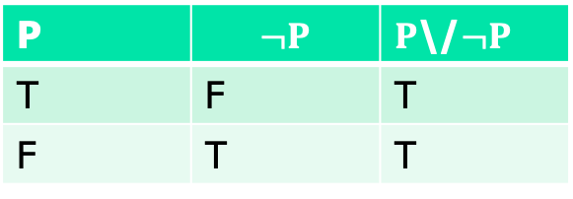
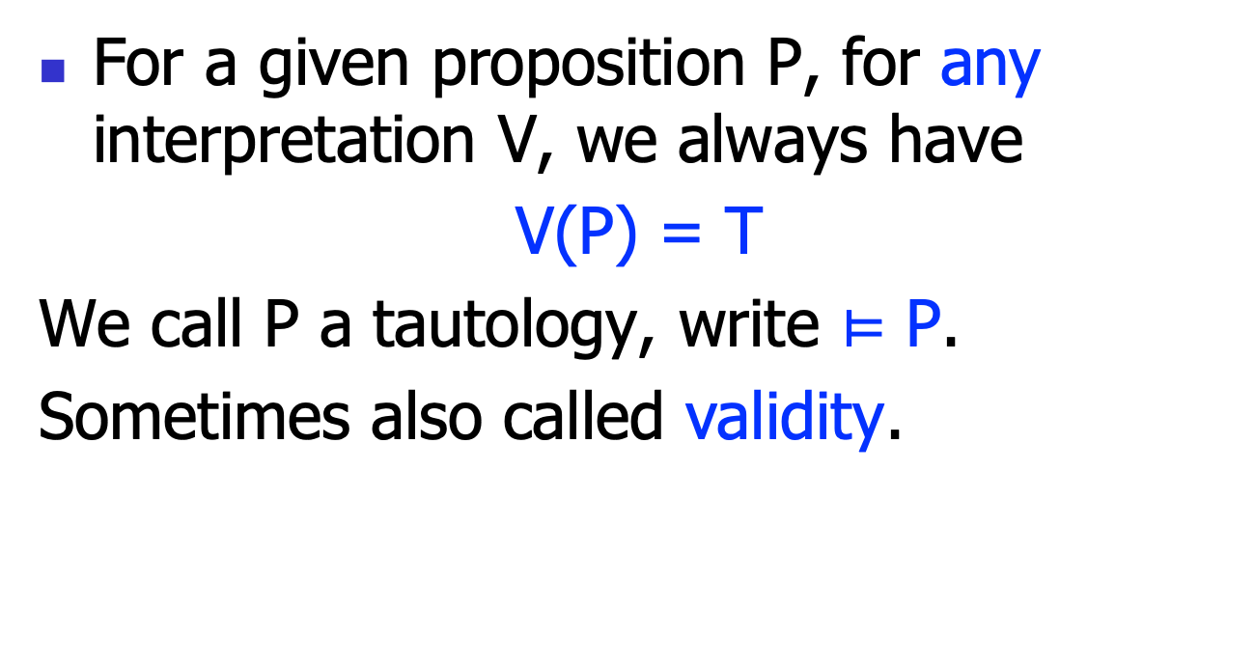
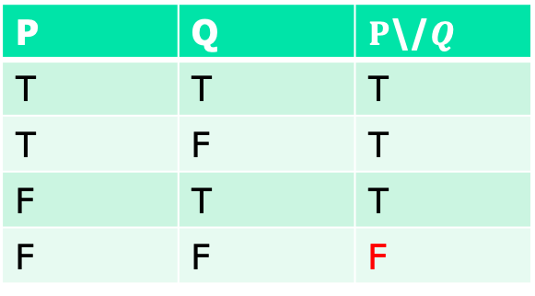
Tautology
For a given proposition P, for any interpretation V, we always have
V(P) = T
We call P a tautology, write $⊨$ P.
Sometimes also called validity.
P | $$¬P$$ | $P$\/$¬P$
T | F | T
F | T | T
P | Q | $P$\/$Q$
T | T | T
T | F | T
F | T | T
F | F | F

Slide 40
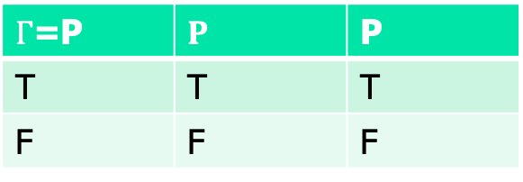
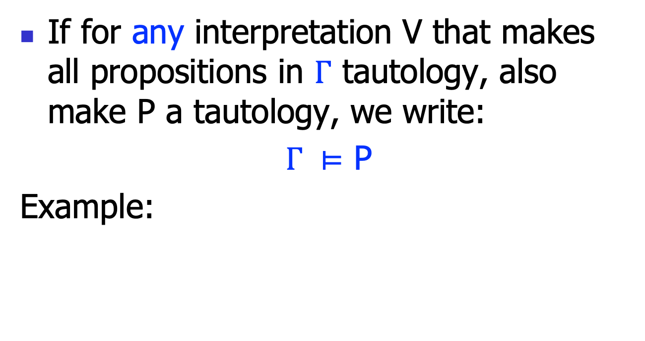
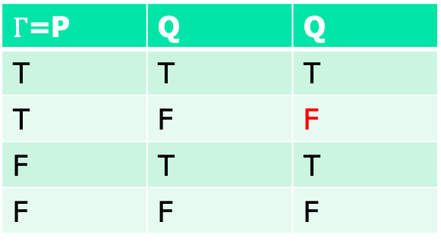
Tautology
If for any interpretation V that makes all propositions in $Γ$ tautology, also make P a tautology, we write:
$Γ ⊨$ P
Example:
$Γ$=P | $$P$$ | P
T | T | T
F | F | F
$Γ$=P | Q | Q
T | T | T
T | F | F
F | T | T
F | F | F

Slide 41
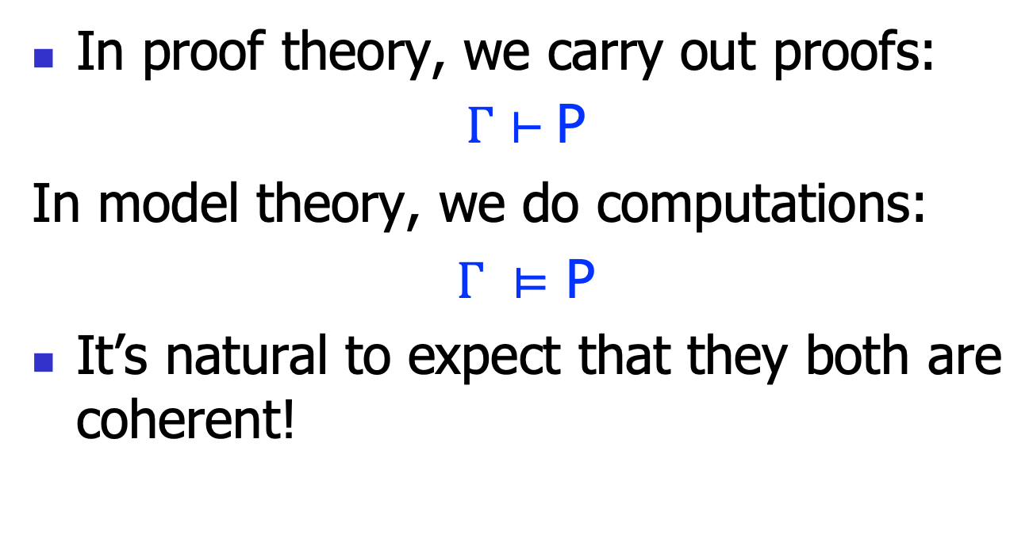
Two notions of validity
In proof theory, we carry out proofs:
$Γ⊢$ P
In model theory, we do computations:
$Γ ⊨$ P
It’s natural to expect that they both are coherent!

Slide 42
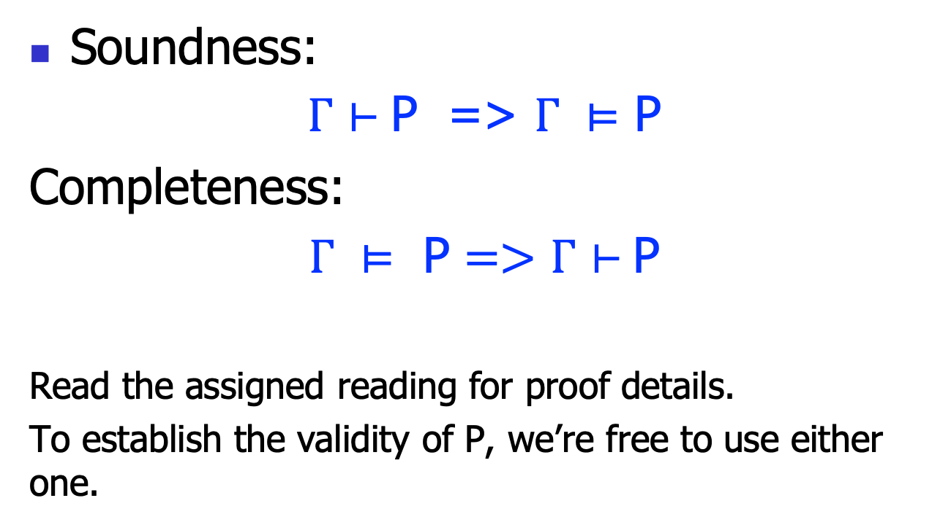
Soundness and completeness
Soundness:
$Γ⊢$ P => $Γ ⊨$ P
Completeness:
$Γ ⊨ \text{P}=>Γ⊢$ P
Read the assigned reading for proof details.
To establish the validity of P, we’re free to use either one.

