Slide 1
Overview
System Programming in C
Baojian Hua
bjhua@ustc.edu.cn

Slide 2
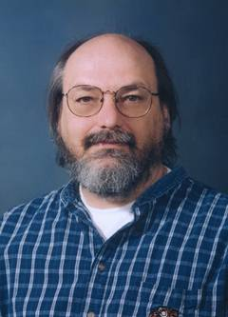
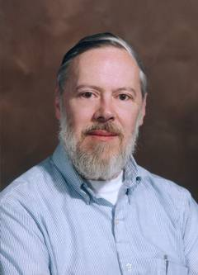
The C Programming Language
Capsule history:
BCPL → B → C → K&R C → ANSI C → C99
1960 1970 1972 1978 1988
LISP → Smalltalk → C++ → Java
1960’s 1970’s 1980’s 1994
C#
2000

Slide 3
The C Programming Language
C is a system programming language
Originally invented to write Unix
and later Linux and Windows
Data types and control structures close to most machines
So you know system deeper, you can program better
Pros and cons:
Can do whatever you want: flexible and powerful
Can do whatever you do NOT want: shoot yourself in the foot

Slide 4
What is this course about?
Modular C programming:
C is the most widely-used system language
OS kernels, network stack, compiler, DB, …
C is low-level
Device driver, embedded (real-time) system, …
Closely related with architectures
Motivating ideas for other languages
C++/Java/C# etc.

Slide 5
What is this course about?
System interfaces
POSIX interfaces
As implemented by almost all operating systems
And build interesting applications on top of such interfaces

Slide 6
Goal of this course
Solid C knowledge:
C and data structures are crucial for CS
Foundations for later computer courses
Familiarize you with computational thinking
e.g.: abstraction (ADT), recursion
System programming skills
Be experienced system programmers

Slide 7
How this course works?

Slide 8
Administrivia
Instructor:
Hua, Baojian: bjhua@ustc.edu.cn
TAs:
Yufei, Wu: wuyf21@mail.ustc.edu.cn
Wenlong, Zheng: zwl21@mail.ustc.edu.cn

Slide 9
Course Home Page
Home page
https://csslab-ustc.github.io/courses/sysprog/
Course administrivia
Lecture notes
Programming assignments
Software
Test and evaluation
Check course home page frequently

Slide 10
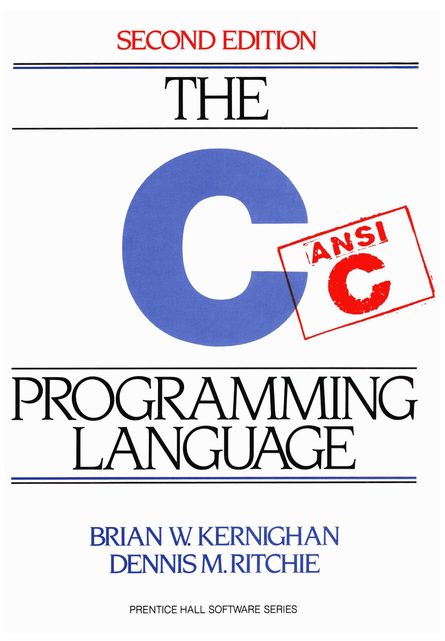
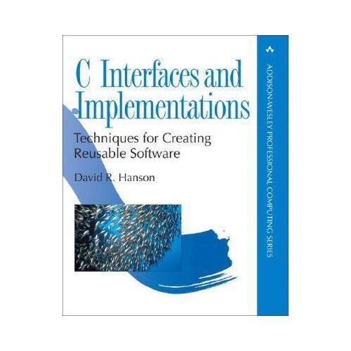
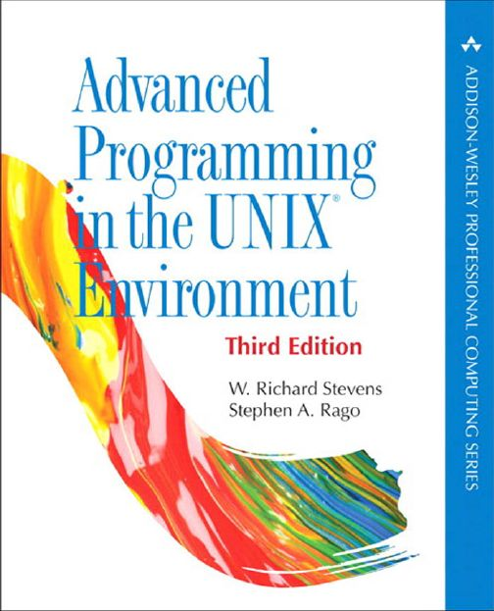
Textbooks and References
The C Programming Language (Second Edition) . Kernighan and Ritchie, 1988.
C Interface and Implementation, 2002.
Unix System Programming. Rietchard Stevens.

Slide 11
Assignments
There are 5 assignments (tentative)
Each consists of some required problems and optional problems (Optional)
Optional assignments are not required, but highly recommended
Solve them independently
Late homework will not be accepted

Slide 12
Assignments
Lab0: preparation
Lab1: Shell
Lab2: Mini Wireshark
Lab3: Mini debugger
Lab4: Concurrency
Lab5: Mini Database (Tentative)

Slide 13
Test and Evaluation
No test :-)
Evaluated
80%: assignments
20%: class attending
No one should fail!

Slide 14
Learning by Doing
Get your hand dirty

Slide 15
Any questions?

