Slide 1
Untyped Lambda Calculus
Principle of Programming Languages
Baojian Hua
bjhua@ustc.edu.cn

Slide 2
Diophantine Equation
Diophantine (3th century, Greece)
a₁*x^{b1}+…+a_{n}*x^{bn} = c
where a, b, c\in Z.
E.g.:
2x - 3y = 5
x²+y²=z²
x^{n}+y^{n}=z^{n} (Fermat’s last theorem)

Slide 3
Hilbert’s 10th problem
[1900] Can we design an algorithm, to determine whether or not a Diophantine equation has solutions?
[1970] Matiyasevich‘s theorem: No such algorithms!
Negative results!
Undecidable problem!

Slide 4
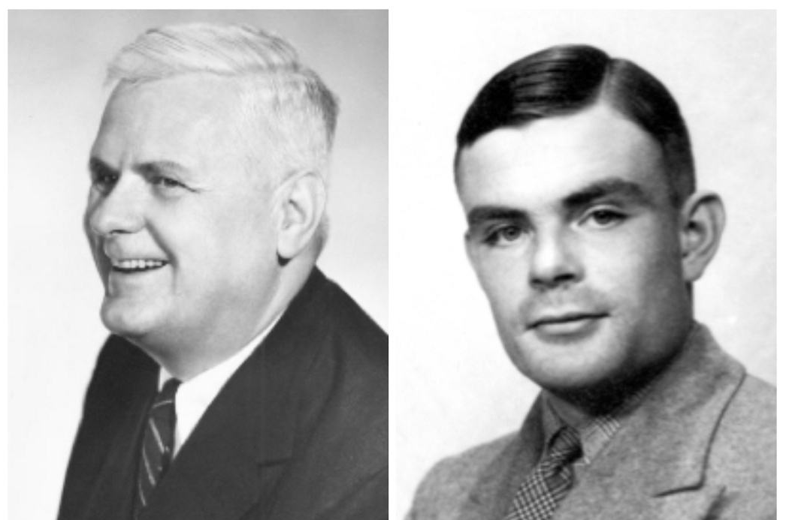
What are computations?
[1930’] Turing machines
[1920’] lambda-calculus
The Church-Turing thesis

Slide 5
Lambda calculus & programming language
[1950’] LISP language, J. MacCarthy
ML, OCaml, F#, …
And various lambda features in nearly ALL languages
[1960’] Landin, The next 700 programming languages
[1970’] GL. Steele, Lambda, the ultimate GOTO

Slide 6
Syntax

Slide 7
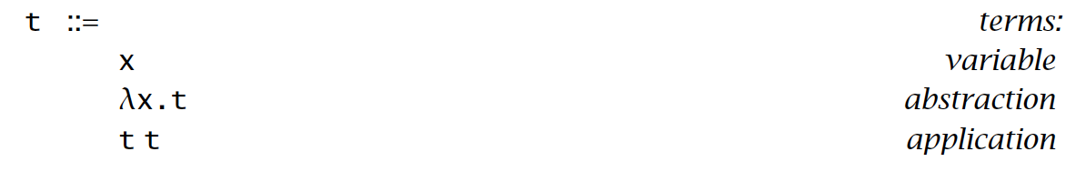
Syntax
Nameless functions:
int f(int x){
return x;
}
λx.x
2. Functions nest:
int f(int x){
int g(int y){
return x;
}
}
λx. λy. x

Slide 8
Syntax
Function invocations:
int f(int x){
return x;
}
f(2);
(λx.x) 2
==> 2
int f(int x){
int g(int y){
return x;
}
}
f(2)
(λx. λy. x) 2
==> λy. 2

Slide 9

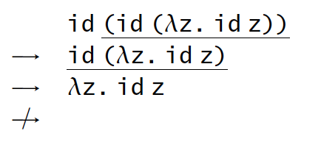
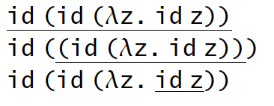
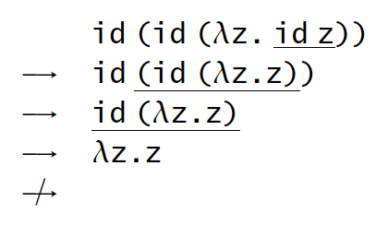
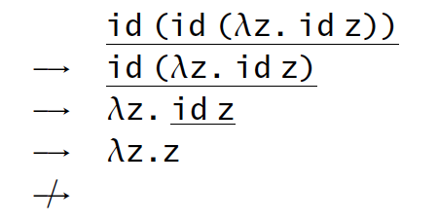
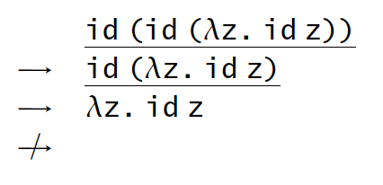
Evaluation
Call-by-value

Slide 10
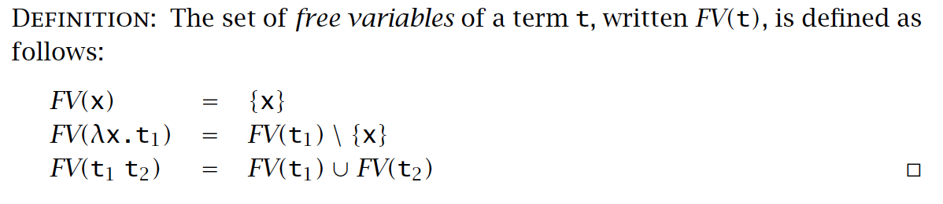
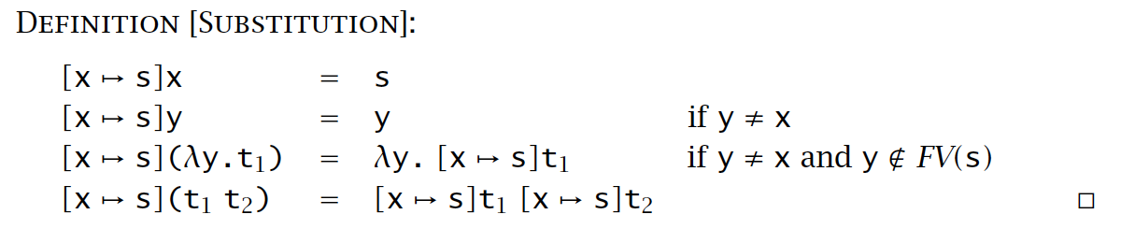
Substitution

Slide 11
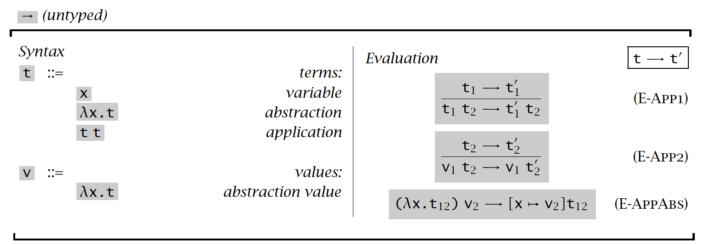
Evaluation

Slide 12
Programming in Lambda Calculus

Slide 13
Multi-arguments
λ(x, y).x --> λx. λy. x
(λ(x, y).x) (3, 4) --> (λx. λy. x) 3 4
The left ones are called un-curry forms
the right ones are called curry forms
the conversion from left ones into right ones are called currying
in honor of H. Curry

Slide 14
Boolean
true = λx. λy. x
false = λx. λy. y
if = λx. λy. λz. x y z
if true x y
--> (λx. λy. λz. x y z) (λx. λy. x) x y
--> (λx. λy. x) x y
--> x

Slide 15
Pair
pair = λf. λs. λp. p f s
fst = λp. p true
snd = λp. p false
fst (pair x y)
--> …
--> x

Slide 16
Church numerals
0 = λs. λz. z
1 = λs. λz. s z
2 = λs. λz. s (s z)
succ = λn. λs. λz. s (n s z)
succ 0
--> … -> 1

Slide 17
Church numerals
+ = λm. λn. λs. λz. m s (n s z)
1 = λs. λz. s z
2 = λs. λz. s (s z)
+ 1 2
--> (λm. λn. λs. λz. m s (n s z)) 1 2
--> …
--> 3

Slide 18
Divergence
omega = (λx. x x) (λx. x x)
omega omega
--> (λx. x x) (λx. x x)
--> …
--> (λx. x x) (λx. x x)
--> …

Slide 19
Summary
The syntax and operational semantics of lambda calculus
A basic model for ALL programming languages
although more syntax sugar are needed in practice

