Slide 1
Symbolic execution
Formal Methods Foundation
Baojian Hua
bjhua@ustc.edu.cn

Slide 2
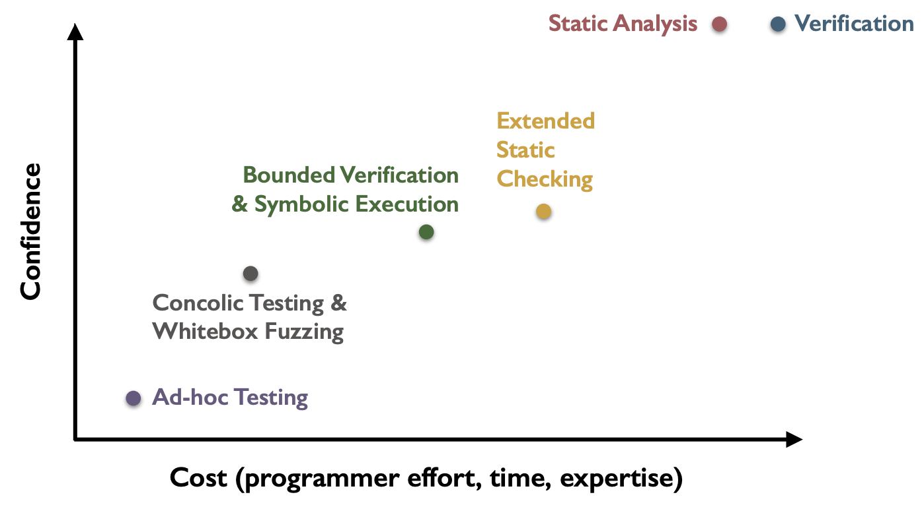
Spectrum of program validation methods
Today’s topic

Slide 3



Why program testing may not work?
// Does the following program throw a
// “DivideByZero” exception?
// Suppose we use a black box testing/fuzzing
// strategy (to generate random inputs):
int foo(int x, int y){
if(x==32467289)
return x/y;
else
return 0;
}
$$\frac{1}{2^{32}}$$
$$\frac{1}{2^{64}}$$
1- $\frac{1}{2^{32}}$

Slide 4
Does white box strategy work?
// White box testing/fuzzing may also be hard:
void foo(int a, int b){
int x = 1, y = 0;
if(a != 0){
y = 3+x;
if(b == 0)
x = 2*(a+b);
}
assert(x-y != 0);
}
Input: a=0, b=0
Get: x=1, y=0
Input: a=1, b=0
Get: x=2, y=4
Input: a=1, b=1
Get: x=1, y=4
…
Can we construct the values for input x and y, to trigger this assertion?

Slide 5


Program testing in general

Slide 6
Automatic test generation
Key question: for a given program, can we craft a tool to generate test cases automatically?
  and effectively?
  also to satisfy certain properties
In this lecture, we discuss a technique called symbolic execution

Slide 7
Symbolic Execution

Slide 8
Brief History
1976: A system to generate test data and symbolically execute programs (Lori Clarke)
1976: Symbolic execution and program testing (James King)
2005-present: practical symbolic execution
  Using SMT solvers
  Heuristics to control exponential explosion
  Heap modeling and reasoning about pointers
  Environment modeling
  Dealing with solver limitation

Slide 9
Symbolic execution
// Step #1: construct ”symbolic” values for
// function inputs:
int foo(int x, int y){
int z = x+y;
if(x==32467289)
return x/y;
else
return 0;
}
Variable | value
x | x
y | y

Slide 10
Symbolic execution
// Step #2: executing the program with the
// symbolic inputs, maintaining the symbolic
// program state:
int foo(int x, int y){
int z = x+y;
if(x==32467289)
return x/y;
else
return 0;
}
Variable | value
x | x
y | y
z | x+y
Values are symbolic expressions.

Slide 11
Symbolic execution
// For branch, we add a “path condition” to the
// corresponding branch:
int foo(int x, int y){
int z = x+y;
if(x==32467289)
return x/y;
else
return 0;
}
Variable | value
x | x
y | y
z | x+y
x == 32467289
x != 32467289
if
x == 32467289
x != 32467289
x/y
0

Slide 12
Symbolic execution
// To check the desired property, we add
// corresponding constraints:
int foo(int x, int y){
int z = x+y;
if(x==32467289)
return x/y;
else
return 0;
}
Variable | value
x | x
y | y
z | x+y
x == 32467289
y==0
x != 32467289
if
x == 32467289
x != 32467289
x/y
0
y==0

Slide 13

Symbolic execution
// Step #3: with the path conditions and
// properties, we can generate constraints:
int foo(int x, int y){
int z = x+y;
if(x==32467289)
return x/y;
else
return 0;
}
Variable | value
x | x
y | y
z | x+y
x == 32467289
y==0
x != 32467289
if
x==32467289 $∧$ y==0
x==32467289
x != 32467289
Essentially, we are asking: is the above logic formulae satisfiable (SAT)? If so, this means that there is a feasible path that triggers the obligation!
x/y
0
y==0

Slide 14

Symbolic execution
// Step #4: feed the generated constraints to
// some solvers (e.g., Z3), to check SAT:
int foo(int x, int y){
int z = x+y;
if(x==32467289)
return x/y;
else
return 0;
}
Variable | value
x | x
y | y
z | x+y
x == 32467289
y==0
x != 32467289
if
x == 32467289
x != 32467289
x == 32467289 $∧$ y==0
x/y
0
The model:
[x == 32467289, y==0]
y==0

Slide 15
Symbolic execution
// Step #5: use the model from the solver, as the
// concrete inputs (to trigger the bug):
int foo(int x, int y){
int z = x+y;
if(x==32467289)
return x/y;
else
return 0;
}
Variable | value
x | 32467289
y | 0
z | 32467289
x == 32467289
y==0
x != 32467289
if
x == 32467289
x != 32467289
x == 32467289 $∧$ y==0
x/y
0
The model:
[x = 32467289, y==0]
y==0

Slide 16
Architecture
programs
symbolic executor
concrete
execution
model
path conditions/obligations
bug triggered?
solver

Slide 17








The general form
// Conceptually, path conditions accumulate:
int foo(int x, int y){
if(b1)
if(b2)
if(…)
if(bn)
return x/y;
else …;
else …;
else …;
else return 0;
}
b1
b1 $∧$b2
b1 $∧$b2 $∧$ ...
b1 $∧$b2 $∧$ ... $∧$bn
b1 $∧$b2 $∧$ ... $∧$bn $∧$y==0
b1 $∧$b2 $∧$ ... $∧ ¬$bn
b1 $∧$b2 $∧$ ... $∧ ¬$bn-1
b1 $∧ ¬$b2
$¬$b1

Slide 18





Process & Forking
parent process
// The program:
int foo(){
if(e1)
if(e11)
…;
else
…;
else
if(e12)
…;
else
…;
}
fork()
fork()
e1
fork()
$¬$e1
e1
e11
e12
e1 $∧$e11
e1$∧$ $¬$e11
$¬$e1 $∧¬$e12
$¬$e1 $∧$e12
e…
e…
e…
e…
By utilizing forking, instead of multi-threading, it is easy to maintain separate program states: symbolic stores, path conditions, etc..

Slide 19
Example
// Symbolically executing the following program:
void foo(int a, int b){
int x = 1, y = 0;
if(a != 0){
y = 3+x;
if(b == 0)
x = 2*(a+b);
}
assert(x-y != 0);
}
Variable | value
a | a
b | b
x | 1
y | 0
Can we construct values for x and y, to trigger this assertion?

Slide 20
Example
Variable | value
a | a
b | b
x | 1
y | 0
a!=0
a==0
// For branching, the process
// forks:
void foo(int a, int b){
int x = 1, y = 0;
if(a != 0){
y = 3+x;
if(b == 0)
x = 2*(a+b);
}
assert(x-y != 0);
}
Variable | value
a | a
b | b
x | 1
y | 0
Variable | value
a | a
b | b
x | 1
y | 0
The obligation:
x-y==0
that is:
1-0==0
USNAT!

Slide 21
Example
Variable | value
a | a
b | b
x | 1
y | 0
a!=0
a==0
// For branching, the process
// forks:
void foo(int a, int b){
int x = 1, y = 0;
if(a != 0){
y = 3+x;
if(b == 0)
x = 2*(a+b);
}
assert(x-y != 0);
}
Variable | value
a | a
b | b
x | 1
y | 4
Variable | value
a | a
b | b
x | 1
y | 0
b==0
b!=0
The obligation:
x-y==0
that is:
1-0==0
Variable | value
a | a
b | b
x | 1
y | 4
Variable | value
a | a
b | b
x | 1
y | 4
USNAT!
The obligation:
x-y==0
that is:
1-4==0
USNAT!

Slide 22
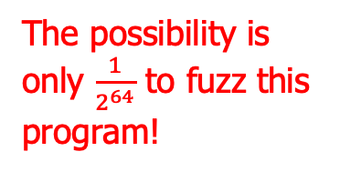
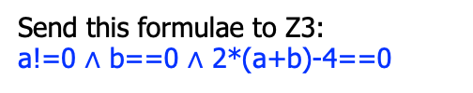
Example
Variable | value
a | a
b | b
x | 1
y | 0
The possibility is only $\frac{1}{2^{64}}$ to fuzz this program!
a!=0
a==0
// For branching, the process
// forks:
void foo(int a, int b){
int x = 1, y = 0;
if(a != 0){
y = 3+x;
if(b == 0)
x = 2*(a+b);
}
assert(x-y != 0);
}
Variable | value
a | a
b | b
x | 1
y | 4
Variable | value
a | a
b | b
x | 1
y | 0
b==0
b!=0
The obligation:
x-y==0
that is:
1-0==0
Variable | value
a | a
b | b
x | 2*(a+b)
y | 4
Variable | value
a | a
b | b
x | 1
y | 4
USNAT!
The obligation:
x-y==0
that is:
2*(a+b)-4==0
The obligation:
x-y==0
that is:
1-4==0
Send this formulae to Z3:
a!=0 ∧ b==0 $∧$ 2*(a+b)-4==0
[a=2, b=0]
USNAT!

Slide 23
Practical Symbolic Execution I:
CrossHair

Slide 24
CrossHair
CrossHair is a widely used symbolic (concolic) execution engine for Python
  open source: https://crosshair.readthedocs.io/
  It leverages Z3 as its backend
We next investigate CrossHair’s practical usage (as a case study)
  as we have discussed the underlying theory

Slide 25
Example #1: the program
Step #1: symbolic execution
def foo(x: int, y: int)-> int: // aforementioned example
assert True // Tells CrossHair to
check this function
if x==123456789:
return x//y
else:
return 0
// To check the target program, run:
$ crosshair check --analysis_kind=asserts test.py
// symbolically executes the program, output:
test.py:7: error: ZeroDivisionError: when calling foo(123456789, 0)

Slide 26
Example #1: the program
Step #2: Test Generation
def foo(x: int, y: int)-> int: # aforementioned example
assert True # Tells CrossHair to
check this function
if x==123456789:
return x//y
else:
return 0
// To generate test cases, run:
$ crosshair cover test.py --example_output_format=pytest > cases_gen.py
// will generate two test cases in the file ”cases_gen.py”:
def test_nest_add():
assert nest_add(123456789, 1) == 123456789
def test_nest_add_2():
assert nest_add(123456790, 0) == 0

Slide 27
Example #1: the program
Step #3: Test replay
def foo(x: int, y: int)-> int: # aforementioned example
assert True # Tells CrossHair to
check this function
if x==123456789:
return x//y
else:
return 0
// To replay the test cases:
$ pytest cases_gen.py
// will perform the test automatically (stripped):
====== test session starts ==
collected 2 items
cases_gen.py .. [100%]
====== 2 passed in 0.08s

Slide 28
Example #2: bug detection
def foo(a: int, b: int):
x = 1
y = 0
if(a != 0):
y = 3+x
if(b == 0):
x = 2*(a+b)
assert(x-y != 0)
Leave the triage of this program as an exercise.

Slide 29
Case #3: crack password
int main(){
int password;
printf(“pls input passwd:”);
scanf(”%d”, &password);
check(password);
return 0;
}
void check(int pw){
unsigned char *p = &pw;
if(p[0]==0)
if(p[1]==1)
if(p[2]==2)
if(p[3]==3)
assert(0);
return;
}

Slide 30
Case #4: vulnerability
def buf_write(buf: List[int], index: int):
assert index >= 0
# oops, index out of bound
buf[index] += 1

Slide 31
Summary for CrossHair
Pros:
  in Python, for Python
  high coverage, (mostly) automated
  high effectiveness (even for programs heavily tested)
Cons:
  expensive
  white-box (i.e., source code needed)
  tied to specific language (clang)

Slide 32
Practical Symbolic Execution II:
Klee

Slide 33
Klee
Klee is a relatively new tool that makes symbolic execution popular (again)
  designed at Stanford
  and now open source: https://klee-se.org/
The original paper:
  KLEE: Unassisted and Automatic Generation of High-Coverage Tests for Complex Systems Programs (OSDI ‘08)

Slide 34
Klee, cont’
We next investigate Klee’s practical usage (as a case study)
  as we have discussed the underlying theory
Required tools:
  Klee: https://klee-se.org/
  clang & llvm: https://clang.llvm.org/
  gcov: https://gcc.gnu.org/onlinedocs/gcc/Gcov.html

Slide 35
Case #1: the program
Step #1: symbolic execution
int foo(int x, int y){ // aforementioned example
int z = x+y;
if(x==32467289)
return x/y;
else
return 0;
}
int main(){
int a=0, b=1;
klee_make_symbolic(&a, sizeof(a), "a");
klee_make_symbolic(&b, sizeof(b), "b");
foo(a, b);
return 0;
}
// Commands:
// compile the target program:
$ clang –O0 –c –emit-llvm –g case1.c
// which generates “case1.bc”
// symbolically executes the “binary”:
$ klee case1.bc

Slide 36
Step #2: error detection
int foo(int x, int y){
int z = x+y;
if(x==32467289)
return x/y;
else
return 0;
}
int main(){
int a=0, b=1;
klee_make_symbolic(&a, sizeof(a), "a");
klee_make_symbolic(&b, sizeof(b), "b");
foo(a, b);
return 0;
}
// Outputs (part):
KLEE: Using Z3 solver backend
KLEE: ERROR: case1.c:6: divide by zero
KLEE: NOTE: now ignoring this error at this location
KLEE: done: total instructions = 51
KLEE: done: completed paths = 2
KLEE: done: partially completed paths = 1
KLEE: done: generated tests = 3

Slide 37
Step #3: tests generation
int foo(int x, int y){
int z = x+y;
if(x==32467289)
return x/y;
else
return 0;
}
int main(){
int a=0, b=1;
klee_make_symbolic(&a, sizeof(a), "a");
klee_make_symbolic(&b, sizeof(b), "b");
foo(a, b);
return 0;
}
// Klee also generates 3 test cases:
test000001.ktest
test000002.ktest
test000003.ktest
// which are binaries that can be checked
// by another tool: klee.ktest-tool:
$ klee.ktest-tool test000001.ktest
a == 0
b == 0

Slide 38
Step #3: tests generation
int foo(int x, int y){
int z = x+y;
if(x==32467289)
return x/y;
else
return 0;
}
int main(){
int a=0, b=1;
klee_make_symbolic(&a, sizeof(a), "a");
klee_make_symbolic(&b, sizeof(b), "b");
foo(a, b);
return 0;
}
$ klee.ktest-tool test000002.ktest
a == 32467289
b == 0
// this triggers the bug!
$ klee.ktest-tool test000003.ktest
a == 32467289
b == 255

Slide 39
Step #4: tests replay
// compile the program:
$ clang –L path/to/solib -lkleeRuntest case1.c
// generate “a.out”
// run the binaries, supply the test case:
$ ./a.out
./klee-last/test000002.ktest
32467289
Floating point exception (core dumped)
// to enable core-dump by disabling apport:
$ sudo service apport stop
int foo(int x, int y){
int z = x+y;
if(x==32467289)
return x/y;
else
return 0;
}
int main(){
int a=0, b=1;
klee_make_symbolic(&a, sizeof(a), "a");
klee_make_symbolic(&b, sizeof(b), "b");
foo(a, b);
return 0;
}

Slide 40
Step #5: debug the core
int foo(int x, int y){
int z = x+y;
if(x==32467289)
return x/y;
else
return 0;
}
int main(){
int a=0, b=1;
klee_make_symbolic(&a, sizeof(a), "a");
klee_make_symbolic(&b, sizeof(b), "b");
foo(a, b);
return 0;
}
// debug the generated core:
$ gdb –-core=core<pid>
// and may supply the symbol table:
(gdb) file a.out
// and debug happily ☺

Slide 41
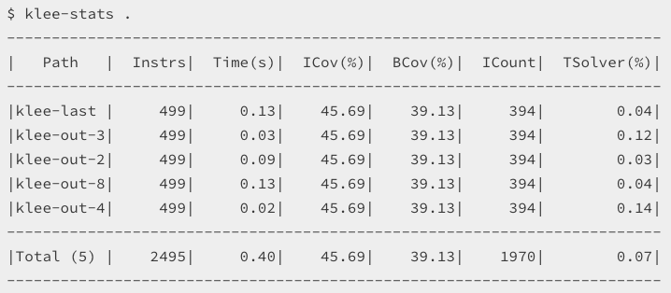
Step #6: auxiliary information
int foo(int x, int y){
int z = x+y;
if(x==32467289)
return x/y;
else
return 0;
}
int main(){
int a=0, b=1;
klee_make_symbolic(&a, sizeof(a), "a");
klee_make_symbolic(&b, sizeof(b), "b");
foo(a, b);
return 0;
}
// to display the statistics:
$ klee.stats .

Slide 42
Case #2: bug detection
void foo(int a, int b){
int x = 1, y = 0;
if(a != 0){
y = 3+x;
if(b == 0)
x = 2*(a+b);
}
assert(x-y != 0);
}
Leave the analysis of this program as an exercise.

Slide 43
Case #3: crack password
int main(){
int password;
printf(“pls input passwd:”);
scanf(”%d”, &password);
check(password);
return 0;
}
void check(int pw){
unsigned char *p = &pw;
if(p[0]==0)
if(p[1]==1)
if(p[2]==2)
if(p[3]==3)
assert(0);
return;
}

Slide 44
Case #4: vulnerability
int main(){
char name[128];
printf(“pls input name:”);
scanf(”%s”, name);
check(name);
return 0;
}
void check(char *name){
char buf[16];
// ooops...
// stack-based overflow
strcpy(buf, name);
return;
}

Slide 45
Summary for Klee
Pros:
  high coverage (read the paper)
  (mostly) automated
  high effectiveness (even for programs heavily tested)
Cons:
  expensive
  white-box (i.e., source code needed)
  tied to specific tools (clang)

Slide 46
Practical Issues with Symbolic Execution

Slide 47
Practical issues
Path explosion
Loops and recursions
Heap modeling
Environment modeling
Constraint solving

Slide 48

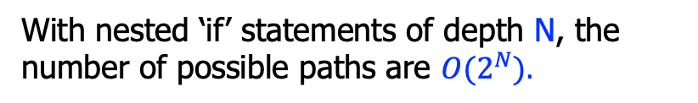



#1: Path explosion
// The program:
int foo(){
if(e1)
if(e11)
…;
else
…;
else
if(e21)
…;
else
…;
}
e1
e1
$¬$e1
e11
e21
e1 $∧$e11
e1$∧¬$e11
$¬$e1 $∧¬$e21
$¬$e1 $∧$e21
e…
e…
e…
e…
With nested ‘if’ statements of depth N, the number of possible paths are ${O(2}^{N}).$

Slide 49
#1: Path explosion
Approach #1: randomly select some path when branching
  sacrifice completeness, but still better than ad-hoc testing/fuzzing
Approach #2: select path according to coverage info’
Approach #3: combine symbolic execution with testing

Slide 50
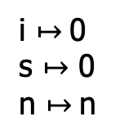

#2: Loops and recursions
// Loops introduce non-termination:
int sum(int n){
int s = 0, i = 0;
while(i<=n){
s = s+i;
i = i+1;
}
return s;
}
i $↦$0
s $↦$ 0
n $↦$n
i<=n
e
$¬$e
e
s

Slide 51
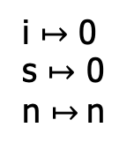
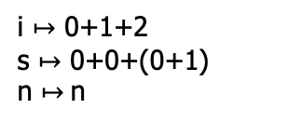
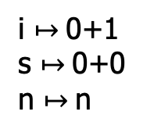
#2: Loops and recursions
// Loops introduce non-termination:
int sum(int n){
int s = 0, i = 0;
while(i<=n){
s = s+i;
i = i+1;
}
return s;
}
i $↦$ 0
s $↦$ 0
n $↦$n
i<=n
0<=n
$¬$e
s
i $↦$0+1
s $↦$0+0
n $↦$n
i<=n
0+1<=n
i<=n
i $↦$ 0+1+2
s $↦$ 0+0+(0+1)
n $↦$n
s
0+1+2<=n
s

Slide 52
#2: Loops and recursion
Bounded symbolic execution
  finitize the loops
// Original:
int sum(int n){
int s = 0, i = 0;
while(e){
S;
}
return s;
}
// New:
int sum(int n){
int s = 0, i = 0;
if(e){
S;
}
return s;
}
One possible conversion

Slide 53
#3: Heap modeling
// The program:
void foobar(int i, int j){
int a[2] = {0};
if(i>1 || j>1)
return;
a[i] = 5;
assert(a[j] != 5);
}
What values of i and j to make the assert() fail?

Slide 54
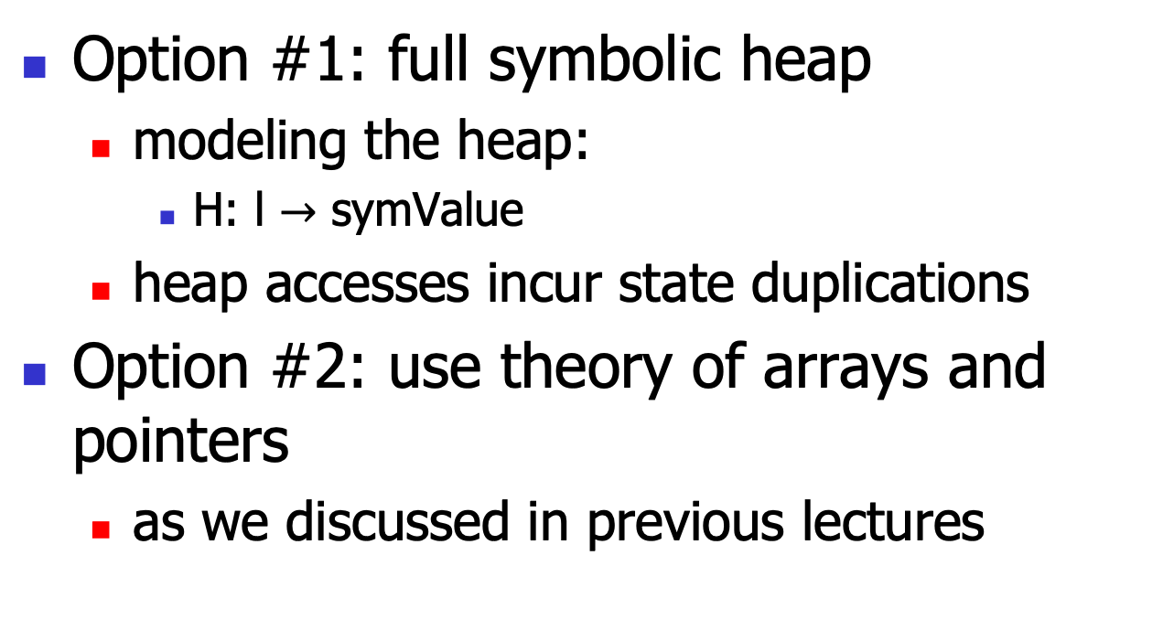
#3: Heap modeling
Option #1: full symbolic heap
  modeling the heap:
    H: l $→$ symValue
  heap accesses incur state duplications
Option #2: use theory of arrays and pointers
  as we discussed in previous lectures

Slide 55
#4: Environment modeling
The software components must interact with the external environments
  invoke libraries, system calls, env. vars, …
The symbolic executor must model the environment
  the whole software stack!
  tedious and error-prone

Slide 56
#4: Environment modeling
Option #1: combine concrete execution
  thus ignore the current path
Option #2: build model
  file systems
  network stack
  …
  approach used in KLEE etc.

Slide 57
#5: constraint solving
// The program:
void foo(int i, int j){
int a = i*i*i;
int b = j*j*j;
1/(a+b);
}
The generated obligation is:
i*i*i+j*j*j==0
which may be beyond the capability of some SMT solvers (recall that the general non-linear theory, in theory, is undecidable).

Slide 58
#5: constraint solving
Option #1: constraint simplification
  optimize the constraints online
    much like optimizations in traditional compilers
Option #2: solver caching and reuse
  incremental solving

Slide 59
Concolic Execution

Slide 60
Concolic Execution Steps
Step #1: generate random concrete input and symbolic input
Step #2, run program with the two inputs
  maintain the concrete+symbolic states
For branching, generate path conditions
  just like in the symbolic execution
  but don’t fork(), only go to feasible path
After one run, negate the result PCs, send them to solver, to get other concreate input
Go to step #2, re-run the program

Slide 61
Architecture
programs
with concrete + symbolic inputs
model
concolic executor
path conditions/obligations
solver

Slide 62
Concolic execution
// Step #1: construct random values as
// initial input:
int foo(int x, int y){
int z = x+y;
if(x==32467289)
return x/y;
else
return 0;
}
Variable | value | sym.value
x | 1 | x
y | 1 | y

Slide 63
Concolic execution
// Step #2: execute the program with both the
// concrete and symbolic values, maintaining the // program state:
int foo(int x, int y){
int z = x+y;
if(x==32467289)
return x/y;
else
return 0;
}
Variable | value | sym.value
x | 1 | x
y | 1 | y
z | 2 | x+y

Slide 64
Concolic execution
// For branch, the executor branches according to
// the concreate values, and we add a “path
// condition” to the
// target branch:
int foo(int x, int y){
int z = x+y;
if(x==32467289)
return x/y;
else
return 0;
}
Variable | value | sym.value
x | 1 | x
y | 1 | y
z | 2 | x+y
x != 32467289
if
x != 32467289
x/y
0

Slide 65
Concolic execution
// When finish and get the PCs, we negate the PCs
// and send it to solver, to get new inputs:
int foo(int x, int y){
int z = x+y;
if(x==32467289)
return x/y;
else
return 0;
}
Variable | value | sym. value
x | 32467289 | x
y | 1 | y
z | 32467290 | x+y
x == 32467289
y==1
if
x == 32467289
x != 32467289
x/y
0

Slide 66

Concolic execution
// With the new path condition and obligations,
// we can generate final constraints:
int foo(int x, int y){
int z = x+y;
if(x==32467289)
return x/y;
else
return 0;
}
Variable | value | sym. value
x | 32467289 | x
y | 1 | y
z | 32467290 | x+y
x == 32467289
y==1
if
x == 32467289
x == 32467289 $∧$ y==0
x/y
0
And the model:
[x == 32467289, y==0]
y==0

Slide 67
Concolic execution
// Generate new input, and rerun the program:
int foo(int x, int y){
int z = x+y;
if(x==32467289)
return x/y;
else
return 0;
}
Variable | value | sym. value
x | 32467289 | x
y | 0 | y
z | 32467289 | x+y
x == 32467289
y==0
if
We run the program 3 rounds in total!
x == 32467289
x == 32467289 $∧$ y==0
x/y
0
Trigger the “DivideByZero”!
y==0

Slide 68






The general form
// Conceptually, we negate one of PCs one time:
int foo(int x, int y){
if(b1)
if(b2)
if(…)
if(bn)
return x/y;
else …;
else …;
else …;
else return 0;
}
b1
b1 $∧$b2
b1 $∧$b2 $∧$ ...
b1
b1 $∧$b2 $∧$ ... $∧$bn
b1
b1 $∧$b2 $∧$ ... $∧$bn $∧$y==0
b2
b…
b1 $∧$b2
b1 $∧$b2 $∧$ ... $∧$bn
x/y
b…
b…
b…

Slide 69
Example
Variable | value | sym.value
x | 2 | x
y | 2 | y
m | 8 | x*x*x
m!=y
// sample function:
int foo(int x, int y){
int m = x*x*x;
if(m==y){
assert(…);
}else{
…;
}
return 1;
}
Variable | value | sym.value
x | 2 | x
y | 2 | y
m | 8 | x*x*x
8
The path cond:
x*x*x!=y
we negate it and send to solver (Z3):
x*x*x==y
but if we found this is unsolvable, we can weaken this by replace the symbolic value of m with its concreate value!
Thus we have this (weakened) PC:
8 == y
we regenerate new input, and restart the execution!

Slide 70
Example
Variable | value | sym.value
x | 2 | x
y | 8 | y
m | 8 | x*x*x
m==y
m!=y
// sample function:
int foo(int x, int y){
int m = x*x*x;
if(m==y){
assert(…);
}else{
…;
}
return 1;
}
Variable | value | sym.value
x | 2 | x
y | 8 | y
m | 8 | x*x*x
Variable | value | sym.value
x | 2 | x
y | 2 | y
m | 8 | x*x*x
8
The path cond:
x*x*x!=y
we negate it and send to solver (Z3):
x*x*x==y
but if we found this is unsolvable, we can weaken this by replace the symbolic value of m with the concreate value!
Thus we have this (weakened) PC:
8 == y
we regenerate new input, and restart the execution!

Slide 71
Advantages of Concolic Execution

Slide 72
Practical issues
Path explosion
Loops and recursions
Environment modeling

Slide 73
#1: Path explosion
// The program:
int foo(){
if(e1)
if(e11)
…;
else
…;
else
if(e21)
…;
else
…;
}
e1
e1
$¬$e1
e11
e21
e1 $∧$e11
e1$∧¬$e11
$¬$e1 $∧¬$e21
$¬$e1 $∧$e21
e…
e…
e…
e…
With nested ‘if’ statements of depth N, the number of possible paths are ${O(2}^{N}).$

Slide 74
#1: Path explosion
In concolic execution, the number of paths explored can be controlled, according to metrics such as:
  the total number
  the coverage
  the timeout
  etc.

Slide 75

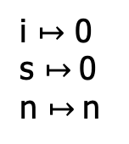
#2: Loops and recursions
// Loops introduce non-termination:
int sum(int n){
int s = 0, i = 0;
while(i<=n){
s = s+i;
i = i+1;
}
return s;
}
i $↦$ 0
s $↦$0
n $↦$n
i$≤$n
e
$¬$e
e
s

Slide 76
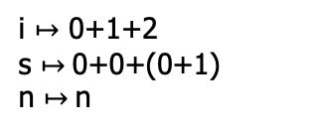


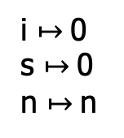

#2: Loops and recursions
// Loops introduce non-termination:
int sum(int n){
int s = 0, i = 0;
while(i<=n){
s = s+i;
i = i+1;
}
return s;
}
i $↦$0
s $↦$0
n $↦$n
i$≤$n
0<=n
$¬$e
s
i $↦$0+1
s $↦$0+0
n $↦$n
i$≤$n
0+1 ≤ n
i $≤$n
i $↦$ 0+1+2
s $↦$0+0+(0+1)
n $↦$n
s
0+1+2 ≤ n
s
No need to finitize the loops.

Slide 77

#3: Environment modeling
// lib() is a library function:
int foo(int n){
if(e){
x = lib(n);
}else{
x = 2*n-4;
}
return 1/x;
}
e
e
$¬$e
lib()
...
If we don’t establish a symbolic model for the “lib()” function, we cannot symbolic check the true branch.
But we can still concolic executes that branch!
So the symbolic model for the environment is just to improve the precision!

Slide 78
Practical Concolic Execution

Slide 79
Demos
See the demo for PathCrawler (for C):
  http://pathcrawler-online.com:8080/doWelcome
And those for PathFinder (for Java):
  https://github.com/javapathfinder

Slide 80
Summary
Symbolic execution is a powerful technique for program testing and automatic test generation
The direct implementation is non-trivial:
  many improvements (variants) for symbolic executors (e.g., concolic execution)
  may be more practical

