Slide 1
Propositional logic
Formal Methods Foundation
Baojian Hua
bjhua@ustc.edu.cn

Slide 2
Mathematical logic
A mathematical field to study reasoning
Proof theory, set theory, model theory, recursion theory
Many connection to other fields of math.
The foundation of math
Also deep connection to CS:
Type theory, logic programming, computer-aided verification (CAV), etc..

Slide 3
Topics in this course
We study propositional and predicate logic
Both the classical one and constructive one
From a more CS and algorithmic point of view:
Computer aided proof engineering, SAT/SMT, etc..
Application to many practical CS problems

Slide 4
Brief history

Slide 5
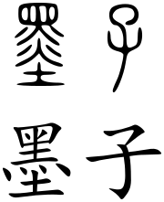
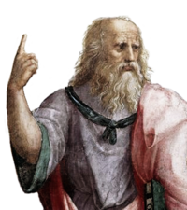
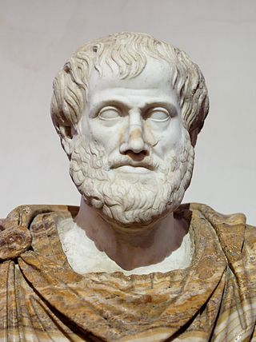
Early time
Formal logic appeared 2000 years ago
China/India/Greece…
More close to philosophy
Mozi/Plato/Aristotle/…
Not rigorous enough, but the modern propositional/predicate logic appeared

Slide 6
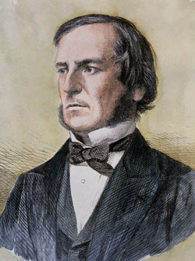
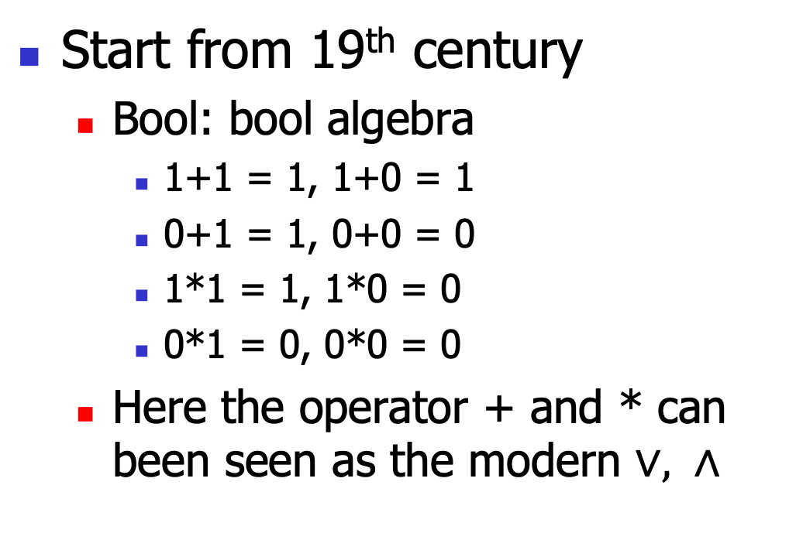
Modern logic
Start from 19th century
Bool: bool algebra
1+1 = 1, 1+0 = 1
0+1 = 1, 0+0 = 0
1*1 = 1, 1*0 = 0
0*1 = 0, 0*0 = 0
Here the operator + and * can been seen as the modern $∨, ∧$

Slide 7
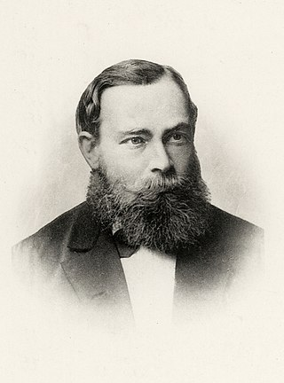
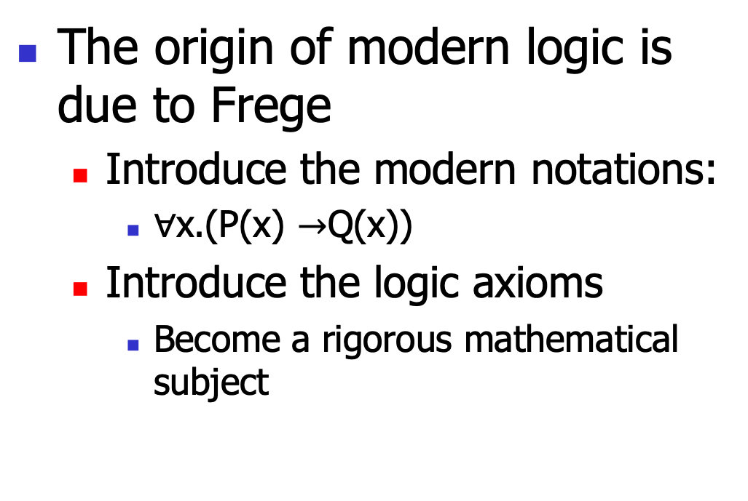
Modern logic
The origin of modern logic is due to Frege
Introduce the modern notations:
$∀$x.(P(x) $→$Q(x))
Introduce the logic axioms
Become a rigorous mathematical subject

Slide 8
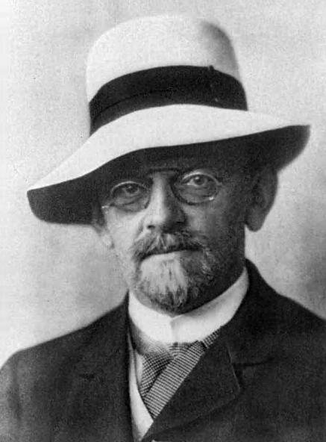
Hilbert‘s program
For the set theory, there appeared many paradox
Russell’s (hair-cutter, God)
To formalize mathematics, Hilbert introduced a program to use the axiomatic approach:
The 10th problem

Slide 9
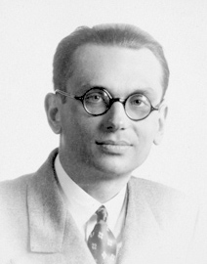
Incompleteness
Gödel proved the incompleteness theorem
Any nontrivial system of axioms is incomplete
There will always be a problem we can not prove or disprove
Make Hilbert’s program impossible

Slide 10
Propositional logic:
The syntax

Slide 11

The syntax
P ::= p
|$T$
| $⊥$
| P $∨$ P
$$\text{|} \text{P}∧\text{P}$$
$$\text{|} \text{P}→\text{P}$$
$$\text{|} ¬\text{P}$$
A set of variable
Top element: think “true”
Bottom element: think “false”
Disjunction: think “or”
Conjunction: think “and”
Imply: think “if”
Negation: think “not”

Slide 12
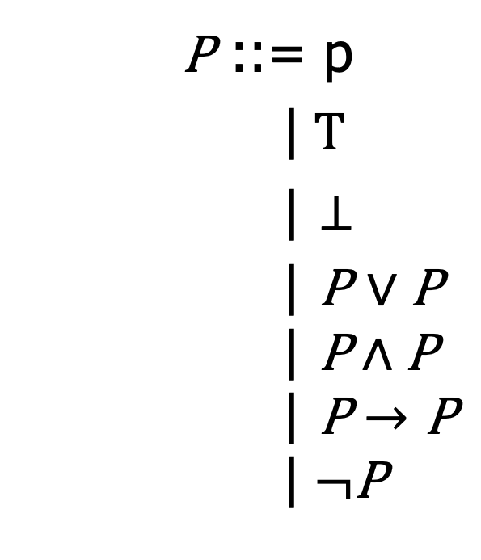
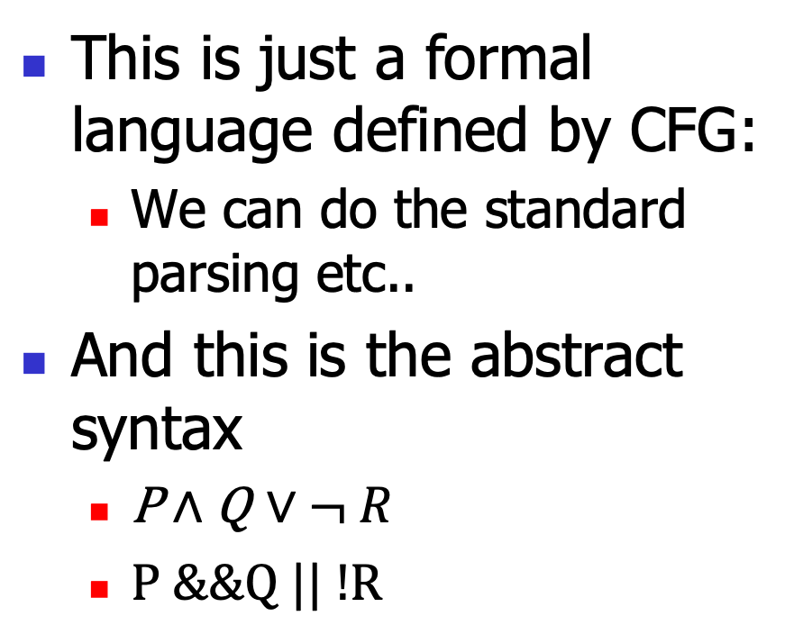
CS view point
This is just a formal language defined by CFG:
We can do the standard parsing etc..
And this is the abstract syntax
$\text{P}∧\text{Q}$ $∨$ $¬ R$
P &&Q || !R
P ::= p
|$T$
| $⊥$
| P $∨$ P
$$\text{|} \text{P}∧\text{P}$$
$$\text{|} \text{P}→\text{P}$$
$$\text{|} ¬\text{P}$$

Slide 13

Examples
$$\text{P}→\text{P}$$
$$\text{P}→\text{Q}→\text{P}$$
$$¬¬\text{P}→\text{P}$$
$P$ $→ ¬¬\text{P}$
P ::= p
|$T$
| $⊥$
| P $∨$ P
$$\text{|} \text{P}∧\text{P}$$
$$\text{|} \text{P}→\text{P}$$
$$\text{|} ¬\text{P}$$

Slide 14
Propositional logic:
The proof system

Slide 15
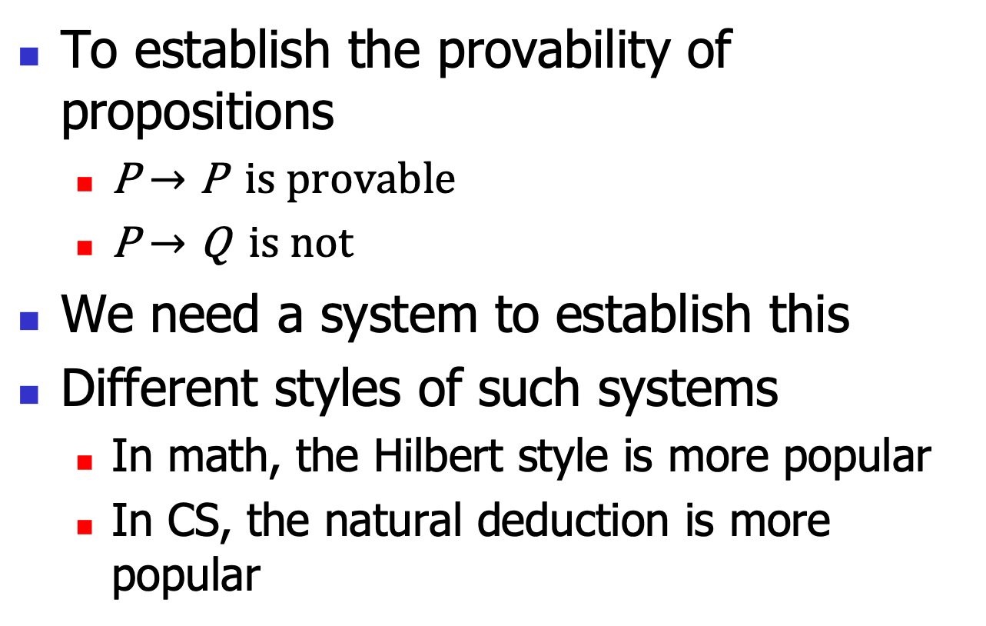
Goals
To establish the provability of propositions
$\text{P}→\text{P}$ is provable
$\text{P}→\text{Q}$ is not
We need a system to establish this
Different styles of such systems
In math, the Hilbert style is more popular
In CS, the natural deduction is more popular

Slide 16
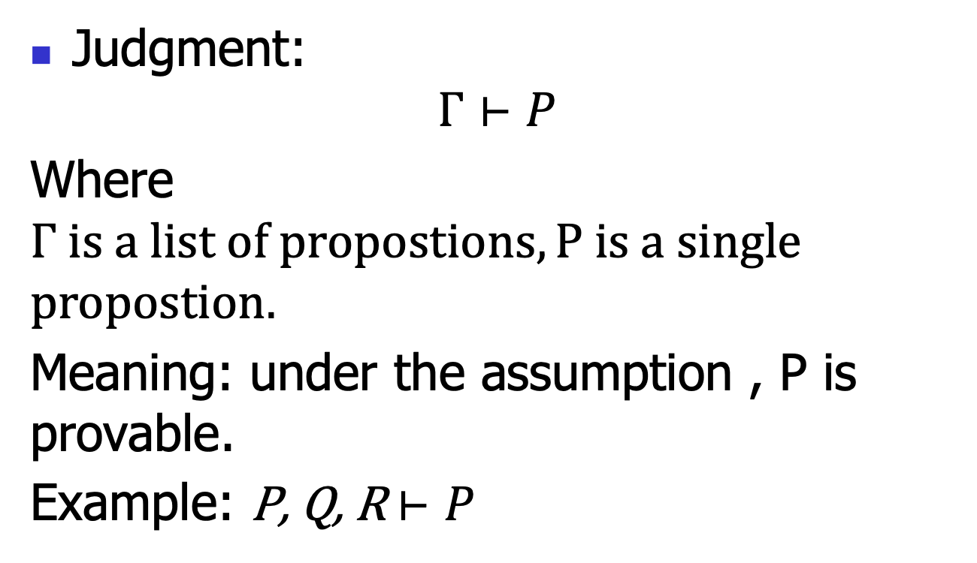
Natural deduction: judgments
Judgment:
$$Γ⊢P$$
Where $Γ is a list of propostions, P is a single$
$$propostion.$$
Meaning: under the assumption , P is provable.
Example: P, Q, R $⊢P$

Slide 17





Natural deduction: Inference rules
Each rule takes this form:
$$Γ1⊢P1$$
$$…$$
$$Γn⊢Pn$$
$$(name)$$
$$Γ⊢P$$
The hypotheses (above the line)
The conclusion (below the line)
The rule name (right the line)
If n==0, then this rule is called an axiom;
Or else called a rule.

Slide 18


Natural deduction: Inference rules
Rule for props:
$$(Var)$$
$$Γ, P⊢P$$
Note this is an axiom.
Informally: under the assumption P, P is provable.

Slide 19


Natural deduction: Inference rules
Rule for T:
$$(TI)$$
$$Γ⊢ T$$
Note this is an axiom.
Informally: T is provable unconditionally.

Slide 20


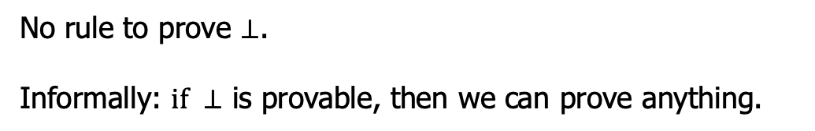

Natural deduction: Inference rules
Rule for $⊥$:
$Γ⊢$ $⊥$
$$(⊥E)$$
$$Γ⊢P$$
No rule to prove $⊥$.
Informally: $if ⊥$ is provable, then we can prove anything.

Slide 21




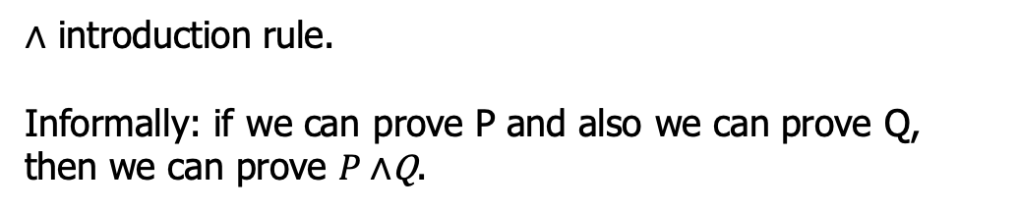

Natural deduction: Inference rules
Rule for $∧$:
$Γ⊢$ $P$
$Γ⊢$ $Q$
$$(∧I)$$
$Γ⊢P∧$Q
$∧$ introduction rule.
Informally: if we can prove P and also we can prove Q, then we can prove $P∧$Q.

Slide 22




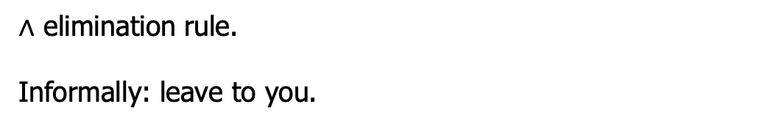


Natural deduction: Inference rules
Rule for $∧$:
$Γ⊢$ $P∧\text{Q}$
$Γ⊢$ $P∧\text{Q}$
$$(∧E1)$$
$$(∧E2)$$
$$Γ⊢P$$
$$Γ⊢Q$$
$∧$ elimination rule.
Informally: leave to you.

Slide 23





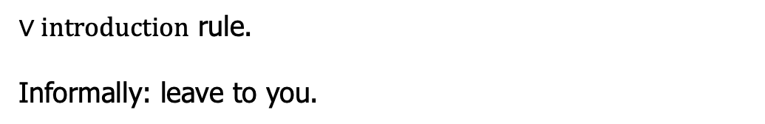


Natural deduction: Inference rules
Rule for $∨$:
$Γ⊢$ $P$
$Γ⊢$ $\text{Q}$
$$(∨I1)$$
$$(∨I2)$$
$Γ⊢P$ $∨ \text{Q}$
$$Γ⊢P ∨ \text{Q}$$
$∨introduction$ rule.
Informally: leave to you.

Slide 24





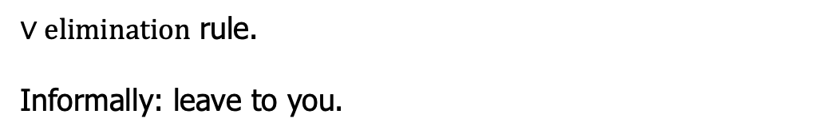
Natural deduction: Inference rules
Rule for $∨$:
$Γ⊢$ $P∨ \text{Q}$
$Γ, P⊢$ $R$
$Γ, Q⊢$ $R$
$$(∨E)$$
$$Γ⊢R$$
$∨elimination$ rule.
Informally: leave to you.

Slide 25







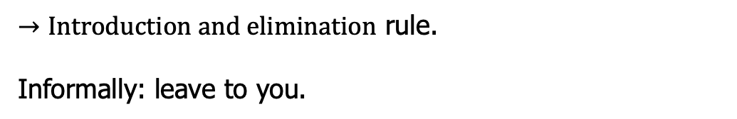

Natural deduction: Inference rules
Rule for$→$:
$Γ, P⊢$ $\text{Q}$
$Γ⊢P$ $→$ $\text{Q}$
$$Γ⊢P$$
$$(→I)$$
$$(→E)$$
$$Γ⊢P→Q$$
$$Γ⊢Q$$
$→Introduction and elimination$ rule.
Informally: leave to you.

Slide 26






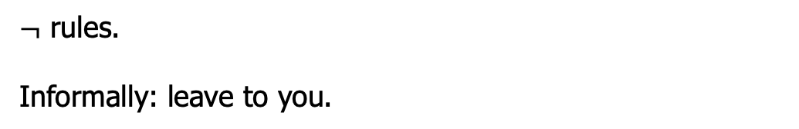

Natural deduction: Inference rules
Rule for$¬$:
$$Γ, P⊢ ⊥$$
$$Γ⊢P$$
$$Γ⊢¬P$$
$$(¬I)$$
$$(¬E)$$
$$Γ⊢¬P$$
$$Γ⊢⊥$$
$¬$ rules.
Informally: leave to you.

Slide 27



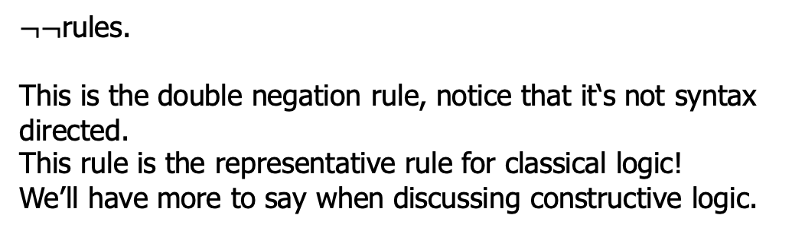
Natural deduction: Inference rules
Rule for$¬¬$:
$$Γ⊢¬¬P$$
$$(¬¬E)$$
$$Γ⊢P$$
$¬¬$rules.
This is the double negation rule, notice that it‘s not syntax directed.
This rule is the representative rule for classical logic!
We’ll have more to say when discussing constructive logic.

Slide 28







Example
Try to prove $P∧Q→P$:
$$(var)$$
$P∧Q⊢P$ $∧Q$
$$(∧E)$$
$$P∧Q⊢P$$
$$(→I)$$
$$⊢P∧Q→P$$
This is called a proof tree!

Slide 29
Proof engineering
There has been great advancement in the automatic or semiautomatic proof assistant
Thus, we can conduct the above proof using such assistant
So CS also boosts math.
Let’s just study one example
You will do more in the 2nd assignment

Slide 30
Propositional logic:
Semantics

Slide 31
Semantics
The above proof system cares about when a proposition is provable
Axioms and proof rules
Roughly, semantics is more about computation
Models and computation rules
To obtain a result of “true” or “false”

Slide 32
The truth table
Truth table encodes the computation rules (recall the Bool logic rules):
Thus, to computer P/\Q, we need an assignment to P and Q, this is called an interpretation
P | Q | P/\Q | P\/Q
T | T | T | T
T | F | F | T
F | T | F | T
F | F | F | F

Slide 33
Interpretation
For a given proposition P, an interpretation V defined by:
V(T) = T
V(F) = F
V(p) = T or F
V(P/\Q) = V(P) op V(Q)
… // leave to you
Essentially, a compiler!
A
B
V

Slide 34
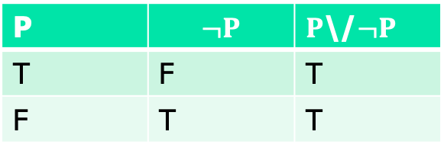
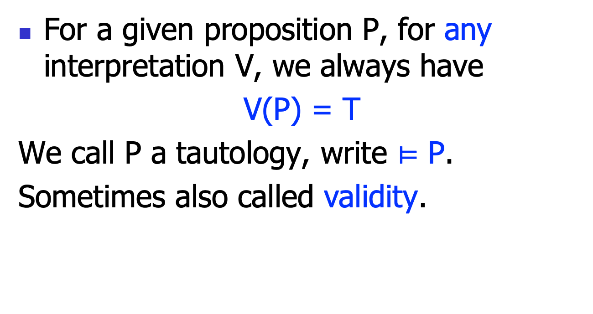
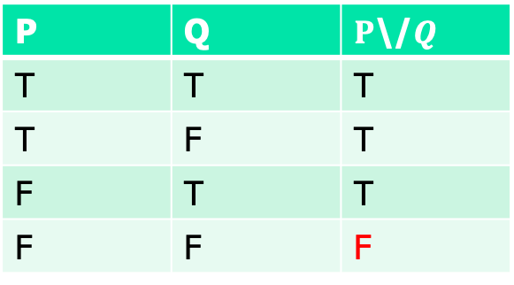
Tautology
For a given proposition P, for any interpretation V, we always have
V(P) = T
We call P a tautology, write $⊨$ P.
Sometimes also called validity.
P | $$¬P$$ | $P$\/$¬P$
T | F | T
F | T | T
P | Q | $P$\/$Q$
T | T | T
T | F | T
F | T | T
F | F | F

Slide 35
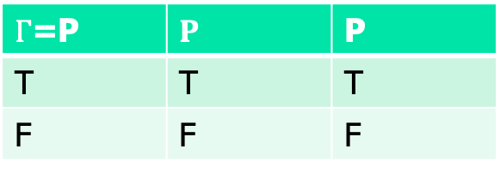
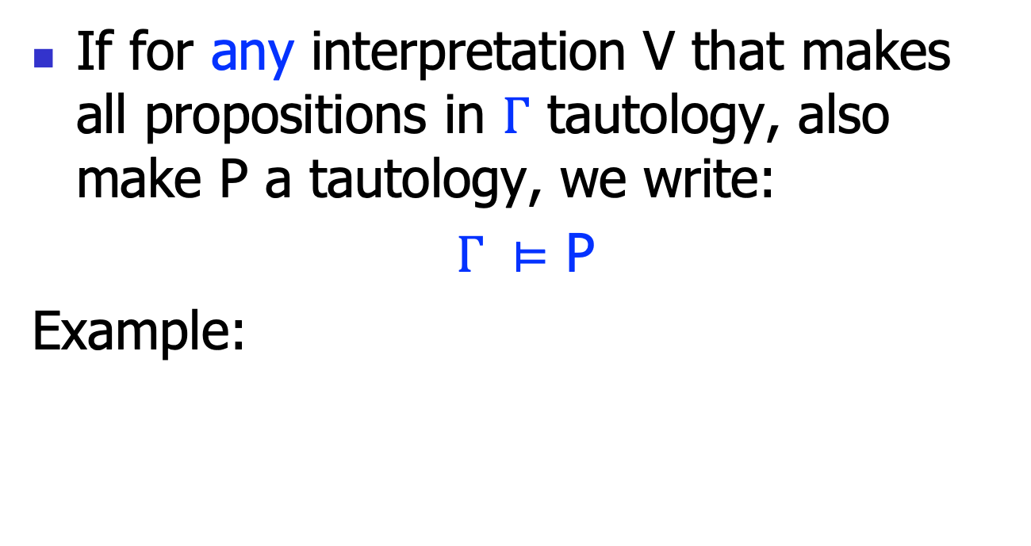
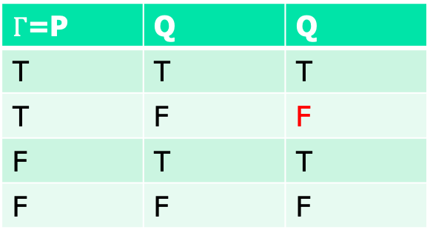
Tautology
If for any interpretation V that makes all propositions in $Γ$ tautology, also make P a tautology, we write:
$Γ ⊨$ P
Example:
$Γ$=P | $$P$$ | P
T | T | T
F | F | F
$Γ$=P | Q | Q
T | T | T
T | F | F
F | T | T
F | F | F

Slide 36
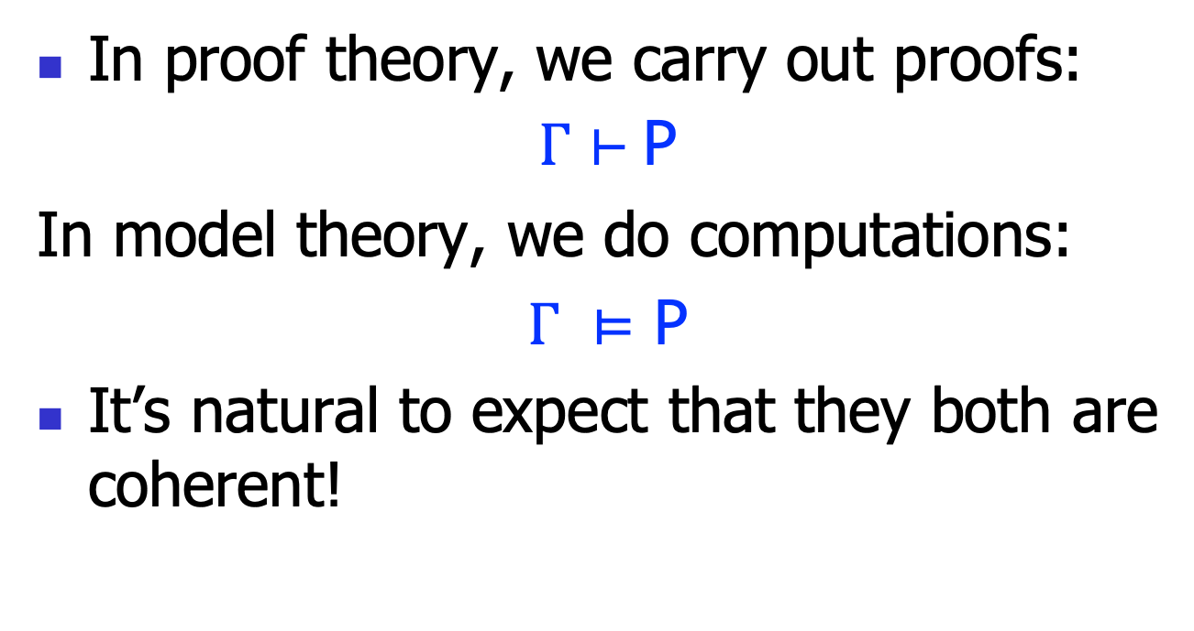
Two notions of validity
In proof theory, we carry out proofs:
$Γ⊢$ P
In model theory, we do computations:
$Γ ⊨$ P
It’s natural to expect that they both are coherent!

Slide 37
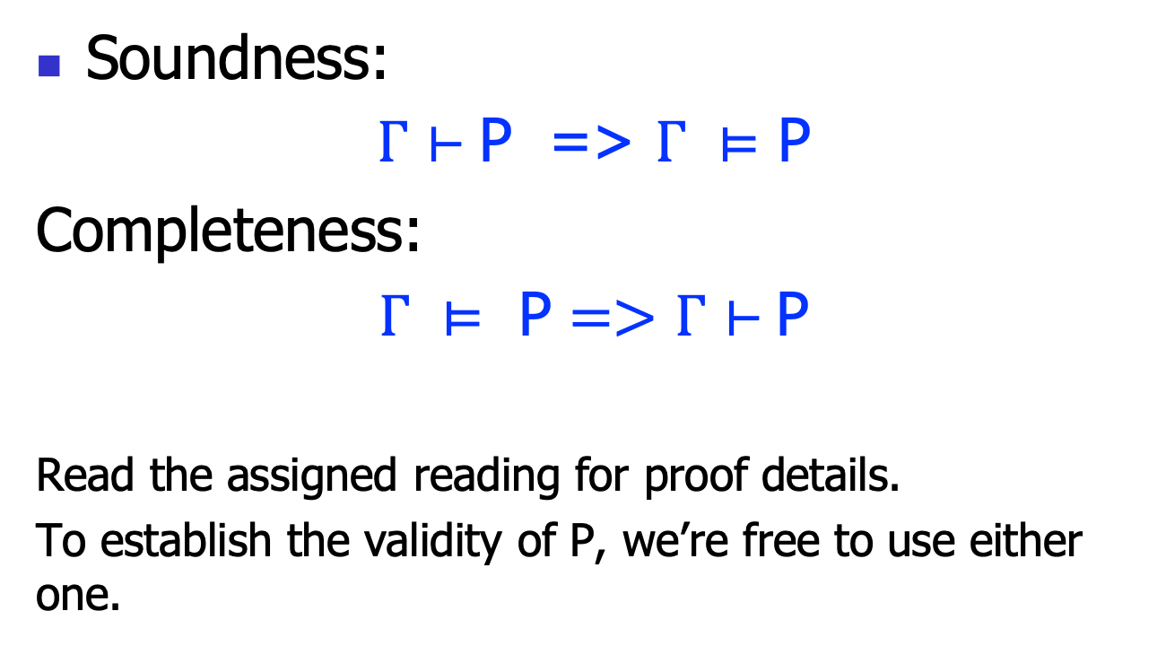
Soundness and completeness
Soundness:
$Γ⊢$ P => $Γ ⊨$ P
Completeness:
$Γ ⊨ \text{P}=>Γ⊢$ P
Read the assigned reading for proof details.
To establish the validity of P, we’re free to use either one.

