Slide 1
Linear Arithmetics
Formal Methods Foundation
Baojian Hua
bjhua@ustc.edu.cn

Slide 2
Motivation: SAT
SAT: given a proposition P, is it satisfiable?
SAT for propositional logic:
NPC, but practically efficient
We’ve studied algorithm like DPLL
SAT for predicate logic:
Undecidable!
restrict to some specific subset: theory

Slide 3
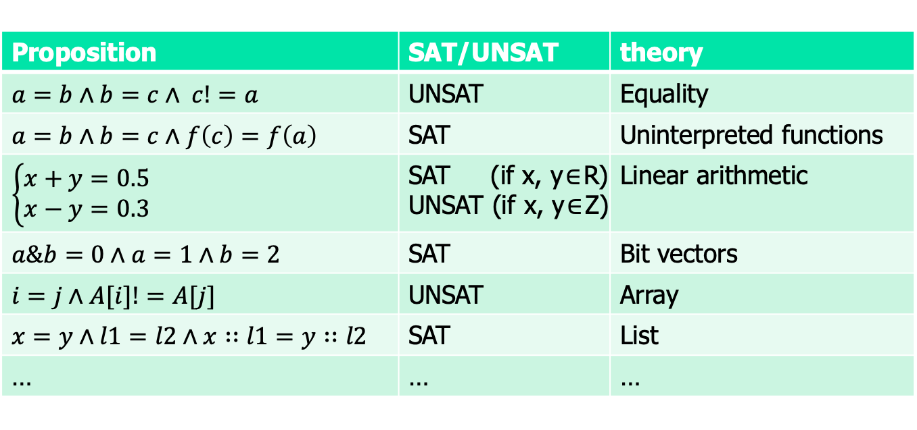
Motivation: theory
Are these satisfiable?
Proposition | SAT/UNSAT | theory
$a=b∧b=c∧ c!=a$ | UNSAT | Equality
$$a=b∧b=c∧f\left(c\right)=f\left(a\right)$$ | SAT | Uninterpreted functions
$$\left\{\begin{aligned}x+y=0.5 \\ x−y=0.3\end{aligned}\right.$$ | SAT (if x, y$∈$R) UNSAT (if x, y$∈$Z) | Linear arithmetic
$a\&b=0∧a=1∧b=2$ | SAT | Bit vectors
$i=j∧A[i]!=A[j]$ | UNSAT | Array
$x=y∧l1=l2∧x∷l1=y∷l2$ | SAT | List
… | … | …

Slide 4

Satisfiability modulo theory (SMT)
SAT
Theory
Solvers
SMT
Equality + UF
Arithmetic
Bit-vectors
…

Slide 5
Linear arithmetic: syntax

Slide 6
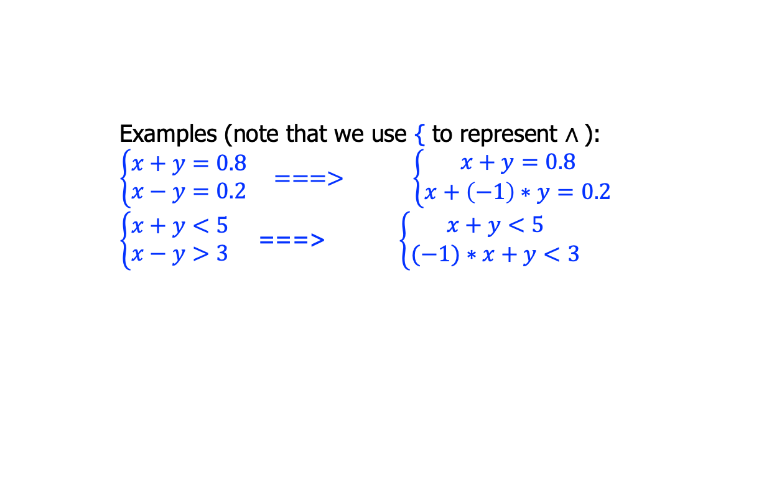

Linear arithmetic: the syntax
x: a set of variables
A ::= x | c | c*x
E ::= A | A+E
R ::= E=E | E<=E | E<E
P ::= R
$\text{|} \text{P}∧\text{P}$
Constant multiply variable. Linear?
c: a set of constants
Only addition
Only =, <=, <
Examples (note that we use { to represent $∧$):
$$\left\{\begin{aligned}x+y=0.8 \\ x−y=0.2\end{aligned}\right. ===> \left\{\begin{aligned}x+y=0.8 \\ x+\left(−1\right)∗y=0.2\end{aligned}\right.$$
$\left\{\begin{aligned}x+y<5 \\ x−y>3\end{aligned}\right.$ ===> $\left\{\begin{aligned}x+y<5 \\ (−1)∗x+y<3\end{aligned}\right.$

Slide 7
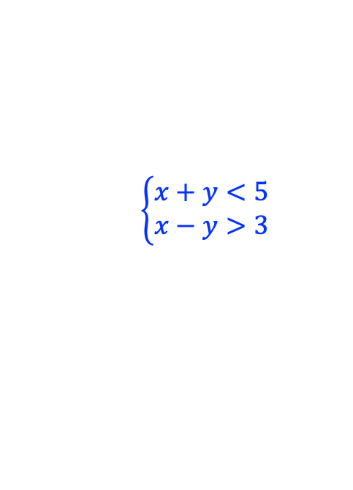
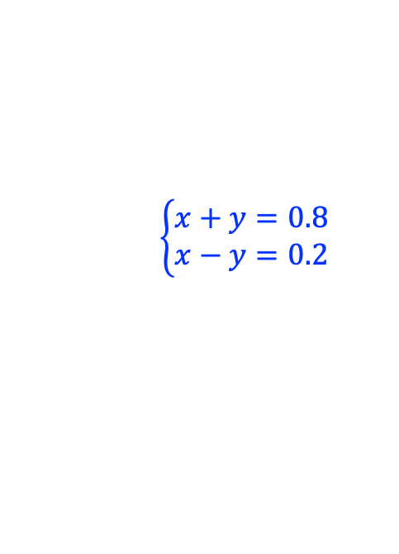
Linear arithmetic: example
$$\left\{\begin{aligned}x+y=0.8 \\ x−y=0.2\end{aligned}\right.$$
$$\left\{\begin{aligned}x+y<5 \\ x−y>3\end{aligned}\right.$$
# Z3 code:
x, y = Reals(‘x y’)
solve(x+y == 0.8,
x-y == 0.2)
# Z3 code:
x, y = Ints(‘x y’)
solve(x+y < 5,
x-y > 3)

Slide 8


Complexity results
A ::= x | c | c*x
E ::= A+E
R ::= E=E | E<=E | E<E
P ::= R
$\text{|} \text{P}∧\text{P}$
On domain rational ($ℚ$): polynomial
On domain integer ($ℤ$): NPC
Algorithms | Fourier-Motzkin | Simplex | B&B | Omega
domain | Q | Q | Z | Z

Slide 9
Fourier-Motzkin variable elimination

Slide 10
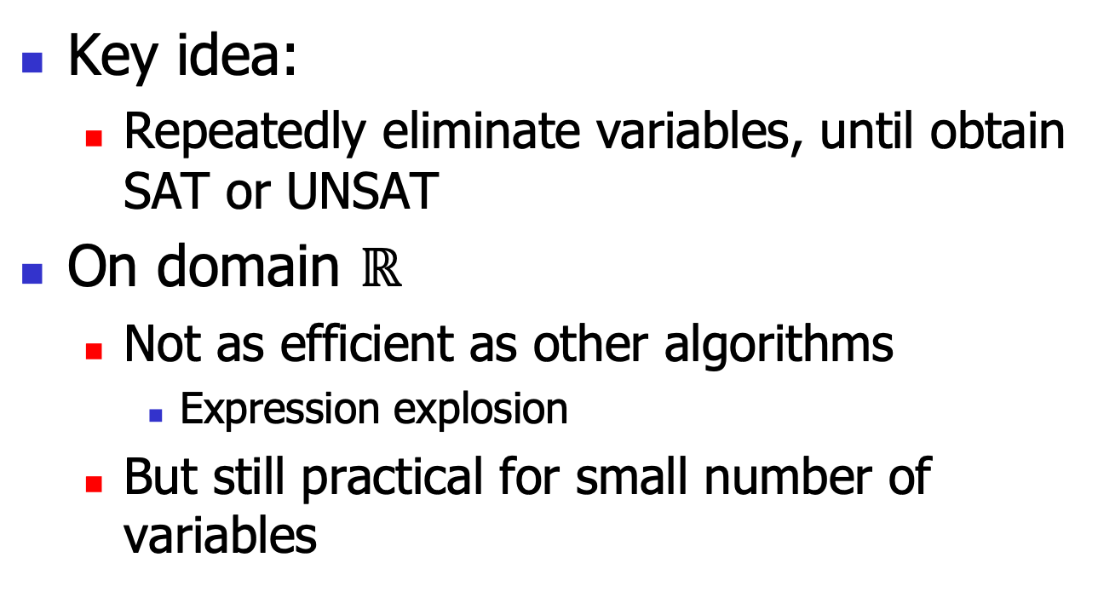
Fourier-Motzkin variable elimination
Key idea:
Repeatedly eliminate variables, until obtain SAT or UNSAT
On domain $ℝ$
Not as efficient as other algorithms
Expression explosion
But still practical for small number of variables

Slide 11
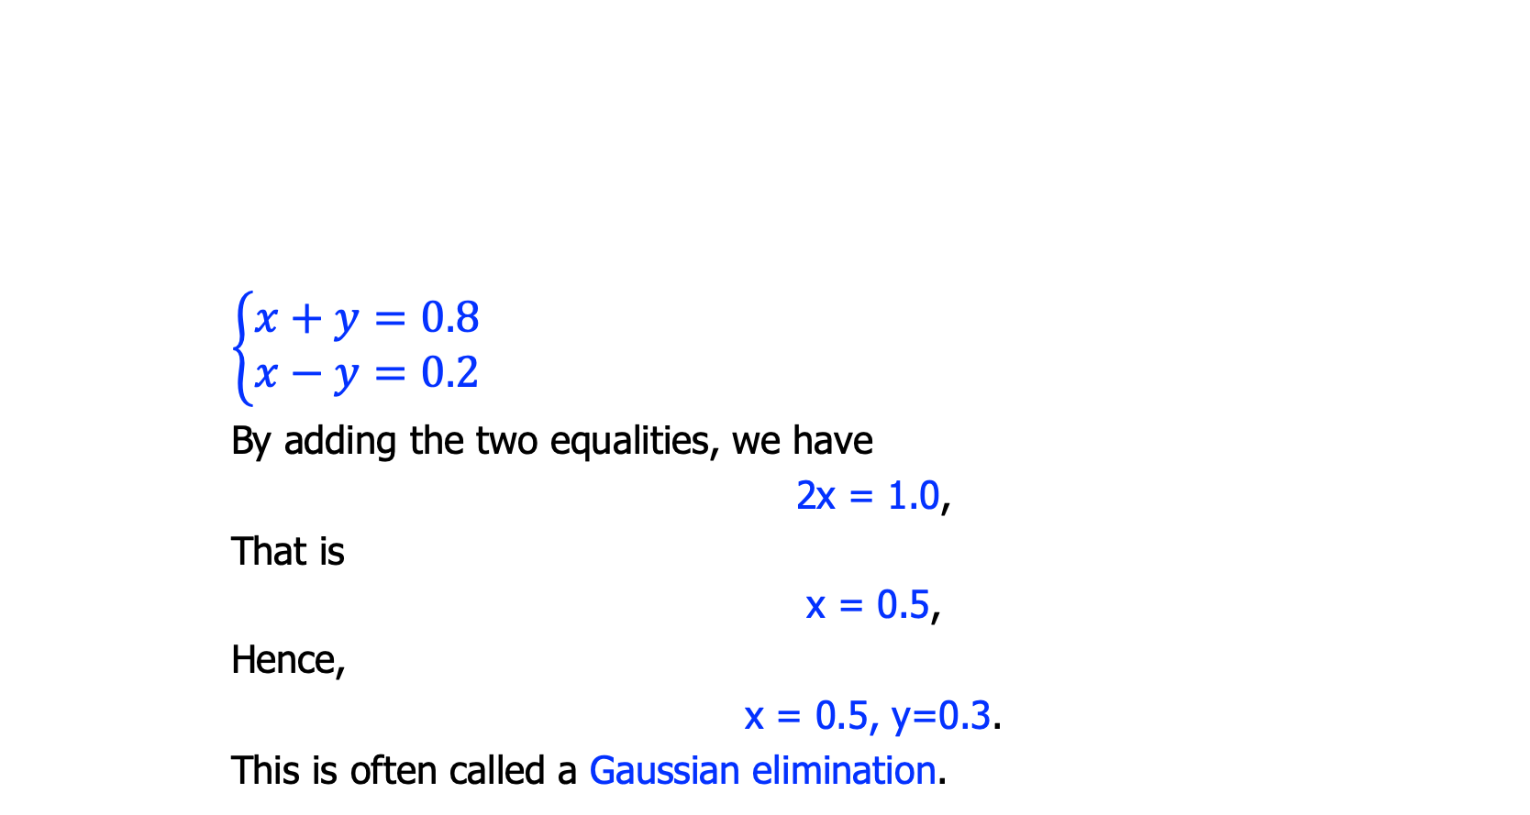
Motivation: solving equality
$$\left\{\begin{aligned}x+y=0.8 \\ x−y=0.2\end{aligned}\right.$$
By adding the two equalities, we have
2x = 1.0,
That is
x = 0.5,
Hence,
x = 0.5, y=0.3.
This is often called a Gaussian elimination.

Slide 12
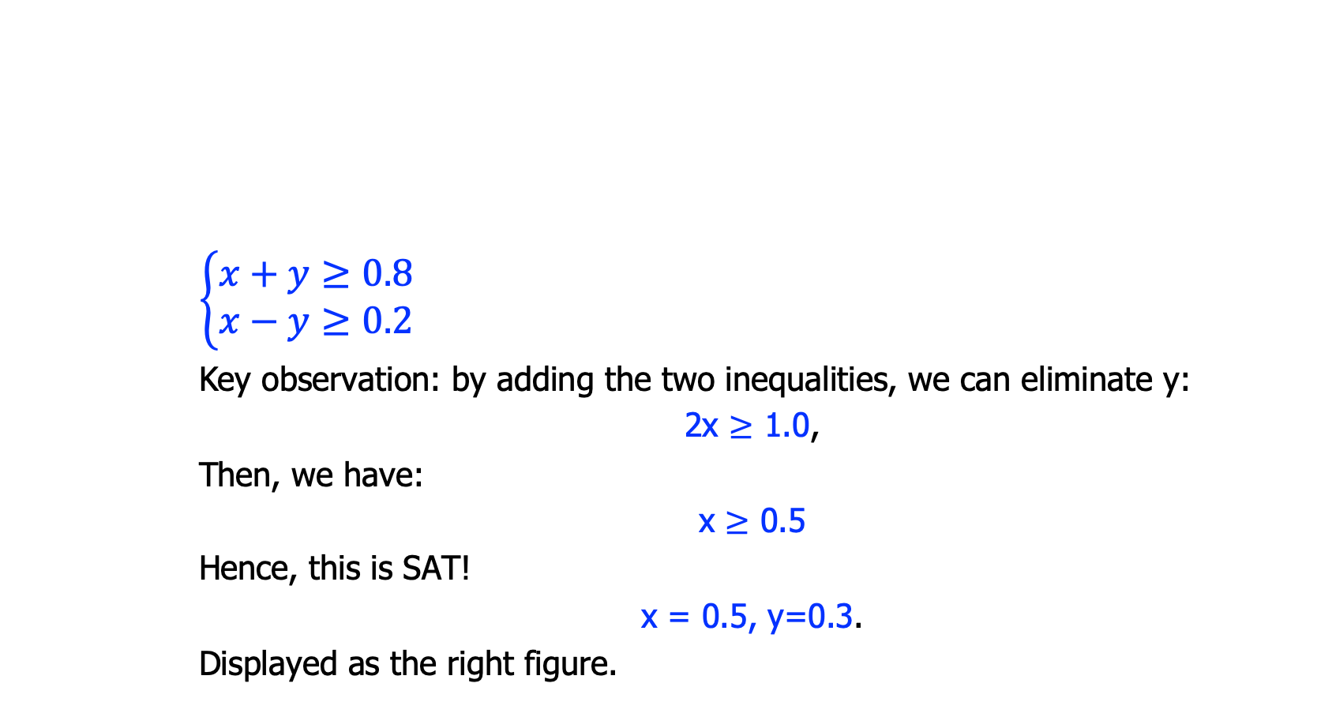
Motivation: solving inequality
$$\left\{\begin{aligned}x+y≥0.8 \\ x−y≥0.2\end{aligned}\right.$$
Key observation: by adding the two inequalities, we can eliminate y:
2x $≥$ 1.0,
Then, we have:
x $≥$ 0.5
Hence, this is SAT!
x = 0.5, y=0.3.
Displayed as the right figure.
(0.5, 0.3)

Slide 13
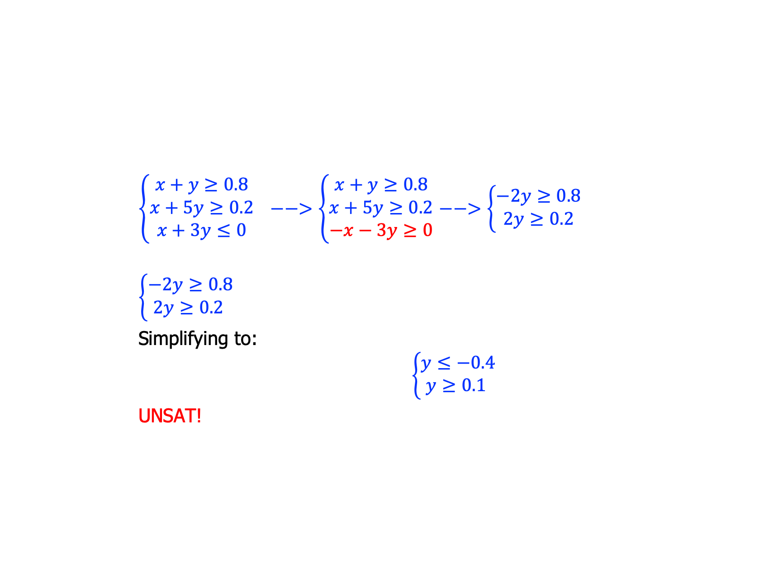
Motivation: solving inequality
$\left\{\begin{aligned}x+y≥0.8 \\ x+5y≥0.2 \\ x+3y≤0\end{aligned}\right. −−>\left\{\begin{aligned}x+y≥0.8 \\ x+5y≥0.2 \\ −x−3y≥0\end{aligned}\right.$ $−−>\left\{\begin{aligned}−2y≥0.8 \\ 2y≥0.2\end{aligned}\right.$
$$\left\{\begin{aligned}−2y≥0.8 \\ 2y≥0.2 \end{aligned}\right.$$
Simplifying to:
$$\left\{\begin{aligned}y≤−0.4 \\ y≥0.1 \end{aligned}\right.$$
UNSAT!

Slide 14
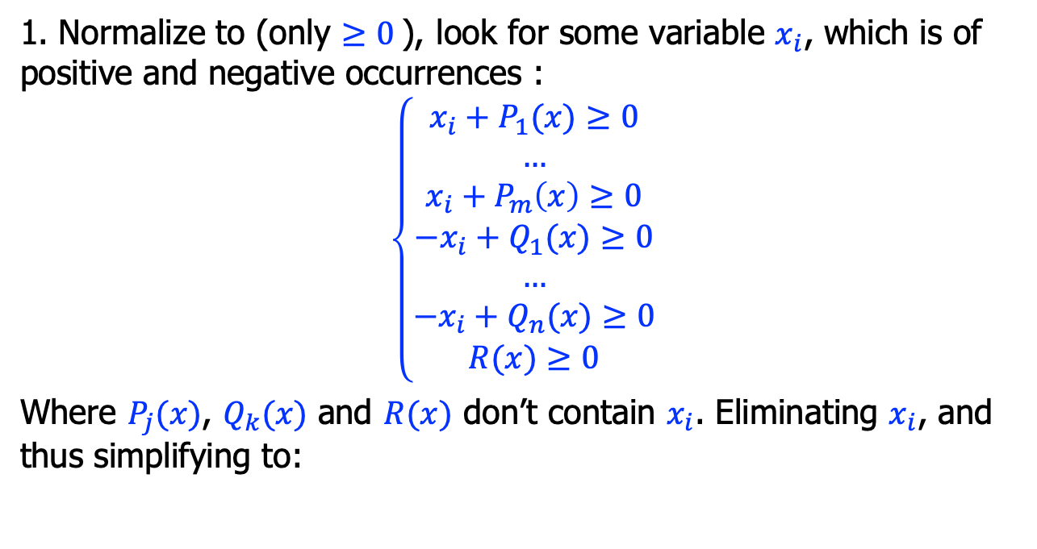
Algorithm
1. Normalize to (only $≥0$), look for some variable $x_{i}$, which is of positive and negative occurrences :
$$\left\{\begin{aligned}x_{i}+P_{1}(x)≥0 \\ … \\ x_{i}+P_{m}\left(x\right)≥0 \\ −x_{i}+Q_{1}(x)≥0 \\ … \\ −x_{i}+Q_{n}(x)≥0 \\ R(x)≥0\end{aligned}\right.$$
Where $P_{j}(x)$, $Q_{k}(x)$ and $R(x)$ don’t contain $x_{i}$. Eliminating $x_{i}$, and thus simplifying to:

Slide 15

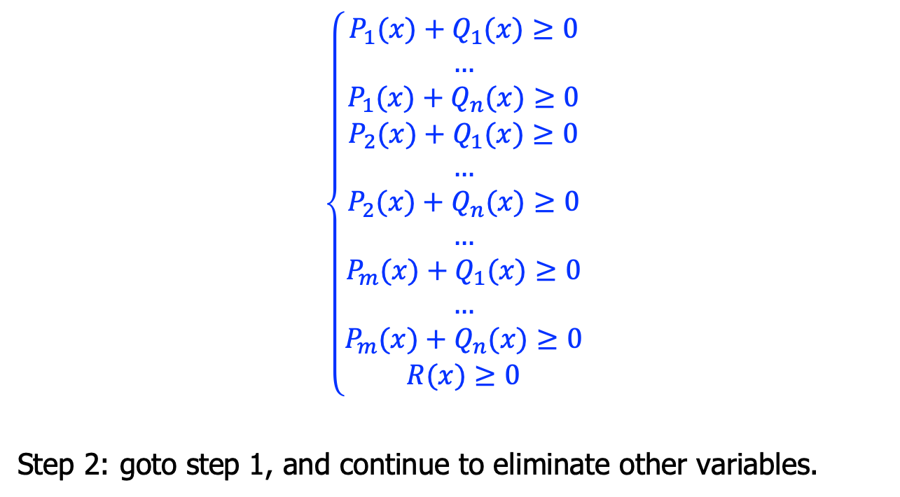
Algorithm, cont’
$$\left\{\begin{aligned}P_{1}(x)+Q_{1}(x)≥0 \\ … \\ P_{1}(x)+Q_{n}(x)≥0 \\ P_{2}(x)+Q_{1}(x)≥0 \\ … \\ P_{2}(x)+Q_{n}(x)≥0 \\ … \\ P_{m}(x)+Q_{1}(x)≥0 \\ … \\ P_{m}(x{)+Q}_{n}(x)≥0 \\ R(x)≥0\end{aligned}\right.$$
Step 2: goto step 1, and continue to eliminate other variables.
$$\left\{\begin{aligned}x_{i}+P_{1}(x)≥0 \\ … \\ x_{i}+P_{m}\left(x\right)≥0 \\ −x_{i}+Q_{1}(x)≥0 \\ … \\ −x_{i}+Q_{n}(x)≥0 \\ R(x)≥0\end{aligned}\right.$$

Slide 16
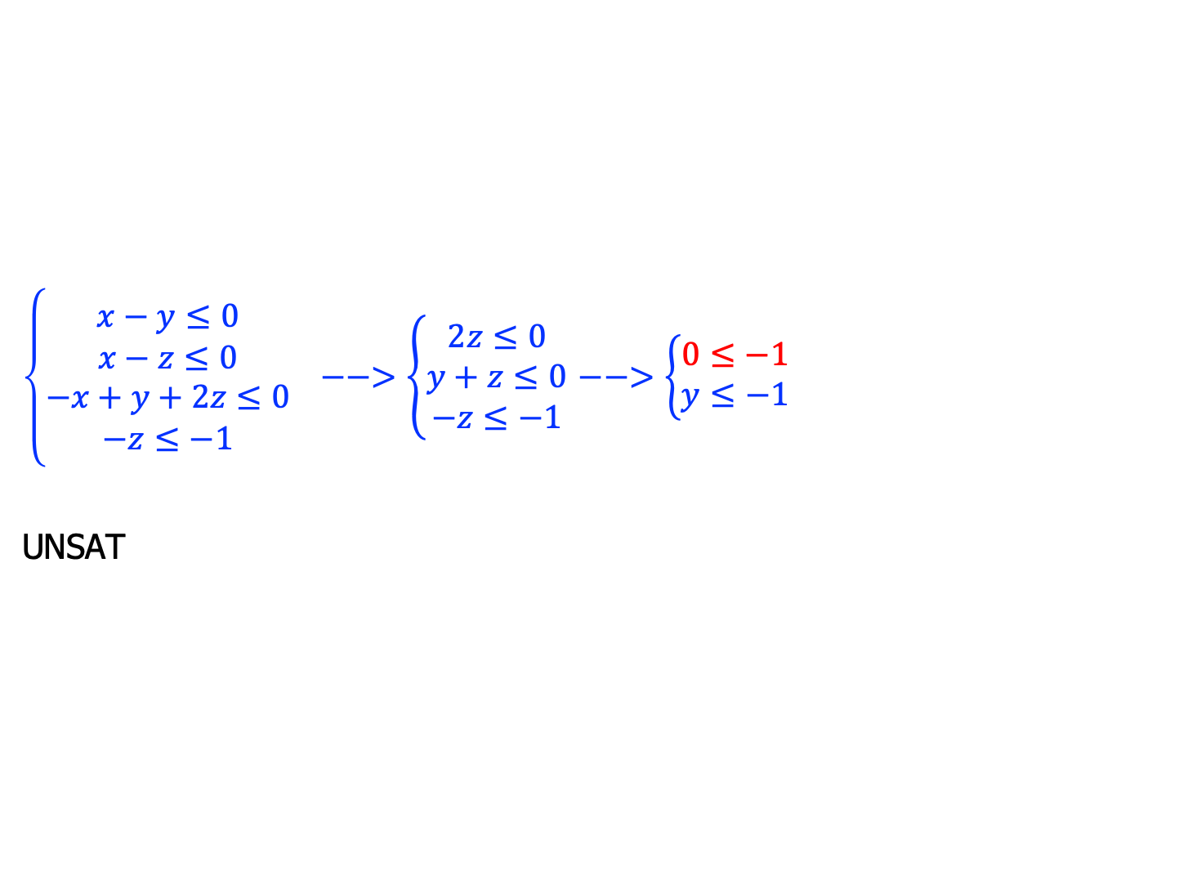
Example
$\left\{\begin{aligned}x−y≤0 \\ x−z≤0 \\ −x+y+2z≤0 \\ −z≤−1\end{aligned}\right. −−>\left\{\begin{aligned}2z≤0 \\ y+z≤0 \\ −z≤−1\end{aligned}\right.$ $−−>\left\{\begin{aligned}0≤−1 \\ y≤−1\end{aligned}\right.$
UNSAT

Slide 17
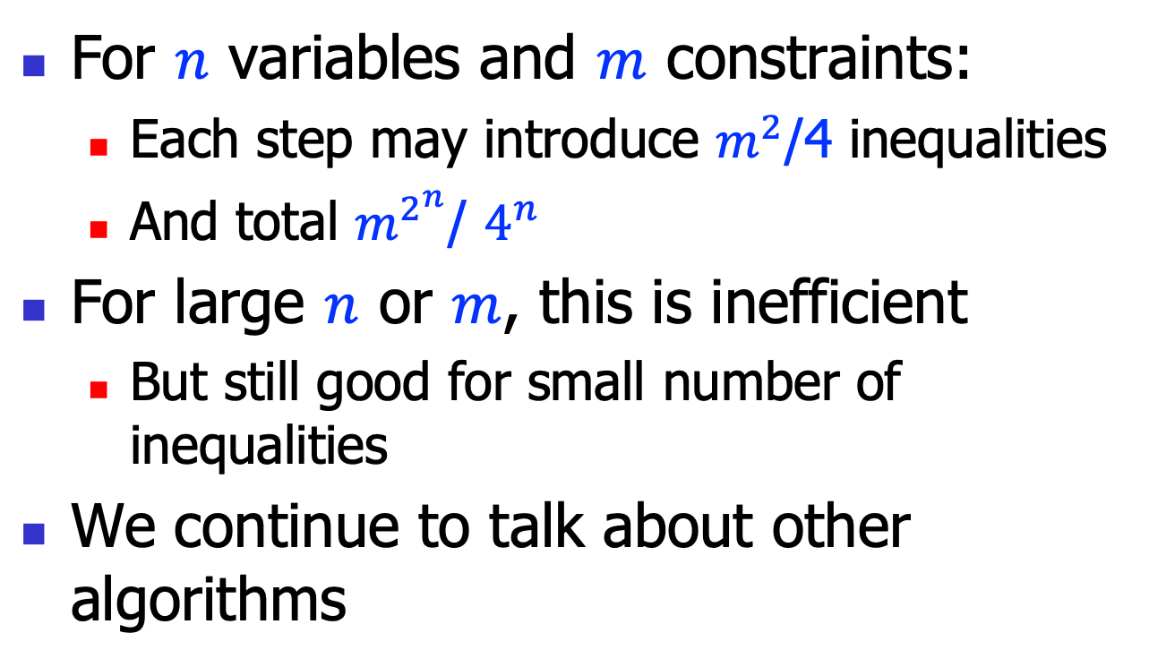
Complexity
For $n$ variables and $m$ constraints:
Each step may introduce $m^{2}$/4 inequalities
And total $m^{2^{n}}$/ $4^{n}$
For large $n$ or $m$, this is inefficient
But still good for small number of inequalities
We continue to talk about other algorithms

Slide 18
Simplex

Slide 19
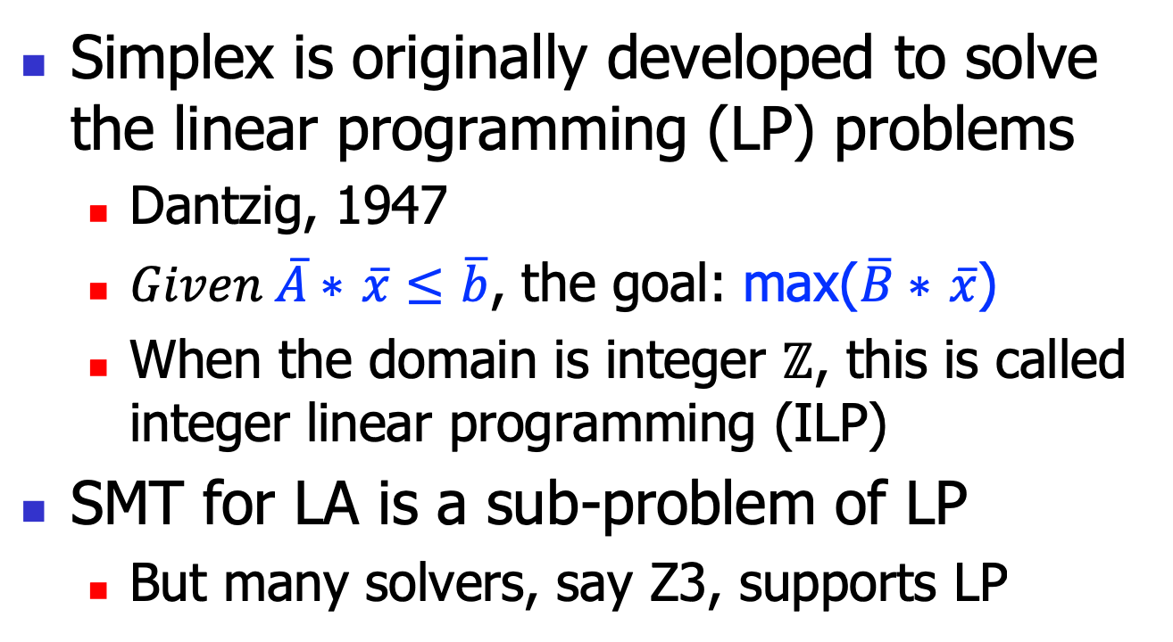
Simplex
Simplex is originally developed to solve the linear programming (LP) problems
Dantzig, 1947
$Given \overline{A}∗$ $\overline{x}≤$ $\overline{b}$, the goal: max($\overline{B}∗$ $\overline{x}$)
When the domain is integer $ℤ$, this is called integer linear programming (ILP)
SMT for LA is a sub-problem of LP
But many solvers, say Z3, supports LP

Slide 20
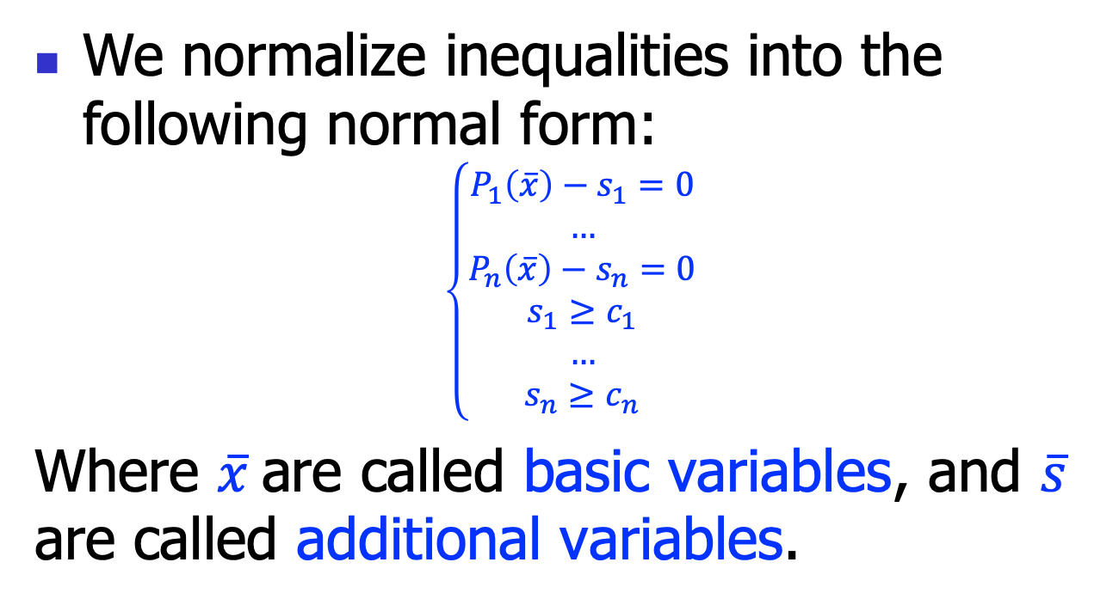
Normal forms
We normalize inequalities into the following normal form:
$$\left\{\begin{aligned}P_{1}\left(\overline{x}\right)−s_{1}=0 \\ … \\ P_{n}\left(\overline{x}\right)−s_{n}=0 \\ s_{1}≥c_{1} \\ … \\ s_{n}≥c_{n}\end{aligned}\right.$$
Where $\overline{x}$are called basic variables, and $\overline{s}$ are called additional variables.

Slide 21
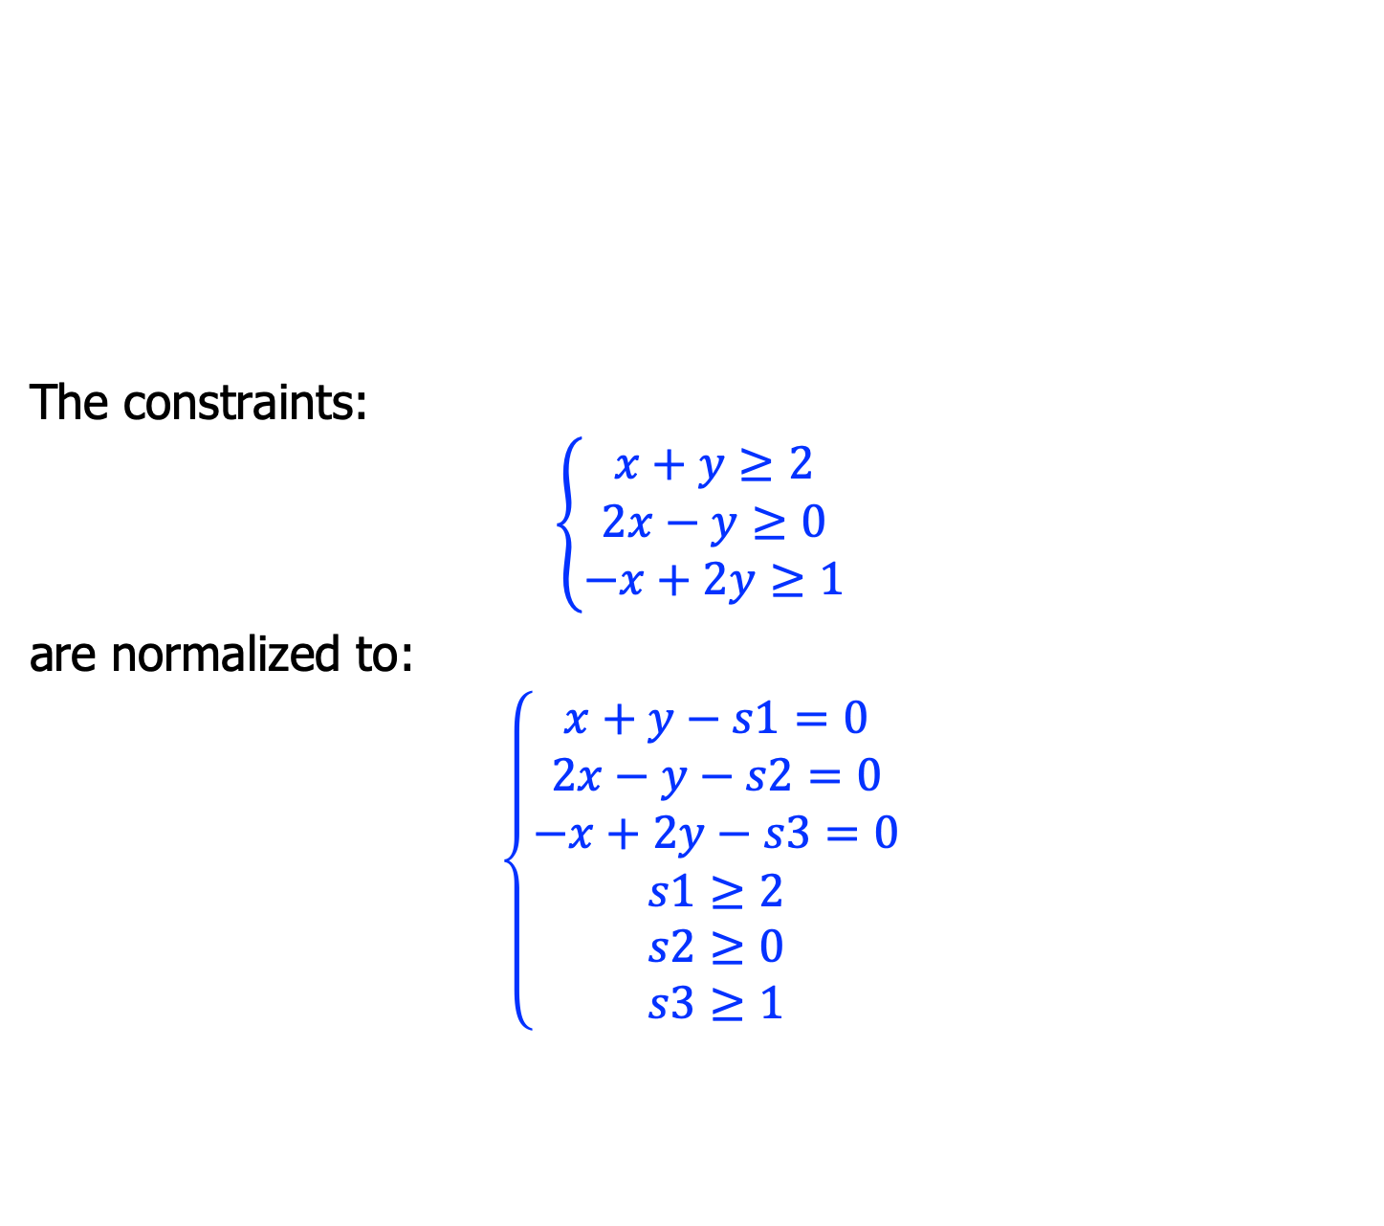
Example
The constraints:
$$\left\{\begin{aligned}x+y≥2 \\ 2x−y≥0 \\ −x+2y≥1\end{aligned}\right.$$
are normalized to:
$$\left\{\begin{aligned}x+y−s1=0 \\ 2x−y−s2=0 \\ −x+2y−s3=0 \\ s1≥2 \\ s2≥0 \\ s3≥1\end{aligned}\right.$$

Slide 22
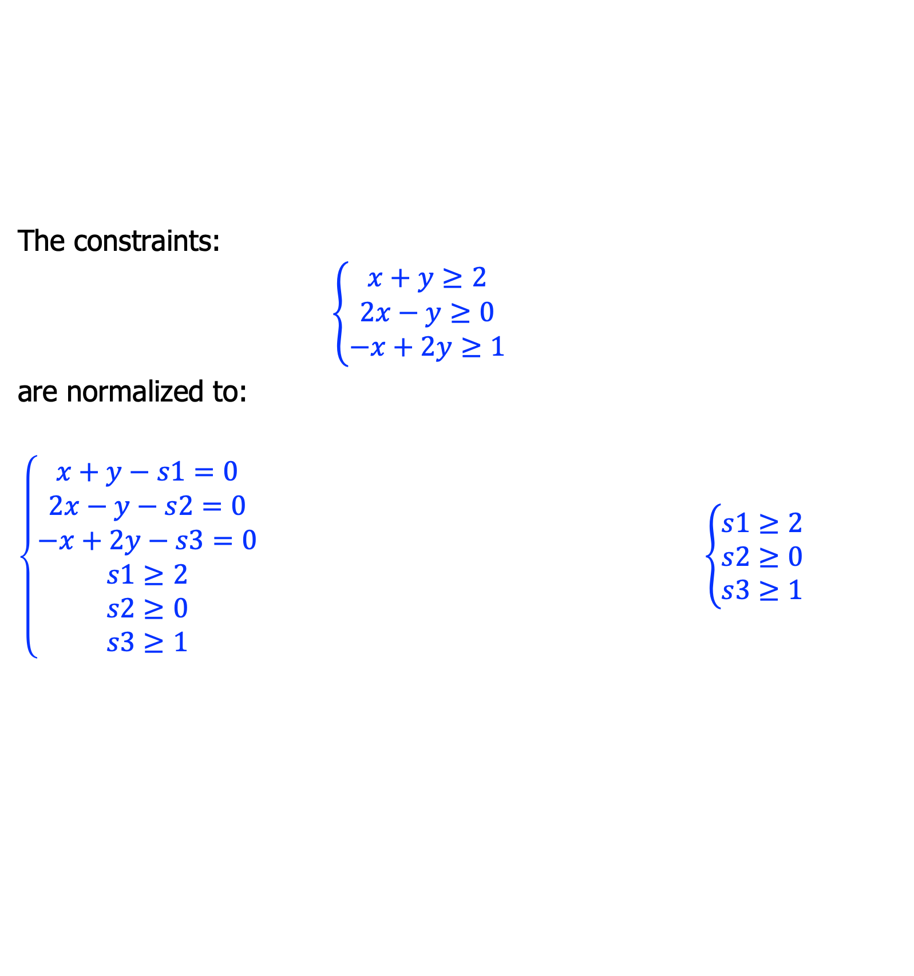
Tableau
The constraints:
$$\left\{\begin{aligned}x+y≥2 \\ 2x−y≥0 \\ −x+2y≥1\end{aligned}\right.$$
are normalized to:
$\left\{\begin{aligned}x+y−s1=0 \\ 2x−y−s2=0 \\ −x+2y−s3=0 \\ s1≥2 \\ s2≥0 \\ s3≥1\end{aligned}\right.$ $\left\{\begin{aligned}s1≥2 \\ s2≥0 \\ s3≥1\end{aligned}\right.$
 | x | y
s1 | 1 | 1
s2 | 2 | -1
s3 | -1 | 2

Slide 23
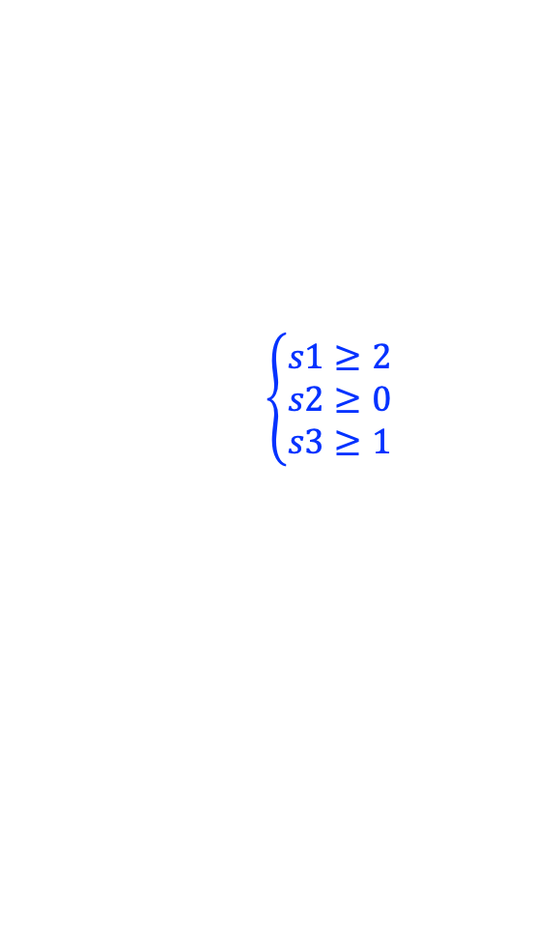
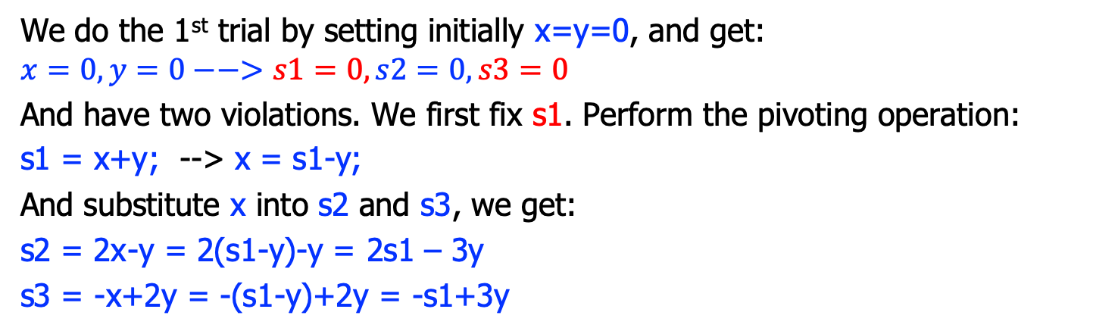
Trial and fix
 | x | y
s1 | 1 | 1
s2 | 2 | -1
s3 | -1 | 2
$$\left\{\begin{aligned}s1≥2 \\ s2≥0 \\ s3≥1\end{aligned}\right.$$
We do the 1st trial by setting initially x=y=0, and get:
$$x=0, y=0−−>s1=0, s2=0, s3=0$$
And have two violations. We first fix s1. Perform the pivoting operation:
s1 = x+y; --> x = s1-y;
And substitute x into s2 and s3, we get:
s2 = 2x-y = 2(s1-y)-y = 2s1 – 3y
s3 = -x+2y = -(s1-y)+2y = -s1+3y
 | s1 | y
x | 1 | -1
s2 | 2 | -3
s3 | -1 | 3

Slide 24
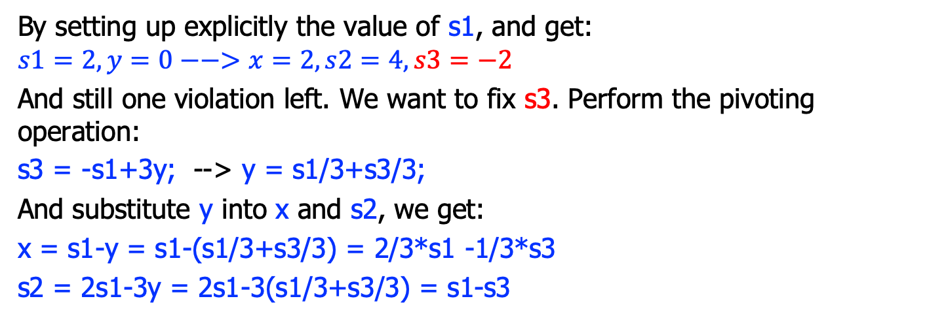
Trial and fix
 | s1 | y
x | 1 | -1
s2 | 2 | -3
s3 | -1 | 3
$$\left\{\begin{aligned}s1≥2 \\ s2≥0 \\ s3≥1\end{aligned}\right.$$
By setting up explicitly the value of s1, and get:
$$s1=2,y=0−−>x=2, s2=4, s3=−2$$
And still one violation left. We want to fix s3. Perform the pivoting operation:
s3 = -s1+3y; --> y = s1/3+s3/3;
And substitute y into x and s2, we get:
x = s1-y = s1-(s1/3+s3/3) = 2/3*s1 -1/3*s3
s2 = 2s1-3y = 2s1-3(s1/3+s3/3) = s1-s3
 | s1 | s3
x | 2/3 | -1/3
s2 | 1 | -1
y | 1/3 | 1/3

Slide 25
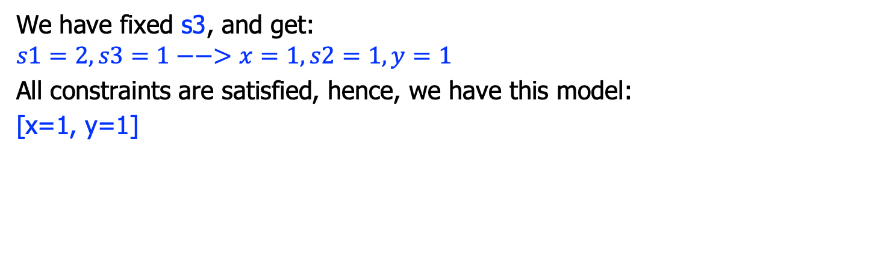
Trial and fix
 | s1 | s3
x | 2/3 | -1/3
s2 | 1 | -1
y | 1/3 | 1/3
$$\left\{\begin{aligned}s1≥2 \\ s2≥0 \\ s3≥1\end{aligned}\right.$$
We have fixed s3, and get:
$$s1=2,s3=1−−>x=1, s2=1, y=1$$
All constraints are satisfied, hence, we have this model:
[x=1, y=1]

Slide 26
Simplex algorithm
simplex(){
tab = constructTableau();
for(each additional var si){
if(si violates its constraint){
if(there is a suitable xj)
pivot(si, xj);
else return UNSAT;
}
}
return SAT;
}

Slide 27

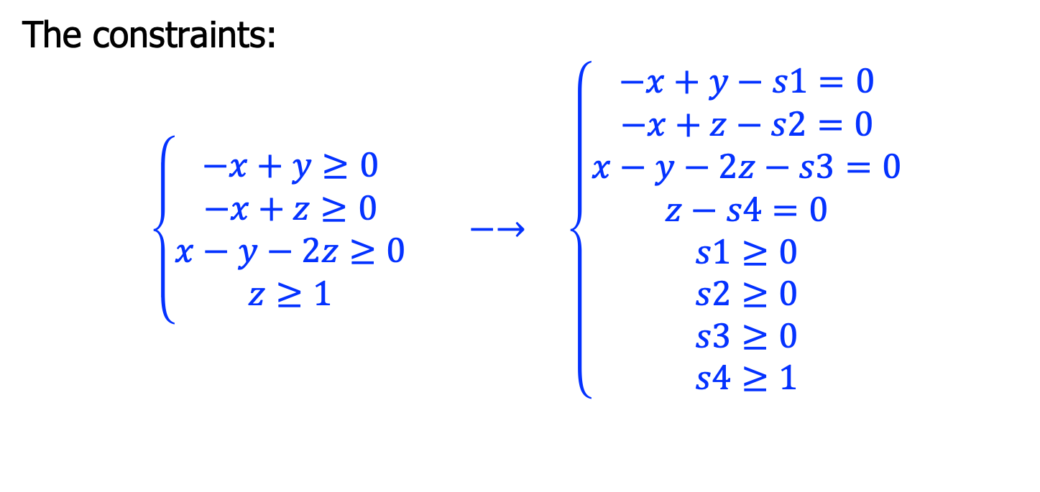
Another Example
The constraints:
$$\left\{\begin{aligned}−x+y≥0 \\ −x+z≥0 \\ x−y−2z≥0 \\ z≥1\end{aligned}\right. −→ \left\{\begin{aligned}−x+y−s1=0 \\ −x+z−s2=0 \\ x−y−2z−s3=0 \\ z−s4=0 \\ s1≥0 \\ s2≥0 \\ s3≥0 \\ s4≥1\end{aligned}\right.$$
 | x | y | z
s1 | -1 | 1 | 0
s2 | -1 | 0 | 1
s3 | 1 | -1 | -2
s4 | 0 | 0 | 1
$$\left\{\begin{aligned}s1≥0 \\ s2≥0 \\ s3≥0 \\ s4≥1\end{aligned}\right.$$

Slide 28
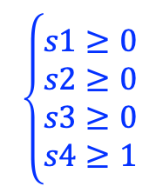
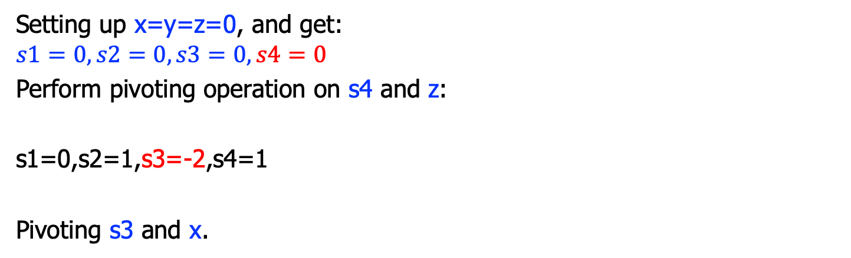
Tableau
 | x | y | z
s1 | -1 | 1 | 0
s2 | -1 | 0 | 1
s3 | 1 | -1 | -2
s4 | 0 | 0 | 1
$$\left\{\begin{aligned}s1≥0 \\ s2≥0 \\ s3≥0 \\ s4≥1\end{aligned}\right.$$
Setting up x=y=z=0, and get:
$$s1=0,s2=0,s3=0,s4=0$$
Perform pivoting operation on s4 and z:
s1=0,s2=1,s3=-2,s4=1
Pivoting s3 and x.
 | x | y | s4
s1 | -1 | 1 | 0
s2 | -1 | 0 | 1
s3 | 1 | -1 | -2
z | 0 | 0 | 1

Slide 29
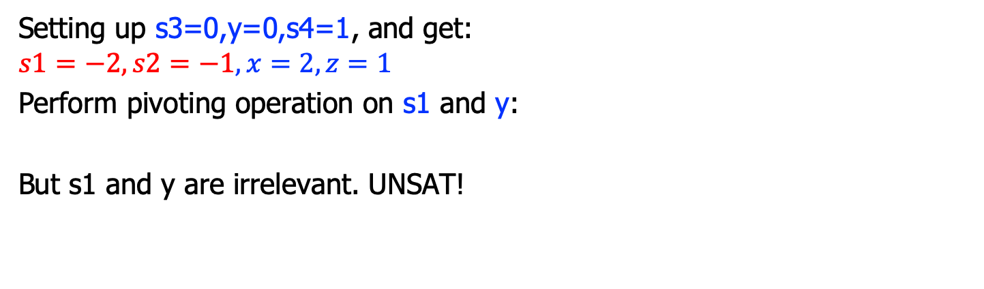
Tableau
 | s3 | y | s4
s1 | -1 | 0 | -2
s2 | -1 | -1 | -1
x | 1 | 1 | 2
z | 0 | 0 | 1
$$\left\{\begin{aligned}s1≥0 \\ s2≥0 \\ s3≥0 \\ s4≥1\end{aligned}\right.$$
Setting up s3=0,y=0,s4=1, and get:
$$s1=−2,s2=−1,x=2,z=1$$
Perform pivoting operation on s1 and y:
But s1 and y are irrelevant. UNSAT!
 | s3 | s1 | s4
y | -1 | 1 | 0
s2 | -1 | 0 | 1
s3 | 1 | -1 | -2
z | 0 | 0 | 1

Slide 30
Branch & Bound

Slide 31
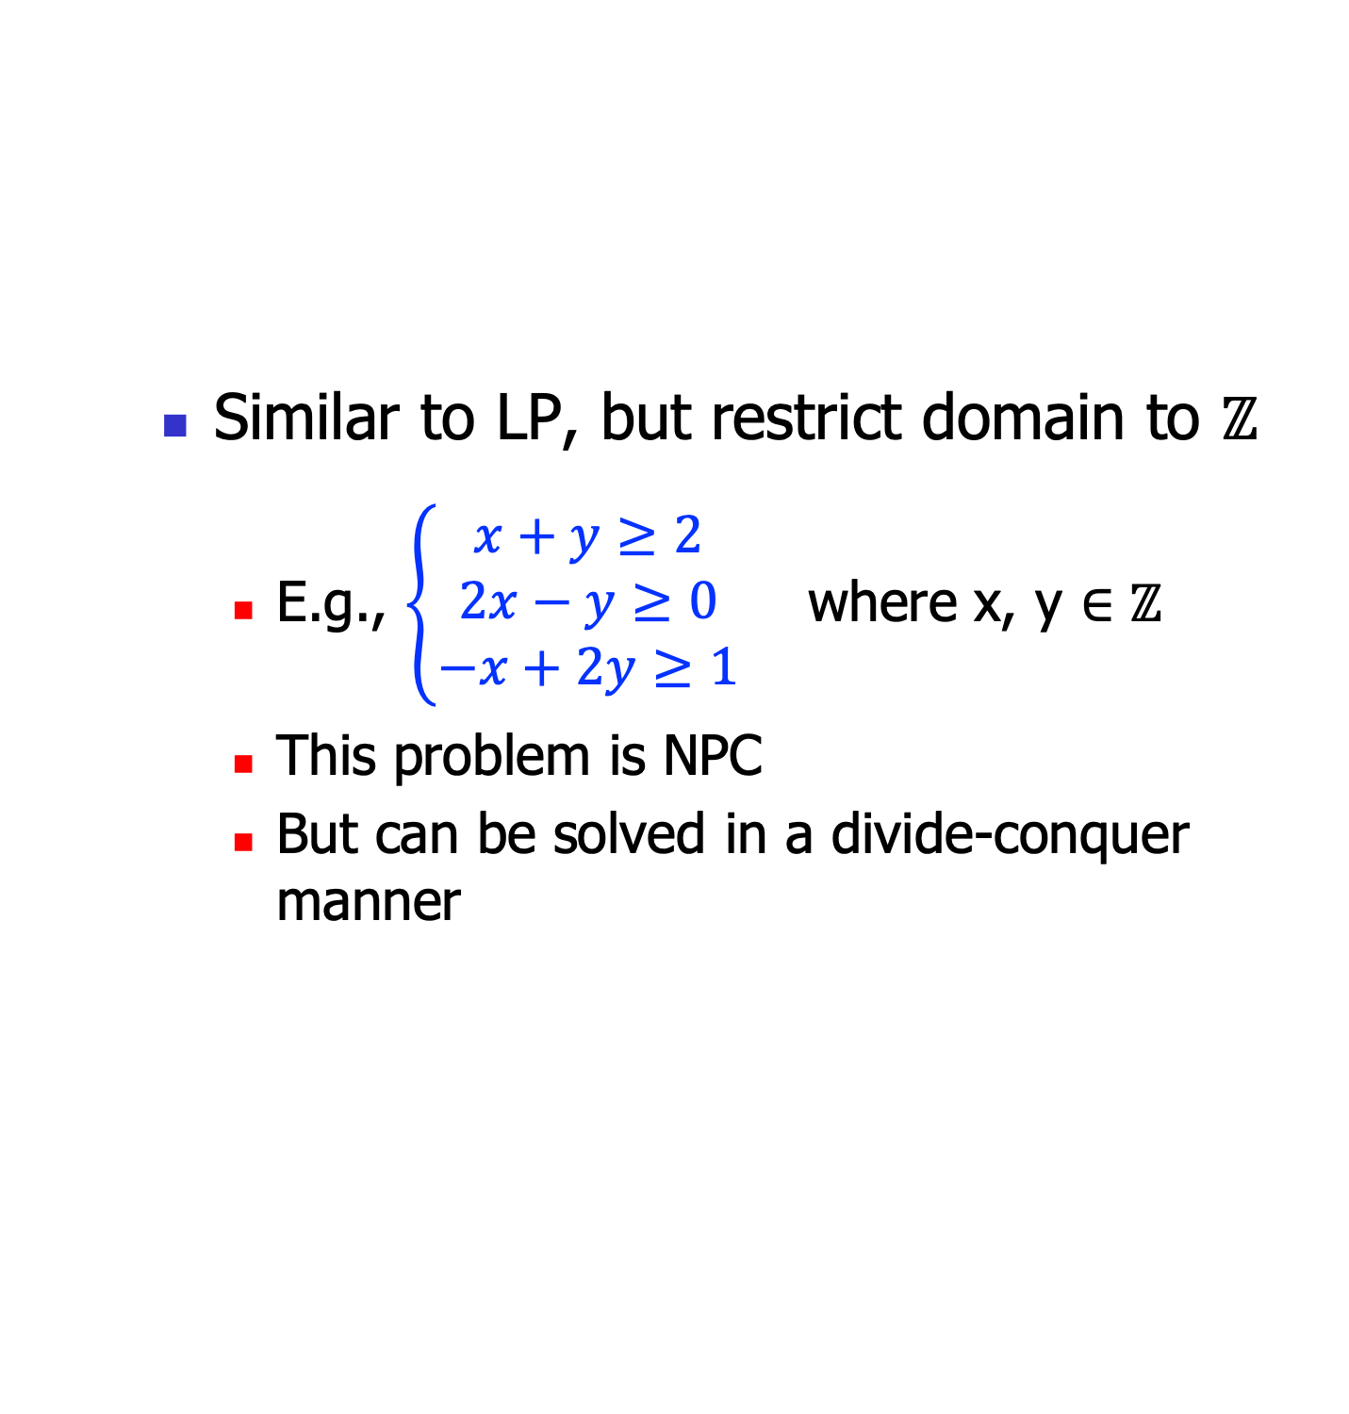
ILP
Similar to LP, but restrict domain to $ℤ$
E.g., $\left\{\begin{aligned}x+y≥2 \\ 2x−y≥0 \\ −x+2y≥1\end{aligned}\right.$ where x, y $∈ℤ$
This problem is NPC
But can be solved in a divide-conquer manner

Slide 32



ILP
Suppose:
[x=1.7, y=3.5]
Similar to LP, but restrict domain to $ℤ$
E.g., $\left\{\begin{aligned}x+y≥2 \\ 2x−y≥0 \\ −x+2y≥1\end{aligned}\right.$ where x, y $∈ℤ$
Key idea:
Solve the problem for x, y$∈ℝ$
No solution, then UNSAT
Find a solution [x=r0, y=r1]
if r0, r1 $∈ℤ$, SAT!
Else suppose c0 $∈ℝ$, then we add two branches:
S $∪$[x $≥ \left\lceil c0\right\rceil$]
S $∪$[x $≤ \left\lfloor c0\right\rfloor$]
$$\left\{\begin{aligned}x+y≥2 \\ 2x−y≥0 \\ −x+2y≥1 \\ x≥2\end{aligned}\right.$$
$$\left\{\begin{aligned}x+y≥2 \\ 2x−y≥0 \\ −x+2y≥1 \\ x≤1\end{aligned}\right.$$

Slide 33





Intuition
Recall our plane model
We want the integer points in the region
The first solution [x= , …]
Add the vertical line
Divide-conquer
$$∗$$
$$∎$$
$$∎$$
$$∎$$
$$∎$$
$$∎$$
$$∎$$
$$∎$$
$$∎$$
$$∗$$
$$∎$$
$$∎$$
$$∎$$
$$∎$$

Slide 34
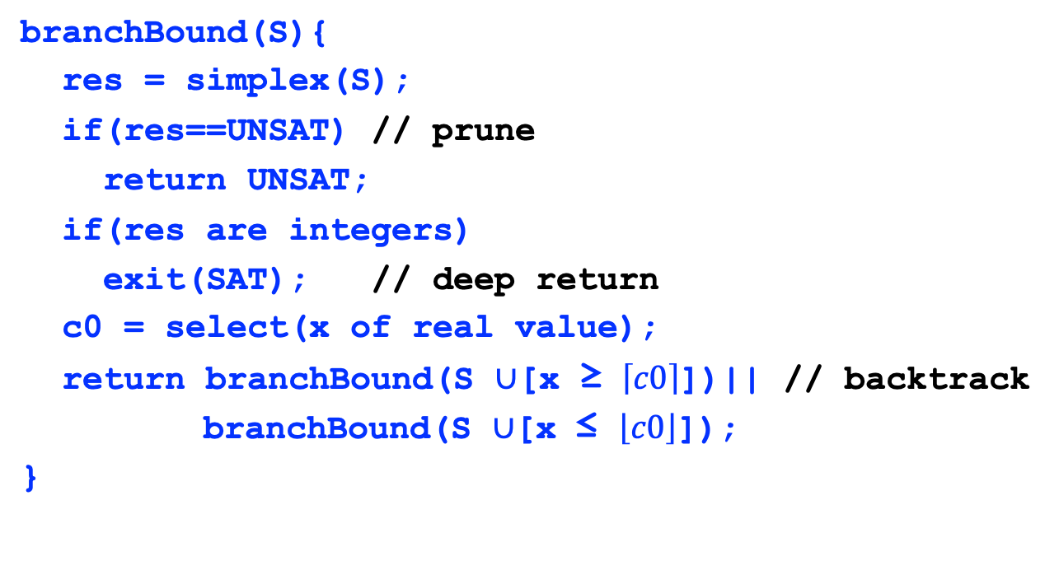
Branch-bound algorithm
branchBound(S){
res = simplex(S);
if(res==UNSAT) // prune
return UNSAT;
if(res are integers)
exit(SAT); // deep return
c0 = select(x of real value);
return branchBound(S $∪$[x ≥ $\left\lceil c0\right\rceil$])|| // backtrack
branchBound(S $∪$[x ≤ $\left\lfloor c0\right\rfloor$]);
}

Slide 35
Graphically: a decision tree
a=1.3
b=4.5
c=-3.8
a<=1
b=4.5
c=-3.8
a>=2
b=4.5
c=-3.8
a<=1
b<=4
c=-3.8
a<=1
b>=5
c=-3.8

Slide 36
LA theory applications

Slide 37
#1: Compiler optimization
foo(int[] A){
for(int i=1; i<10; i++){
A[j+i] = A[j];
}
}
For this to be feasible, we must guarantee that A[j] is a constant. For this example, that is:
j+i=j /\
i>=1 /\
i<10
must be UNSAT!
// Loop invariant hoisting:
foo(int[] A){
int t = A[j];
for(int i=1; i<10; i++){
A[j+i] = t;
}
}

Slide 38

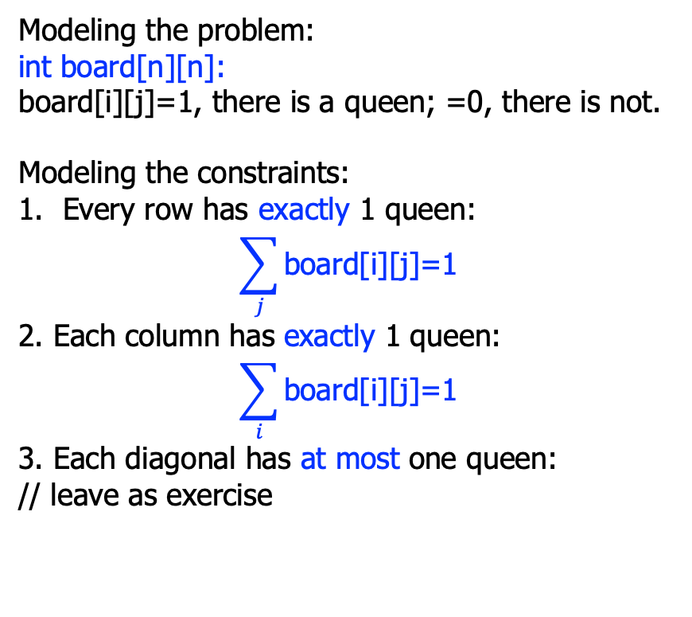
#2: n-queens puzzle
Modeling the problem:
int board[n][n]:
board[i][j]=1, there is a queen; =0, there is not.
Modeling the constraints:
Every row has exactly 1 queen:
$$\sum_{j}{\text{board}\text{[}\text{i}\text{][}\text{j}\text{]=1}}$$
2. Each column has exactly 1 queen:
$$\sum_{i}{\text{board}\text{[}\text{i}\text{][}\text{j}\text{]=1}}$$
3. Each diagonal has at most one queen:
// leave as exercise
Is it possible to put n queens on a n*n board, so that no queen can attack each other?
Not on the same row;
Not on the same column;
Not on the same diagonal.
The above is a 4-queens puzzle.

Slide 39
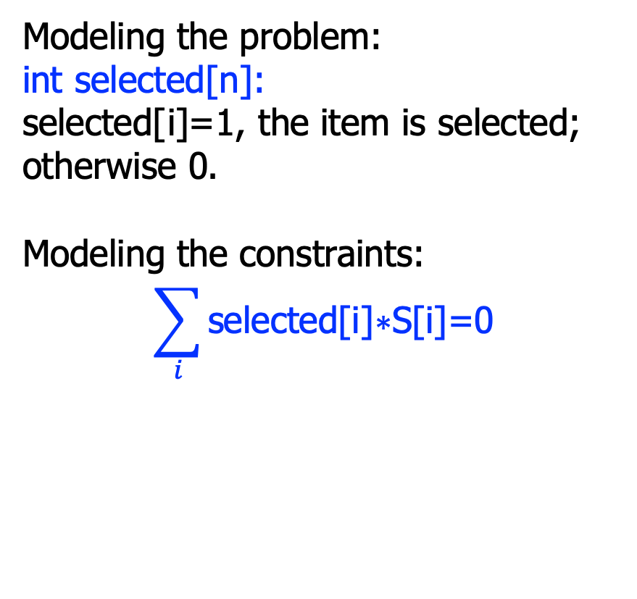
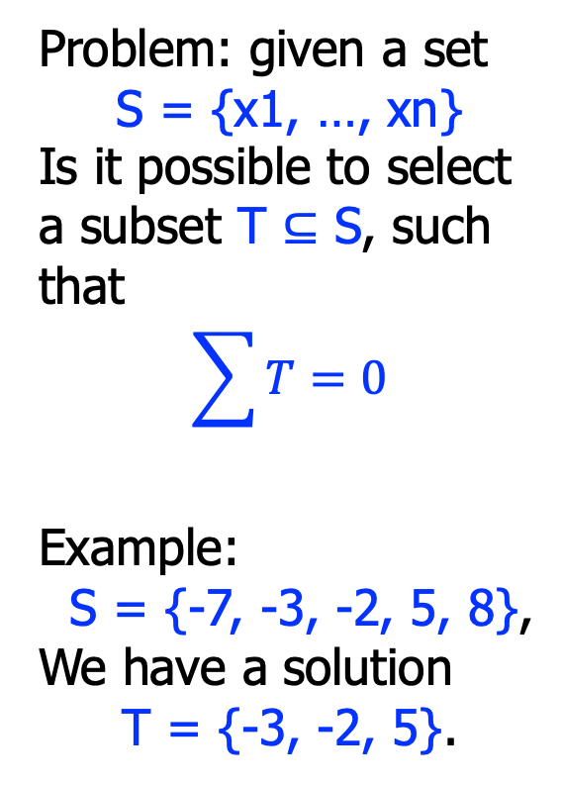
#3: subset sum problem
Modeling the problem:
int selected[n]:
selected[i]=1, the item is selected; otherwise 0.
Modeling the constraints:
$$\sum_{i}{\text{selected}\text{[}\text{i}\text{]}\text{∗}\text{S}\text{[}\text{i}\text{]=0}}$$
Problem: given a set
S = {x1, …, xn}
Is it possible to select a subset T $⊆$ S, such that
$$\sum{T}=0$$
Example:
S = {-7, -3, -2, 5, 8},
We have a solution
T = {-3, -2, 5}.

Slide 40
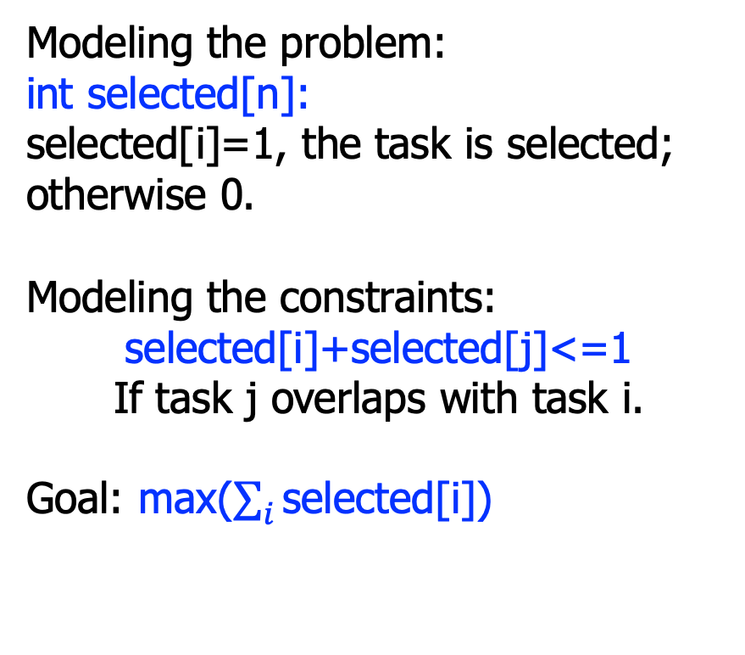
#4: task scheduling
Modeling the problem:
int selected[n]:
selected[i]=1, the task is selected; otherwise 0.
Modeling the constraints:
selected[i]+selected[j]<=1
If task j overlaps with task i.
Goal: max($\sum_{i}{\text{selected}\text{[}\text{i}\text{]}}$)
Problem: given n tasks with start and finish time:
S = {s1, …, sn}
F = {f1, …, fn}
How to arrange them, so that there are maximum number of tasks.
Example:
S={1, 3, 0, 5, 8, 5}
F={2, 4, 6, 7, 9, 9}
Max = 4.

Slide 41
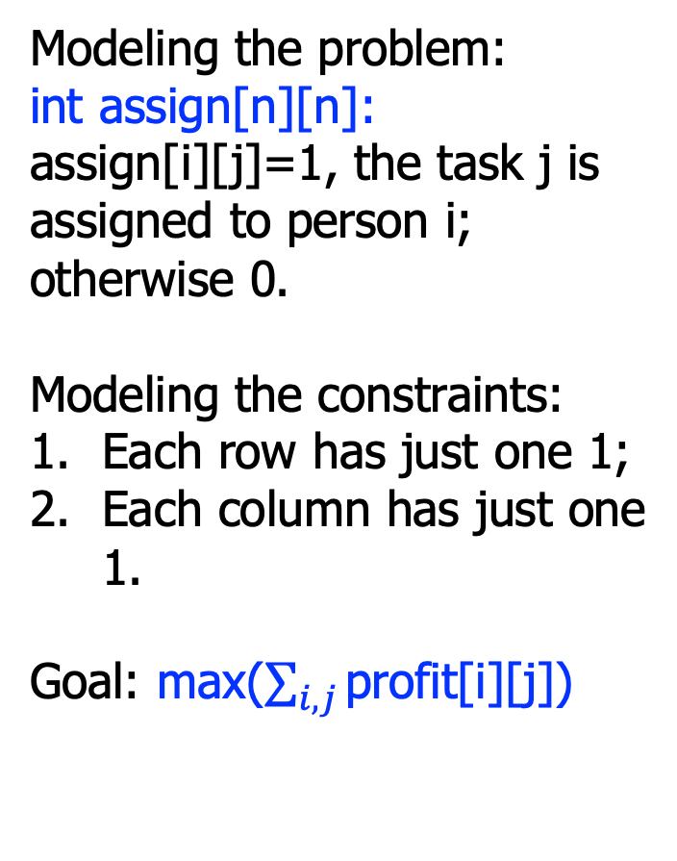
#5: task assignment
Modeling the problem:
int assign[n][n]:
assign[i][j]=1, the task j is assigned to person i; otherwise 0.
Modeling the constraints:
Each row has just one 1;
Each column has just one 1.
Goal: max($\sum_{i,j}{\text{profit}\text{[}\text{i}\text{][}\text{j}\text{]}}$)
Problem: for n persons p1, …, pn and n tasks t1, …, tn, with the specific profit, when person pi does task tj:
How to assign the n tasks to n persons, to maximize the profit.
 | t1 | … | tn
p1 | c11 | … | c1n
…
pn | cn1 | … | cnn

Slide 42
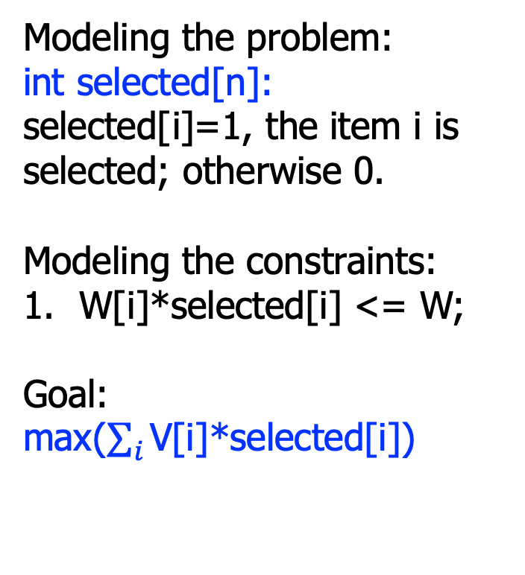
#6: 0-1 knapsack
Modeling the problem:
int selected[n]:
selected[i]=1, the item i is selected; otherwise 0.
Modeling the constraints:
W[i]*selected[i] <= W;
Goal: max($\sum_{i}{\text{V}\text{[}\text{i}\text{]}\text{∗}\text{selected}\text{[}\text{i}}$])
Problem: given n items with weight W and value V:
For a knapsack of maximal weight W, how to select items to maximize V.
 | t1 | … | tn
V | v1 | … | vn
W | w1 | … | wn

Slide 43
Summary
These problems can also be solved in an algorithmic oriented way
Greedy or dynamic programming
But encoding them in SMT is natural and easy
We just write down the constraints, but not the algorithms
Right tools for the right problems!

