Slide 1
Pointer programs
Formal Methods Foundation
Baojian Hua
bjhua@ustc.edu.cn

Slide 2
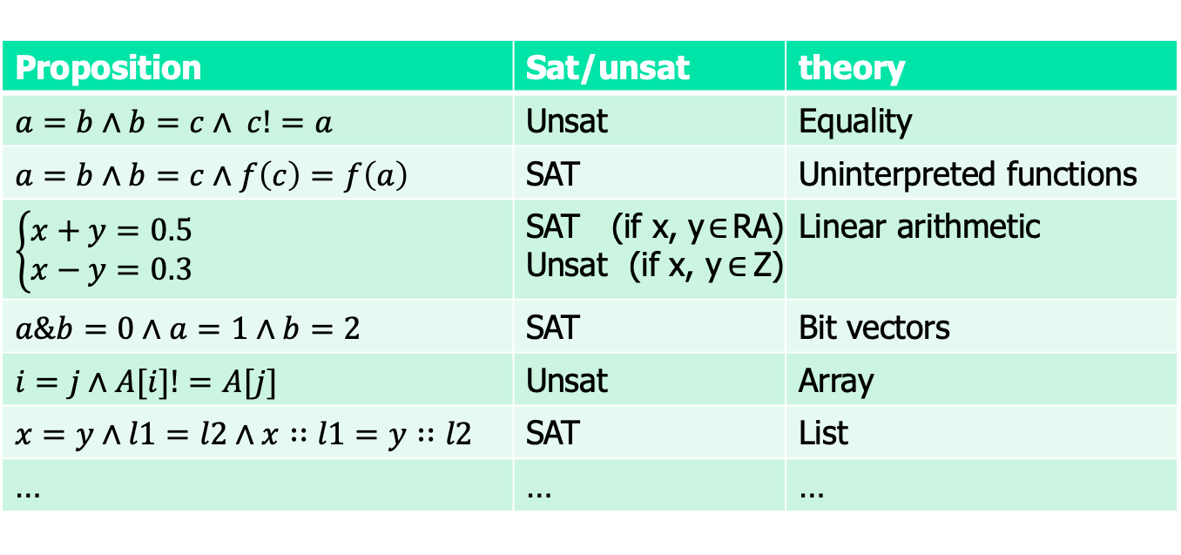
Motivation: theory
Are these satisfiable?
Proposition | Sat/unsat | theory
$a=b∧b=c∧ c!=a$ | Unsat | Equality
$$a=b∧b=c∧f\left(c\right)=f\left(a\right)$$ | SAT | Uninterpreted functions
$$\left\{\begin{aligned}x+y=0.5 \\ x−y=0.3\end{aligned}\right.$$ | SAT (if x, y$∈$RA) Unsat (if x, y$∈$Z) | Linear arithmetic
$a\&b=0∧a=1∧b=2$ | SAT | Bit vectors
$i=j∧A[i]!=A[j]$ | Unsat | Array
$x=y∧l1=l2∧x∷l1=y∷l2$ | SAT | List
… | … | …

Slide 3

Satisfiability modulo theory (SMT)
SAT
Theory
Solvers
SMT
Equality + UF
Arithmetic
Bit-vectors
…

Slide 4
Motivation: pointers
Pointers are a key programming feature in nearly all languages
Some called references, handles, etc..
But pointers are subtle to use and to reason about
Improper use introduces subtle bugs
This lecture is about a theory to reason about pointers

Slide 5
Motivation: pointers
// subtle bug #1: dangling reference:
int *p, *q;
*p = 88;
// subtle bug #2: pointer alias
p = q;
free(q);
*p = 88;
// subtle bug #3: double free
p = q;
free(p);
free(q);

Slide 6
Memory model
A flat infinite memory address
Byte addressable
Each object is of a finite & dedicated size
Address 0 is not addressable
A pointer is just a memory address
Essentially, this is a memory model based on the ones for C/C++

Slide 7
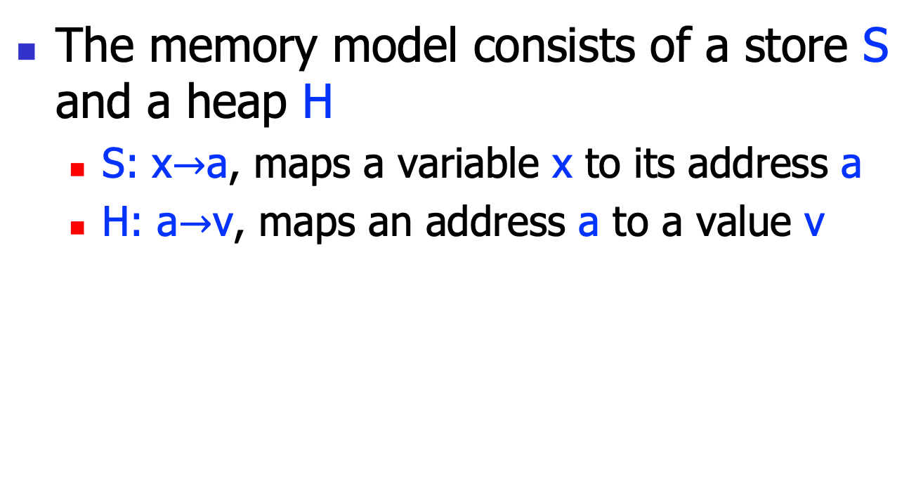
Memory model
The memory model consists of a store S and a heap H
S: x$→$a, maps a variable x to its address a
H: a$→$v, maps an address a to a value v
H:
Or, think the store S as the compiler symbol table, and the heap H as the memory.
S:
x
88
y
99
x = 88;
y = 99;
p = &y;
q = &p;
p
q

Slide 8
Syntax & semantics

Slide 9

Pointers: the syntax
T ::= x | T+E | &x | &*T | *T | NULL
E ::= x | n | E+E | E-E | *T
R ::= T=T | T<T | E=E | E<E
P ::= R
| ~R
$\text{|} \text{P}∧\text{P}$
This is essentially a fragment of the C language.
However, some operations are not supported, such as the conversion between pointers and integers.

Slide 10

Example
// Let p, q be pointer variables;
// and i, j be integer variables. Legal propositions:
*(p+i)==1
*(p+*p)==0
p==q /\ *p==5
*********p==1
p<q
// Illegal ones:
p+i
p==i
*(p+q)
*1==1
p<i
T ::= x | T+E | &x | &*T | *T | NULL
E ::= x | n | E+E | E-E | *T
R ::= T=T | T<T | E=E | E<E
P ::= R
| ~R
$\text{|} \text{P}∧\text{P}$

Slide 11
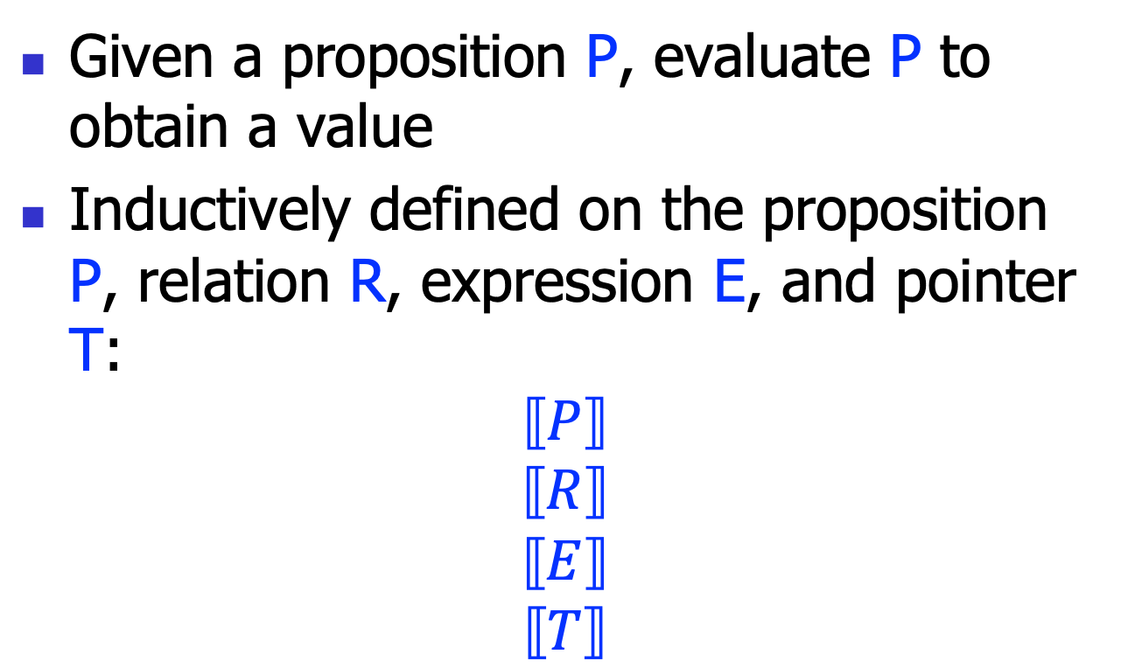
Semantics
Given a proposition P, evaluate P to obtain a value
Inductively defined on the proposition P, relation R, expression E, and pointer T:
$$⟦P⟧$$
$$⟦R⟧$$
$$⟦E⟧$$
$$⟦T⟧$$

Slide 12
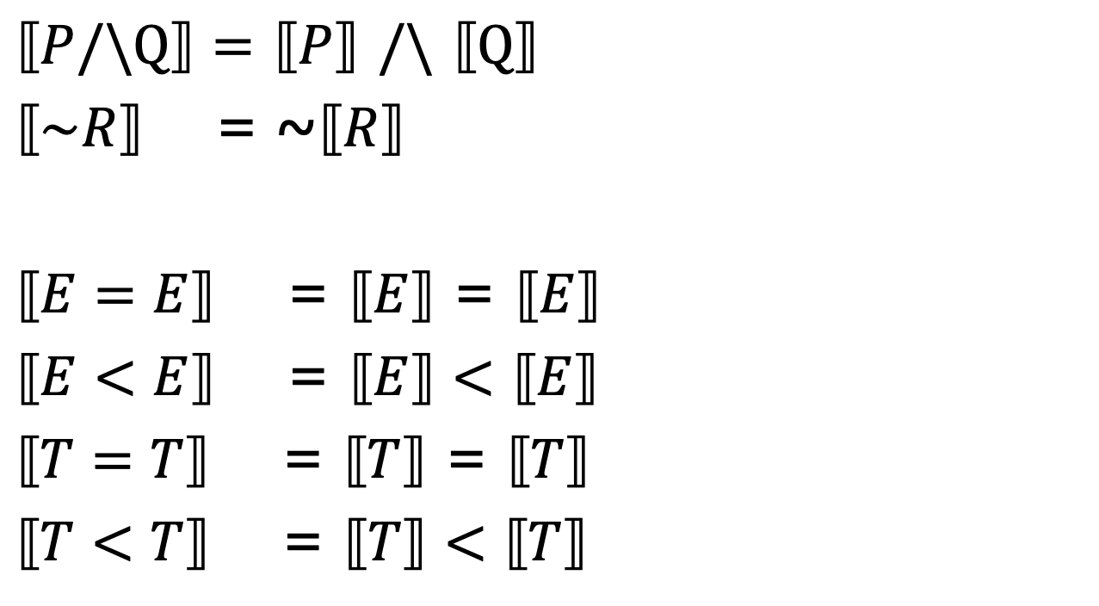
Semantics: propositions
$⟦P/\backslash Q⟧=$ $⟦P⟧$ $/\backslash$ $⟦Q⟧$
$⟦\sim R⟧$ = ~$⟦R⟧$
$⟦E=E⟧$ = $⟦E⟧$ = $⟦E⟧$
$⟦E<E⟧$ = $⟦E⟧<⟦E⟧$
$⟦T=T⟧$ = $⟦T⟧$ = $⟦T⟧$
$⟦T<T⟧$ = $⟦T⟧<⟦T⟧$

Slide 13
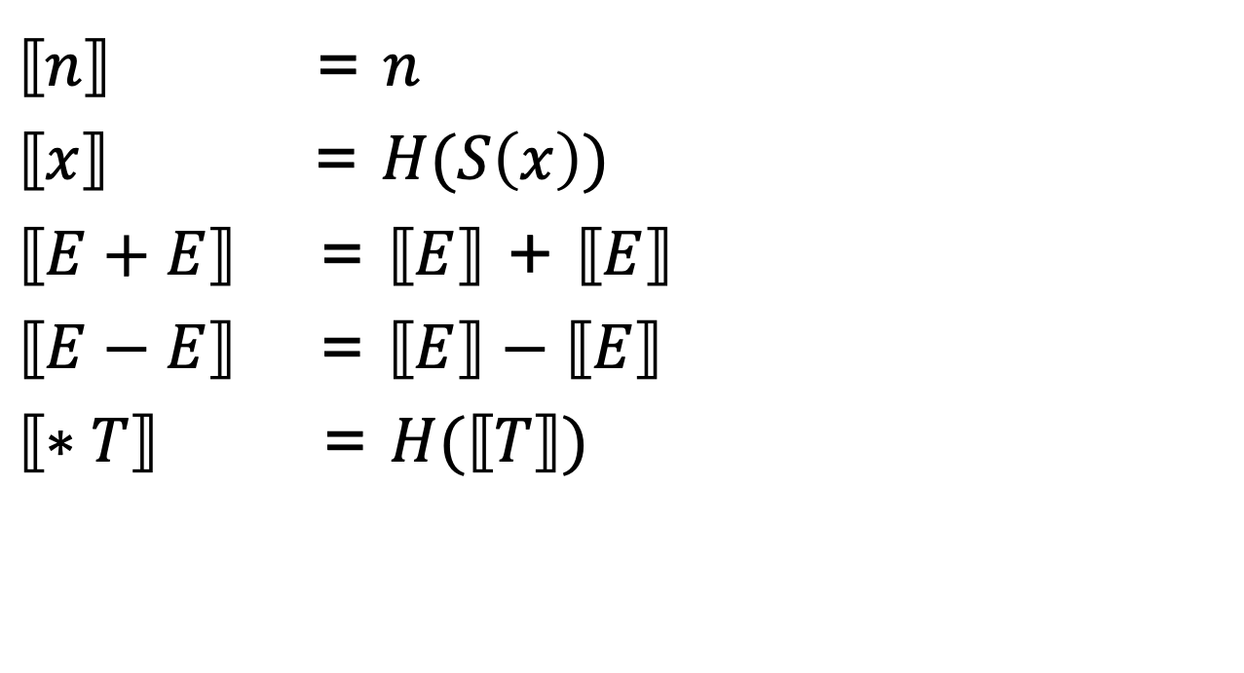
Semantics: expressions
$⟦n⟧$ = $n$
$⟦x⟧$ = $H(S\left(x\right))$
$⟦E+E⟧$ = $⟦E⟧$ + $⟦E⟧$
$⟦E−E⟧$ = $⟦E⟧−⟦E⟧$
$⟦∗T⟧$ = $H(⟦T⟧)$
H:
S:
x
88
y
99
p
q

Slide 14
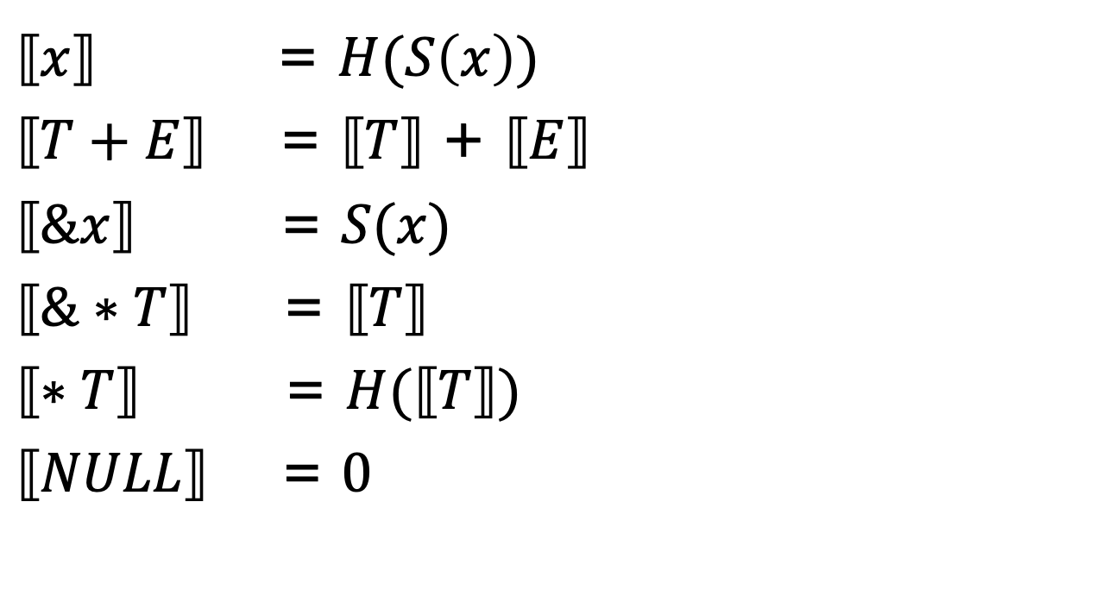
Semantics: pointers
$⟦x⟧$ = $H(S\left(x\right))$
$⟦T+E⟧$ = $⟦T⟧$ + $⟦E⟧$
$⟦\&x⟧$ = $S(x)$
$⟦\&∗T⟧$ = $⟦T⟧$
$⟦∗T⟧$ = $H(⟦T⟧)$
$⟦NULL⟧$ = $0$
H:
S:
x
88
y
99
p
q

Slide 15
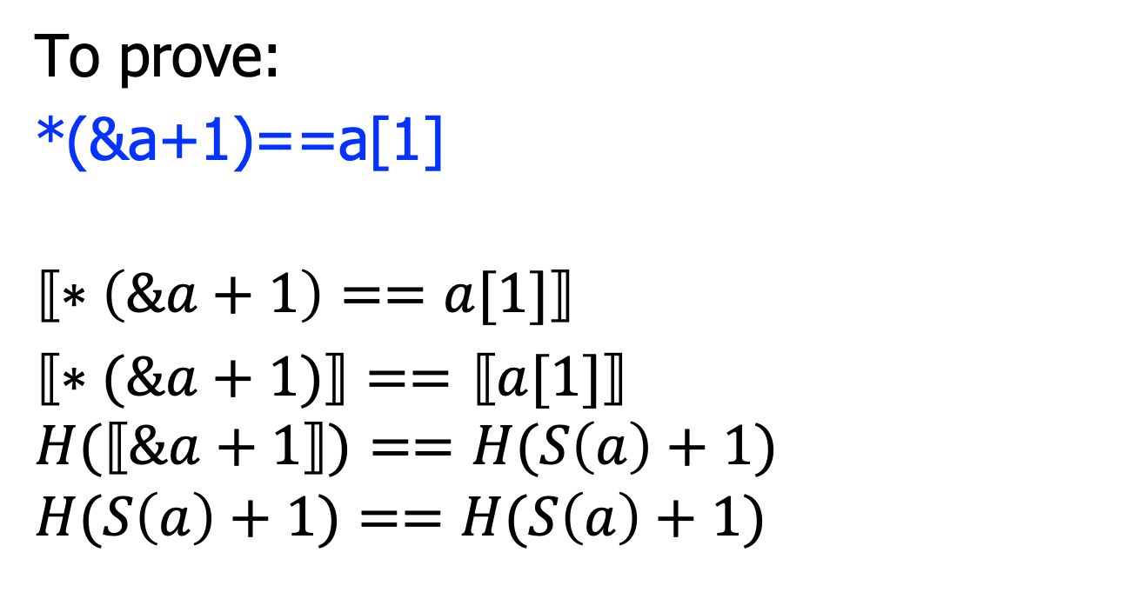
Example
H:
S:
x
To prove:
*(&a+1)==a[1]
$$⟦∗\left(\&a+1\right)==a[1]⟧$$
$⟦∗(\&a+1)⟧==$ $⟦a[1]⟧$
$$H(⟦\&a+1⟧)==H(S\left(a\right)+1)$$
$$H(S\left(a\right)+1)==H(S\left(a\right)+1)$$
88
y
99
p
q

Slide 16
A decision procedure

Slide 17
Semantics-based decision procedure
The basic idea is to eliminate pointers
By encoding their meaning with the store S and the heap H
Exactly as what we’ve
done in the semantics
discussion
This gives us a decision procedure
pointers
w.o/
pointers
E

Slide 18
Decision procedure
// Input: the proposition P
sat(P){
P’ = ⟦P⟧;
return sat(P’);
}

Slide 19
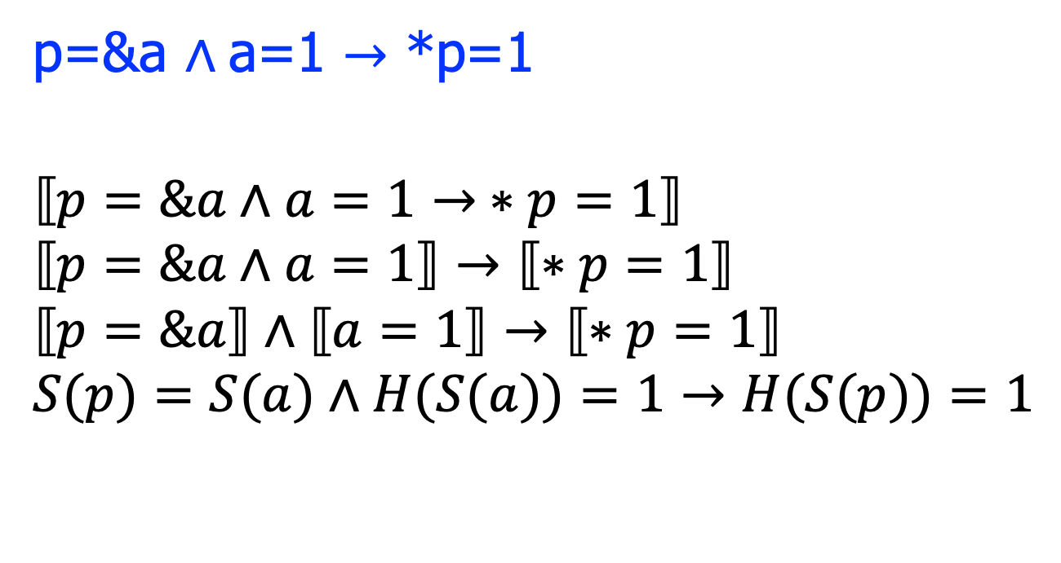
Example
p=&a $∧$a=1 $→$ *p=1
$$⟦p=\&a∧a=1→ ∗p=1⟧$$
$$⟦p=\&a∧a=1⟧→⟦∗p=1⟧$$
$$⟦p=\&a⟧∧⟦a=1⟧→⟦∗p=1⟧$$
$$S(p)=S(a)∧H(S(a))=1→H(S(p))=1$$

Slide 20
Pure variables
We call a variable x pure, if x’s address is not taken of: &x
Or else, the variable x is called escaped
We can introduce a new sort a memory : R(x)
The standard translation: H(S(x))
For pure vars, new translation: R(x)

Slide 21

Extended memory model
With the new memory R:
R:
H:
R: register file
S: symbol table
H: memory
5
S:
x
$⟦x⟧$ = $R\left(x\right)$
88
y
99
p
q

Slide 22

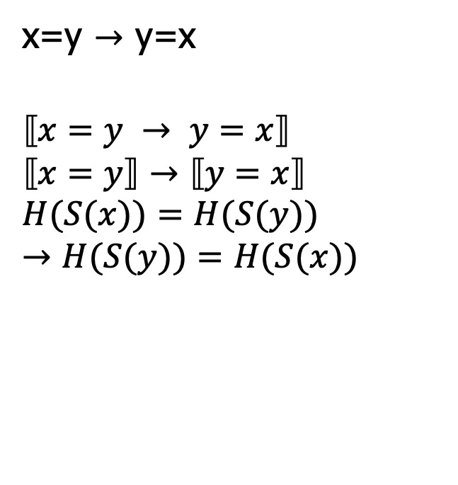
Example
x=y $→$ y=x
$$⟦x=y → y=x⟧$$
$$⟦x=y⟧→⟦y=x⟧$$
$$H(S(x))=H(S(y))→H(S(y))=H(S(x))$$
x=y $→$ y=x
$$⟦x=y → y=x⟧$$
$$⟦x=y⟧→⟦y=x⟧$$
$$R(x)=R(y)→R(y)=R(x)$$

Slide 23
Memory partitions
The basic idea to partition the memory further
so that we have a more fine-grained memory model
so that we can reason more subtle properties of the memory
We study a type-based approach

Slide 24
Memory partitions
Key observation: for these var declarations:
int *p;
int **q;
Can p and q be alias?
That is, can they point to the same memory address?
The answer is NO.
(recall we don’t have type conversion!)
R:
H:
r
5
S:
x
88
y
99
p
So, for vars with difference types, we partition H into different H*, H**, etc..
q

Slide 25


Example
*p=1 $∧$ **q=1 $→$ p!=q
$$⟦∗p=1∧∗q=3.14→ p!=q⟧$$
$$H\left(R\left(p\right)\right)=1∧H(H\left(R\left(q\right))\right)=1→R\left(p\right)!=R\left(q\right)$$
*p=1 $∧$ **q=1 $→$ p!=q
$$⟦∗p=1∧∗q=3.14→ p!=q⟧$$
$$H1\left(R\left(p\right)\right)=1∧H1(H2\left(R\left(q\right))\right)=1→R\left(p\right)!=R\left(q\right)$$

Slide 26
Summary
To reason about pointer-based programs, we develop a pointer logic
The key insight is to establish a proper memory model
On that, this theory is reduced to an array or uninterpreted theory

