Slide 1
Heterogeneous Programming Overview
The Euclid Seminar
Baojian Hua
bjhua@ustc.edu.cn

Slide 2
What is this about?

Slide 3
5Ws
What?
Why?
When?
Who?
hoW?

Slide 4
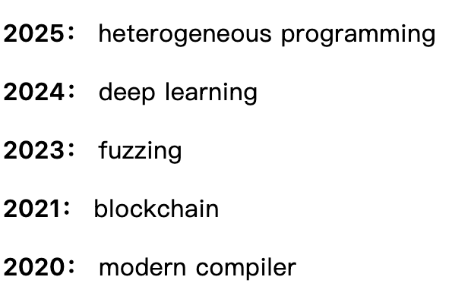
What is this Euclid seminar?
The Euclid summer school is an annual meeting in CSS group
To learn something new systematically and to motivate novel ideas
Topics in recent several years:

Slide 5
Why this seminar?
Always innovate
Build a growth-oriented team

Slide 6
When to organize this seminar?
In each summer
But for this round of seminar, this winter

Slide 7
Who is in charge this seminar?
The students organize the seminar
You are the Prof.!

Slide 8
How?
Seek a balance between theory and practice
bias to practice if conflict
Read text, write code, discuss, brain storming, …
So, self-motivation is essential

Slide 9
What about this year?

Slide 10
Topic
Heterogeneous programming
We start with GPU, but may scale to NPU, TPU and beyond
To systematically investigate the programming capabilities

Slide 11
Resources
Seminar page:
https://csslab-ustc.github.io/seminar/2025/
Schedule and resources

Slide 12
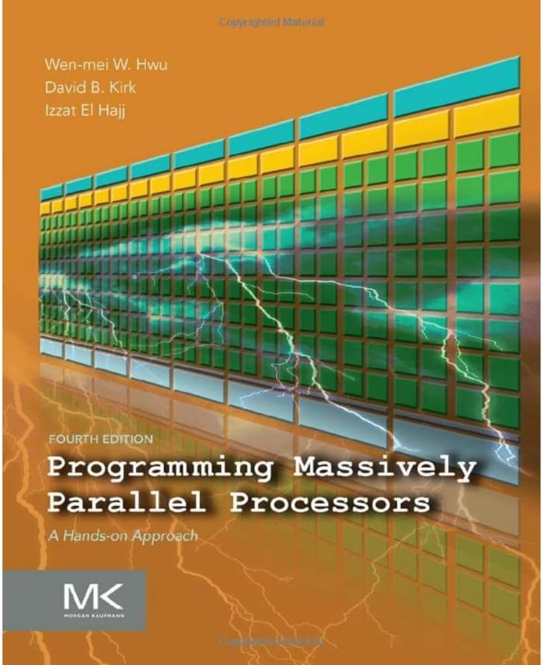
Textbooks & Reference
Key textbook:
Programming Massively Parallel Processors
Other references on website

Slide 13
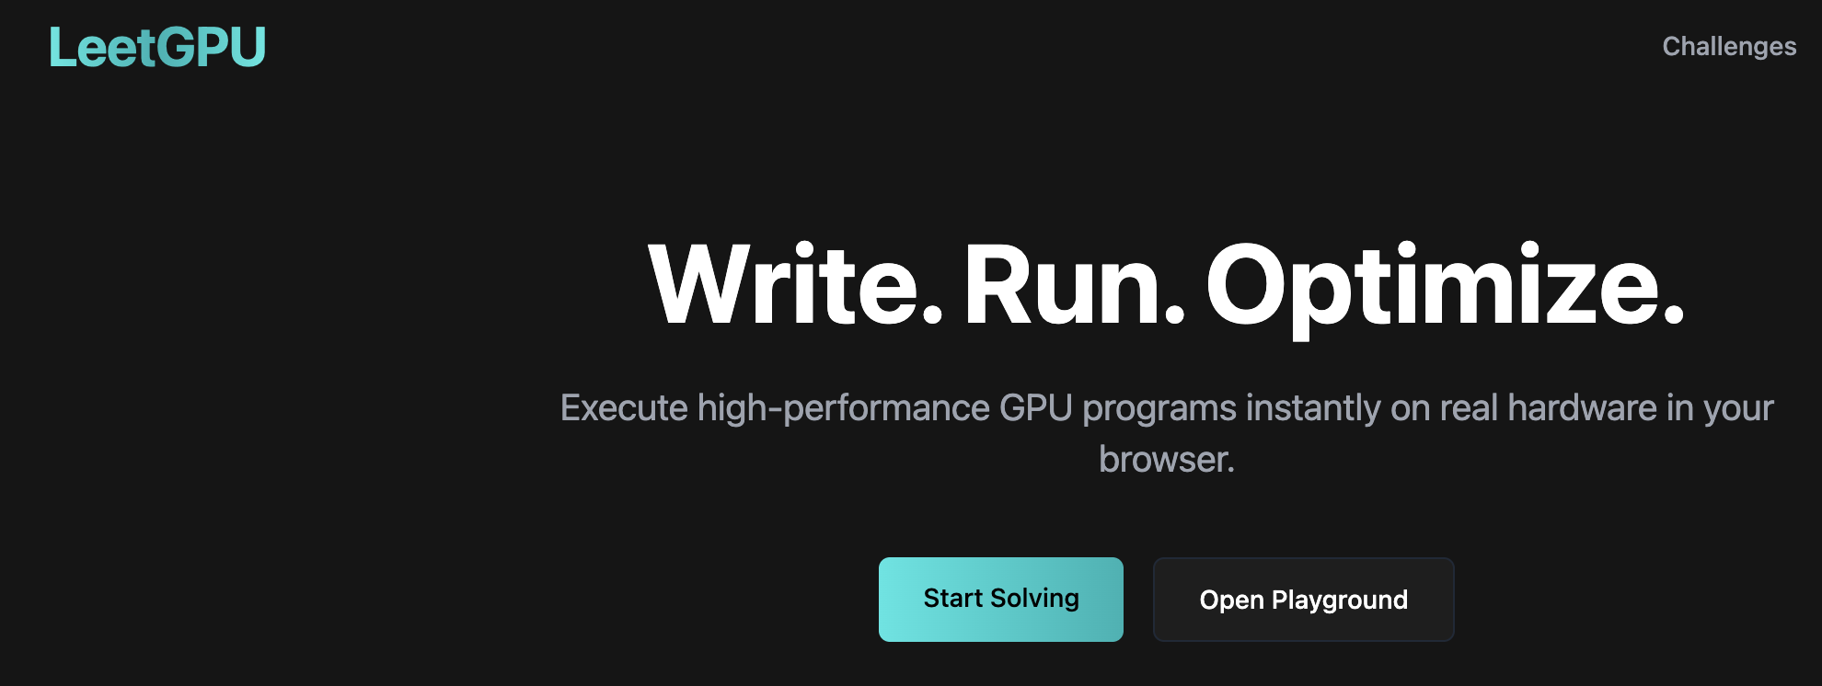
Programming practice
Required: https://leetgpu.com/
At least the “easy” and “medium” problems
Optional:
the hydra project code:
projects/2025/hydra/

Slide 14
Summary
Happy hacking!

