Slide 1
Advanced Compiler Design: Overview
The Euclid Seminar
Baojian Hua
bjhua@ustc.edu.cn

Slide 2
What is this about?

Slide 3
5Ws
What?
Why?
When?
Who?
hoW?

Slide 4
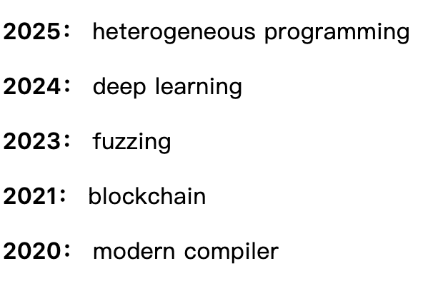
What is this Euclid seminar?
The Euclid summer school is an annual meeting in CSS group
To learn something new systematically and to motivate novel ideas
Topics in recent several years:

Slide 5
Why this seminar?
Always be innovative and illuminating
Build a growth-oriented team

Slide 6
When to organize this seminar?
In each summer
May continue to the next semister

Slide 7
Who attends this seminar?
Group members
The students organize the seminar
You are the Prof.!

Slide 8
How?
Seek a balance between theory and practice
bias to practice if conflict
Read text, write code, discuss, brain storming, …
So, self-motivation is essential
Do NOT use AI for this seminar

Slide 9
What about this year?

Slide 10
Topic
Advanced compiler design
We start with traditional compiler, then to advanced topics in compiler designs and recent research progress
To systematically investigate the core ideas of compiler designs

Slide 11
Resources
Seminar page:
https://csslab-ustc.github.io/seminar/2026/
Schedule and resources

Slide 12


Textbooks & Reference
Key textbooks:
Modern compiler implementation in Java
Advanced Compiler Design
Other references on website

Slide 13
Programming practice
Required: build the Tiger compiler

Slide 14
Summary
Happy hacking!

