Slide 1
Imperative Objects
Principle of Programming Languages
Baojian Hua
bjhua@ustc.edu.cn

Slide 2
OOP
One of the programming paradigms:
young, from the history point of view
very popular, due to industry push
But may be also the most controversial
Object: “say something to express one's disapproval of or disagreement with something.”

Slide 3
Motivation
Simulate OOP with the syntactic features we’ve learned
especially the imperative features
Nearly satisfying…:
for most OOP features, but not for all
We’ll establish a direct technique in future lectures

Slide 4
Object-Oriented Programming: OOP

Slide 5
What is OOP?
Multiple representations
Encapsulations
Subtyping
Inheritance
Open recursion

Slide 6
Multiple representations
The object determines what operations should be executed
Same operations can be implemented by different classes (objects)

Slide 7
Multiple representations
interface J{
void foo();
}
class A implements J{
void foo(){…}
}
class B implements J{
void foo(){…}
}
void f(J obj){
// which foo()?
obj.foo();
}
// 1. interface invoke
// 2. dynamic dispatch
// 3. performance penalty

Slide 8
Encapsulation
Objects’ states are hidden from outside of objects themselves
Only objects’ methods are allowed to access their internal states
A form of ADT

Slide 9
Multiple representations
class A{
private int x;
public int get(){
return x;
}
public void set(int x){
this.x = x;
}
}
void f(A obj){
// legal
obj.set(55);
// illegal
obj.x = 44;
}

Slide 10
Subtyping
An interfaces with more methods are subtypes of those with fewer methods
It’s always safe to offer a subtype, when a supertype is required
Just like the record type as we’ve discussed

Slide 11
Subtyping
interface I{
void foo();
}
interface J extends I{
void bar();
}
void f(I obj){
// interface invoke
obj.foo();
}
J x = …;
f(x);

Slide 12
Inheritance
Inheritance operates on classes
To inherit not only methods, but also fields

Slide 13
Inheritance
class A{
int x;
void foo();
void baz();
}
class B extends A{
int y;
void foo();
void bar();
}
vptr
A::foo
x
A::baz
vptr
B::foo
x
A::baz
y
B::bar

Slide 14
Open recursion
The behavior of “this” is very special
It allows to late binding of some methods
that is, to invoke current unavailable methods

Slide 15
Open recursion
class A{
void f(){
this.g();
}
void g(){
}
}
class B extends A{
void g(){
throw ...;
}
}
new B().f();

Slide 16
Object Encoding

Slide 17
Objects
Objects are a piece of encapsulating data
with methods to to access these data
We’ll make use of a counter to serve as our running example

Slide 18
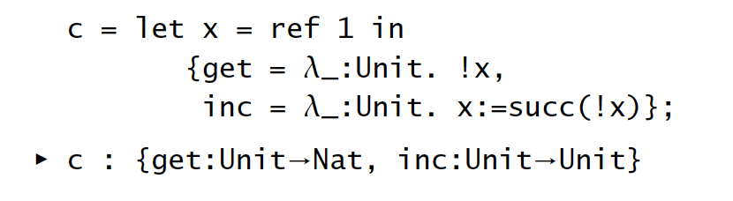
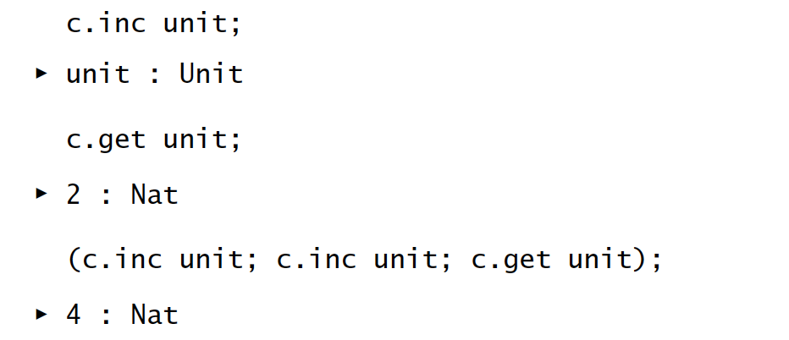
Objects

Slide 19

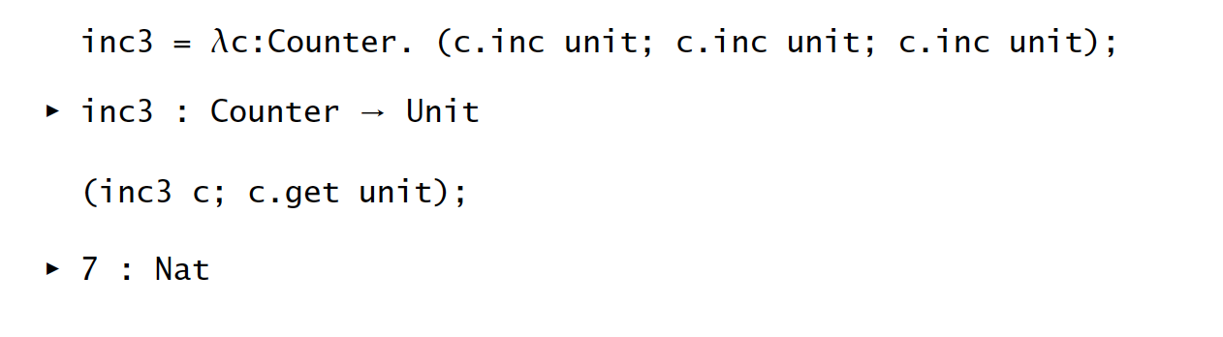
Type abbreviations

Slide 20
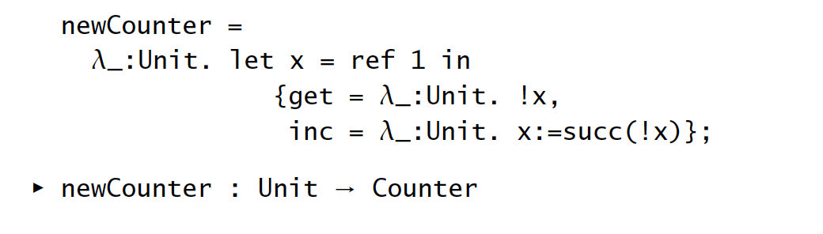
Objects generators

Slide 21
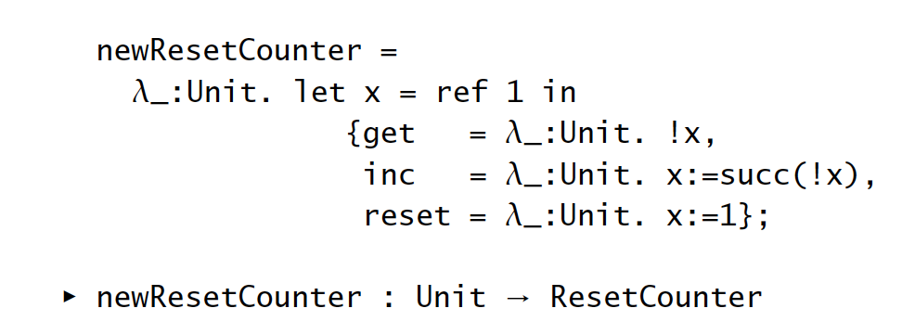
Subtyping

Slide 22
Class
Class can be thought of functions:
take objects representations as arguments
generate class type (virtual function tables)

Slide 23
Classes
class A{
private int x;
public A(int x){
this.x = x;
}
public int get(){
return this.x;
}
public void set(int x){
this.x = x;
}
}
// classes are functions:
A: (int x) -> {get, set}

Slide 24
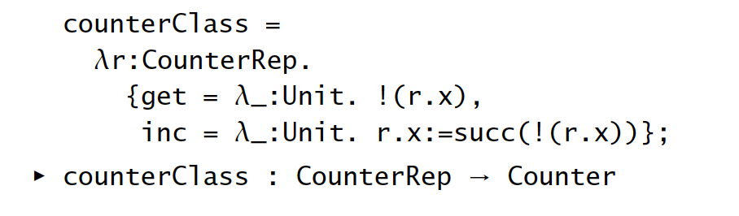
Classes

Slide 25
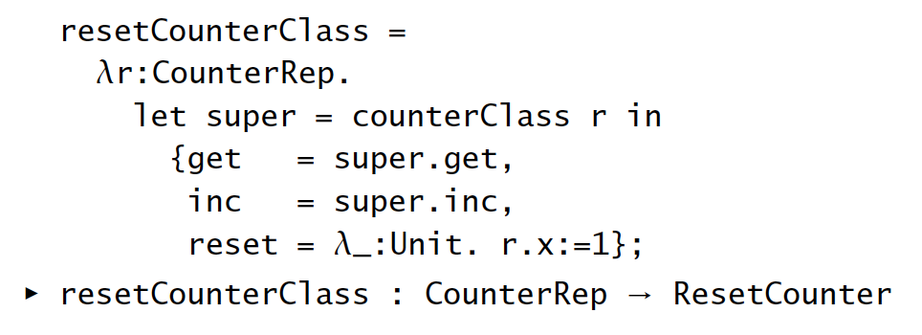
Subclasses

Slide 26
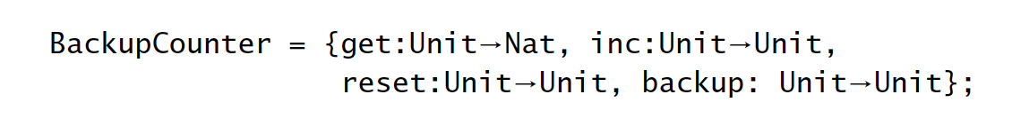

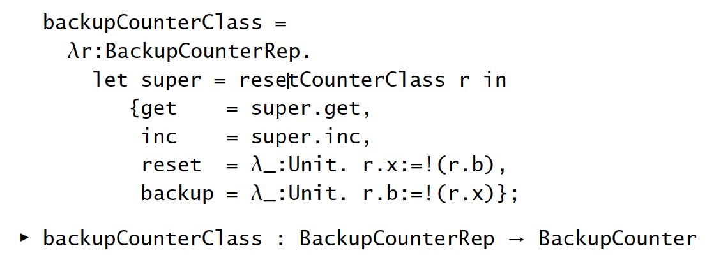
Instance variables
Adding a new method “backup()”, to backup the internal state:

Slide 27
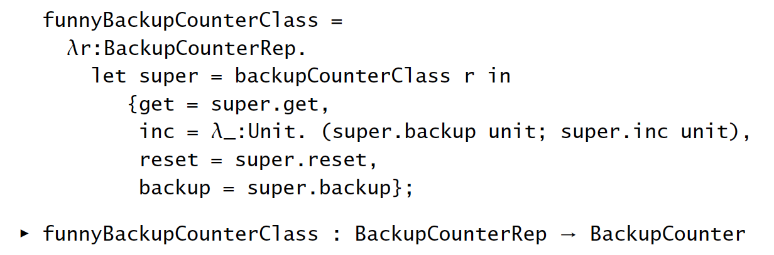
Calling superclass methods
In subclass, we can class methods in super classes, via “super”.

Slide 28
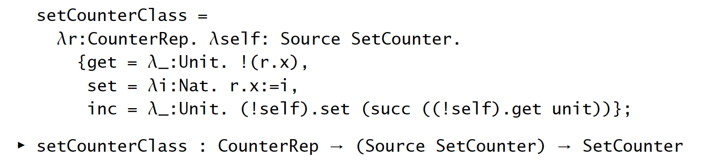
“This”

Slide 29
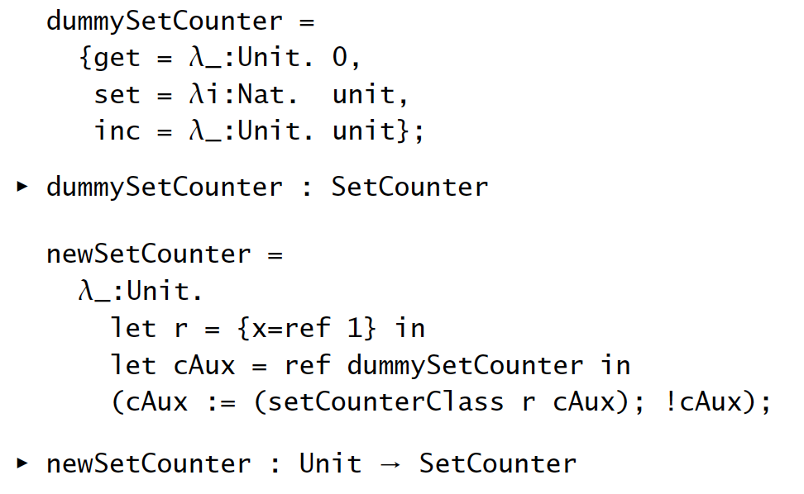
vptr
get
x
set
inc

Slide 30
Summary
Imperative objects
Simulate OOP using functional languages (with imperative features)
Mostly satisfying
except for some features
will discuss a more direct formalization

