Slide 1
Featherweight Java
Principle of Programming Languages
Baojian Hua
bjhua@ustc.edu.cn

Slide 2
Direct Encoding
Give a direct account of the syntax and semantics
and to prove its properties
Instead of encoding the core language into some primitive core calculus

Slide 3
Motivation
Featherweight Java (FJ for short) is a subset of Java
To establish the semantics of Java
in a functional style
i.e., no assignments!
Thus, this lecture requires some familiarity with Java

Slide 4
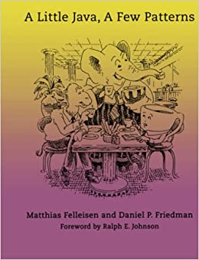

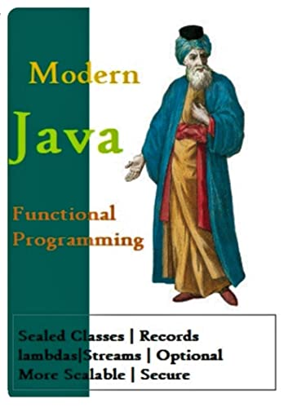
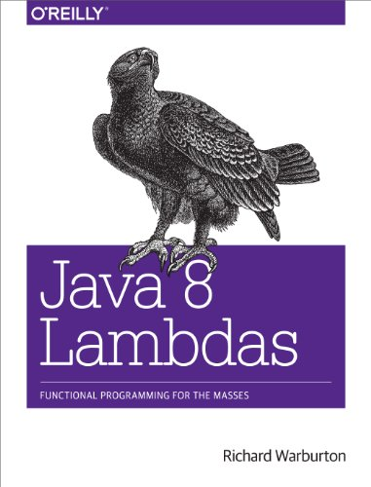
Functional Java
Java is becoming more functional after 8.0
lambda, stream, type switch, …
Several books on this topic:

Slide 5
Featherweight Java

Slide 6
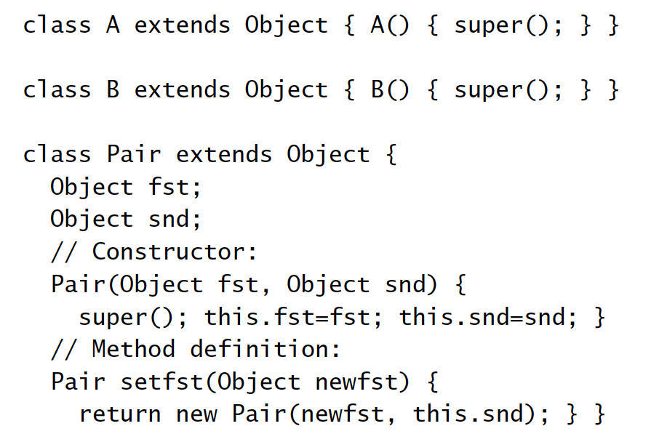
Example

Slide 7
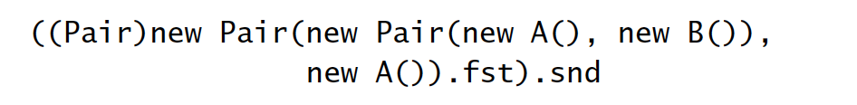
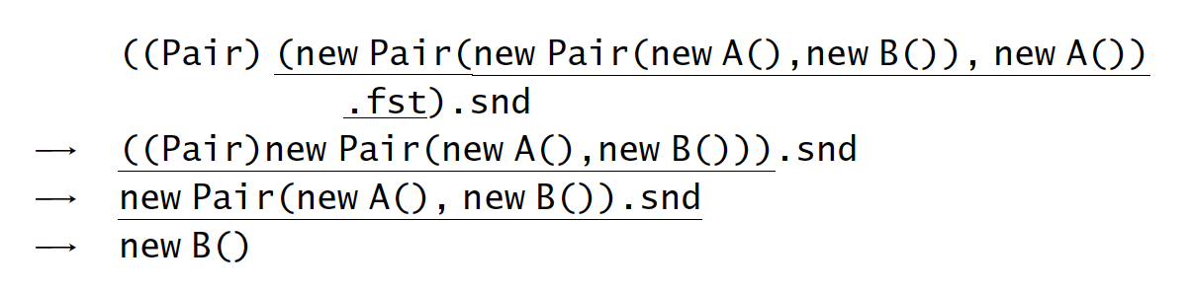
Operations

Slide 8
Structural and nominal types
class A{
int x;
}
class B{
int x;
}
// is this legal?
B obj = new A();
1. Nominal types:
The equality between types are based on type names!
Example: C, Java
2. structural types:
The equality between types are based on structures!
Example: ML
type a = {x: int};
type b = {x: int};

Slide 9
Advantages of nominal types
To support runtime types
type representations
e.g., Class in Java
casting
e.g., (T)obj in Java
dynamic type tests
e.g., instanceof in Java
reflection
e.g., Field or Method in Java

Slide 10
Advantages of nominal types
To support recursive types
e.g.,
class List{
int data;
List next;
}

Slide 11
Advantages of nominal types
Make subtype checking easier
programmers do the hard work!
e.g.,
class A{
…
}
class B extends A{
…
}

Slide 12
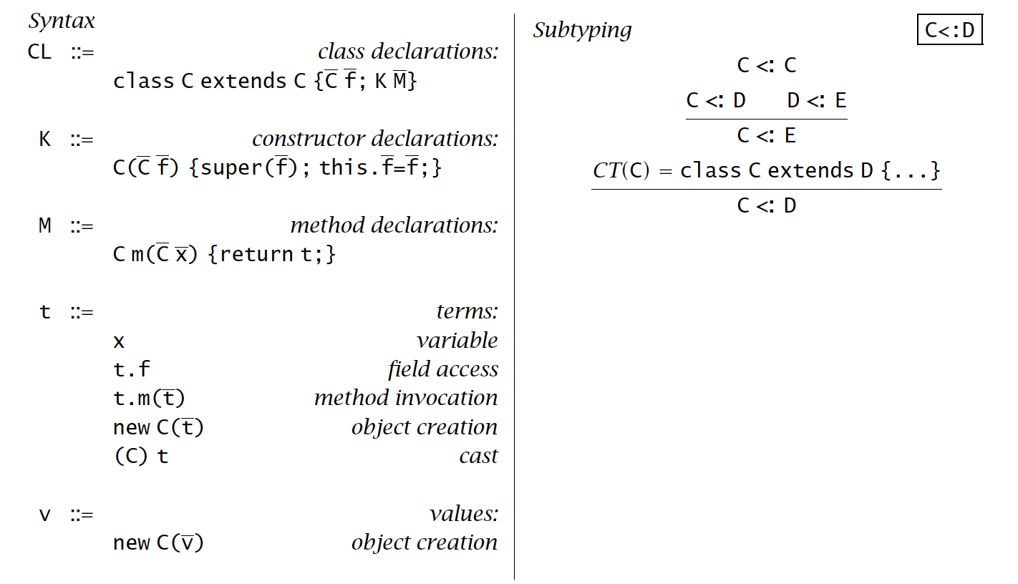
Syntax

Slide 13
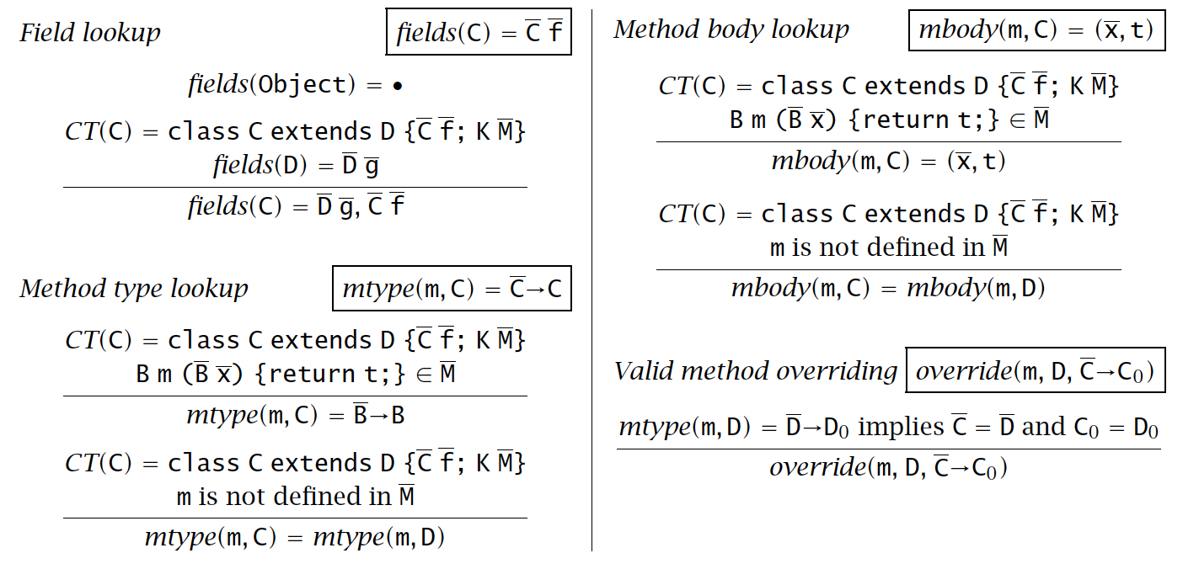
Class Table Operations

Slide 14
Class Table Operations

Slide 15
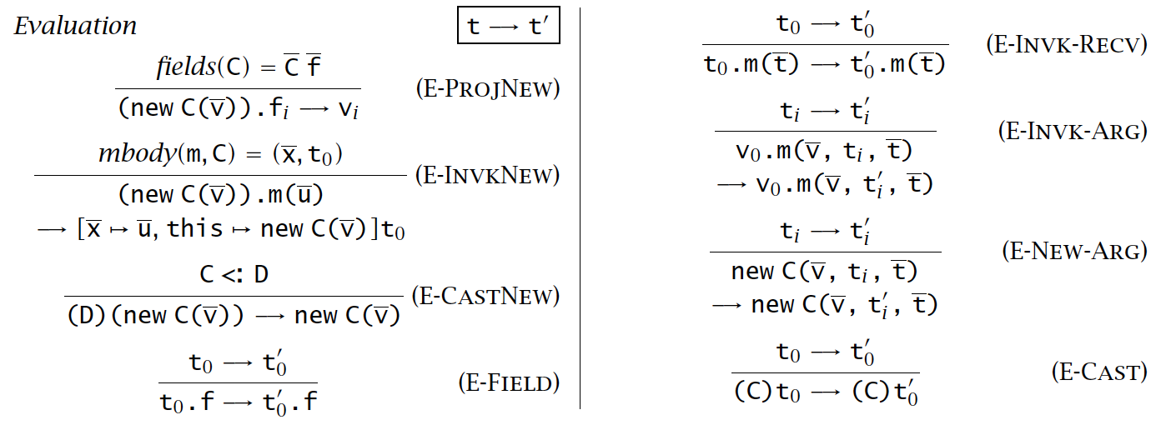
Evaluation

Slide 16
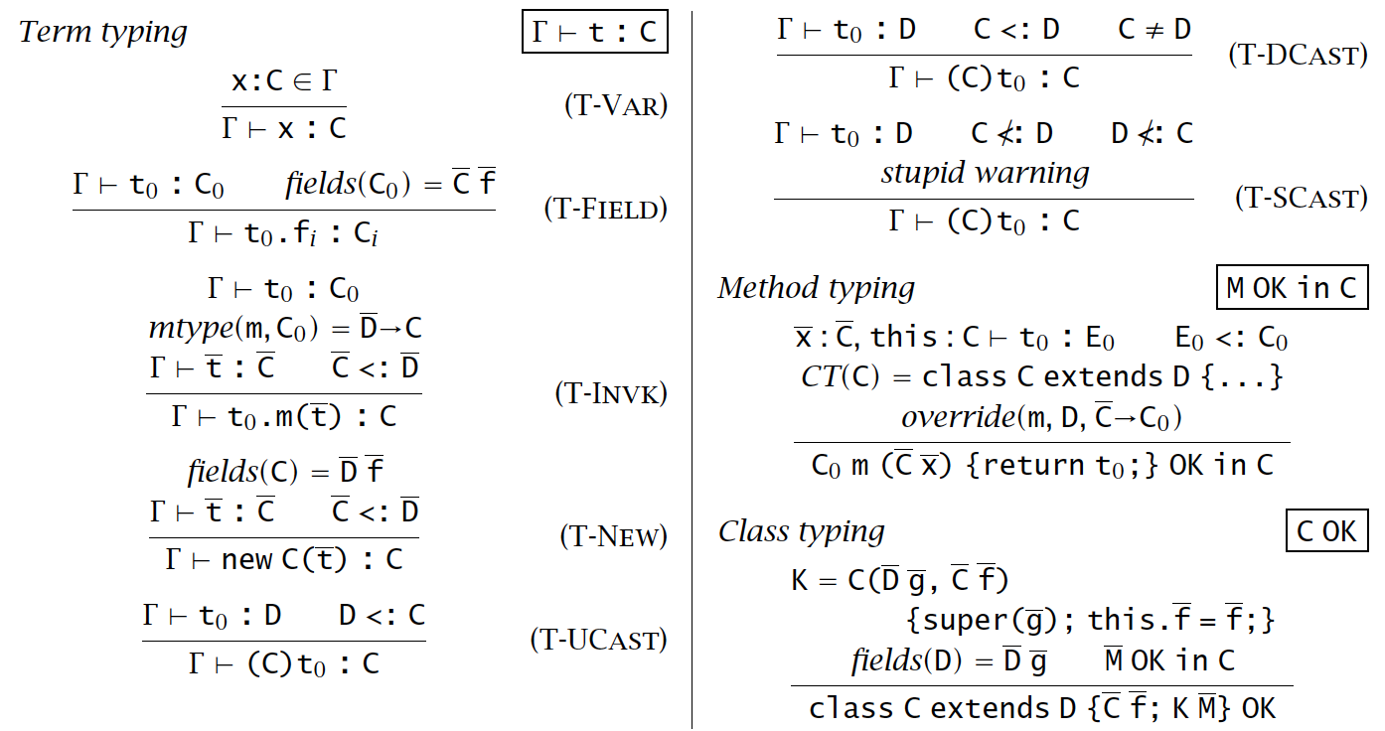
Typing

Slide 17
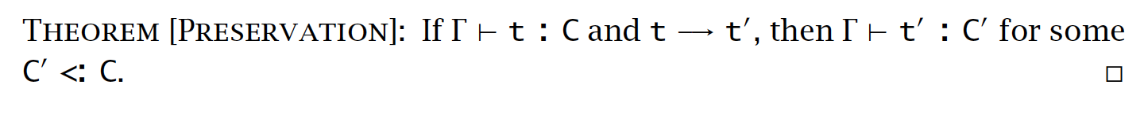
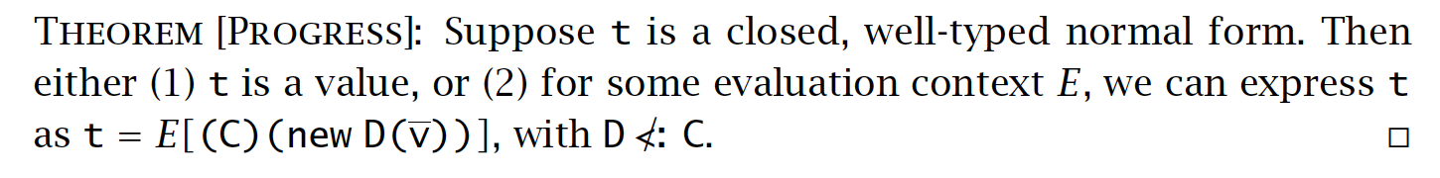
Properties

Slide 18
Summary
Featherweight Java
A direct encoding of core of Java
Key takeaways
Model languages (systems) with as concise and clean as possible cores
then scale to larger or full systems

