Slide 1
Overview
Compiler
Baojian Hua
bjhua@ustc.edu.cn

Slide 2
What is a Compiler?
A compiler translates programs insource languages into programs intarget languages.
Source languages:
C/C++, Java, C#, html, SQL, LaTeX, ...
Target languages:
X86/64, ARM, MIPS, DSLs, …
The concept of compiling is often more general than this

Slide 3
High-level View
source program
compiler
static computations
target program
machine
dynamic computations
results

Slide 4
Long History
Long history of study in CS
in 50’s last century, Fortran
Almost all of the key ideas in compiler design are also important in other problem domains
You will end up using compiler design principles in almost every software development project

Slide 5
Still active today
Compiler design is still an active area of research
Tremendous amount of activity in various forms of security and safety-related compilation
New languages and new heterogeneous machines
Domain-specific languages
We will read some recent research papers, in addition to working on our own compiler projects

Slide 6
Compiler matters
Till 2019, there are about 76 ACM Turing award winners
Top fields: compiler, programming languages, algorithms and complexity, AI, crytopography, ...
Compiler related: 20+
To name a few:
Alan Perlis (Algo), John McCarthy (Lisp), Don. Knuth (TeX), John Barkus (Fortran), Niklaus Wirth (Pascal), Barbara Liskov (ADT), Robin Milner (ML), Alan Kay (OOP), Frances Alan (optimizing compilers), ...
Why?

Slide 7
Compiler Structure
Compilers are structured in a highly modularized fashion
promotes better correctness, maintenance, etc
permits easier retargeting for new architectures
naturally follows the static/dynamic staging of high-level source programs

Slide 8
Compiler structure
string of characters
lexical analyzer
sequence of tokens
parser
symbol table
abstract syntax tree
semantic analyzer
intermediate code
code generator
relocatable object code

Slide 9
Compiler phases, more detailed…
lex
parse
parsing actions
semantic analysis
Source program
Tokens
Reductions
Abstract syntax
Translate
translate
canonicalize
instruction selection
control flow analysis
Translate
IR trees
IR trees
Assem
Flow Graph
register allocation
code emission
assembler
Relocatable
code
linker
Flow Graph
Register
assignment
Assembly code
Machine code

Slide 10
Every phase is different
All in all, every phase presents unique challenges, and makes use of different (math) concepts, data structures, and algorithms
A major aspect of compiler design, therefore, is how to synthesize all of this into a coherent, reliable, and robust system

Slide 11
Theory & Practice
Regular expression
Finite Automata
Contex-free
Grammar
Attrirbute
Grammar
Type Theory
lex
parse
parsing actions
semantic analysis
Dynamic
Programming
Non-computable
Graph theory
translate
optimizaiton
instruction selection
control flow analysis
Lattice,
fix-point
NP-complete
data
flow
analysis
register allocation
code
emission
assembler, linker

Slide 12
Theory & Practice
The beauty of a compiler comes from its elegant combination of theory and practice
Theory part: automata, grammar, type theory, closure, lattice, fix-point, …
Practice part: various data structures & algorithms, software engineering techniques to handle all of them

Slide 13
How This Course Works

Slide 14
Structure of this course
Lectures
Now
Readings
Textbooks, research papers
Exercises & quizzes
On paper
Projects
development of a compiler from scratch

Slide 15
Online Resources
Web site:
http://csslab-ustc.github.io/courses/compiler
Material:
course policies and schedule of lectures
readings and exercises
project information
development resources
some lecture notes
Check the web site frequently

Slide 16
Textbooks & Reference
Modern compiler implementation in C/ML/Java (tiger book)
Compilers: principals, techniques and tools (dragon book)
Advanced compiler design and implementation (whale book)
Engineering a compiler (ark book)

Slide 17
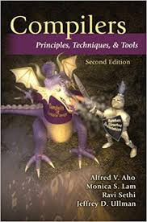
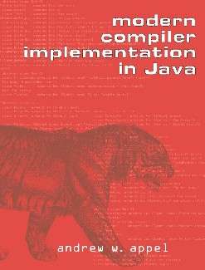
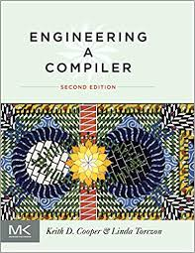
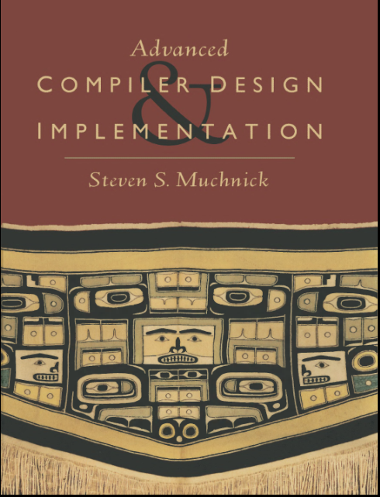
Textbooks & References
(dragon book)
(tiger book)
(ark book)
(whale book)

Slide 18
Projects
You’ll build a working compiler Tiger, from scratch, in Java for (a subset of) Java
7 labs planned + one final
Lab1: lexer and parser
Lab2: abstract syntax tree and type checker
Lab3: control-flow graph
Lab4: instruction selection
Lab5: register allocation
Lab6: garbage collector
Lab7: static single-assignment
Final: a project on your own
lab 1 is out, start early

Slide 19
Projects
In each lab, you’ll build a working component step by step
Using Java as the implementation languages
chick-and-egg
we offer some code skeleton

Slide 20
Evaluation
50%: projects
50%: middle and final test

Slide 21
Summary
Compiler design is the most fruitful and amazing subject of research in CS!
Many beautiful results
Still relevant today, in every aspects of programming
More challenges and open problems!
This is intended to be a fun and engaging project-oriented class

Slide 22
Last Thing
Prepare textbook
Install software
Start early on lab1

