Slide 1
Functional List
C and Data Structures
Baojian Hua
bjhua@ustc.edu.cn

Slide 2
Recap
The extensible array-based implementation of linear list:
may be too slow
insert or delete operations involve data movement
may waste too much space
only a small portion of the allocated space is occupied with data
General computer science idea:
“pay as you go”

Slide 3
Polymorphic Abstract Data Types in C
// recall the “List_t” ADT:
#ifndef LIST_H
#define LIST_H
typedef void *poly;
typedef struct List_t *List_t;
List_t List_new();
int List_length(List_t l);
poly List_nth(List_t l, int n);
void List_insert(List_t l, poly x, int i);
poly List_delete(List_t l, int i);
void List_foreach(List_t l, void (*f)(poly));
#endif

Slide 4
Functional List
A functional list is inductively defined:
case #1: it is empty, or
case #2: a head element and a tail of another smaller list
(x1, (x2, (x3, …)))
head: x1; tail: (x2, (x3, …))
Next, we sometimes say “list” for simplicity

Slide 5
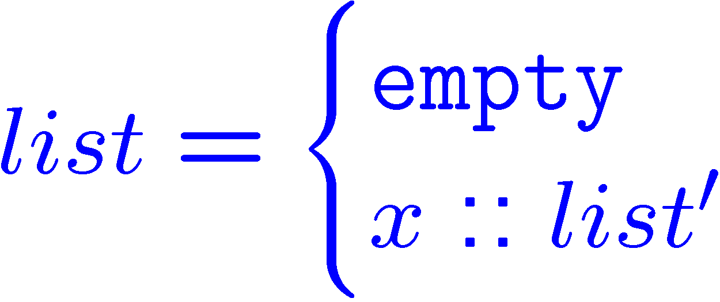
Mathematical Notation
A functional list is inductively defined:
case #1: it is empty, or
case #2: a head element and a tail of another smaller list

Slide 6
Data Structure
We use a pointer “p” to point to a list:
case #1: NIL, empty list
case #2: CONS, head::tail,

Slide 7
Implementation
// Turn the above figure into C, we have:
// in file “fun-list.c”
#include <stdlib.h>
#include “list.h”
enum List_Kind_t {NIL, CONS};
struct List_t{
enum List_Kind_t kind;
union{
struct{
Poly_t data;
List_t next;
}cons;
}u;
};

Slide 8
Create a list
// “List_new” returns an empty list
List_t List_new(){
List_t l = calloc(sizeof(*l));
l->kind = NIL;
// l->u?
return 0;
}

Slide 9
Add a new Head
List_t List_concat(Poly_t data, List_t l){
List_t temp = calloc(sizeof(*temp));
temp->kind = CONS;
temp->u.cons.data = data;
temp->u.cons.next = l;
return temp;
}
l
temp
…
data
data
data
data
next
next
next
next

Slide 10
Operation: “foreach”
void List_foreach(List_t l, void (*f)(poly)){
switch(l->kind){
case NIL: return;
case CONS:{
f(l->u.cons.data);
List_foreach(l->u.cons.next, f);
// tail recursion
}
}
}

Slide 11
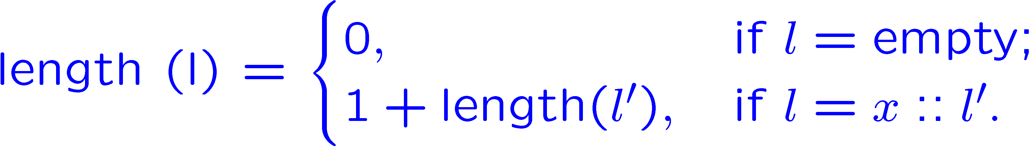
Operation: “length”
l
…
data
data
data
data
next
next
next
next

Slide 12
Operation: “length”
int List_length(List_t l){
switch(l->kind){
case NIL: return 0;
case CONS:{
return 1 + List_length(l->u.cons.next);
}
}
l
…
data
data
data
data
next
next
next
next

Slide 13
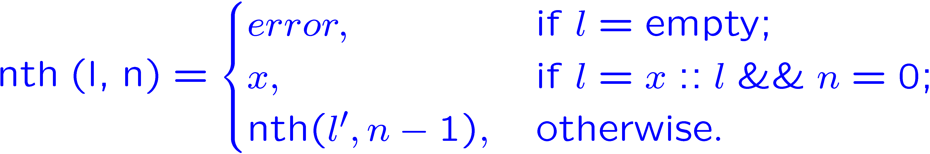
Operation: “nth”
l
…
data
data
data
data
next
next
next
next

Slide 14
Operation: “nth”
Poly_t List_nth(List_t l, int n){
switch(l->kind){
case NIL: error(“empty list”);
case CONS:{
if(0==n)
return l->u.cons.data;
return List_nth(l->u.cons.next, n-1);
}
}
l
…
data
data
data
data
next
next
next
next

Slide 15
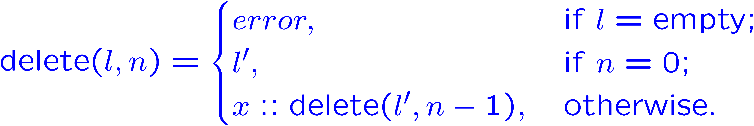
Operation: “delete(l, n)”
l
…
data
data
data
data
next
next
next
next

Slide 16
Operation: “delete”
List_t List_delete(List_t l, int n){
switch(l->kind){
case NIL: error(“empty list”);
case CONS:{
if(0==n)
return l->u.cons.next;
return List_concat(
l->u.cons.data,
List_delete(l->u.cons.next, n-1));
}

Slide 17
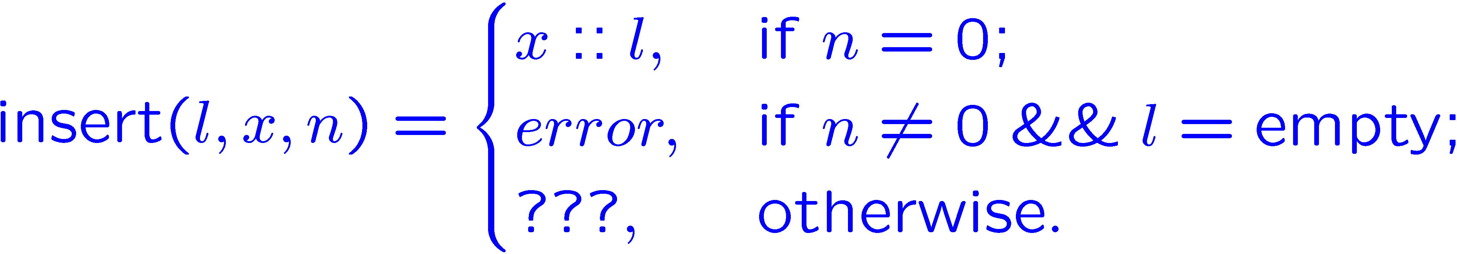
Operation: “insert(l, x, n)”
l
…
data
data
data
data
next
next
next
next

Slide 18
Operation: “insert”
List_t List_insert(List_t l, poly x, int n){
if(0==n)
return List_concat(x, l);
if(0==l)
error(“…”);
return List_concat(l->data,
List_insert(l->next, x, n-1);
}
l
…
data
data
data
data
next
next
next
next

Slide 19
Summary
Functional programming:
long history, even older than C
stem from mathematics
John Macathy’s LISP (60’s)
and later Scheme, ML, Haskell, JavaScript, etc.
for long time considered impractical
efficiency issue
renew industry’s interest in recent decade
e.g., F# from Microsoft
good for parallel, multi-core, etc.

Slide 20
Summary
Pros:
good for programmer
data structures are persistent
elegant, easy to write, easy to maintain, easy to debug
Cons:
(maybe) bad for machine
code maybe too slow
both MS vc and GCC are bad in dealing this
demand better compiler supports

