Slide 1
Functions
Compiler
Baojian Hua
bjhua@ustc.edu.cn

Slide 2
Back-end Structure
IR
instruction selector
Assem
register allocator
TempMap
instruction scheduler
Assem

Slide 3
Function, or Procedure, or method, or …
High-level abstraction of code
logically-grouped
Good for engineering:
design and abstraction
develop, testing, maintain and evolve
…
Implementation?
we start with C-style functions
and deal with more advanced forms later

Slide 4
API & ABI
Application Programming Interface
interfaces between source programs
Application Binary Interface
interfaces between binary programs
conventions on low-level details:
how to pass arguments?
how to return values?
how to make use of registers?
…
we posted the x86 ABI document on course page

Slide 5
Address Space
0xffffffff
Address space is the way how programs use memory
highly architecture and OS dependent
right is the typical layout of 32-bit x86/Linux
OS
0xc00000000
stack
heap
data
text
0x08048000
0x00100000
BIOS,
VGA
0x00000000

Slide 6
Call Stack
A list of frames
each for one function invocation
with two dedicated regs
Grows down to lower address
Frame also called activation record
high address
frame 0
frame 1
%ebp
frame 2
%esp
low address

Slide 7
Stack frame
int f(int arg1, ..., int argn){...}
high address
argn
frame 0
...
In modern RISC machines (even CISC), several parameters would be passed via registers.
arg1
frame 1
ret-addr
bp
saved-bp
saved-reg
frame 2
(f)
sp
...
spilled-reg
low address
...

Slide 8
Registers

Slide 9
Register usage
Must be careful on register usage
caller-save: Caller to save and restore, callee is free to destroy these registers
Don’t perserve across function calls
callee-save: Callee must restore these registers before returning to caller
Preserved across function calls

Slide 10
Register usage
Should value reside in caller-save or callee-save registers?
not so easy to determine
and no general rules
must be very careful with language features such as longjmp, goto, or exceptions
We would come back to this issue later in register allocation part

Slide 11
CISC vs RISC
// x64 regs (16):
rax, rcx, rdx, rbx,
rsp, rbp, rsi, rdi,
r8, r9, r10, r11,
r12, r13, r14, r15
// callee saved:
rbp, rbx, r12, r13,
r14, r15
// AArch64 regs:
r0-r11,
r12, r13(sp), r14(br), r15(pc)
// callee saved:
r4-r11, r13

Slide 12
Escape variables
A variable is said to be escape if:
& operator applied
accessed in inner functions
call-by-reference
Escape variables should be put in memory, instead of in registers
better in heap
see the next example

Slide 13
Escape variables
// C code
long *f(){
long x = 9;
long *y = &x;
return y;
}
// x64 code:
f:
pushq %rbp
movq %rsp, %rbp
subq $32, %rsp
movq $9, -24(%rbp)
leaq -24(%rbp), %rax
movq %rax, -16(%rbp)
leave
ret
x
y

Slide 14
Implementation
Design a frame (activation record) data structure, to maintain:
the frame size,
detailed layout,
garbage collection info,
synchronization, etc.
Thus, capsulate the machine-related details
good for retargeting the compiler

Slide 15
Interface
#ifndef FRAME_H
#define FRAME_H
typedef ... Frame_t;
// allocate “bytes” space for a variable in this frame
int Frame_allocVar(Frame_t, int numBytes);
// create a new frame
Frame_t Frame_new();
// current size of the frame
int Frame_size(Frame_t);
#endif

Slide 16
Calling conventions

Slide 17
Where to pass parameters?
Typical calling conventions:
pass them in registers
pass them via stack (typically: the call stack)
a combination of the two schemes
parts in registers, parts on the stack
This involves not only the ISA, but also the languages

Slide 18
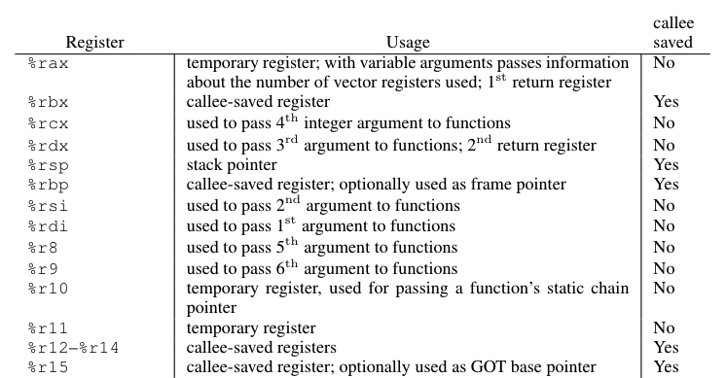
Sample Calling Conventions: x64

Slide 19
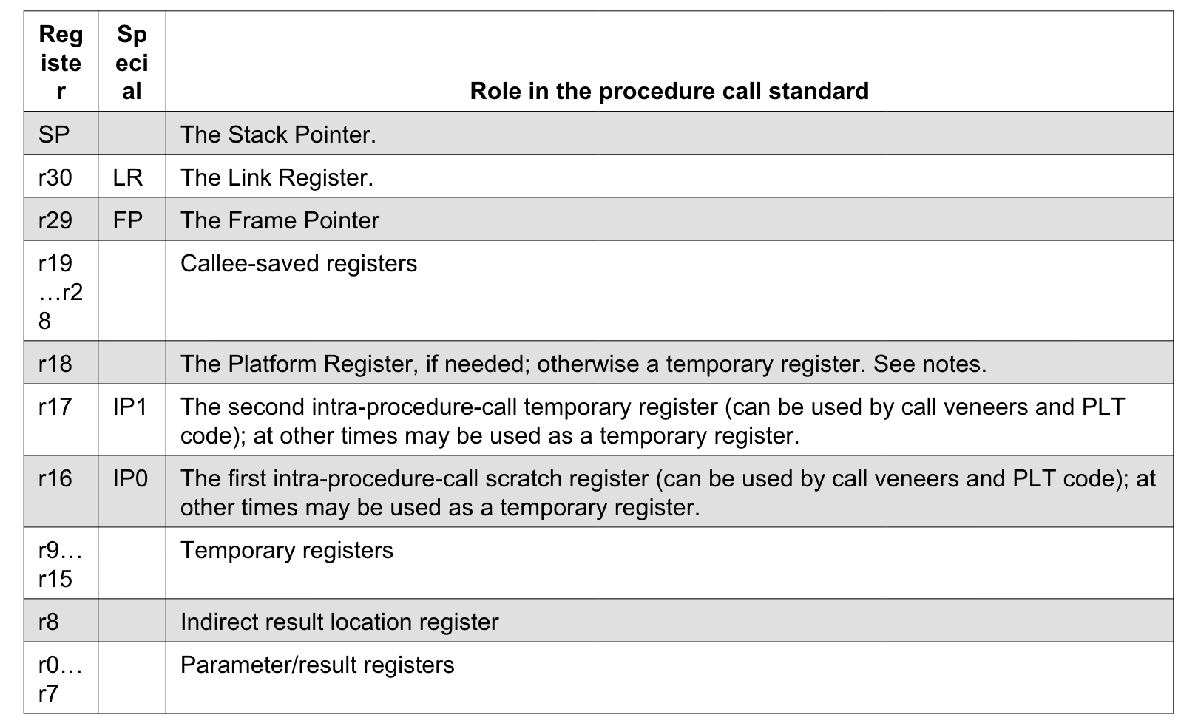
Sample Calling Conventions: AArch64

Slide 20
Calling convention: x64 vs AArch64
// example:
f(1,2,3,4,5,6,7,8,9);
// AArch64:
mov x0, 9
str x0, [sp]
mov x7, 8
mov x6, 7
mov x5, 6
mov x4, 5
mov x3, 4
mov x2, 3
mov x1, 2
mov x0, 1
bl g
// x64:
movq $1, %rdi
movq $2, %rsi
movq $3, %rdx
movq $4, %rcx
movq $5, %r8
movq $6, %r9
pushq $9
pushq $8
pushq $7
call f

Slide 21
Putting together
// C code
int main(void){
f(100)+1;
return 0;
}
long f(long x){
return g(x);
}
long g(long x){
return x+3;
}
// x64 code
main:
pushq %rbp
movq %rsp, %rbp
movq $100, %rdi
call f
incq %rax
xorq %rax, %rax
leave
ret

Slide 22
Putting together
// C code
int main(void){
f(100)+1;
return 0;
}
long f(long x){
return g(x);
}
long g(long x){
return x+3;
}
// x64 code
main:
pushq %rbp
movq %rsp, %rbp
movq $100, %rdi
call f
incq %rax
xorq %rax, %rax
leave
ret
…
...
…
ret-addr
old rbp
…
%rbp
...
…
%rsp

Slide 23
Putting together
// C code
int main(void){
f(100)+1;
return 0;
}
long f(long x){
return g(x);
}
long g(long x){
return x+3;
}
// x64 code
g:
pushq %rbp
movq %rsp, %rbp
movq %rdi, %rax,
addq $3, %rax
leave
ret

Slide 24
Putting together
// C code
int main(void){
f(100)+1;
return 0;
}
long f(long x){
return g(x);
}
long g(long x){
return x+3;
}
// AArch64 code
main:
stp x29, x30, [sp, -16]!
mov x29, sp
mov x0, 100
bl f
mov w0, 0
ldp x29, x30, [sp], 16
ret

Slide 25
Putting together
// C code
int main(void){
f(100)+1;
return 0;
}
long f(long x){
return g(x);
}
long g(long x){
return x+3;
}
// AArch64 code
f:
stp x29, x30, [sp, -32]!
mov x29, sp
str x0, [sp, 24]
ldr x0, [sp, 24]
bl g
ldp x29, x30, [sp], 32
ret
…
...
...
br
...
...
sp
...
…

Slide 26
Putting together
// C code
int main(void){
f(100)+1;
return 0;
}
long f(long x){
return g(x);
}
long g(long x){
return x+3;
}
// AArch64 code
g:
sub sp, sp, #16
str x0, [sp, 8]
ldr x0, [sp, 8]
add x0, x0, 3
add sp, sp, 16
ret

Slide 27
More on Parameter Passing

Slide 28
Parameter passing
The so-far discussed parameter passing strategy is called call-by-value
always copy from caller to callee
even for aggregate values (say, structs)
callee is free to modify its own copies
Used in mainstream like C, Java, ML, etc..
Also other strategies:
call-by-reference, -by-name, -by-need

Slide 29
Call-by-reference
Arguments are escaped in some languages (e.g., C++)
actual arguments and formal parameters are aliases
// C++ style reference:
int f(int &x, int y){
x = 3;
y = 4;
return 0;
}
// a call
f(a, b);

Slide 30
Simulating call-by-reference
// original C++ code:
int f(int &x, int y){
x = 3;
y = 4;
return 0;
}
// a call
f(a, b);
// simulated:
int f(int *x, int y){
*x = 3;
y = 4;
return 0;
}
// the call becomes:
f(&a, b);

Slide 31
Moral
Call-by-reference is widely considered a bad design of C++
the code is inherently inefficient!
the code is ambiguous in nature
x = 4; (?)
A variant of this is the so-called call-by-value/result
call-by-value, but write back the result

Slide 32
Call-by-value/result
Upon call, the actual arguments is copied
But callee only modifies a local version
Upon exit, callee copies the local version to actual arguments
and formal parameters are aliases
// code:
int f(int @x, int y){
x = 3;
y = 4;
return 0;
}
// a call
f(a, b);

Slide 33
Simulating call-by-value/result
// original code:
int f(int @x, int y){
x = 3;
y = 4;
return 0;
}
// a call
f(a, b);
// simulated:
int f(int *x, int y){
int temp = *x;
temp = 3;
y = 4;
*x = temp;
return 0;
}
// the call becomes:
f(&a, b);

Slide 34
Moral
What’s the difference between call-by-value and call-by-value-result?
Is call-by-value/result more efficient than call-by-reference? Why or why not?
We’d come back to a more interesting optimization called register promotion
same idea to pull values into registers

Slide 35
Call-by-name
Some languages use call-by-name (e.g., Algo60 and Haskell)
Arguments are not evaluated, until they are really needed in the callee
For each argument, create a function, called a thunk
// code:
int f(int name x, int y){
if(y)
return x;
return 0;
}
// a call
f(a, b);

Slide 36
Simulating call-by-name
// original code:
int f(int name x, int y){
if(y)
return x;
return 0;
}
// a call
f(a, b);
// simulated:
int f(tX: unit->int, int y){
if(y)
return tX();
return 0;
}
// the call becomes:
f(lambda()=>a, b);
this function is called a lambda!

Slide 37
Moral
A serious problem with call-by-name, is that the arguments may be evaluated many times
A better solution is to memoize the evaluation result, and reuse the result
This method is called call-by-need, or sometimes lazy-evaluation

Slide 38
Simulating call-by-need
// simulated:
int f(tX: unit->int, int y){
if(y)
return tX() + tX();
else return 0;
}
// the call becomes:
val xMemoize = ref NONE
f(fn() =>
case !xMemoize of
NONE => xMemoize :=
SOME a; a
| SOME i => i, b);
// original code:
int f(int need x, int y){
if(y)
return x + x;
return 0;
}
// a call
f(a, b);

Slide 39
Nested Functions

Slide 40
Nested Functions
Functions declared in the body of another function
So the inner one could refer to the variables in the outer ones
such kind of functions are called open
int f(int x, int y){
int m;
int g(int z){
int h (){
return m+z;
}
return 1;
}
return 0;
}

Slide 41
Nested Functions
How to access those variables in outer functions?
Three classical methods:
lambda lifting
static link
display
int f(int x, int y){
int m;
int g(int z){
int h (){
return m+z;
}
return 1;
}
return 0;
}

Slide 42
Lambda lifting
In lambda lifting, the program is translated into a form such that all procedures are closed
The translation process starts with the inner-most procedures and works its way outwards

Slide 43
Lambda lifting example
int f(int x, int y){
int m;
int g(int z){
int h (){
return m+z;
}
return 1;
}
return 0;
}
int f(int x, int y){
int m;
int g(int z){
int h(int &m, int &z){
return m+z;
}
return 1;
}
return 0;
}

Slide 44
Lambda lifting example
int f(int x, int y){
int m;
int g(int z){
int h (){
return m+z;
}
return 1;
}
return 0;
}
int f(int x, int y){
int m;
int g(int &m, int z){
int h(int &m, int &z){
return m+z;
}
return 1;
}
return 0;
}

Slide 45
Lambda lifting example
int f(int x, int y){
int m;
int g(int z){
int h(){
return m+z;
}
return 1;
}
return 0;
}
// flatten
int f(int x, int y){
int m;
return 0;
}
int g(int &m, int z){
return 1;
}
int h(int &m, int &z){
return m+z;
}

Slide 46
Moral
Pros: easy to implement, source-to-source translations
even on AST or other IRs
Cons: all variables are escaped
Thus must reside in stack
extra arguments passing
on some architectures, more arguments are passed in memory, inefficient

Slide 47
Static links
An alternative approach is to add an additional piece of information to the activation records, called the static link
The static link is a pointer to the activation record of the enclosing procedure

Slide 48
Static links example
int f(int x, int y){
int m;
int g(int z){
int h(){
return m+z;
}
return 1;
}
return 0;
}
int f(link_f, int x, int y){
int m;
int g(link_g, int z){
int h(link_h){
return link_h->prev->m+
link_h->z;
}
return 1;
}
return 0;
}

Slide 49
Static links example
int f(int x, int y){
int m;
int g(int z){
int h(){
return m+z;
}
h(33);
return 1;
}
g(22);
return 0;
}
int f(link_f, int x, int y){
int m;
int g(link_g, int z){
int h(link_h){
return link_h->prev->m+
link_h->z;
}
h(&{z=z, prev=link_g}, 33);
return 1;
}
g(&{m=m, prev=link_f}, 22);
return 0;
}

Slide 50
Pros and cons
Pros: little extra overhead on parameter passing
the static link
Cons: there is still the overhead to climb up a static link chain to access non-locals
Especially when stack is deep

Slide 51
Implementation details
First, each function is annotated with its enclosing depth, hence its variables
When a function at depth n accesses a variable at depth m
emit code to climb up n-m links to visit the appropriate activation record

Slide 52
Implementation details
When a procedure p at depth n calls a procedure q at depth m:
if n <m (ie, q is nested within p):
note: in first-order languages, n+1=m
q’s static link = q’s dynamic link
if n ≥ m:
q’s prelude must follow m -n static links, starting from the caller’s (p’s) static link
the result is the static link for q

Slide 53
Moral
In theory, static links do not seem very good
functions may be deeply nested
However, real programs access mainly local/global variables,
or occasionally variables just one or several static links away
Still, experiments show that static links are inferior to the lambda-lifting approach
Personally, I believe static links are infeasible to optimizations

Slide 54
Display
The 3rd way to handle nest functions is to use a display
A display is a small stack of pointers to activation records
The display keeps track of the lexical nesting structure of the program
Essentially, it points to the currently set of activation records that contain accessible variables

Slide 55
Higher-order functions
Functions may serve more than just being called
can be passed as arguments
can return as results
can be stored in data structures
objects! we’d discuss later
If functions do not nest, then the compiling technique is simple
A code address
e.g., the “function pointer” in C

Slide 56
Nested Higher-order functions
But if higher-order functions do nest, it’s much trickier to compile:
as found in Lisp, ML, or Scheme
even lambdas in recent C++, C#, Python, or Java
Later, we would cover more advanced techniques to handle this

Slide 57
Summary
For unnested (first or higher-order), or nested first-order functions:
compiled to a code pointer
For nested higher-order functions
compiled to a closure
to be discussed in future

