Slide 1
Mathematical foundation
Formal Methods Foundation
Baojian Hua
bjhua@ustc.edu.cn

Slide 2
Goals
We review some of the key results from basic mathematics
Set, relation, and function
Basic computation complexity results
Context free grammar
Induction
We assume you have learned some of this from elementary math course
We just give a quick review, to make this course self-contained

Slide 3
Set, Relation, and Function

Slide 4
Sets
Set: a group of (infinite) elements
{x₁, x₂, …, x_{n}}
or predicated form:
{x | P(x)}
e.g.:
{x | x>0 is an integer}

Slide 5
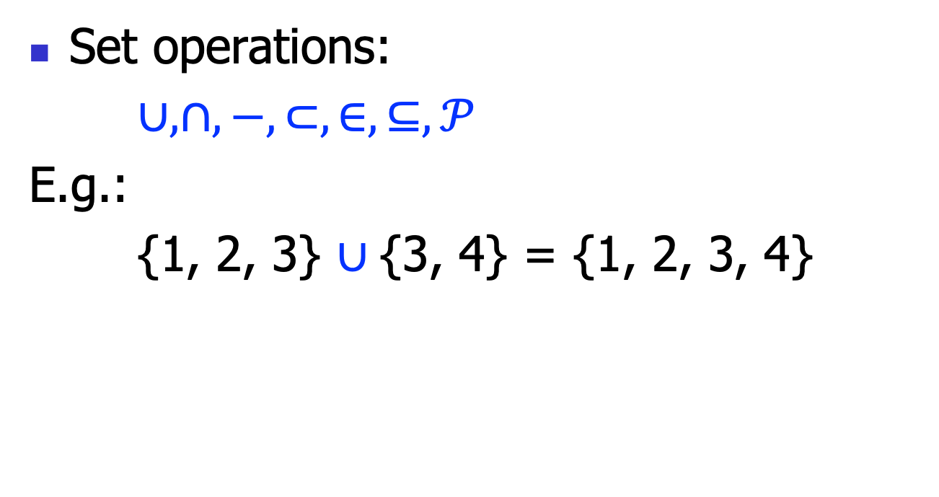
Set Operations
Set operations:
$∪, ∩,−,⊂, ∈,⊆,𝒫$
E.g.:
{1, 2, 3} $∪${3, 4} = {1, 2, 3, 4}

Slide 6
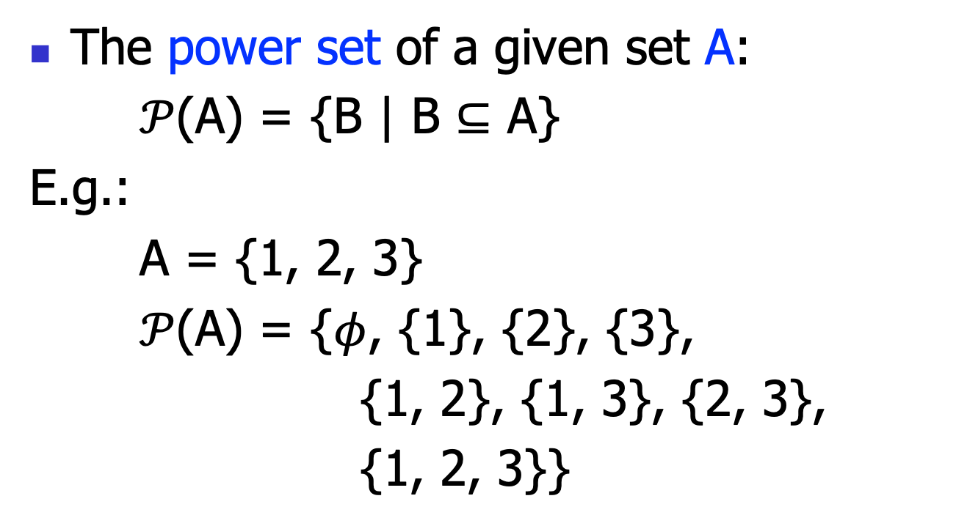
Power Set
The power set of a given set A:
$𝒫$(A) = {B | B $⊆$ A}
E.g.:
A = {1, 2, 3}
$𝒫$(A) = {$φ$, {1}, {2}, {3},
{1, 2}, {1, 3}, {2, 3},
{1, 2, 3}}

Slide 7
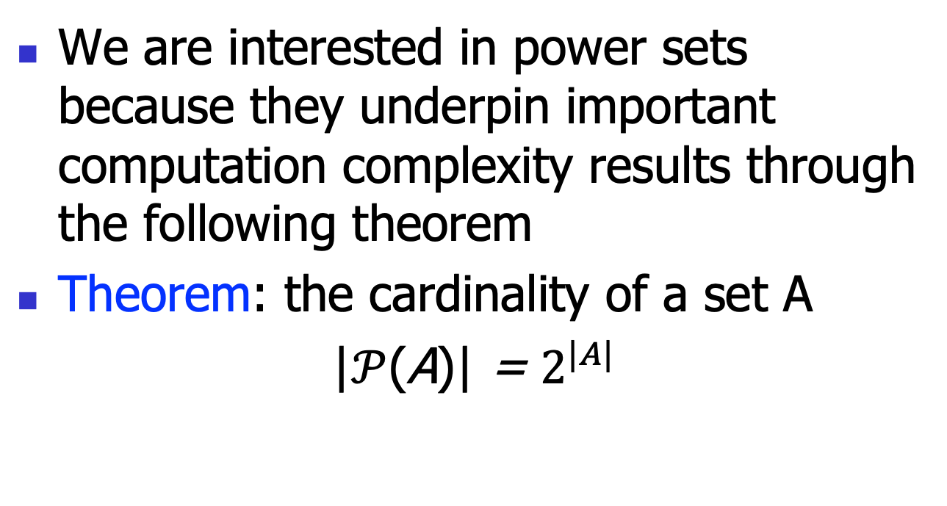
Power Set
We are interested in power sets because they underpin important computation complexity results through the following theorem
Theorem: the cardinality of a set A
|$𝒫$(A)| = $2^{|A|}$

Slide 8
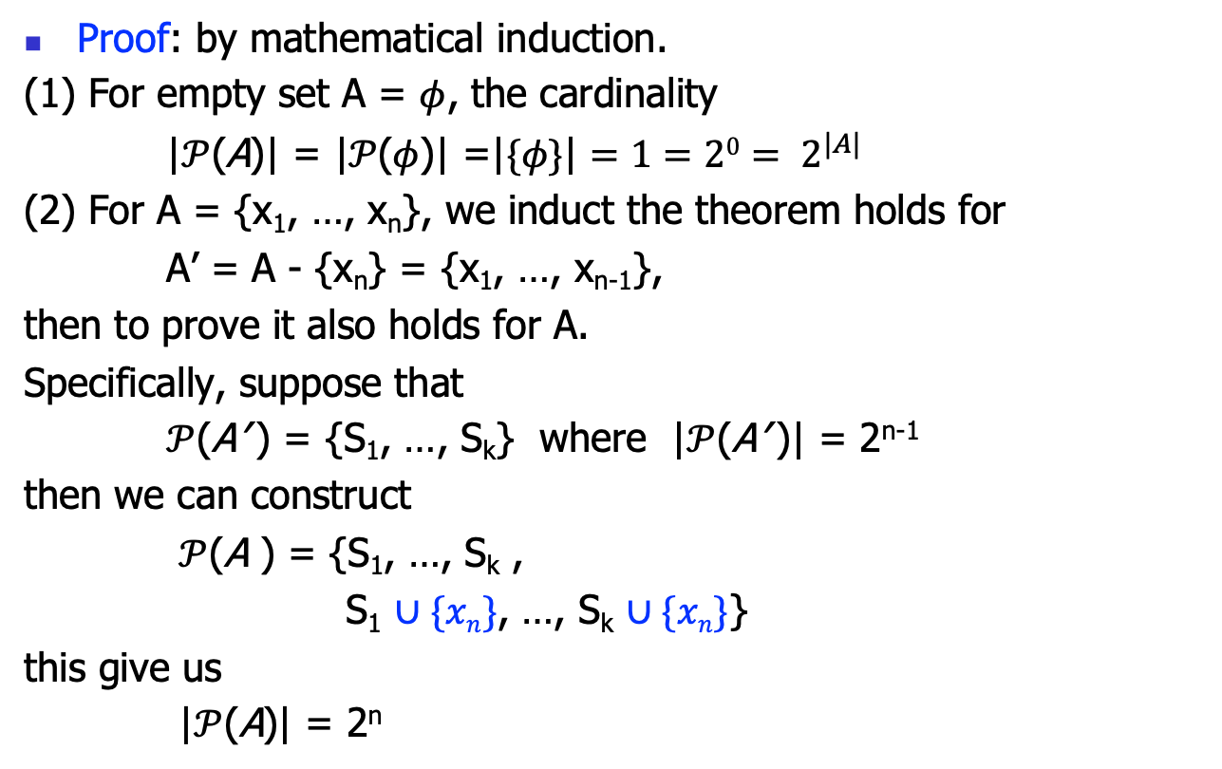
Power Set
Proof: by mathematical induction.
(1) For empty set A = $φ$, the cardinality
|$𝒫$(A)| = ${\text{|}𝒫\text{(}φ\text{)|} \text{=}\text{|}\{φ\text{\}}\text{|}=1=20= 2}^{|A|}$
(2) For A = {x₁, …, x_{n}}, we induct the theorem holds for
A’ = A - {x_{n}} = {x₁, …, x_{n-1}},
then to prove it also holds for A.
Specifically, suppose that
$𝒫$(A’ ) = {S₁, …, S_{k}} where |$𝒫$(A’ )| = 2^{n-1}
then we can construct
$𝒫$(A ) = {S₁, …, S_{k} ,
S₁ $∪\{xn\}$, …, S_{k} $∪\{xn\}$}
this give us
|$𝒫$(A)| = 2^{n}

Slide 9
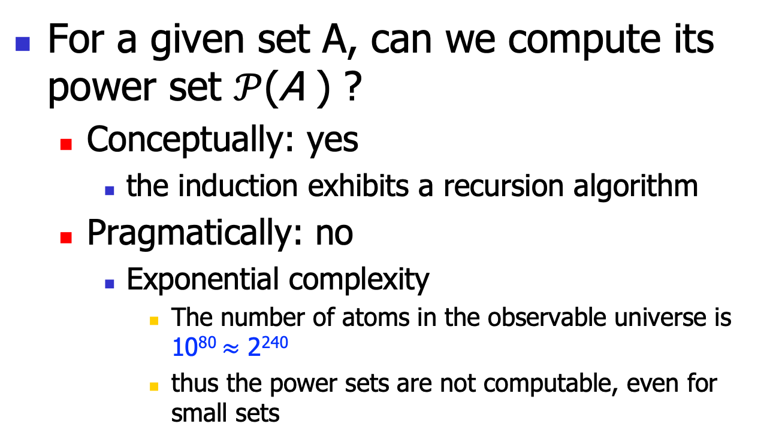
Complexity Implication
For a given set A, can we compute its power set $𝒫$(A ) ?
Conceptually: yes
the induction exhibits a recursion algorithm
Pragmatically: no
Exponential complexity
The number of atoms in the observable universe is 10⁸⁰ $≈$ 2²⁴⁰
thus the power sets are not computable, even for small sets

Slide 10
Set Application

Slide 11
Complexity Implication
For a given set A, can we compute its power set $𝒫$(A ) ?
Conceptually: yes
the induction exhibits a recursion algorithm
Pragmatically: no
Exponential complexity
The number of atoms in the observable universe is 10⁸⁰ $≈$ 2²⁴⁰
thus the power sets are not computable, even for small sets

Slide 12
Relation

Slide 13
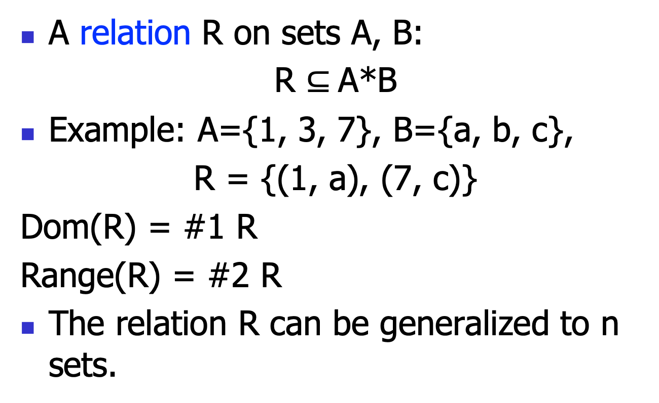
Relation
A relation R on sets A, B:
R $⊆$A*B
Example: A={1, 3, 7}, B={a, b, c},
R = {(1, a), (7, c)}
Dom(R) = #1 R
Range(R) = #2 R
The relation R can be generalized to n sets.

Slide 14
Relation Application

Slide 15
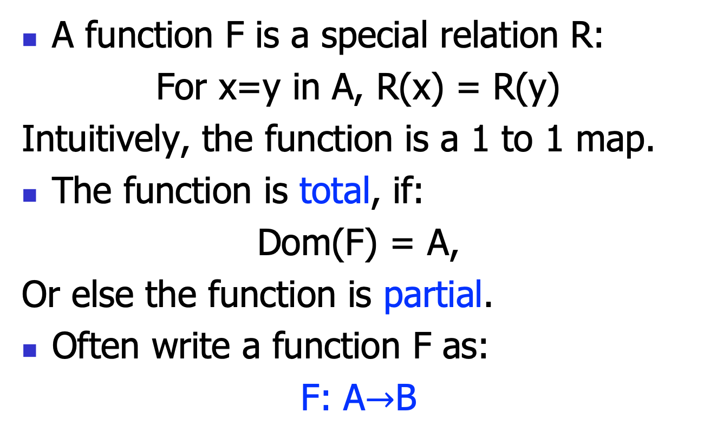
Function
A function F is a special relation R:
For x=y in A, R(x) = R(y)
Intuitively, the function is a 1 to 1 map.
The function is total, if:
Dom(F) = A,
Or else the function is partial.
Often write a function F as:
F: A$→$B

Slide 16
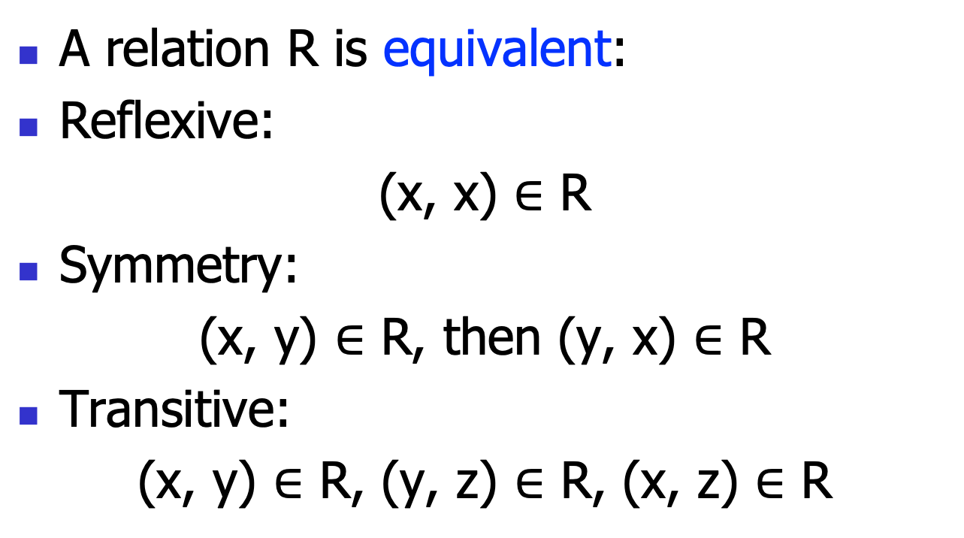
More Relation
A relation R is equivalent:
Reflexive:
(x, x) $∈$ R
Symmetry:
(x, y) $∈$ R, then (y, x) $∈$ R
Transitive:
(x, y) $∈$ R, (y, z) $∈$ R, (x, z) $∈$ R

Slide 17
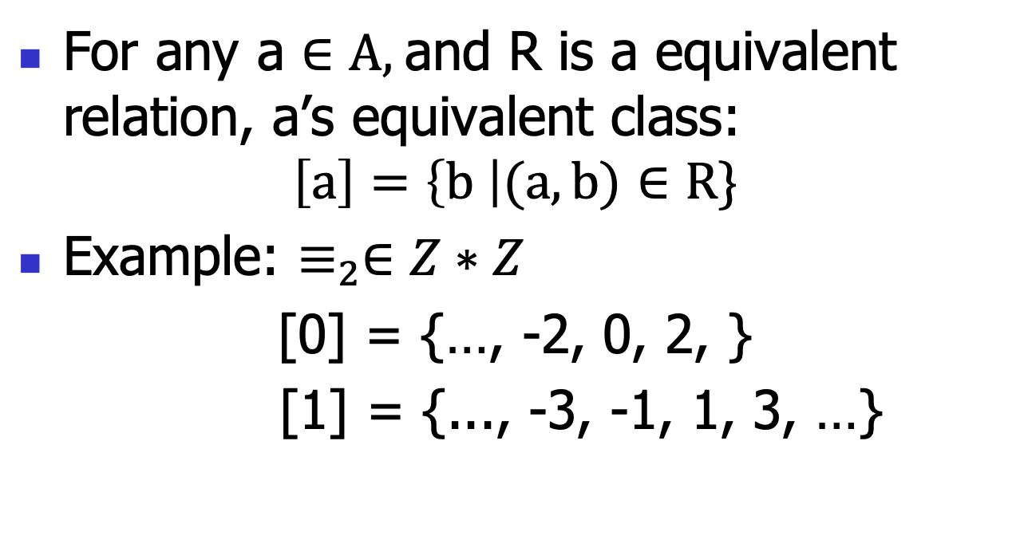
Equivalent class
For any a $∈A,$and R is a equivalent relation, a’s equivalent class:
$$\left[a\right]=\left\{b \right|(a, b)∈R\}$$
Example: $≡_{2}∈Z∗Z$
[0] = {…, -2, 0, 2, }
[1] = {..., -3, -1, 1, 3, …}

Slide 18
Function Application

Slide 19
Basic computation complexity

Slide 20
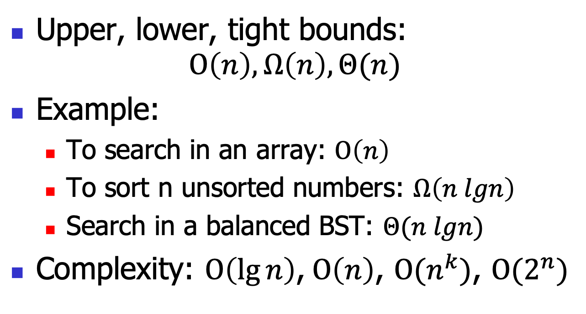
Some notations on complexity
Upper, lower, tight bounds:
$$O\left(n\right), Ω\left(n\right), Θ(n)$$
Example:
To search in an array: $O\left(n\right)$
To sort n unsorted numbers: $Ω\left(n lgn\right)$
Search in a balanced BST: $Θ(n lgn)$
Complexity: $O\left(\lg{n}\right)\text{,} O\left(n\right)$, $O{(n}^{k})$, $O{(2}^{n})$

Slide 21
Some notations on complexity
Undecidability:
There is NO computer program to do it!
Example: Given an arbitrary program p as input, write an algorithm to test: whether or not this program p will terminate.
This is the famous “halting problem”
We’ll see several other undecidable problems in future lectures
void f(){
return;
}
void f(){
for(;;);
}

Slide 22
undecidable != unsolvable
Reveal some limitations of (Turing machine-based model of) programming
One can use approximations
Not the exact answer, but usable
And various fragments of general problems are still decidable, thus solvable
Don’t rely on computer programming!
Ex., do experiments

Slide 23
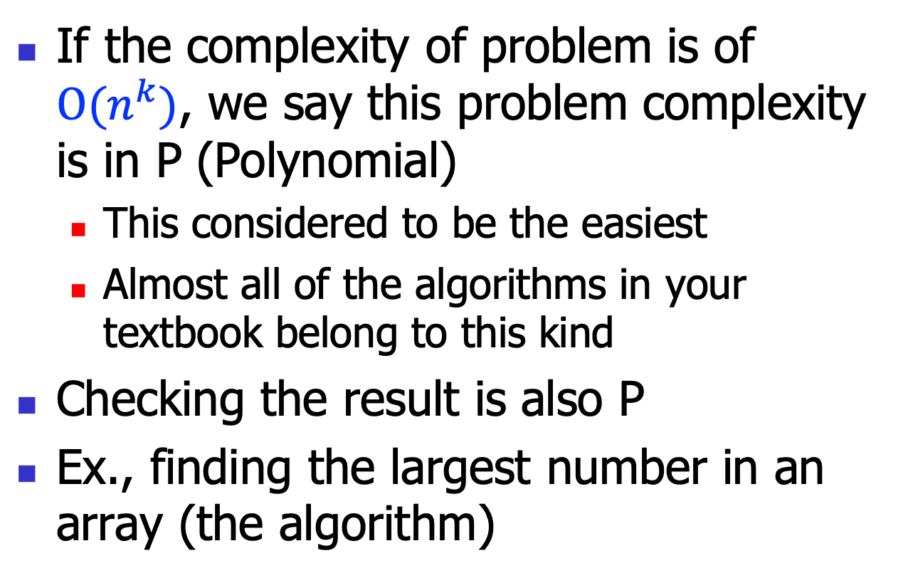
P complexity
If the complexity of problem is of $O(n^{k})$, we say this problem complexity is in P (Polynomial)
This considered to be the easiest
Almost all of the algorithms in your textbook belong to this kind
Checking the result is also P
Ex., finding the largest number in an array (the algorithm)

Slide 24
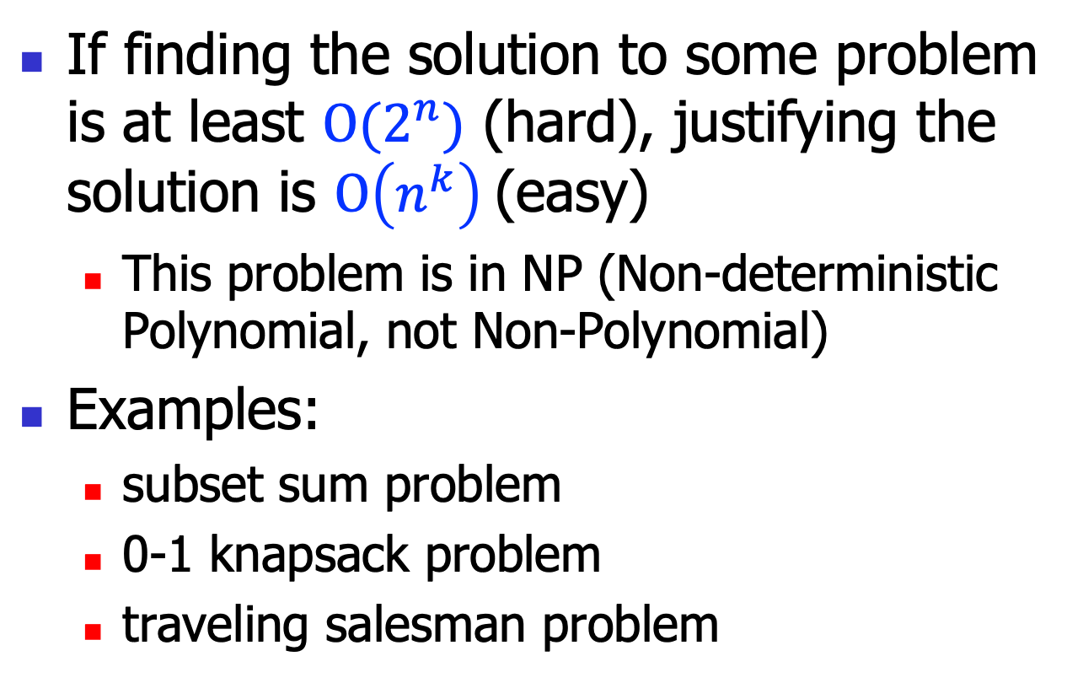
NP complexity
If finding the solution to some problem is at least $O(2^{n})$ (hard), justifying the solution is $O\left(n^{k}\right)$(easy)
This problem is in NP (Non-deterministic Polynomial, not Non-Polynomial)
Examples:
subset sum problem
0-1 knapsack problem
traveling salesman problem

Slide 25
Subset sum problem
Given a set S = {x_1, …, x_n}
Find a subset T of S, such that \sum T = 0
T is nonempty
E.g., S = {5, 8, -2, -3}
Algorithm?

Slide 26
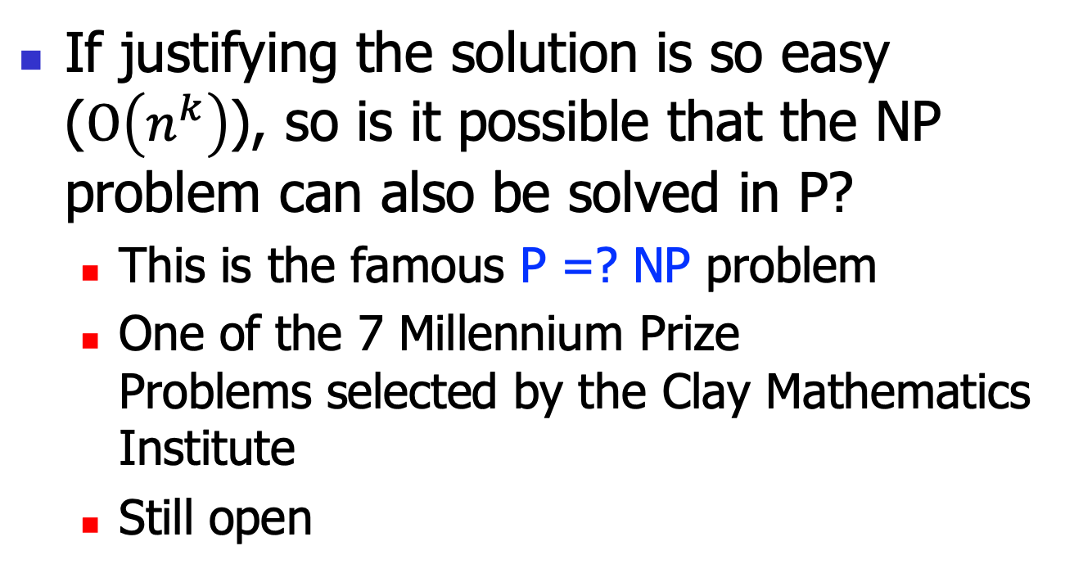
P =? NP
If justifying the solution is so easy ($O\left(n^{k}\right)$), so is it possible that the NP problem can also be solved in P?
This is the famous P =? NP problem
One of the 7 Millennium Prize Problems selected by the Clay Mathematics Institute
Still open
NP
P

Slide 27
NP-Complete (NPC)
All problems in NP can be transformed to a subset of NP-complete
Intuitively, this is the hardest problems in NP
If NPC has can be solved in polynomial time, so does NP
The first NPC is SAT
Cook, 1971
Now, several hundreds
More later in this course
NP
P
NPC

Slide 28
NP-hard
NP-hard is even more difficult than NP
Even the solution may not be justified in polynomial time
So generally considered beyond the modern CS
NP
NP-hard
P

Slide 29
The 7 Millennium Prize Problems
P versus NP
The Hodge conjecture (algebraic geometry)
The Poincaré conjecture
solved, by Grigori Perelman (topology)
The Riemann hypothesis
Yang–Mills existence and mass gap
Navier–Stokes existence and smoothness
The Birch and Swinnerton-Dyer conjecture

