Slide 1
Symbolic execution
Formal Methods Foundation
Baojian Hua
bjhua@ustc.edu.cn

Slide 2
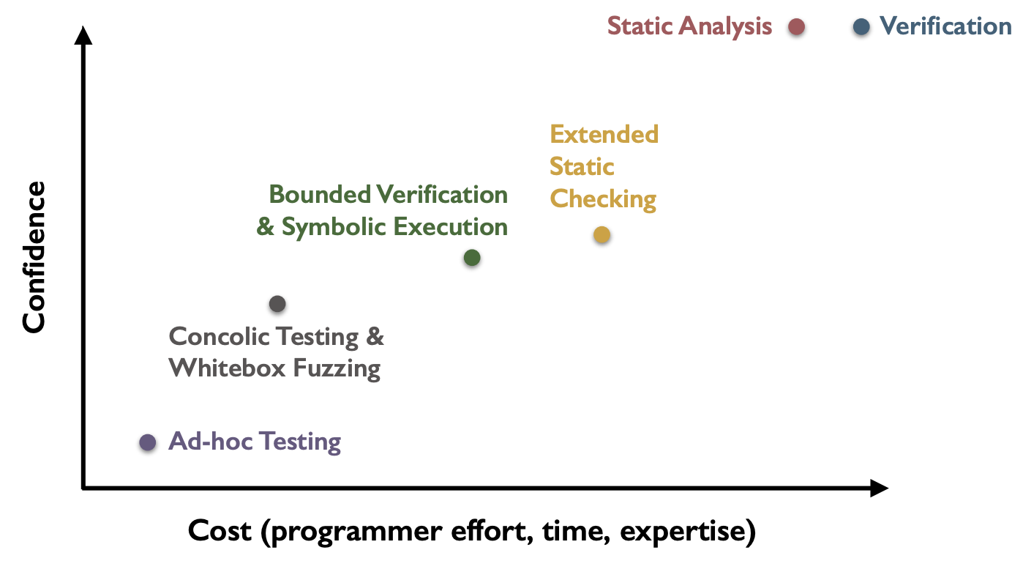
Spectrum of program validation methods
Today’s topic

Slide 3



Why program testing may not work?
// Does the following program throw a
// “DivideByZero” exception?
// Suppose we use a black box testing/fuzzing
// strategy (to generate random inputs):
int foo(int x, int y){
if(x==32467289)
return x/y;
else
return 0;
}
$$\frac{1}{2^{32}}$$
$$\frac{1}{2^{64}}$$
1- $\frac{1}{2^{32}}$

Slide 4
Does white box strategy work?
// White box testing/fuzzing may also be hard:
void foo(int a, int b){
int x = 1, y = 0;
if(a != 0){
y = 3+x;
if(b == 0)
x = 2*(a+b);
}
assert(x-y != 0);
}
Input: a=0, b=0
Get: x=1, y=0
Input: a=1, b=0
Get: x=2, y=4
Input: a=1, b=1
Get: x=1, y=4
…
Can we construct the values for input x and y, to make this assertion fail?

Slide 5


Program testing in general

Slide 6
Automatic test generation
Key question: for a given program, can we craft a tool to generate test cases automatically?
and effectively?
also to satisfy certain properties
In this lecture, we discuss a technique called symbolic execution

Slide 7
Symbolic Execution

Slide 8
Brief History
1976: A system to generate test data and symbolically execute programs (Lori Clarke)
1976: Symbolic execution and program testing (James King)
2005-present: practical symbolic execution
Using SMT solvers
Heuristics to control exponential explosion
Heap modeling and reasoning about pointers
Environment modeling
Dealing with solver limitation

Slide 9
Symbolic execution
// Step #1: construct ”symbolic” values for
// function inputs:
int foo(int x, int y){
int z = x+y;
if(x==32467289)
return x/y;
else
return 0;
}
Variable | value
x | x
y | y

Slide 10
Symbolic execution
// Step #2: executing the program with the
// symbolic inputs, maintaining the symbolic
// program state:
int foo(int x, int y){
int z = x+y;
if(x==32467289)
return x/y;
else
return 0;
}
Variable | value
x | x
y | y
z | x+y
Values are symbolic expressions.

Slide 11
Symbolic execution
// For branch, we add a “path condition” to the
// corresponding branch:
int foo(int x, int y){
int z = x+y;
if(x==32467289)
return x/y;
else
return 0;
}
Variable | value
x | x
y | y
z | x+y
x == 32467289
x != 32467289
if
x == 32467289
x != 32467289
x/y
0

Slide 12
Symbolic execution
// To check the desired property, we add
// corresponding constraints:
int foo(int x, int y){
int z = x+y;
if(x==32467289)
return x/y;
else
return 0;
}
Variable | value
x | x
y | y
z | x+y
x == 32467289
y==0
x != 32467289
if
x == 32467289
x != 32467289
x/y
0
y==0

Slide 13

Symbolic execution
// Step #3: with the path conditions and
// properties, we can generate constraints:
int foo(int x, int y){
int z = x+y;
if(x==32467289)
return x/y;
else
return 0;
}
Variable | value
x | x
y | y
z | x+y
x == 32467289
y==0
x != 32467289
if
x==32467289 $∧$ y==0
x==32467289
x != 32467289
Essentially, we are asking: is the above logic formulae satisfiable (SAT)? If so, this means that there is a feasible path that triggers the obligation!
x/y
0
y==0

Slide 14

Symbolic execution
// Step #4: feed the generated constraints to
// some solvers (e.g., Z3), to check SAT:
int foo(int x, int y){
int z = x+y;
if(x==32467289)
return x/y;
else
return 0;
}
Variable | value
x | x
y | y
z | x+y
x == 32467289
y==0
x != 32467289
if
x == 32467289
x != 32467289
x == 32467289 $∧$ y==0
x/y
0
The model:
[x == 32467289, y==0]
y==0

Slide 15
Symbolic execution
// Step #5: use the model from the solver, as the
// concrete inputs (to trigger the bug):
int foo(int x, int y){
int z = x+y;
if(x==32467289)
return x/y;
else
return 0;
}
Variable | value
x | 32467289
y | 0
z | 32467289
x == 32467289
y==0
x != 32467289
if
x == 32467289
x != 32467289
x == 32467289 $∧$ y==0
x/y
0
The model:
[x = 32467289, y==0]
y==0

Slide 16
Architecture
programs
symbolic executor
concrete
execution
model
path conditions/obligations
bug triggered?
solver

Slide 17








The general form
// Conceptually, path conditions accumulate:
int foo(int x, int y){
if(b1)
if(b2)
if(…)
if(bn)
return x/y;
else …;
else …;
else …;
else return 0;
}
b1
b1 $∧$b2
b1 $∧$b2 $∧$ ...
b1 $∧$b2 $∧$ ... $∧$bn
b1 $∧$b2 $∧$ ... $∧$bn $∧$y==0
b1 $∧$b2 $∧$ ... $∧ ¬$bn
b1 $∧$b2 $∧$ ... $∧ ¬$bn-1
b1 $∧ ¬$b2
$¬$b1

Slide 18





Process & Forking
parent process
// The program:
int foo(){
if(e1)
if(e11)
…;
else
…;
else
if(e12)
…;
else
…;
}
fork()
fork()
e1
fork()
$¬$e1
e1
e11
e12
e1 $∧$e11
e1$∧$ $¬$e11
$¬$e1 $∧¬$e12
$¬$e1 $∧$e12
e…
e…
e…
e…
By utilizing forking, instead of multi-threading, it is easy to maintain separate program states: symbolic stores, path conditions, etc..

Slide 19
Example
// Symbolically executing the following program:
void foo(int a, int b){
int x = 1, y = 0;
if(a != 0){
y = 3+x;
if(b == 0)
x = 2*(a+b);
}
assert(x-y != 0);
}
Variable | value
a | a
b | b
x | 1
y | 0
Can we construct values for x and y, to trigger this assertion?

Slide 20
Example
Variable | value
a | a
b | b
x | 1
y | 0
a!=0
a==0
// For branching, the process
// forks:
void foo(int a, int b){
int x = 1, y = 0;
if(a != 0){
y = 3+x;
if(b == 0)
x = 2*(a+b);
}
assert(x-y != 0);
}
Variable | value
a | a
b | b
x | 1
y | 0
Variable | value
a | a
b | b
x | 1
y | 0
The obligation:
x-y==0
that is:
1-0==0
USNAT!

Slide 21
Example
Variable | value
a | a
b | b
x | 1
y | 0
a!=0
a==0
// For branching, the process
// forks:
void foo(int a, int b){
int x = 1, y = 0;
if(a != 0){
y = 3+x;
if(b == 0)
x = 2*(a+b);
}
assert(x-y != 0);
}
Variable | value
a | a
b | b
x | 1
y | 4
Variable | value
a | a
b | b
x | 1
y | 0
b==0
b!=0
The obligation:
x-y==0
that is:
1-0==0
Variable | value
a | a
b | b
x | 1
y | 4
Variable | value
a | a
b | b
x | 1
y | 4
USNAT!
The obligation:
x-y==0
that is:
1-4==0
USNAT!

Slide 22
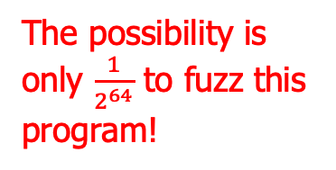
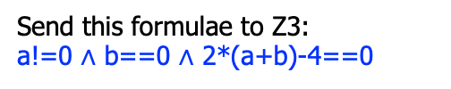
Example
Variable | value
a | a
b | b
x | 1
y | 0
The possibility is only $\frac{1}{2^{64}}$ to fuzz this program!
a!=0
a==0
// For branching, the process
// forks:
void foo(int a, int b){
int x = 1, y = 0;
if(a != 0){
y = 3+x;
if(b == 0)
x = 2*(a+b);
}
assert(x-y != 0);
}
Variable | value
a | a
b | b
x | 1
y | 4
Variable | value
a | a
b | b
x | 1
y | 0
b==0
b!=0
The obligation:
x-y==0
that is:
1-0==0
Variable | value
a | a
b | b
x | 2*(a+b)
y | 4
Variable | value
a | a
b | b
x | 1
y | 4
USNAT!
The obligation:
x-y==0
that is:
2*(a+b)-4==0
The obligation:
x-y==0
that is:
1-4==0
Send this formulae to Z3:
a!=0 ∧ b==0 $∧$ 2*(a+b)-4==0
[a=2, b=0]
USNAT!

Slide 23
Practical Issues with Symbolic Execution

Slide 24
Practical issues
Path explosion
Loops and recursions
Heap modeling
Environment modeling
Constraint solving

Slide 25

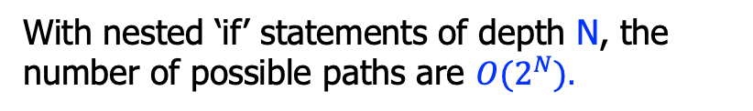



#1: Path explosion
// The program:
int foo(){
if(e1)
if(e11)
…;
else
…;
else
if(e21)
…;
else
…;
}
e1
e1
$¬$e1
e11
e21
e1 $∧$e11
e1$∧¬$e11
$¬$e1 $∧¬$e21
$¬$e1 $∧$e21
e…
e…
e…
e…
With nested ‘if’ statements of depth N, the number of possible paths are ${O(2}^{N}).$

Slide 26
#1: Path explosion
Approach #1: randomly select some path when branching
sacrifice completeness, but still better than ad-hoc testing/fuzzing
Approach #2: select path according to coverage info’
Approach #3: combine symbolic execution with testing

Slide 27
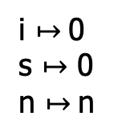

#2: Loops and recursions
// Loops introduce non-termination:
int sum(int n){
int s = 0, i = 0;
while(i<=n){
s = s+i;
i = i+1;
}
return s;
}
i $↦$0
s $↦$ 0
n $↦$n
i<=n
e
$¬$e
e
s

Slide 28
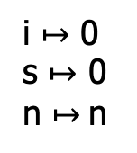
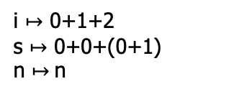
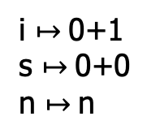
#2: Loops and recursions
// Loops introduce non-termination:
int sum(int n){
int s = 0, i = 0;
while(i<=n){
s = s+i;
i = i+1;
}
return s;
}
i $↦$ 0
s $↦$ 0
n $↦$n
i<=n
0<=n
$¬$e
s
i $↦$0+1
s $↦$0+0
n $↦$n
i<=n
0+1<=n
i<=n
i $↦$ 0+1+2
s $↦$ 0+0+(0+1)
n $↦$n
s
0+1+2<=n
s

Slide 29
#2: Loops and recursion
Bounded symbolic execution
finitize the loops
// Original:
int sum(int n){
int s = 0, i = 0;
while(e){
S;
}
return s;
}
// New:
int sum(int n){
int s = 0, i = 0;
if(e){
S;
}
return s;
}
One possible conversion

Slide 30
#3: Heap modeling
// The program:
void foobar(int i, int j){
int a[2] = {0};
if(i>1 || j>1)
return;
a[i] = 5;
assert(a[j] != 5);
}
What values of i and j to make the assert() fail?

Slide 31
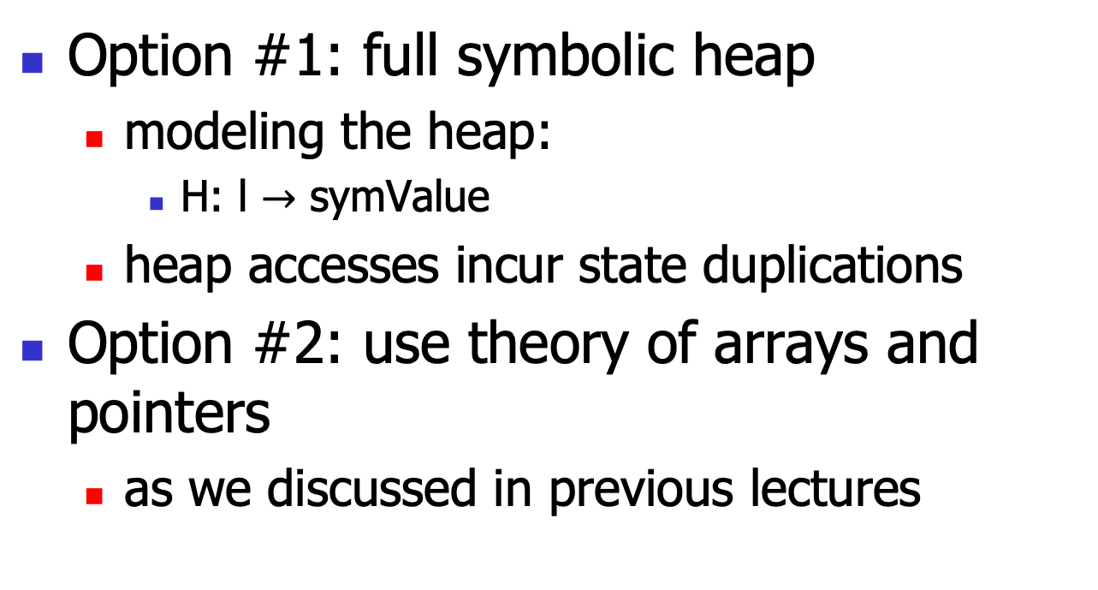
#3: Heap modeling
Option #1: full symbolic heap
modeling the heap:
H: l $→$ symValue
heap accesses incur state duplications
Option #2: use theory of arrays and pointers
as we discussed in previous lectures

Slide 32
#4: Environment modeling
The software components must interact with the external environments
invoke libraries, system calls, env. vars, …
The symbolic executor must model the environment
the whole software stack!
tedious and error-prone

Slide 33
#4: Environment modeling
Option #1: combine concrete execution
thus ignore the current path
Option #2: build model
file systems
network stack
…
approach used in KLEE etc.

Slide 34
#5: constraint solving
// The program:
void foo(int i, int j){
int a = i*i*i;
int b = j*j*j;
1/(a+b);
}
The generated obligation is:
i*i*i+j*j*j==0
which may be beyond the capability of some SMT solvers (recall that the general non-linear theory, in theory, is undecidable).

Slide 35
#5: constraint solving
Option #1: constraint simplification
optimize the constraints online
much like optimizations in traditional compilers
Option #2: solver caching and reuse
incremental solving

Slide 36
Practical Symbolic Execution with Klee

Slide 37
Klee
Klee is a relatively new tool that makes symbolic execution popular (again)
designed at Stanford
and now open source: https://klee-se.org/
The original paper:
KLEE: Unassisted and Automatic Generation of High-Coverage Tests for Complex Systems Programs (OSDI ‘08)

Slide 38
Klee, cont’
We next investigate Klee’s practical usage (as a case study)
as we have discussed the underlying theory
Required tools:
Klee: https://klee-se.org/
clang & llvm: https://clang.llvm.org/
gcov: https://gcc.gnu.org/onlinedocs/gcc/Gcov.html

Slide 39
Case #1: the program Step #1: symbolic execution
int foo(int x, int y){ // aforementioned example
int z = x+y;
if(x==32467289)
return x/y;
else
return 0;
}
int main(){
int a=0, b=1;
klee_make_symbolic(&a, sizeof(a), "a");
klee_make_symbolic(&b, sizeof(b), "b");
foo(a, b);
return 0;
}
// Commands:
// compile the target program:
$ clang –O0 –c –emit-llvm –g case1.c
// which generates “case1.bc”
// symbolically executes the “binary”:
$ klee --solver-backend=z3 case1.bc

Slide 40
Step #2: error detection
int foo(int x, int y){
int z = x+y;
if(x==32467289)
return x/y;
else
return 0;
}
int main(){
int a=0, b=1;
klee_make_symbolic(&a, sizeof(a), "a");
klee_make_symbolic(&b, sizeof(b), "b");
foo(a, b);
return 0;
}
// Outputs (part):
KLEE: Using Z3 solver backend
KLEE: ERROR: case1.c:6: divide by zero
KLEE: NOTE: now ignoring this error at this location
KLEE: done: total instructions = 51
KLEE: done: completed paths = 2
KLEE: done: partially completed paths = 1
KLEE: done: generated tests = 3

Slide 41
Step #3: tests generation
int foo(int x, int y){
int z = x+y;
if(x==32467289)
return x/y;
else
return 0;
}
int main(){
int a=0, b=1;
klee_make_symbolic(&a, sizeof(a), "a");
klee_make_symbolic(&b, sizeof(b), "b");
foo(a, b);
return 0;
}
// Klee also generates 3 test cases:
test000001.ktest
test000002.ktest
test000003.ktest
// which are binaries that can be checked
// by another tool: klee.ktest-tool:
$ klee.ktest-tool test000001.ktest
a == 0
b == 0

Slide 42
Step #3: tests generation
int foo(int x, int y){
int z = x+y;
if(x==32467289)
return x/y;
else
return 0;
}
int main(){
int a=0, b=1;
klee_make_symbolic(&a, sizeof(a), "a");
klee_make_symbolic(&b, sizeof(b), "b");
foo(a, b);
return 0;
}
$ klee.ktest-tool test000002.ktest
a == 32467289
b == 0
// this is the bug!
$ klee.ktest-tool test000003.ktest
a == 32467289
b == 255

Slide 43
Step #4: tests replay
int foo(int x, int y){
int z = x+y;
if(x==32467289)
return x/y;
else
return 0;
}
int main(){
int a=0, b=1;
klee_make_symbolic(&a, sizeof(a), "a");
klee_make_symbolic(&b, sizeof(b), "b");
foo(a, b);
return 0;
}
// compile the program:
$ clang –L path/to/solib -lkleeRuntest case1.c
// generate “a.out”
// run the binaries, supply the test case:
$ ./a.out
./klee-last/test000002.ktest
32467289
Floating point exception (core dumped)
// to enable core-dump:
sudo service apport stop

Slide 44
Step #5: debug the core
int foo(int x, int y){
int z = x+y;
if(x==32467289)
return x/y;
else
return 0;
}
int main(){
int a=0, b=1;
klee_make_symbolic(&a, sizeof(a), "a");
klee_make_symbolic(&b, sizeof(b), "b");
foo(a, b);
return 0;
}
// debug the core:
$ gdb –-core=core<pid>
// and may supply the symbol table:
(gdb) file a.out
// and debug happily ☺

Slide 45
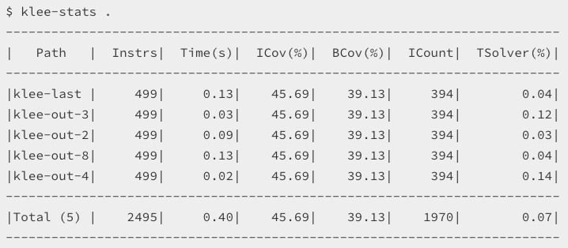
Step #6: auxiliary information
int foo(int x, int y){
int z = x+y;
if(x==32467289)
return x/y;
else
return 0;
}
int main(){
int a=0, b=1;
klee_make_symbolic(&a, sizeof(a), "a");
klee_make_symbolic(&b, sizeof(b), "b");
foo(a, b);
return 0;
}
// to display the statistics:
$ klee.stats .

Slide 46
Case #2: bug detection
void foo(int a, int b){
int x = 1, y = 0;
if(a != 0){
y = 3+x;
if(b == 0)
x = 2*(a+b);
}
assert(x-y != 0);
}
Leave this as an exercise.

Slide 47
Case #3: crack password
int main(){
int password;
printf(“pls input passwd:”);
scanf(”%d”, &password);
check(password);
return 0;
}
void check(int pw){
unsigned char *p = &pw;
if(p[0]==0)
if(p[1]==1)
if(p[2]==2)
if(p[3]==3)
assert(0);
return;
}

Slide 48
Case #4: vulnerability
int main(){
char name[128];
printf(“pls input name:”);
scanf(”%s”, name);
check(name);
return 0;
}
void check(char *name){
char buf[16];
// ooops...
// stack-based overflow
strcpy(buf, name);
return;
}

Slide 49
Summary for Klee
Pros:
high coverage (read the paper)
(mostly) automated
high effectiveness (even for programs heavily tested)
Cons:
expensive
white-box (i.e., source code needed)
tied to specific tools (clang)

Slide 50
Summary
Symbolic execution is a powerful technique for program testing and automatic test generation
The direct implementation is non-trivial:
we will discuss further improvements (variants) for symbolic executors
may be more practical

