Slide 1
Concolic Execution
Formal Methods Foundation
Baojian Hua
bjhua@ustc.edu.cn

Slide 2
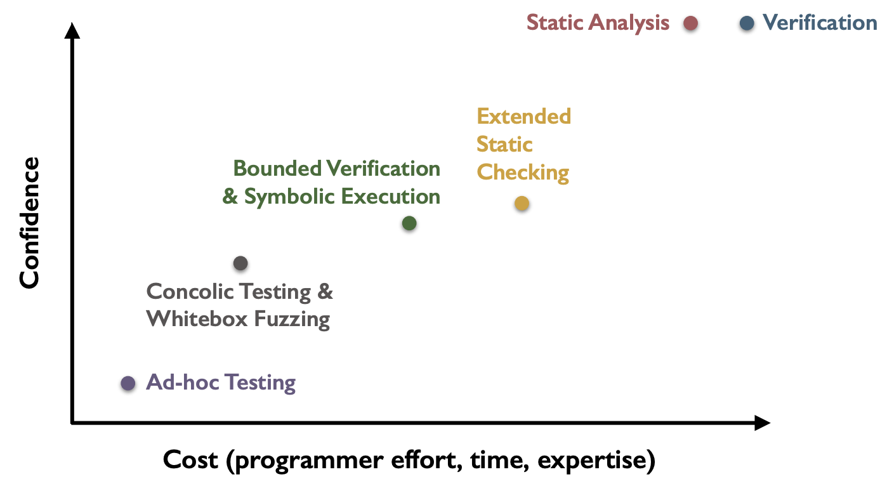
Spectrum of program validation methods
Today’s topic

Slide 3






Recap: path explosion
// How to test the following program effectively?
int foo(){
if(e1)
if(e11)
…;
else
…;
else
if(e21)
…;
else
…;
}
e1
e1
$¬$e1
e11
e21
e1 $∧$e11
e1$∧$ $¬$e11
$¬$e1$∧$ $¬$e21
$¬$e1 $∧$e21
e…
e…
e…
e…
With nested ‘if’ statements of depth N, the number of possible paths are ${O(2}^{N}).$

Slide 4

Recap: Environment modeling
// lib() is a library function:
int foo(int n){
if(e){
x = lib(n);
}else{
x = 2*n-4;
}
return 1/x;
}
if(e)
e
$¬$e
lib()
...
If we don’t establish a symbolic model for the “lib()” function, we cannot check the true branch symbolically.
But we can still executes that branch concretely!
So the symbolic model for the library function is just to improve the precision!

Slide 5
Recap: Solver limitation
// sample function:
int foo(int x, int y){
int m = x*x*x;
if(m==y){
assert(…);
}else{
…;
}
return 1;
}
m==y
e
$¬$e
…
...
The left path condition is:
x*x*x==y
Generally, it’s beyond the capability of many modern solvers.

Slide 6
Concolic execution
Concolic = Concrete + symbolic
Initially developed around 2005:
DART: Directed Automated Random Testing, by Patrice Godefroid; Nils Klarlund; Koushik Sen, 2005
CUTE: a concolic unit testing engine for C, by Koushik Sen; Darko Marinov; Gul Agha, 2005

Slide 7
Concolic Execution

Slide 8
Concolic Execution Steps
Step #1: generate random concrete input and symbolic input
Step #2, run program with the two inputs
maintain the concrete+symbolic states
For branching, generate path conditions
just like in the symbolic execution
but don’t fork(), only go to feasible path
After one run, negate the result PCs, send them to solver, to get other concreate input
Go to step #2, re-run the program

Slide 9
Architecture
programs
with concrete + symbolic inputs
model
concolic executor
path conditions/obligations
solver

Slide 10
Concolic execution
// Step #1: construct random values as
// initial input:
int foo(int x, int y){
int z = x+y;
if(x==32467289)
return x/y;
else
return 0;
}
Variable | value | sym.value
x | 1 | x
y | 1 | y

Slide 11
Concolic execution
// Step #2: execute the program with both the
// concrete and symbolic values, maintaining the // program state:
int foo(int x, int y){
int z = x+y;
if(x==32467289)
return x/y;
else
return 0;
}
Variable | value | sym.value
x | 1 | x
y | 1 | y
z | 2 | x+y

Slide 12
Concolic execution
// For branch, the executor branches according to
// the concreate values, and we add a “path
// condition” to the
// target branch:
int foo(int x, int y){
int z = x+y;
if(x==32467289)
return x/y;
else
return 0;
}
Variable | value | sym.value
x | 1 | x
y | 1 | y
z | 2 | x+y
x != 32467289
if
x != 32467289
x/y
0

Slide 13
Concolic execution
// When finish and get the PCs, we negate the PCs
// and send it to solver, to get new inputs:
int foo(int x, int y){
int z = x+y;
if(x==32467289)
return x/y;
else
return 0;
}
Variable | value | sym.value
x | 32467289 | x
y | 1 | y
z | 32467290 | x+y
x == 32467289
y==1
if
x == 32467289
x != 32467289
x/y
0

Slide 14

Concolic execution
// With the new path condition and obligations,
// we can generate final constraints:
int foo(int x, int y){
int z = x+y;
if(x==32467289)
return x/y;
else
return 0;
}
Variable | value | sym.value
x | 32467289 | x
y | 1 | y
z | 32467290 | x+y
x == 32467289
y==1
if
x == 32467289
x == 32467289 $∧$ y==0
x/y
0
And the model:
[x == 32467289, y==0]
y==0

Slide 15
Concolic execution
// Generate new input, and rerun the program:
int foo(int x, int y){
int z = x+y;
if(x==32467289)
return x/y;
else
return 0;
}
Variable | value | sym.value
x | 32467289 | x
y | 0 | y
z | 32467289 | x+y
x == 32467289
y==0
if
We run the program 3 rounds in total!
x == 32467289
x == 32467289 $∧$ y==0
x/y
0
Trigger the “DivideByZero”!
y==0

Slide 16






The general form
// Conceptually, we negate one of PCs one time:
int foo(int x, int y){
if(b1)
if(b2)
if(…)
if(bn)
return x/y;
else …;
else …;
else …;
else return 0;
}
b1
b1 $∧$b2
b1 $∧$b2 $∧$ ...
b1
b1 $∧$b2 $∧$ ... $∧$bn
b1
b1 $∧$b2 $∧$ ... $∧$bn $∧$y==0
b2
b…
b1 $∧$b2
b1 $∧$b2 $∧$ ... $∧$bn
x/y
b…
b…
b…

Slide 17
Example
Variable | value | sym.value
x | 2 | x
y | 2 | y
m | 8 | x*x*x
m!=y
// sample function:
int foo(int x, int y){
int m = x*x*x;
if(m==y){
assert(…);
}else{
…;
}
return 1;
}
Variable | value | sym.value
x | 2 | x
y | 2 | y
m | 8 | x*x*x
8
The path cond:
x*x*x!=y
we negate it and send to solver (Z3):
x*x*x==y
but if we found this is unsolvable, we can weaken this by replace the symbolic value of m with its concreate value!
Thus we have this (weakened) PC:
8 == y
we regenerate new input, and restart the execution!

Slide 18
Example
Variable | value | sym.value
x | 2 | x
y | 8 | y
m | 8 | x*x*x
m==y
m!=y
// sample function:
int foo(int x, int y){
int m = x*x*x;
if(m==y){
assert(…);
}else{
…;
}
return 1;
}
Variable | value | sym.value
x | 2 | x
y | 8 | y
m | 8 | x*x*x
Variable | value | sym.value
x | 2 | x
y | 2 | y
m | 8 | x*x*x
8
The path cond:
x*x*x!=y
we negate it and send to solver (Z3):
x*x*x==y
but if we found this is unsolvable, we can weaken this by replace the symbolic value of m with the concreate value!
Thus we have this (weakened) PC:
8 == y
we regenerate new input, and restart the execution!

Slide 19
Advantages of Concolic Execution

Slide 20
Practical issues
Path explosion
Loops and recursions
Environment modeling

Slide 21


#1: Path explosion
// The program:
int foo(){
if(e1)
if(e11)
…;
else
…;
else
if(e21)
…;
else
…;
}
e1
e1
$¬$e1
e11
e21
e1 $∧$e11
e1$∧¬$e11
$¬$e1 $∧¬$e21
$¬$e1 $∧$e21
e…
e…
e…
e…
With nested ‘if’ statements of depth N, the number of possible paths are ${O(2}^{N}).$

Slide 22
#1: Path explosion
In concolic execution, the number of paths explored can be controlled, according to metrics such as:
the total number
the coverage
the timeout
etc.

Slide 23
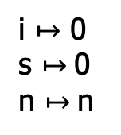
#2: Loops and recursions
// Loops introduce non-termination:
int sum(int n){
int s = 0, i = 0;
while(i<=n){
s = s+i;
i = i+1;
}
return s;
}
i $↦$ 0
s $↦$0
n $↦$n
i<=n
e
$¬$e
e
s

Slide 24
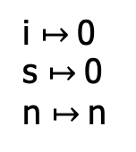
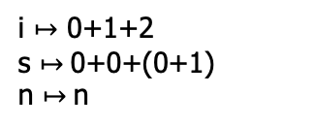
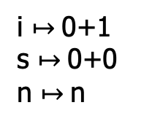
#2: Loops and recursions
// Loops introduce non-termination:
int sum(int n){
int s = 0, i = 0;
while(i<=n){
s = s+i;
i = i+1;
}
return s;
}
i $↦$0
s $↦$0
n $↦$n
i<=n
0<=n
$¬$e
s
i $↦$0+1
s $↦$0+0
n $↦$n
i<=n
0+1<=n
i<=n
i $↦$ 0+1+2
s $↦$0+0+(0+1)
n $↦$n
s
0+1+2<=n
s
No need to finitize the loops.

Slide 25
#3: Environment modeling
// lib() is a library function:
int foo(int n){
if(e){
x = lib(n);
}else{
x = 2*n-4;
}
return 1/x;
}
e
e
$¬$e
lib()
...
If we don’t establish a symbolic model for the “lib()” function, we cannot symbolic check the true branch.
But we can still concolic executes that branch!
So the symbolic model for the environment is just to improve the precision!

Slide 26
Practical Concolic Execution

Slide 27
Demos
See the demo for PathCrawler (for C):
http://pathcrawler-online.com:8080/doWelcome
And those for PathFinder (for Java):
https://github.com/javapathfinder

Slide 28
Summary
Concolic execution is a more practical (and flexible) infrastructure for program testing
sacrifice completeness for usability
Many practical tools with many applications
with many improvements

