Slide 1
Operational semantics
Formal Methods Foundation
Baojian Hua
bjhua@ustc.edu.cn

Slide 2
Semantics
We’re talking about the semantics of a program rigorously
Different styles for defining semantics:
Operational semantics
build a virtual machine, compile to the VM
Axiomatic semantics
Add specifications, compile to logic
Denotational semantics
Build model, compile to math

Slide 3
Semantics
In this course, we‘ll discuss both the operational semantics (this lecture), and the axiomatic semantics (the next few lectures)
Both of them are very successful in defining language semantics and also in wide use

Slide 4
A very small language: IMP
E ::= n | x | E+E | E-E | E*E | E/E
B ::= true | false | E==E | E<E
| B&&B | B||B | !B
S ::= skip
| x=E
| S;S
| f(E1, …, En)
| if(B, S, S)
| while(B, S)
F ::= def f(x1, …, xn){S; return E;}
// IMP is widely used in verification literature.

Slide 5
Sample programs
def sum(n):
s = 0
i = 0
while i <= n:
s = s+i
i = i+1
return s
def max(m, n):
c = m
if n > c:
c = n
return c
def gcd(m, n):
while m != n:
if m >= n:
m = m-n
else:
n = n-m
return m

Slide 6

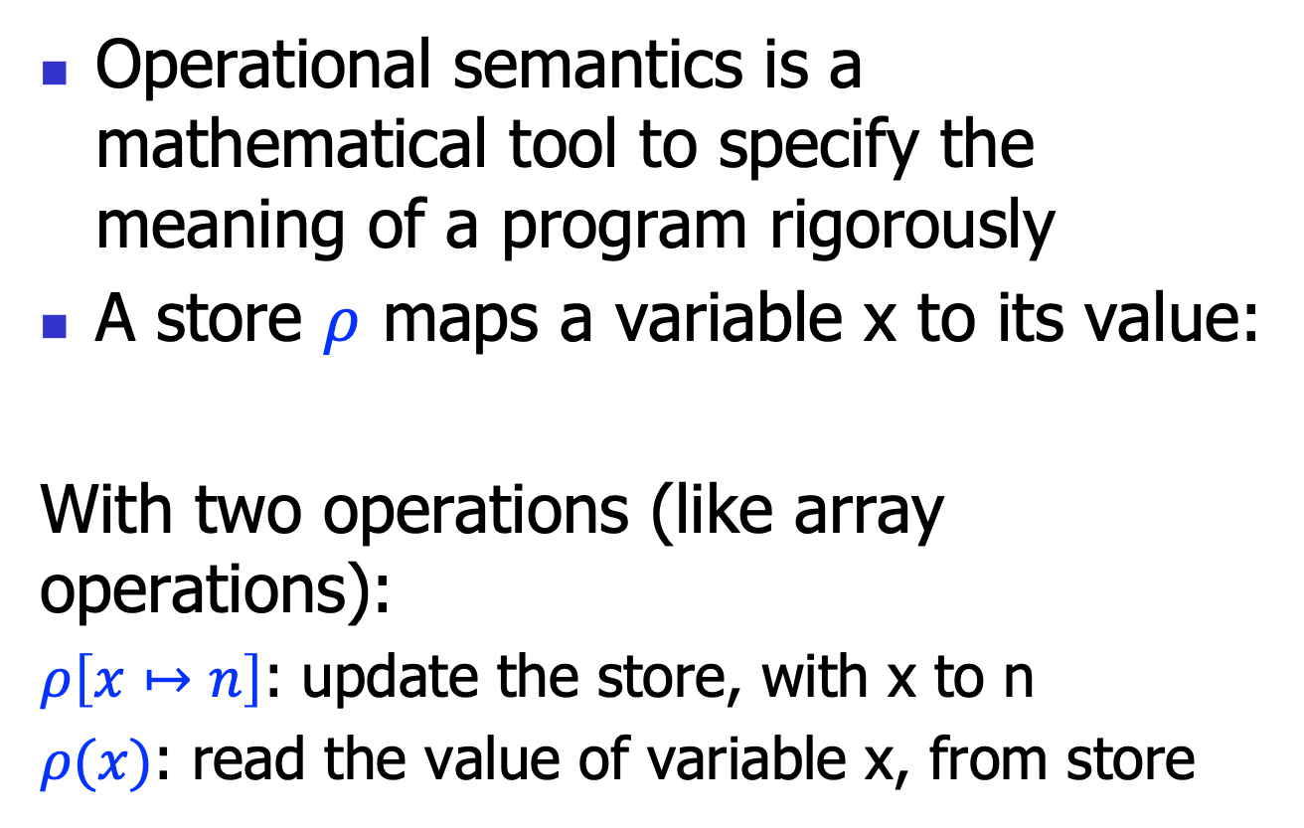
Operational semantics: store
Operational semantics is a mathematical tool to specify the meaning of a program rigorously
A store $ρ$ maps a variable x to its value:
With two operations (like array operations):
$ρ\left[x↦n\right]$: update the store, with x to n
$ρ(x)$: read the value of variable x, from store
$$ρ:x↦n$$

Slide 7

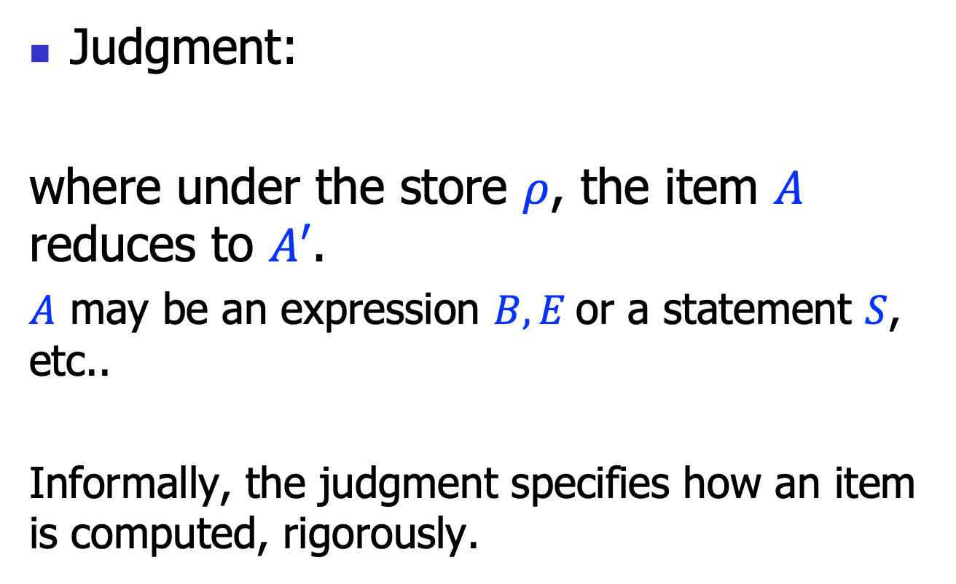
Operational semantics: judgment
Judgment:
where under the store $ρ$, the item $A$ reduces to $A′$.
$A$ may be an expression $B,E$or a statement $S$, etc..
Informally, the judgment specifies how an item is computed, rigorously.
$$ρ⊢A→A′$$

Slide 8

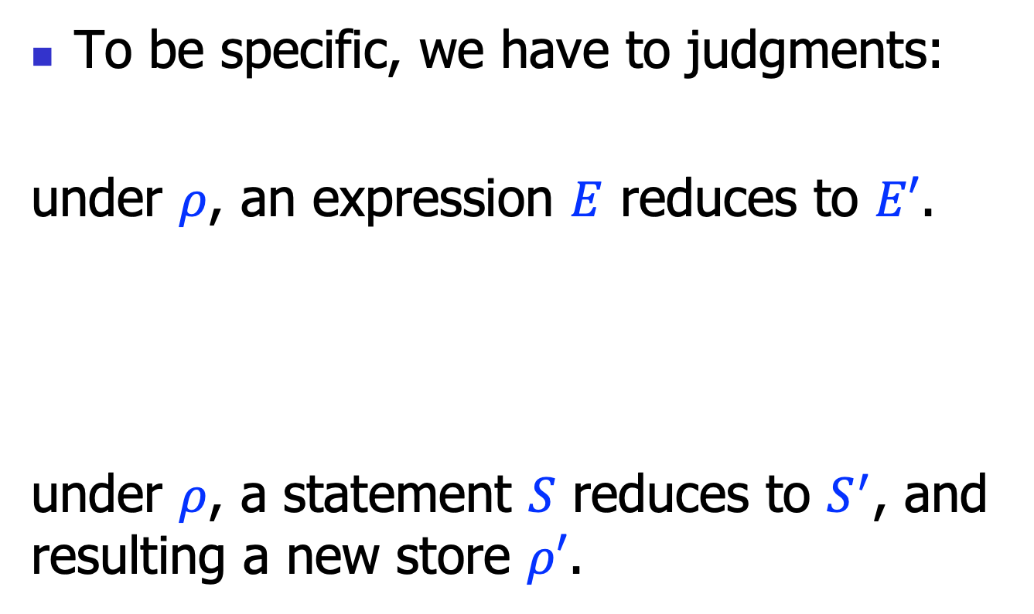

Operational semantics
To be specific, we have to judgments:
under $ρ$, an expression $E$ reduces to $E′$.
under $ρ$, a statement $S$ reduces to $S^{′}$, and resulting a new store $ρ′$.
$$ρ⊢E→E′$$
$ρ⊢S→S^{′};ρ$’

Slide 9
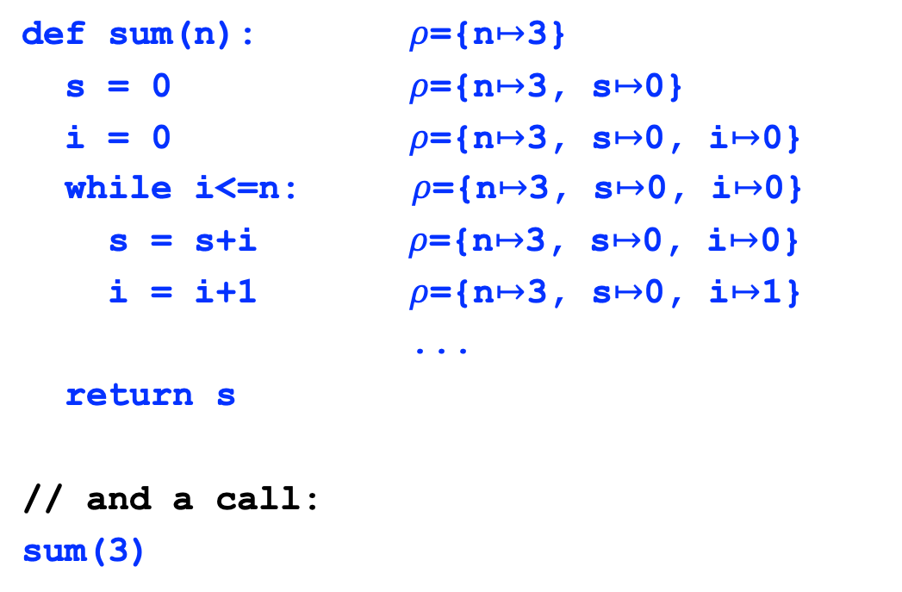
Example
def sum(n): $ρ$={n$↦$3}
s = 0 $ρ$={n$↦$3, s$↦$0}
i = 0 $ρ$={n$↦$3, s$↦$0, i$↦$0}
while i<=n:$ρ$={n$↦$3, s$↦$0, i$↦$0}
s = s+i$ρ$={n$↦$3, s$↦$0, i$↦$0}
i = i+1 $ρ$={n$↦$3, s$↦$0, i$↦$1}
...
return s
// and a call:
sum(3)

Slide 10

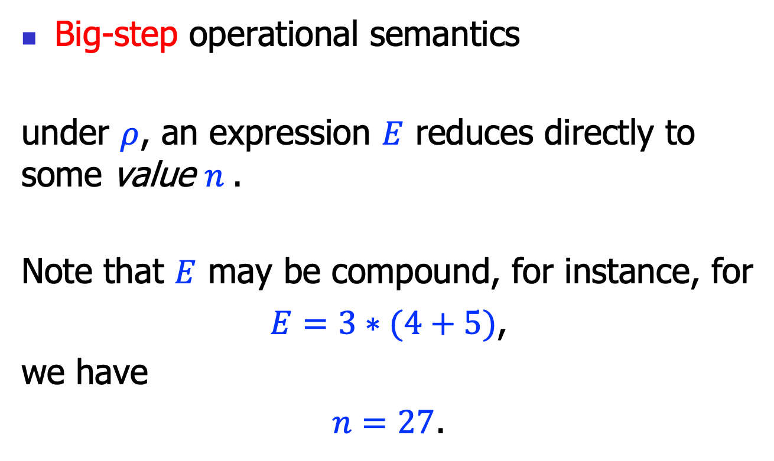
Operational semantics styles
Big-step operational semantics
under $ρ$, an expression $E$ reduces directly to some value $n$.
Note that $E$ may be compound, for instance, for
$E=3∗(4+5)$,
we have
$n=27$.
$$ρ⊢E⟹n$$

Slide 11

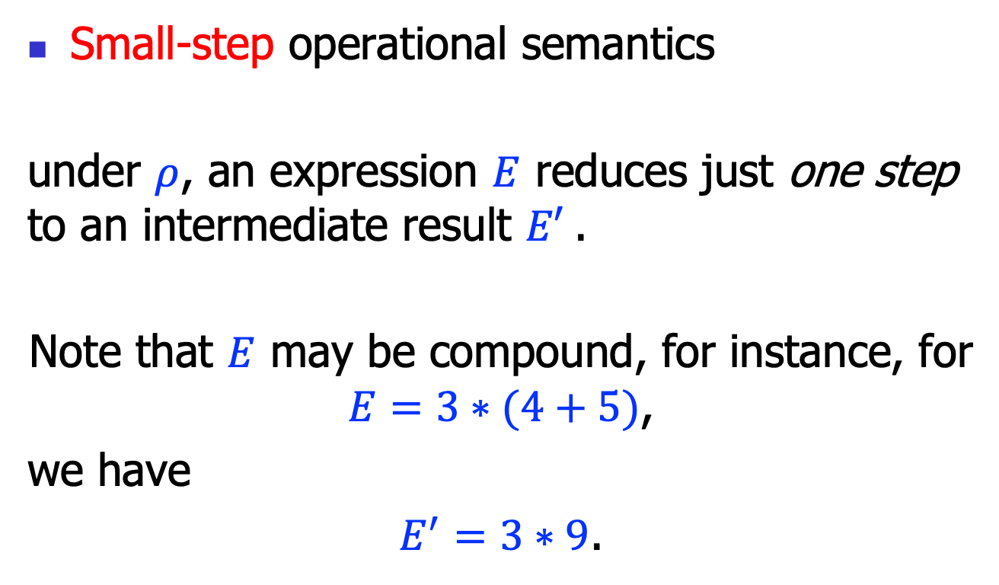
Operational semantics styles
Small-step operational semantics
under $ρ$, an expression $E$ reduces just one step to an intermediate result $E′$.
Note that $E$ may be compound, for instance, for $E=3∗(4+5)$,
we have
$E^{′}=3∗9$.
$$ρ⊢E→E′$$

Slide 12
Big-step Operational Semantics

Slide 13









Rules for expressions (1)
$$(E−n)$$
$$ρ⊢n⟹n$$
$$ρ\left(x\right)=n$$
$$(E−x)$$
$$ρ⊢x⟹n$$
$$ρ⊢E1⟹n1$$
$$ρ⊢E2⟹n2$$
$$n=n1+n2$$
$$(E−+)$$
$$ρ⊢E1+E2⟹n$$

Slide 14










Rules for expressions (2)
$$ρ⊢E1⟹n1$$
$$ρ⊢E2⟹n2$$
$$n=n1−n2$$
$$(E−−)$$
$$ρ⊢E1−E2⟹n$$
$$ρ⊢E1⟹n1$$
$$ρ⊢E2⟹n2$$
$$n=n1∗n2$$
$$(E−∗)$$
$$ρ⊢E1∗E2⟹n$$
$$ρ⊢E1⟹n1$$
$$ρ⊢E2⟹n2$$
$$n=n1/n2$$
$$(E−/)$$
$$ρ⊢E1/E2⟹n$$

Slide 15














Rules for booleans (3)
$$ρ⊢E1⟹n1$$
$$ρ⊢E2⟹n2$$
$$n1==n2$$
$$(E−==1)$$
$ρ⊢E1==E2⟹$ true
$$ρ⊢E1⟹n1$$
$$ρ⊢E2⟹n2$$
$$n1≠n2$$
$$(E−==2)$$
$ρ⊢E1==E2⟹$false
$$ρ⊢E1⟹n1$$
$$ρ⊢E2⟹n2$$
$$n1==n2$$
$$(E−≠1)$$
$ρ⊢E1!=E2⟹$false
$$ρ⊢E1⟹n1$$
$$ρ⊢E2⟹n2$$
$$n1≠n2$$
$$(E−≠2)$$
$ρ⊢E1!=E2⟹$true

Slide 16












Rules for booleans (4)
$$ρ⊢E1⟹n1$$
$$ρ⊢E2⟹n2$$
$$n1>n2$$
$$(E−>1)$$
$ρ⊢E1>E2⟹$true
$$ρ⊢E1⟹n1$$
$$ρ⊢E2⟹n2$$
$$n1≯n2$$
$$(E−>2)$$
$ρ⊢E1>E2⟹$false
$$ρ⊢E1⟹n1$$
$$ρ⊢E2⟹n2$$
$$n1≥n2$$
$$(E−≥1)$$
$ρ⊢E1>=E2⟹$true
$$ρ⊢E1⟹n1$$
$$ρ⊢E2⟹n2$$
$$n1<n2$$
$$(E−≥2)$$
$ρ⊢E1>=E2⟹$false

Slide 17











Rules for booleans (5)
$$ρ⊢E1⟹n1$$
$$ρ⊢E2⟹n2$$
$$n1<n2$$
$$(E−<1)$$
$ρ⊢E1<E2⟹$true
$$ρ⊢E1⟹n1$$
$$ρ⊢E2⟹n2$$
$$n1≮n2$$
$$(E−<2)$$
$ρ⊢E1<E2⟹$false
$$ρ⊢E1⟹n1$$
$$ρ⊢E2⟹n2$$
$$n1≤n2$$
$$(E−≤1)$$
$ρ⊢E1<=E2⟹$true
$$ρ⊢E1⟹n1$$
$$ρ⊢E2⟹n2$$
$$n1≰n2$$
$$(E−≤2)$$
$ρ⊢E1<=E2⟹$false

Slide 18








Rules for statement (1)
$$(E−Skip)$$
$$ρ⊢skip⟹ρ$$
$$ρ⊢E⟹n$$
$$(E−Assign)$$
$$ρ⊢x=E⟹ρ[x↦n]$$
$$ρ⊢S1⟹ρ1$$
$$ρ1⊢S2⟹ρ2$$
$$(E−Seq)$$
$$ρ⊢S1;S2⟹ρ2$$

Slide 19







Rules for statement (2)
$ρ⊢B⟹$true
$$ρ⊢S1⟹ρ1$$
$$(E−If1)$$
$$ρ⊢if\left(B;S1;S2\right)⟹ρ1$$
$ρ⊢B⟹$false
$$ρ⊢S2⟹ρ2$$
$$(E−If2)$$
$$ρ⊢if(B;S1;S2)⟹ρ2$$

Slide 20






Rules for statement (3)
$ρ⊢B⟹$false
$$(E−While1)$$
$$ρ⊢while\left(B;S\right)⟹ρ$$
$ρ⊢B⟹$true
$$ρ⊢S⟹ρ′$$
$$ρ′⊢while(B;S)⟹ρ′′$$
$$(E−While2)$$
$$ρ⊢while\left(B;S\right)⟹ρ′′$$

Slide 21
Small-step Operational Semantics

Slide 22











Rules for expressions (1)
$$ρ\left(x\right)=n$$
$$(E−x)$$
$$ρ⊢x→n$$
$$ρ⊢E1→E1^{′}$$
$$(E−+1)$$
$$ρ⊢E1+E2→E1^{′}+E2$$
$$ρ⊢E2→E2^{′}$$
$$(E−+2)$$
$$ρ⊢n1+E2→n1+E2′$$
$$n=n1+n2$$
$$(E−+3)$$
$$ρ⊢n1+n2→n$$

Slide 23








Rules for expressions (2)
$$ρ⊢E1→E1^{′}$$
$$(E−−1)$$
$$ρ⊢E1−E2→E1^{′}−E2$$
$$ρ⊢E2→E2^{′}$$
$$(E−−2)$$
$$ρ⊢n1−E2→n1−E2′$$
$$n=n1−n2$$
$$(E−−3)$$
$$ρ⊢n1−n2→n$$

Slide 24






Rules for expressions (3)
$$ρ⊢E1→E1^{′}$$
$$(E−∗1)$$
$$ρ⊢E1∗E2→E1^{′}∗E2$$
$$ρ⊢E2→E2^{′}$$
$$(E−∗2)$$
$$ρ⊢n1∗E2→n1∗E2′$$
$$n=n1∗n2$$
$$(E−∗3)$$
$$ρ⊢n1∗n2→n$$

Slide 25






Rules for expressions (4)
$$ρ⊢E1→E1^{′}$$
$$(E−/1)$$
$$ρ⊢E1/E2→E1^{′}/E2$$
$$ρ⊢E2→E2^{′}$$
$$(E−/2)$$
$$ρ⊢n1/E2→n1/E2′$$
$$n=n1/n2$$
$$(E−/3)$$
$$ρ⊢n1/n2→n$$

Slide 26








Rules for booleans (5)
$$ρ⊢E1→E1^{′}$$
$$(E−==1)$$
$$ρ⊢E1==E2→E1^{′}==E2$$
$$ρ⊢E2→E2^{′}$$
$$(E−==2)$$
$$ρ⊢n1==E2→n1==E2′$$
$$n1==n2$$
$$(E−==3)$$
$ρ⊢n1==n2→$true
$$n1≠n2$$
$$(E−==4)$$
$ρ⊢n1==n2→$false

Slide 27









Rules for expressions (6)
$$ρ⊢E1→E1^{′}$$
$$(E−≠1)$$
$$ρ⊢E1≠E2→E1^{′}≠E2$$
$$ρ⊢E2→E2^{′}$$
$$(E−≠2)$$
$$ρ⊢n1≠E2→n1≠E2′$$
$$n1≠n2$$
$$(E−≠3)$$
$ρ⊢n1≠n2→$true
$$n1==n2$$
$$(E−≠4)$$
$ρ⊢n1≠n2→$false

Slide 28








Rules for expressions (7)
$$ρ⊢E1→E1^{′}$$
$$(E−>1)$$
$$ρ⊢E1>E2→E1^{′}>E2$$
$$ρ⊢E2→E2^{′}$$
$$(E−>2)$$
$$ρ⊢n1>E2→n1>E2′$$
$$n1>n2$$
$$(E−>3)$$
$ρ⊢n1>n2→$true
$$n1≯n2$$
$$(E−>4)$$
$ρ⊢n1>n2→$false

Slide 29









Rules for expressions (8)
$$ρ⊢E1→E1^{′}$$
$$(E−≥1)$$
$$ρ⊢E1≥E2→E1^{′}≥E2$$
$$ρ⊢E2→E2^{′}$$
$$(E−≥2)$$
$$ρ⊢n1≥E2→n1≥E2′$$
$$n1≥n2$$
$$(E−≥3)$$
$ρ⊢n1≥n2→$true
$$n1≱n2$$
$$(E−≥4)$$
$ρ⊢n1≥n2→$false

Slide 30








Rules for expressions (9)
$$ρ⊢E1→E1^{′}$$
$$(E−<1)$$
$$ρ⊢E1<E2→E1^{′}<E2$$
$$ρ⊢E2→E2^{′}$$
$$(E−<2)$$
$$ρ⊢n1<E2→n1<E2′$$
$$n1<n2$$
$$(E−<3)$$
$ρ⊢n1<n2→$true
$$n1≮n2$$
$$(E−<4)$$
$ρ⊢n1<n2→$false

Slide 31









Rules for expressions (10)
$$ρ⊢E1→E1^{′}$$
$$(E−≤1)$$
$$ρ⊢E1≤E2→E1^{′}≤E2$$
$$ρ⊢E2→E2^{′}$$
$$(E−≤2)$$
$$ρ⊢n1≤E2→n1≤E2′$$
$$n1≤n2$$
$$(E−≤3)$$
$ρ⊢n1≤n2→$true
$$n1≰n2$$
$$(E−≤4)$$
$ρ⊢n1≤n2→$false

Slide 32





Rules for statements (1)
$$(E−Skip)$$
$$ρ⊢skip→ .;ρ$$
$$ρ⊢E→E′$$
$$(E−Assign1)$$
$$ρ⊢x=E→x=E^{′};ρ$$
$$(E−Assign2)$$
$$ρ⊢x=n→.;ρ[x↦n]$$

Slide 33




Rules for statements (2)
$$ρ⊢S1→S1′;ρ′$$
$$(E−Seq1)$$
$$ρ⊢S1;S2→S1^{′};S2;ρ′$$
$$ρ⊢S1→ .;ρ′$$
$$(E−Seq2)$$
$$ρ⊢S1;S2→S2; ρ′$$

Slide 34



Rules for statements (3)
$$ρ⊢B→B′$$
$$(E−If1)$$
$$ρ⊢if\left(B;S1;S2\right)→if\left(B′;S1;S2\right); ρ$$
$$(E−If2)$$
$$ρ⊢if(true;S1;S2)→S1; ρ$$
$$(E−If3)$$
$$ρ⊢if(false;S1;S2)→S2; ρ$$

Slide 35





Rules for statements (4)
$$ρ⊢B→B′$$
$$(E−While1)$$
$$ρ⊢while\left(B;S\right)→while\left(B′;S\right); ρ$$
$ρ⊢B→$true
$$(E−While2)$$
$$ρ⊢while\left(B;S\right)→S;while\left(B;S\right); ρ$$
$ρ⊢B→$false
$$(E−While3)$$
$$ρ⊢while\left(B;S\right)→ .;ρ$$

Slide 36
Function call/return
Function calls and returns as special syntactic sugar (like Basic)
x = f(E1, …, En)
-->
x1 = E1;
…;
xn = En;
S_{f};
x = f;
return E;
-->
f = E;

Slide 37
Summary
We discussed operational semantics
For a very small imperative language
The operational semantics rules can be implemented as is:
often called an interpreter (or concrete execution)
This is also the key idea for VMs

