Slide 1


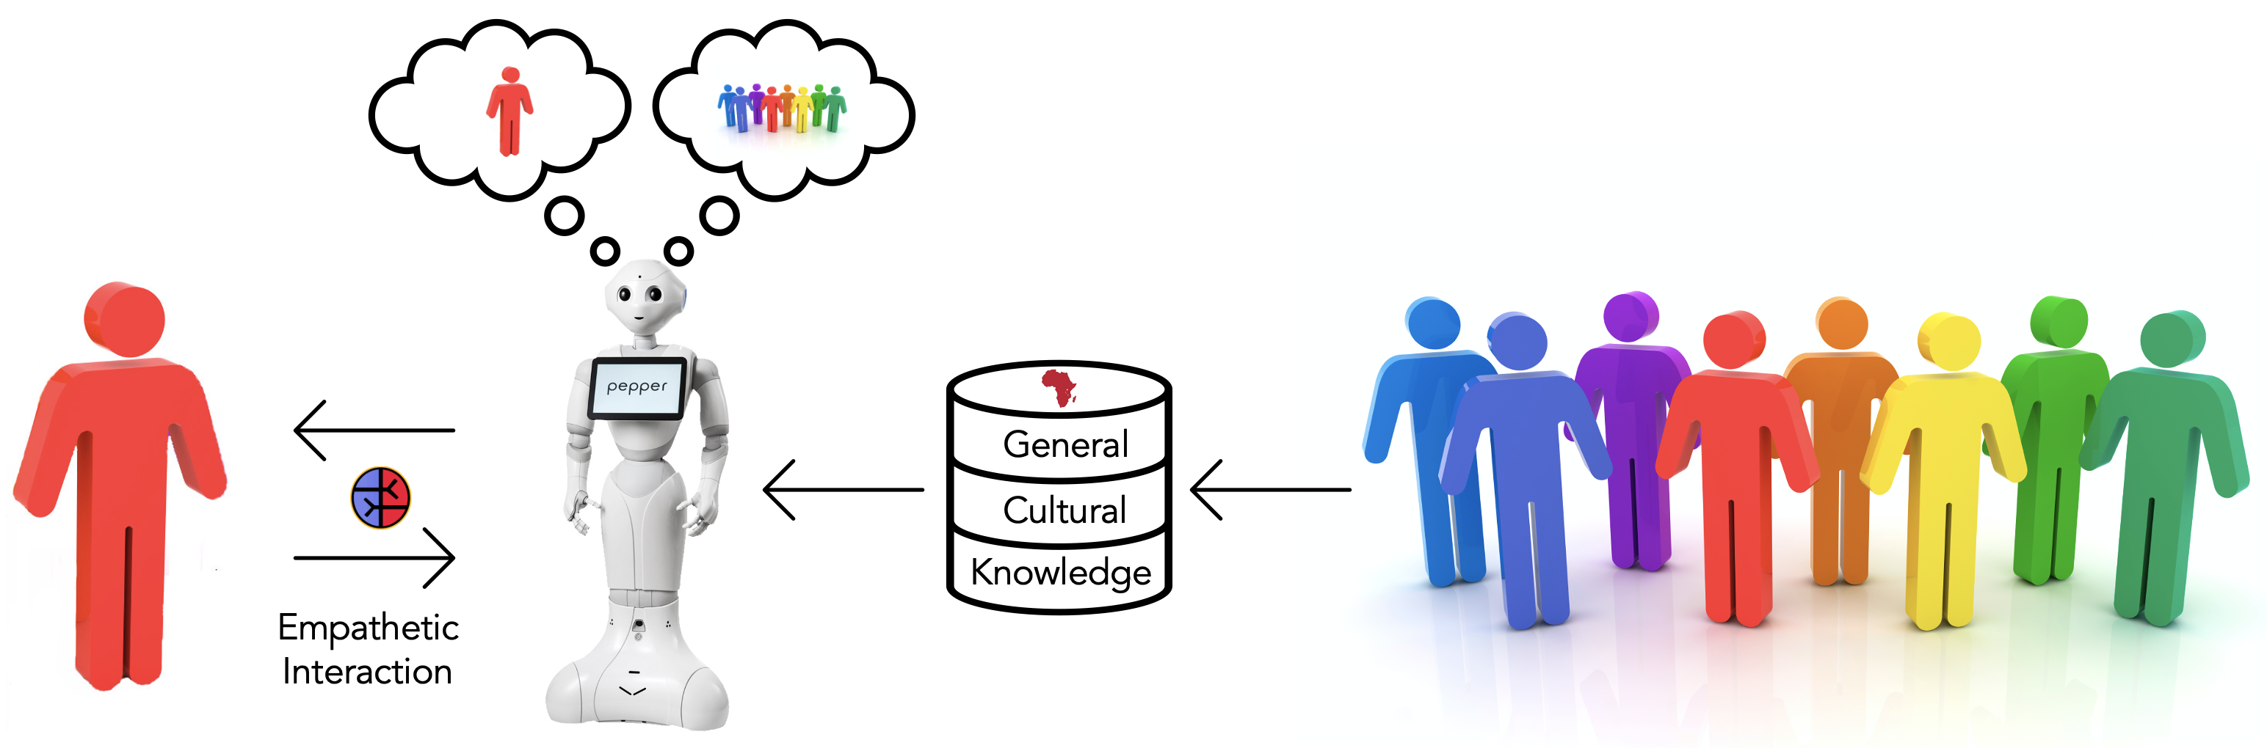
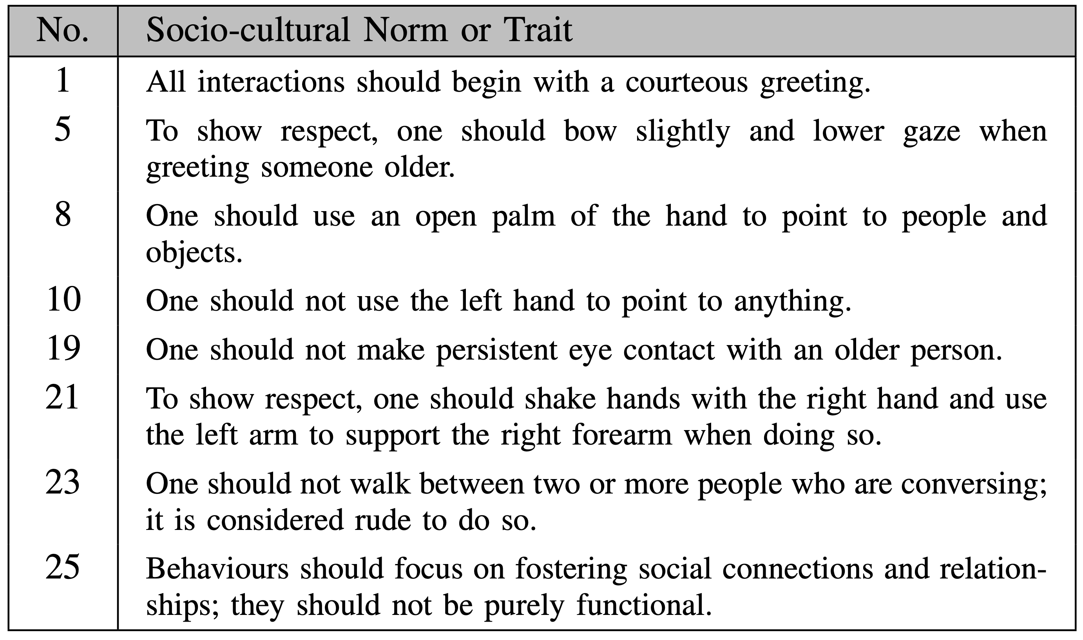
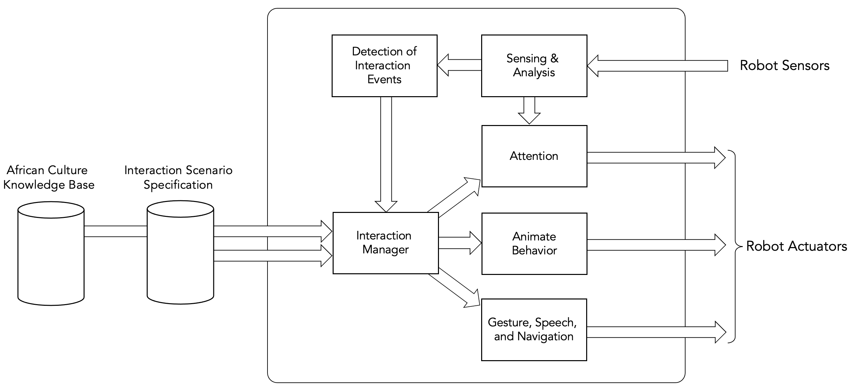


Culturally Sensitive Social Robotics for Africa
Principal Investigators
David Vernon, Carnegie Mellon University Africa
Pravesh Ranchod, University of the Witwatersrand Benjamin Rosman, University of the Witwatersrand
Research Goals
www.cssr4africa.org
CSSR4Africa is a three-year research project to develop culturally sensitive social robotics for Africa. It has the following objectives.
Identify the verbal and non-verbal social and cultural norms of human interaction that are prevalent in countries in Africa.
Encapsulate them in the behavioural patterns of social robots so that they can engage with African people in a manner that is consistent with their expectations of acceptable social interaction.
Demonstrate these culturally-sensitive social robot behaviours in two use cases: one for giving a tour of a university laboratory, and one for assisting and giving directions to visitors at the reception of a university.
In order to ensure that the project objectives can be achieved in the time available, we restrict the scope of the project to the cultures and social practices that are prevalent in Rwanda and South Africa.
Methodology
Person-specific cultural knowledge underpins culturally competent empathetic social interaction
General cultural knowledge underpins culturally sensitive polite social interaction
Preliminary Findings
Graphic based on (Bruno et al. 2017)
A sample of the verbal and non-verbal social and cultural norms of human interaction that are prevalent in countries in Africa (Zantou and Vernon 2023)
CSSR4Africa System Architecture
References
B. Bruno, N. Y. Chong, H. Kamide, S. Kanoria, J. Lee, Y. Lim, A. K. Pandey, C. Papadopoulos, I. Papadopoulos, F. Pecora, A. Saffioti, and A. Sgorbissa, “Paving the way for culturally competent robots: A position paper”, in 26th IEEE International Symposium on Robot and Human Interactive Communication (RO-MAN), Lisbon, Portugal, 2017, pp. 553-560.
B. Bruno, C. T. Recchiuto, I. Papadopoulos, A. Saffiotti, C. Koulouglioti, R. Menicatti, F. Mastrogiovanni, R. Zaccaria, and A. Sgorbissa, “Knowledge representation for culturally competent personal robots: requirements, design principles, implementation, and assessment,” International Journal of Social Robotics, vol. 11, no. 3, pp. 515–538, 2019.
A. Akinade, Y. Haile, N. Mutangana C. Tucker, and D. Vernon, “Culturally Competent Social Robots Target Inclusion in Africa”, Science Robotics, 2023.
P. Zantou and D. Vernon, “Culturally-Sensitive Human-Robot Interaction: A Case Study with the Pepper Humanoid Robot”, Proc. IEEE Africon, Nairobi, Kenya, September, 2023.
P. Zantou and D. Vernon, “Inclusion Drives Sustainable Development: The Case of Social Robotics for Africa”, Poster Presentation, ACM SIGCAS/SIGCHI Conference on Computing and Sustainable Societies - COMPASS, 2023.
A. Khaliq, U. Kockemann, F. Pecora, A. Saffiotti, B. Bruno, C. Recchiuto, A. Sgorbissa, H.-D. Bui, and N. Chong, “Culturally aware planning and execution of robot actions,” in IEEE/RSJ International Conference on Intelligent Robots and Systems (IROS), 2018, pp. 326–332.
This project is funded by the African Engineering and Technology Network (Afretec) Inclusive Digital Transformation Research Grant Program which is managed by Carnegie Mellon University Africa and receives financial support from the Mastercard Foundation.

