Slide 1
KBC Group
Company presentation
Spring 2006
Web site: www.kbc.com
Ticker codes: KBC BB (Bloomberg)
KBKBT BR (Reuters)

Slide 2

Mid-term outlook
Belgium:
 | Gross income | C/I, banking | Loan-loss ratio | Net profit
Retail | 5% CAGR | Low 60s | < 0.25% | >10% CAGR
Business customers | >2% on RWA | < 43% | < 0.35% | >10% CAGR
 | RWA, CAGR | Profit, CAGR | Loan-loss ratio | Cost/Income
Banking | 10% – 15% | 10% – 15% | < 0.50% | < 60%
CEE:
 | Premium income, CAGR | Net profit , CAGR | Combined ratio
Insurance | 15% – 25% | 25% - 35% | 95%
 | AUM growth, mutual funds | AUM growth, pension products
AM | 15% – 20% | 10% - 20%
Financial outlook as disclosed in June 2005

Slide 3
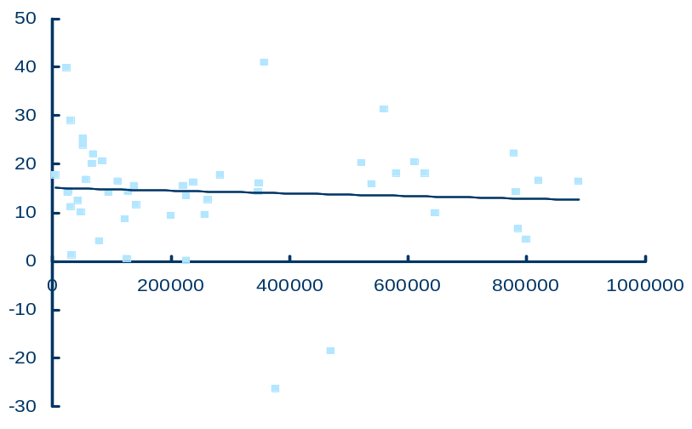
Anticipating future challenges
ROE
In %
Europe’s top 50 and Belgium’s top 10
Total assets
In millions of EUR
Source: McKinsey, 2003 data
When looking at the key success factors in retail financial services, KBC believes that the company’s scale is not necessarily the most important factor. We believe that it is vital to hold significant market share in the relevant individual markets, and, at the same time, excelling in the implementation of distribution and operating models.
We therefore focus on designing initiatives to further strengthen the current franchises and to ensure ‘distribution excellence’ and ‘lean processing’. We will not enter into completely new lines of business or geographic zones. If necessary, further opportunistic operational alliances may be set up in certain areas to generate additional scale effects.

Slide 4
Recent strategy initiatives - examples
Management objective | Examples | Required mgt. attention 2006-07 | Additional capital 2006-07
Strengthening CEE franchise: - Buy-out of third parties - Acquisitions - Accelerated organic growth | - e.g., 40% of K&H (Hungary), 7% of CSOB Bank - e.g., the Balkans, Romania, Poland - e.g., SME, HNWI & consumer finance development
Strengthening the Belgian franchise | - Strengthening of non-life distribution channels, launch of innovative ‘longevity’ life products, etc.
Strengthening the Private Banking franchise | - Setting up of cost-saving central back-office functions (potentially, small add-on acquisitions)
Distribution excellence | - Integration of distribution channel management per local market, setting up of a distribution competence centre to leverage distribution experience throughout the Group, etc.
Lean operations | - Setting up of Group product factories and shared services, co-sourcing of selected activities, etc.










 High

Low
We identified some 25 ‘business initiatives’ - illustrated in the above table – in order
to strengthen current franchises (better market penetration, product offering, distribution channels, management control, etc.) and to ensure further ‘distribution excellence’ and ‘lean processing’ in the future.
The implementation will be spread over a 3-to-5-year period and will enable KBC to safeguard its competitive position and growth prospects in the long term. In 2006, management attention and capital allocation will be focused on the buy-out of third-party interests in CEE (since these are expected to be immediately value-enhancing) and on the implementation of a new organisational structure (for more details, see further).

Slide 5
  Organic growth:
  Accelerating business development
  (e.g., bancassurance, SME, HNWI and consumer finance business, branch openings)
  Buy-out of third-party interests
Russia
Estonia
Latvia
Lithuania
Current presence
(5 countries – 65 m inhabitants)
Geographic add-ons:
  The Balkans
  Romania, e.g., via greenfield
  Poland (banking) and Hungary (insurance) to increase existing foothold (expected to occur post-2007)
  Depending on opportunities
Belarus
Poland
Czech
Ukraine
Slovakia
Moldova
Slovenia
Hungary
Romania
Croatia
Bulgaria
Bosnia
Serbia
Albania
Macedonia
Turkey
KBC’s CEE strategy is focused on accelerating organic growth (incl. buying out third-party interests) and making selected geographic add-on investments.
The additional allocation of capital for third-party buy-outs and add-on acquisitions will be assessed on the basis of a set of conservative parameters, both strategic and financial, in line with our past track record in this respect.

